Slide 1
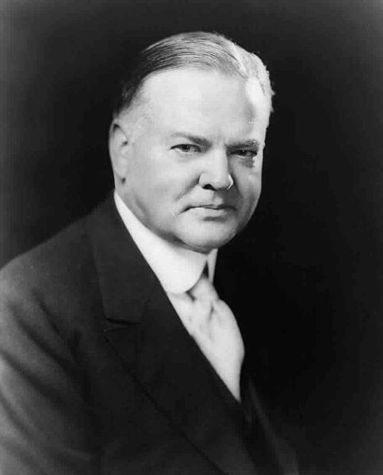
Welcome to Hooverville
USHC 6.3

Slide 2
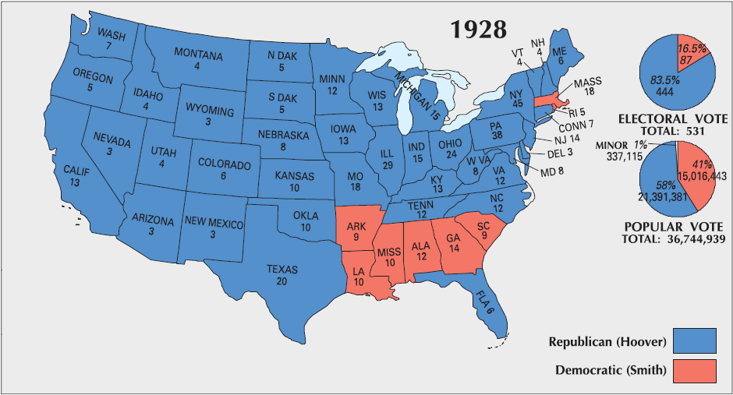

1928 Presidential Election
1928
1932
1936
1940

Slide 3
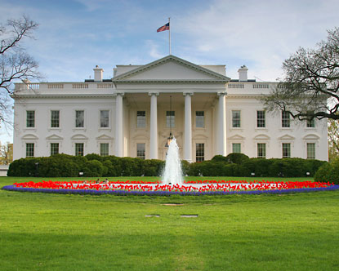
Herbert Hoover
(R-IA)
Thirty-first President of the U.S.
1929-1933
www.whitehouse.gov/about/presidents/warrenharding

Slide 4

ECONOMIC PROBLEMS in the late 1920s
CHEAP CREDIT
The Federal Reserve is a government-created central bank that determines interest rates.

Slide 5



ECONOMIC PROBLEMS in the late 1920s
SPECULATION
CHEAP CREDIT
BUYING
“ON MARGIN”

Slide 6
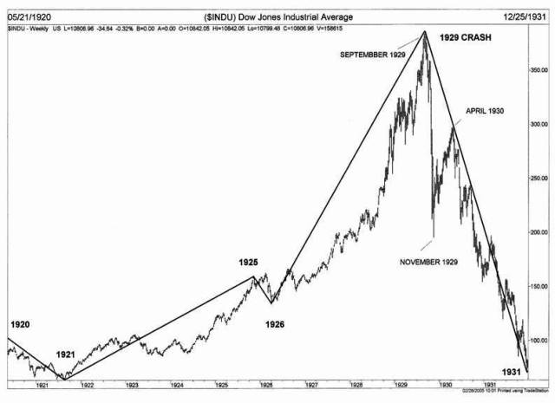
Stock Market CRASH

Slide 7
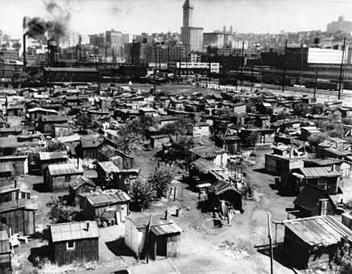
“Hoovervilles”
It’s ALWAYS the Presidents’ fault.

Slide 8
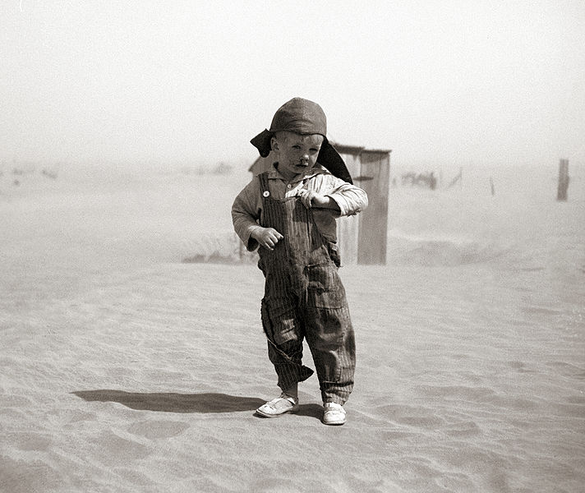
The Dust Bowl
Farm Economy Collapses

Slide 9
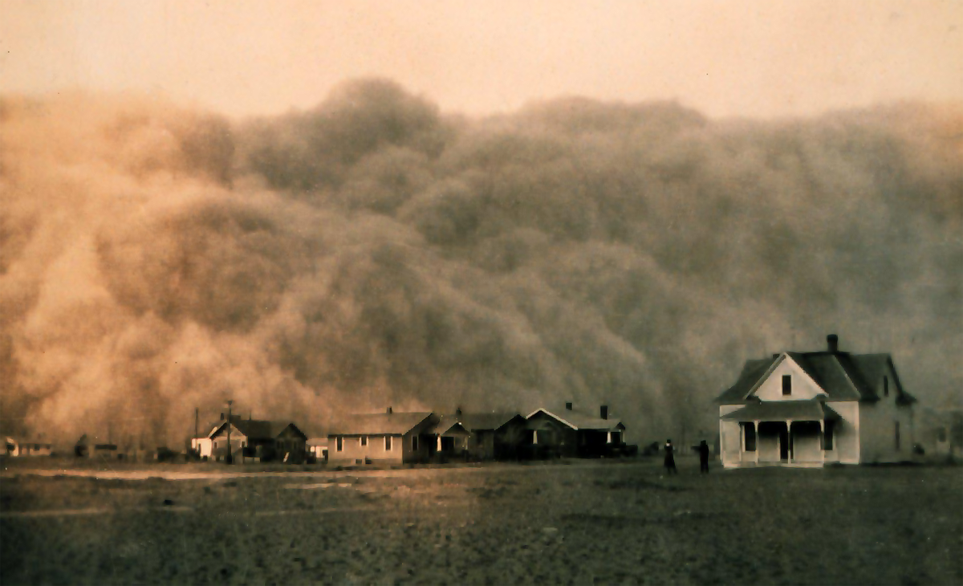
A Dust Storm in Texas (1935)

Slide 10
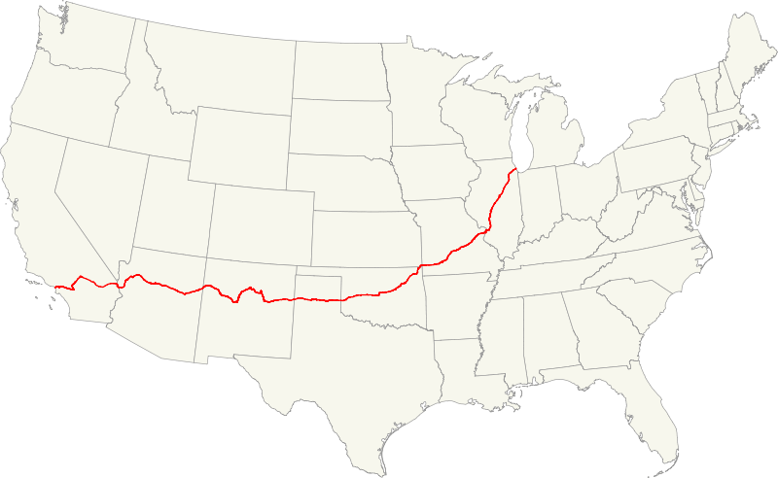

Route 66
“Okies”

Slide 11
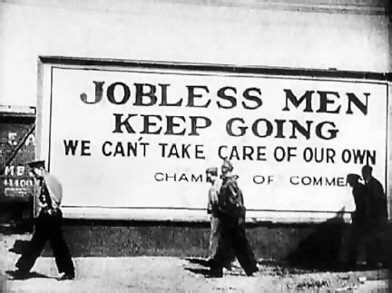
25%
Peak Unemployment
50%
Black Unemployment During Depression

Slide 12
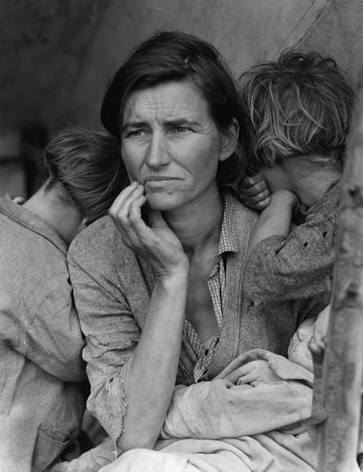
Migrant Mother
(1936)

Slide 13
The Hoover Myth
Hoover just sat there and did nothing about the Depression. It wasn’t until FDR that the government tried to do something.
FALSE
ZZZ…

Slide 14
Tax Increase

Slide 15

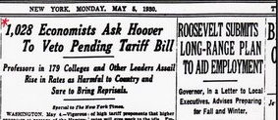
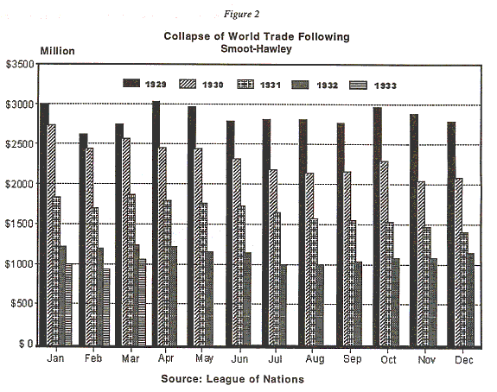

Hawley-Smoot Tariff
Second-highest tariff in U.S. History

Slide 17


Hoover Had Limits
Voluntary Charitable Efforts
Direct Relief
for the Poor

Slide 18
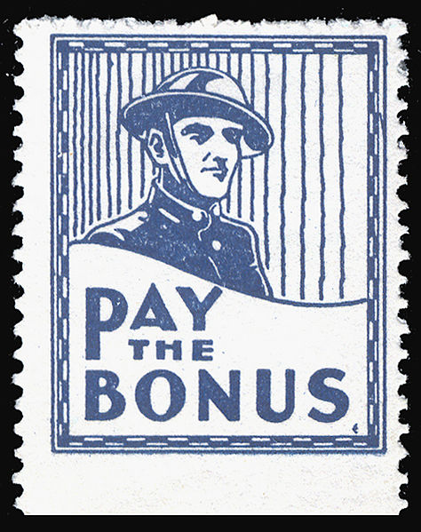

Slide 19
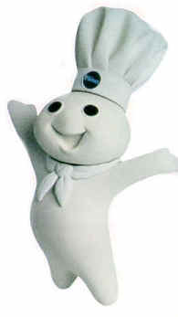

The “Bonus Expeditionary Force”
aka, “Bonus Army”
Summer, 1932
The doughboys
want their dough.

Slide 20
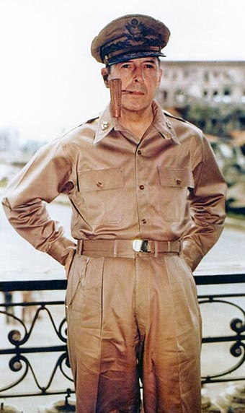
No Substitute for Victory
MACARTHUR

Slide 21
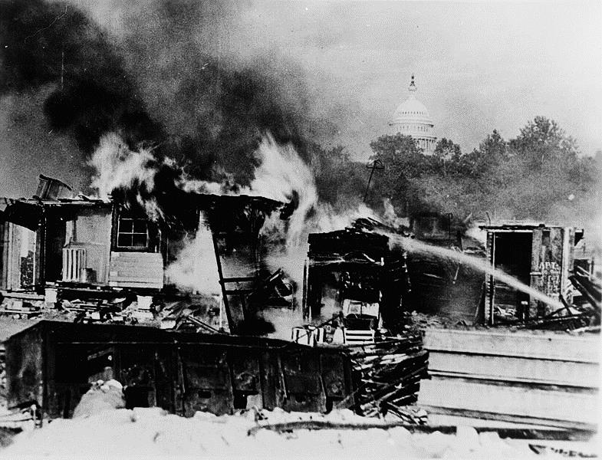

Slide 22





LEARNING.
DELIVERED.

