Slide 1
The Rejection of Internationalism
USHC-5.5

Slide 2
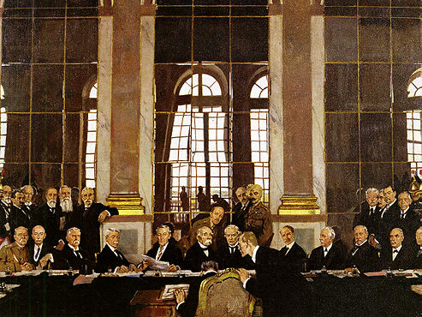
The Treaty of Versailles
June 28, 1919

Slide 3
The League of Nations
Wilson’s Baby

Slide 5
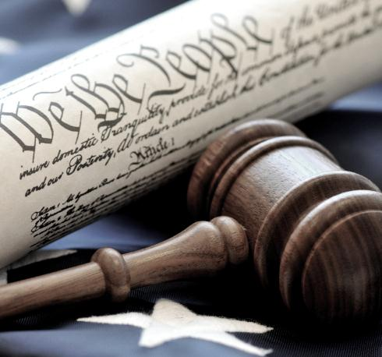
Ratifying Treaties
“[The President] shall have Power, by and with the Advice and Consent of the Senate, to make Treaties, provided two thirds of the Senators present concur....”
-- Article II, Section 2

Slide 6
2/3
The Senate vote necessary to ratify a treaty

Slide 7
0
The number of senators included in Wilson’s peace delegation to Europe.

Slide 8
The U.S. Senate
1910-1920
Republican Majority

Slide 9
The League of Nations
An Entangling Alliance???

Slide 10
Article X of the League Covenant
The Members of the League undertake to respect and preserve as against external aggression the territorial integrity and existing political independence of all Members of the League. In case of any such aggression or in case of any threat or danger of such aggression the Council shall advise upon the means by which this obligation shall be fulfilled.

Slide 11
Three Views of the Treaty
Internationalists
Ratify the Treaty AS IS
Reservationists
Ratify the Treaty with Reservations
Irreconcilables
DON’T RATIFY the Treaty

Slide 12
SOVEREIGNTY

Slide 13
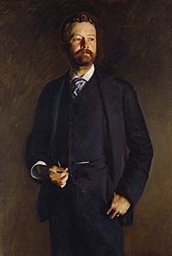
Lodge Reservations
14
Stipulations
View
Sen. Henry Cabot Lodge (R-MA)

Slide 14
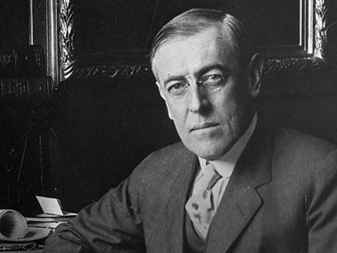
Wilson’s Dilemma
Compromise with Reservationists or stand his ground?

Slide 15
EUROPE TO US:
Reservations OK!

Slide 16
“The Senate must take its medicine.”
-- Woodrow Wilson

Slide 17
NO COMPROMISE

Slide 18
A “Solemn Referendum”
1920
BIGGER Republican Majority

Slide 19
The United States never joined the League.
Wilson’s mission to intimately involve the U.S. in global affairs was a failure.

Slide 20
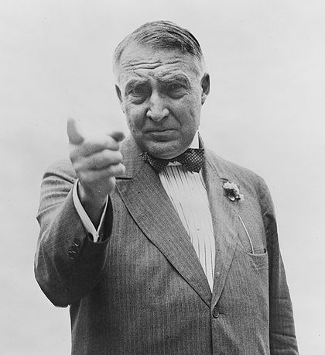
Warren G. Harding
(R-OH) 29th POTUS 1921-1923
MORE INFO

Slide 21
Return to Normalcy

Slide 22
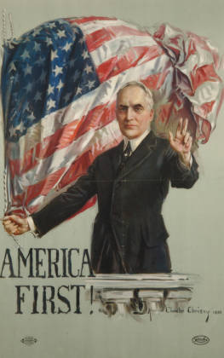
Americanism
Call it the selfishness of nationality if you will. I think it's an inspiration to patriotic devotion
to safeguard America first, to stabilize America first, to prosper America first, to think of America first.
-- Warren G. Harding
Campaign Speech (1920)

Slide 23
MYTH
U.S. foreign policy was isolationist during the 1920s.

Slide 24
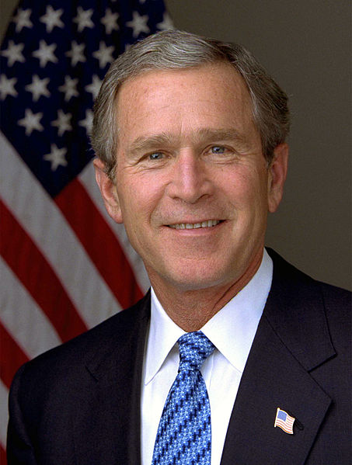
The Isolationism Myth
“If you study the '20s... there was an American-first policy that said, 'Who cares what happens in Europe?’”
-- George W. Bush

Slide 25
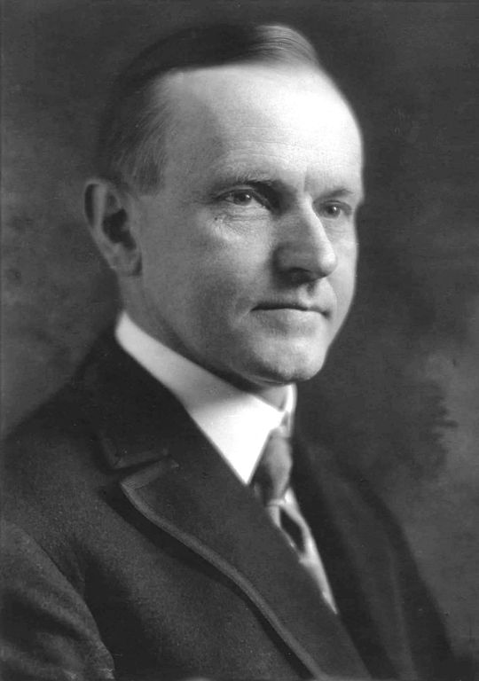
Isolationism
“It will be well not to be too much disturbed by the thought of either isolation or entanglement of pacifists and militarists. The physical configuration of the earth has separated us from all of the Old World, but the common brotherhood of man… has united us by inseparable bonds with all humanity.”
-- Calvin Coolidge
Inaugural Address (1925)

Slide 26
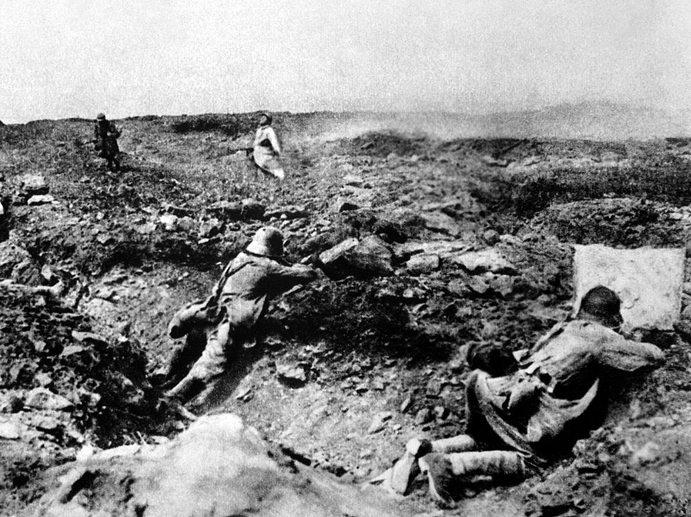
World War I
IT SUCKED!

Slide 27
Let’s NOT do that again!

Slide 28
Peace and Understanding

Slide 29
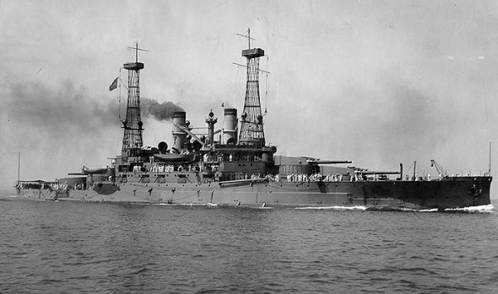
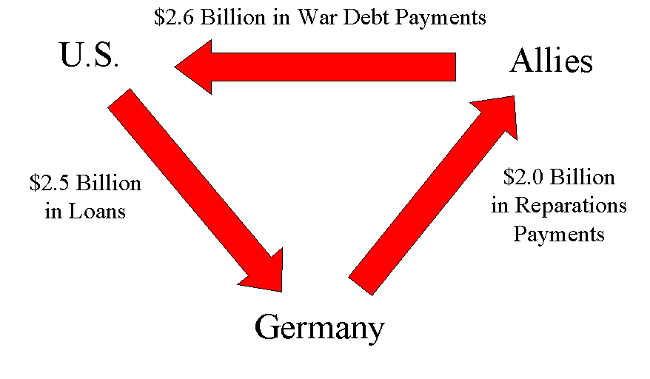
America: World Leader
Washington Naval Conference
Dawes Plan
Kellogg-Briand Pact

Slide 30
Washington Naval Conference
(1921)
Naval Arms Control
Avoid Arms Race
Photo by PIXNOIZE

Slide 31
Washington Naval Conference
(1921)
RATIOS
Nation | Capital Ships | Aircraft Carriers
Britain | 5 | 5
U.S. | 5 | 5
Japan | 3 | 3
Photo by PIXNOIZE

Slide 32
U.S.S. South Carolina
DISMANTLED (1924)

Slide 33
Dawes Plan
NOTE: This is different from the Dawes Act (1887)

Slide 34
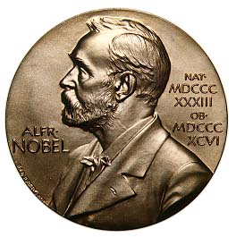
Dawes Plan

Slide 35
Kellogg-Briand Pact
(1929)
Renounced war as an “instrument of national policy”

Slide 36
Non-Intervention

Slide 37
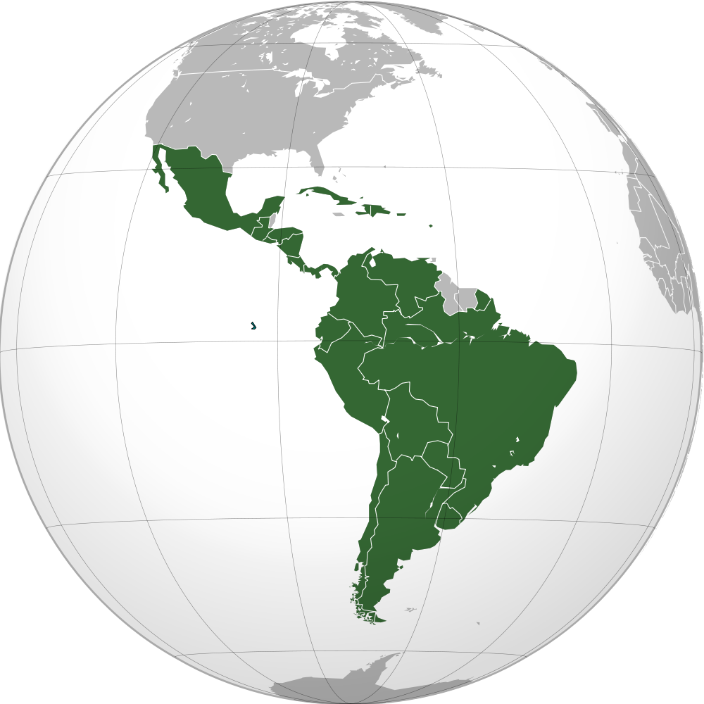
“Good Neighbor” Policy
Non-intervention in Latin America
IMPERIALISM

Slide 38
Neutrality Acts (1930s)
NO AID
TO
BELLIGERENTS
Dbachmann

Slide 39
LEARNING.
DELIVERED.

