Slide 1
The Spanish-American War
Color Palette By: Piahr
US HISTORY INTENSIVE REVIEW
USHC-5.2
Notes:
Image Source: http://marshallmatlock.com/2012/01/the-mans-man-xxxix-teddy-roosevelt/

Slide 2
MAIN IDEA
The Spanish-American War marks the United States’ emergence as a WORLD POWER,

Slide 3
?
How did the United States go from an isolated nation to being a world power?

Slide 4
1898
Big Year

Slide 5
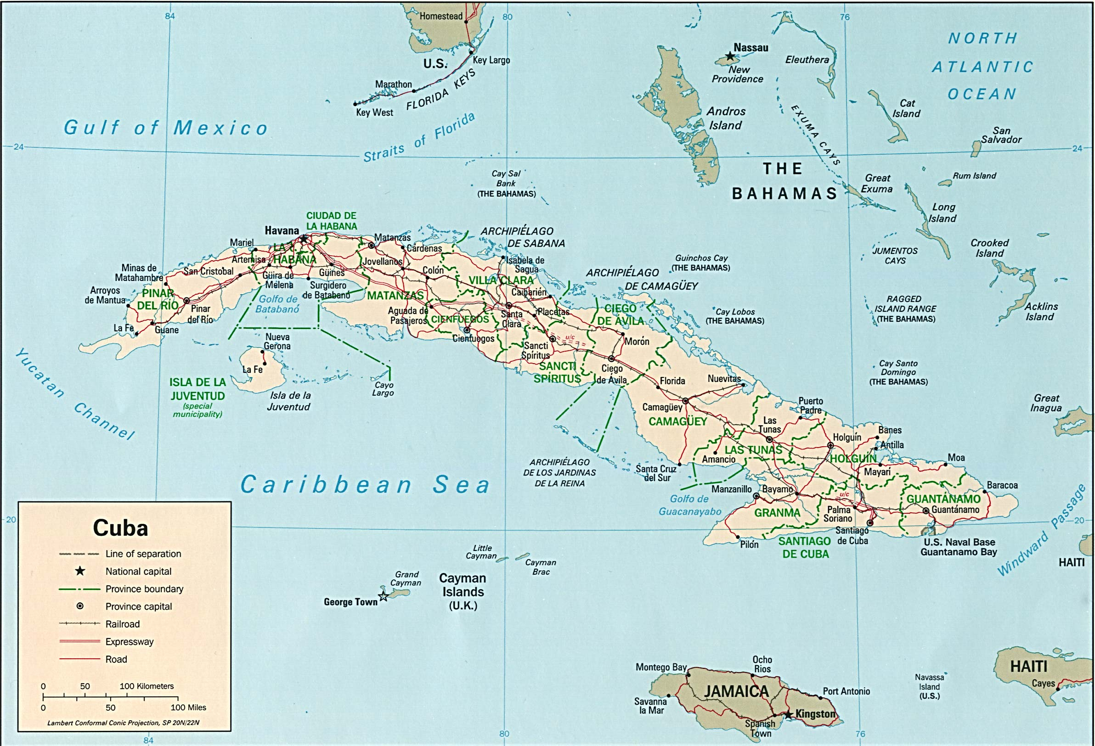
Cuban Independence
1890s
CUBA VS. SPAIN

Slide 6
Teller Amendment
1898
WE DON’T WANT CUBA
ANNEXATION
…Not OFFICIALLY, at least!

Slide 7
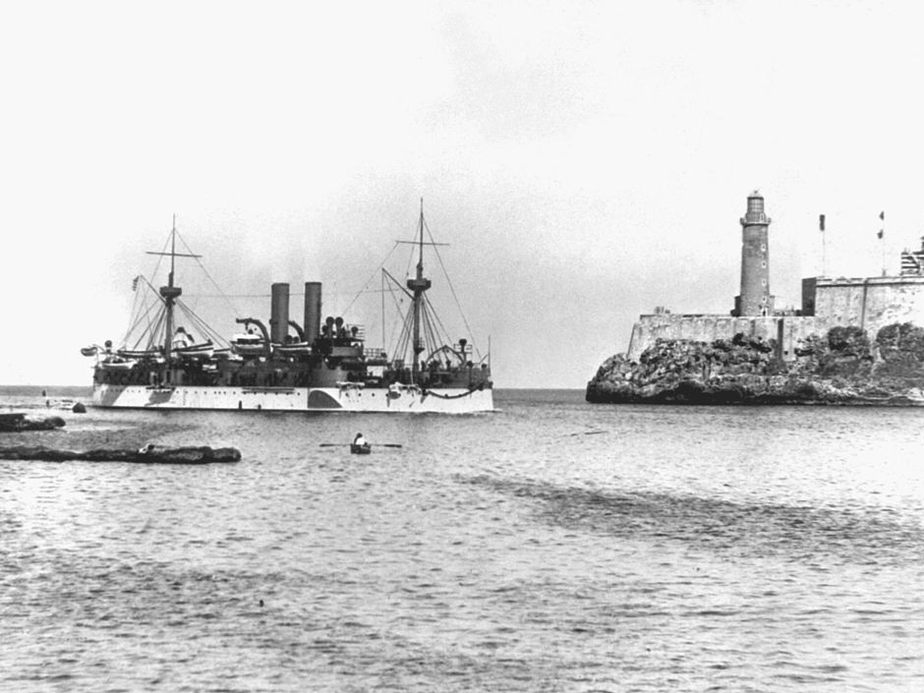
DON’T Forget This!!!
USS Maine entering Havana Harbor on 25 January 1898

Slide 8
Explosion of the U.S.S. Maine
Feb.15, 1898

Slide 9
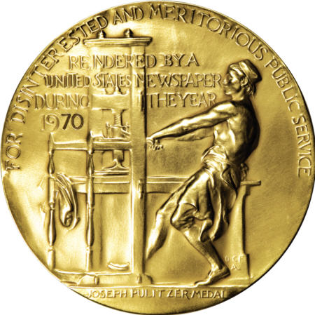
Pulitzer Prize

Slide 10
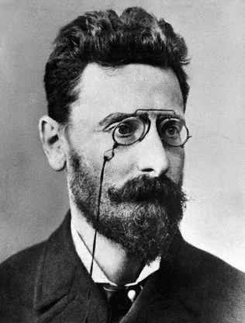
Yellow Journalism
Sensational Headlines
to increase
Circulation
Joseph Pulitzer New York World
William Randolph Hearst New York Journal

Slide 11
?

Slide 12
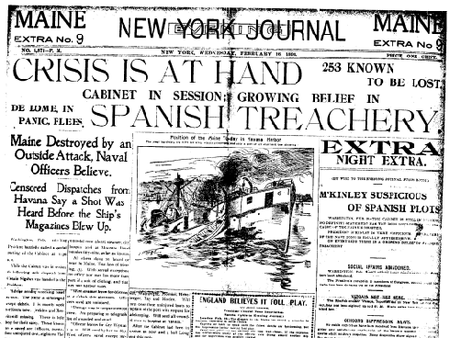

Slide 13
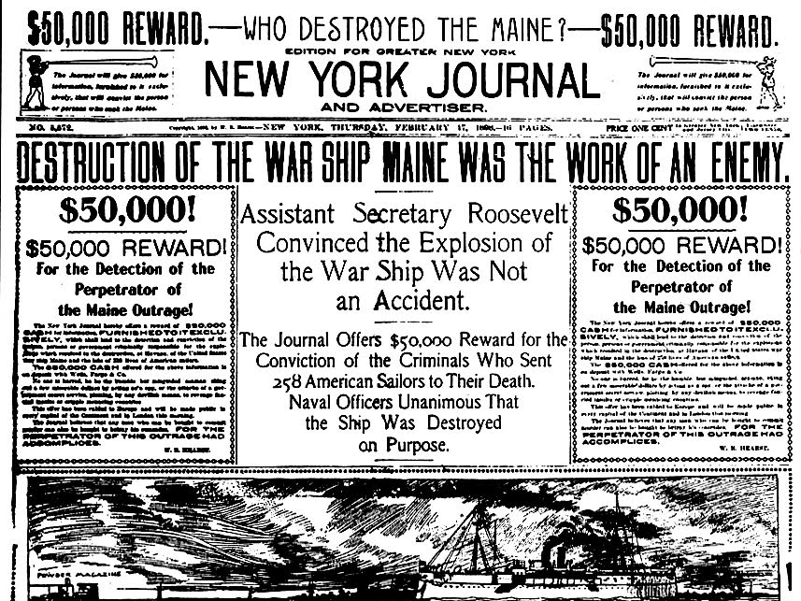
Notes:
http://www.bibliotecapleyades.net/sociopolitica/sociopol_mediacontrol95.htm

Slide 16
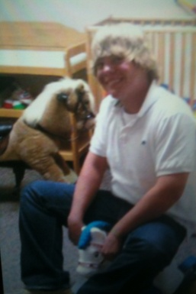
Simply put...
Yellow Journalism

Slide 17
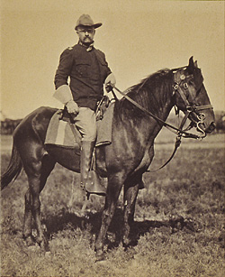
SPLENDID

Slide 18
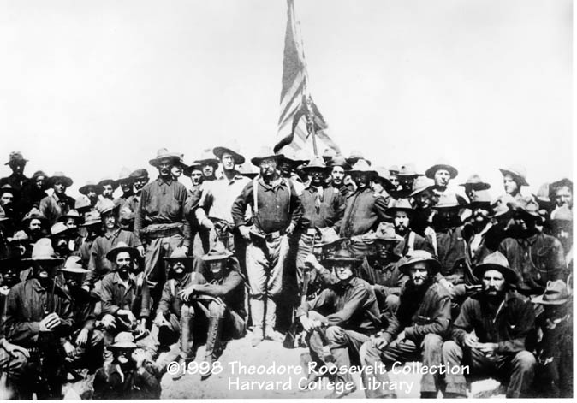
Rough Riders
Teddy Roosevelt’s Volunteer Regiment
Battle of San Juan Hill

Slide 19
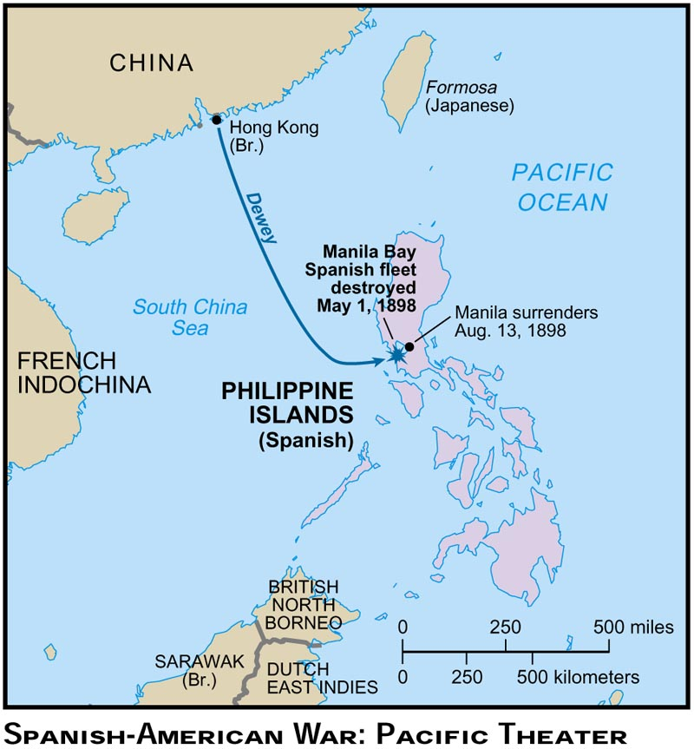
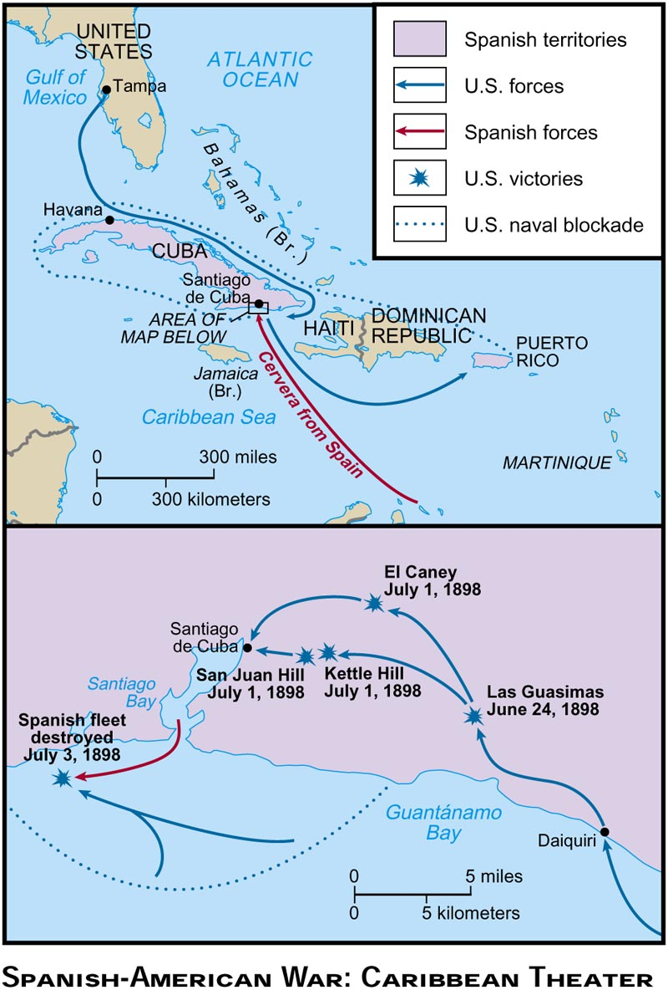
AMERICA!!!

Slide 20
Treaty of Paris
1898
For $20 million, the U.S. gets:
PACIFIC | CARIBBEAN
Philippines | Puerto Rico
Guam | “Free” Cuba

Slide 21
EMPIRE

Slide 22
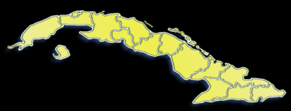
Platt Amendment
1901
PROTECTORATE (Limited Sovereignty)
NO treaties without U.S. approval
U.S. can intervene in cases of civil unrest
Perpetual Naval Lease @ Guantanamo Bay

Slide 23
A Legacy of Resentment
Cuban resentment against the United States would culminate in the establishment of Fidel Castro’s anti-American government in the 1959 Cuban Revolution.

Slide 24
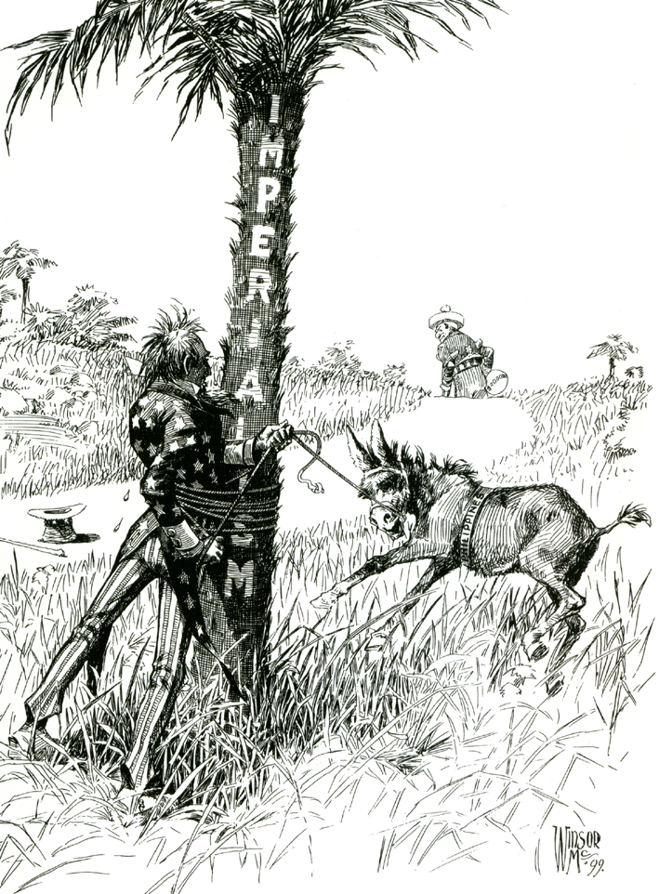
Imperialism in the Philippines
The Ultimate Foreign Entanglement
Notes:
1899 political cartoon by Winsor McCay. Uncle Sam (representing the United States), gets entangled with rope around a tree labeled "Imperialism" while trying to subdue a bucking colt or mule labeled "Philippines" while a figure representing Spain walks off over the horizon. Reference to the United States taking control of the Philippines from Spain at end of the Spanish American War and the subsequent Philippine-American War.

Slide 26
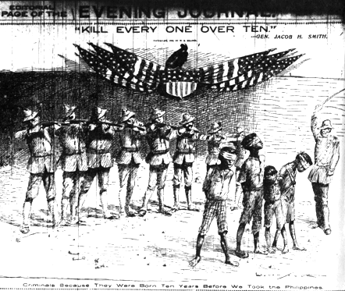
For Humanity’s Sake…
Notes:
"Kill every one over ten." - Gen. Jacob H. Smith.
Bottom caption: "Criminals Because They Were Born Ten Years Before We Took the Philippines"
New York Journal -- May 5, 1902.

Slide 27
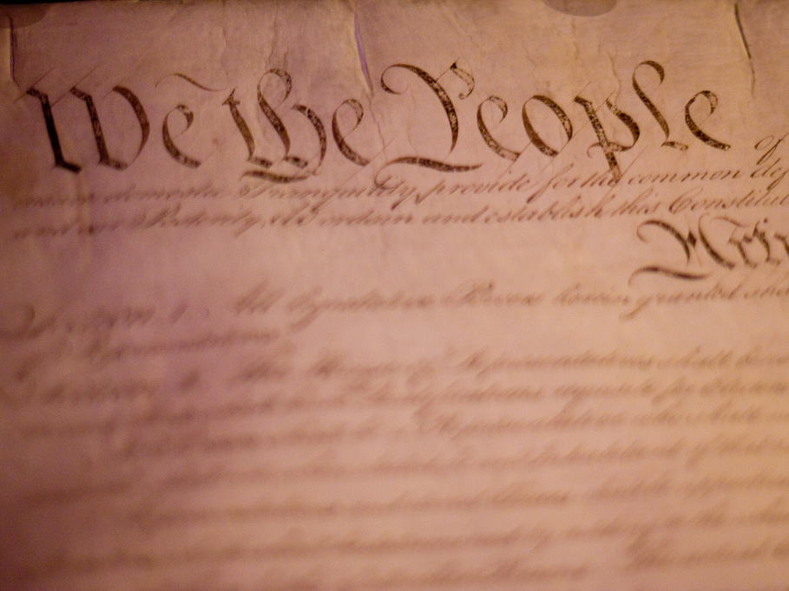
What about THIS?
Photo Credit: kjd

Slide 28
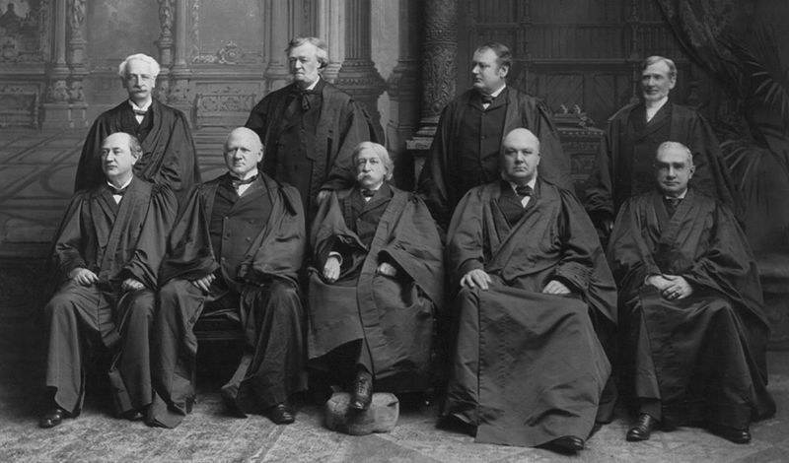
The Insular Cases
1901-1905
The Constitution does not follow the flag.

Slide 29
For Humanity’s Sake…
Notes:
"Kill every one over ten." - Gen. Jacob H. Smith.
Bottom caption: "Criminals Because They Were Born Ten Years Before We Took the Philippines"
New York Journal -- May 5, 1902.

Slide 30
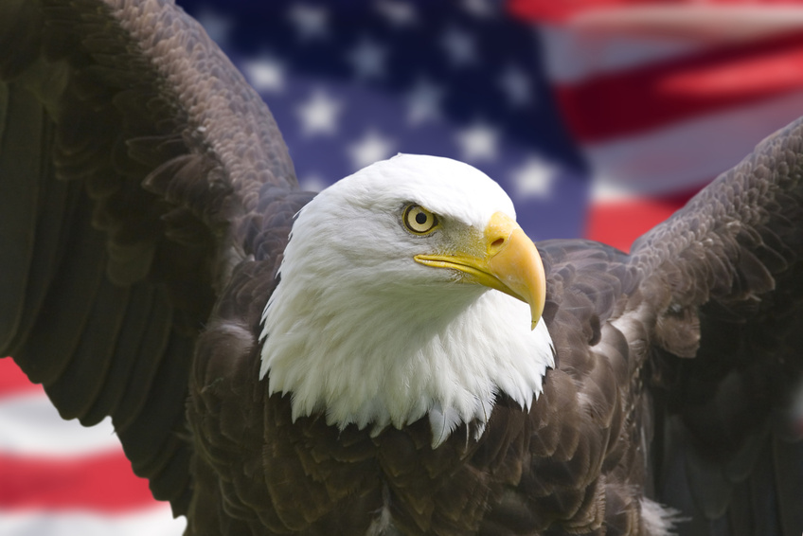
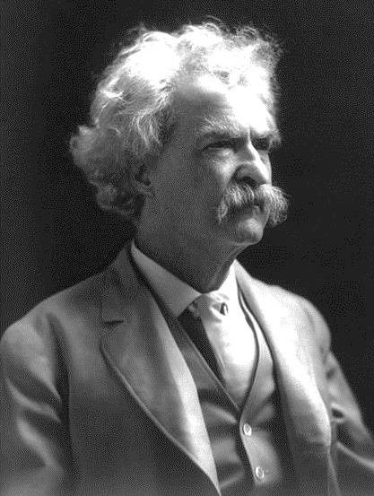
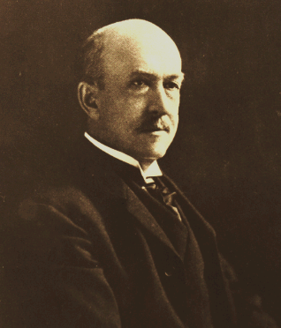
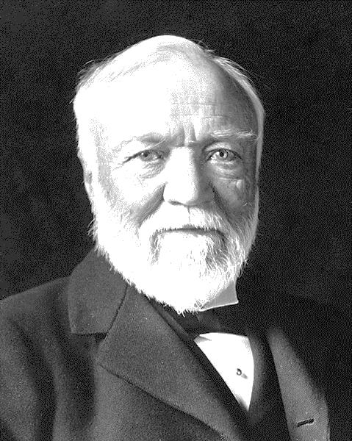
Anti-Imperialist League
Mark Twain
Writer
William G. Sumner
Professor
Andrew Carnegie
Industrialist

Slide 31
Anti-Imperialism
“If we Americans believe in self-government, why do we let it slip away from us? Why do we barter it away for military glory as Spain did?”
-- William Graham Sumner
The Conquest of the United States by Spain
Sumner

Slide 32
Anti-Imperialism
“If you take away the Constitution, what is American liberty and all the rest? Nothing but a lot of phrases.”
-- William Graham Sumner
The Conquest of the United States by Spain
Sumner

Slide 33
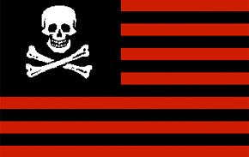
Mark Twain’s Idea for a New Flag...
Notes:
Jolly Roger Image Credit: WarX, edited by Manuel Strehl

Slide 34
The Imperialism Debate
Imperialists
Filipinos are incapable of self-government.
Anti-Imperialists
We sacrifice our values by becoming an imperial power.

Slide 35
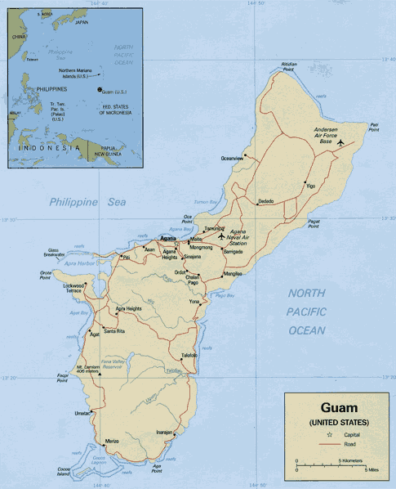
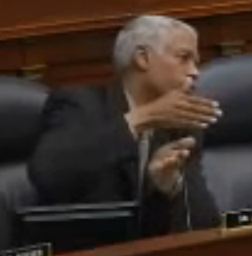
Is Guam in Danger???
Rep. Hank Johnson (D-GA)
Congressional Hearing,
March 2010

Slide 36
LEARNING.
DELIVERED.

