Slide 1
American Imperialism
Color Palette By: Piahr
1867-1914
INTENSIVE REVIEW VERSION
USHC-5.1
Notes:
Image Source: http://marshallmatlock.com/2012/01/the-mans-man-xxxix-teddy-roosevelt/

Slide 2
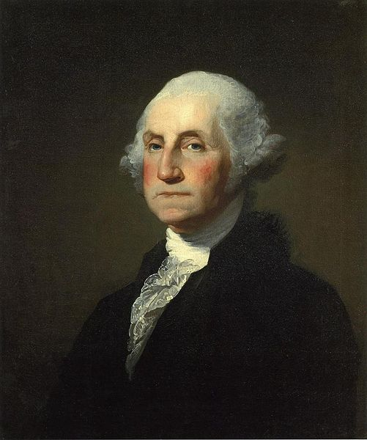
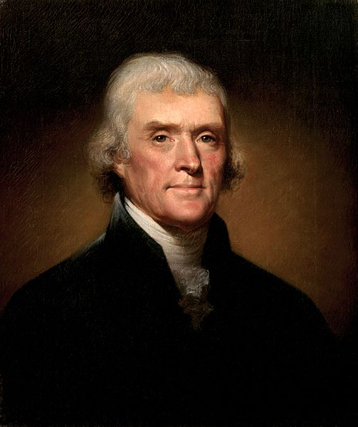
“ISOLATIONISM”
No Entangling Alliances!

Slide 3
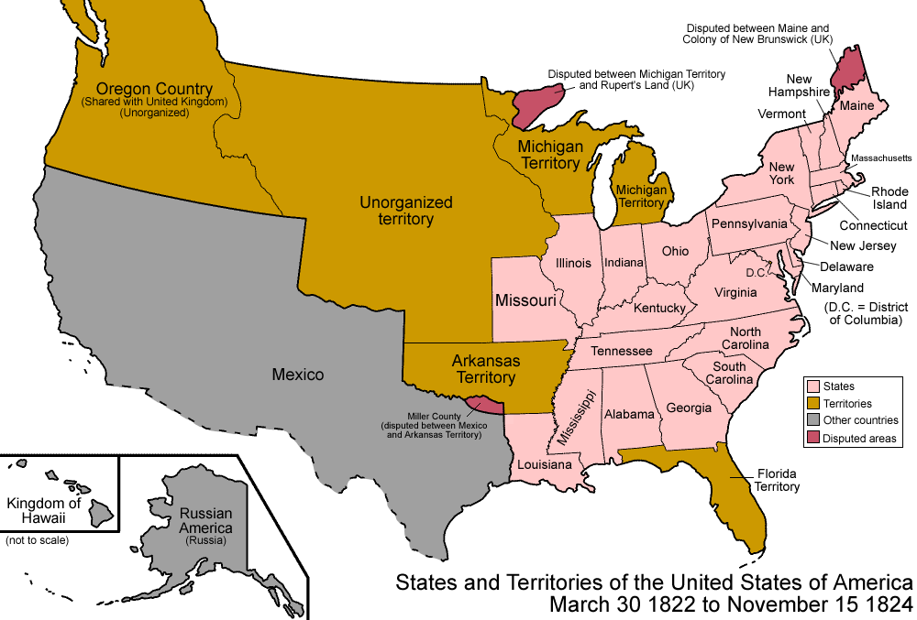
America Then…
Map Credit: Golbez

Slide 4
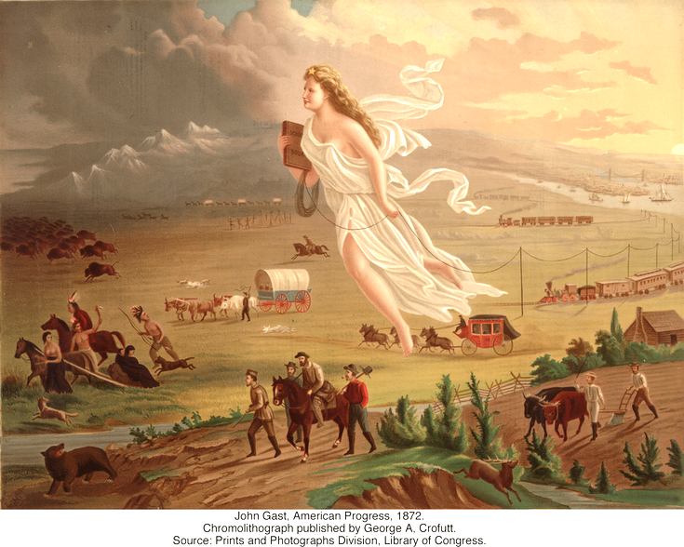
In the Meantime…
Mission Accomplished!

Slide 5
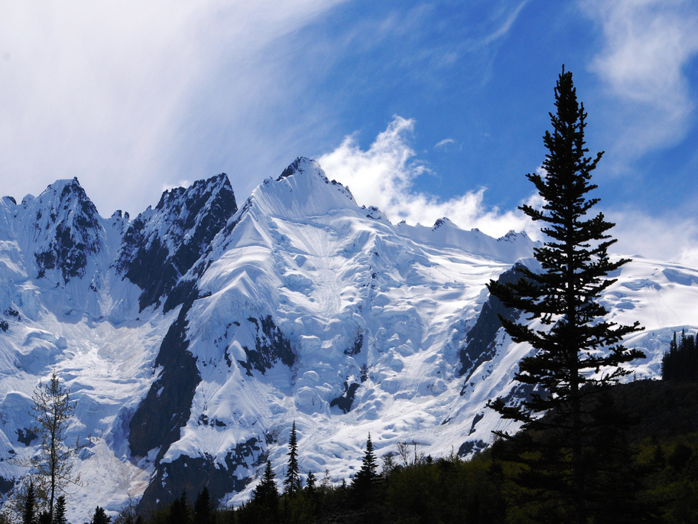
Alaska Purchase
1867
No more land in North America
Photo Credit: jjjj56cp

Slide 6
So bored… What now???

Slide 7
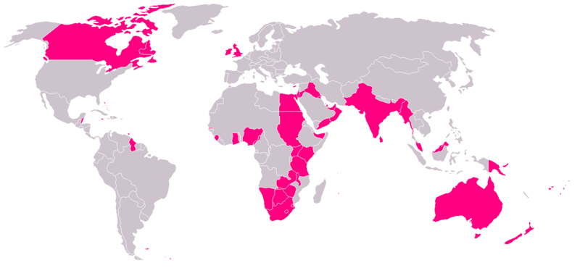
Imperialism
We could totally do this!
The British Empire (c. 1921)

Slide 8
ISOLATIONISM vs. INTERVENTIONISM
19th CENTURY (1800s)
ISOLATIONISM (Neutrality)
AVOID conflicts with other nations whenever possible
20th CENTURY (1900s)
INTERVENTION
ENGAGE other nations in order to promote the national interest of the United States

Slide 9
MOTIVATIONS for US Imperialism

Slide 10
Social Darwinism
Justification for Imperialism

Slide 11
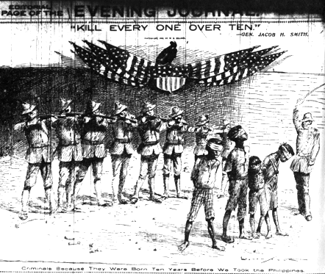
Survival of the Fittest
Notes:
"Kill every one over ten." - Gen. Jacob H. Smith.
Bottom caption: "Criminals Because They Were Born Ten Years Before We Took the Philippines"
New York Journal -- May 5, 1902.

Slide 12
Expansion of MARKETS
Photo by Thomas Hawk

Slide 13
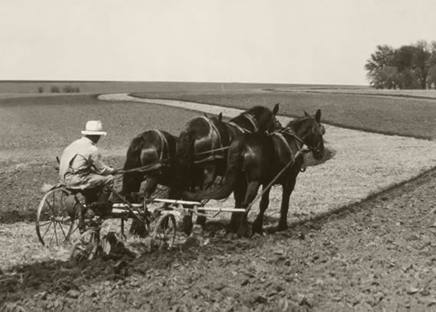
Crop Prices Stabilize

Slide 14
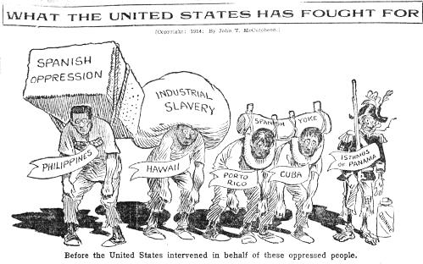
BEFORE U.S. Imperialism

Slide 15
AFTER U.S. Imperialism

Slide 16
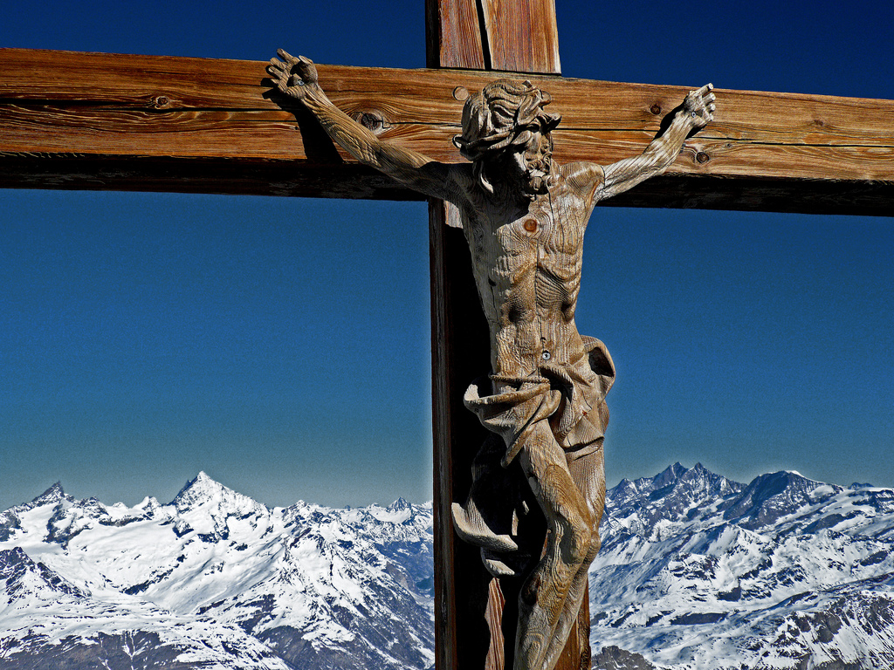
Spread Christianity
& Western Civilization
Photo by an untrained eye

Slide 17
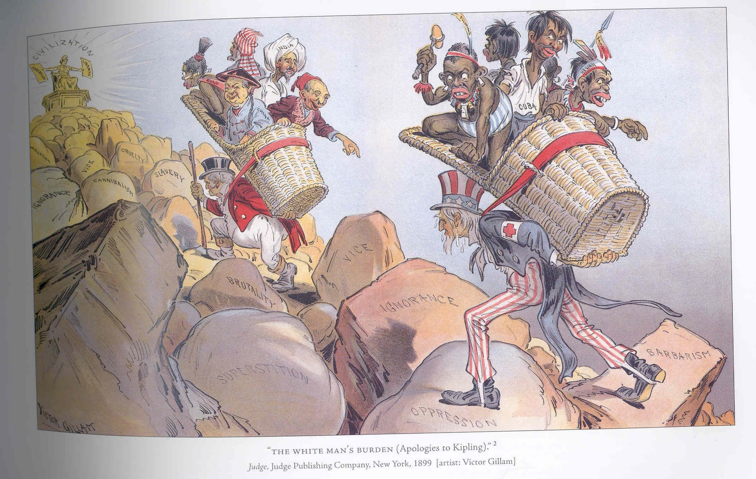
The “White Man’s Burden”
Notes:
http://lorifisher.blogspot.com/2010/10/imperialism-and-social-darwinism.html

Slide 18
The “White Man’s Burden”
Take up the white man's burden- Send forth the best ye breed- Go bind your sons to exile To serve your captives need To wait, in heavy harness, On fluttered folk and wild- You new-caught sullen peoples, Half devil and half child.
-- Rudyard Kipling,
"The White Man's Burden"
Notes:
http://lorifisher.blogspot.com/2010/10/imperialism-and-social-darwinism.html

Slide 19
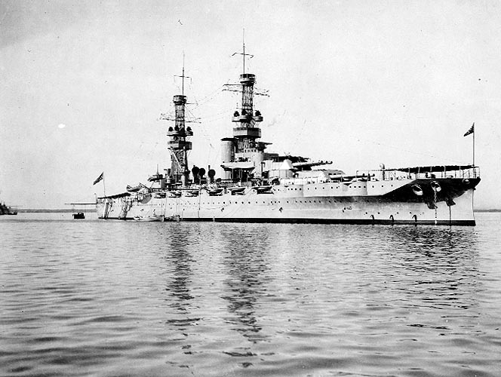
Naval Bases

Slide 20
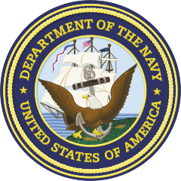
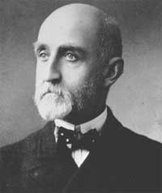
Sea Power
Mahan, The Influence of Sea Power Upon History (1890)
Thesis:
Great nations must have great navies
Rear Admiral Alfred Thayer Mahan

Slide 21
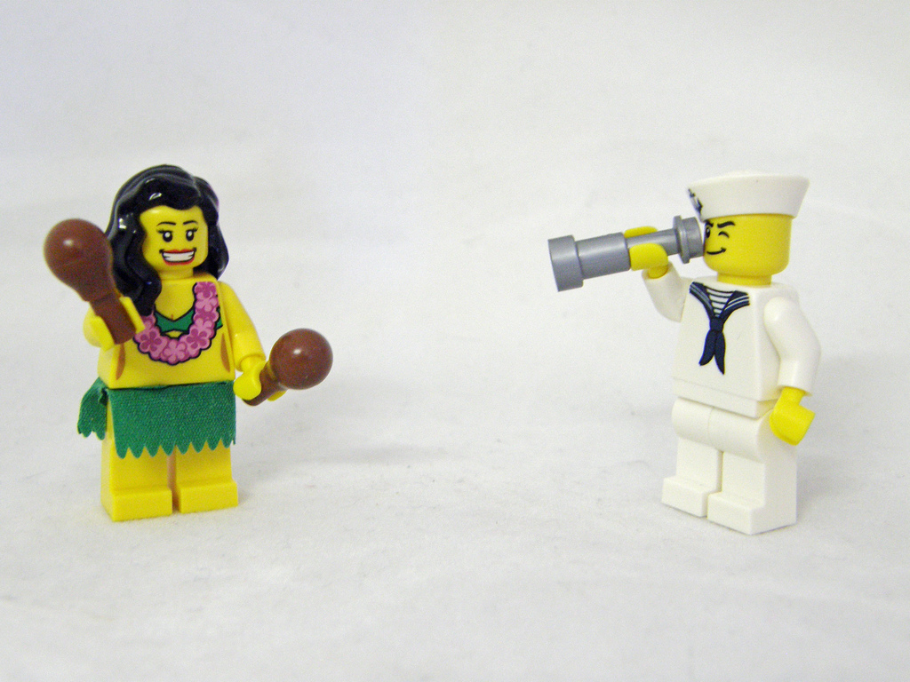
Aloha!
Photo Credit: Kaptain Kobold

Slide 22
Hawaii Annexation
1898
Pearl Harbor (Naval Base)
Re-fueling station for American ships
Notes:
http://mrcochran.com/Imperialism/imperialism%20webquest.htm

Slide 23
America projects its POWER
Photo by CelebMuscle

Slide 24
RESENTMENT
The fruits of foreign intervention
The U.S. involvement in Latin America and the Pacific was resented in the Philippines and Cuba, whose people had sought independence.

Slide 25
LEARNING.
DELIVERED.

