Slide 1
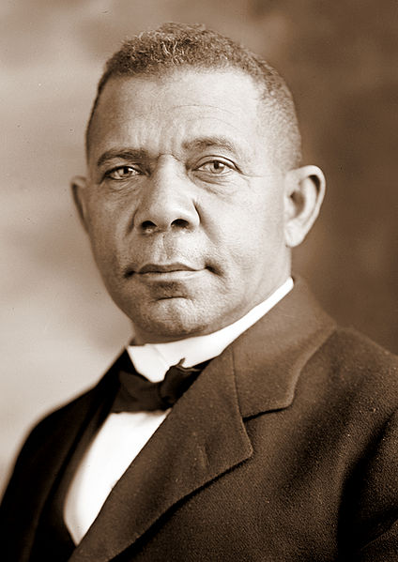
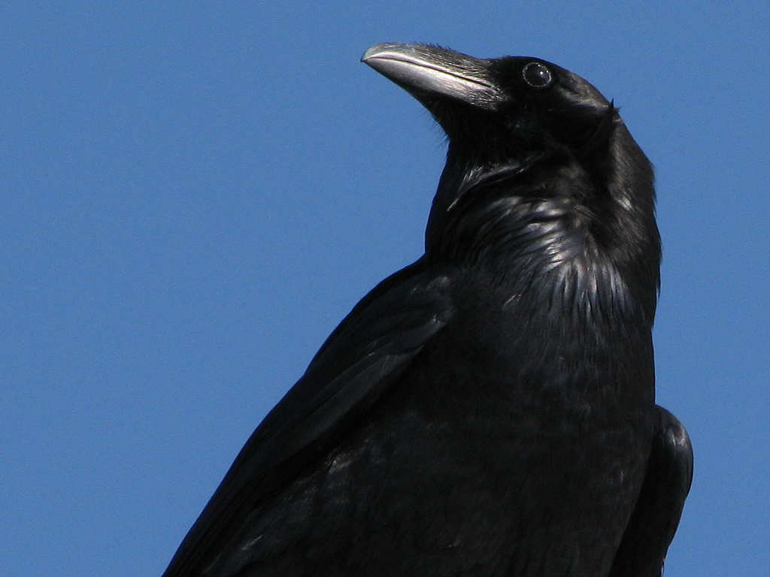
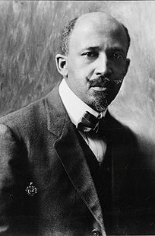
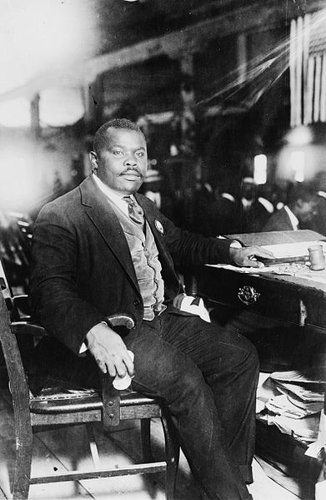
The Nadir of American Race Relations
Photo by stonebird

Slide 2
USHC 3.5
Evaluate the varied responses of African Americans to the restrictions imposed on them in the post-Reconstruction period, including the leadership and strategies of Booker T. Washington, W. E. B. DuBois, and Ida B. Wells-Barnett.

Slide 3
Na·dir
[ney-der]
Noun
3. the lowest point; point of greatest adversity or despair.

Slide 4
Jim Crow
Photo by stonebird

Slide 5
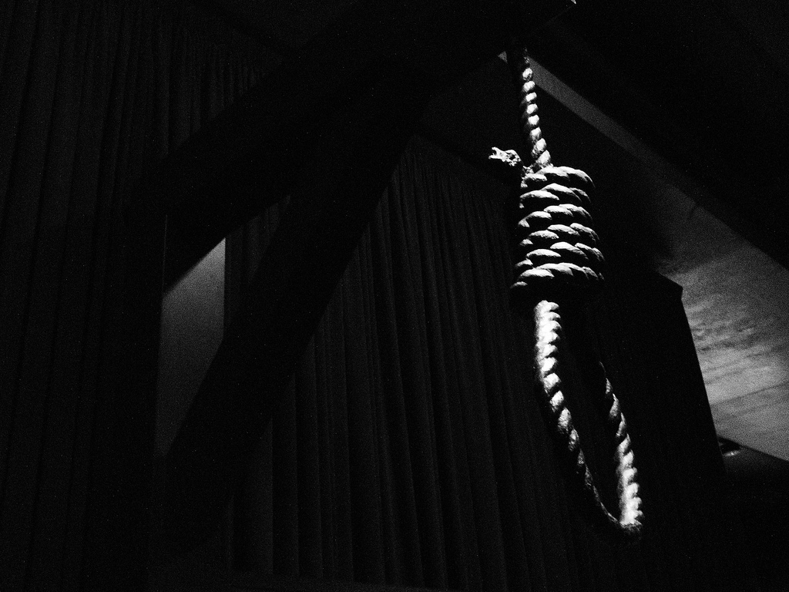
Lynching
Extralegal killings – many racially motivated – were prevalent during this time.
Photo by Fraser Mummery

Slide 6
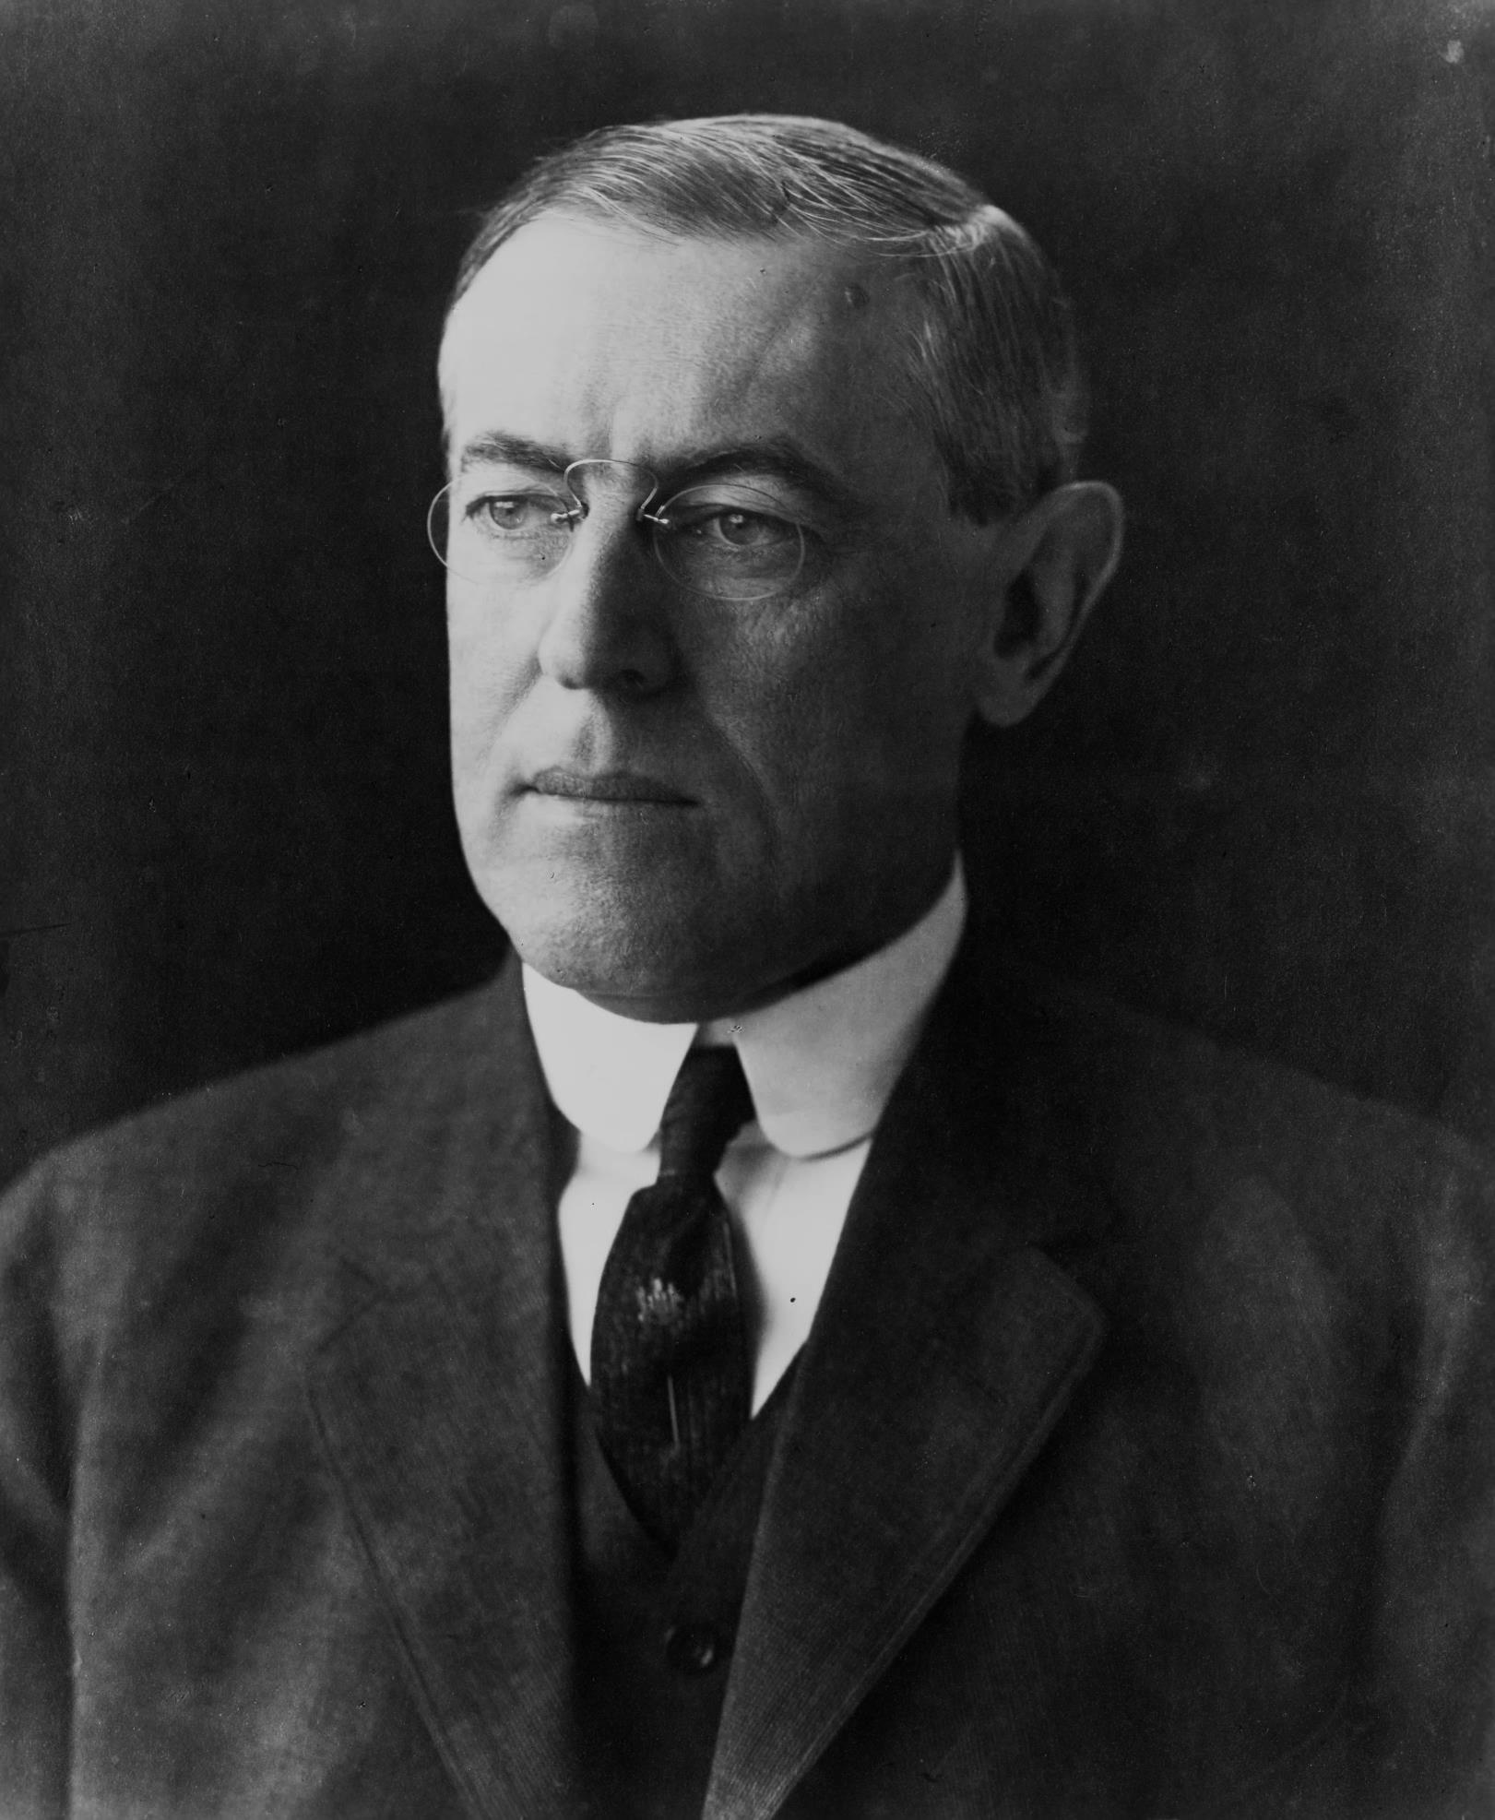
Progressive reformers did little to help.

Slide 7
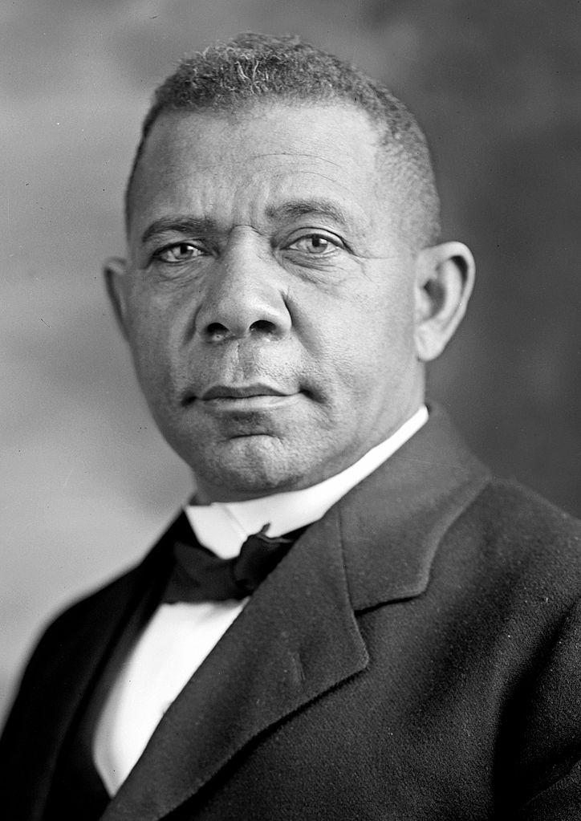
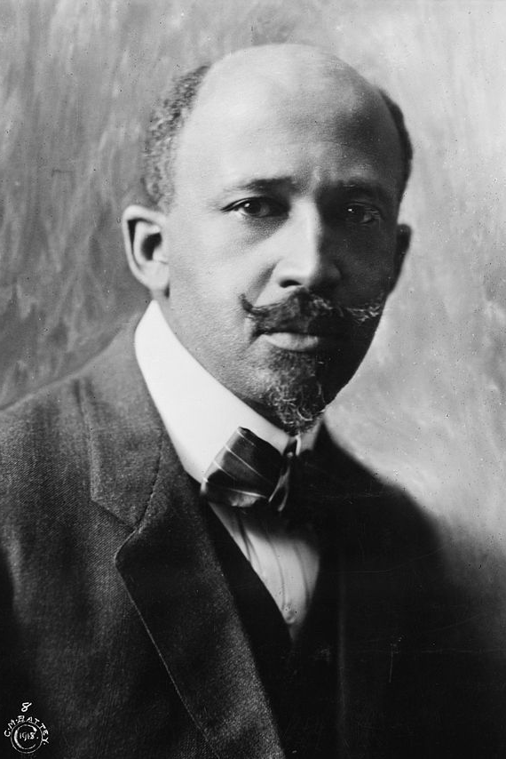
VS
Booker T. Washington
W.E.B. DuBois

Slide 8
Booker T. WASHINGTON
b. 1856 in Virginia
Up from Slavery
TUSKEGEE Institute
Academic & Vocational Training

Slide 9
ECONOMIC ADVANCEMENT
Priority #1
Booker T. Washington

Slide 10
Atlanta Compromise
Sought White Support for Self-Help
(in return for NOT pursuing the vote).
Booker T. Washington

Slide 11
MONEY BEFORE POWER
power BEFORE money

Slide 12
W.E.B. DuBois
A Founder of the NAACP
Harvard Graduate
Voting Rights Advocate

Slide 13
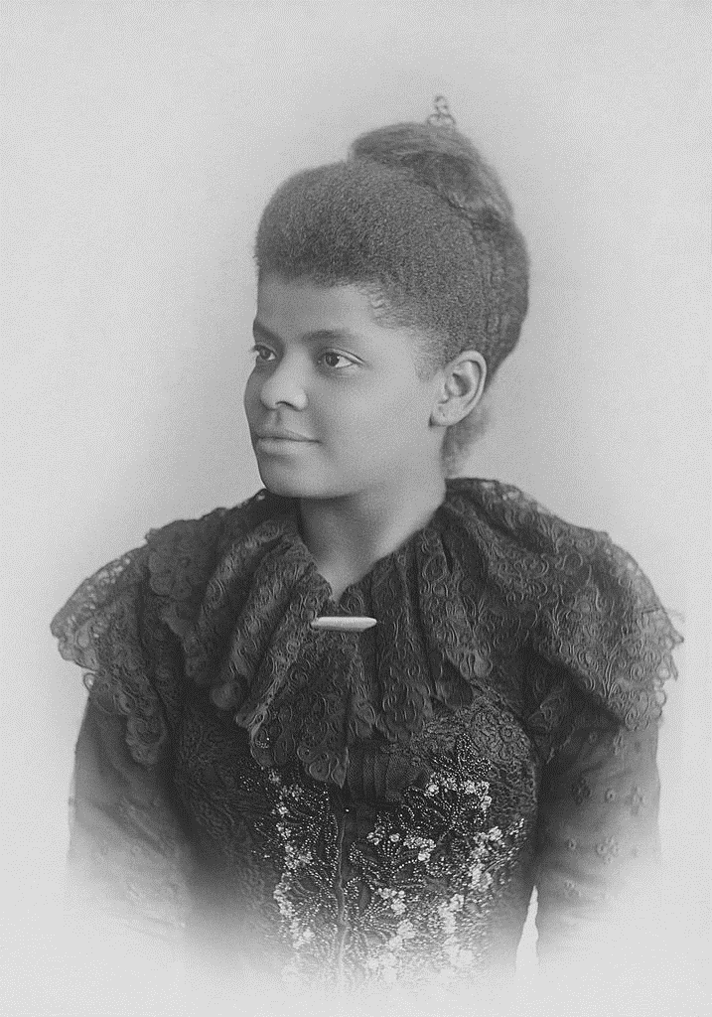
Ida B. Wells
Muckraking journalist and anti-lynching advocate
Photo by Fraser Mummery

Slide 14
Marcus Garvey
“Back to Africa” Movement
Black Nationalism

Slide 15
THE IMAGE OF GOD
“If the white man has the idea of a white God, let him worship his God as he desires… Whilst our God has no color, yet it is human to see everything through one's own spectacles, and since the white people have seen their God through white spectacles, we have… to see our God through our own spectacles.”
-- Marcus Garvey

