Slide 1
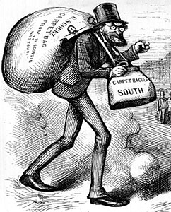


Reconstruction in the South
1867-1877
USHC 3.4
Summarize the end of Reconstruction, including the role of anti–African American factions and competing national interests in undermining support for Reconstruction; the impact of the removal of federal protection for freedmen; and the impact of Jim Crow laws and voter restrictions on African American rights in the post-Reconstruction era.

Slide 2
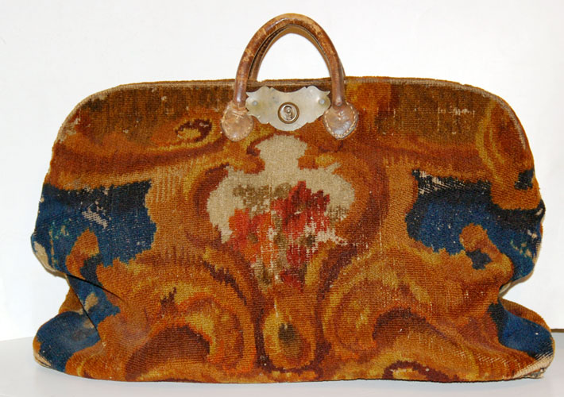
Carpetbag

Slide 3
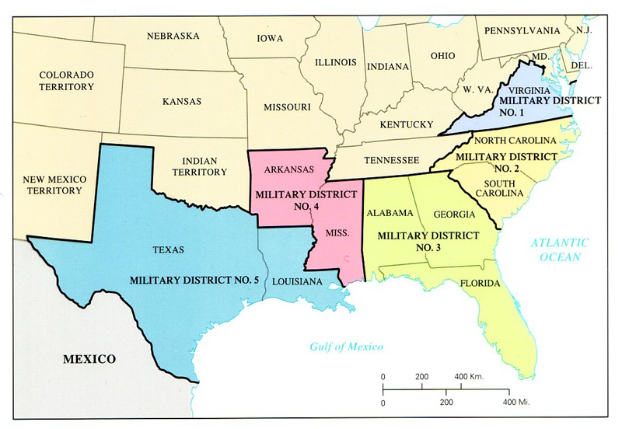
“Carpetbaggers”
Nickname applied by Southern whites to people who migrated South after the Civil War

Slide 4
The “Carpetbagger”
Stereotype

Slide 5
“Carpetbaggers”
Individual carpetbaggers’ goals were diverse:
Power
Opportunity
Wealth
Service

Slide 6
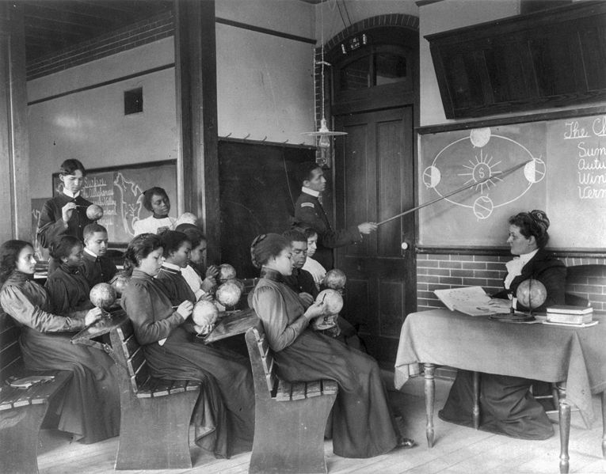
Educating Freedmen and Women
Although many carpetbaggers went South to seek fortune and political office, many went South to educate freedmen and women.
Hampton Institute (VA)
Late Nineteenth Century

Slide 7
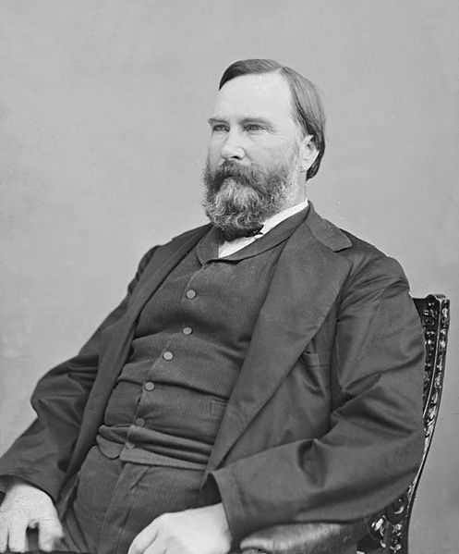
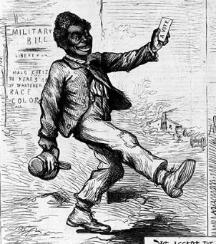
The Republican Coalition
in the South
“Carpetbaggers”
“Scalawags”
Freedmen

Slide 8
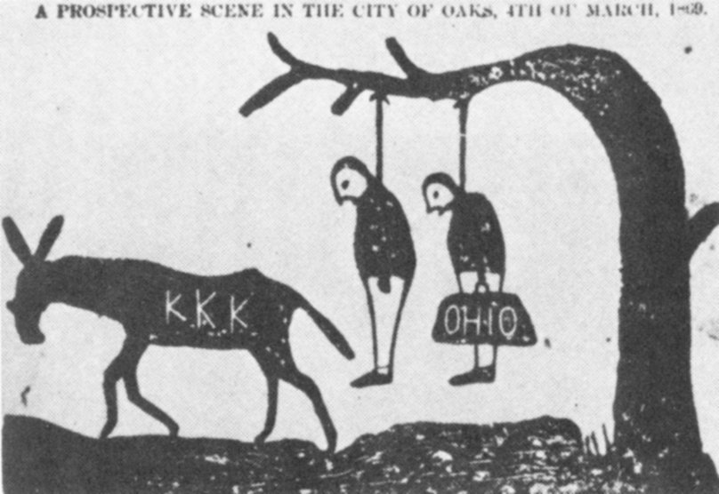
Resistance to Reconstruction

Slide 9
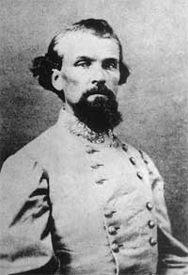
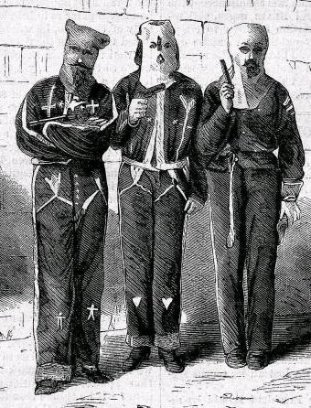
The (First) Ku Klux Klan
1865-1874
Gen. Nathan Bedford Forrest, CSA
Vigilantism

Slide 10
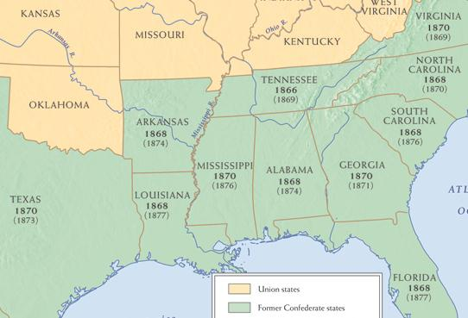
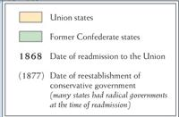

Restoration of Southern “Home Rule”
1869-1877
1869
1870
1869
1874
1877
1876
1874
1871
1873
1877
1877

Slide 11
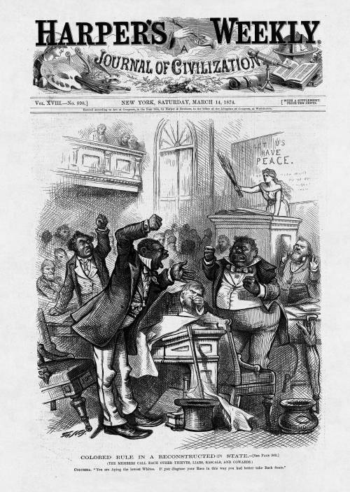
1874
Northern public opinion turns against Radical Reconstruction.
Perception of
“Colored Rule”
and corruption in the South under Carpetbag state governments
http://blackhistory.harpweek.com/7illustrations/reconstruction/coloredrule.htm

Slide 12
1874 Congressional Elections
U.S. House
of Representatives
VOTERS REACT TO:
Bad Economy
Political Corruption
Reconstruction Policy

Slide 13
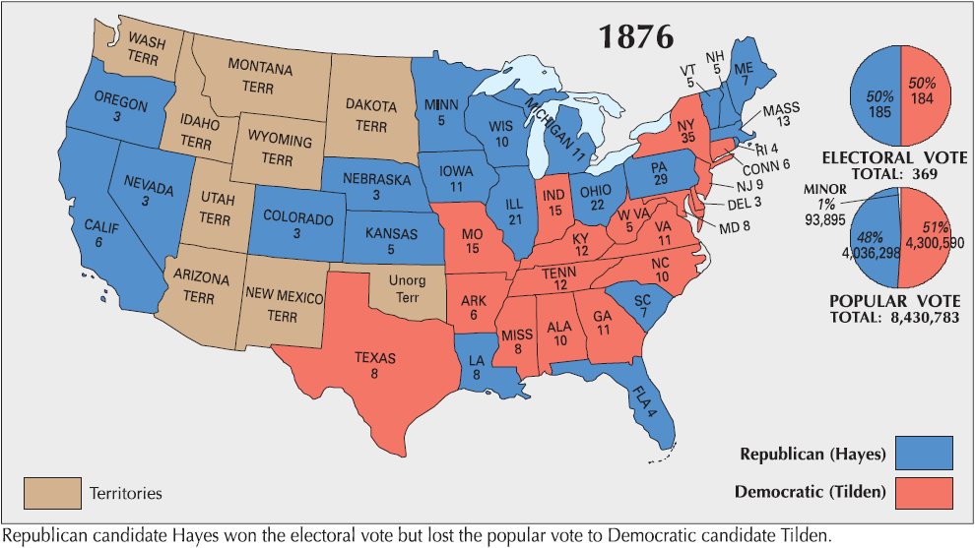
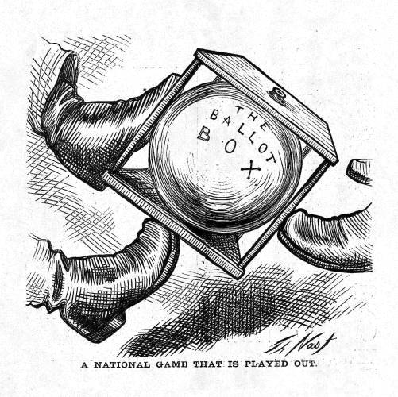
Election of 1876
Democratic Platform
Republican Platform
Tilden: 184
Hayes: 166
Disputed: 19
FTW: 185
1868
1872
1876

Slide 14
http://elections.harpweek.com/controversy.htm

Slide 15
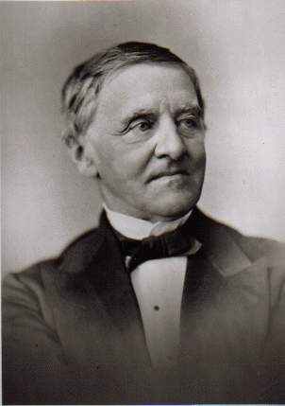
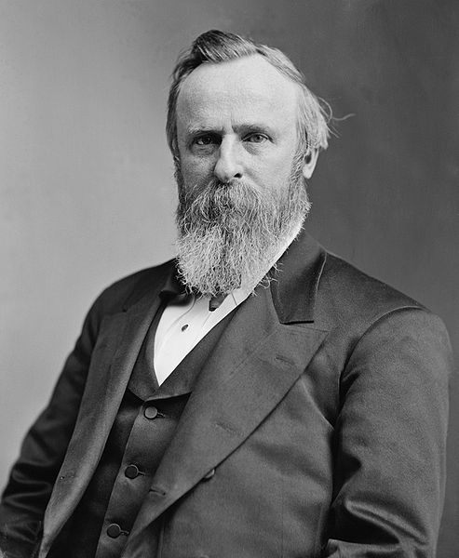
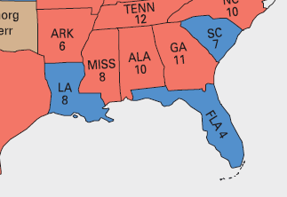

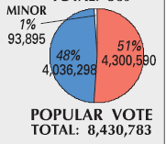

Compromise of 1877
DISPUTED ELECTION
184
166
Rutherford B. Hayes
(R-OH)
Samuel Tilden
(D-NY)
185
“Rutherfraud”
Notes:
By 1876, South Carolina, Louisiana, and Florida were the only states that still had garrisons of federal troops supporting the Republican state governments through force of arms. All three states had disputed election returns due to massive fraud by both parties. An Electoral Commission, voting on party lines, certified the election for Hayes, who had been twenty votes shy of victory (while Tilden had been only one vote shy). Democrats in Congress staged a filibuster in protest, but a compromise was reached in which the Democrats would accept the result in return for the removal of federal troops from the South and a promise from Hayes not to intervene in the Southern states’ internal politics (i.e., not enforcing the Fifteenth Amendment).

Slide 16
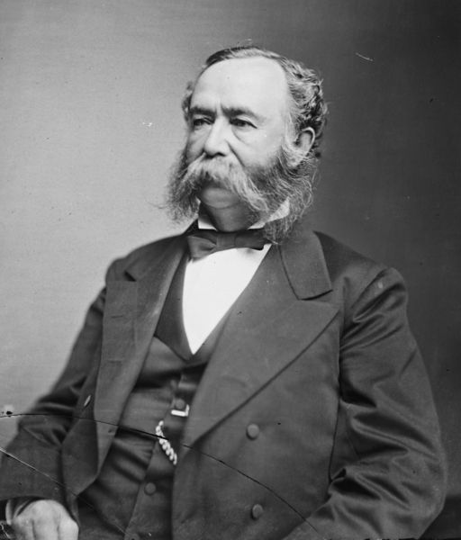
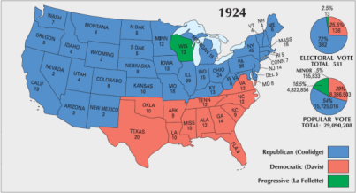
“Redeemer” Governments
Southern White “Bourbon” Democrats re-assert authority
“Solid South”
  DEMOCRATIC STRONGHOLD
    Republican Party a non-entity in Southern politics until the 1960s
Gov. Wade Hampton (SC)

Slide 17

The “Solid South”
Almost 50 Years Later

Slide 18
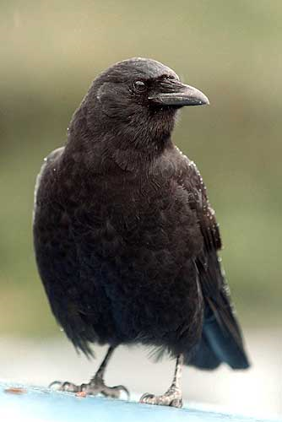
Jim Crow
Segregation
and Voting Restrictions
“Jim Crow” Laws
Racial Segregation
Literacy Tests
Poll Tax
Designed to keep Black citizens from voting
Grandfather Clause

Slide 19


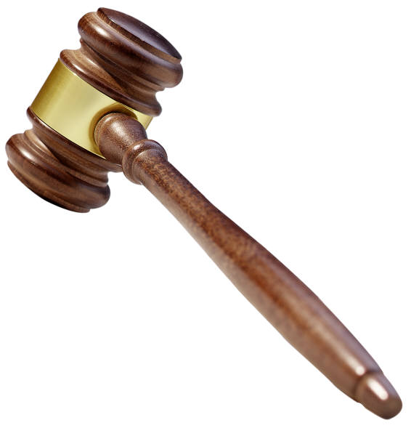
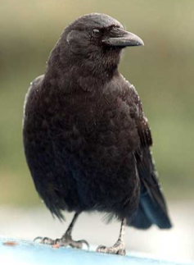

The Supreme Court and Civil Rights
(Late Nineteenth Century)
In the late 19th century, the Supreme Court upheld Jim Crow, as well as restrictions on voting (since these restrictions did not explicitly discriminate based on race).

Slide 20
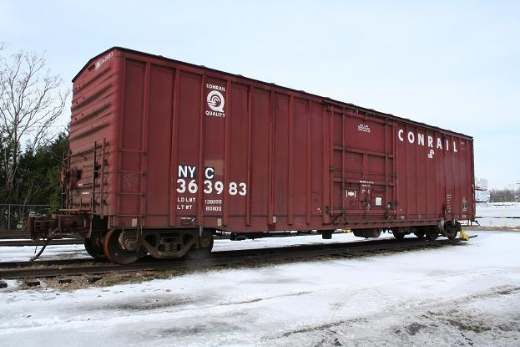
Plessy v. Ferguson
(1896)
Louisiana Racial Segregation Case
“Separate But Equal”
Overturned by Brown v. Board (1954)
14

Slide 21





LEARNING.
DELIVERED.

