Slide 1
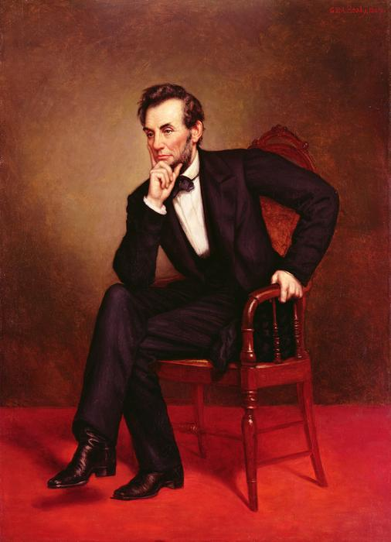
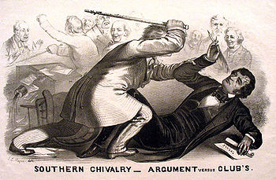

The Road to Civil War 1820-1860

Slide 2
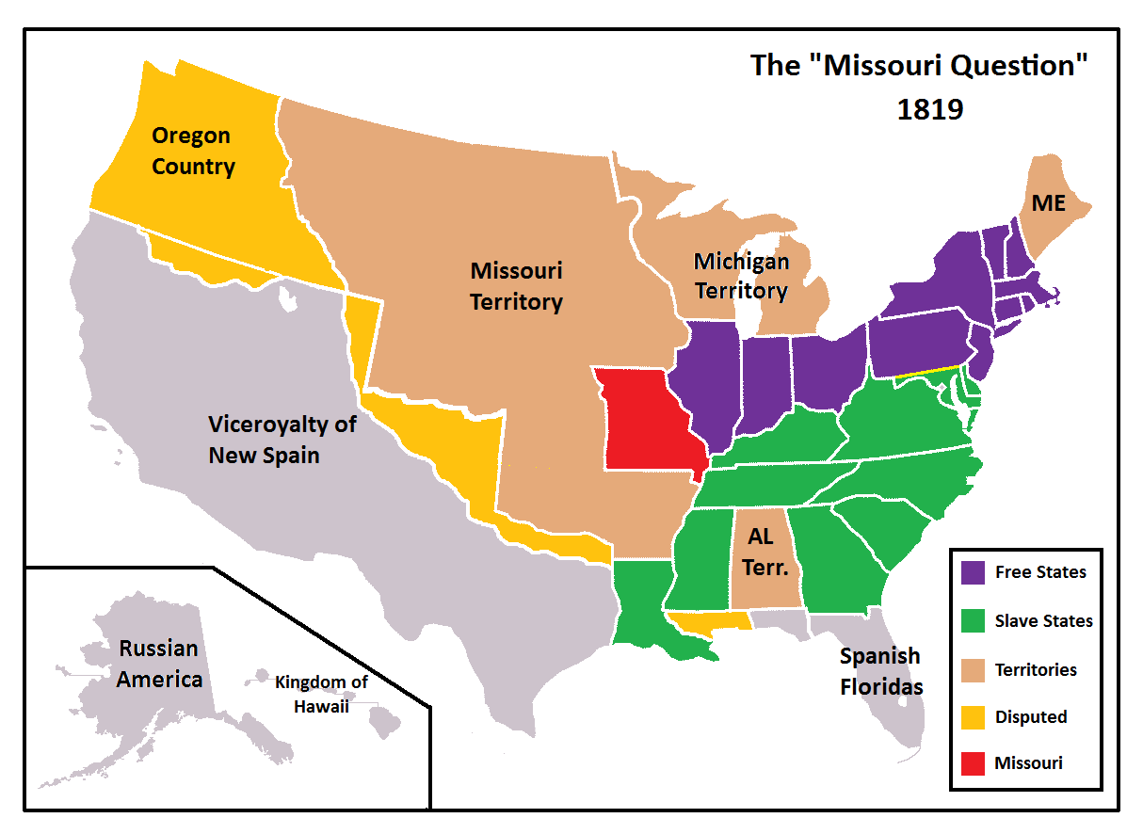

Slide 3
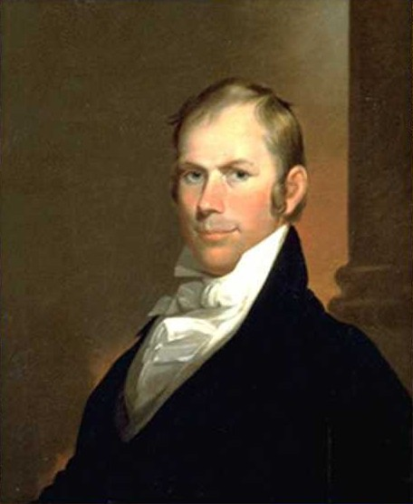
36˚30’
Missouri Compromise
(1820)

Slide 4
The American System
National Bank
Internal Improvements
Protective Tariff
The South Loses

Slide 5
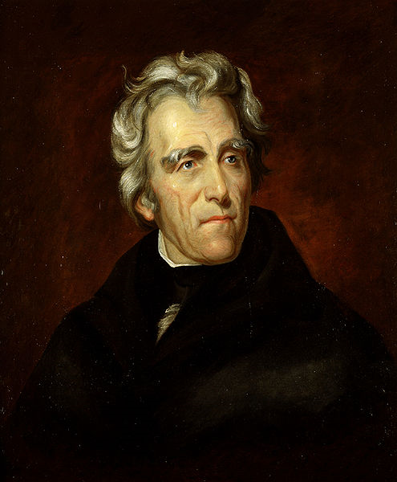

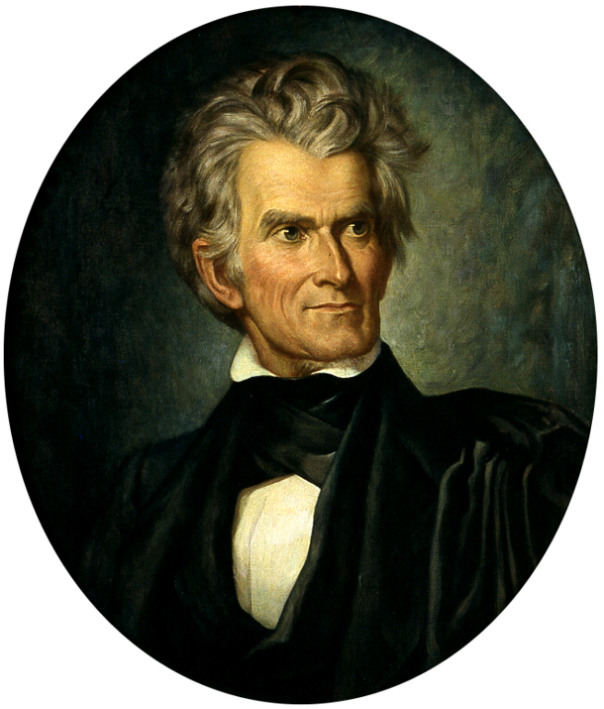
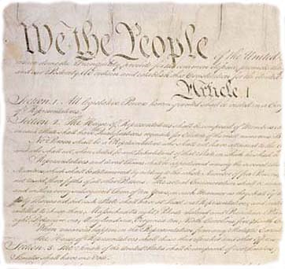
NULLIFICATION
1828-1833

Slide 6
The American System
National Bank
Internal Improvements
Protective Tariff
The South Loses

Slide 7
The “Great Compromiser”
Clay’s Compromises
1. Missouri (1820)
2. Nullification (1833)
3. 1850 (1850)

Slide 8
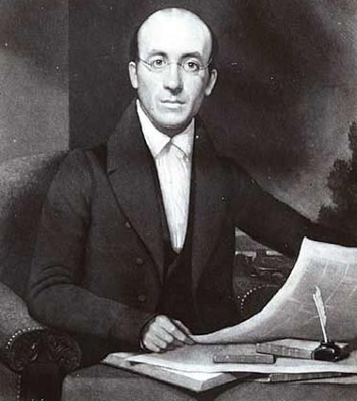
  1831

Slide 9

Texas
  Independence
1845 Annexation

Slide 10
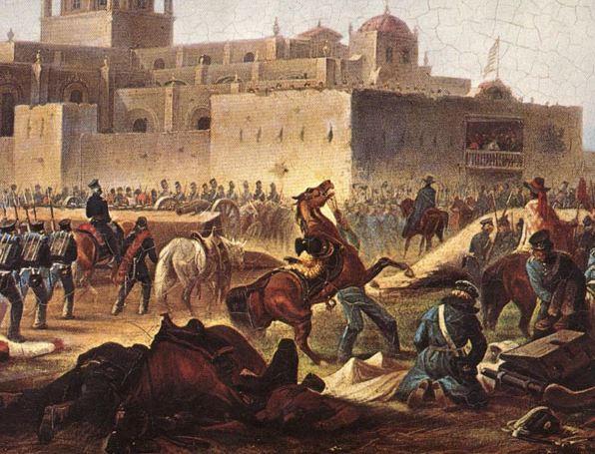
The Mexican War
1846-1848
http://www.il.ngb.army.mil/museum/HistoricalEvents/MexicanWar.htm

Slide 11
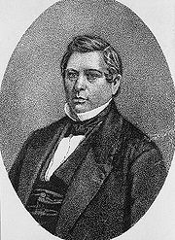
Wilmot Proviso
FREE SOIL
"Provided, That, as an express and fundamental condition to the acquisition of any territory from the Republic of Mexico by the United States… neither slavery nor involuntary servitude shall ever exist in any part of said territory..."
NEVER PASSED
David Wilmot
(D – PA)

Slide 12
Abolitionism vs. Free Soil
Abolitionism Opposition to SLAVERY | Free Soil Opposition to the SPREAD of slavery
Geographic Base: NORTHEAST | Geographic Base: NORTHWEST

Slide 13
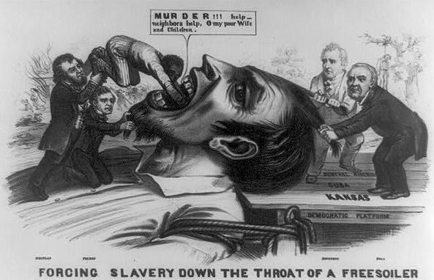

Slide 14
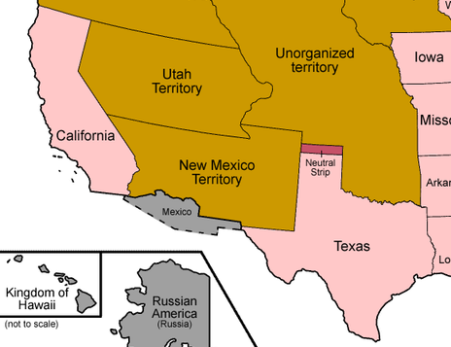
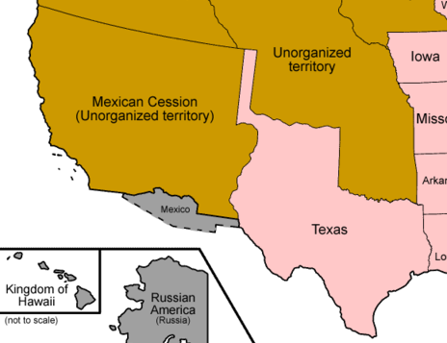
?

Slide 15
The Compromise of 1850
For the North:
For the South:
The New Mexico Territory:
Slavery in Washington, DC:
Admit California as a Free State
STRONGER Fugitive Slave Law
Popular Sovereignty in Mexican Cession
Texas sells land / Federal Gov. assumes debt
Abolish Slave Trade in Washington, D.C.

Slide 16
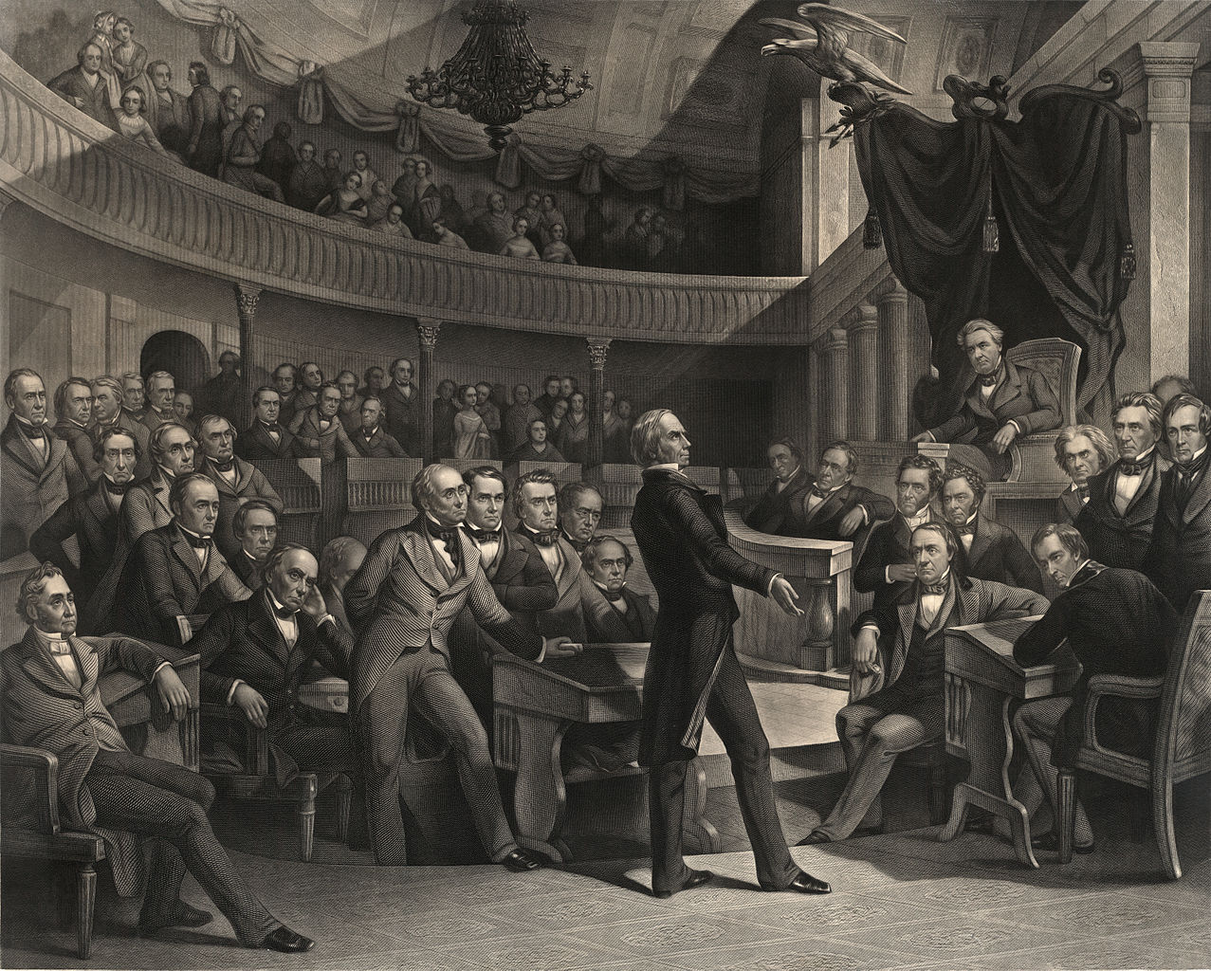
The Compromise of 1850 was supposed to be the final compromise between the sections…
and it was – just for different reasons than Clay had intended.

Slide 17
The 1830s vs. the 1850s
1830s
COMPROMISE Accept differences in order to keep the peace (e.g., “Gag Rule” on Slavery)
1850s
CONFLICT Advance sectional and/or moral interest at the expense of sectional harmony

Slide 18
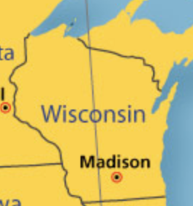
Personal Liberty Laws
Passed by Wisconsin and
other Northern states
  Guaranteed jury trials
  for accused slaves
De facto Nullification

Slide 19
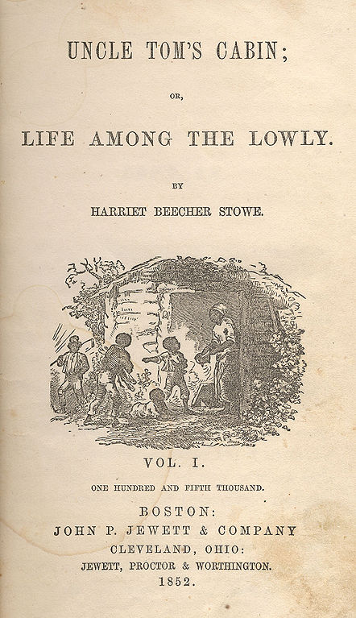
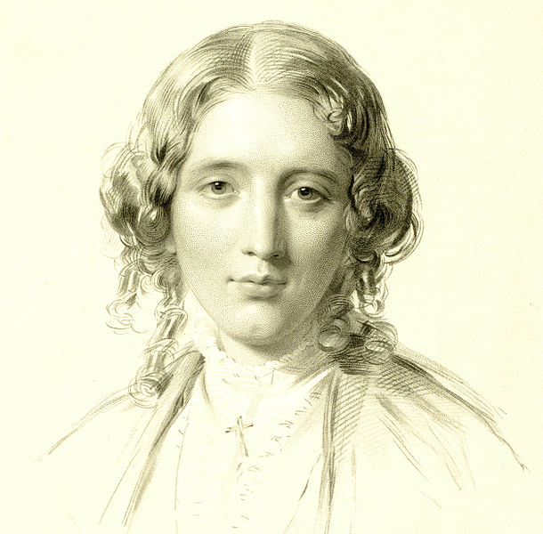
Uncle Tom’s Cabin
Stowe
Harriet Beecher Stowe’s bestselling
anti-slavery novel (1852)
Original Illustrations: http://utc.iath.virginia.edu/uncletom/illustra/53illf.html

Slide 20

Some books make us
Re-Think

Slide 21
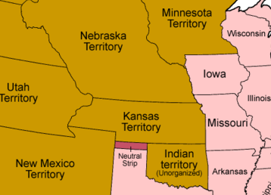
The Kansas-Nebraska Act
POPULAR
SOVEREIGNTY
In Kansas and Nebraska Territories on the issue of slavery
MISSOURI COMPROMISE
ANIMATED MAP:
http://teachingamericanhistory.org/neh/interactives/sectionalism/lesson3/

Slide 22
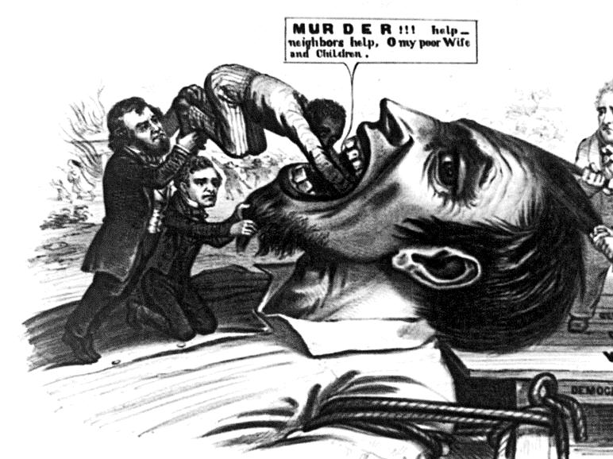
FREE SOIL
Opposition to the SPREAD of Slavery

Slide 23

Republican Party
1854
Northern Whigs +
Northern Free Soil Democrats
Free Soil
  NOT abolitionist

Slide 24
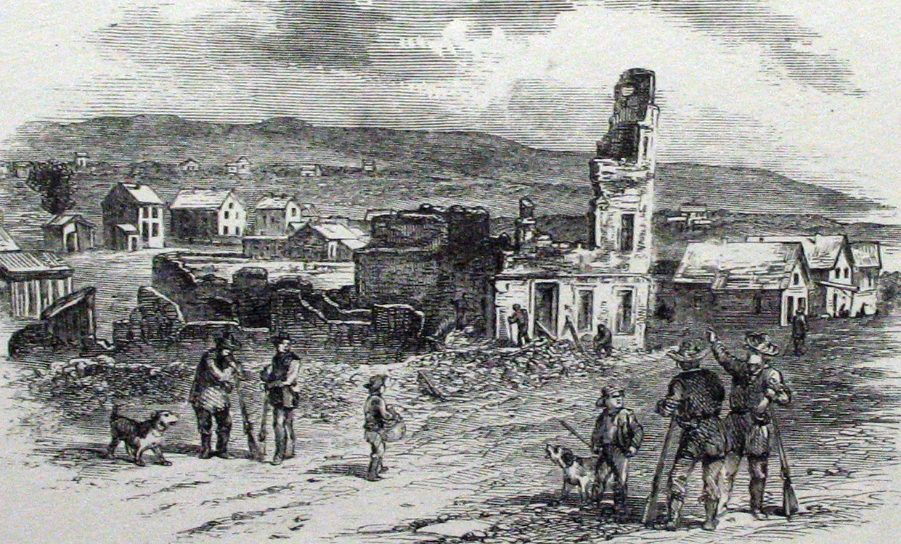
“Bleeding Kansas”
1855-1859
56 Dead
Lawrence, KS, after the “Sack of Lawrence” by proslavery settlers

Slide 25
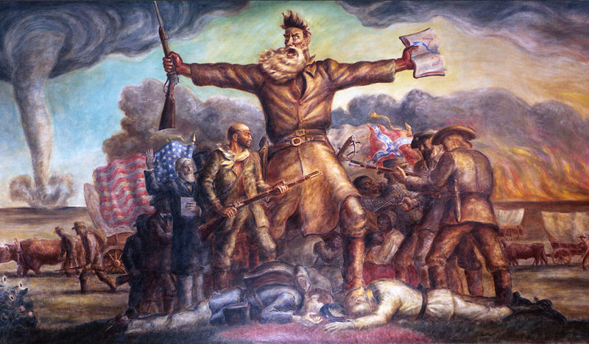
John Brown (Violent Abolitionist)
John Steuart Curry, “Tragic Prelude,” 1937-1941

Slide 26
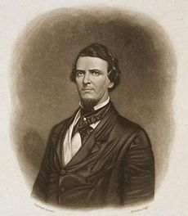
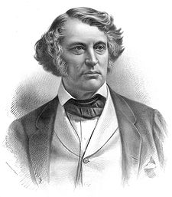
Brooks/Sumner Incident
(1856)
vs.
Rep. Preston Brooks (SC)
Sen. Charles Sumner (MA)

Slide 27
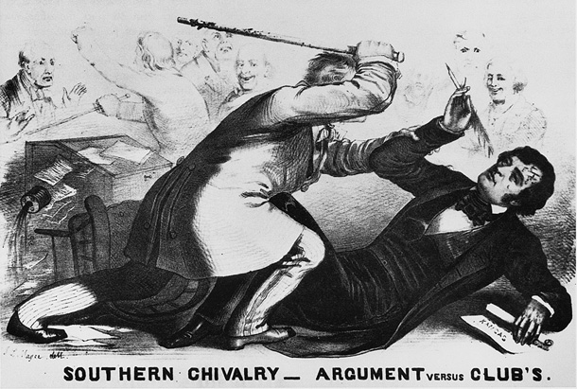
SLAP!
READ Sumner’s Speech
READ Brooks’ Defense

Slide 28
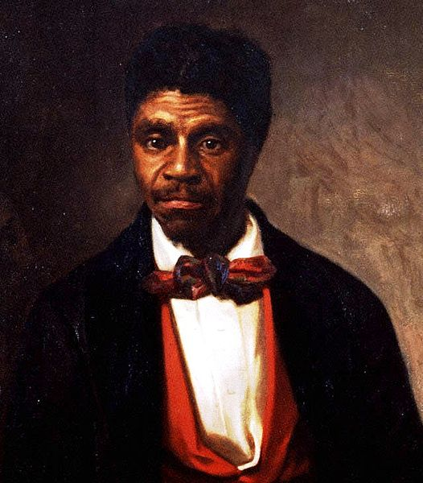

Dred Scott v. Sandford
(1857)
FACTS OF THE CASE:
Dred Scott, a slave, lived with his master in free territory for two years.
Scott claimed this made him a free man.

Slide 29



Dred Scott v. Sandford
(1857)
THE DECISION:
People of African descent (incl. Scott) could not be U.S. citizens.
Congress can’t forbid slavery in federal territories (violation of property rights)
  Ergo, the Missouri Compromise is Unconstitutional
Judicial Activism

Slide 30
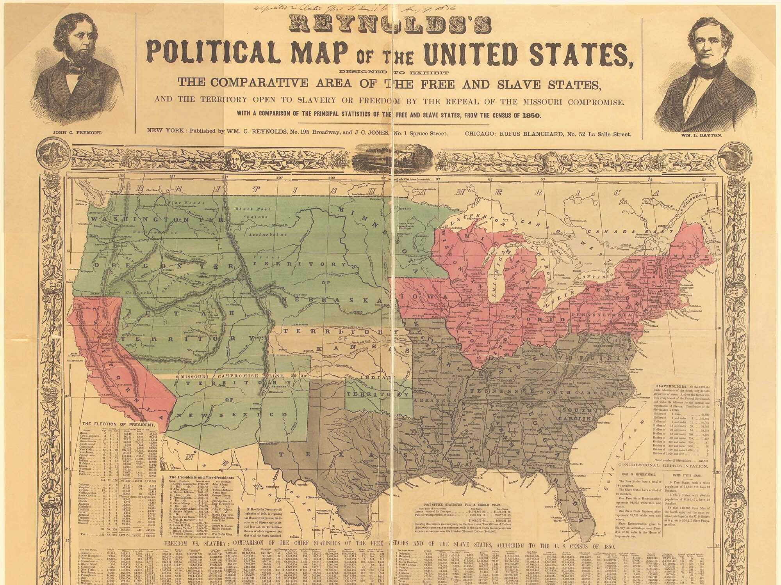
“Slave Power” Conspiracy?

Slide 31

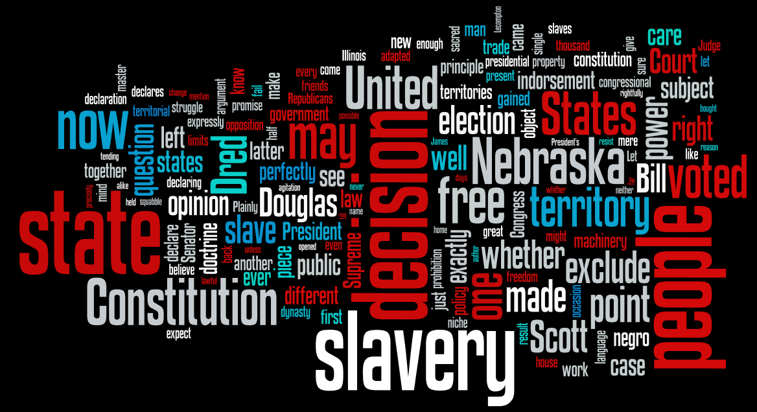
“House Divided” Speech
Abraham Lincoln
1858

Slide 32

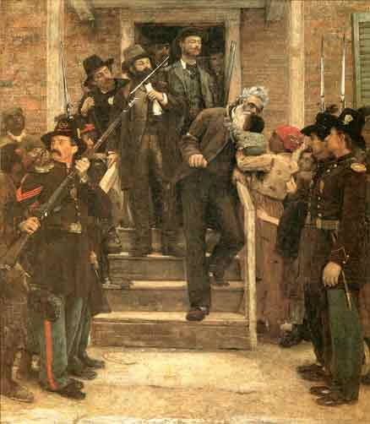
John Brown’s Raid
(1859)
OBJECTIVE:
  Seize a federal arsenal
    Harpers Ferry, VA
TREASON
  Tried, Convicted, Executed
  Different reactions in North and South

Slide 34
Paranoia
NORTH: “Slave Power” Conspiracy
The South wants to spread slavery throughout the nation
Mason-Dixon Line
SOUTH: North plans to destroy Southern slavery by igniting slave revolts.

Slide 35
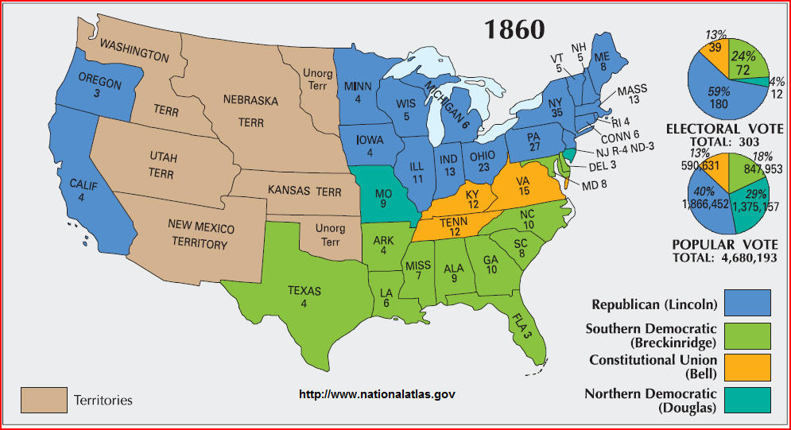
1860 Presidential Election

Slide 36
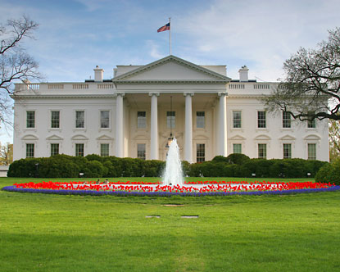
Abraham Lincoln
(R-IL)
Sixteenth President of the U.S.
1861-1865
Democratic Party split
Election prompted secession of states in the Deep South
http://www.whitehouse.gov/history/presidents/al16.html

Slide 37
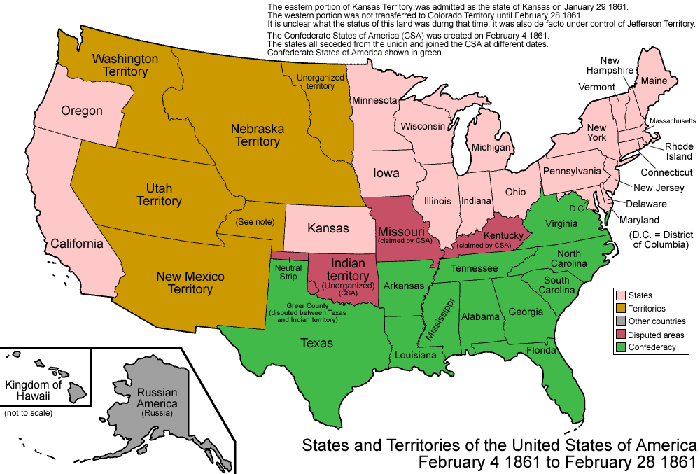
Secession

Slide 38








