Slide 1
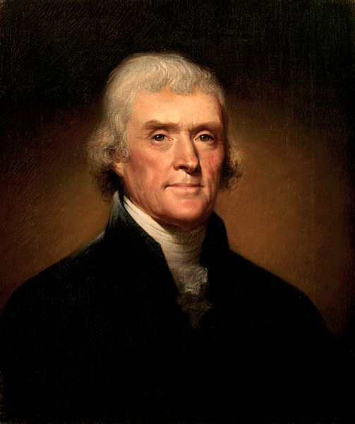
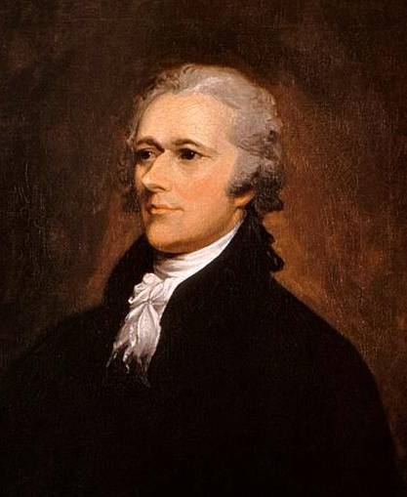

Jefferson vs. Hamilton
The Clash of the Cabinet
USHC 1.6
Analyze the development of the two-party system during the presidency of George Washington, including controversies over domestic and foreign policies and the regional interests of the Democratic-Republicans and the Federalists.

Slide 2
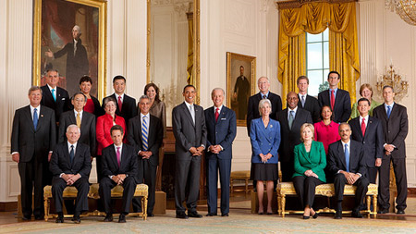
The President’s Cabinet
http://www.whitehouse.gov/administration/cabinet

Slide 3
Washington’s Cabinet
NAME | POSITION | STATE
Thomas Jefferson | Sec. of State | VA
Alexander Hamilton | Sec. of Treasury | NY
Henry Knox | Sec. of War | MA
Edmund Randolph | Atty. General | VA

Slide 4
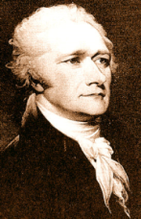
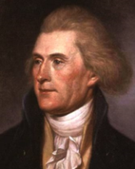
FEDERALISTS | The First Party System | REPUBLICANS
HAMILTON John Adams | Leaders | JEFFERSON James Madison
Strong CENTRAL Gov. | Federalism | States’ Rights
LOOSE Construction | Constitution | STRICT Construction
YES | Gov. Involvement in Economy | NO
VERY YES | National Bank | NO
YES | Protective Tariff | NO
YES | Federal Assumption of State War Debts | NO
Urban (Commerce) | Supporters | Rural (Agrarian)

Slide 5
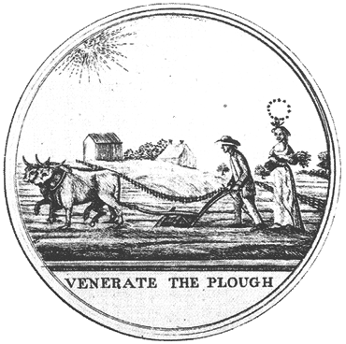

Slide 6
Agrarianism
“Those who labor in the earth are
the chosen people of God, if ever
he had a chosen people, whose breasts he has made his peculiar deposit for substantial and genuine virtue. It is the focus in which he keeps alive that sacred fire, which otherwise might escape from the face of the earth.”
-- Notes on the State of Virginia

Slide 7
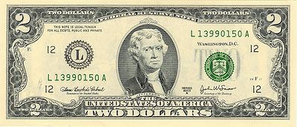


Slide 8
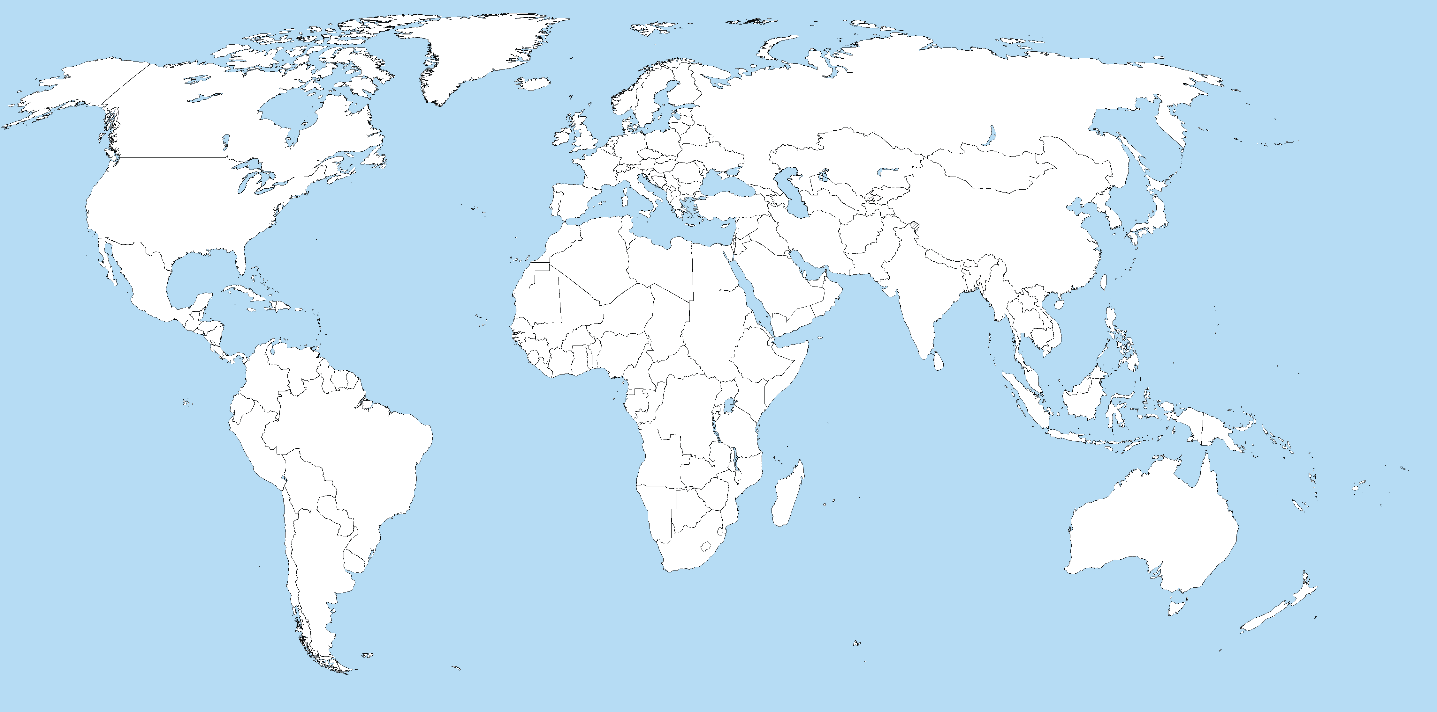
The Jeffersonian
Economic Model
RAW MATERIALS
FINISHED GOODS
MANUFACTURING
AGRICULTURE
CLICK HERE
to read an excerpt from Jefferson’s Notes on the State of Virginia.
Jefferson’s economic model depended on a laissez-faire policy of FREE TRADE between the U.S. and Europe.

Slide 9

US in 1789

Slide 10

Hamilton’s Proposals
Hamilton’s economic proposals pursued three goals:
Public Credit
National Bank
Domestic Manufacturing

Slide 11
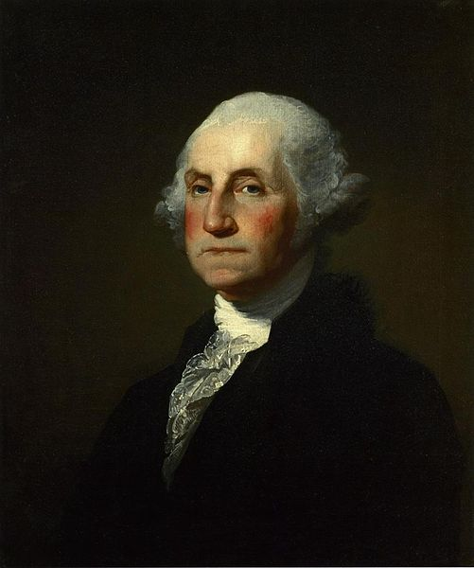
Washington’s Farewell Address
WARNINGS AGAINST:
Political Partisanship
Entangling Alliances

Slide 12
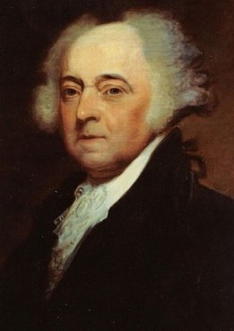
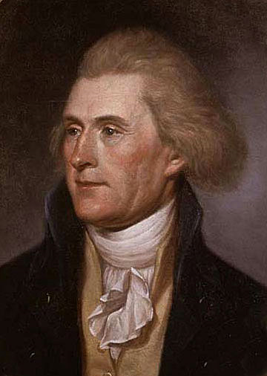
The Election of 1796
John Adams
Thomas Jefferson
VS.
FEDERALIST
REPUBLICAN

Slide 13
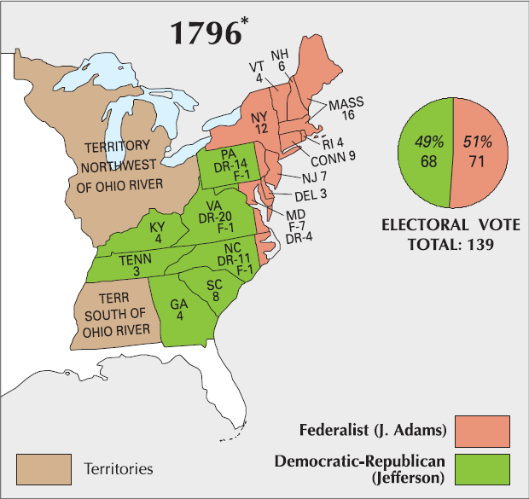

SECTIONALISM
1796
1800

Slide 14
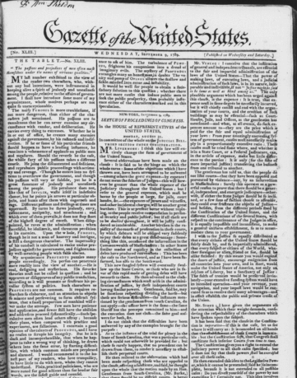
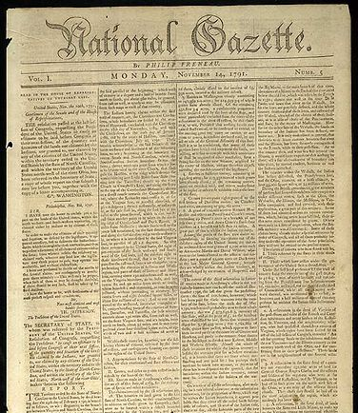

Partisan Newspapers
Gazette of the United States
(Federalist)
National Gazette
(Republican)

Slide 15
tOOTHLESS
BLIND
old
crippled
Bald
Adams
Querulous

Slide 16
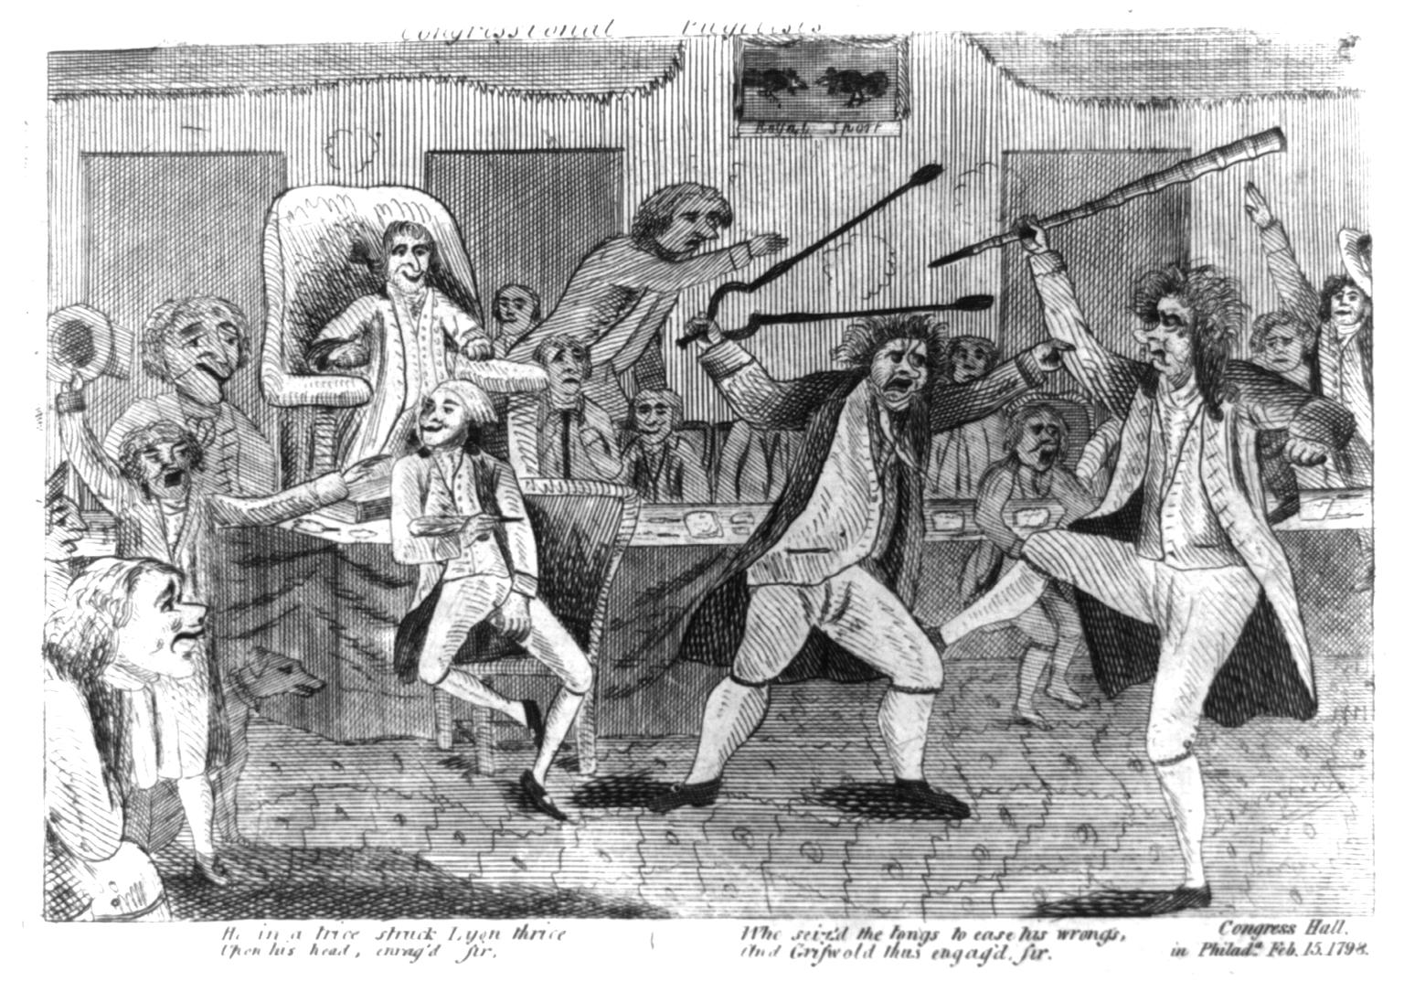
The Griswold-Lyon Fight
1798

Slide 17
The Alien and Sedition Acts
1798
Federalists in Congress place restrictions on citizenship and POLITICAL SPEECH.

Slide 18
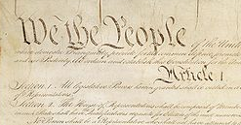


Was the Sedition Act constitutional?
From Amendment I:
Congress shall make no law… abridging the freedom of speech, or of the press…
RESERVED

Slide 19
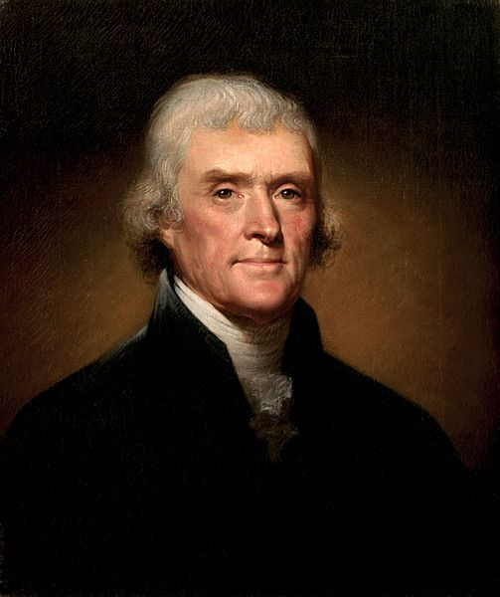
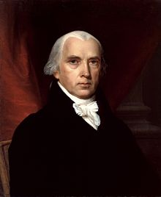
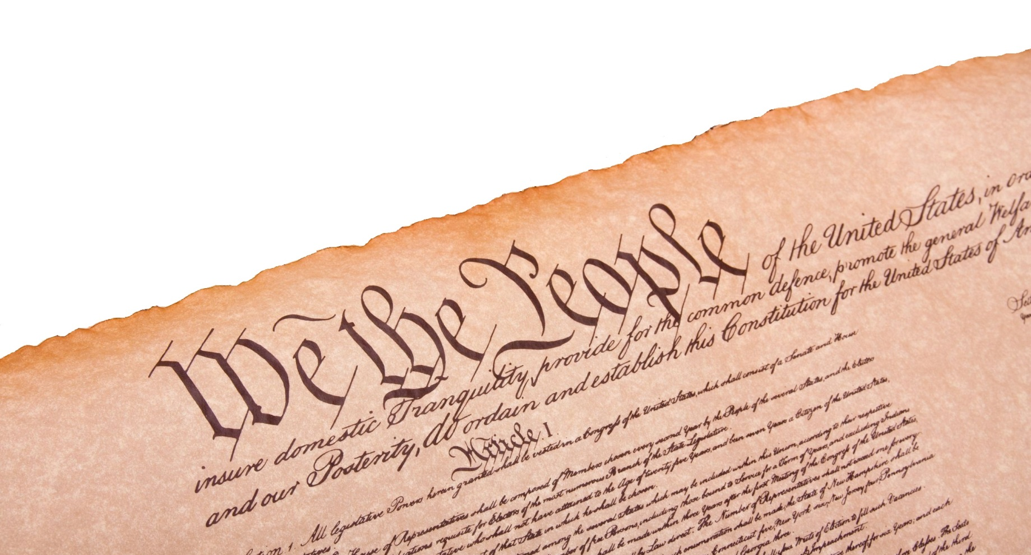
Virginia and Kentucky Resolutions
Jefferson
Madison

Slide 20
State legislatures can protest [and nullify] unconstitutional laws.
Jefferson
Madison

Slide 21
Kentucky Resolutions
In questions of power, then, let no more be heard of confidence in man, but
bind him down…by the chains of the Constitution.

Slide 22
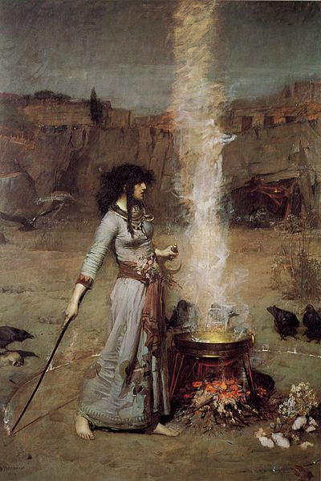
Jefferson
to John Taylor of Caroline
“A little patience, and we
shall see the reign of witches pass over, their spells dissolve, and the people, recovering their true sight, restore their government to its true principles.”

Slide 23
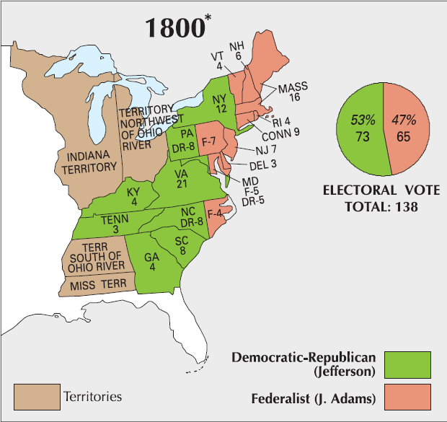
REVOLUTION
1796
1800

Slide 24
…and Congress, too!

Slide 25








