Slide 1
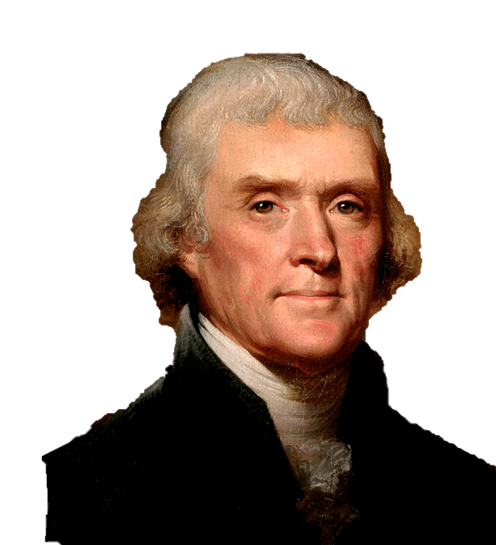
The Declaration of Independence
US HISTORY EOC REVIEW

Slide 2
USHC 1.3
Analyze the impact of the Declaration of Independence and the American Revolution on establishing the ideals of a democratic republic.

Slide 3
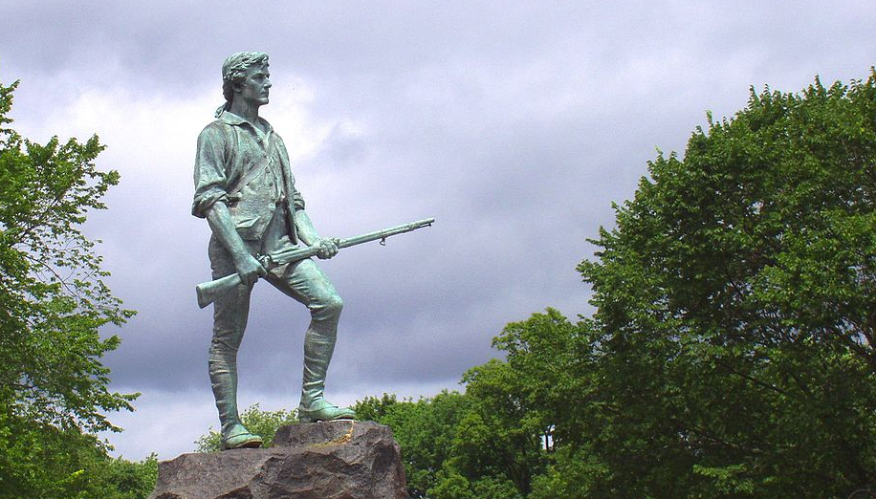
LEXINGTON & cONCORD
April, 1775
Photo Credit: Daderot

Slide 4
15 Months later
15 Months

Slide 5
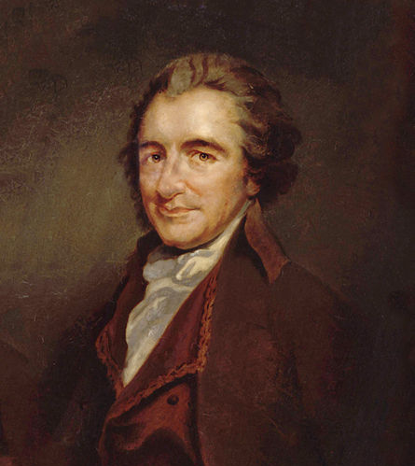
Why did it take so long?
Thomas Paine

Slide 6
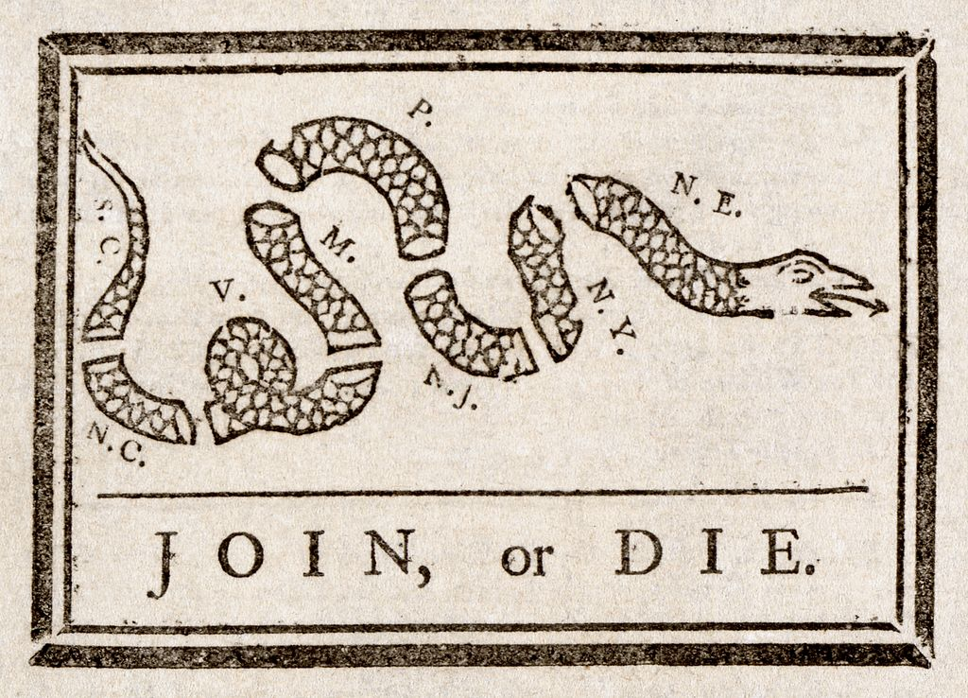

Slide 7
IN CONGRESS, JULY 4, 1776
The unanimous Declaration of the thirteen united States of America
When in the Course of human events it becomes necessary for one people to dissolve the political bands which have connected them with another and to assume among the powers of the earth, the separate and equal station to which the Laws of Nature and of Nature's God entitle them, a decent respect to the opinions of mankind requires that they should declare the causes which impel them to the separation.

Slide 8
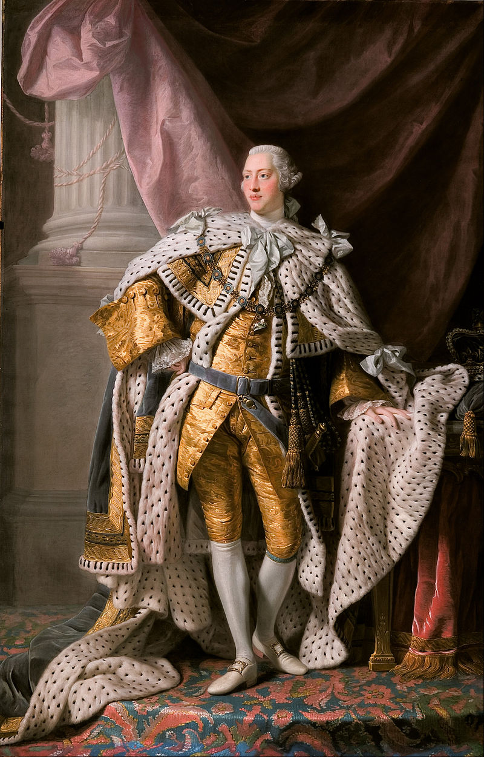
DEAR GEORGE
#stumped

Slide 9
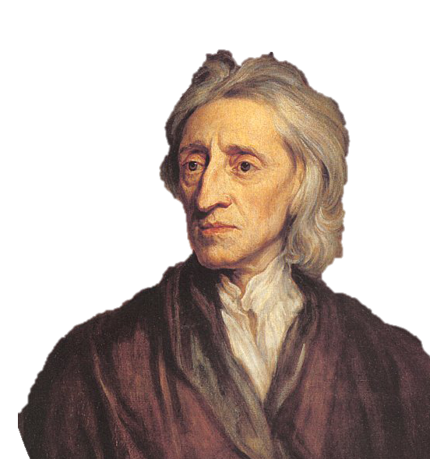
JOHN LOCKE
Influencer
Limited Government

Slide 10
JOHN LOCKE
Appeal to Natural Law

Slide 11
TWO AUDIENCES:
INTERNAL | EXTERNAL
People in the newly-independent states who are either on the fence or inclined to support the British | Foreign nations (such as France) who may be inclined to offer military and financial assistance to the United States

Slide 12
TWO AUDIENCES:
INTERNAL | EXTERNAL
People in the newly-independent states who are either on the fence or inclined to support the British | Foreign nations (such as France) who may be inclined to offer military and financial assistance to the United States

Slide 13
We hold these truths to be self-evident, that all men are created equal, that they are endowed by their Creator with certain unalienable Rights, that among these are Life, Liberty and the pursuit of Happiness. — That to secure these rights, Governments are instituted among Men, deriving their just powers from the consent of the governed, — That whenever any Form of Government becomes destructive of these ends, it is the Right of the People to alter or to abolish it, and to institute new Government, laying its foundation on such principles and organizing its powers in such form, as to them shall seem most likely to effect their Safety and Happiness.

Slide 14
Natural rights
Life
Liberty
Property

Slide 15
Natural rights
Life
Liberty
Pursuit of Happiness

Slide 16
ECONOMIC FREEDOM
Life
Liberty
Pursuit of Happiness

Slide 17
REVOLUTION
Right of
People have the right to overthrow oppressive governments.

Slide 18
Prudence, indeed, will dictate that Governments long established should not be changed for light and transient causes; and accordingly all experience hath shewn that mankind are more disposed to suffer, while evils are sufferable than to right themselves by abolishing the forms to which they are accustomed.

Slide 19
But when a long train of abuses and usurpations, pursuing invariably the same Object evinces a design to reduce them under absolute Despotism, it is their right, it is their duty, to throw off such Government, and to provide new Guards for their future security. — Such has been the patient sufferance of these Colonies; and such is now the necessity which constrains them to alter their former Systems of Government.

Slide 20
The history of the present King of Great Britain is a history of repeated injuries and usurpations, all having in direct object the establishment of an absolute Tyranny over these States. To prove this, let Facts be submitted to a candid world.
#stumped

Slide 21
DEAR GEORGE
#stumped

Slide 22
He has dissolved Representative Houses repeatedly, for opposing with manly firmness his invasions on the rights of the people.
He has erected a multitude of New Offices, and sent hither swarms of Officers to harrass [sic] our people, and eat out their substance.
#stumped

Slide 23
He has plundered our seas, ravaged our Coasts, burnt our towns, and destroyed the lives of our people.
He is at this time transporting large Armies of foreign Mercenaries to compleat the works of death, desolation and tyranny, already begun with circumstances of Cruelty & perfidy scarcely paralleled in the most barbarous ages, and totally unworthy the Head of a civilized nation.
#stumped

Slide 24
He has constrained our fellow Citizens taken Captive on the high Seas to bear Arms against their Country, to become the executioners of their friends and Brethren, or to fall themselves by their Hands.
He has excited domestic insurrections [slave rebellions] amongst us, and has endeavoured to bring on the inhabitants of our frontiers, the merciless Indian Savages, whose known rule of warfare, is an undistinguished destruction of all ages, sexes and conditions.
#stumped

Slide 25
“These United Colonies are, and of Right ought to be Free and Independent States… and that as Free and Independent States, they have full Power to levy War, conclude Peace, contract Alliances, establish Commerce, and to do all other Acts and Things which Independent States may of right do.”

Slide 26
FULL COMMITMENT

Slide 27
DOMESTIC POLICY | FOREIGN POLICY
ARTICLES OF CONFEDERATION The Principles of the Declaration in Action: DECENTRALIZED GOVERNMENT No Independent Executive | ALLIANCE WITH FRANCE (following the Battle of Saratoga) “The enemy of my enemy is my friend.” Why did France assist the United States? _________________________

Slide 28
DOMESTIC POLICY | FOREIGN POLICY
ARTICLES OF CONFEDERATION The Principles of the Declaration in Action: DECENTRALIZED GOVERNMENT No Independent Executive | ALLIANCE WITH FRANCE (following the Battle of Saratoga) “The enemy of my enemy is my friend.” Why did France assist the United States? _________________________

Slide 29
REPUBLICANISM
Northern states passed gradual emancipation laws.
(Southern states did not.)
Most states disestablished their state-supported churches.

Slide 30
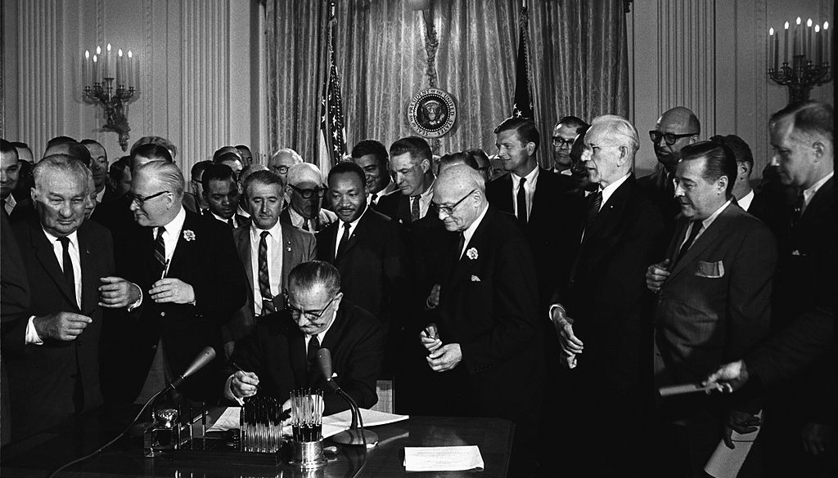
ALL MEN ARE CREATED EQUAL
President Johnson signs the Civil Rights Act of 1964.

Slide 31
AN INFLUENTIAL DOCUMENT
15 Months

Slide 32
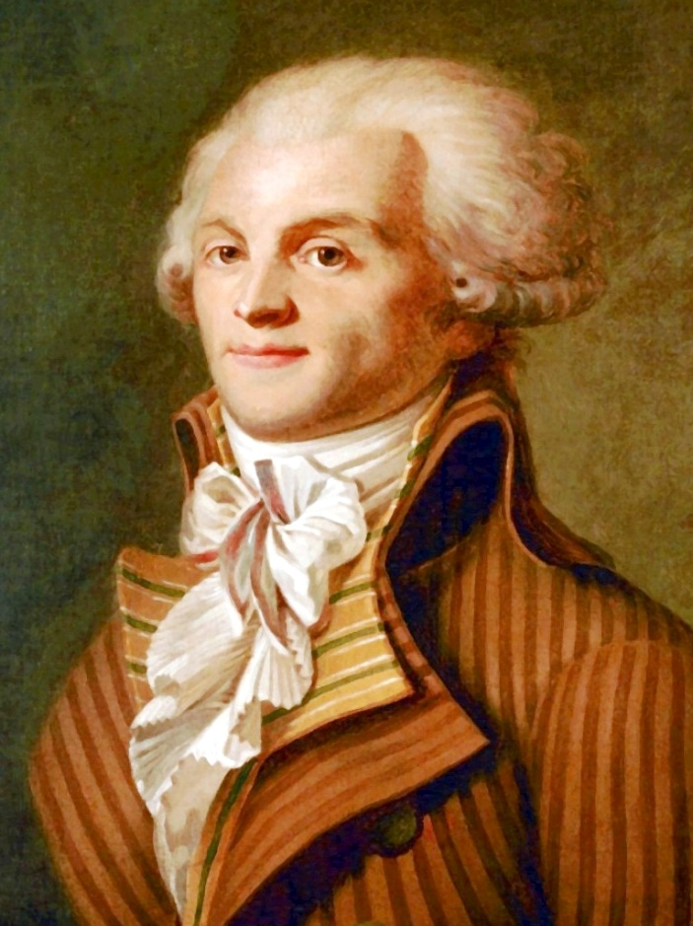
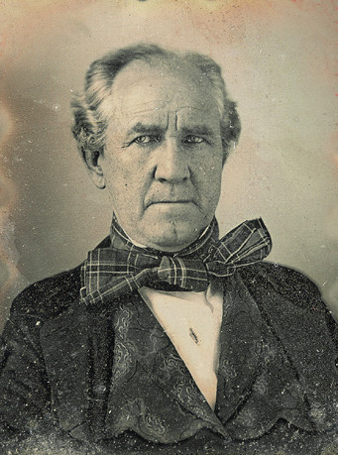
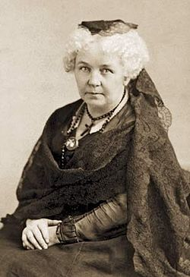
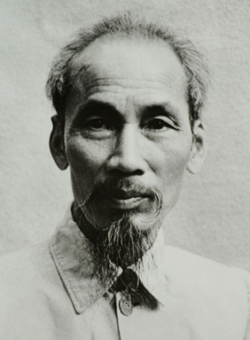
15 Months

