Slide 1


South Carolina
End-of-Course
Examination in US History
INTENSIVE
REVIEW
USHC 1.2
Analyze the early development of representative government and political rights in the American colonies, including the influence of the British political system and the rule of law as written in the Magna Carta and the English Bill of Rights, and the conflict between the colonial legislatures and the British Parliament over the right to tax that resulted in the American Revolutionary War.

Slide 2



A Long Train of Abuses and Usurpations
The Causes of the American Revolution

Slide 3
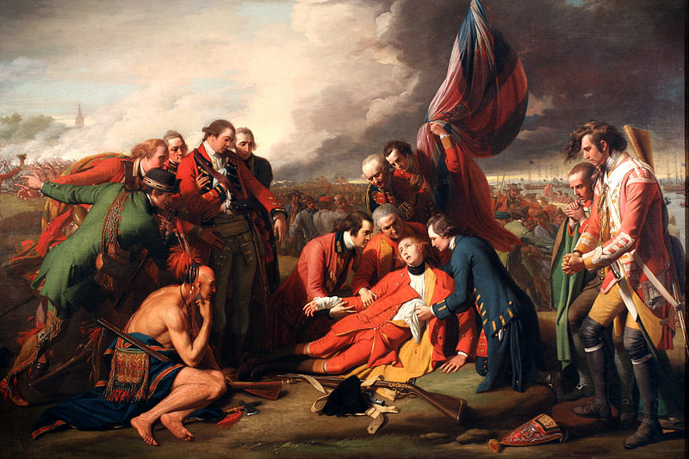
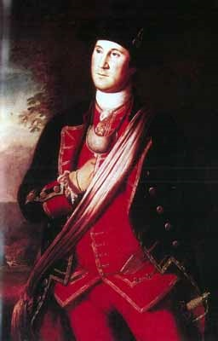
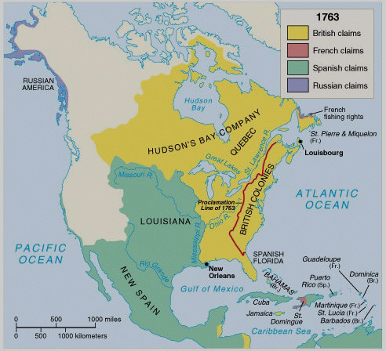
The French and Indian War
1754-63

Slide 4
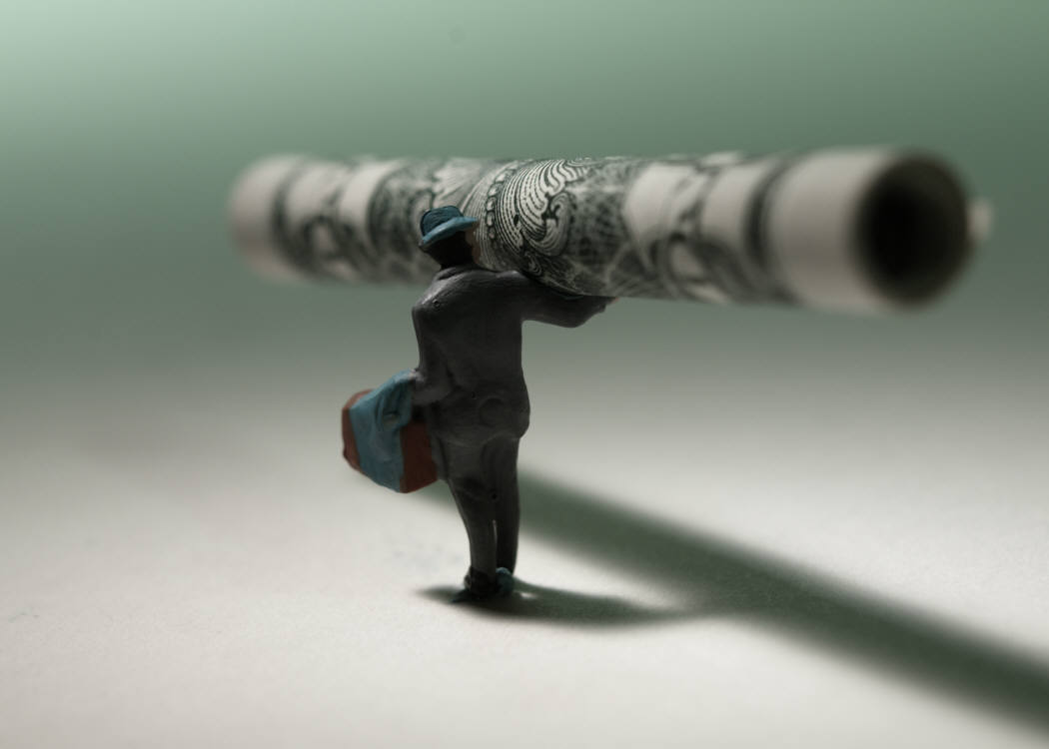
Wars
Cost
Money

Slide 5
British National Debt
Following the French and Indian War

Slide 6
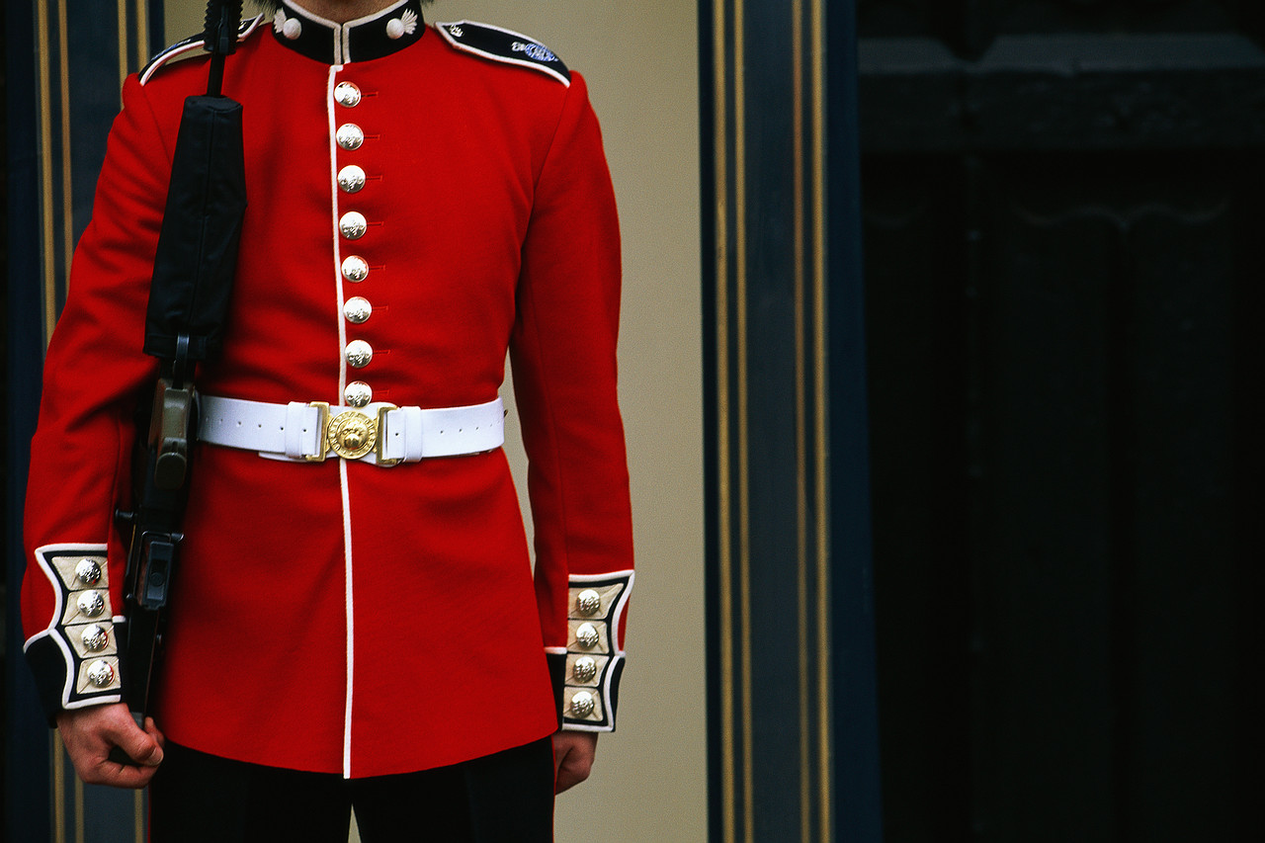
Cost of
Quartering
Troops
in the colonies

Slide 7

Parliament Taxes the Colonies
Sugar Act (1764)
Stamp Act (1765)
Townshend Acts (1767)

Slide 8

Smuggling
A Serious
Problem
Photo Credit: Mary Harrsch

Slide 9

The Sugar Act
1764
IMPORT Tax
on
Foreign Sugar
ADMIRALTY COURTS
Jury Trials

Slide 10
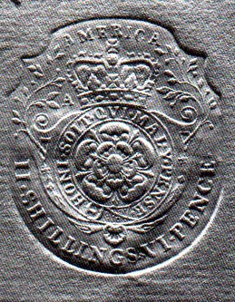
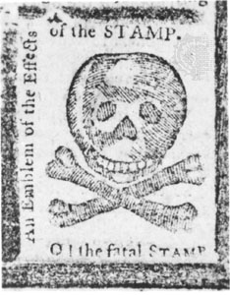
The Stamp Act
1765
INTERNAL Tax
on
legal documents
MASS RESISTANCE
Boycotts
Mob Violence

Slide 11
NO
TAXATION
WITHOUT
REPRESENTATION

Slide 12
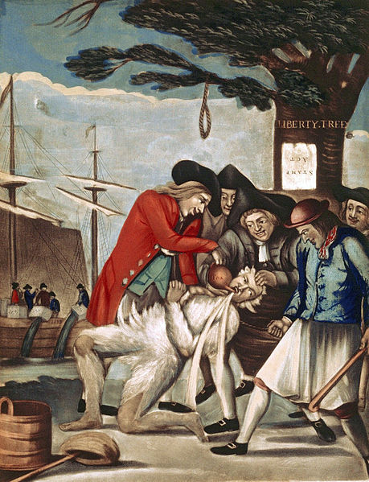
Sons of Liberty
Resistance Movement(s)
Intimidation
Mass Protests

Slide 13
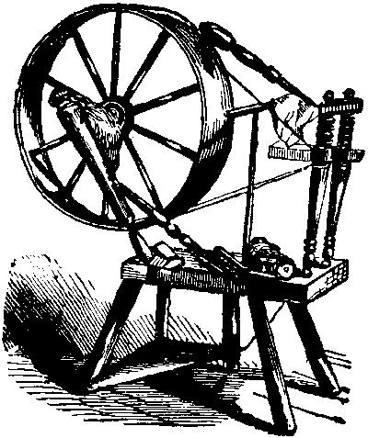
Daughters of Liberty
Homespun Fabric
Reduced dependence
on British textiles

Slide 14
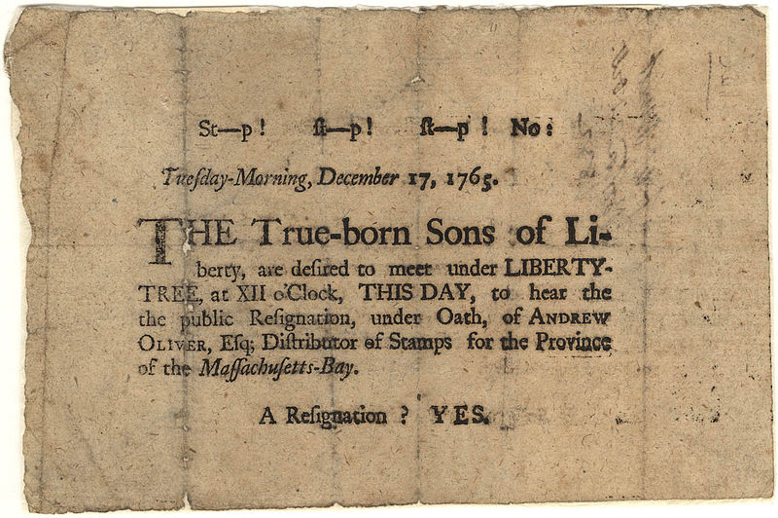

Slide 15
The Stamp Act
1765
INTERNAL Tax
on
legal documents
REPEALED
MASS RESISTANCE
Boycotts
Mob Violence

Slide 16





Parliament’s Not Done

Slide 17




Townshend Acts
1767
Tax on
Imports

Slide 19
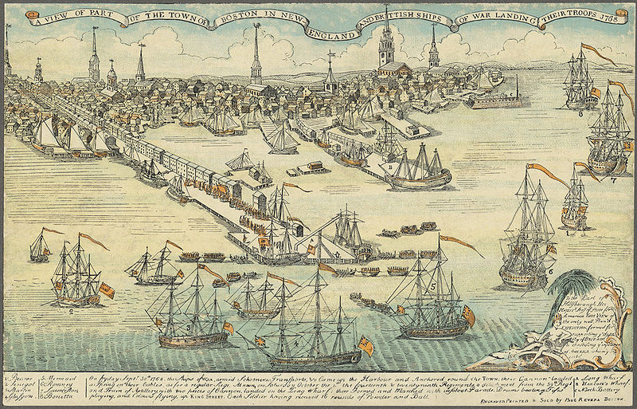
Paul Revere's engraving of British troops landing in Boston in 1768.

Slide 20
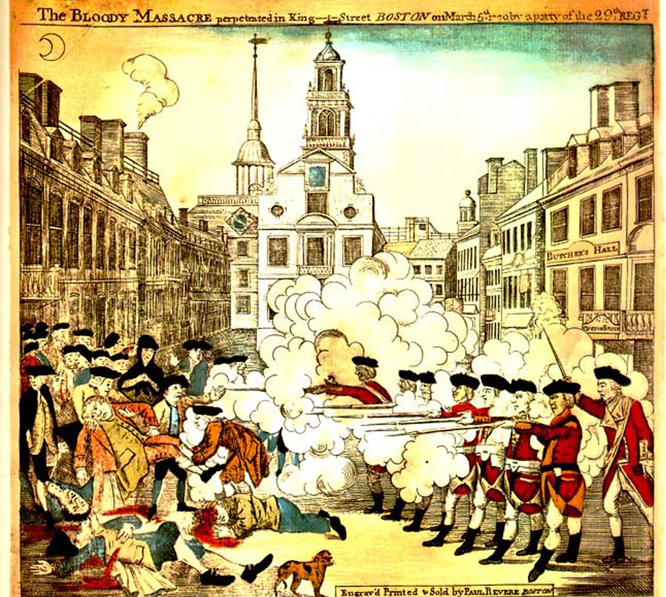
Boston Massacre
Confrontation
between
British Troops
and a
Rowdy Mob
1770

Slide 22
Townshend Acts
With one exception...
1767
Tax on
Imports
REPEALED

Slide 23
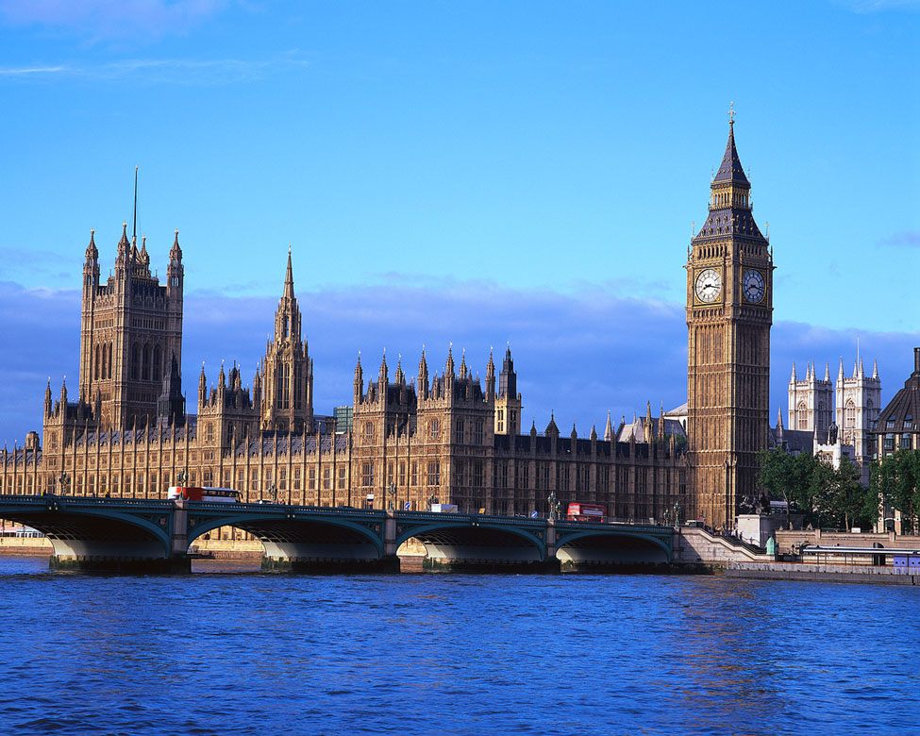
Just because we don’t tax... doesn’t mean that we can’t!

Slide 24

The Chain of Events
Leading to the Revolution
Tea Act
Boston Tea Party
Intolerable Acts
Lexington & Concord
Photo Credit: Darwin Bell

Slide 25
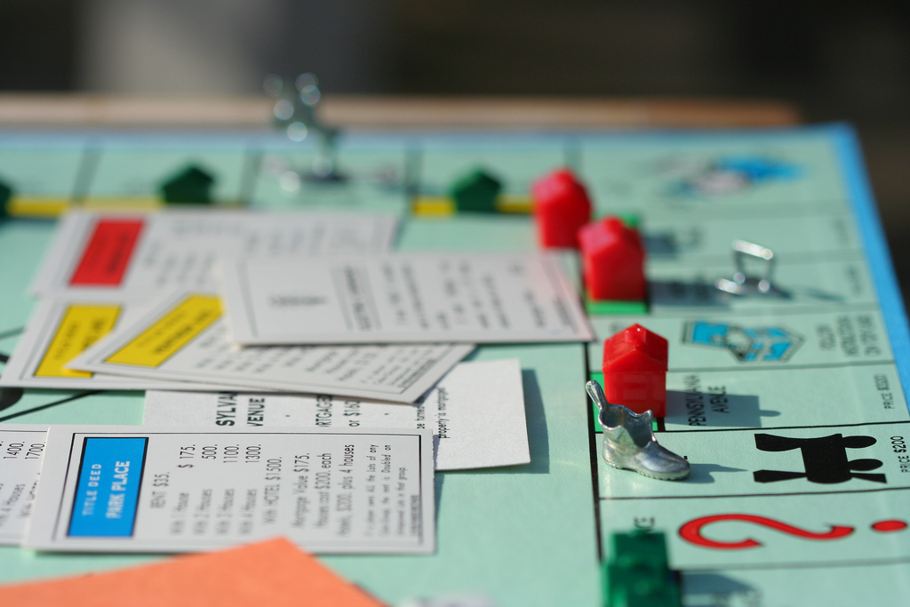
The Tea Act
Parliament
Grants a
Monopoly
to a British
Company
1773
Photo Credit: John-Morgan

Slide 26
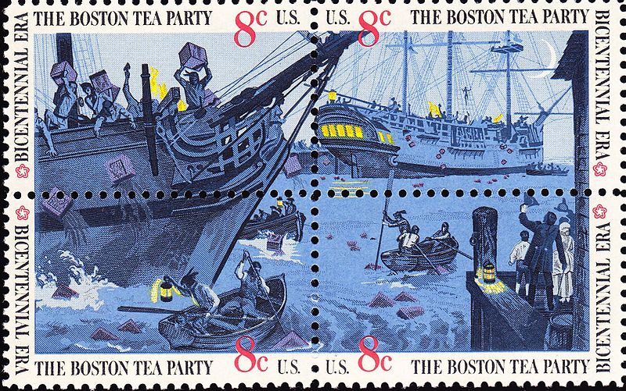
Boston Tea Party
1773

Slide 27
Intolerable Acts
1774
MARTIAL LAW

Slide 28
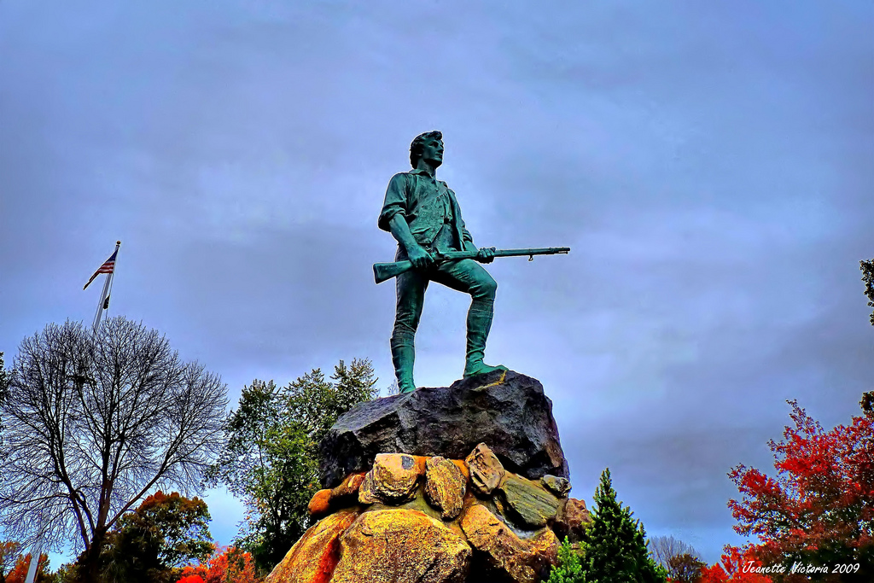
The
Minuteman
Photo Credit : Jeanette Runyon

Slide 29
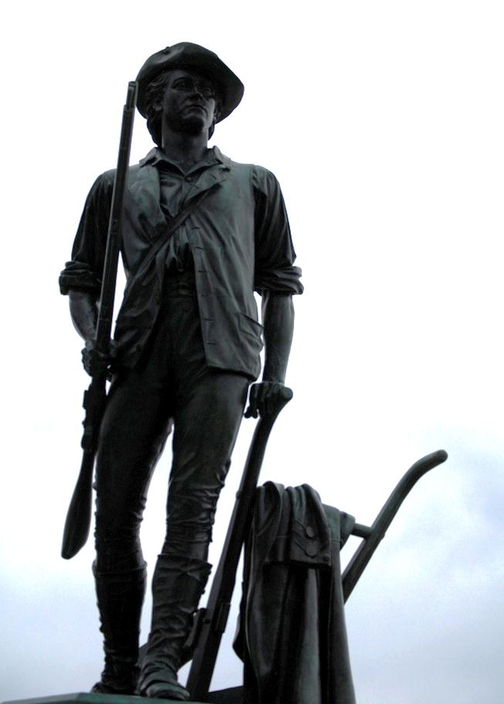
The
Minuteman
Photo Credit: Rachel Ford James

Slide 30
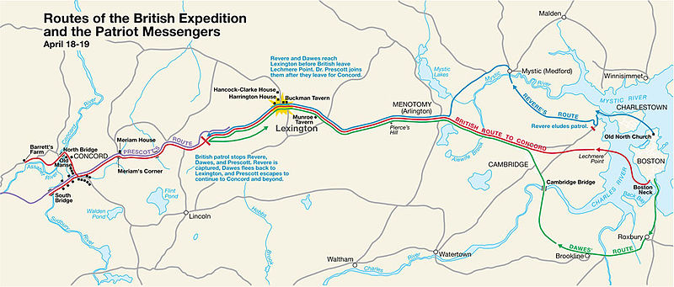
Lexington & Concord
1775
OBJECTIVE:
Seize the Arsenal

Slide 31
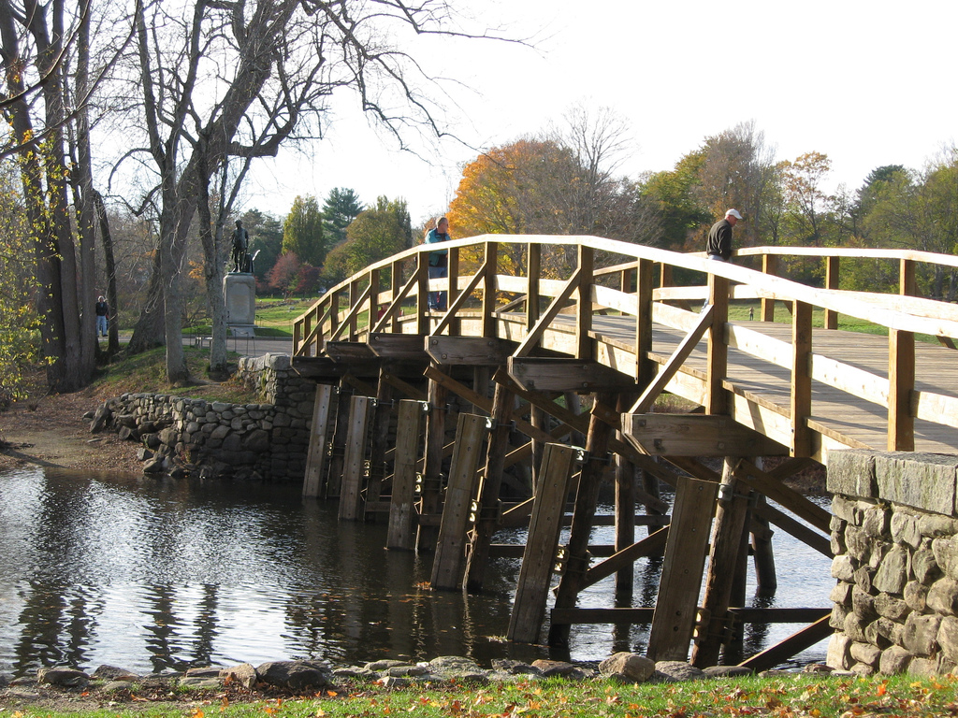

Slide 32
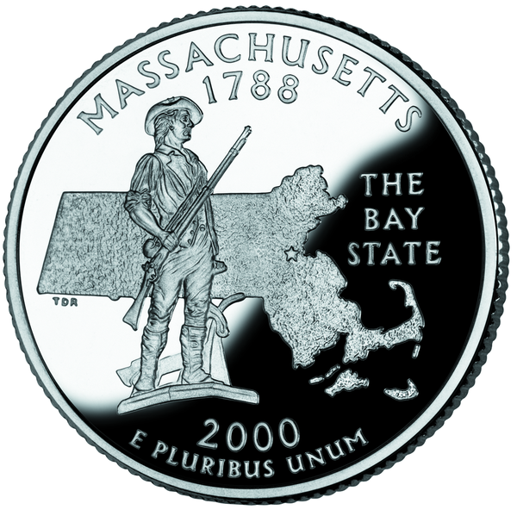

Slide 33








