Slide 1

US HISTORY
EOC REVIEW
USHC 1.1
Summarize the distinct characteristics of each colonial region in the settlement and development of British North America, including religious, social, political, and economic differences.

Slide 2
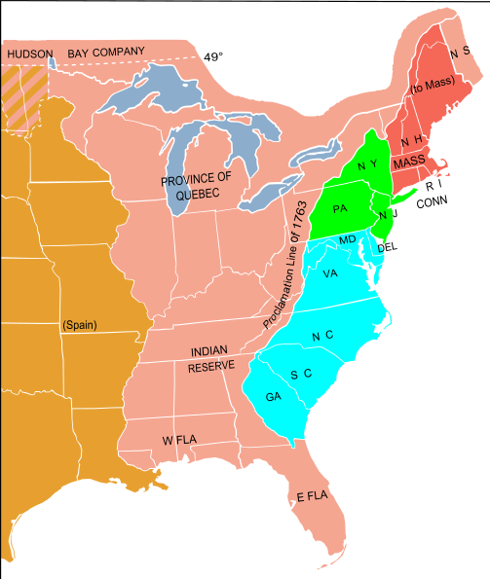
Motives for Colonizing
RELIGIOUS
ECONOMIC

Slide 3
Thirteen Colonies
New England
Massachusetts
Mid-Atlantic
Pennsylvania
Southern
Virginia
South Carolina

Slide 4
Religion
New England
Mid-Atlantic
Southern
Religious “Freedom”
(Tolerance)
LIMITED
Diversity
& Tolerance
Religion
NOT
a motive

Slide 5
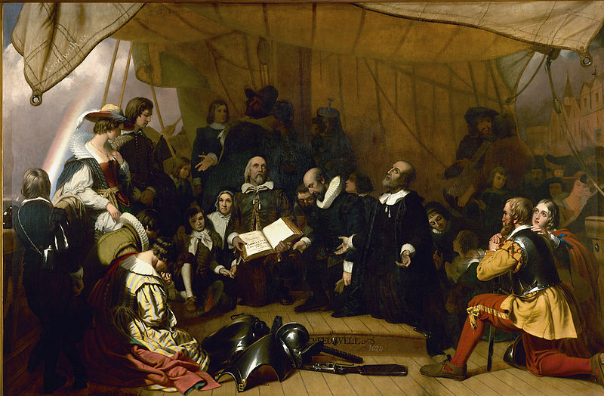
The “Pilgrims” (Plymouth)
Religious Dissidents

Slide 6

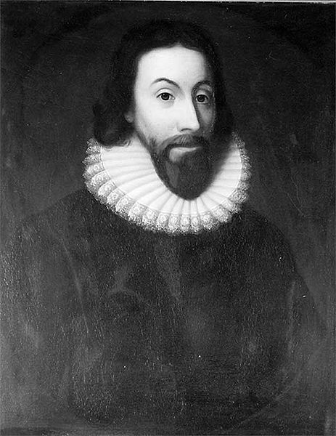
Massachusetts Bay Colony
Puritans
City on
a Hill!
John Winthrop Governor

Slide 7
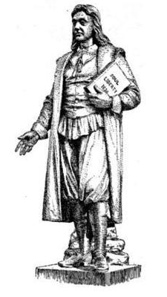
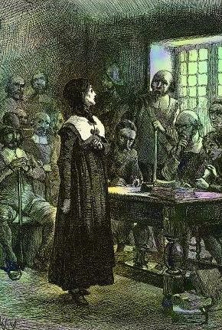
TOLERATION
Religious dissenters, such as Roger Williams and Anne Hutchinson, were EXILED.
Williams started the Rhode Island colony.
Williams
Hutchinson

Slide 8

Mid-Atlantic Colonies
(Limited) Religious Toleration & Diversity
Catholics Maryland
Quakers Pennsylvania

Slide 9
Southern Colonies
“All About the Benjamins”
Church of England Established

Slide 10
Religion
New England
Mid-Atlantic
Southern
Religious “Freedom”
(Tolerance)
LIMITED
Diversity
& Tolerance
Religion
NOT
a motive

Slide 11
Society
New England
Southern
Egalitarian
(Clergy Dominant)
Hierarchical
(Landowners Dominant)

Slide 12
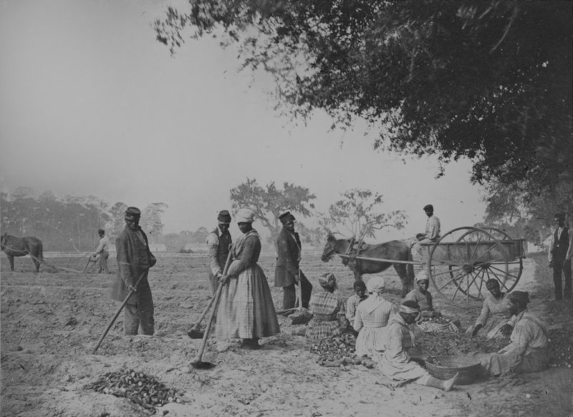
Plantation Slavery
(Southern Colonies)

Slide 13
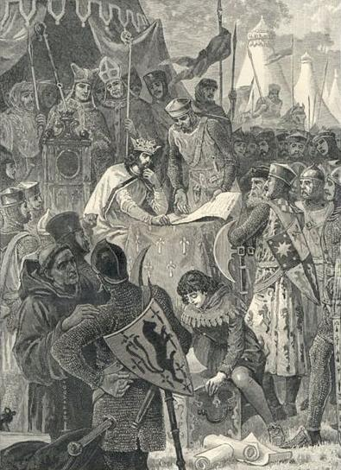
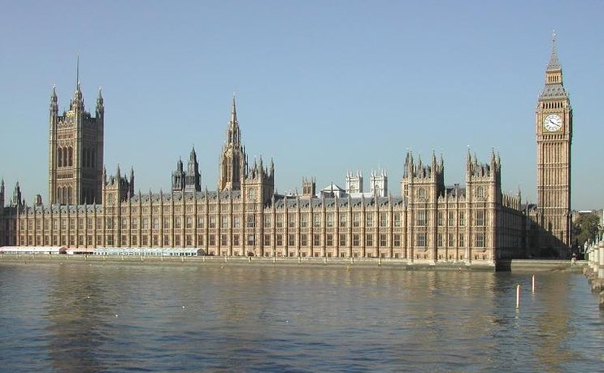
English Political Traditions
Parliament
Magna Carta

Slide 14
English
Political Traditions
Popular Government
Representative Government

Slide 15
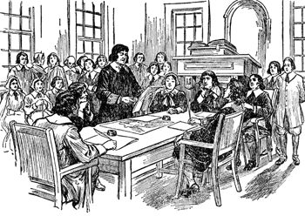
Town Meetings
(New England)
Egalitarian
Democratic

Slide 16
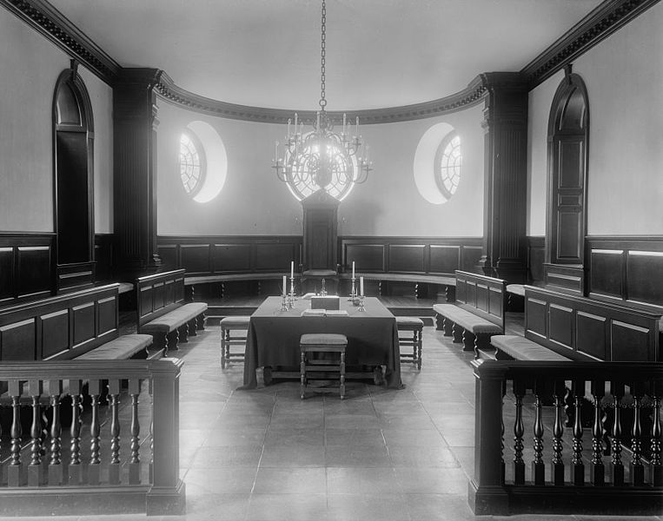
House of Burgesses
(Virginia)
Aristocratic Representative

Slide 17
Economy
New England
Mid-Atlantic
Southern
Commerce
Shipbuilding
Fishing
Staple Crops
Wheat, Corn
Family Farms
CASH Crops
Tobacco, Rice, Indigo
Slave Labor

Slide 18
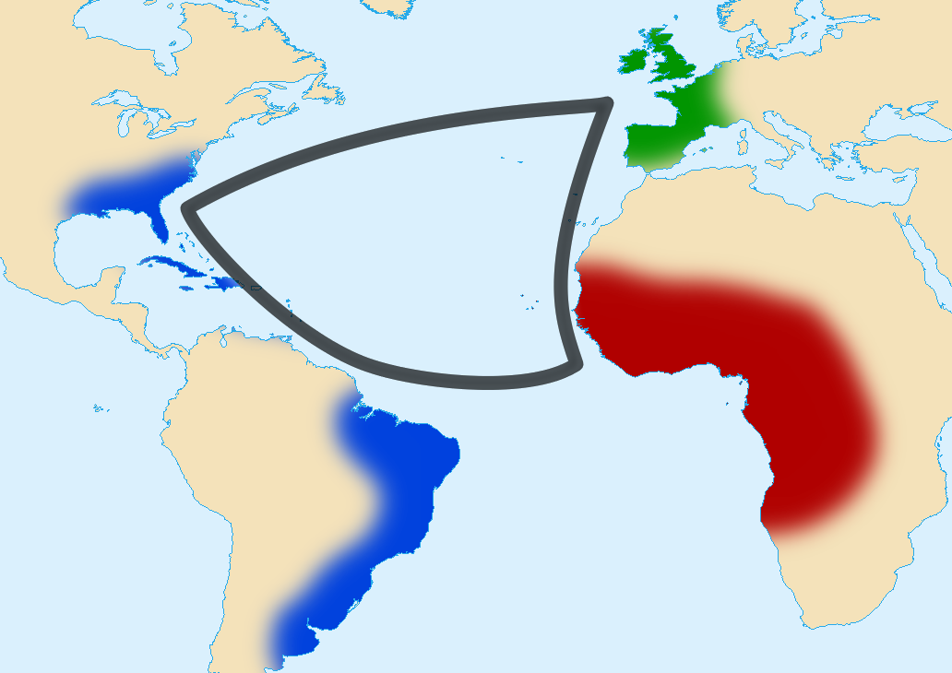
The Triangular Trade
RAW GOODS
FINISHED GOODS
SLAVES

Slide 19
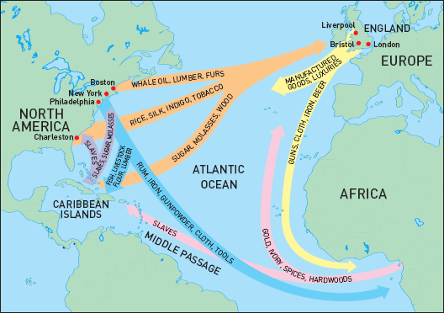
Colonial Trade Routes

Slide 20

Mercantilism
Economic Regulation
(Primarily of Trade)
  Navigation Acts (1651)
    SALUTARY
    NEGLECT
      Strict Enforcement

Slide 21







