Slide 1
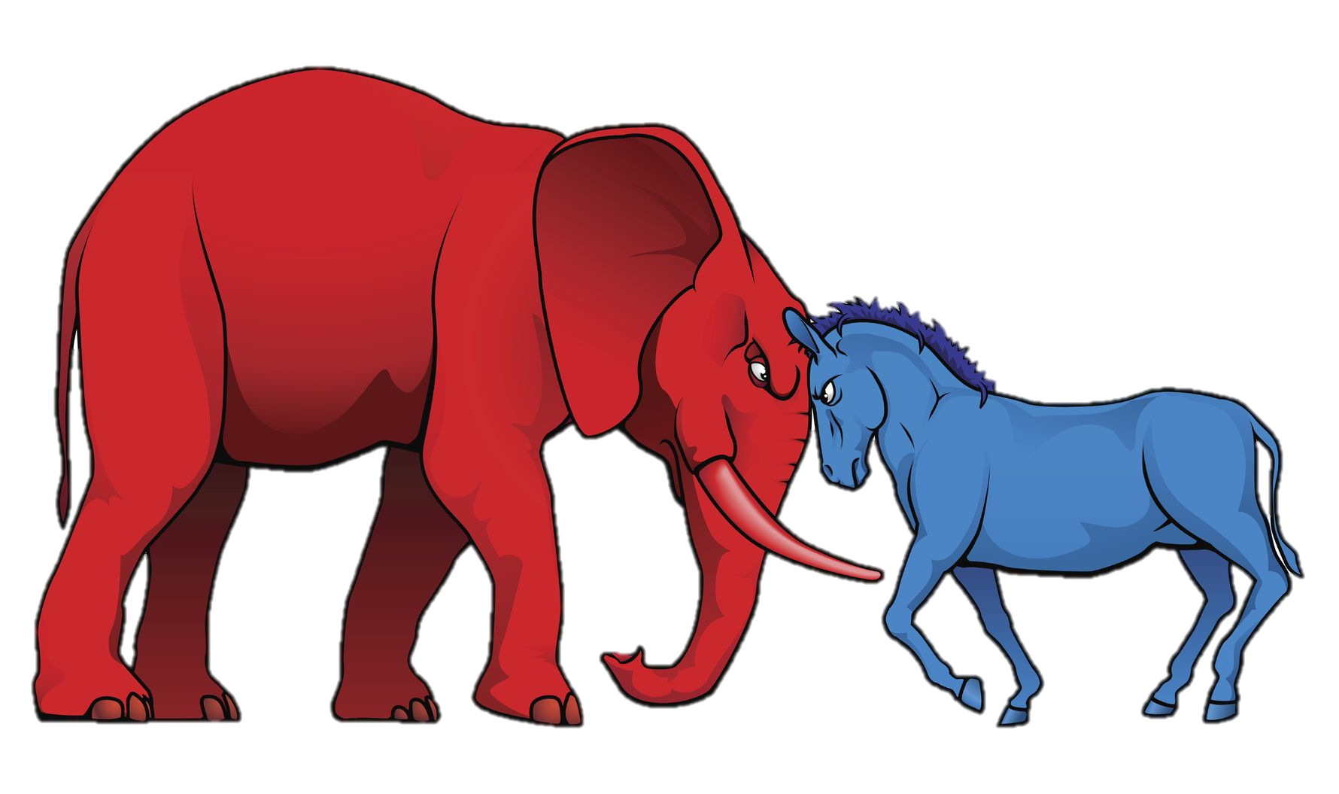
Party Identification
#apgov

Slide 2
objectives
In what ways do people identify with political parties?
What factors influence party preference?
@TomRichey

Slide 3
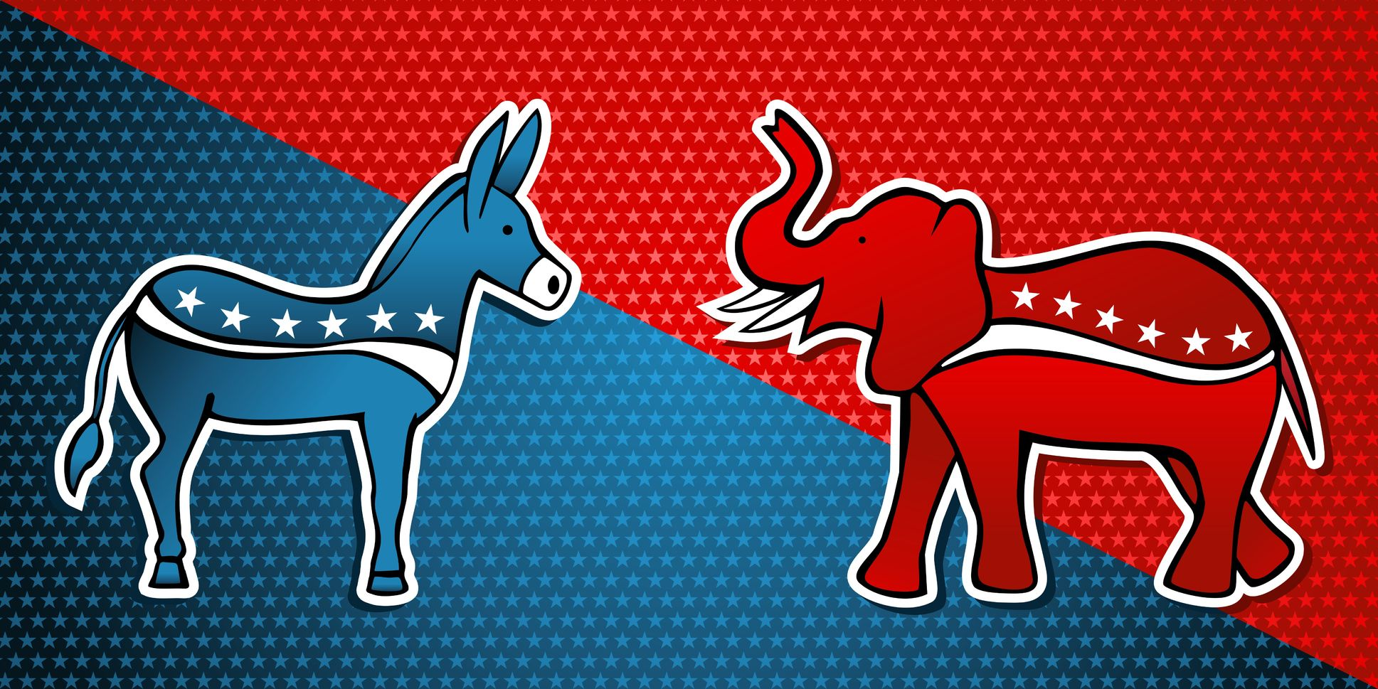
The Simple Version
DEMOCRATS | INDEPENDENTS | REPUBLICANS

Slide 4
The Simple Version
DEMOCRATS | INDEPENDENTS | REPUBLICANS
30% | 45% | 25%

Slide 5
Nearly half of the electorate self-identifies as independent.

Slide 6
Expressions of Party Preference
Voter Registration
Self-Identification
Tendency to Support Party
Candidates
Policies
Voting in Primary Elections

Slide 7
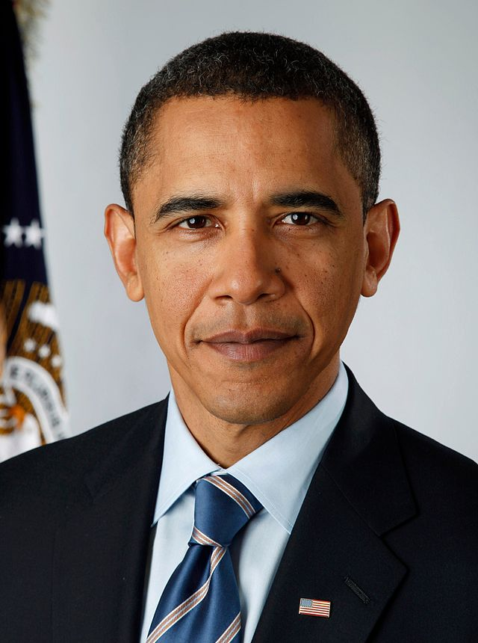
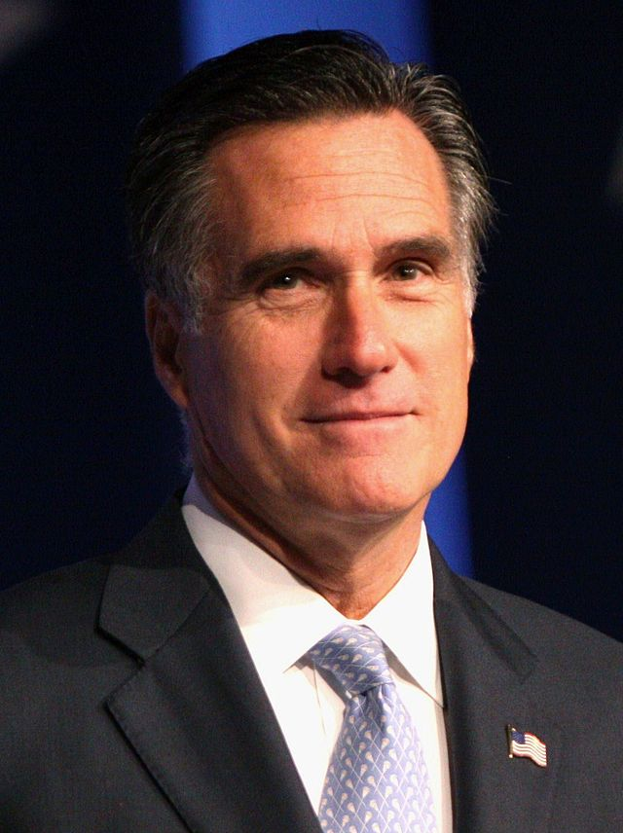
98.3%
Voted for one of the two major party candidates in the 2012 election.
Photo by Pete Souza
Photo by Gage Skidmore
51.1% | 1.7% | 47.2%

Slide 8
LEANERS

Slide 9
Some Independents Lean Left

Slide 10
Some Independents Lean Right

Slide 11
98.3%
Chose a party when it came crunch time.
Photo by Pete Souza
Photo by Gage Skidmore
51.1% | 1.7% | 47.2%

Slide 12
Expressions of Party Preference
Voter Registration
Self-Identification
Tendency to Support Party
Candidates
Policies
Voting in Primary Elections

Slide 13
The Complex Version
DEMOCRATS |  | INDEPENDENTS |  |  | REPUBLICANS
STRONG | WEAK | LEANS | INDEPENDENT | LEANS | WEAK | STRONG

Slide 14
Factors Influencing Party ID
Upbringing / Socialization
Life Experience
Attachment
Political Climate

Slide 15
70%
Your parents are most influential in determining your political affiliation.

Slide 16
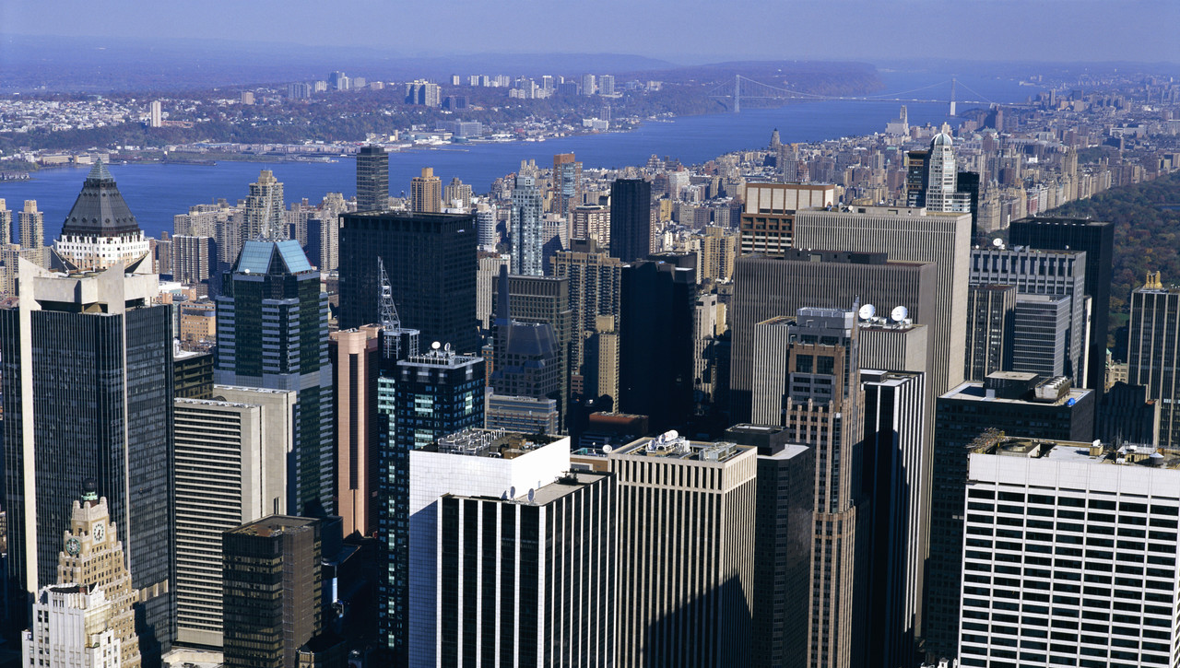
Experience Matters, Too.

Slide 17
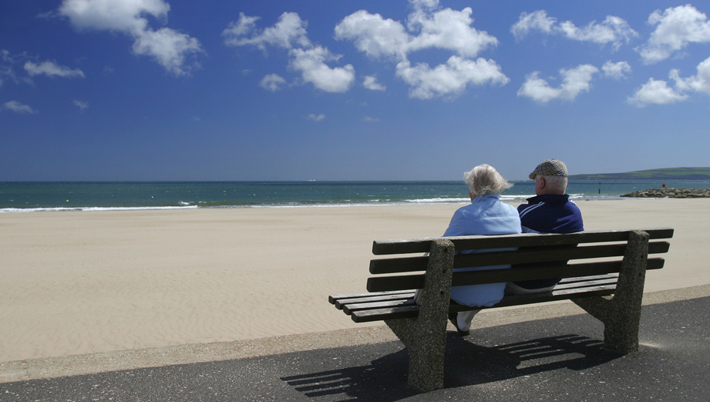
We get more attached with time.

Slide 18
Realignment
As coalitions shift between parties, so do individuals.

Slide 19
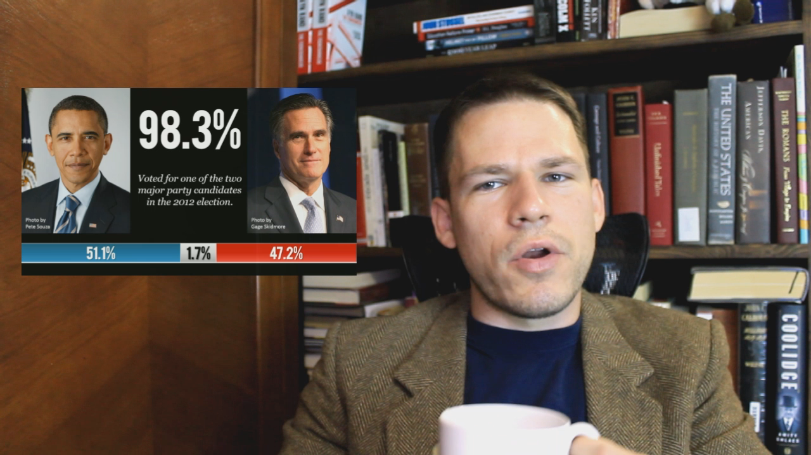
E-LECTURE
Available on YouTube!
@TomRichey

Slide 20
LEARNING. DELIVERED.

