Slide 1
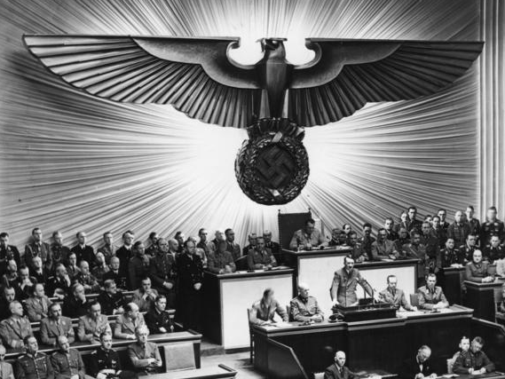
TOTALITARIANISM in Interwar Europe
German Federal Archive (cc 3.0)

Slide 2
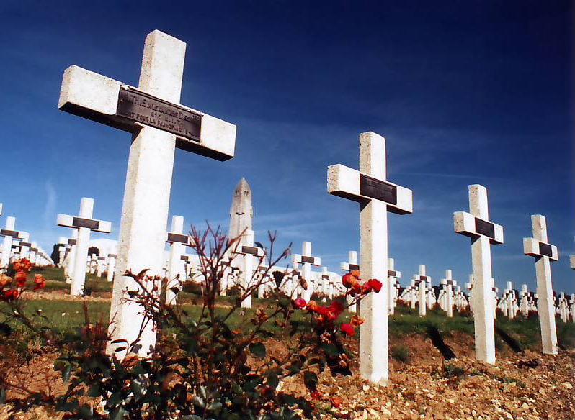
WWI IS OVER
Photo by Ketounette (cc 3.0)

Slide 3
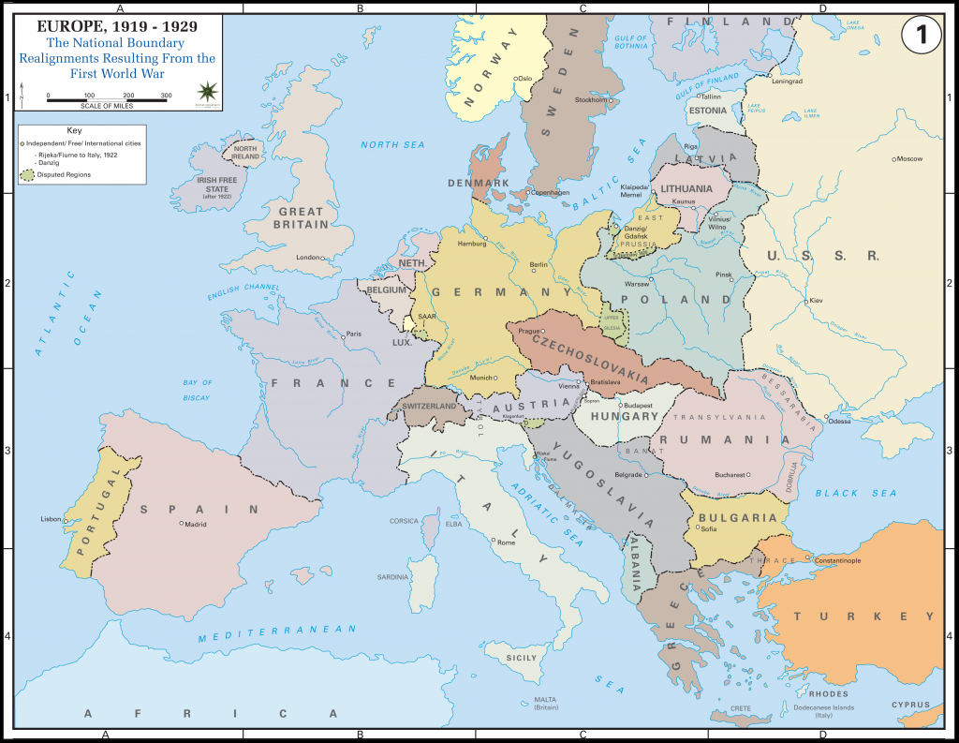
EUROPE IS NOW safe...

Slide 4
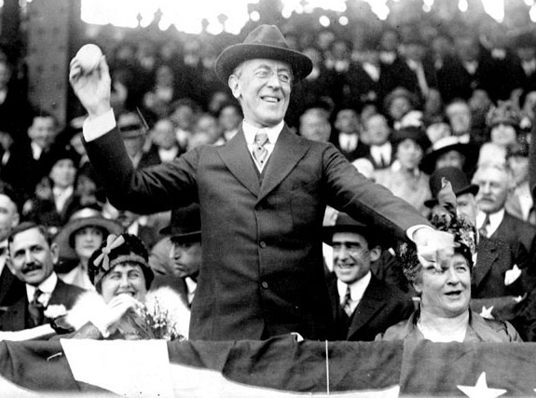
FOR DEMOCRACY

Slide 5
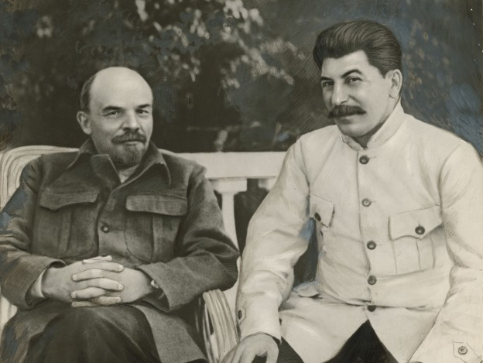
J/K LOL

Slide 6
Totalitarianism
Authoritarian & dictatorial governments that control all aspects of public and private life.
State > Individual

Slide 7
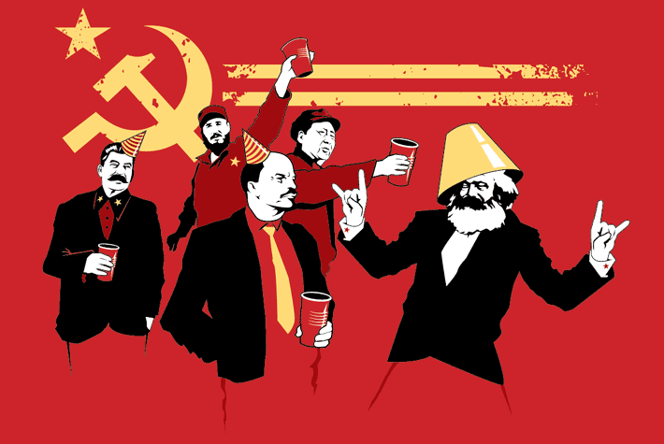
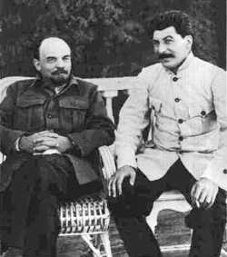
Bolshevik Revolution
(Russia/Soviet Union) 1917
Vladimir Lenin
Joseph Stalin

Slide 8
STRIKE ONE

Slide 9
Self-Determination OF pEOPLES

Slide 10
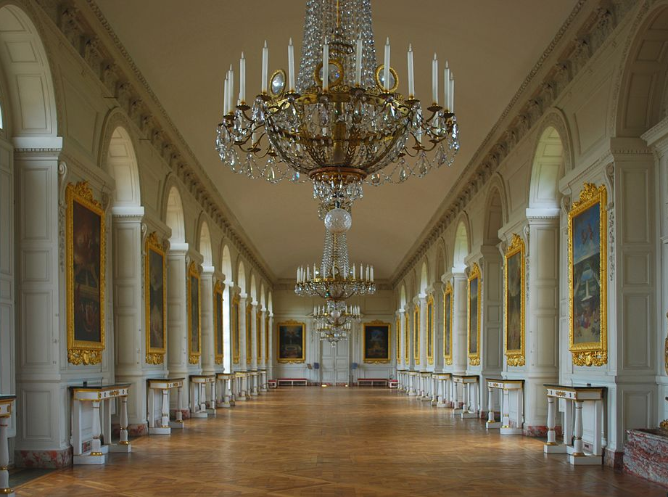
Treaty of Trianon
The OTHER Versailles Treaty
Photo by Mkonikkara (cc 3.0)

Slide 11
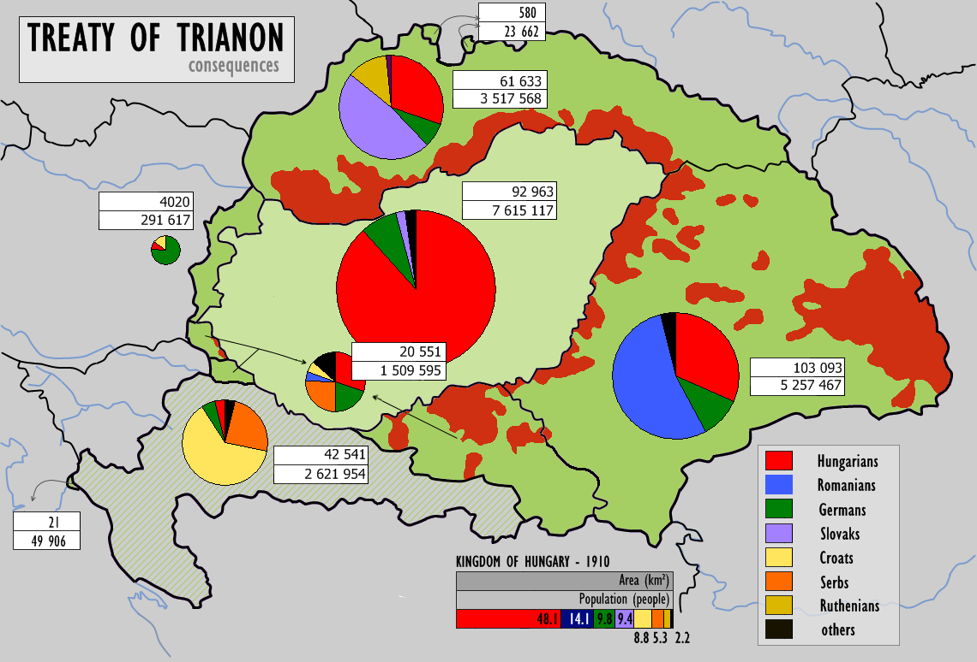
Map by CoolKoon (cc 3.0)

Slide 12
An explanation of the Treaty of Trianon from a Hungarian perspective

Slide 13
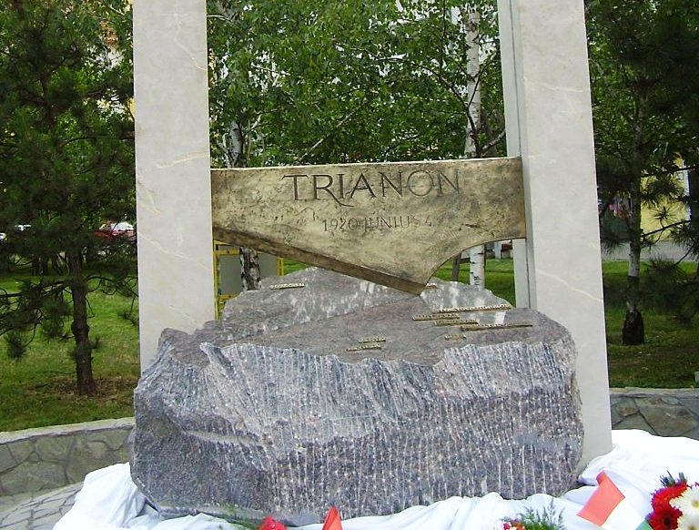

Slide 14
STRIKE TWO

Slide 15
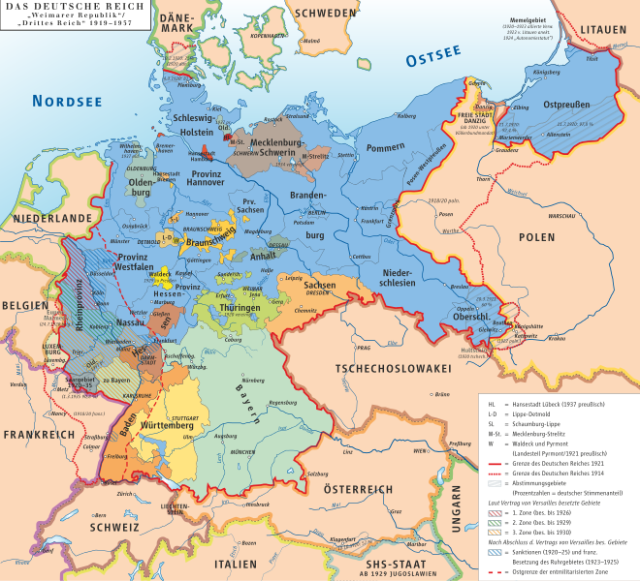
The Weimar Republic
1919-1933
Germany briefly experimented with liberal democracy.
ECONOMIC PROBLEMS
Map by kgberger (cc 2.5)

Slide 16
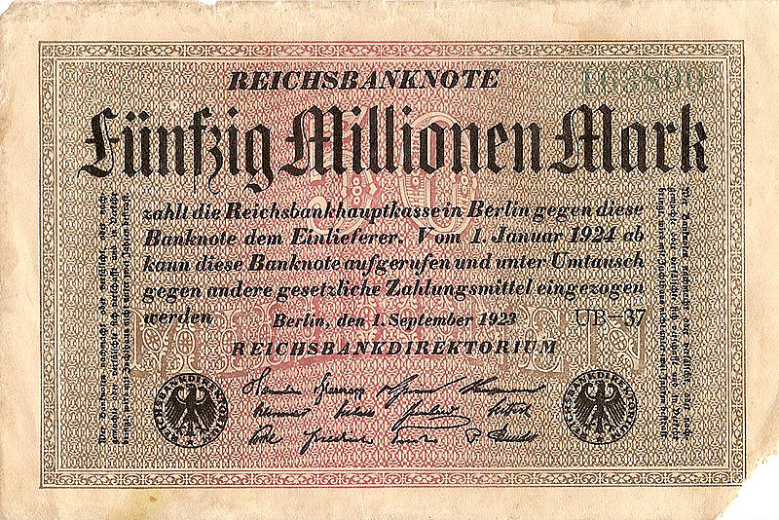
HYPERINFLATION

Slide 17
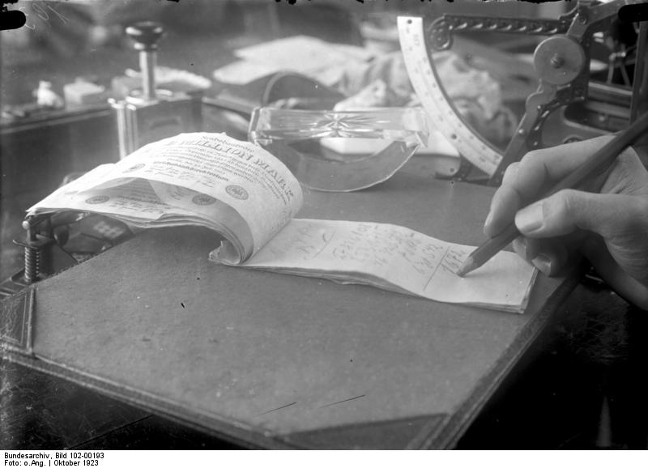
A Million German Marks = NOTEPAPER
German Federal Archives (cc 3.0)

Slide 18
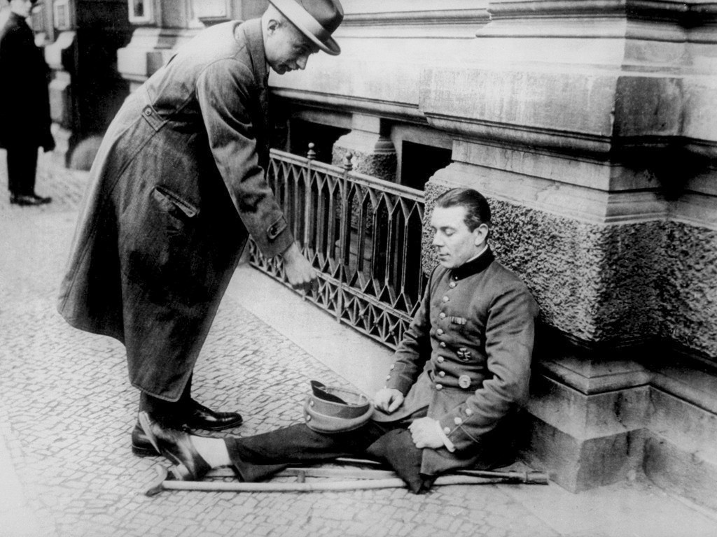
German Federal Archives (cc 3.0)

Slide 19
STRIKE three

Slide 20
Democracy is OUT!
Photo by Keith Allison (cc 2.0)

Slide 21
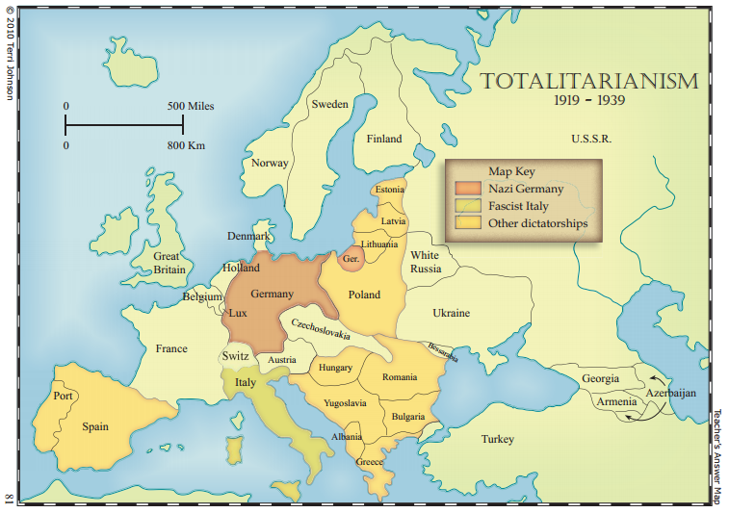
SOURCE: http://www.knowledgequestmaps.com Used With Permission

Slide 22
Totalitarian Regimes
“Left Wing”
Soviet Union
Communism/ Bolshevism/ Leninism
Lenin/Stalin
“Right Wing”
Germany | Italy
National Socialism (Nazism) | Fascism
Hitler | Mussolini

Slide 23
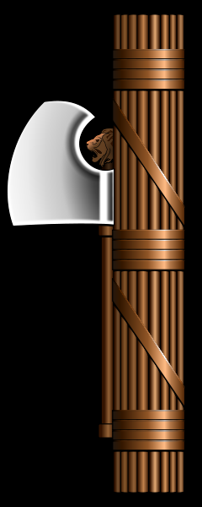
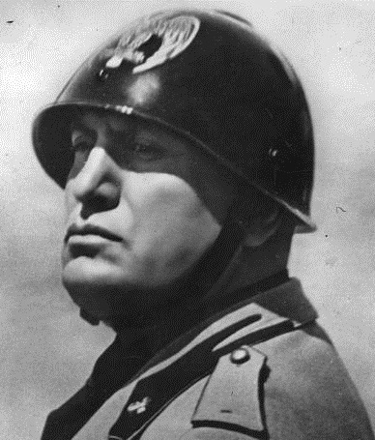
Fascism
(Italy)
RADICAL AUTHORITARIAN NATIONALISM
Benito Mussolini
Il Duce

Slide 24
Statue of Romulus and Remus in Rome, GA

Slide 25
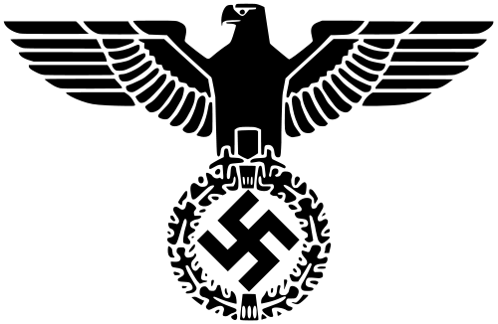
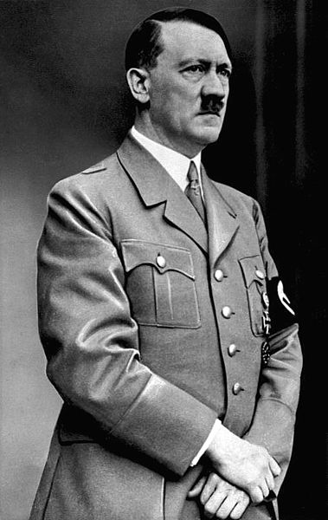
Nazi Party
(Germany)
1933
Adolf Hitler
der Fürher
National Socialist
German Workers Party

Slide 26
Fascism and Bolshevism Common Traits
 |  | Fascism | Bolshevism
1. |  | YES | YES
2. |  | YES | YES
3. |  | YES | YES
4. |  | YES | YES
5. |  | YES? | YES?
Opposition to Liberal Democracy
Unity through Hatred (common enemy)
Government by a Party Elite
The Cult of the Leader
Totalitarianism

Slide 27
The Problem of the Left/Right Dichotomy
Posters reproduced for educational purposes in accordance with fair use.

Slide 28
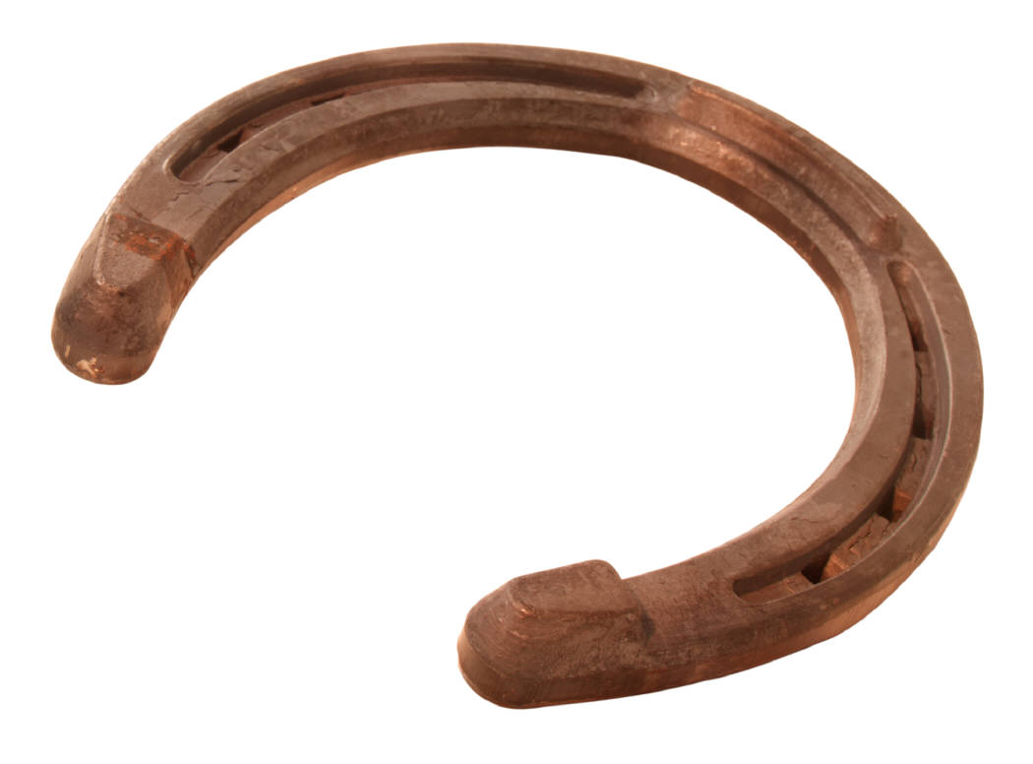
The Problem of the Left/Right Dichotomy
Democrats (US)
Conservatives (UK)
Labour (UK)
Republicans (US)
“MODERATE GOVERNMENTS”
Fascists
Nazis
Communists
“FAR RIGHT”
“FAR LEFT”

Slide 29
Contrasting Totalitarian Regimes
LEFT WING
RIGHT WING
OPPOSITION
to Social Hierarchy
SUPPORT
for Social Hierarchy

Slide 30
Contrasting Totalitarian Regimes
Bolshevism
Fascism
Internationalist
Goal:
Worldwide Communist Revolution
Nationalist
Mussolini – Fascism “not for export”
CLASS HATRED rather than racial hatred.
(Soviet states were ethnically diverse)
Master Race Ideologies
The enemy = outsiders & ethnic minorities

