Slide 1
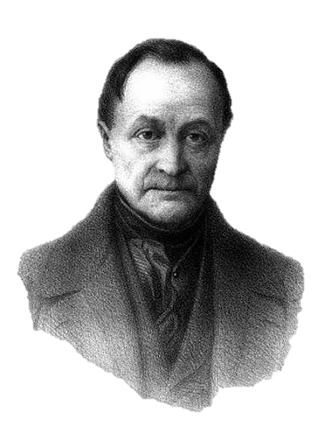
Auguste Comte
Father of Positive Philosophy

Slide 2
Positive

Slide 3
Think positive thoughts...
Photo by 55Laney69 (cc 2.0)

Slide 4
Positive is not always Positive
Photo by Wheeler Cowperthwaite (cc 2.0)

Slide 5
Positivism
The ONLY valid knowledge is knowledge gained through the scientific method.

Slide 6
3 Stages
THEOLOGICAL (Fictitious)
METAPHYSICAL (Abstract)
POSITIVE (Scientific)

Slide 7
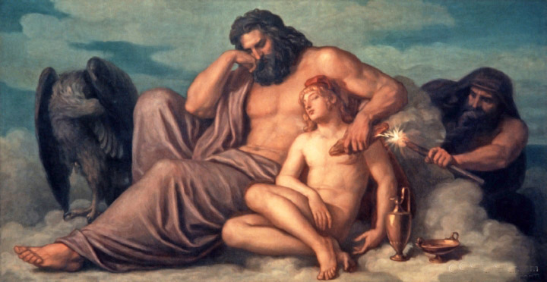
Theological

Slide 8
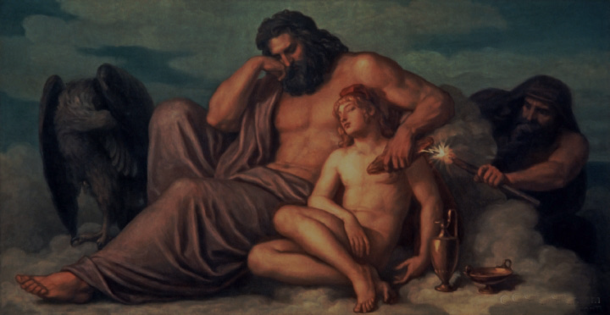
Religion without Science

Slide 9
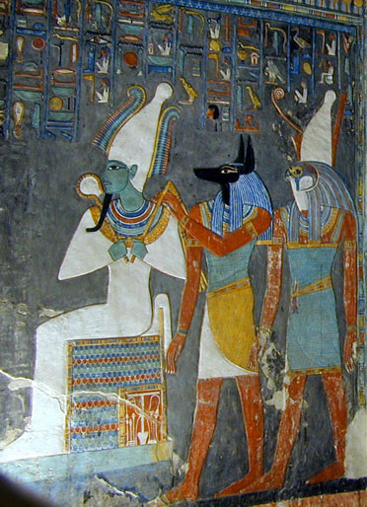
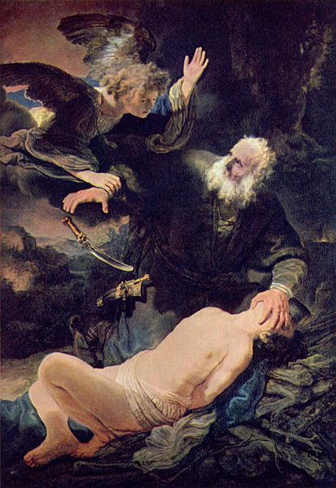
Fetishism
Fetishism
Polytheism
Monotheism
Photo by Jean-Pierre Dalbéra

Slide 10
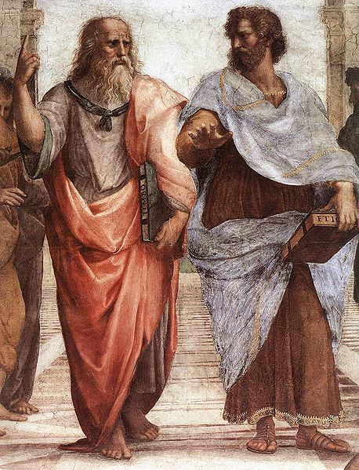
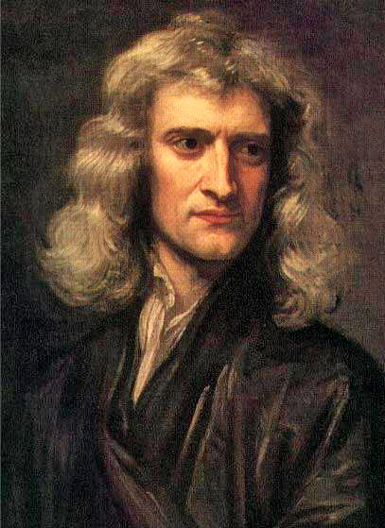
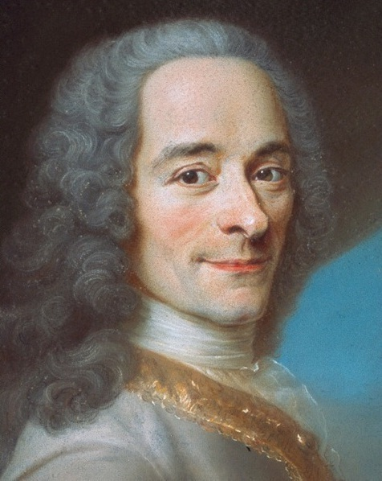
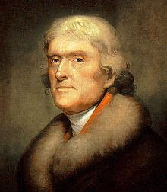
Metaphysical
An abstract Power guides events in the world.

Slide 11
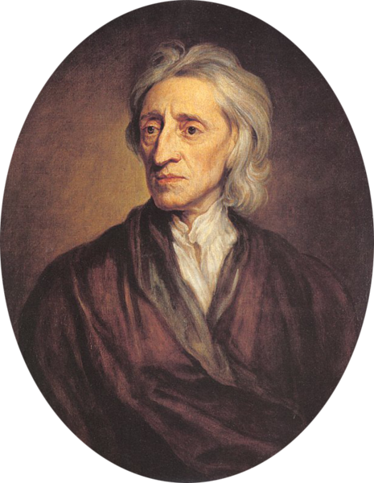
Metaphysical
Universal laws based on ABSTRACT principles

Slide 12
Scientific Religion

Slide 13
On the Reasonableness of Christianity (1695)

Slide 14
ATHEISM Locke advocated religious toleration with one dangerous exception.

Slide 15
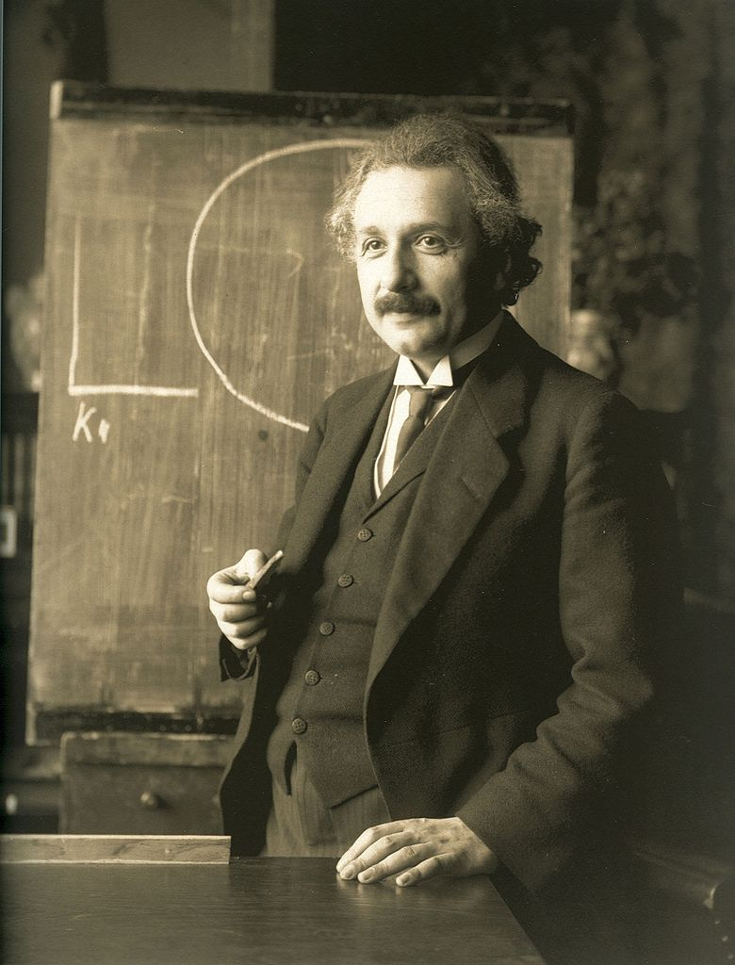
Positive
Observation
Experimentation

Slide 16
Science
Independent of Religion

Slide 17
NOT Mutually Exclusive
Different stages can exist within the same society...

Slide 18
NOT Mutually Exclusive
And even within the same mind.

Slide 19
3 Stages
THEOLOGICAL (Fictitious)
METAPHYSICAL (Abstract)
POSITIVE (Scientific)

Slide 20
Auguste Comte
Sociologist
and
Humanist

Slide 21
RANKING the Sciences
Sociology
Biology
Chemistry
From the most ancient to the most modern
Increasing Complexity
Physics
Astronomy
Mathematics

Slide 22
Superiority of Social Sciences
Sociology
Biology
Chemistry
Physics
Astronomy
Mathematics

Slide 23
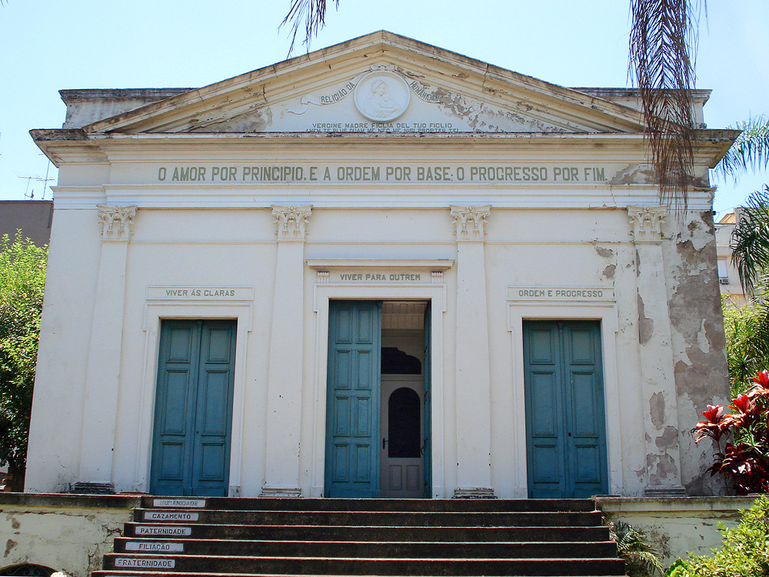
The Religion of Humanity
Comte proposed a new secular religion as a positivist alternative to supernatural religion.
Photo Credit: Tetraktys (Wikipedia – cc 3.0)

Slide 24
Altruism
The morality of an action is determined by how it affects OTHER human beings.

Slide 25
"vivre pour autrui"
("live for others")

Slide 26
Comte laid the Foundation
for Modernist Philosophy

Slide 27
Check out the e-lecture on

Slide 28
LEARNING. DELIVERED.

