Slide 1
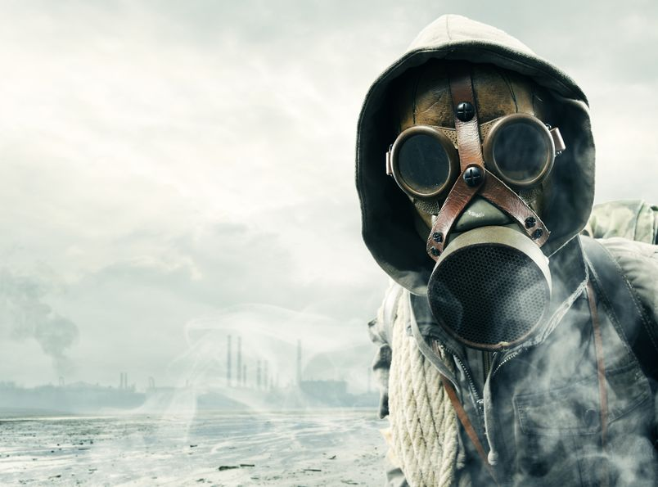
CAUSES OF WWI

Slide 2
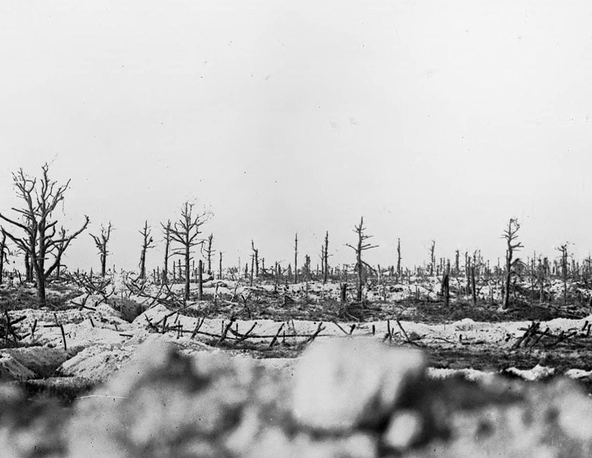
1914 - 1918
Battlefield in the Marne between Souain and Perthes, 1915. (Bibliotheque nationale de France)

Slide 3
38M CASUALTIES
Battlefield in the Marne between Souain and Perthes, 1915. (Bibliotheque nationale de France)

Slide 4
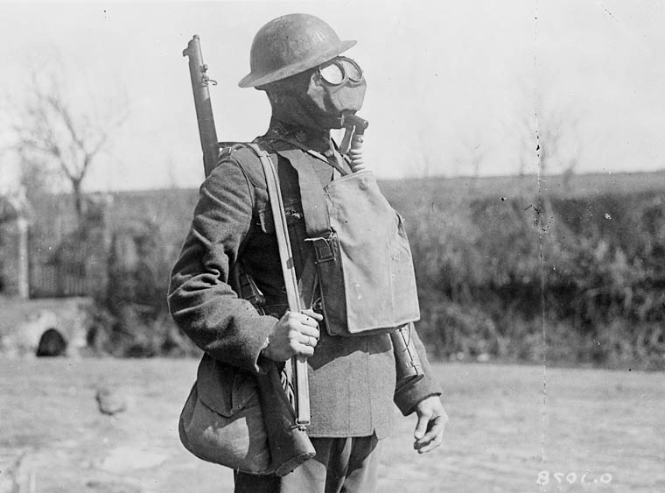
What started this mess?
Notes:
http://4acre.wordpress.com/2010/12/06/mustard-gas/

Slide 5
CAUSES of World War I
M
A
I
N
ILITARISM
LLIANCES
MPERIALISM
ATIONALISM

Slide 6
MILITARISM

Slide 7
Anglo-German ARMS Race

Slide 8
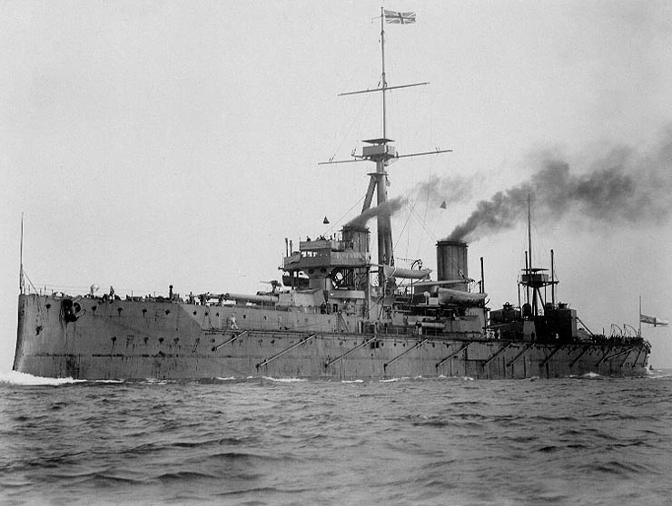
H.M.S. Dreadnought

Slide 9
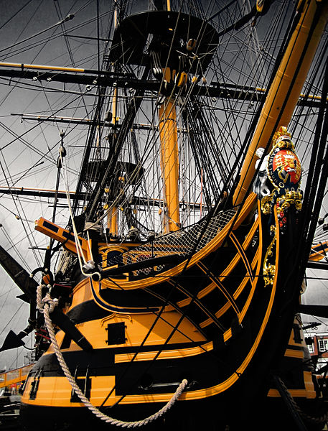
Royal Navy Ship Names
H.M.S. Arrogant
H.M.S. Gladiator
H.M.S. Unbeaten
H.M.S. Unbending
H.M.S. Unbroken
H.M.S. Undaunted
H.M.S. Valiant
H.M.S. Vampire
H.M.S. Vanquisher
H.M.S. Vehement
H.M.S. Vengeance
H.M.S. Victory
CLICK TO SEE MORE!
Credit: Jamie Campbell

Slide 10
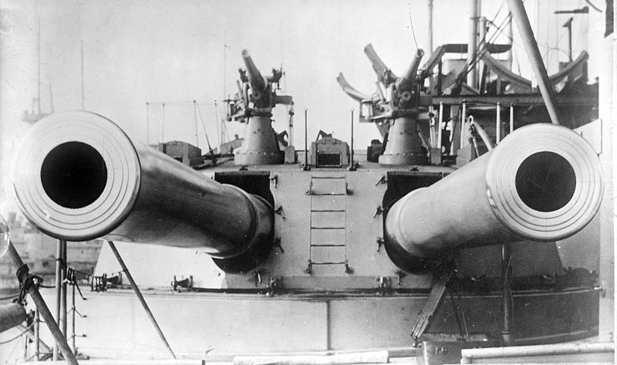
H.M.S. Dreadnought (1906)
12 in.

Slide 11
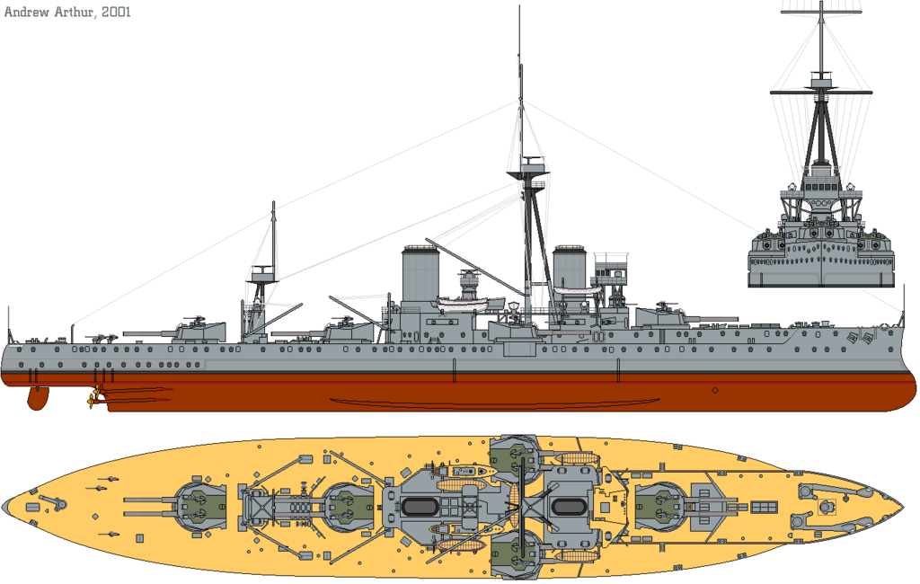
"HMS Dreadnought (1911) profile drawing" by Emoscopes

Slide 12
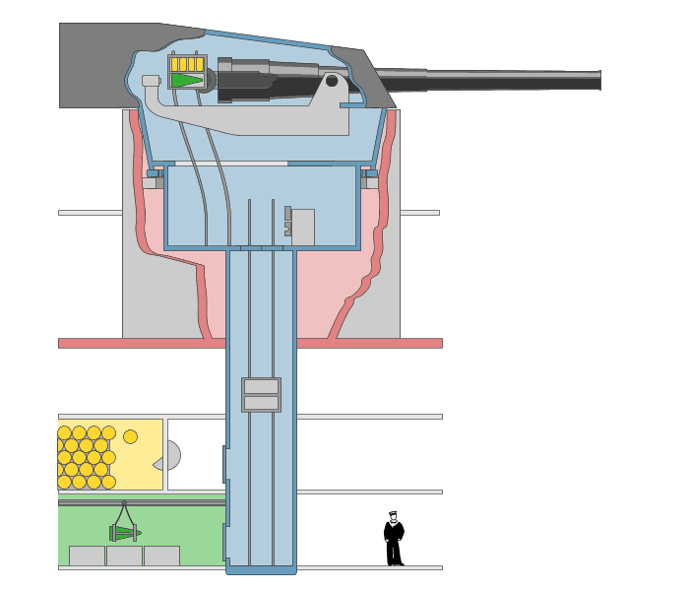
FULLY AUTOMATED
A Revolution in Weaponry
Art Credit: Emoscopes

Slide 13
Percentage Distribution of the World's Manufacturing Production
 | 1870 | 1913
USA | 23.3 | 35.8
Germany | 13.2 | 15.7
U.K. | 31.8 | 14.0
France | 10.3 | 6.4
Russia | 3.7 | 5.5
Italy | 2.4 | 2.7
Others | 15.3 | 19.9
Source: http://www.fordham.edu/halsall/mod/indrevtabs1.asp

Slide 14
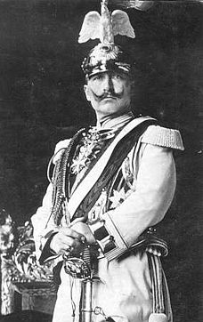
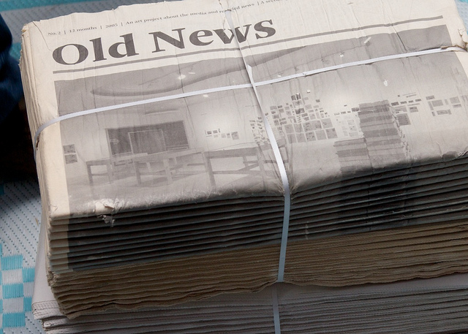
The Daily Telegraph Affair
LINK
Photo by @Doug88888
A PR move gone seriously wrong!
Wilhelm II “Kaiser Bill”

Slide 15
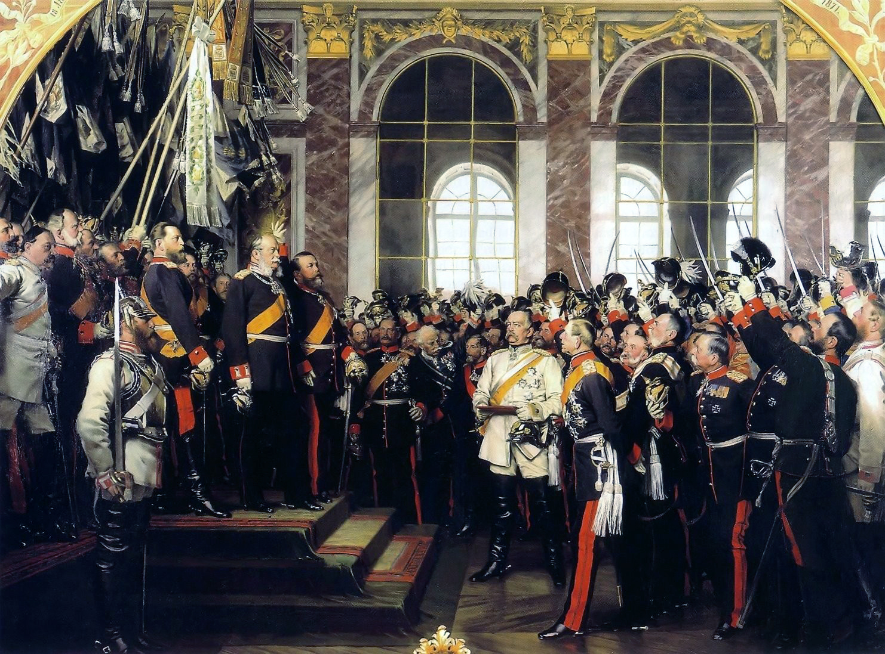
FRANCO-GERMAN TENSIONS

Slide 16
The ALLIANCE System

Slide 17
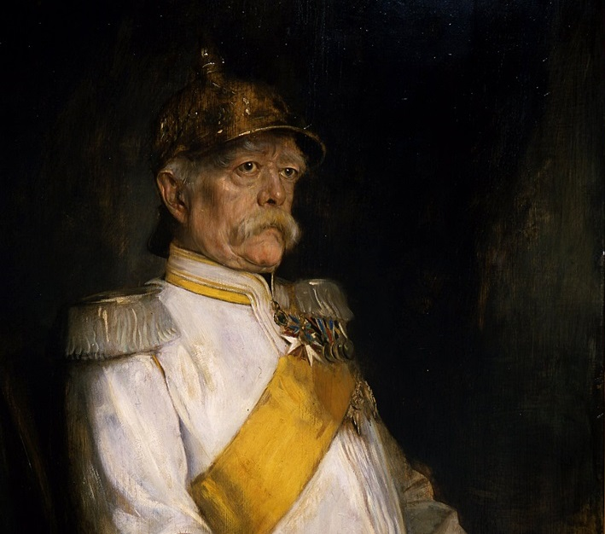
ARCHITECT

Slide 18
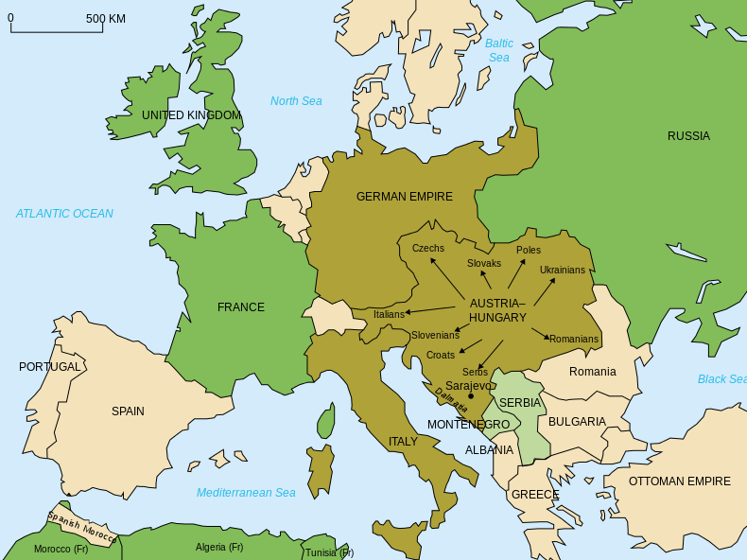
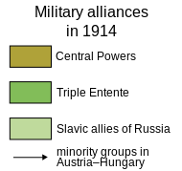
Alliances
Map Credit: historicair

Slide 19
Triple Entente
Britain France Russia
Central Powers
Germany Austria-Hungary Ottoman Empire Italy
Map Credit: historicair

Slide 20
Photo by Jayel Aheram

Slide 21
The objective was
NOT to go to war.
Photo by Jayel Aheram

Slide 22
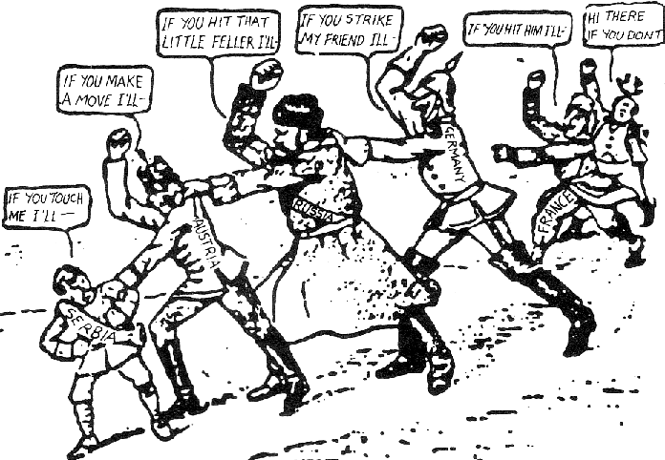
1914 American Cartoon

Slide 23
IT WORKS!!!

Slide 24
IT WORKS!!!
...until it doesn’t.

Slide 25
IMPERIALISM
National Rivalry Goes Global

Slide 26
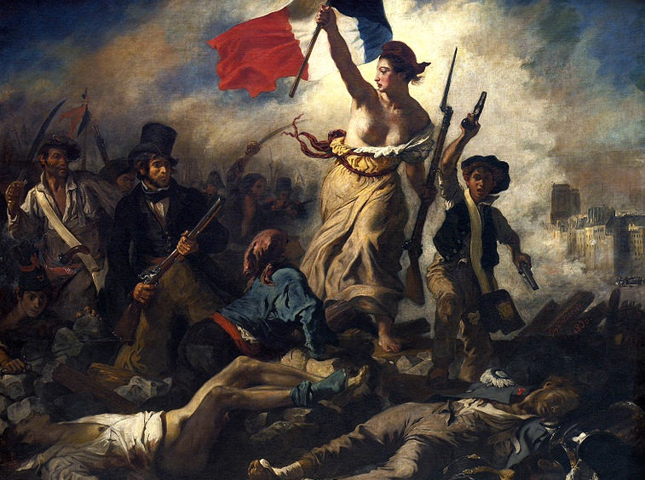
NATIONALISM
Liberty Leading the People (Eugène Delacroix, 1830)

Slide 27
Self-Determination on the Basis of Ethnicity
Liberty Leading the People (Eugène Delacroix, 1830)

Slide 28
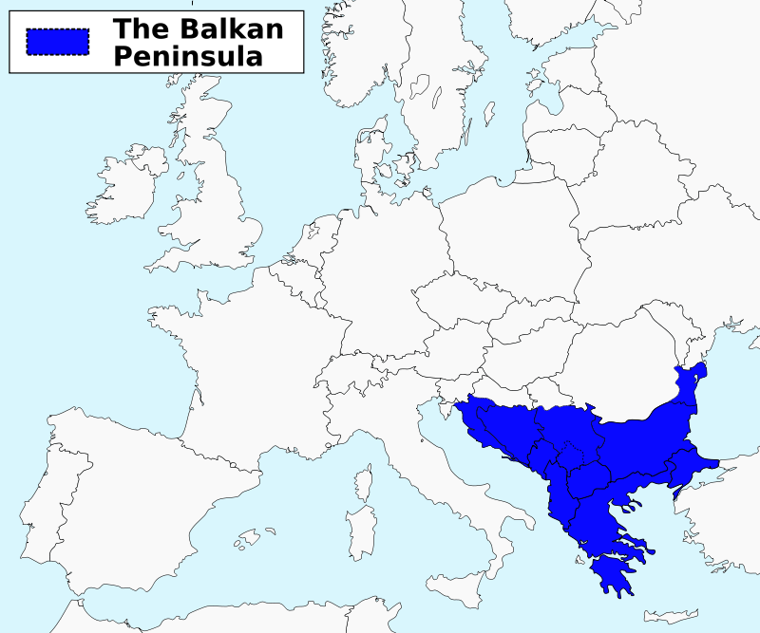
Map Credit: ArnoldPlaton

Slide 29
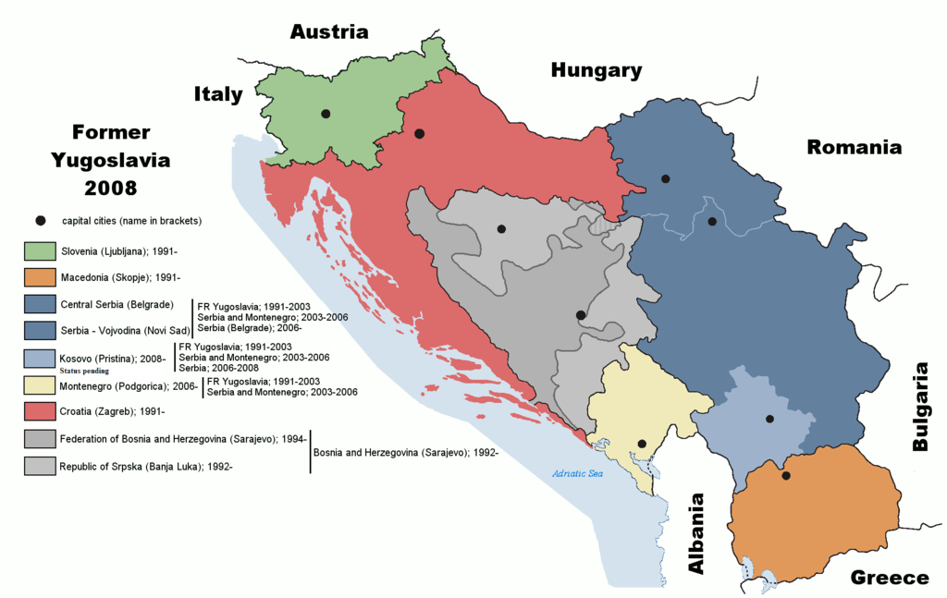
The “Former Yugoslavia”
Map Credit: Ijanderson977

Slide 30
It looks peaceful enough
Miss Snyder in Croatia
(Used With Permission)

Slide 31
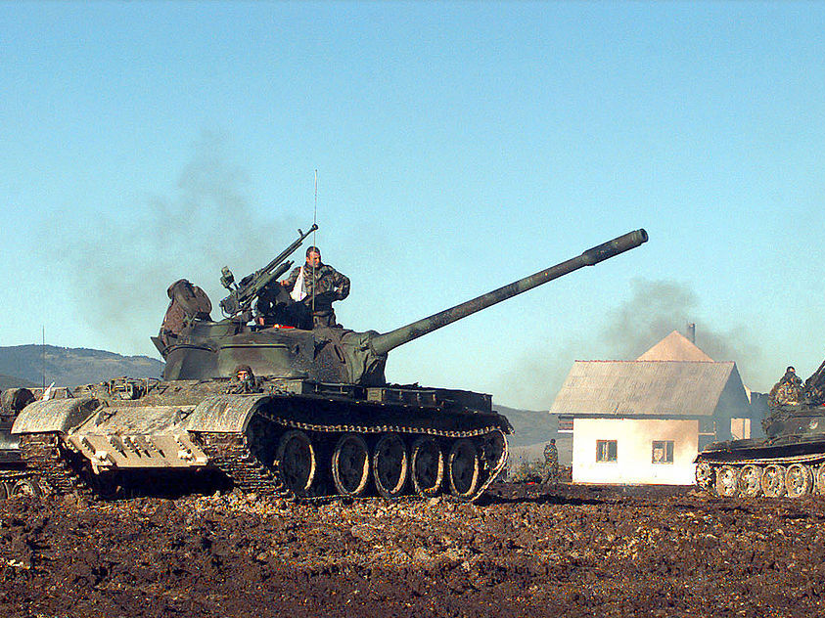
DON’T BE FOOLED

Slide 32
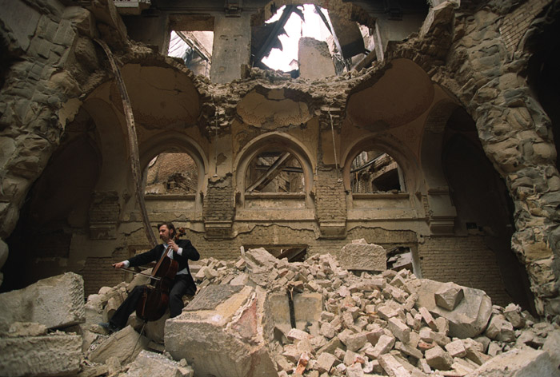
Vedran Smailović playing on top of the ruins of the National library (1992)
Photo Credit: Mikhail Evstafiev

Slide 33
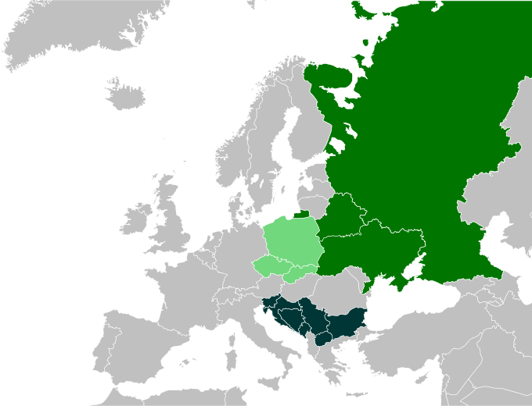
PAN-SLAVISM
Map Credit:
CrazyPhunk

Slide 34
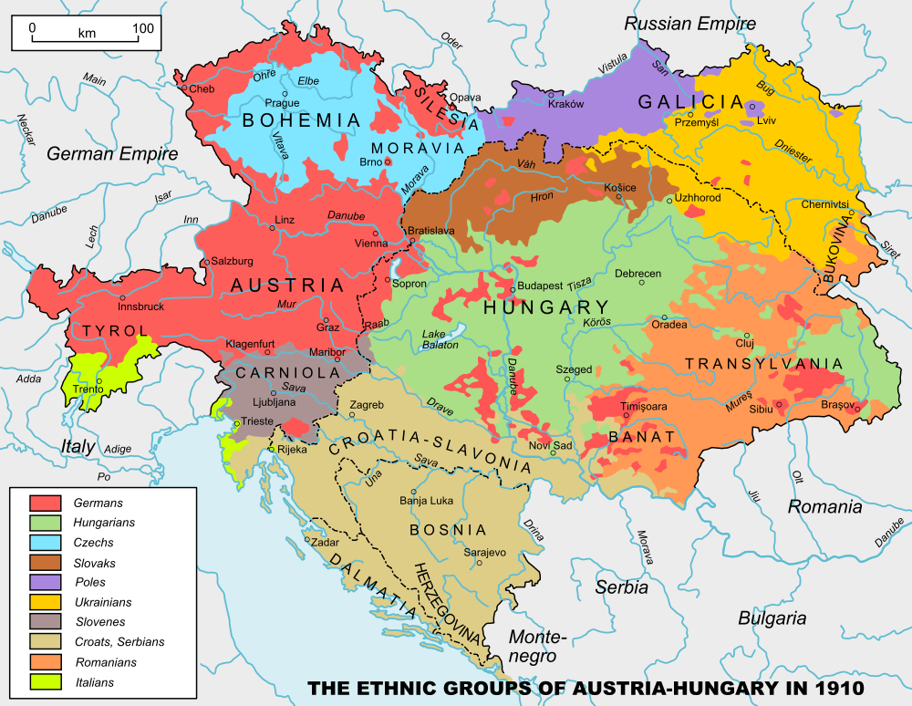

Slide 35
The Black Hand
Serbian Nationalists
Photo by FotoRita [Allstar maniac]

Slide 36
SLAVS

Slide 37
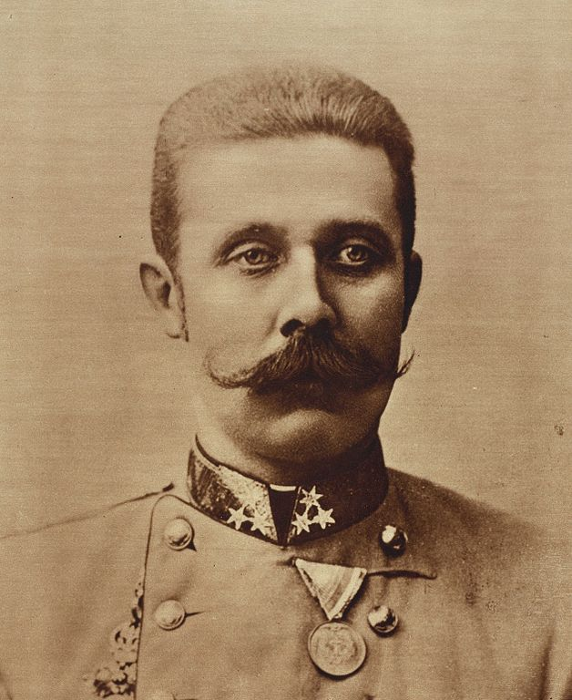
HEIR
Archduke Franz Ferdinand of Austria

Slide 38
ARCHDUKE

Slide 39
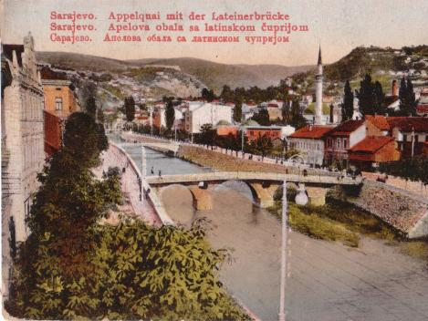
SARAJEVO
Picture Credit: Aloysius

Slide 40
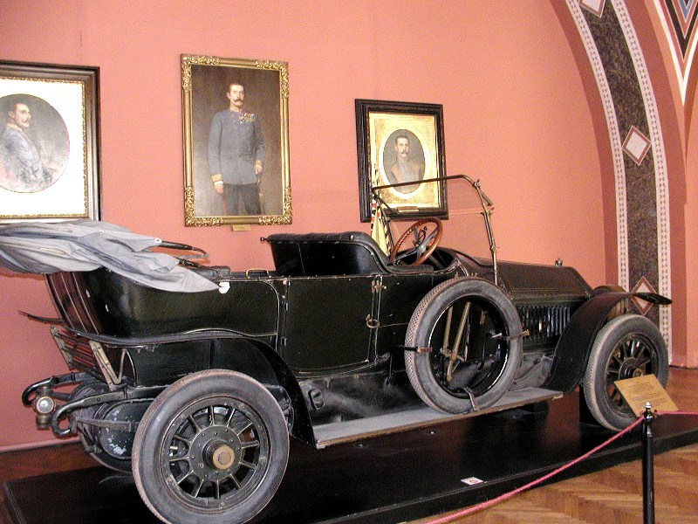
Photo by Alexf

Slide 41
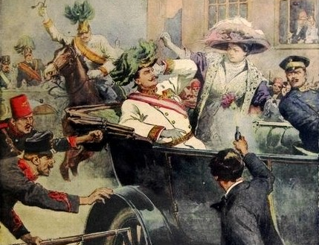

Slide 42
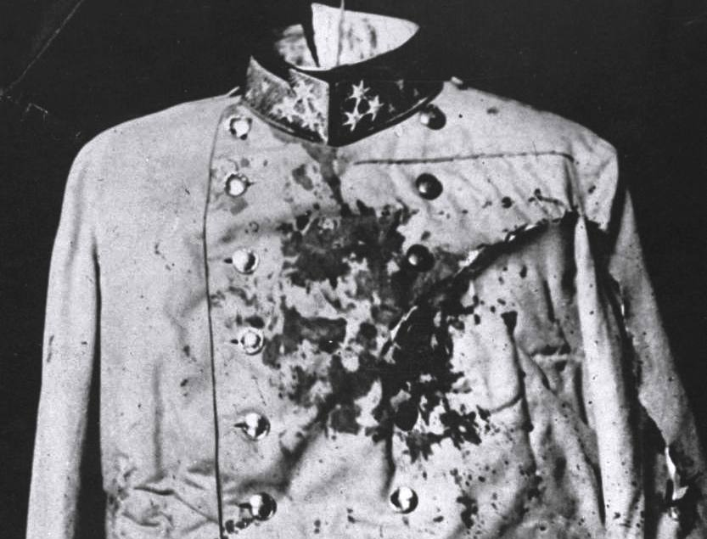

Slide 43
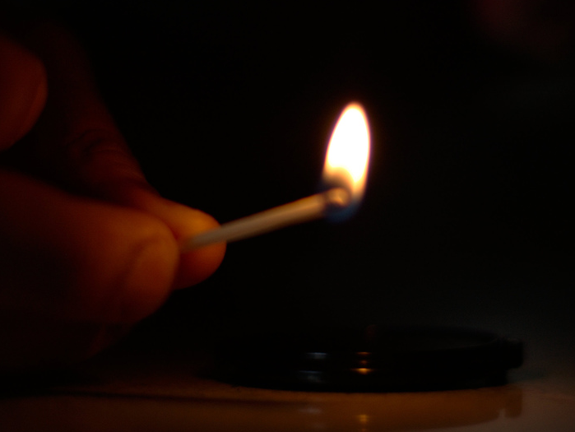
IGNITE
Photo by ☻☺

Slide 44
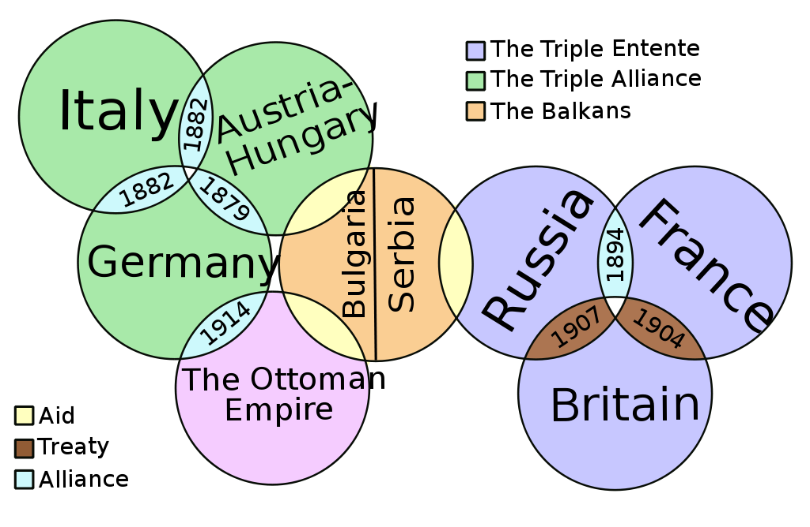
The Web of Alliances
Art Credit: It Is Me Here Xiaphias

Slide 45
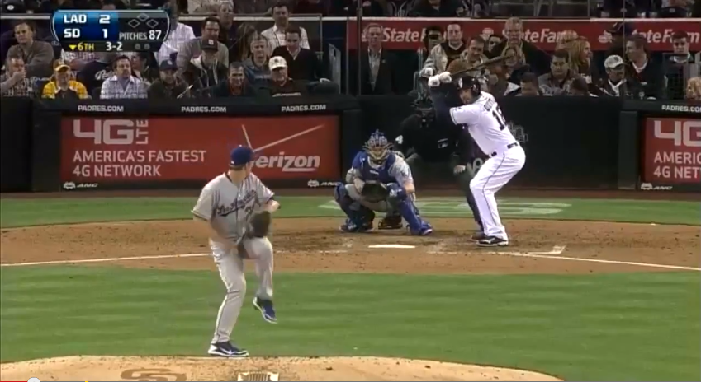
The Bench Clears…
http://www.youtube.com/watch?v=eZ3eA5ytOqg

Slide 46
CAUSES of World War I
M
A
I
N
ILITARISM
LLIANCES
MPERIALISM
ATIONALISM

Slide 47
Triple Entente
Britain France Russia
Central Powers
Germany Austria-Hungary Ottoman Empire Italy
Map Credit: historicair

