Slide 1
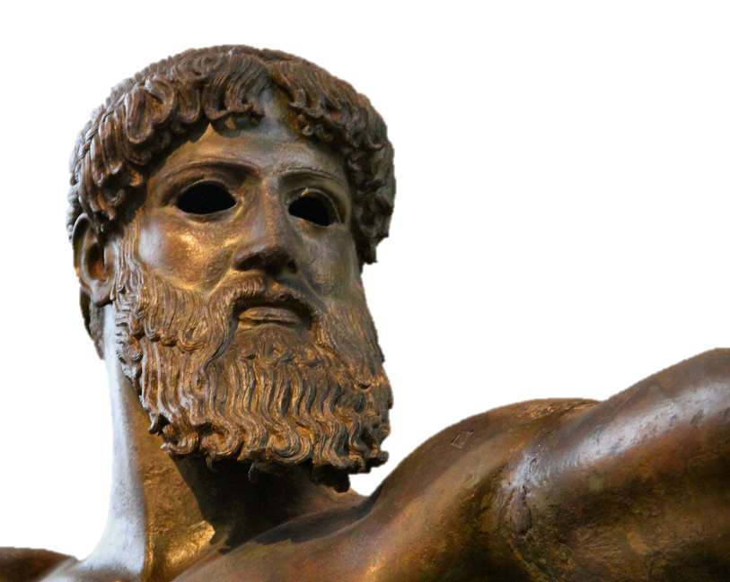
Ancient Greek Mythology
Some rights reserved by dynamosquito

Slide 2
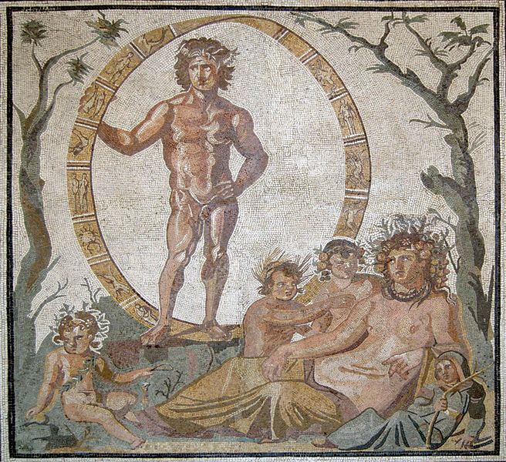
In the Beginning...
Uranus
“Father Sky”
Gaia
“Mother Earth”

Slide 3
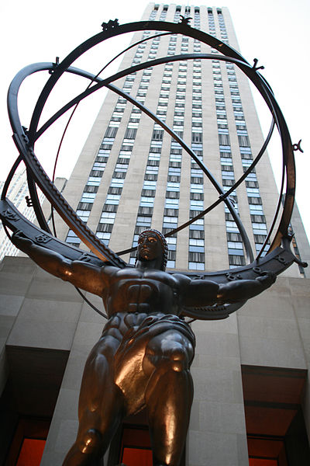
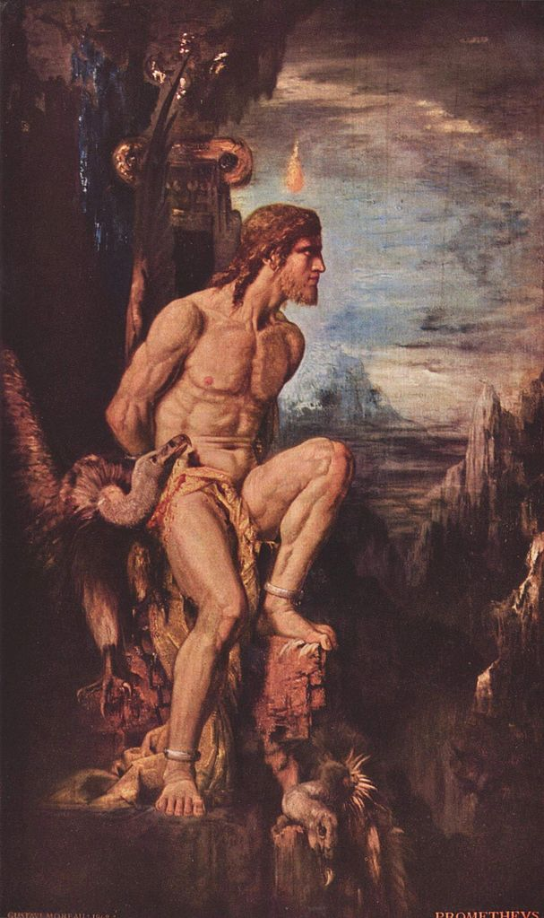
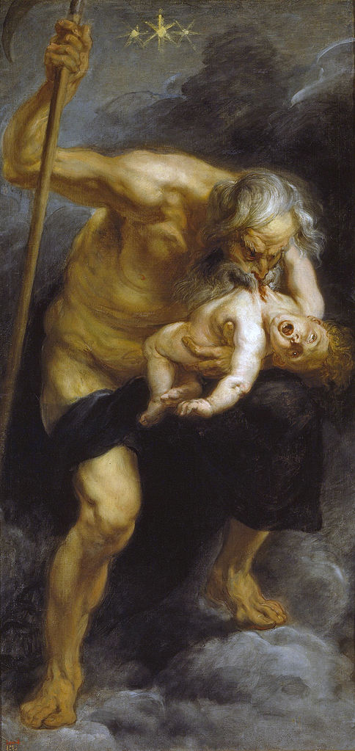
The Titans
Descendants of Gaia and Uranus
atlas
Prometheus
Cronus

Slide 4
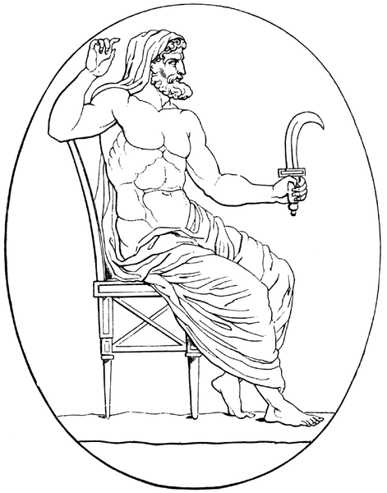
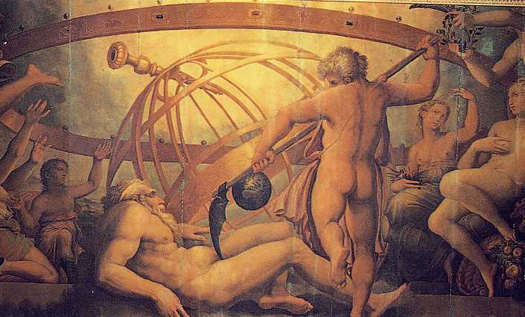
O U C H ! ! !
Cronus overthrows Uranus
Cronus Pictured With Sickle
The Mutilation of Uranus: fresco by Giorgio Vasari and Cristofano Gherardi, c. 1560

Slide 5
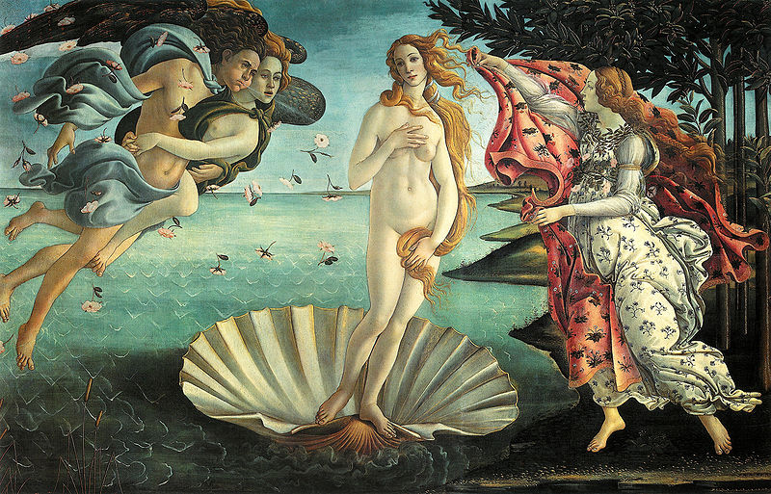
Botticelli, The Birth of Venus, 1482-1486

Slide 6
Cronus
Understandably PARANOID
Peter Paul Reubens, Cronus Devours Poseidon

Slide 7
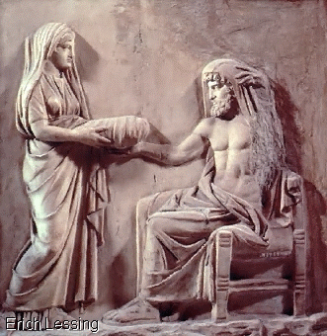

Slide 8
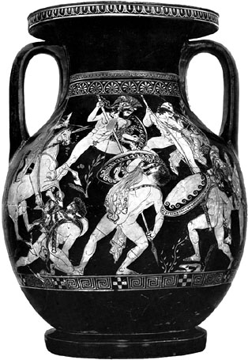
Titanomachy
War of the Titans
Zeus,
Poseidon
Hades
defeat Cronus and the Titans

Slide 9
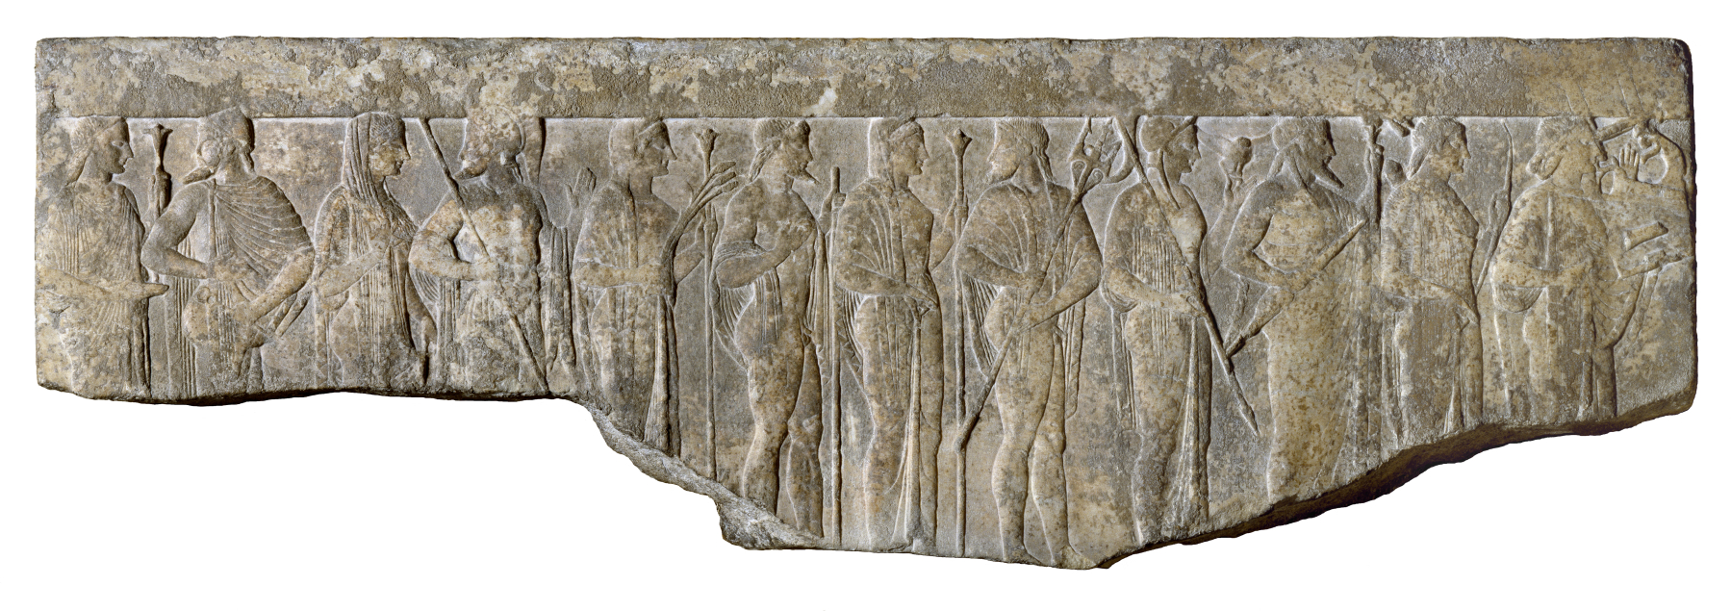
The Olympians

Slide 10
The Olympians
Zeus (Jupiter) Poseidon (Neptune) Apollo Hermes (Mercury) Ares (Mars) Hephaestus (Vulcan) | Hera (Juno) Athena (Minerva) Aphrodite (Venus) Artemis (Diana) Demeter (Ceres) Hestia (Vesta)
Hades (Pluto)

Slide 11
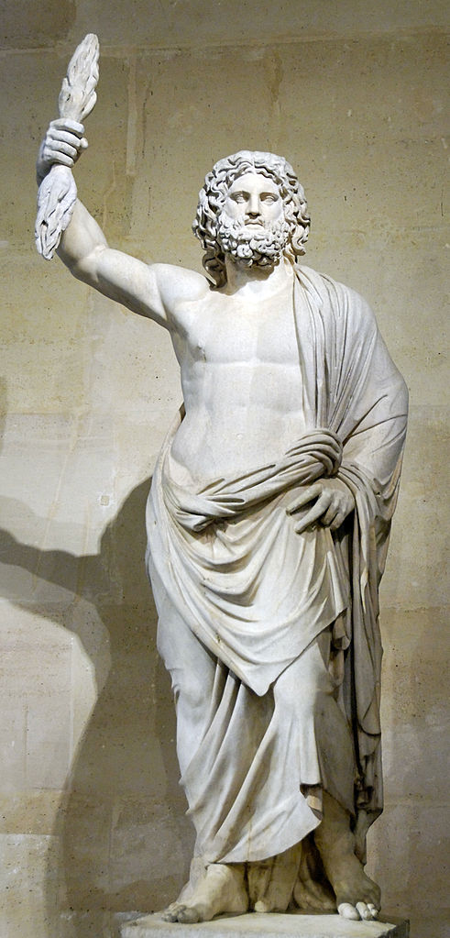
Zeus
Lord of Sky and Thunder
King of the Gods
Known for his many romantic escapades

Slide 12
Poseidon
TRIDENT
Lord of the Sea
HIGH MAINTENANCE
Causes earthquakes, storms, and shipwrecks when ignored

Slide 13
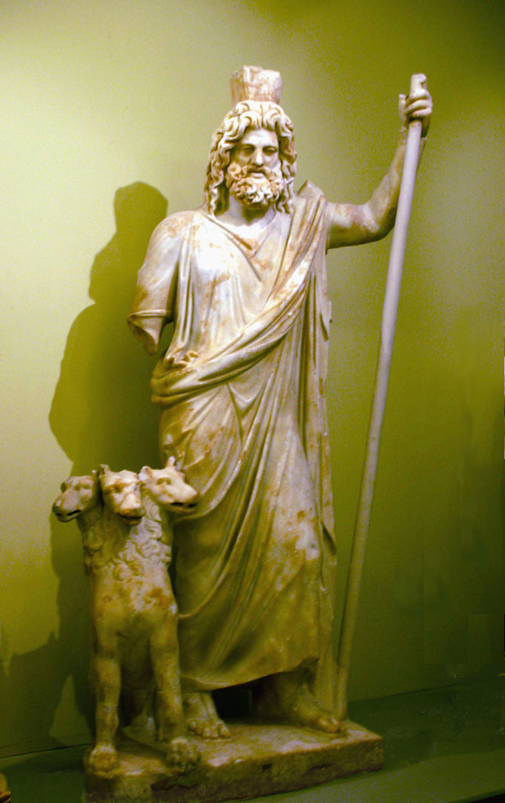
Hades
Lord of the Underworld
Hades with his hell hound, Cerberus, guardian of the gates of the Underworld

Slide 14
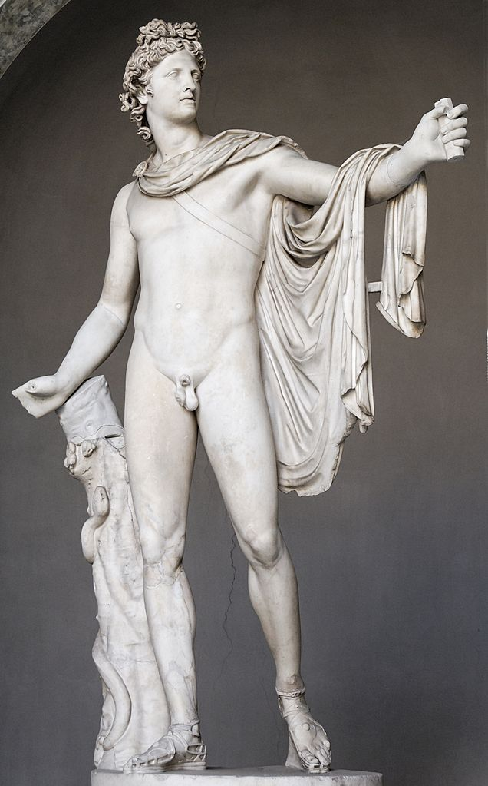
Apollo
god of the sun, prophecy, music, poetry, etc.

Slide 15
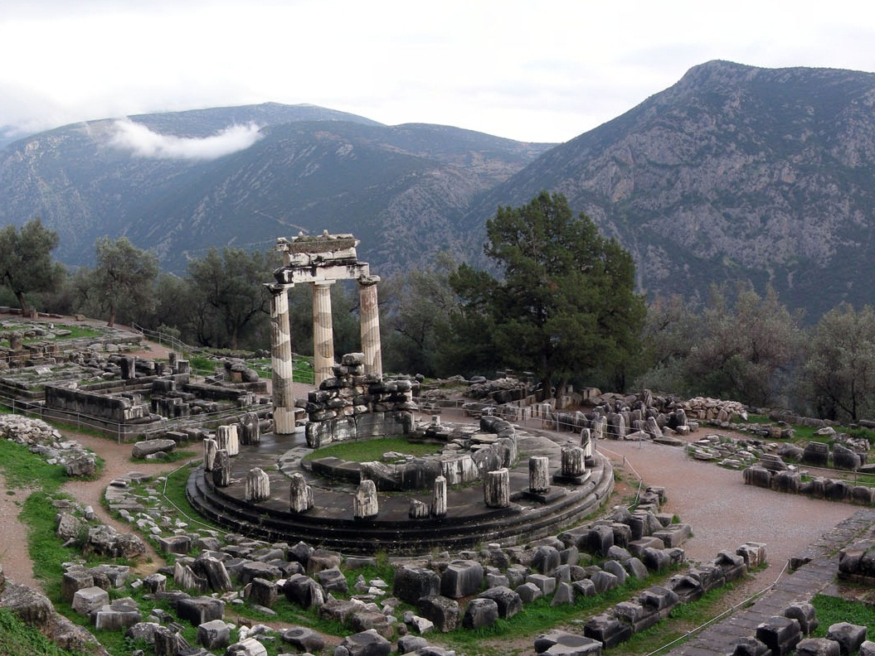
The Oracle
At Delphi
Greeks would visit Apollo’s Oracle seeking prophecies about the future.
Photo Credit: Luarvick

Slide 16
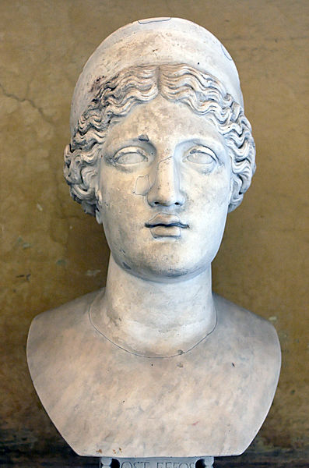
Hera
Queen of the Gods
Women and Marriage
Sister AND Wife of Zeus

Slide 17
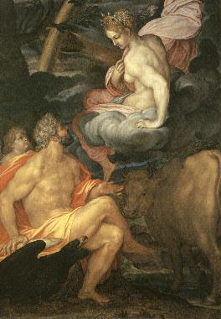
Ambrogio Figino, Io and Zeus

Slide 18
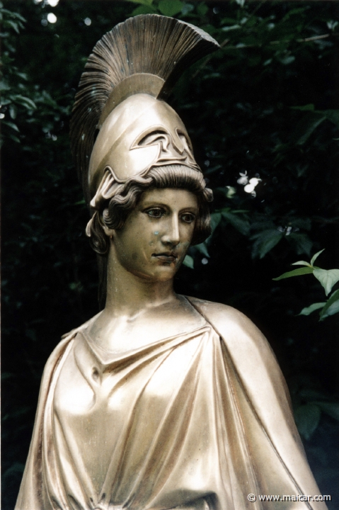
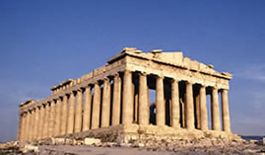
Athena
Patroness of Athens
W
Wisdom & Warfare
The Parthenon (Athens)

Slide 19
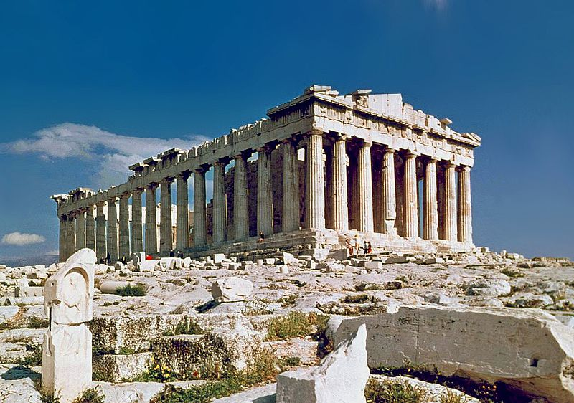
The Parthenon
Parthenos = Virgin
Photo Credit: Steve Swayne

Slide 20
The Nashville Parthenon
Some rights reserved by Serge Melki

Slide 21
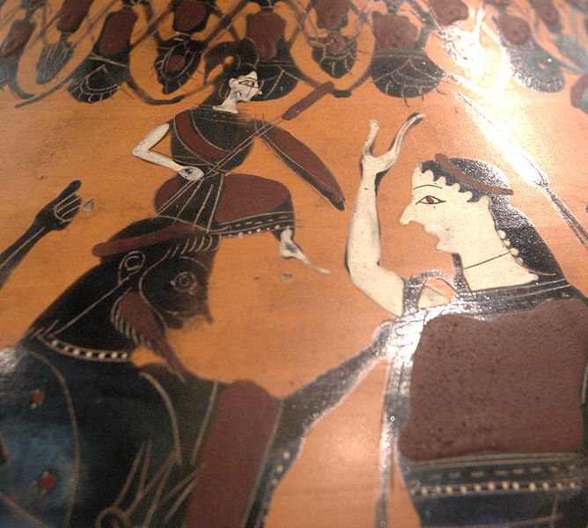

Slide 22
Aphrodite
love, beauty, pleasure and procreation
Carson picked this!

Slide 23
Botticelli, The Birth of Venus, 1482-1486

Slide 24
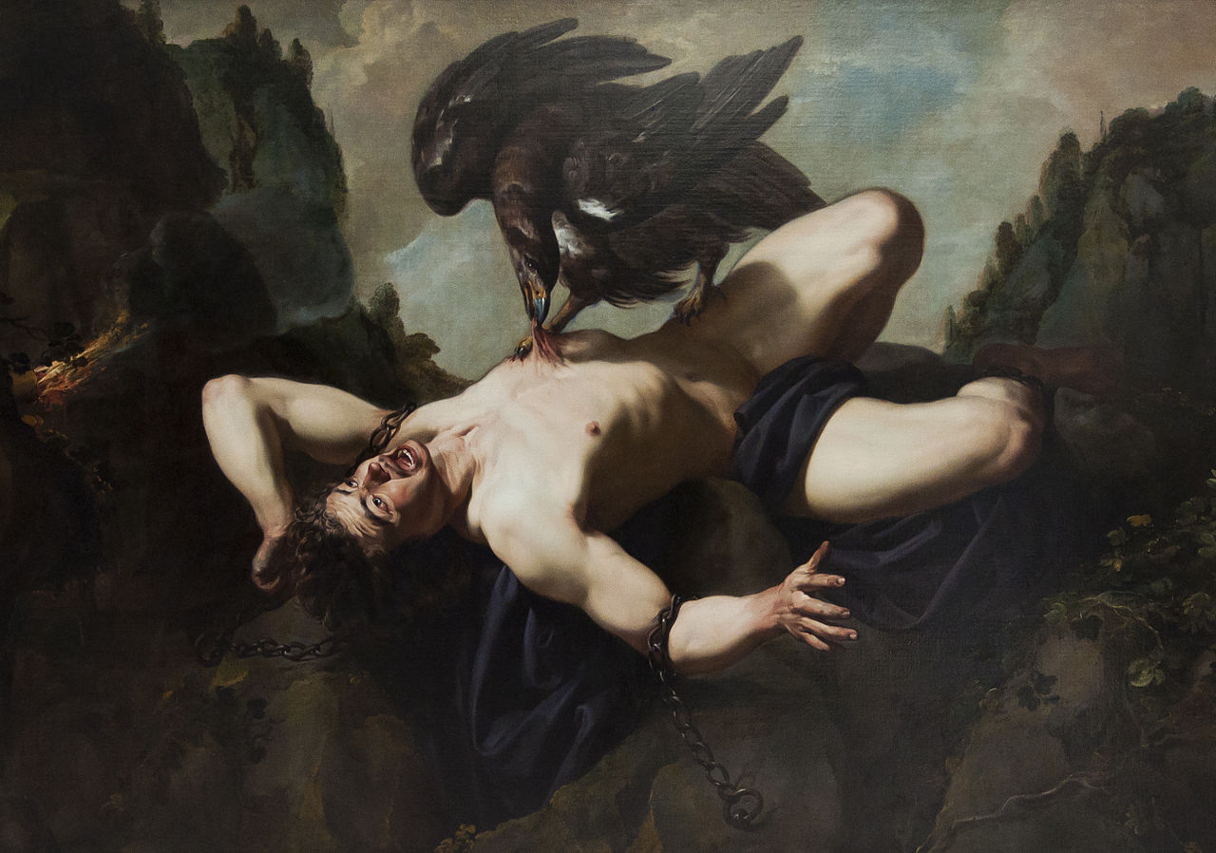
Prometheus by Theodoor Rombouts (1597–1637)

Slide 25
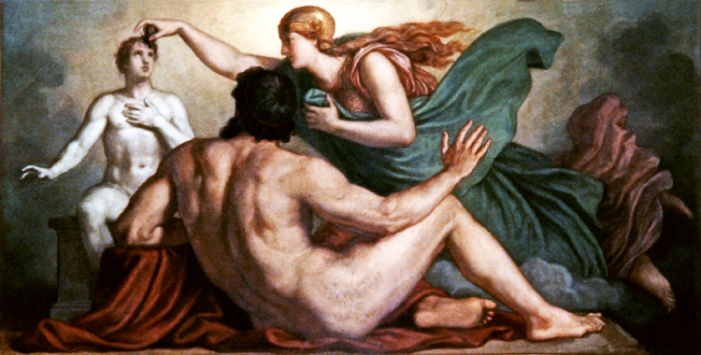
Prometheus
Patron of Mankind
Prometheus watches Athena endow his creation with reason (painting by Christian Griepenkerl, 1877)

Slide 26
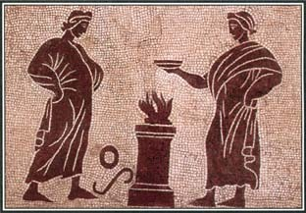
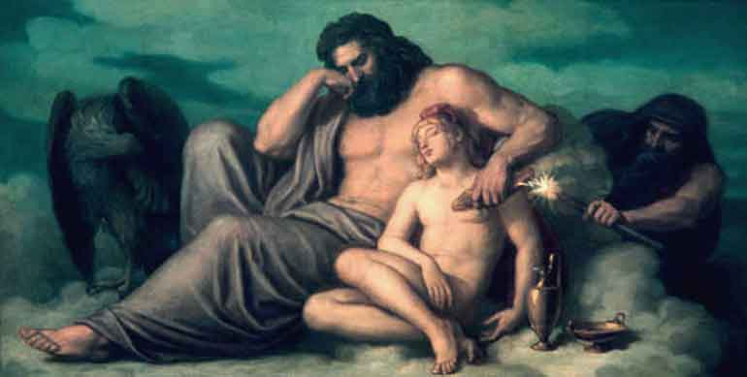
Prometheus
Patron of Mankind
The Theft of Fire
Prometheus Tricks Zeus
Prometheus tricked Zeus twice on behalf of humanity.

Slide 27
The Theft of Fire, Christian Griepenkerl

Slide 28
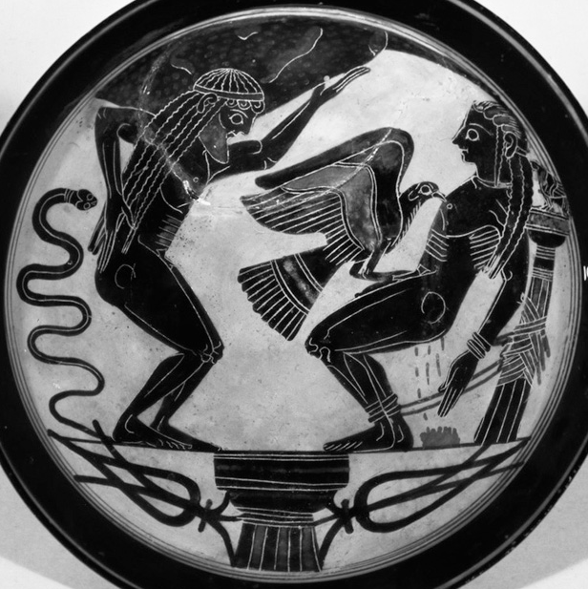
Punishment
Atlas and Prometheus facing their respective punishments from Zeus

Slide 29
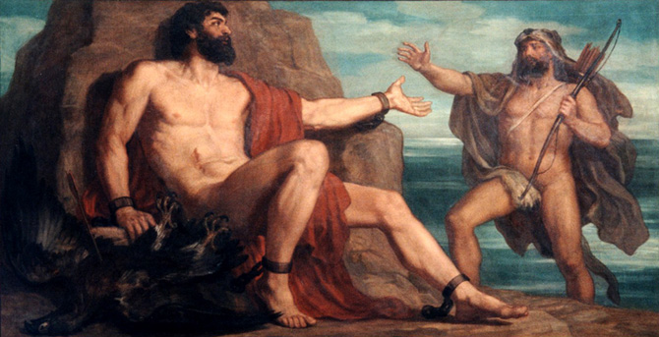
RESCUED
Prometheus Being Rescued by Hercules, by Christian Griepenkerl

Slide 30
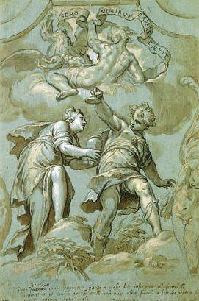
Prometheus, Epimetheus AND Pandora
NEVER accept a gift from Zeus
-- Prometheus to Epimetheus

Slide 31
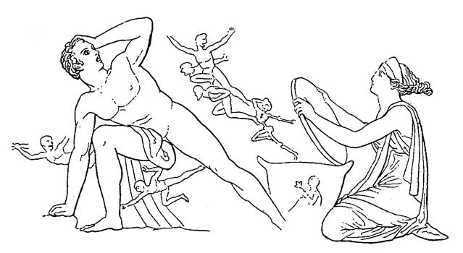
Pandora
The First Woman
created by Zeus as a revenge against Prometheus and men
“All Gifts”
HOPE Sometimes, it’s all we have left!

Slide 32
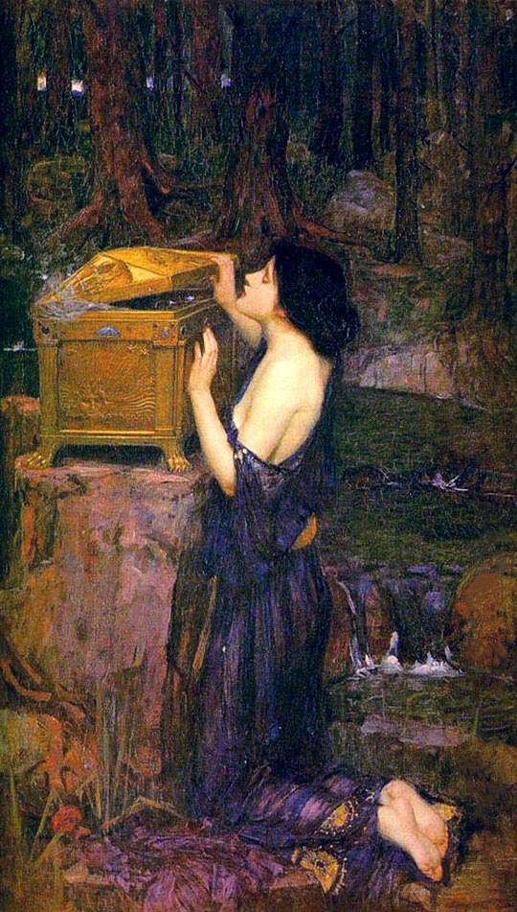
Women
The Ancient Greek View
“From her is the race of women and female kind: of her is the deadly race and tribe of women who live amongst mortal men to their great trouble, no helpmeets in hateful poverty, but only in wealth.”
-- Hesiod (Greek Writer)
John William Waterhouse, Pandora (1896)

