Slide 1
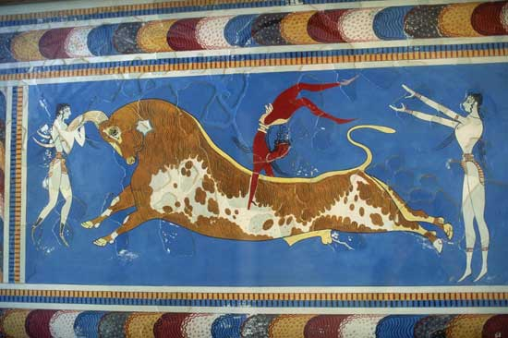

Greece
Minoan and Mycenaean

Slide 2
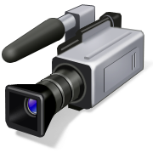
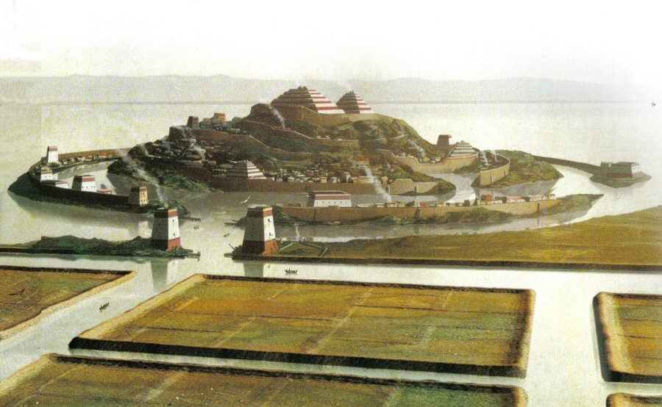
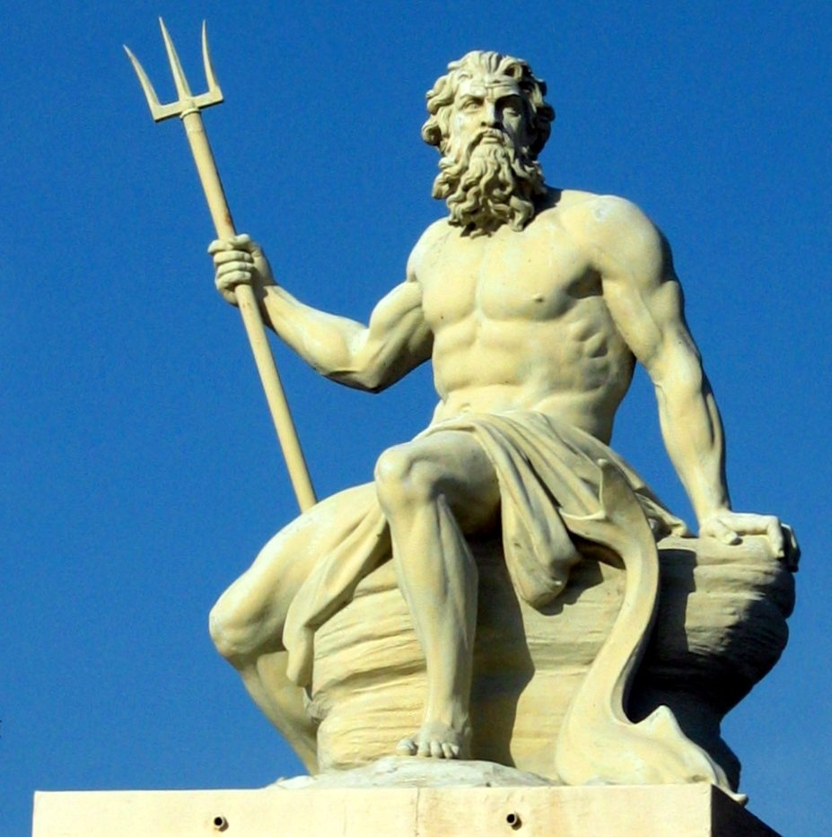
Atlantis
POSEIDON

Slide 3
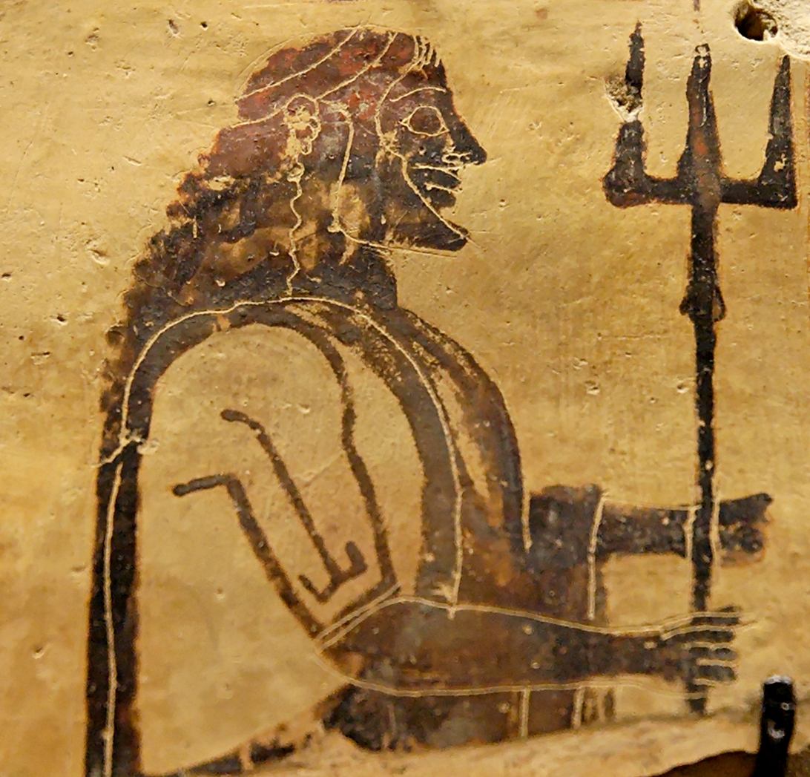
ANGRY

Slide 4
Myth or Reality?

Slide 5
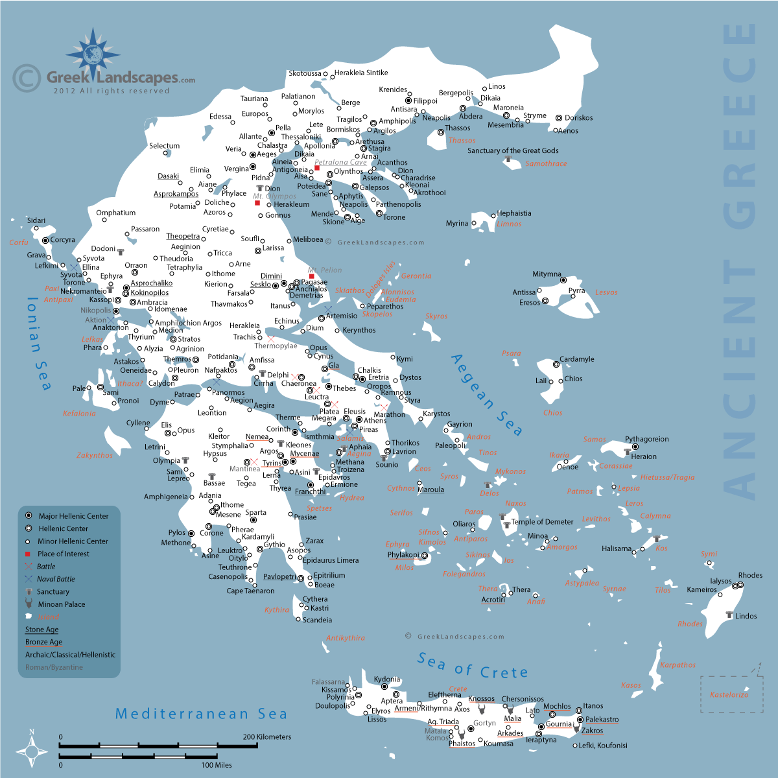
Crete
Signs of the earliest Greek civilization are found on the island of Crete.

Slide 6

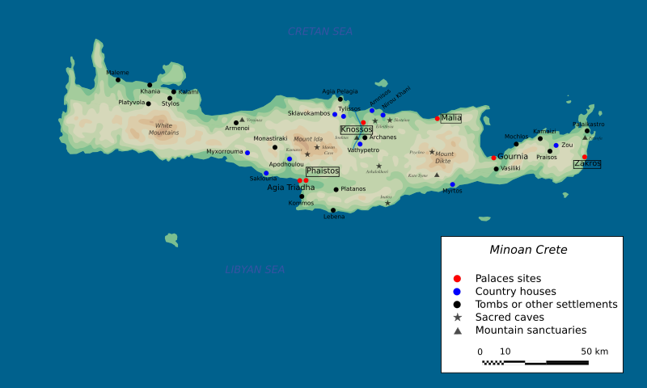
“Minoan”
Greece
Advanced Technology
Earliest Greek Civilization
(c. 2700-1500 B.C.)
Named for Minos
(Mythical King)
Crete

Slide 7
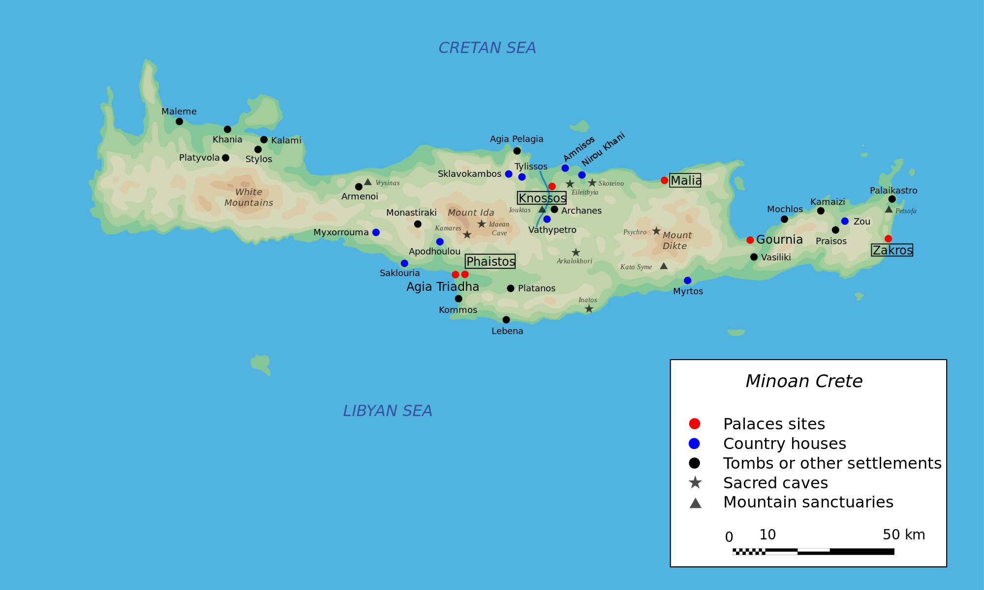
Knossos
Knossos is the most famous archaeological site in Crete.

Slide 8
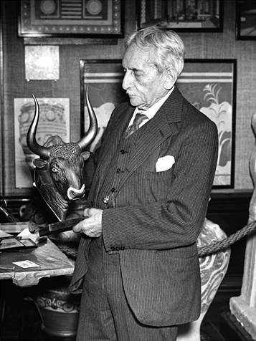
Sir Arthur Evans
Evans discovered archaeological evidence of the Minoan civilization in 1900.

Slide 9
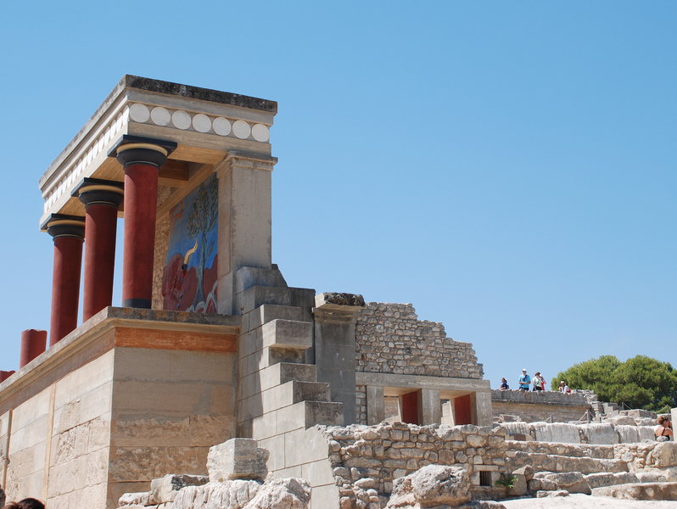
The Palace at Knossos
Some rights reserved by tjuel

Slide 10
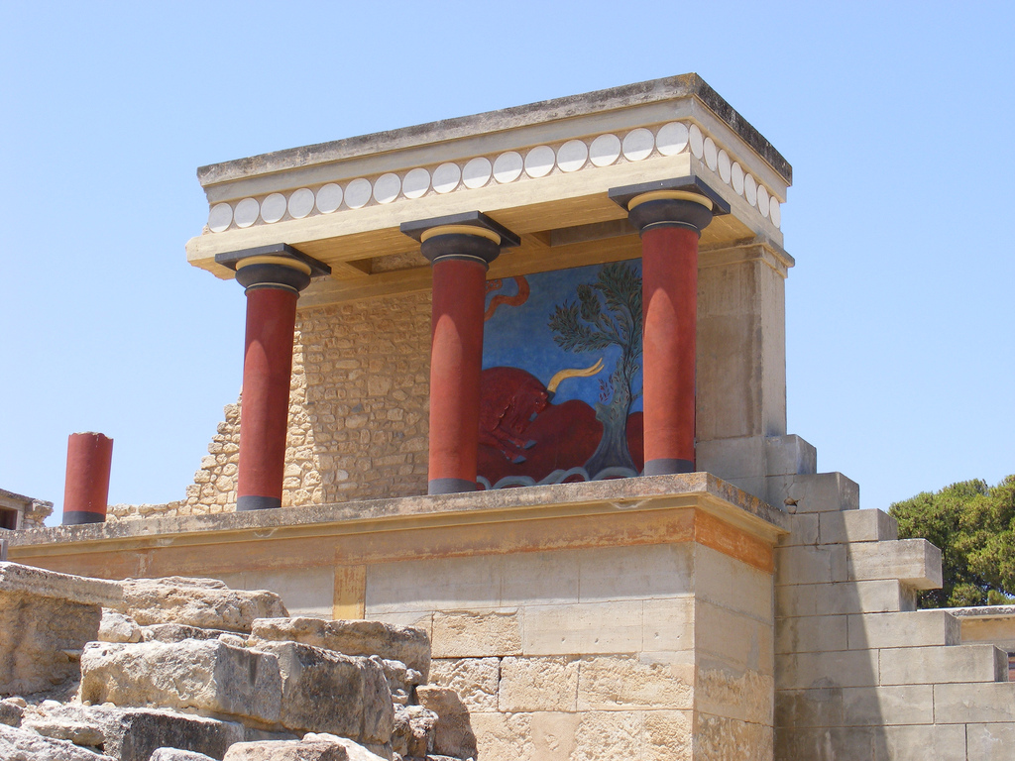
Some rights reserved by paula_mcmillen

Slide 11
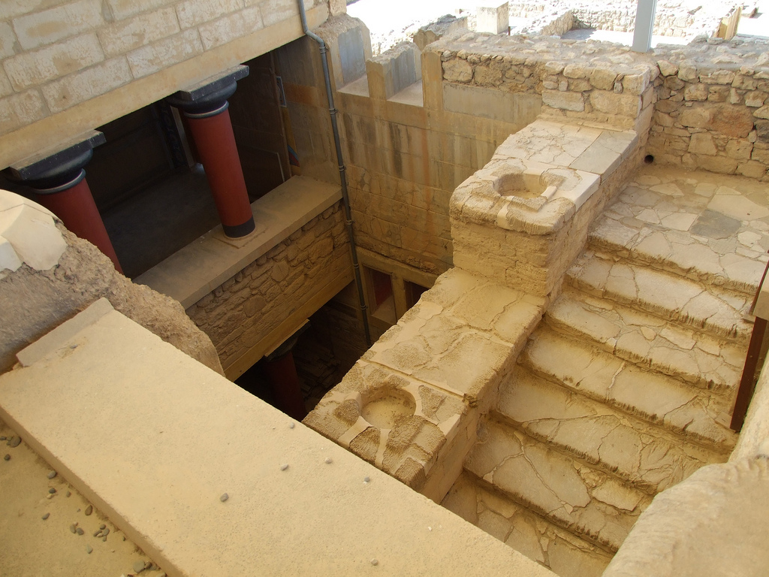
Some rights reserved by Paradasos

Slide 12
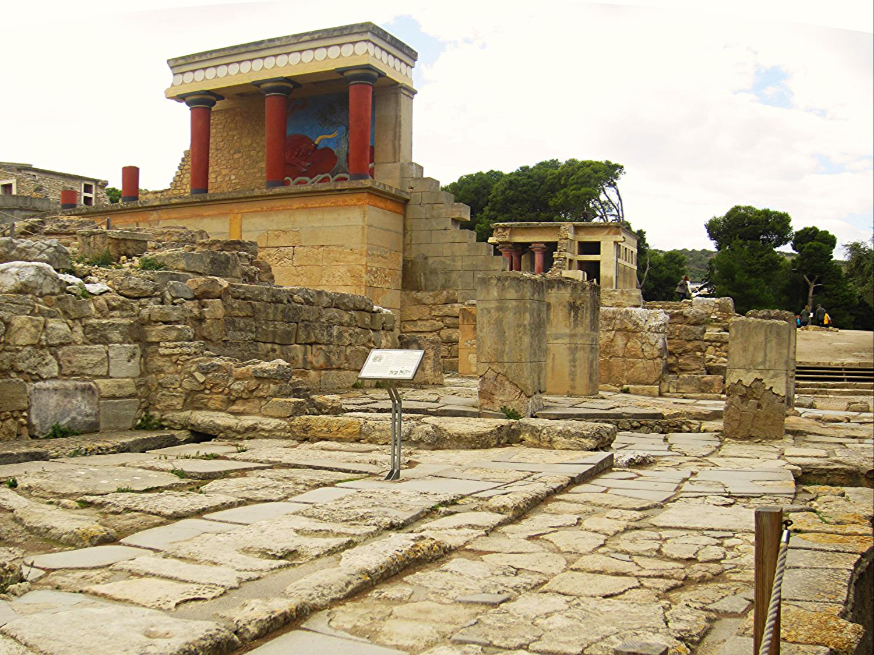
PANORAMA

Slide 13
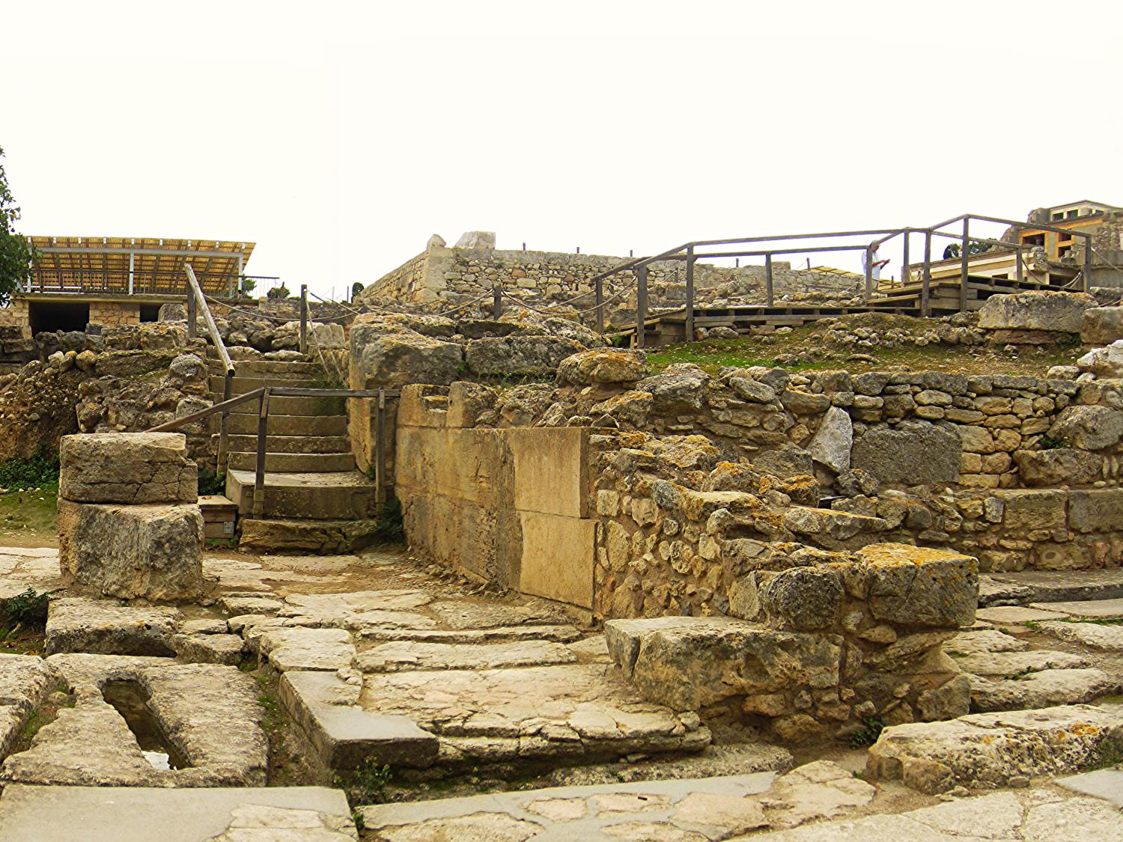

Slide 14
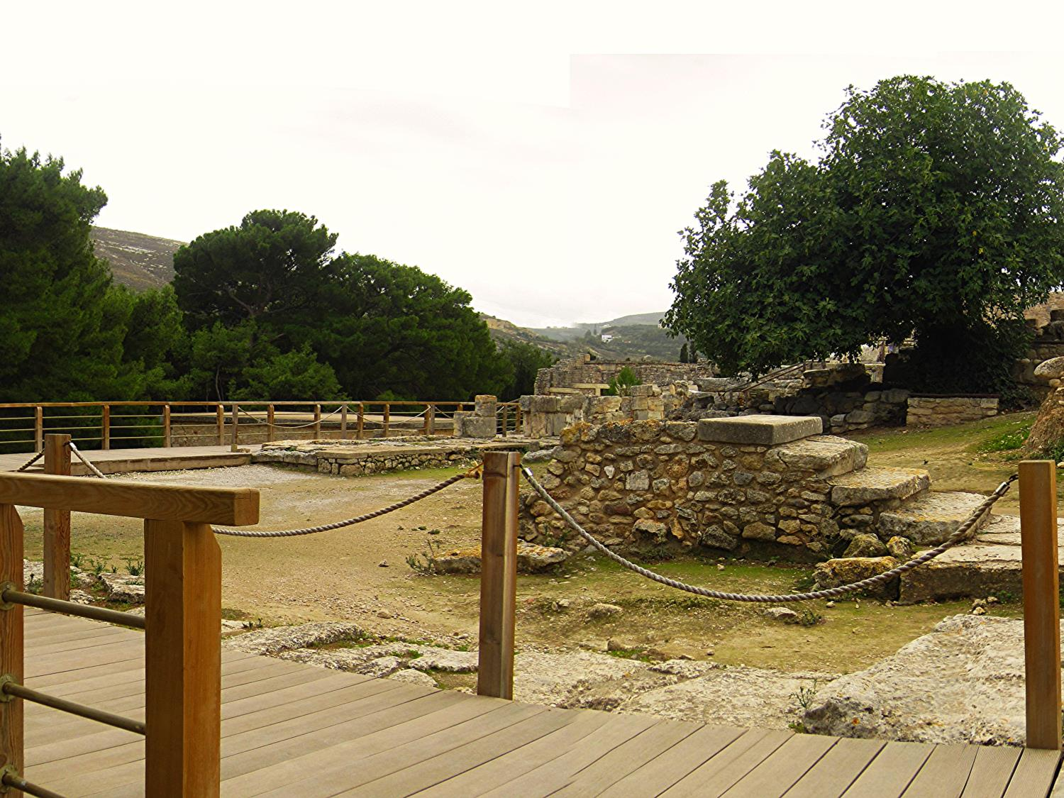
Photo by Nelo Hotsuma

Slide 15
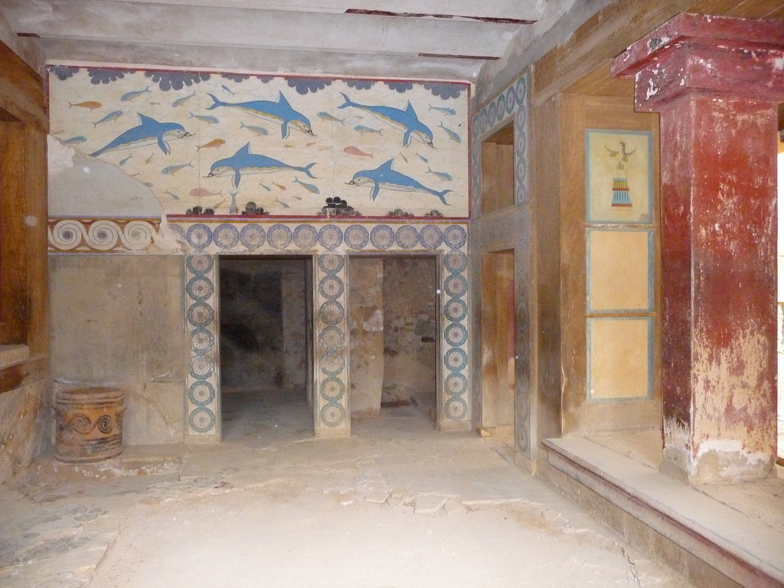
Fresco
A wall mural painted directly onto wet plaster
Some rights reserved by Rick Payette

Slide 16
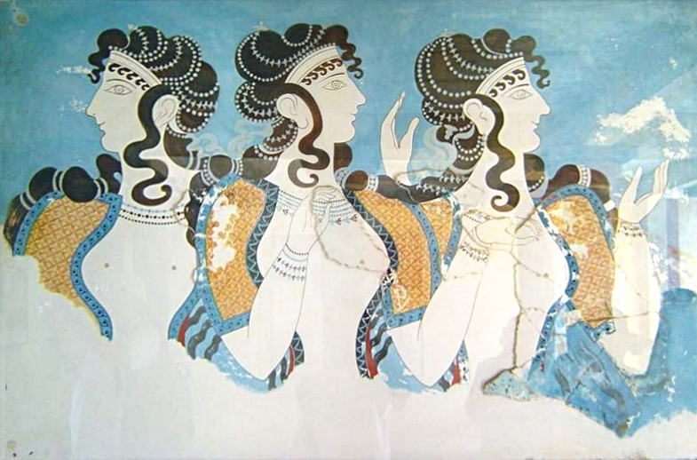
Women
Photo by cavorite

Slide 17
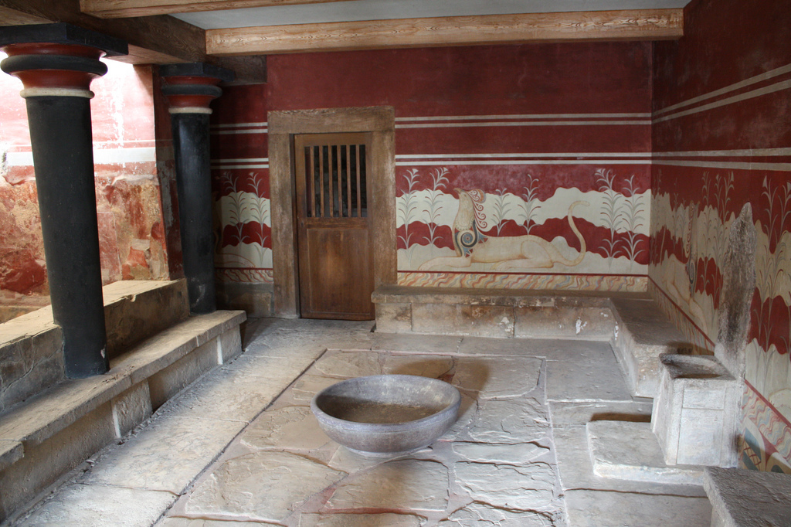
Throne Room
Photo by Shadowgate

Slide 18
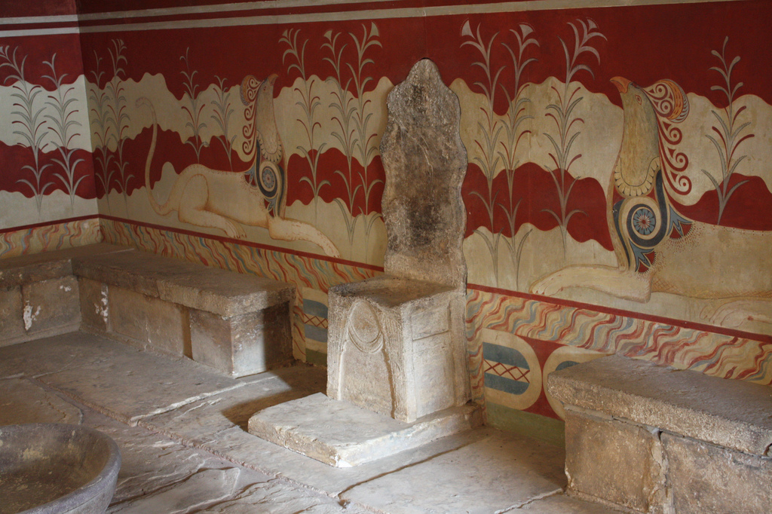
Photo by Shadowgate

Slide 19
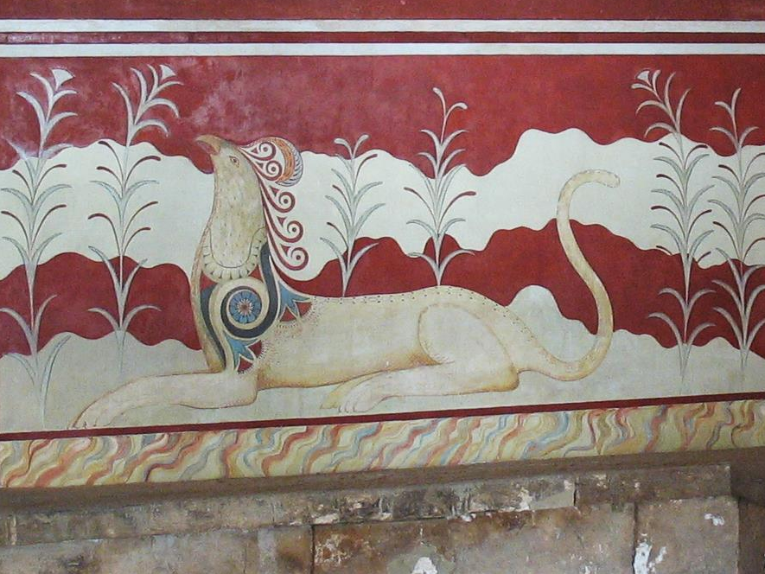
Griffin
Photo by Alberto Perdomo

Slide 20
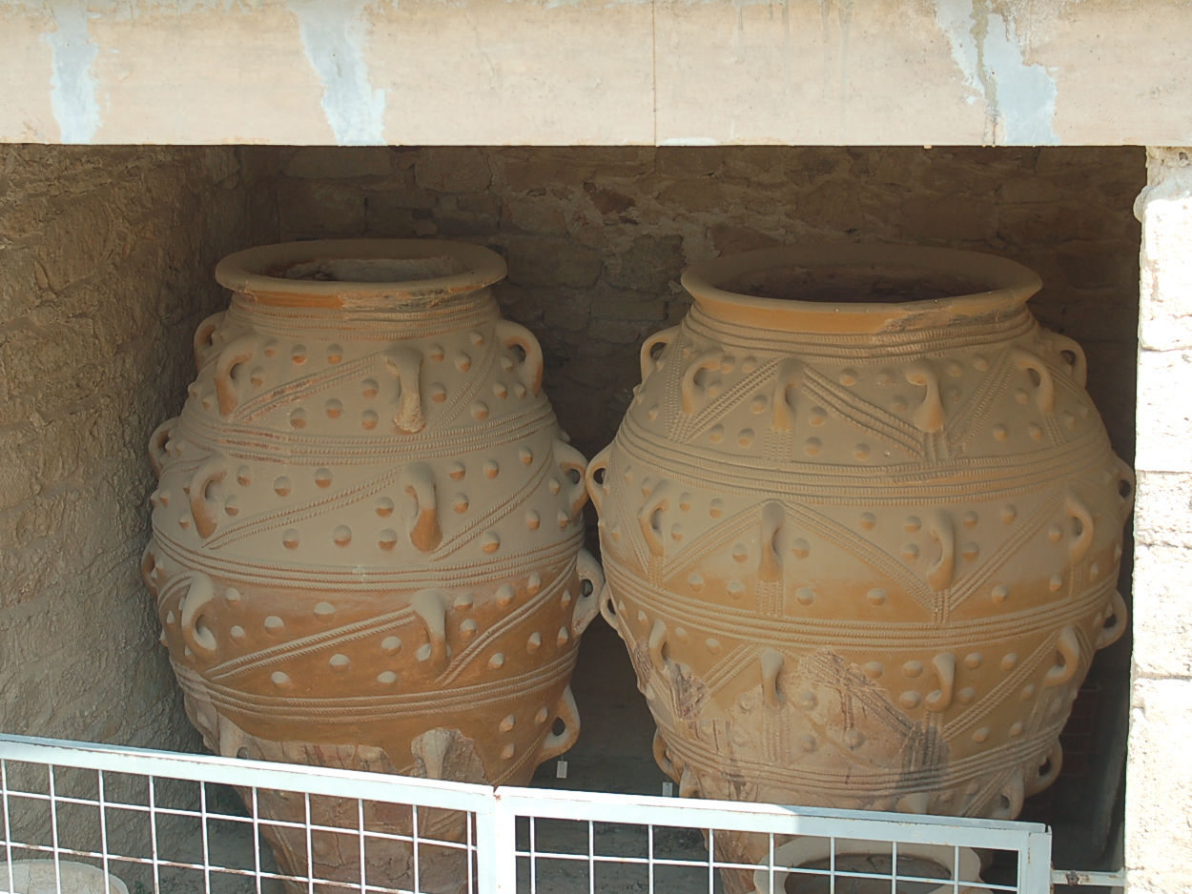
Photo by Gorka Palazio

Slide 21
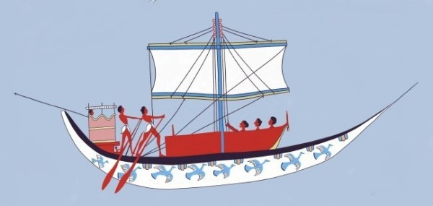
Commercial Power
A ship crew painted by a Minoan artist

Slide 22
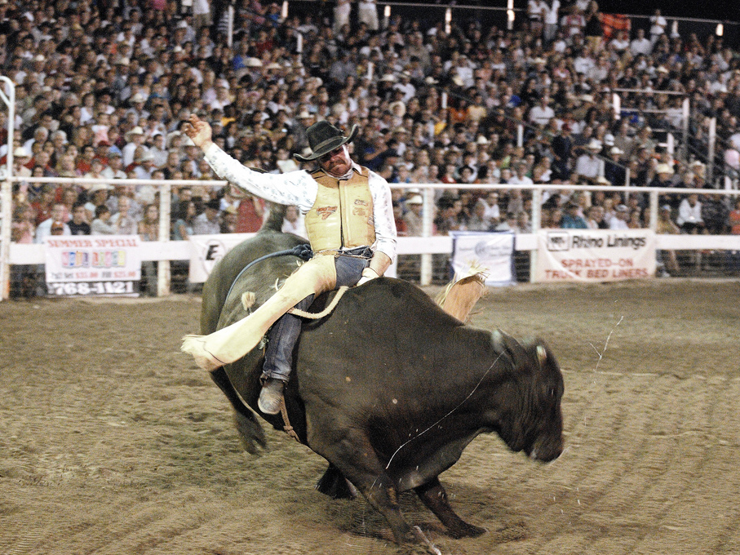
BULL SPORTS
https://www.youtube.com/watch?v=oq8yFsCdHqA
Photo by Eric Ward

Slide 23
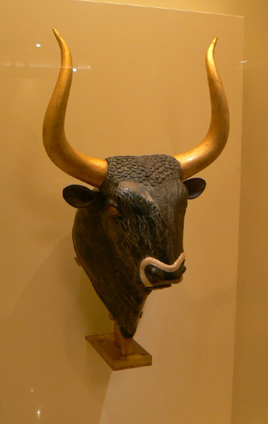
Veneration of the Bull
Bulls are a frequent subject in Minoan art, suggesting religious significance.
Minoan Bull Sculpture

Slide 24
Minoan Bull Jumping

Slide 25
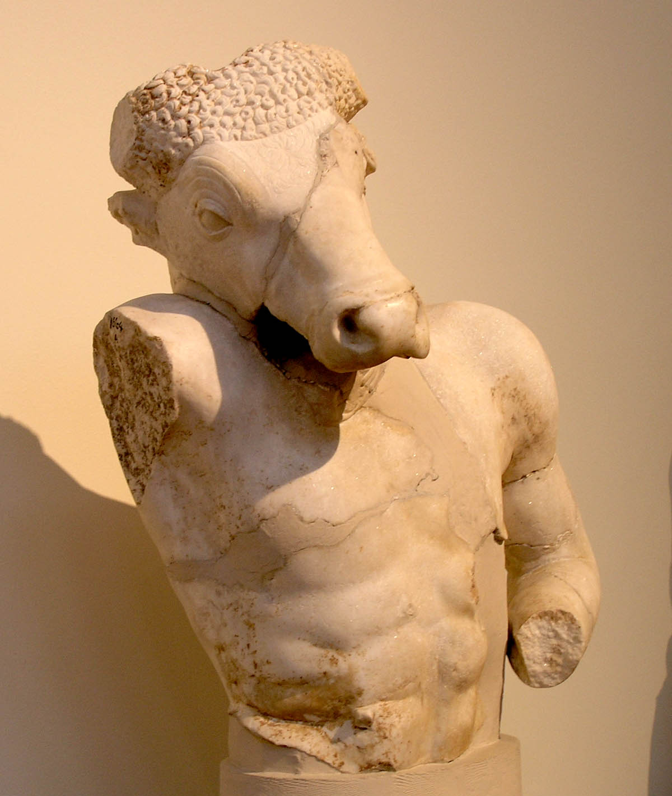
MINOTAUR
1/2 Human
1/2 Bull
5/3 AWESOME!
Photo by Marsyas

Slide 26
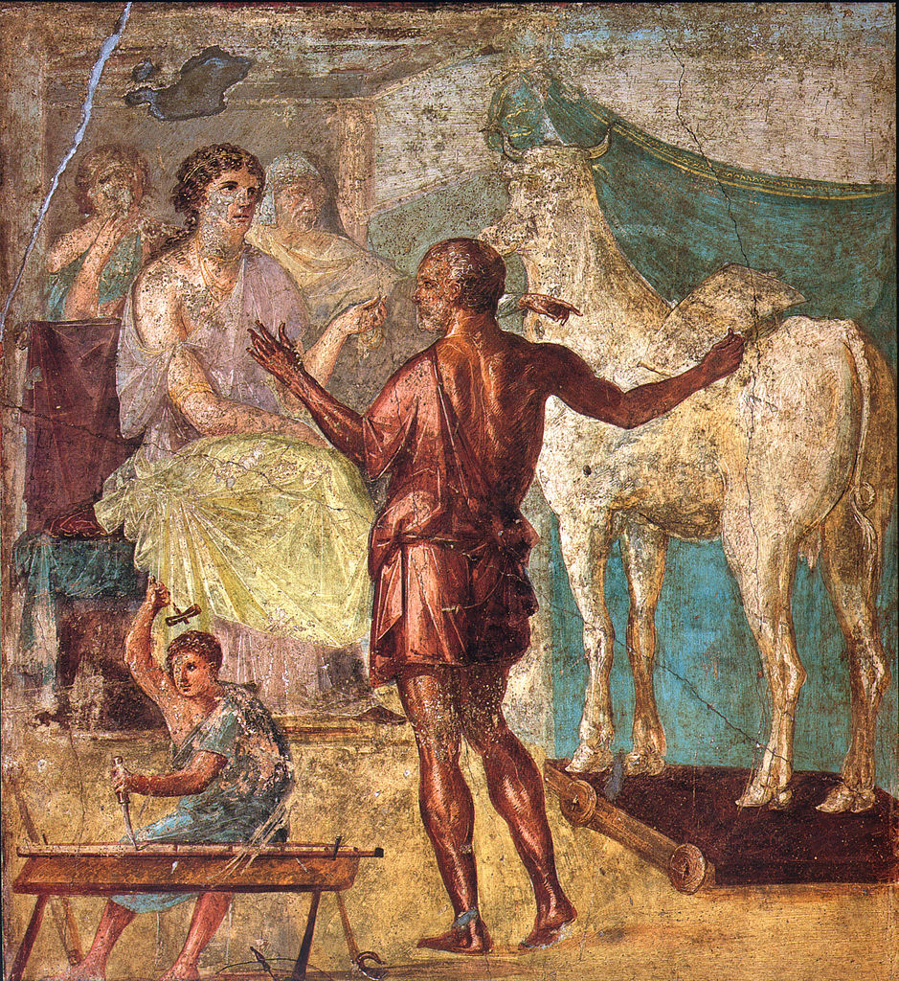
Daedalus,, and
Pasiphae’s
Wooden Cow
Pasiphae
Queen of Crete
Daedalus
Engineer
Roman fresco from the northern wall of the triclinium in the Casa dei Vettii (VI 15,1) in Pompeii

Slide 27
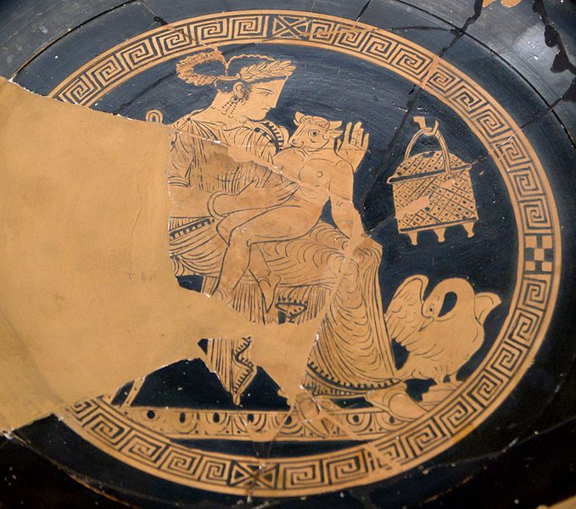
Too Cute

Slide 28
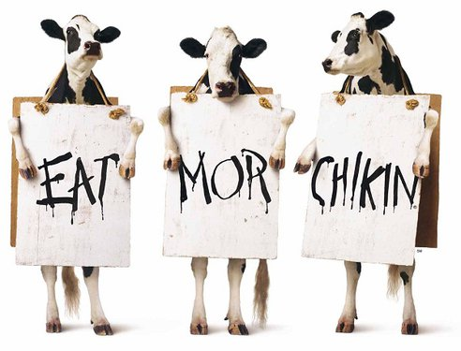

Slide 29
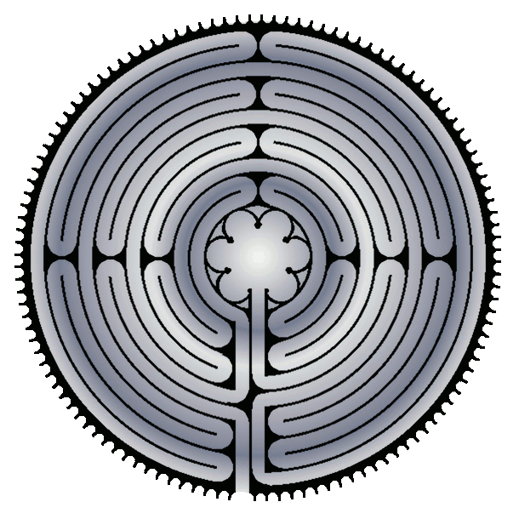
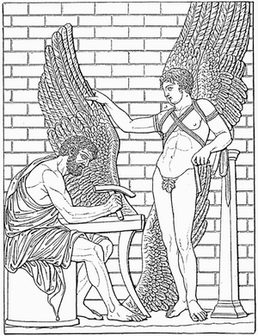
Labyrinth
MINOTAUR
Daedalus
(Mythical Engineer)

Slide 30
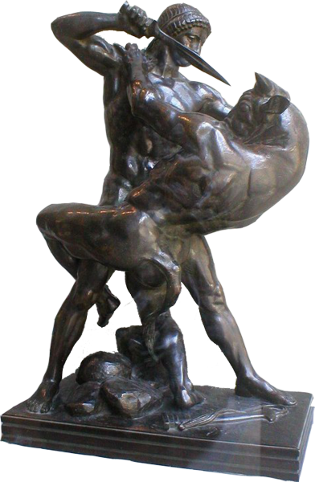
Theseus
Son of Aegeus
(King of Athens)
Minotaur Slayer!!!

Slide 31
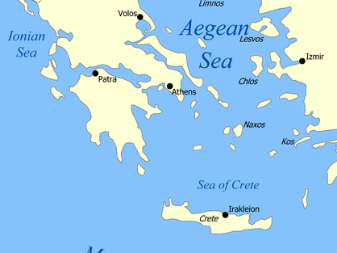
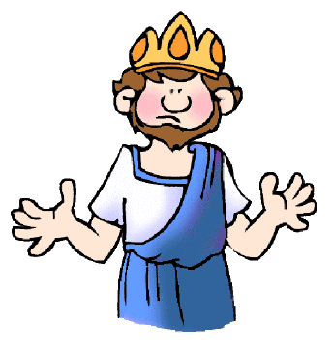
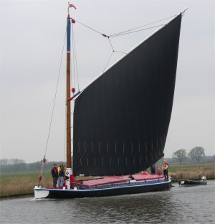

OOPS!

Slide 32
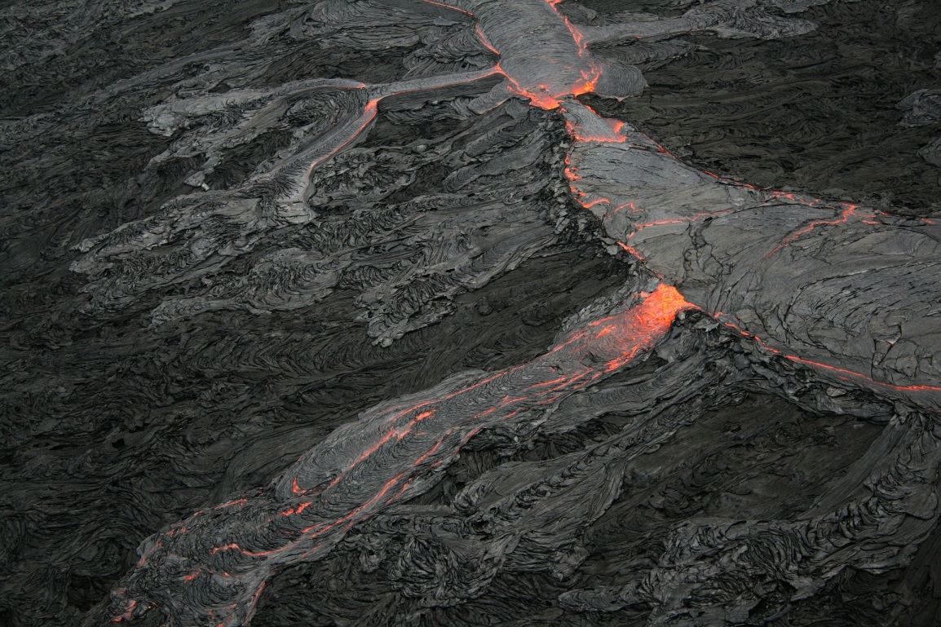
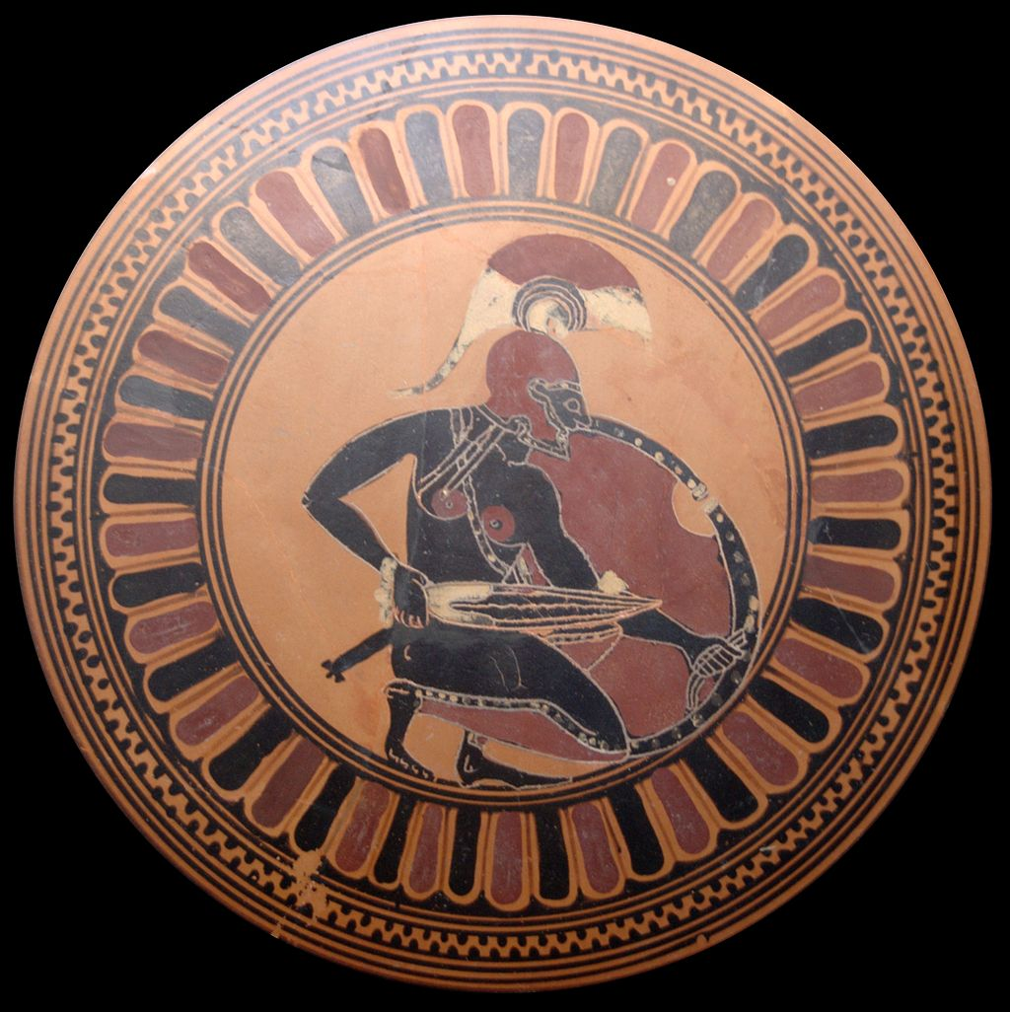
COLLAPSE THEORIES
Photo by Brocken Inaglory
Volcanic Eruption?
Invasion?

Slide 33
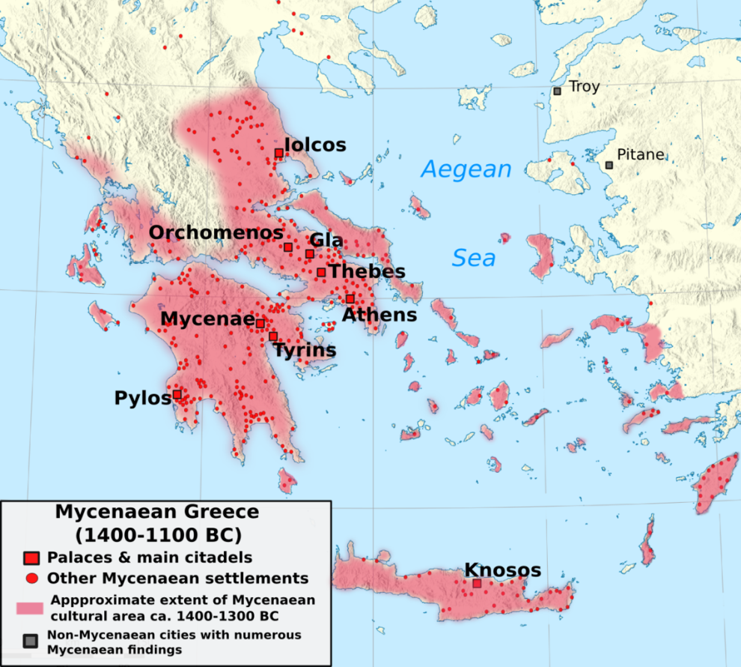
Mycenaean Greece
Bronze Age civilization based in
mainland Greece
c. 1600-1100 B.C.
Retrieved from Wikipedia

Slide 34

Retrieved from Wikipedia

Slide 35
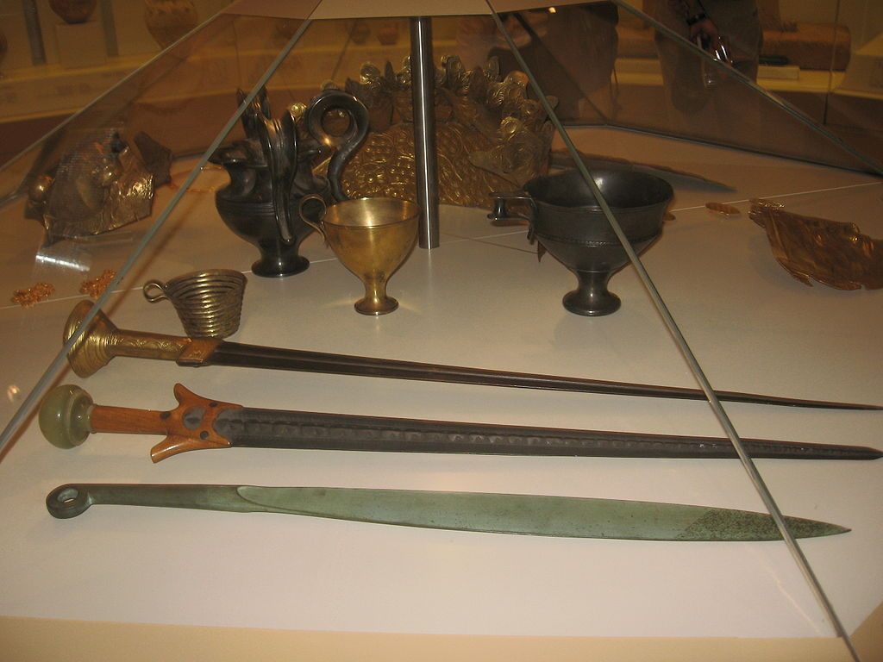
Bronze Age
Technology
Swords and cups found at Mycenae
Photo Credit: Mierlo (Wikipedia)

Slide 36
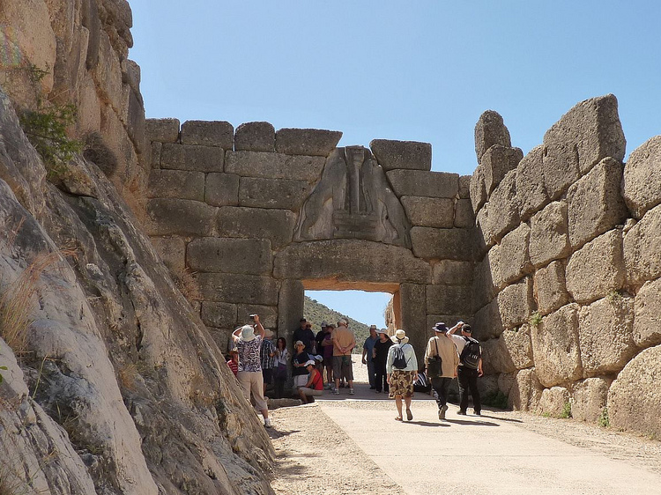
Ruins of Mycenae
How do these ruins compare to the ruins of Knossos?
Some rights reserved by Ronny Siegel

Slide 37
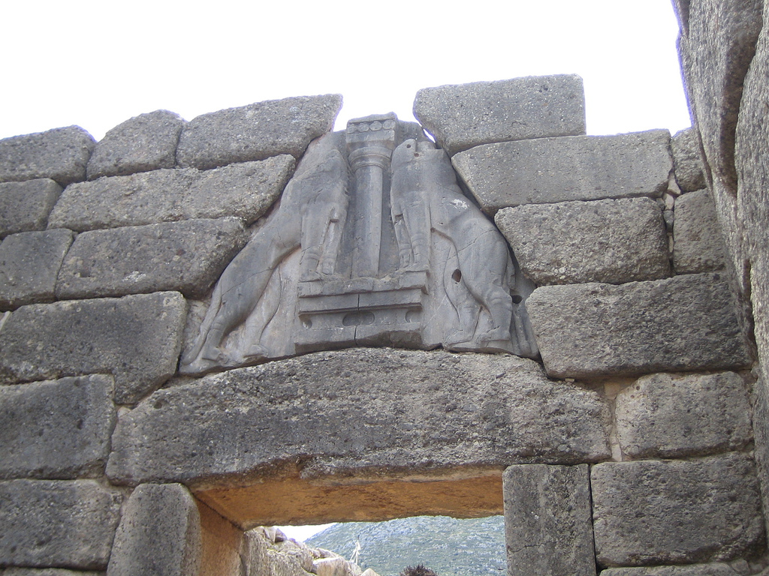
The Lion Gate
Some rights reserved by feather_true

Slide 38
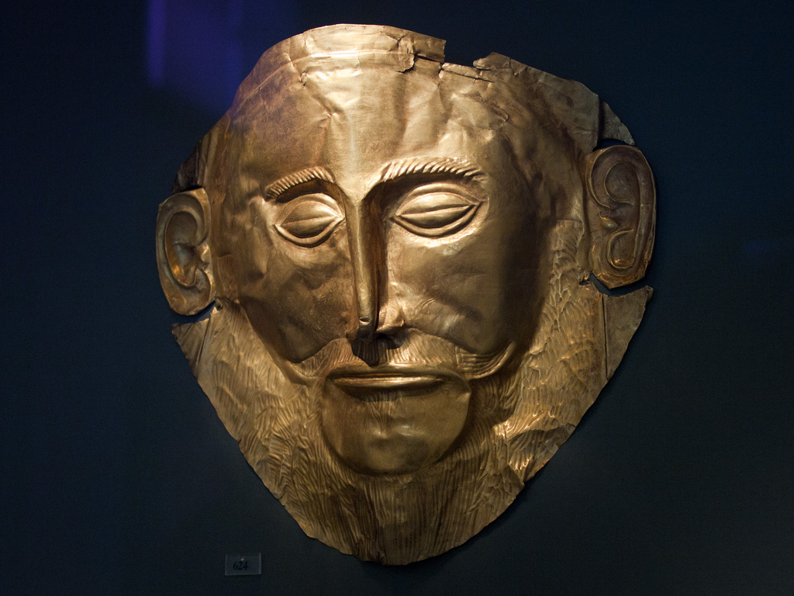
Mask of Agamemnon
Mycenaean Artifact
Some rights reserved by tylerkaraszewski

Slide 39
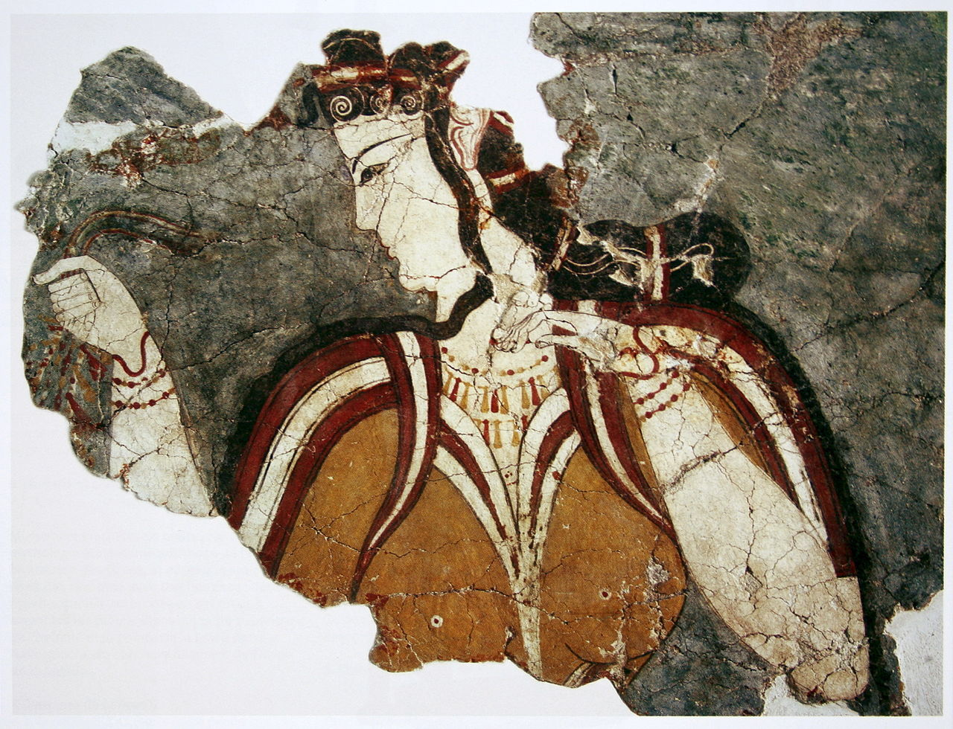
Female Figure
13th century B.C.

Slide 40
Compare to Minoan Art
Photo by cavorite

Slide 41
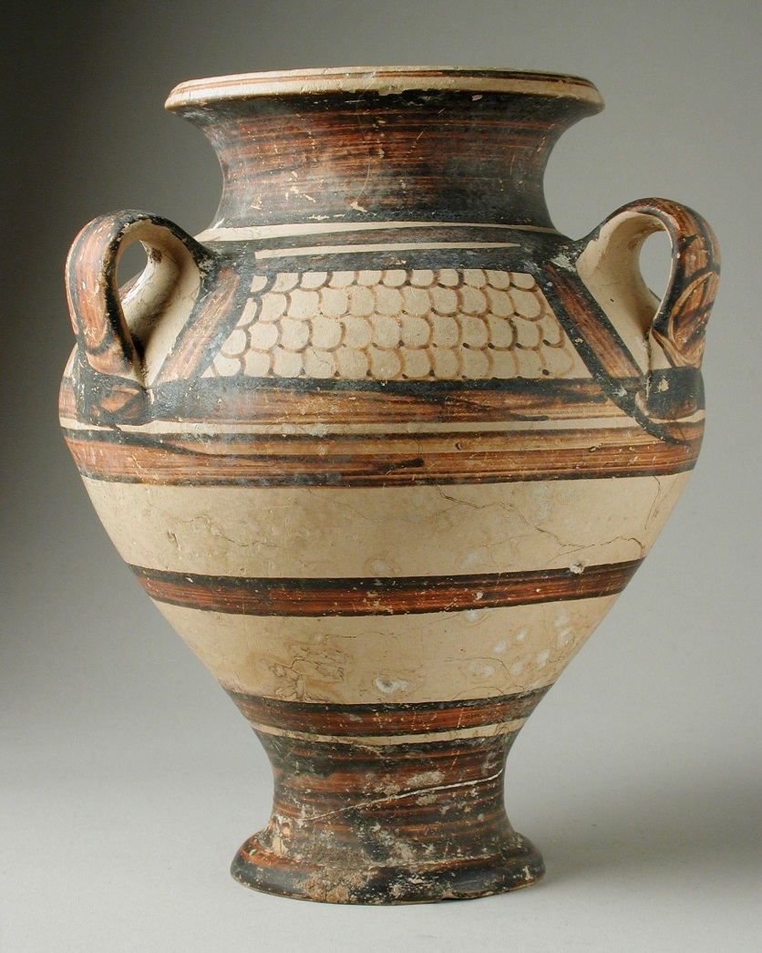
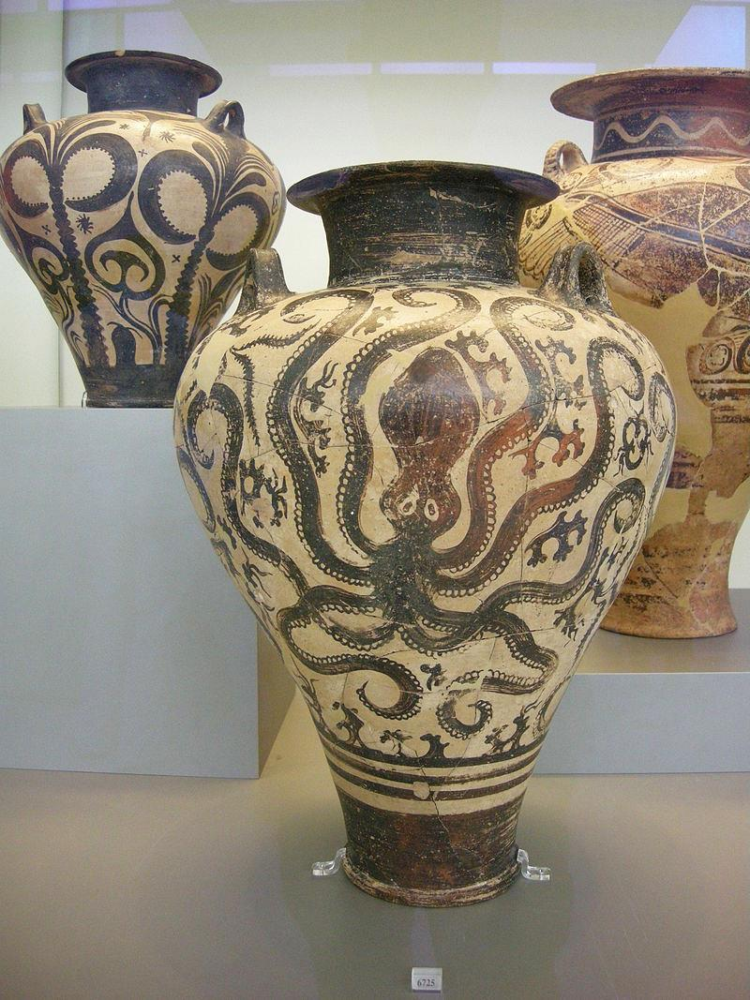
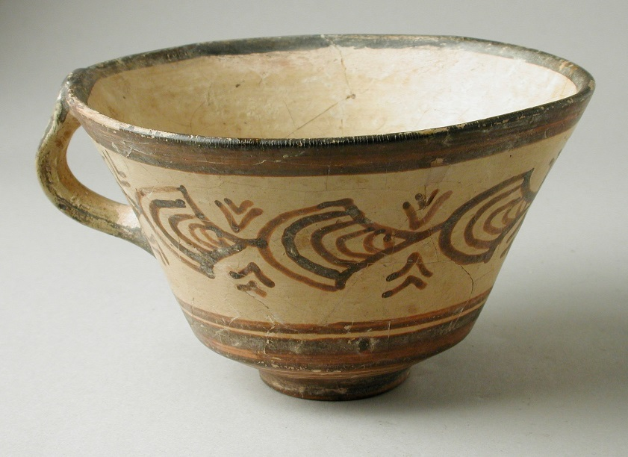
Photos by Ashley Van Haeften (L) & sailko (R)

Slide 42

Who Was More
Minoans
Mycenaeans
Advanced?

Slide 43
Who Was
Minoans
Mycenaeans
STRONGER?

Slide 44
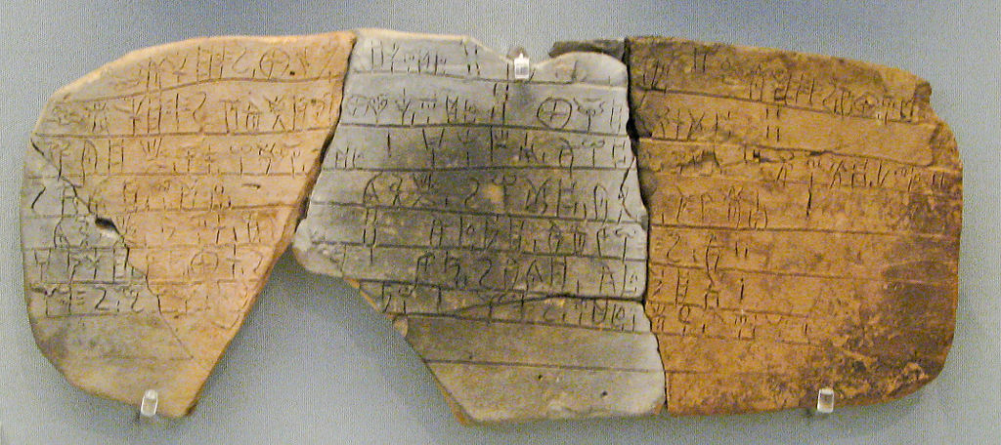
Evidence of Contact
Similar Alphabets
    Linear B (Mycenaean Writing)
Photo: Sharon Mollerus

Slide 45
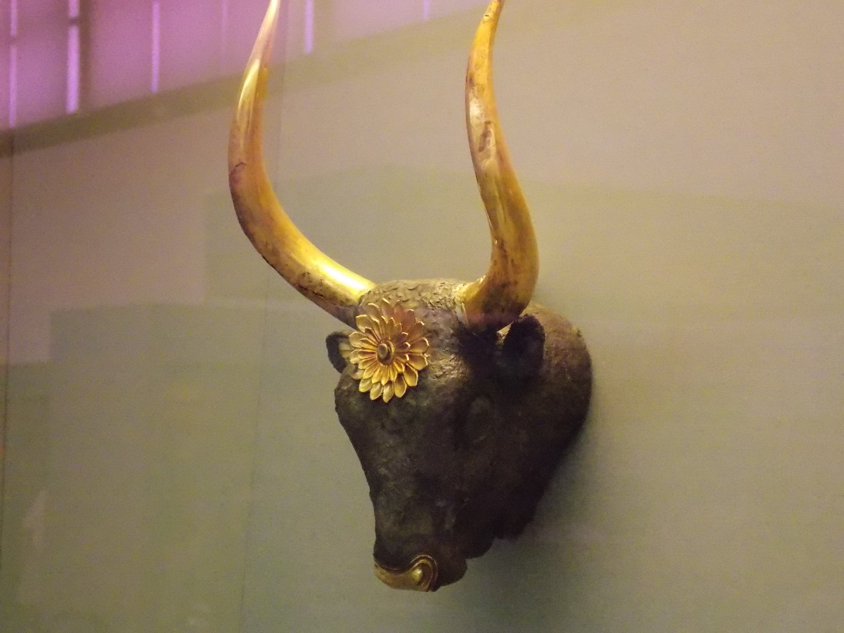
Mycenaean Bull Sculpture
Photo by Dimitris Kamaras

Slide 46
Contrasting Civilizations
Minoans
Crete
Peaceful
No Sign of Military
No Fortifications
Mycenaeans
Mainland Greece
Warlike
Armor & Weapons
Large City Walls
If these two civilizations went to war, who would win?

Slide 47
A Lesson
It’s no good to build a great civilization
if you can’t defend it…
Some rights reserved by tjuel

Slide 48

Greek Dark Ages
c. 1100-800 B.C.
  Mycenaean Civilization collapsed
  No evidence of writing during this time

Slide 49

Traditions
  ORAL
(Imagine a 300 year long game of telephone.)

Slide 50
Timeline of Greek Civilizations
Minoan Greece | c. 2700-1500 B.C.
Mycenaean Greece | c. 1600-1100 B.C.
Greek Dark Ages | c. 1100-800 B.C.
Archaic Greece | c. 800-500 B.C.
Classical Greece | c. 500-300 B.C.

Slide 51


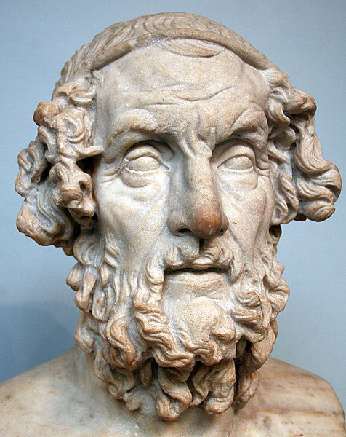
HOMER
Homer’s epic poems were written after the Dark Ages from surviving oral traditions.

Slide 52








