Slide 1
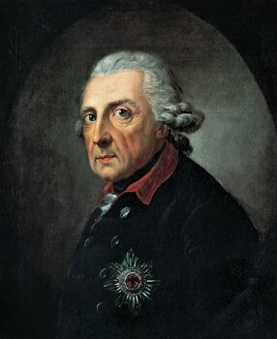

Enlightened Absolutism

Slide 2
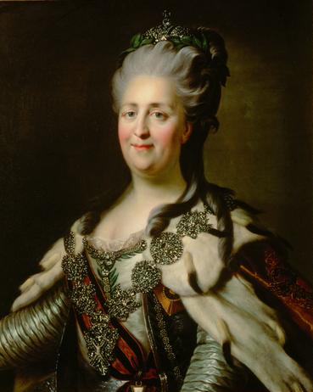
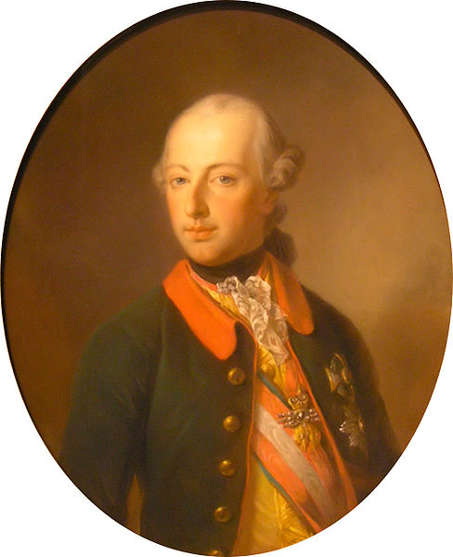
Enlightened Absolutism
Absolutists in the 18th century attempted to apply the principles of the Enlightenment in their kingdoms.

Slide 3
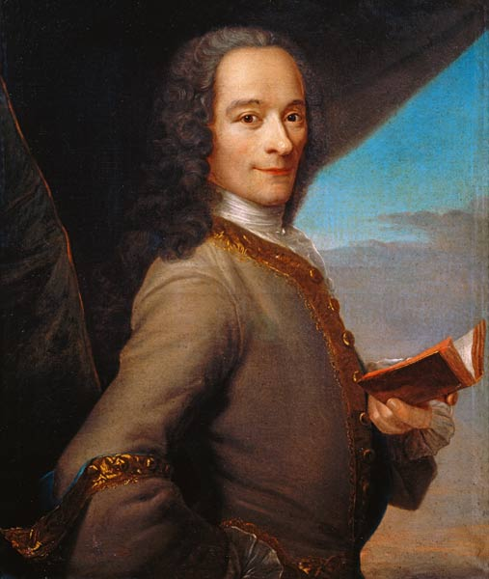
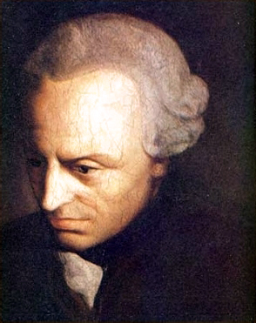
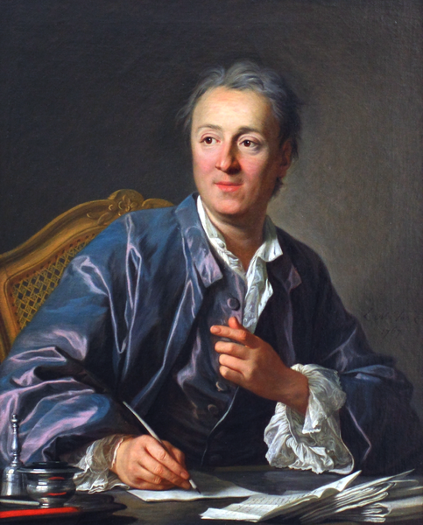
Enlightened Absolutism
Many philosophes supported strong monarchy as the best tool to implement the goals and ideals of the Enlightenment.

Slide 4

A “TOP DOWN” APPROACH

Slide 5
“Let us admit the truth: the arts and philosophy extend to only the few; the vast mass, the common people and the bulk of the nobility, remain what nature has made them, that is to say savage beasts.”
-- Frederick the Great to Voltaire

Slide 6
IT’S A
TRAP!

Slide 7
TOLERATION of religious minorities
REFORM of institutions
ABSOLUTISM (DUH!)
PATRONAGE of the philosophes
T
R
A
P

Slide 8
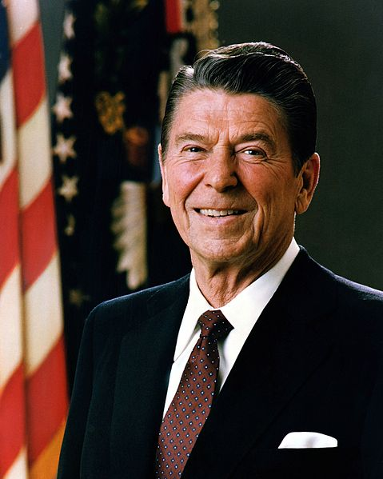
"The nine most terrifying words in the English language are: I'm from the government and I'm here to help.”
-- Ronald Reagan

Slide 9
The Enlightened Absolutists
Catherine II
(Russia)
Frederick II
(Prussia)
Joseph II
(Austria)

Slide 10
Frederick
“the Great”
Prussia

Slide 11

First SERVANT of the State

Slide 12
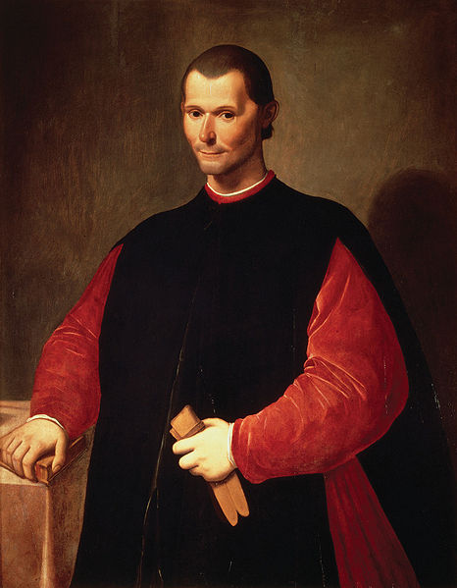
Anti-Machiavel
(1740)
Frederick argued against Machiavelli that a ruler should be chiefly concerned with the well-being of his subjects.

Slide 13
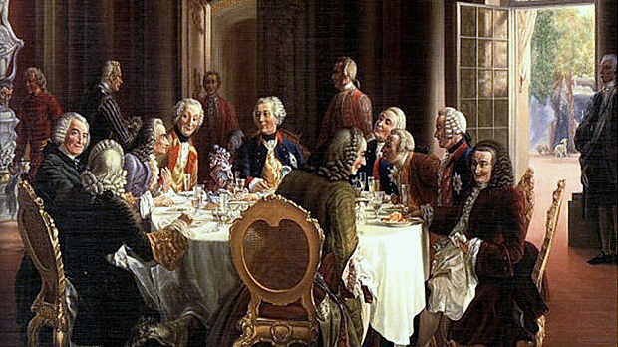
PATRONAGE
Frederick corresponded with Voltaire, who was a regular guest at his court before their relationship soured.

Slide 14
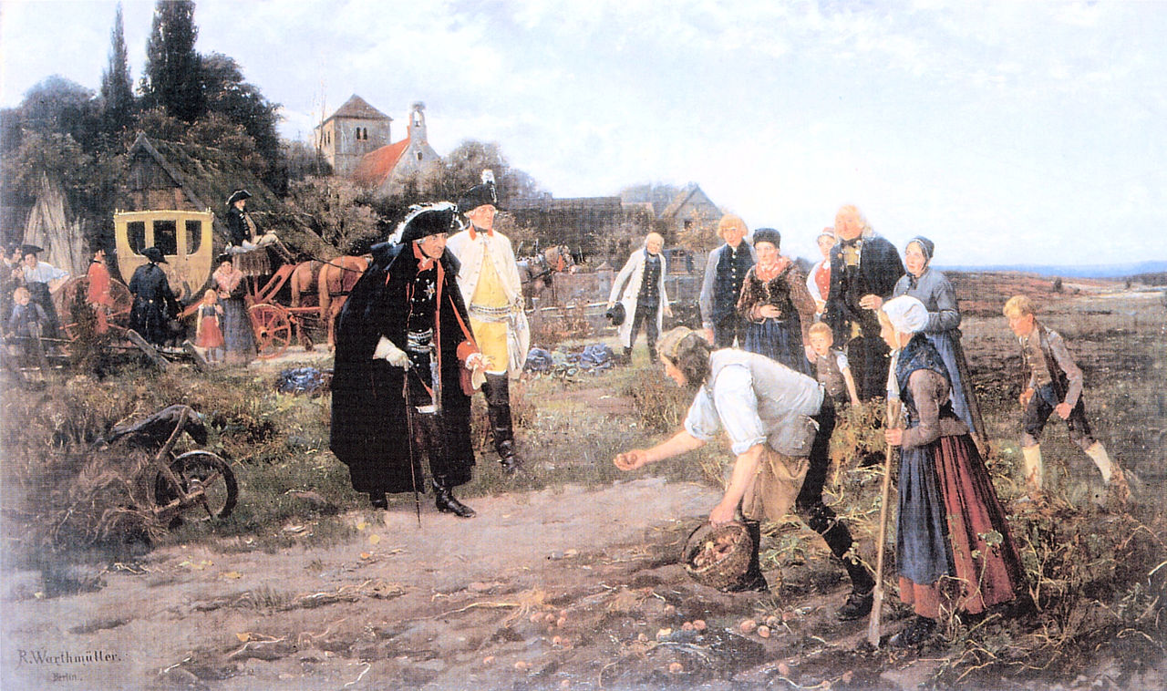
Frederick inspects a potato harvest.

Slide 15
Potatoes were introduced as a new crop in Prussia during Frederick’s reign.

Slide 16
I like science... and progress... and food.

Slide 17
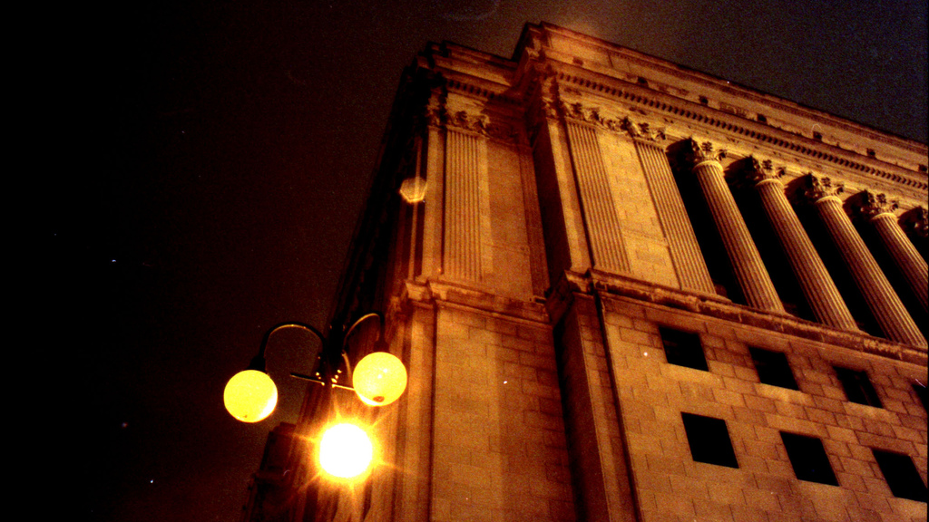
Civil
Service
Reform
Frederick reformed the Prussian bureaucracy, allowing for men
of non-noble birth to fill senior government posts.
Some rights reserved by la vaca vegetariana

Slide 18
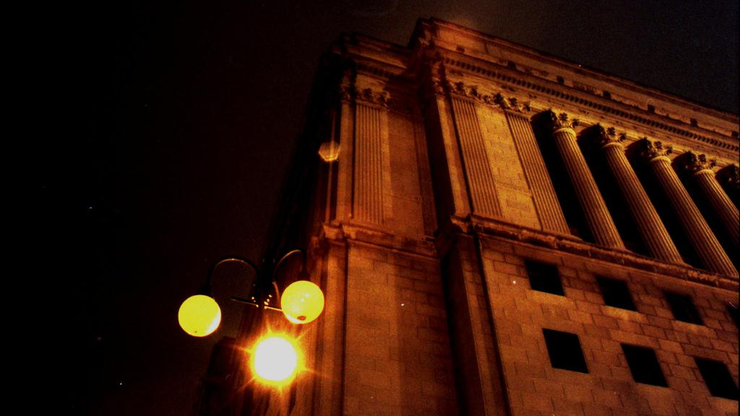
MERITOCRACY
Some rights reserved by la vaca vegetariana

Slide 19
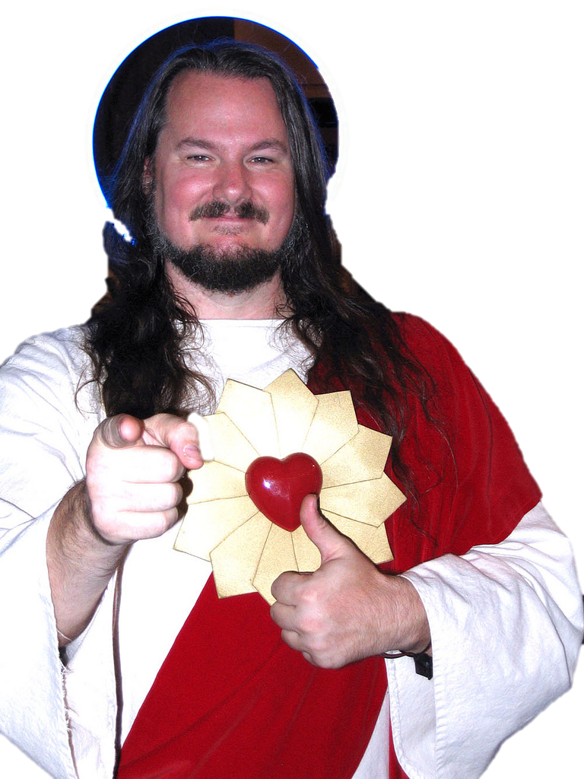
Religious Toleration
Frederick expanded religious toleration in Prussia, but still favored Protestants for key government posts.
Some rights reserved by disavian

Slide 20
The officer says: "Do not argue--drill!"
The tax collector: "Do not argue--pay!"
The pastor: "Do not argue--believe!"
Only one ruler in the world says: "Argue as much as you please, but obey!“
-- Kant, “What Is Enlightenment?”

Slide 21
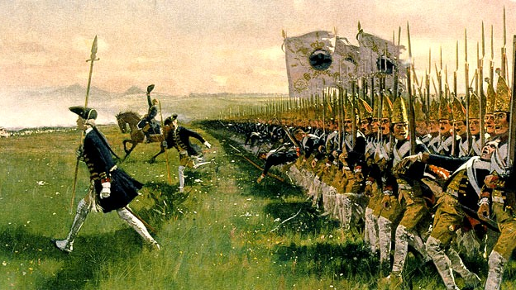
MILITARISM
Frederick continued to support a highly militarized state, contrary to the principles of the Enlightenment.

Slide 22
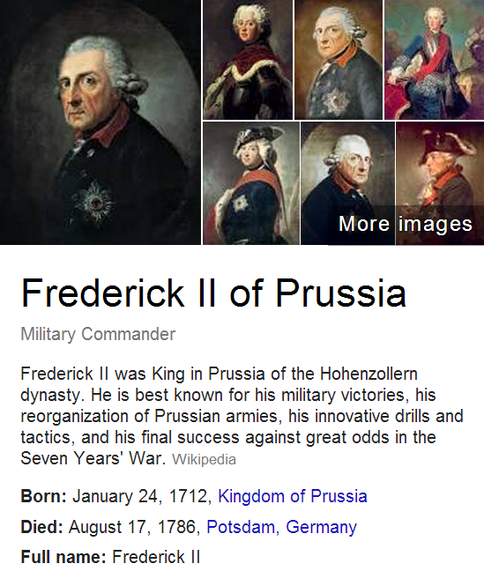

Slide 23
Catherine
“the Great”
Russia

Slide 24
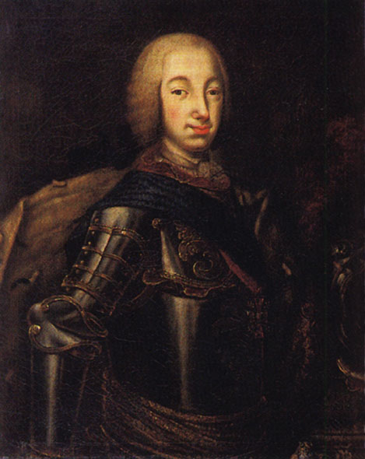
Assassination?
Catherine’s husband, Peter III, died less than a year after taking the throne – likely by assassination.

Slide 25
And I helped!

Slide 26

PATRONAGE
Catherine purchased Diderot’s library...
Then paid him a salary to be her “librarian.”
Some rights reserved by geishaboy500

Slide 27
Queens
Dig Me!
Catherine corresponded with Voltaire, who appreciated her flattery.

Slide 28
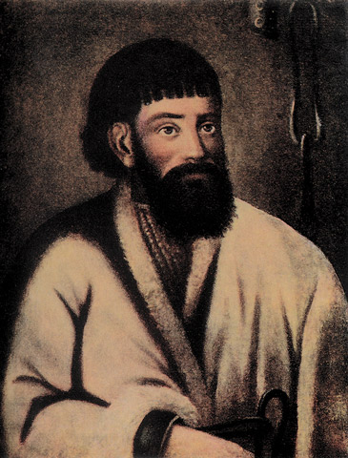
Pugachev’s Rebellion
1773-1775
Uprising of peasants & Cossacks on the Russian frontier

Slide 29
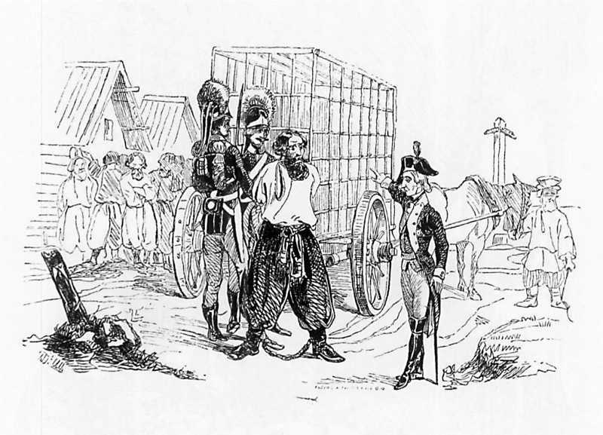
CRUSHED

Slide 30
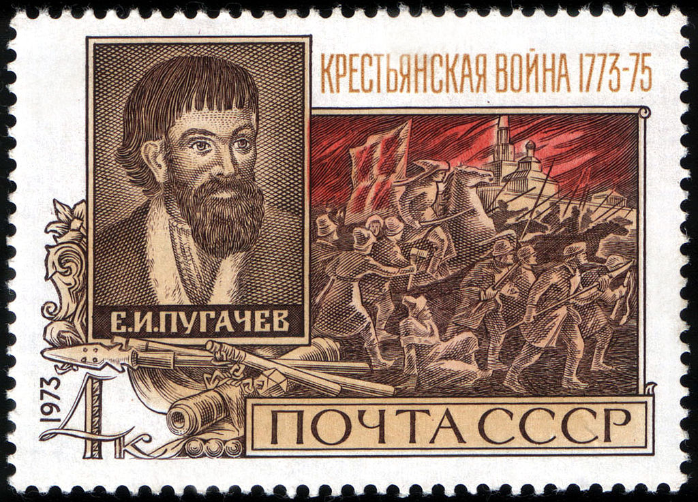

Slide 31
Why would Pugachev have been celebrated as a hero during the Soviet era?

Slide 32
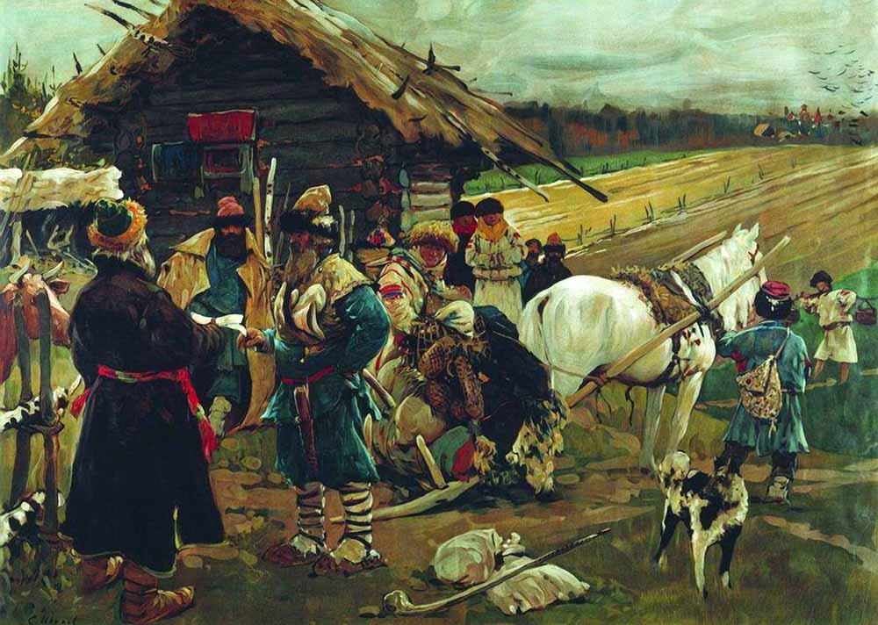
REFORM

Slide 33
Catherine was too dependent on the support of the nobility to make serious modernizing reforms (e.g., serfdom).

Slide 34
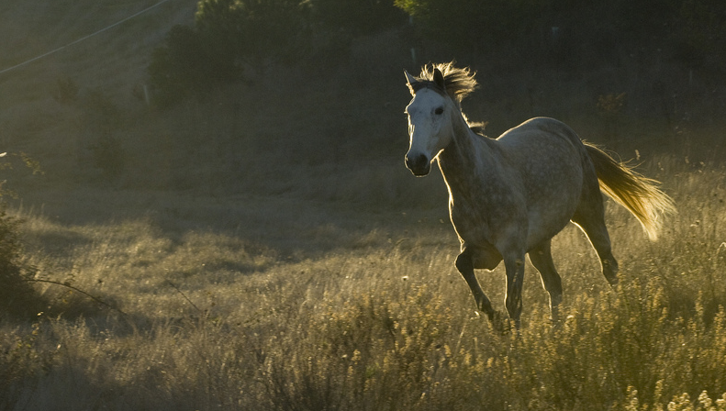
It’s not true.
Some rights reserved by Simon du Vinage

Slide 35

Joseph II
Austria

Slide 36
MOST Radical
LEAST
Effective

Slide 37
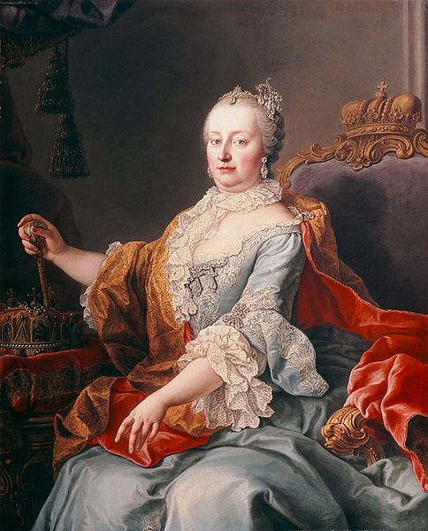
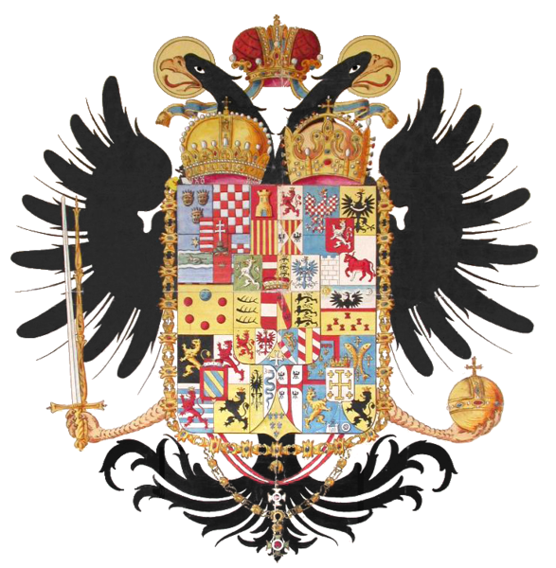
Co-Ruler with Maria Theresa
1765-1780

Slide 38
Religious Toleration
Joseph’s generous religious toleration policy included private worship for Jews.
Some rights reserved by disavian

Slide 39
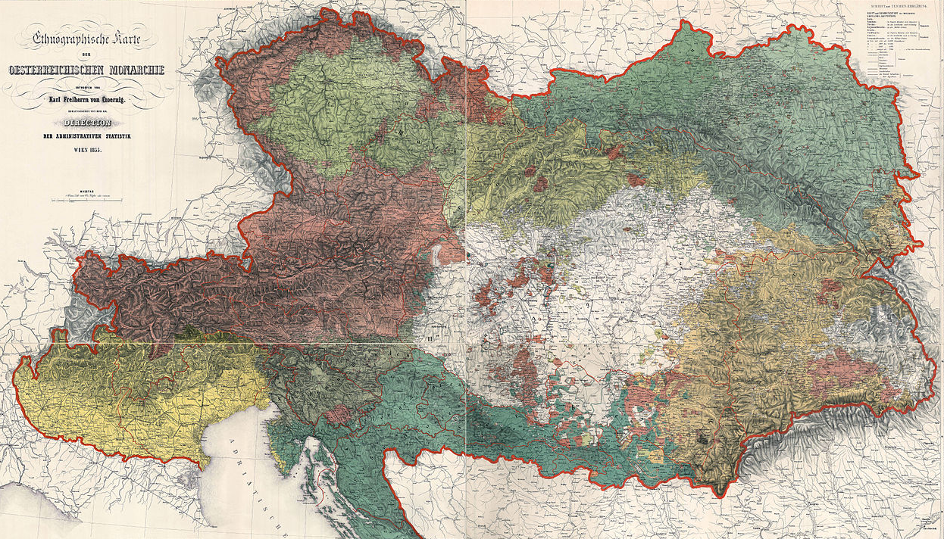
Map of the Austrian Empire
Multi-Ethnic Empire

Slide 40
Centralization
of Administration

Slide 41
REFORM

Slide 42
REFORM
Joseph abolished “serfdom” and granted more rights to peasants (although landlords retained some control).

Slide 43
MOST Radical
LEAST
Effective

Slide 44

Joseph’s successors undid many of his reforms.
Some rights reserved by Matt McGee

Slide 45
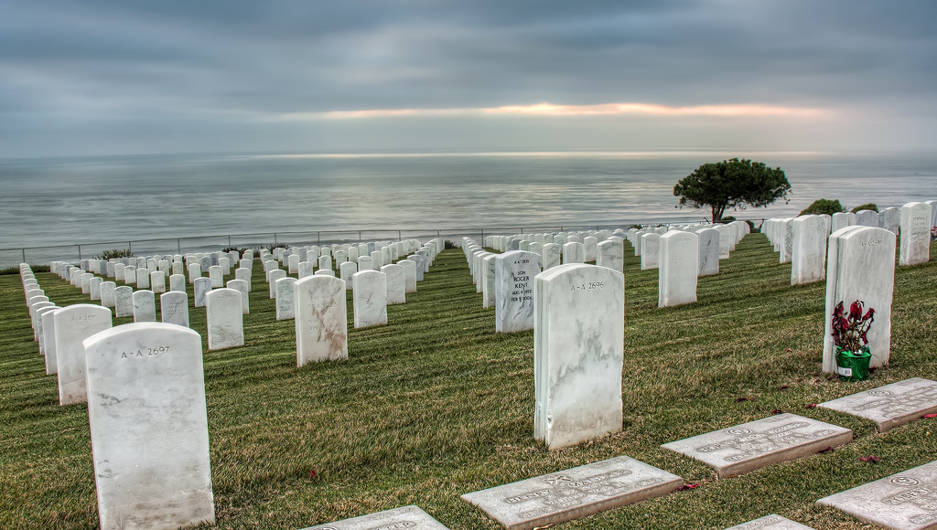
“Here lies Joseph II, who failed in all he undertook.”
-- Self-Suggested Epitaph
Some rights reserved by Chad McDonald

Slide 46
IT’S A
TRAP!

Slide 47
TOLERATION of religious minorities
REFORM of institutions
ABSOLUTISM (DUH!)
PATRONAGE of the philosophes
T
R
A
P

Slide 48
The Enlightened Absolutists
Catherine II
(Russia)
Frederick II
(Prussia)
Joseph II
(Austria)

Slide 49
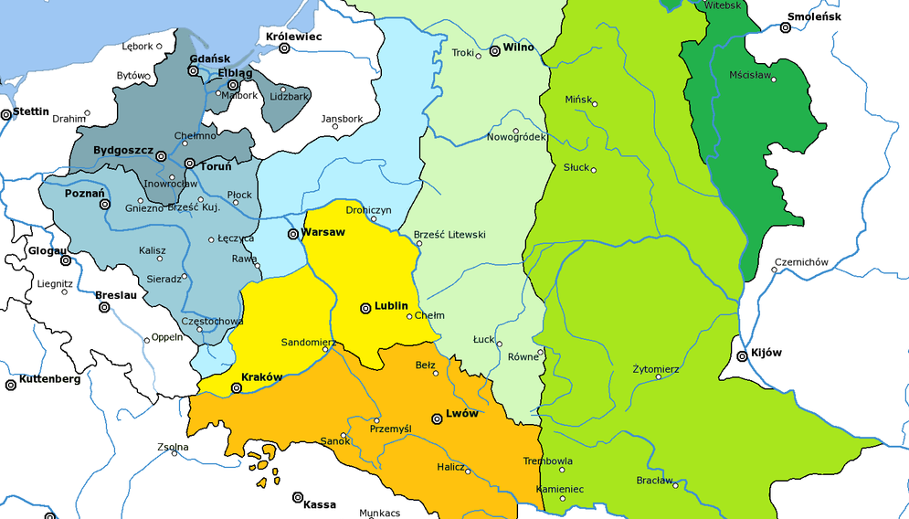
Partitions of Poland
Map Credit: Halibutt (Wikipedia)

Slide 50







