Slide 1
Deductive VS Inductive Reasoning

Slide 2
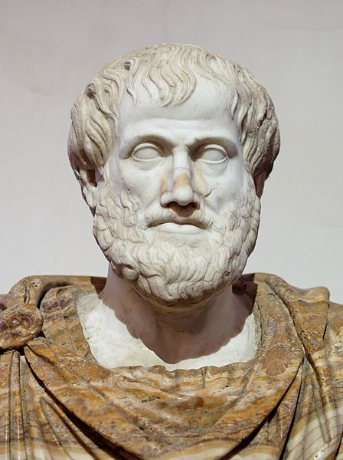
DEDUCTIVE REASONING
Aristotle (Ancient Greek Philosopher)
Start with a premise
Premises lead to a certain conclusion

Slide 3
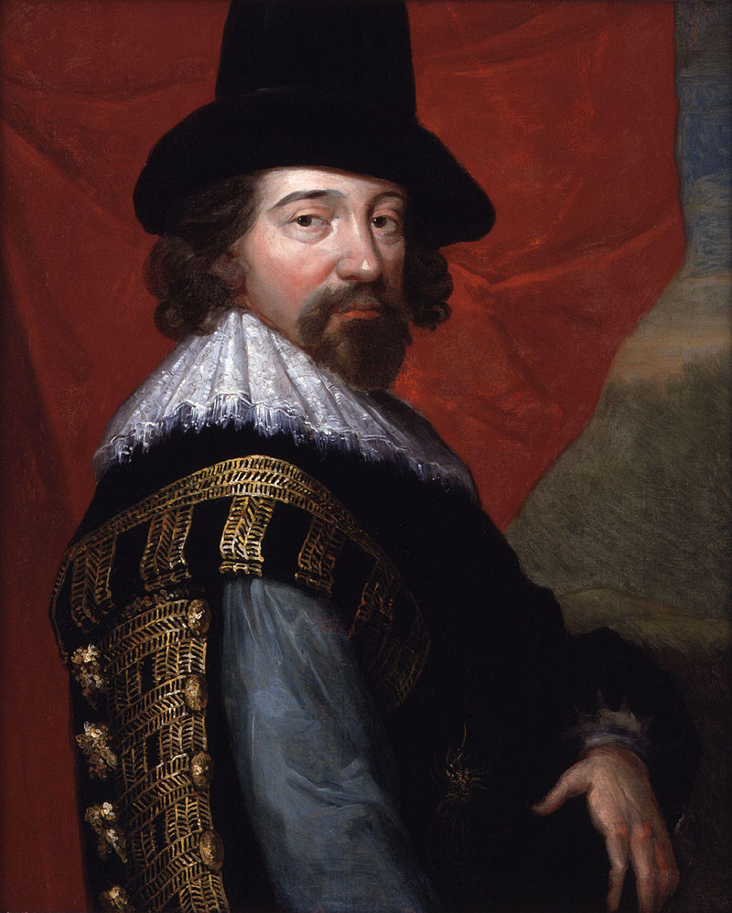
INDUCTIVE REASONING
Sir Francis Bacon (17th Century English Philosopher)
Make repeated observations
Generalize repeatedly observed phenomena

Slide 4
INDUCTIVE REASONING
Sir Francis Bacon (17th Century English Philosopher)
Novum Organum (1620)
(New Method)

Slide 5
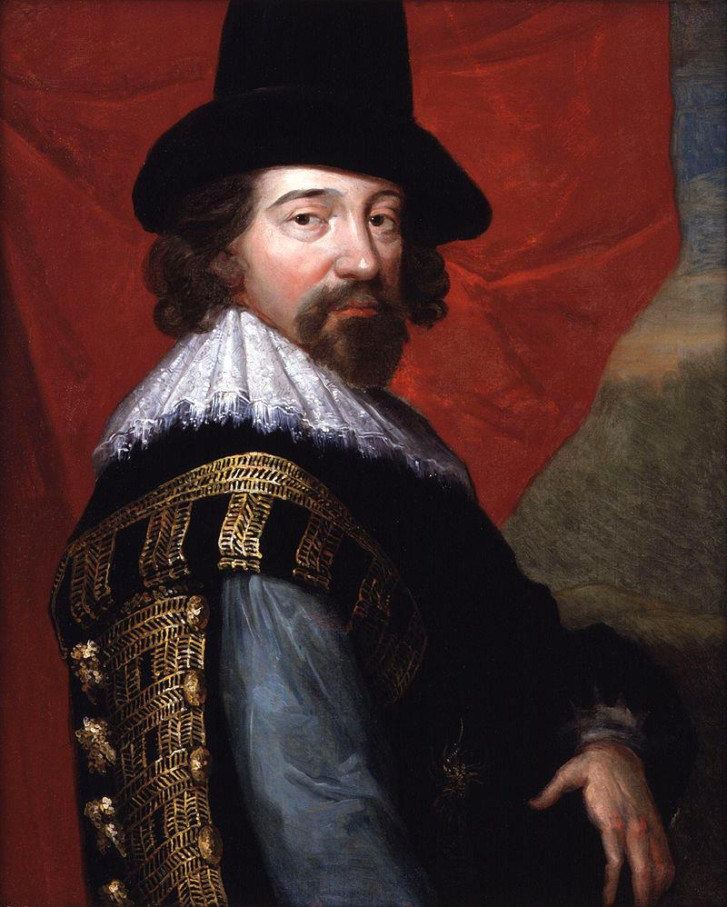
vs

Slide 6
A willingness to challenge ancient authorities

Slide 7
GENERALIZATION
INDUCTIVE
Bottom Up
DEDUCTIVE
Top Down
SPECIFIC INSTANCE

Slide 8
GENERALIZATION
Note that many experts will denounce this as an oversimplification but it helps get the general idea across.
INDUCTIVE
Bottom Up
DEDUCTIVE
Top Down
SPECIFIC INSTANCE

Slide 9
DEDUCTIVE
Conclusions are drawn from PREMISES.
Start With
PREMISES
Some rights reserved by Kurt Raschke

Slide 10
TOP DOWN LOGIC
Start With
PREMISES
Some rights reserved by Kurt Raschke

Slide 11
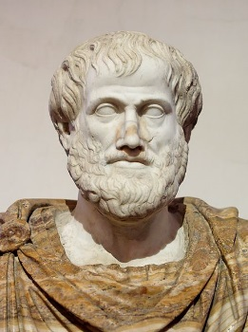
Deductive Reasoning
Premises Lead to a Certain Conclusion
All men are mortal.
Socrates is a man.
Therefore,
Socrates is mortal.
Premises
Conclusion

Slide 13
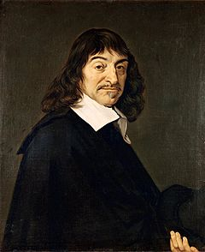
Deductive Reasoning
Premises Lead to a Certain Conclusion
What thinks must exist.
I am thinking.
Therefore,
I exist.
Premises
Conclusion

Slide 14
Deductive Reasoning
Premises Lead to a Certain Conclusion
Good students pass exams.
Blake is a good student.
Therefore,
Blake will pass his exam.
Premises
Conclusion

Slide 15
Deductive Reasoning
Premises Lead to a Certain Conclusion
All men are mortal.
Socrates is a man.
Therefore,
Socrates is mortal.
If the conclusion is FALSE

Slide 16
Deductive Reasoning
Premises Lead to a Certain Conclusion
Then check your PREMISES
All men are mortal.
Socrates is a man.
Therefore,
Socrates is mortal.
If the conclusion is FALSE

Slide 17
INDUCTIVE
Conclusions are drawn from several observations.
Start With OBSERVATIONS
Some rights reserved by Kurt Raschke

Slide 18
EMPIRICISM
Start With OBSERVATIONS
Some rights reserved by Kurt Raschke

Slide 19
CONNECT THE DOTS
The more data, the greater the probability of the conclusion being true.

Slide 20
CONNECT THE DOTS
The more data, the greater the probability of the conclusion being true.

Slide 21
CONNECT THE DOTS
The more data, the greater the probability of the conclusion being true.

Slide 22
CONNECT THE DOTS
The more data, the greater the probability of the conclusion being true.

Slide 23
CONNECT THE DOTS
The more data, the greater the probability of the conclusion being true.

Slide 24
CONNECT THE DOTS
The more data, the greater the probability of the conclusion being true.

Slide 25
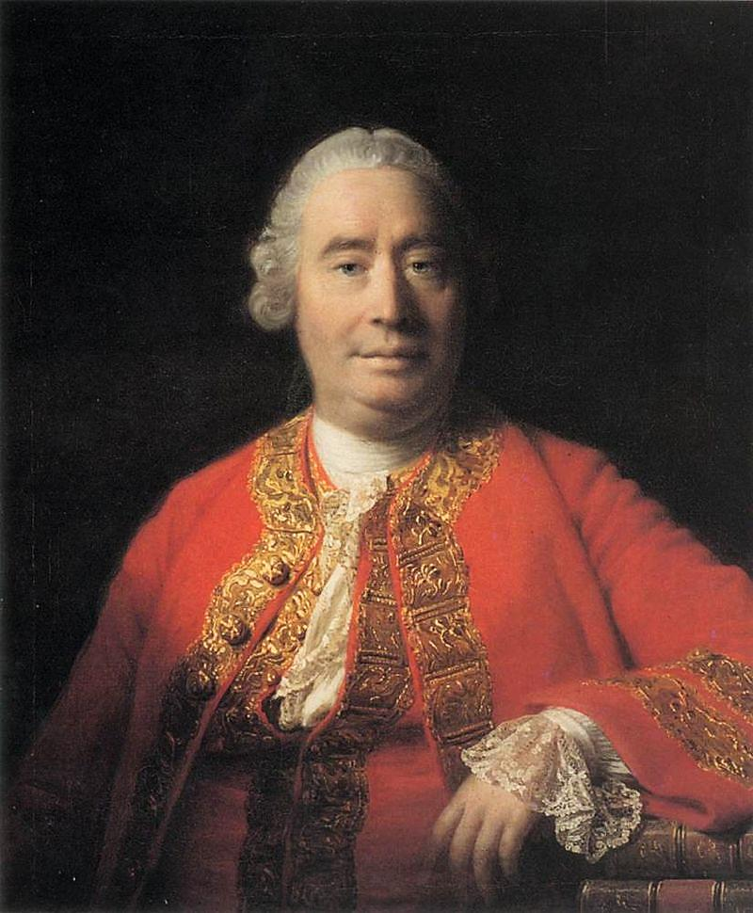
The Problem of Induction
David Hume
“Skeptical Scotsman”

Slide 26
The sun always rises in the East…
Photo by Thangaraj Kumaravel

Slide 27
All swans are white.
Photo by Dani Vázquez

Slide 28
All of the swans I’ve seen are white.
Photo by Dani Vázquez

Slide 29
DIFFERING GOALS
Deductive Reasoning | Inductive Reasoning
Certainty | Probability

Slide 30
THE SCIENTIFIC METHOD
An ongoing process of induction and deduction.
Graphic Credit: ArchonMagnus

