Slide 1
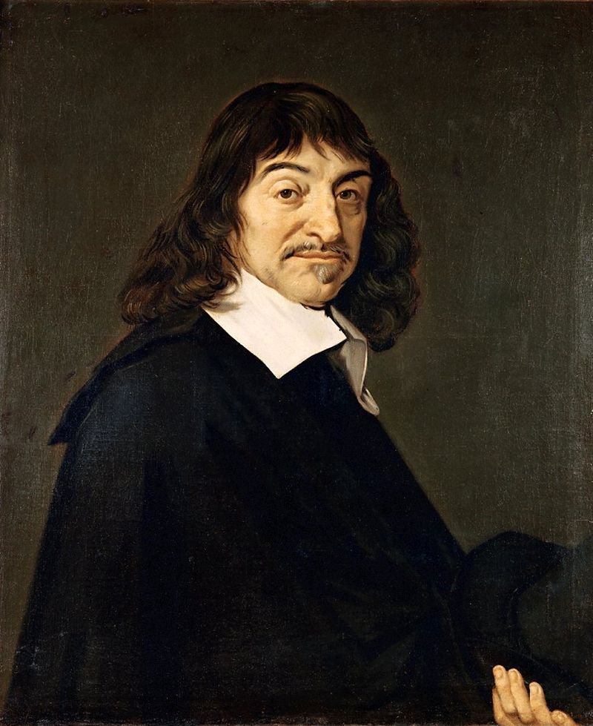
COGITO ERGO SUM

Slide 2
René Descartes
Principles of Philosophy
(1644)

Slide 3
#1
THAT in order to seek truth, it is necessary once in the course of our life, to doubt, as far as possible, of all things.

Slide 4
#2
That we ought also to consider as false all that is doubtful.

Slide 5
#3
That we ought not meanwhile to make use of doubt in the conduct of life.

Slide 6
#4
We may doubt of sensible things.

Slide 7
Rationalism

Slide 8
Arrive at truth through reason rather than through the senses (empiricism).
Rationalism

Slide 9
Dualism

Slide 10
Two Types of Substance:
Mind & Body
Dualism

Slide 11
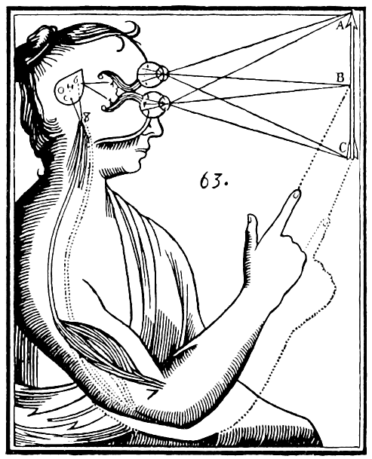
SAY WHAT?

Slide 12
Materialism | Dualism
Empiricism | Rationalism
Senses Only | Mind & Senses

Slide 13
Materialism | Dualism
Empiricism | Rationalism
Senses Only | Mind & Senses

Slide 14
#5
We may also doubt of mathematical demonstrations.

Slide 15
#6
That we possess a free-will, by which we can withhold our assent from what is doubtful, and thus avoid error.

Slide 16
#7
That we cannot doubt of our existence while we doubt, and that this is the first knowledge we acquire when we philosophize in order.

Slide 17
For there is a repugnance in conceiving that what thinks does not exist at the very time when it thinks.

Slide 18
Accordingly, the knowledge, I THINK, THEREFORE I AM, is the first and most certain that occurs to one who philosophizes orderly.

Slide 19
COGITO ERGO SUM

