Slide 1
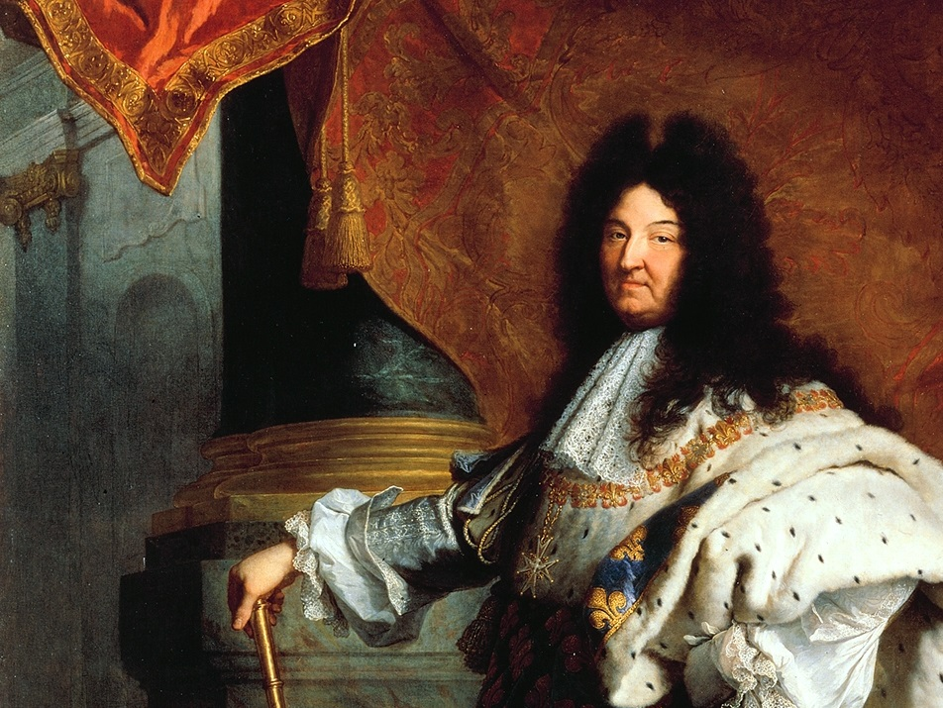
Louis XIV

Slide 2
Weak Kings
A French Tradition
Fleur de Lis
(Lily Flower)
French Monarchy Symbol
Image by Sodacan

Slide 3
Fit for a King???
Photo by lisaclarke

Slide 4
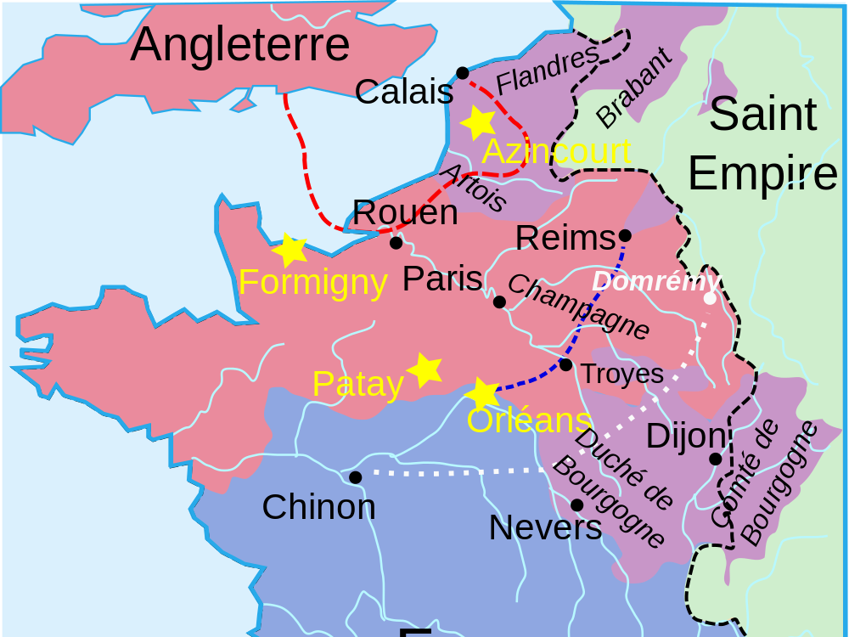
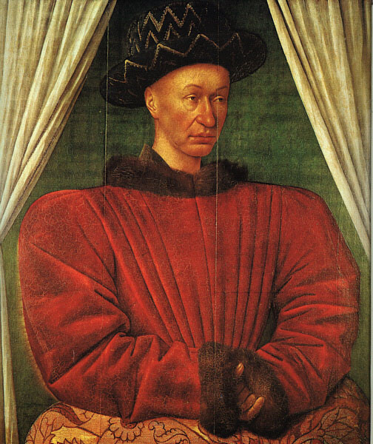
Charles VII
When this French flower king’s domain was overrun by the English in the fifteenth century...
Map Credit: Aliesin

Slide 5
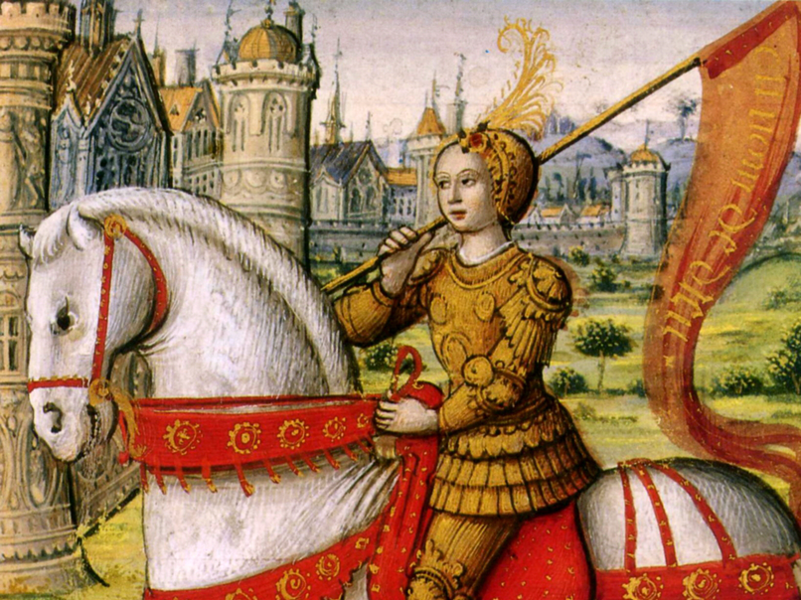
Teenage Girl
To the rescue!!!

Slide 6
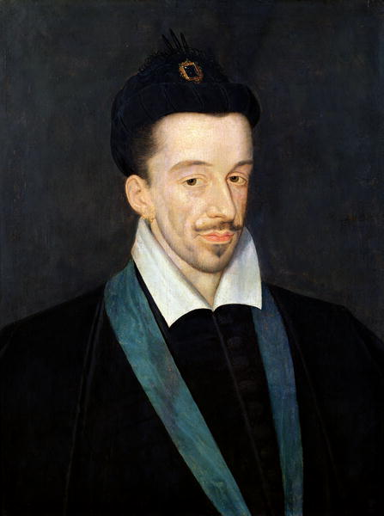
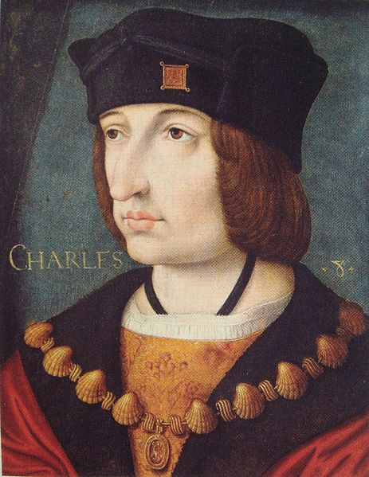
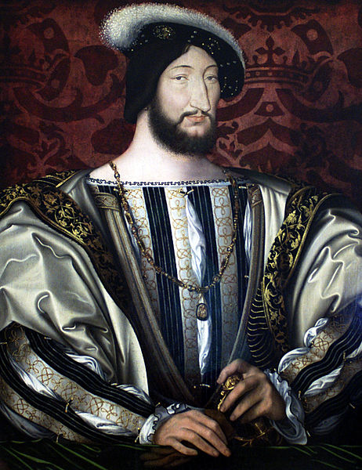
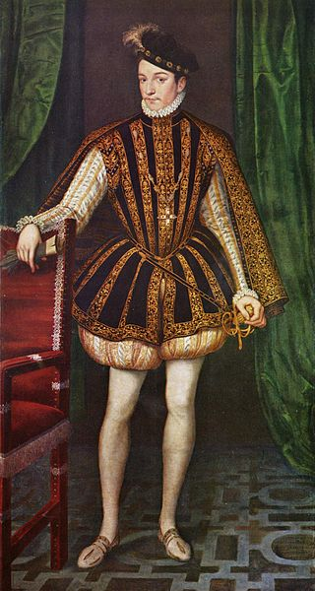
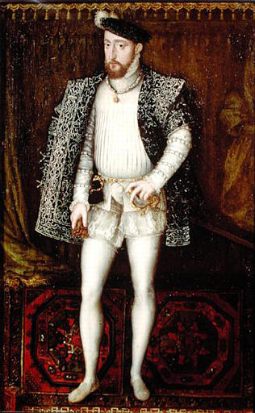
Forgettable Kings
France had no shortage of them!

Slide 7
Dude...
Put on some pants!

Slide 8
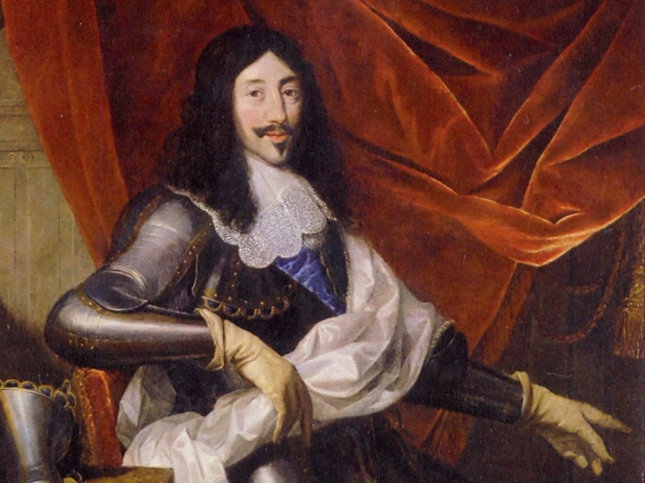
Louis XIII Another Forgettable King

Slide 9
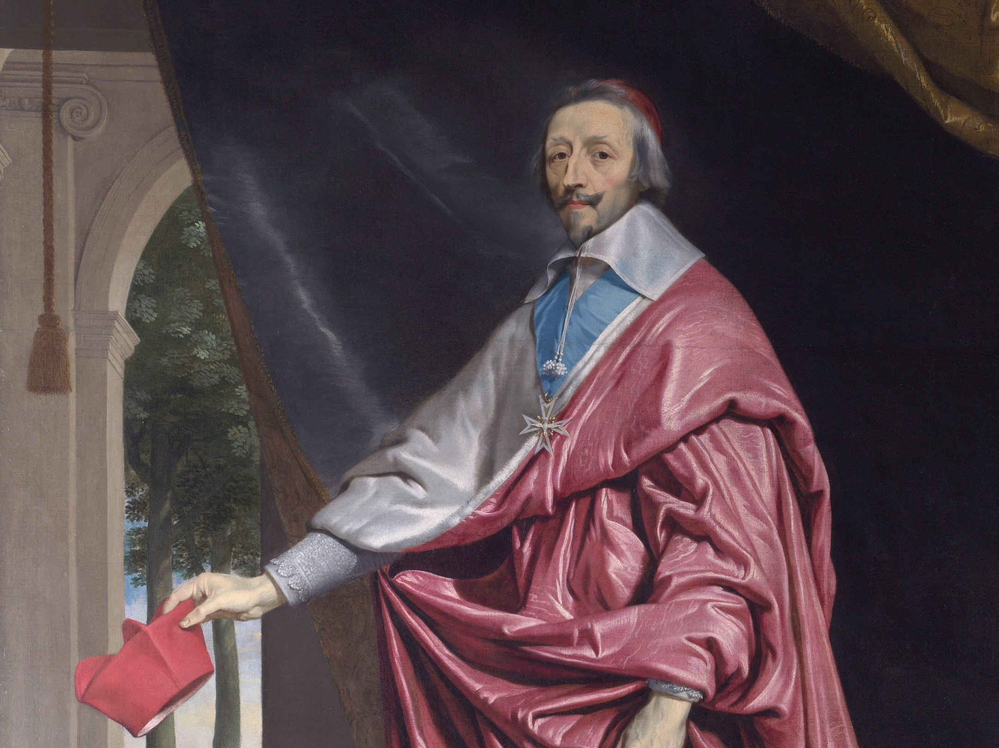
Cardinal Richelieu
Louis XIII’s Chief Minister

Slide 10
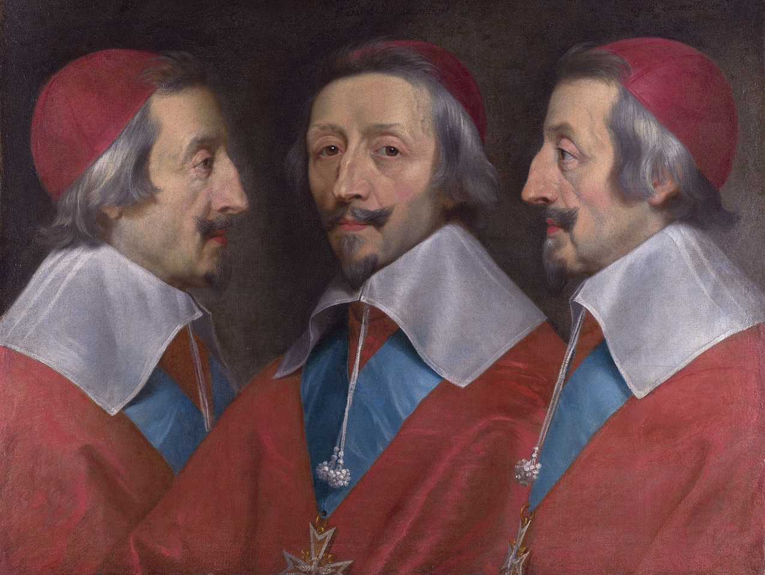
MUCH MORE MEMORABLE

Slide 11
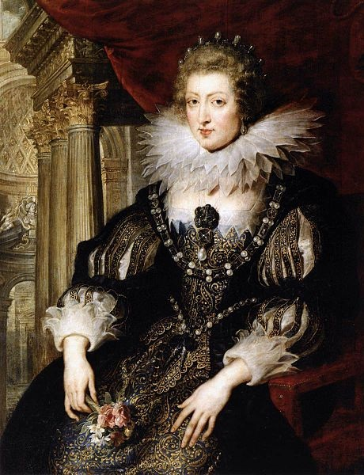
Childless
Louis XIII’s queen, Anne of Austria, gave birth to FOUR stillborn children.

Slide 12
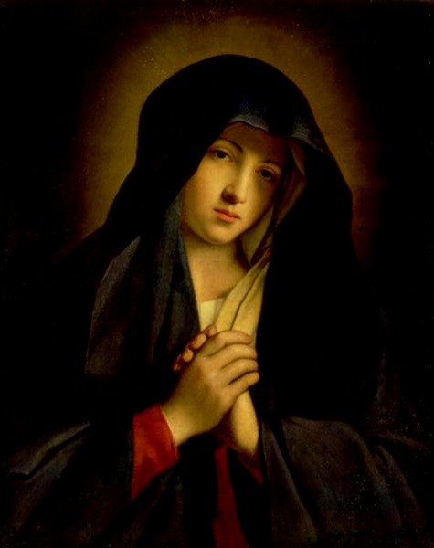
WANTED: MIRACLE
Louis XIII dedicated France to the Virgin Mary in 1638.

Slide 13
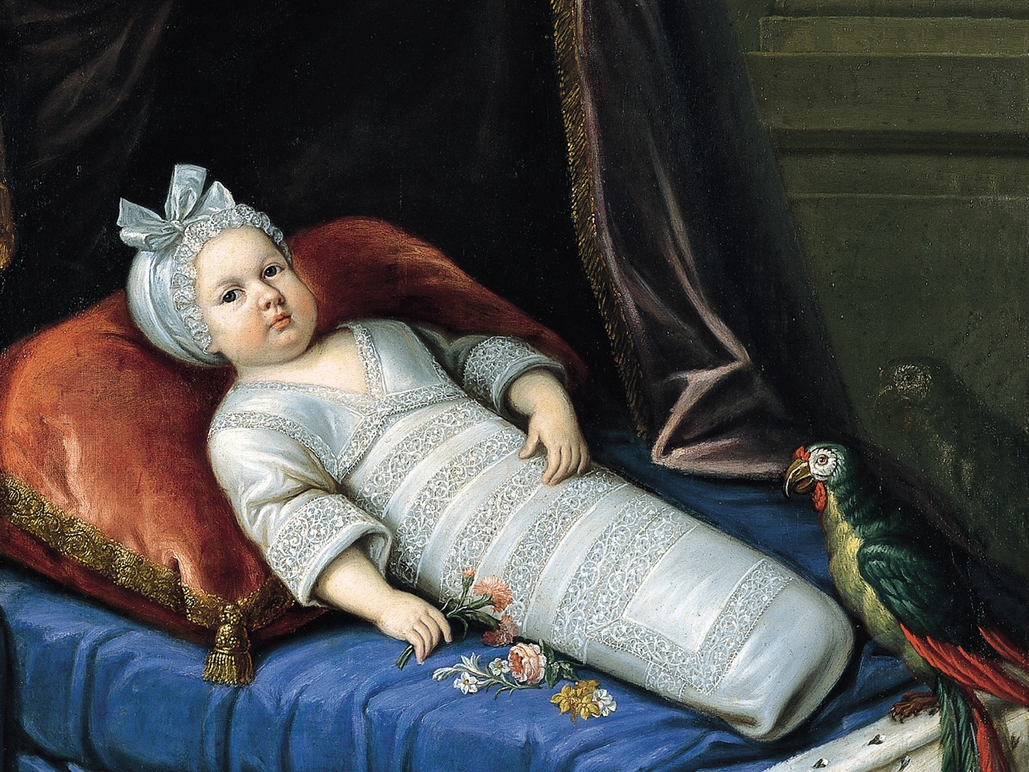
Louis-Dieudonné
the God-given
This miracle baby would bring the French monarchy to unprecedented glory.

Slide 14
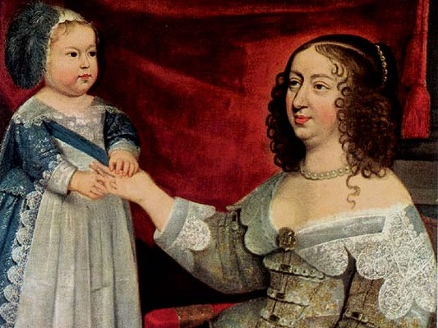
Mama’s Boy
Anne of Austria doted over her son much more than was normal for aristocratic women of the time.

Slide 15
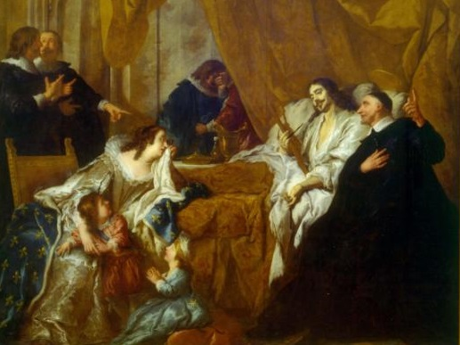
R.I.P.

Slide 16
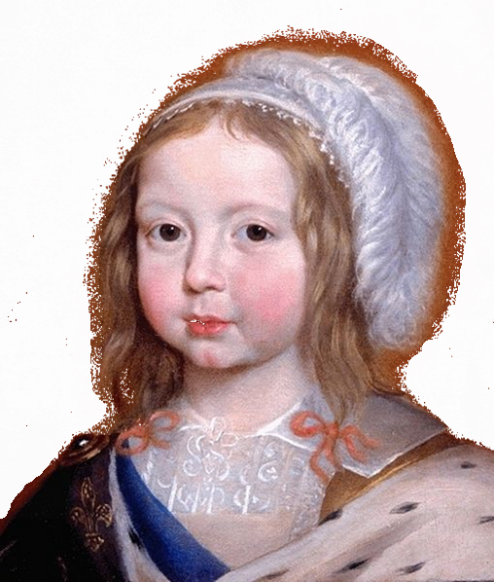
A Boy King
Louis’ father died when he was four.

Slide 17
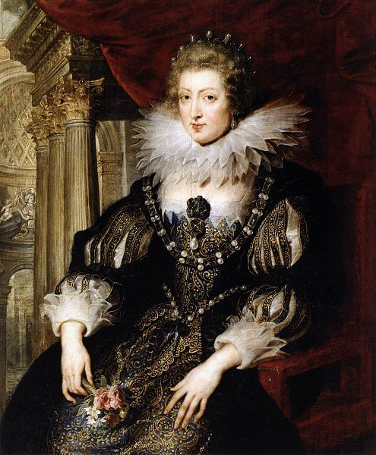
Anne of Austria
Louis’ Mother
Queen Regent

Slide 18
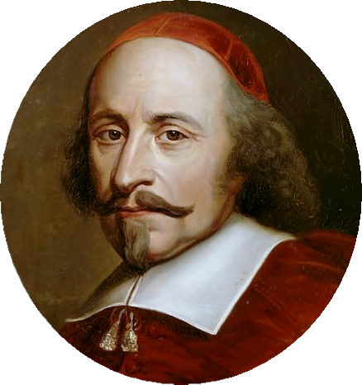
Cardinal Mazarin
Chief Minister of France
1642-1661

Slide 19
The Fronde
French for “sling”
French nobles and Parisian townspeople rebelled against Cardinal Mazarin.
Photo by whiteafrican

Slide 20
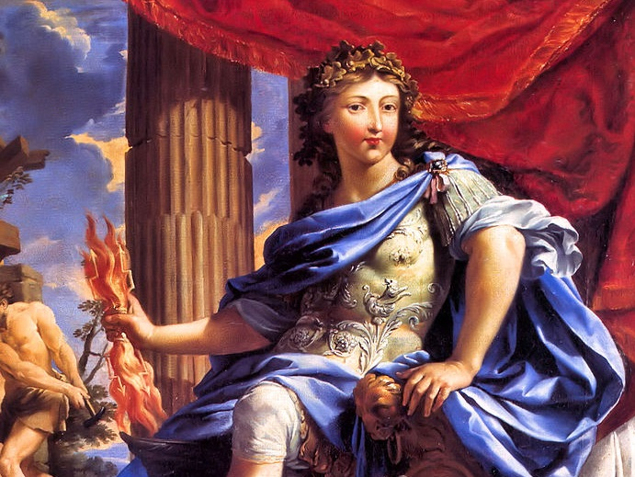
Louis WINS

Slide 21
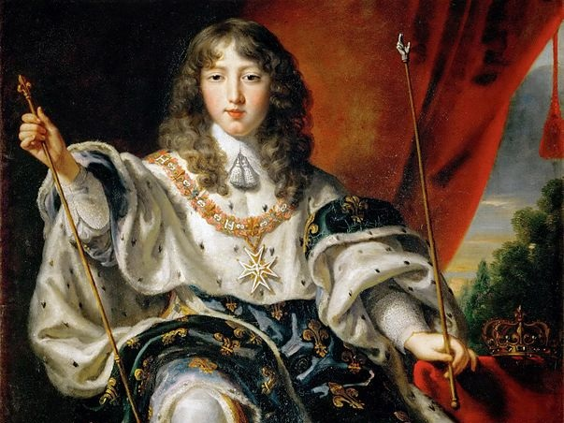
NEVER AGAIN
Notes:
http://commons.wikimedia.org/wiki/File:Louis_XIV_by_Juste_d'Egmont.jpg

Slide 22
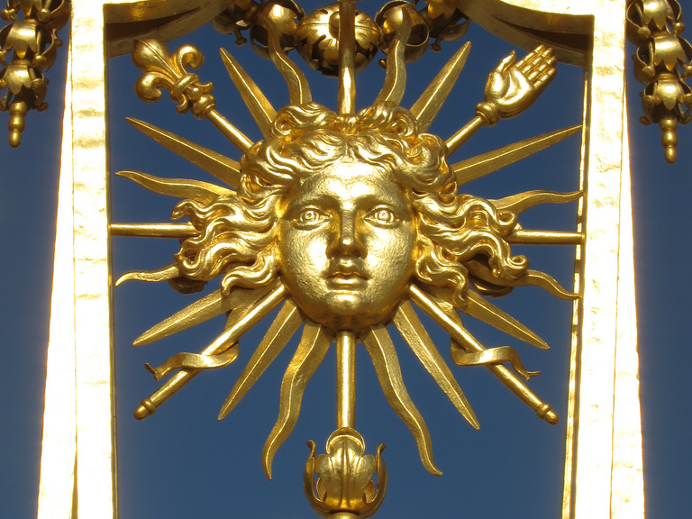
The Sun King
Some rights reserved by waitscm

Slide 23
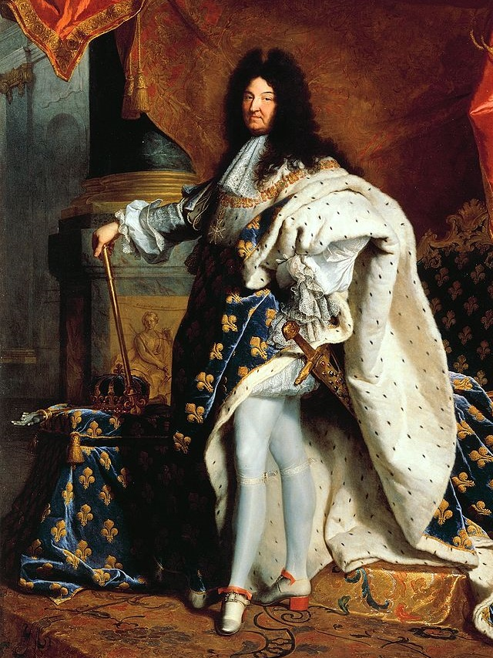
L’etat c’est moi.

Slide 24
I am the State.

Slide 25
Un roi. Une loi. Une foi.

Slide 26
ONE King

Slide 27
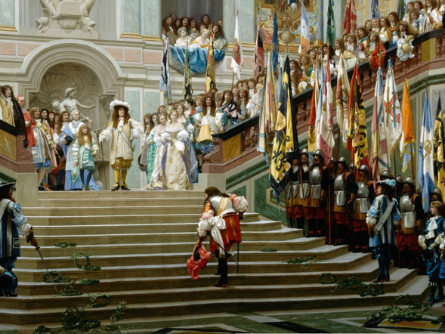
Louis put the nobles in their place.

Slide 28
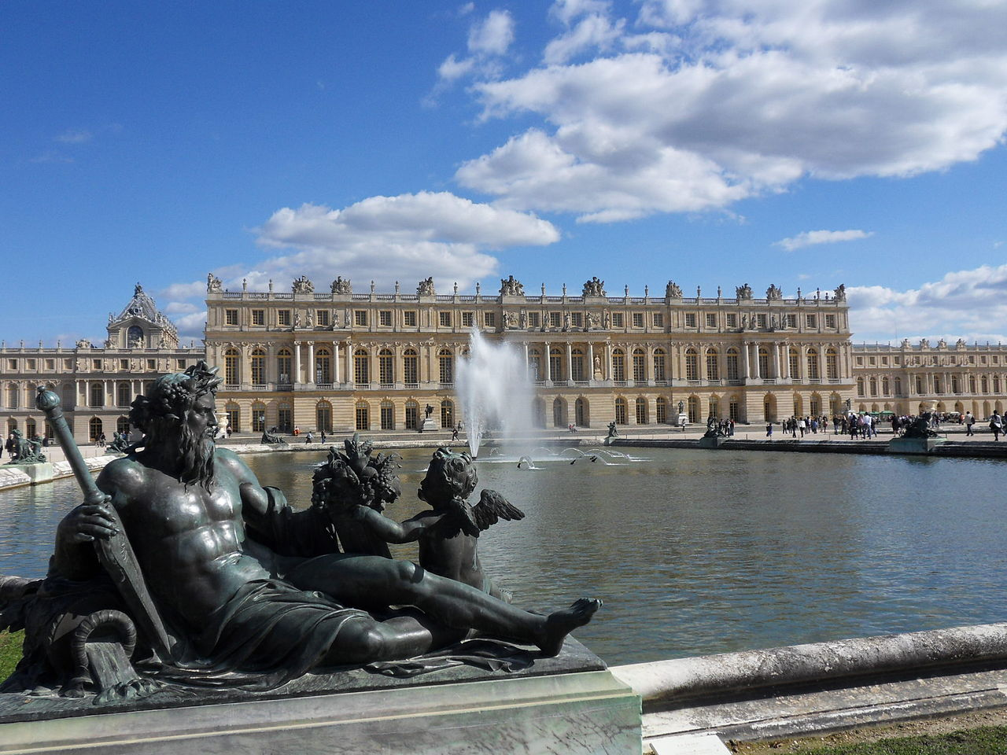
Versailles
French nobles were expected to attend to Louis regularly at his new palace at Versailles…
Photo Credit: G CHP

Slide 29
…or fall out of favor.
WHO DAT?

Slide 30
SWORD Nobles
Old Nobility
Some rights reserved by Vasnic64

Slide 31
ROBE Nobles
New Nobility
Some rights reserved by byronv2

Slide 32
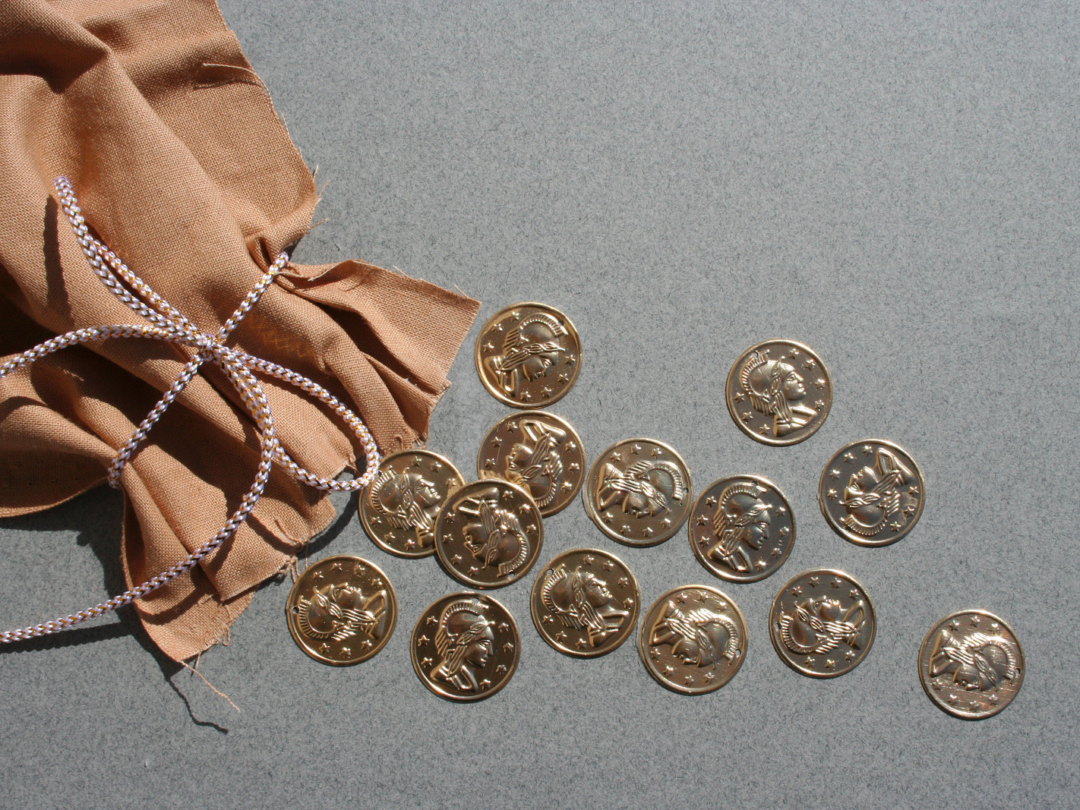
Sale of Titles and Offices
Some rights reserved by lars hammar

Slide 33
Independent Revenue
Some rights reserved by stevendepolo

Slide 34
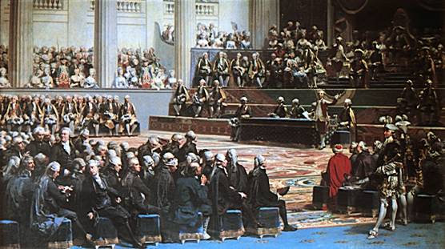
UNNECESSARY
Louis never had to convene the Estates General, the king’s advisory representative body.

Slide 35
Some rights reserved by Ben Husmann

Slide 36
The Estates General would not convene again until 1789.

Slide 37
ONE Law

Slide 38
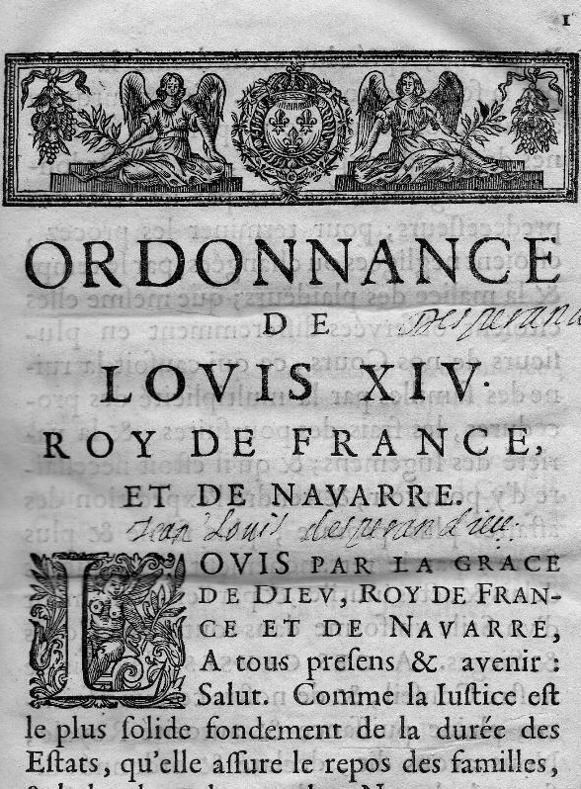
The Code Louis
Louis attempted to standardize the laws in France, which were based on regional customs.

Slide 39
ONE Faith

Slide 40
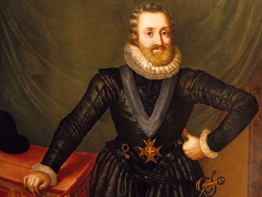
Edict of Nantes
Henry IV of France
Louis’ grandfather
Had been a Protestant before becoming king.
“Paris is worth the Mass”
Edict of Nantes
1598
Toleration for Huguenots in some French towns

Slide 41
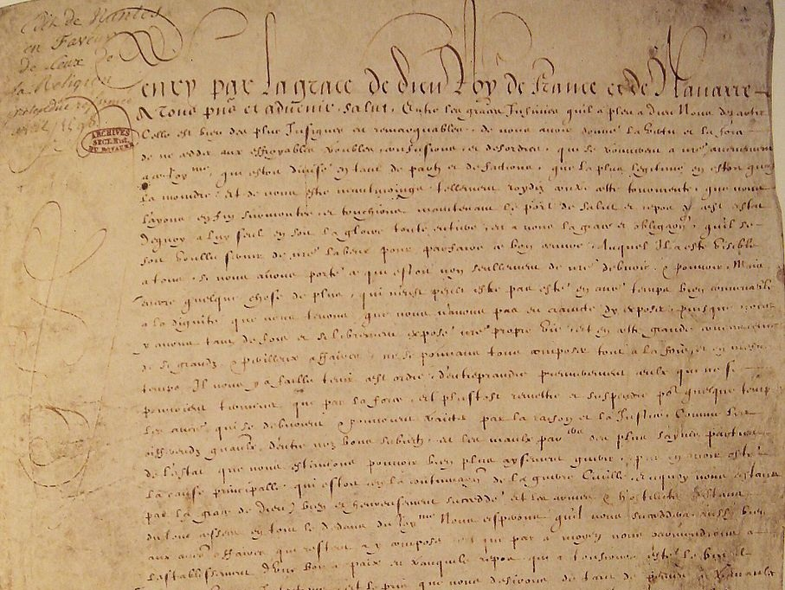
REVOKED

Slide 42
Edict of Fontainebleau (1685)

Slide 43
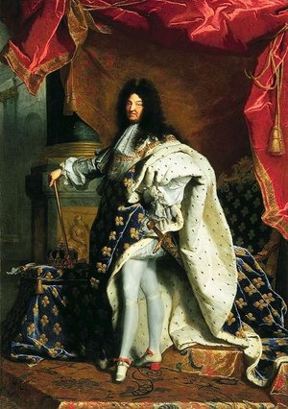
Edict of Fontainebleau (1685)
“We have determined that we can do nothing better, in order wholly to obliterate the memory of the troubles, the confusion, and the evils which the progress of this false religion has caused in this kingdom… than entirely to revoke the said Edict of Nantes…”
Read More

Slide 44
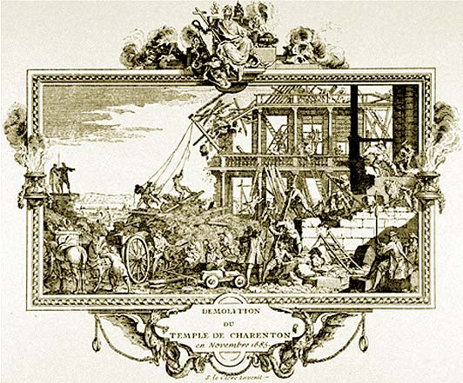
Notes:
http://www.crommelin.org/history/Ancestors/Scheffer/Charenton/Charenton.htm

Slide 45
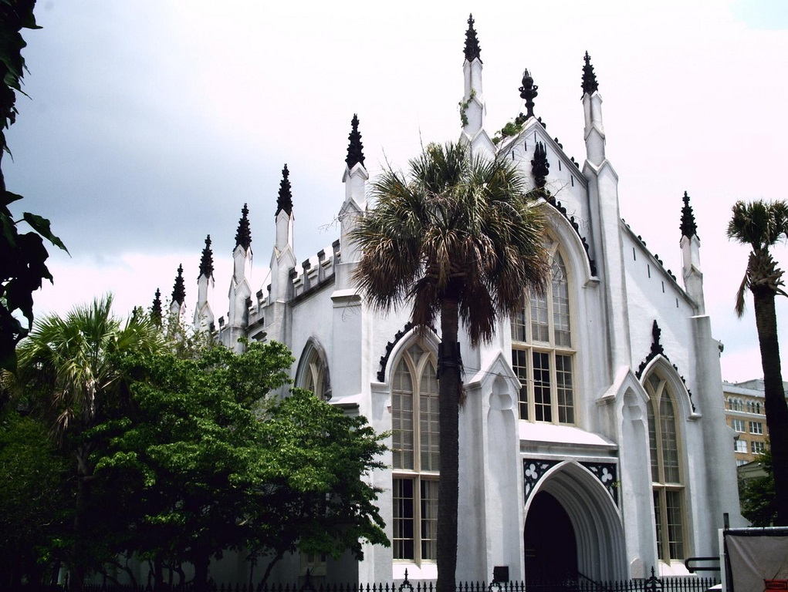
Huguenot Church
Charleston, SC
Photo by Aya37

Slide 46
Gallicanism
The Pope has no power over political matters.
Some rights reserved by Rene Bastiaanssen

Slide 47
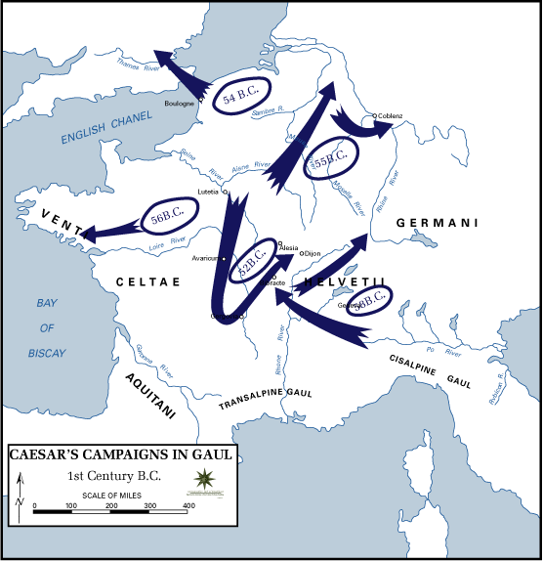
GAUL
GAUL was the Roman name for modern day France.

Slide 48
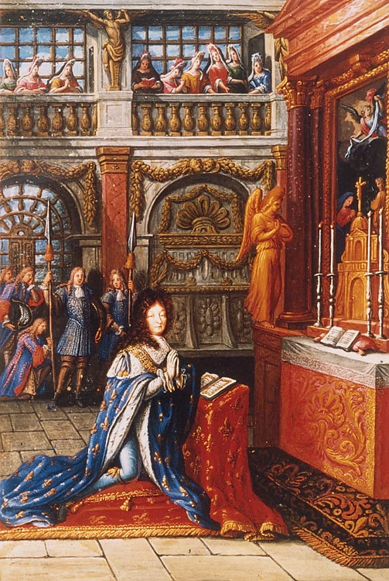
Louis was a devout CATHOLIC

Slide 49
But above all, he was KING
Some rights reserved by jbelluch

Slide 50
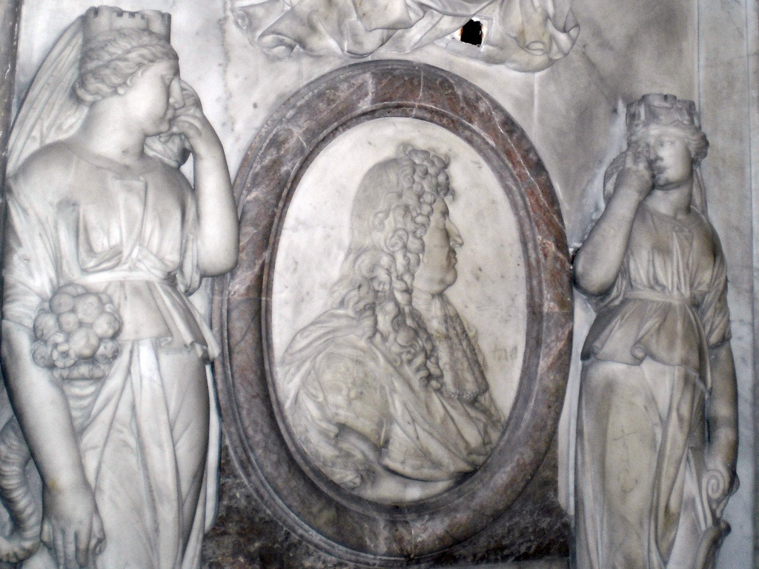
“I am leaving you, but the state remains forever.” -- Last Words of Louis XIV
Photo by Grangeburn

