Slide 1
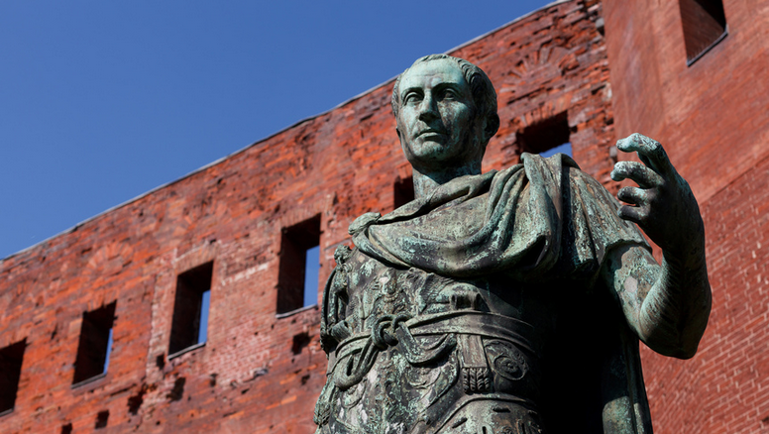
THE ROMAN CIVIL WARS
© Julien Meunier
Used With Permission

Slide 2
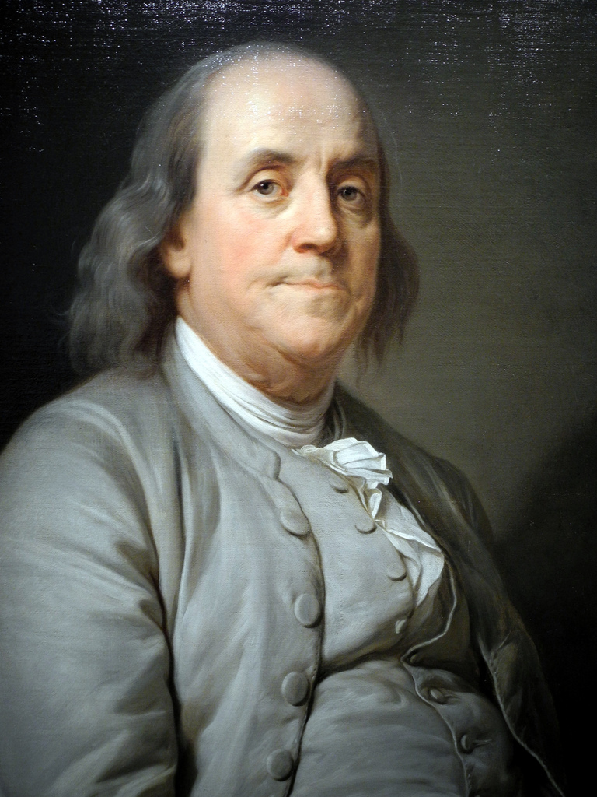
A REPUBLIC
if you can keep it.

Slide 3
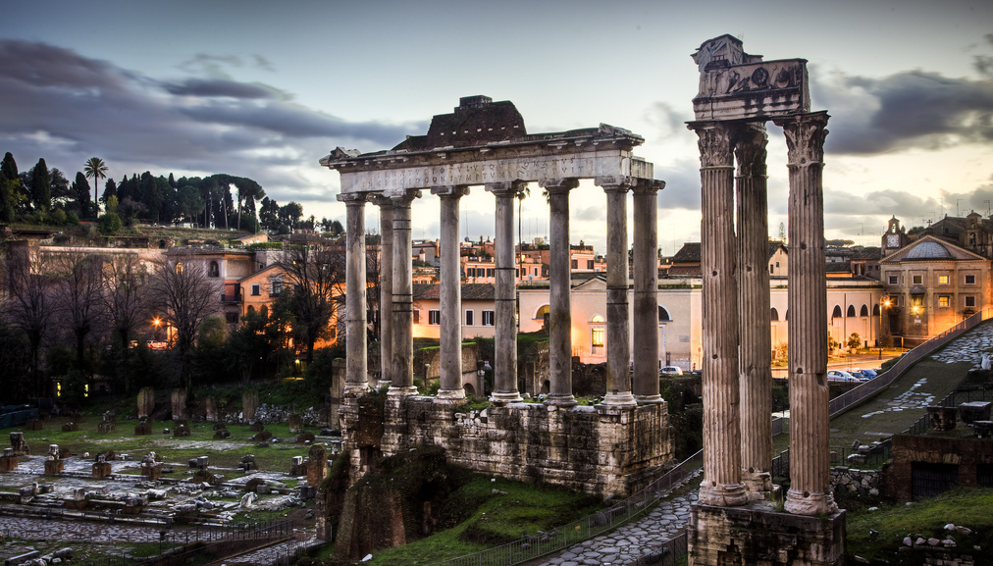
The Romans Didn’t keep theirs.
Photo Credit: Benson Kua

Slide 4
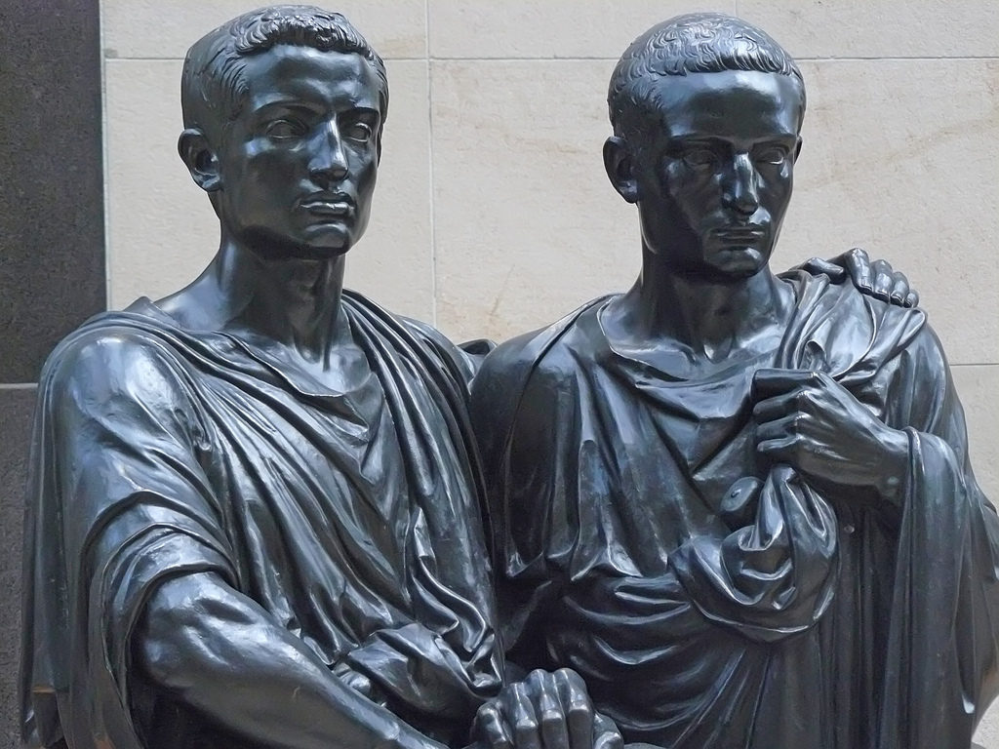
The Gracchi: A Turning Point
Mary Harrsch

Slide 5
Political Violence

Slide 6
Political Violence
The Roman Republic would be undermined by several civil wars in a 60 year period.

Slide 7
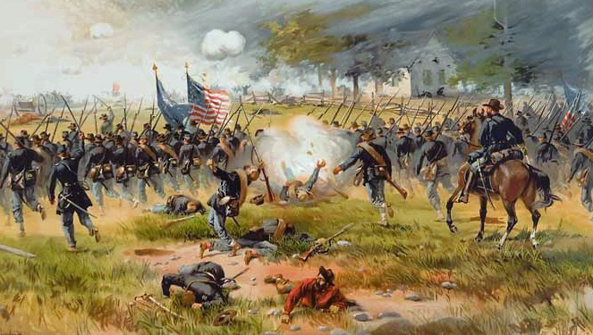
ONE CIVIL WAR
IN 225 YEARS

Slide 8
Senatus Populusque Romanus
The Senate and People of Rome
Art Credit: Ssolbergj

Slide 9
Political Divisions
in the Late Republic
OPTIMATES (The Senate) | POPULARES (The “People”)
Power Base:
Upper Classes
Power Base:
Lower Classes
INCREASE
the Senate’s Power
(Aristocracy)
DECREASE
the Senate’s Power
(Democracy)
Sulla, Pompey
Marius, Caesar

Slide 10
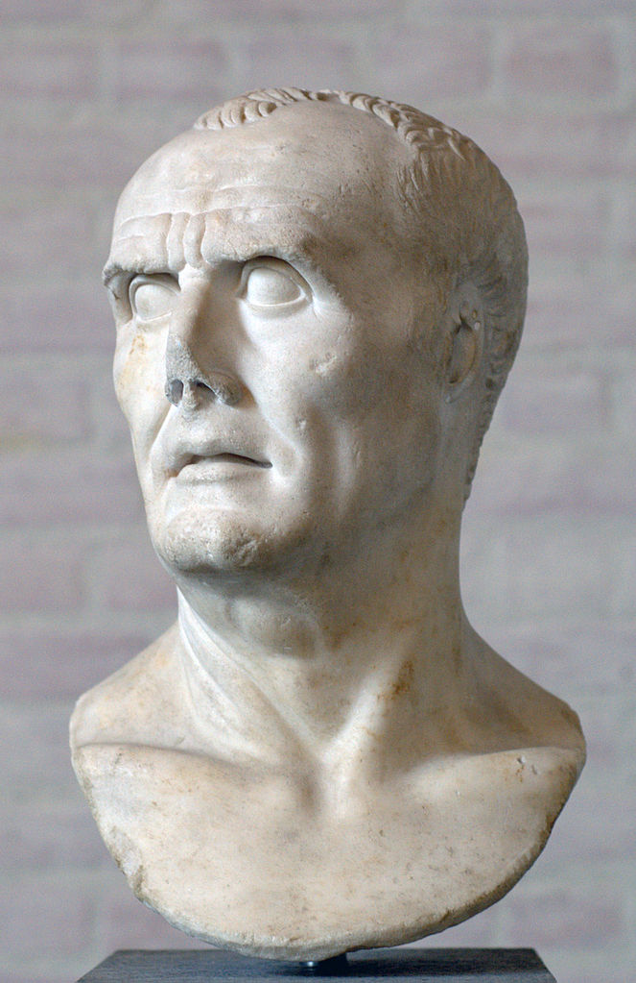
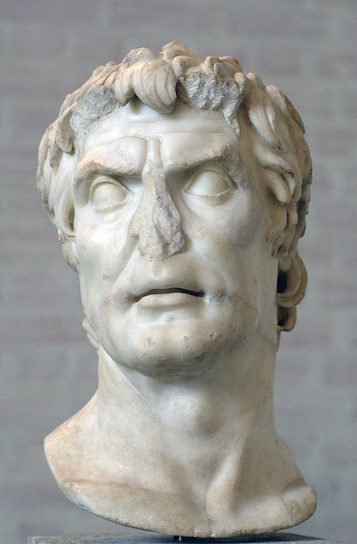
Marius vs. sulla
88-87 B.C.
MARIVS
SULLA

Slide 11
Gaius Marius
157-86 B.C.
SUCCESSFUL GENERAL
Consul 104-100 B.C.
MARIVS

Slide 12
NOVUS HOMO
Marius was the first in his family to hold a consulship.
MARIVS

Slide 13
The Marian reforms
107 B.C.
Property requirements
for Military Service
MARIVS

Slide 14
The Marian reforms
107 B.C.
Professional Military Force
Attached to Commander
MARIVS

Slide 15
five
consecutive consulships
104-100 B.C.
How did this undermine republicanism?
MARIVS

Slide 16
L. Cornelius Sulla
138-78 B.C.
Patrician General
Defeated Marius in a Civil War
SULLA

Slide 17
L. Cornelius Sulla
138-78 B.C.
DICTATOR
Restored the Senate’s political power
SULLA

Slide 18
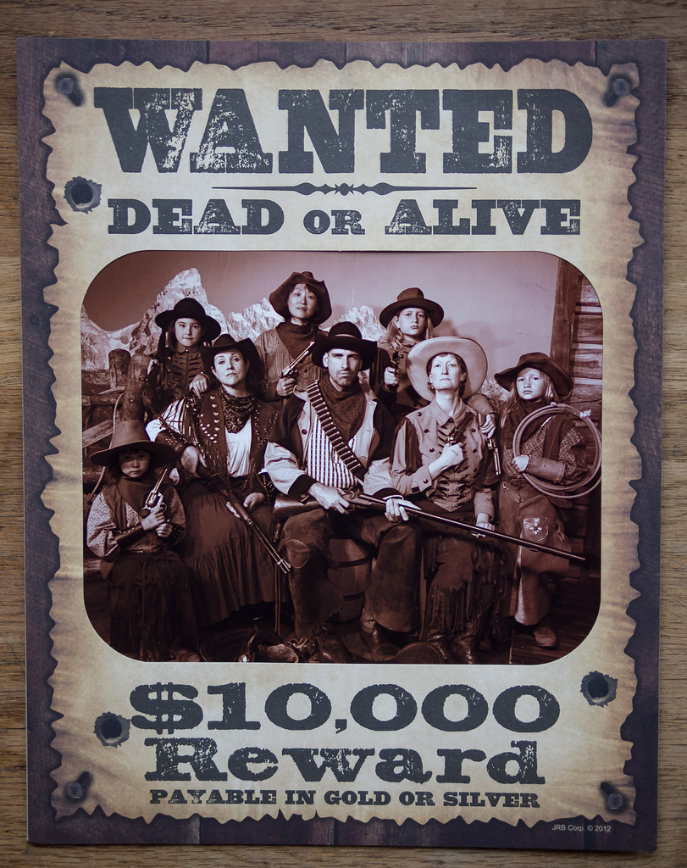
PROSCRIPTION LISTS
Sulla declared his personal enemies to be enemies of the state.
Photo by Big Ben in Japan (cc 2.0)

Slide 19
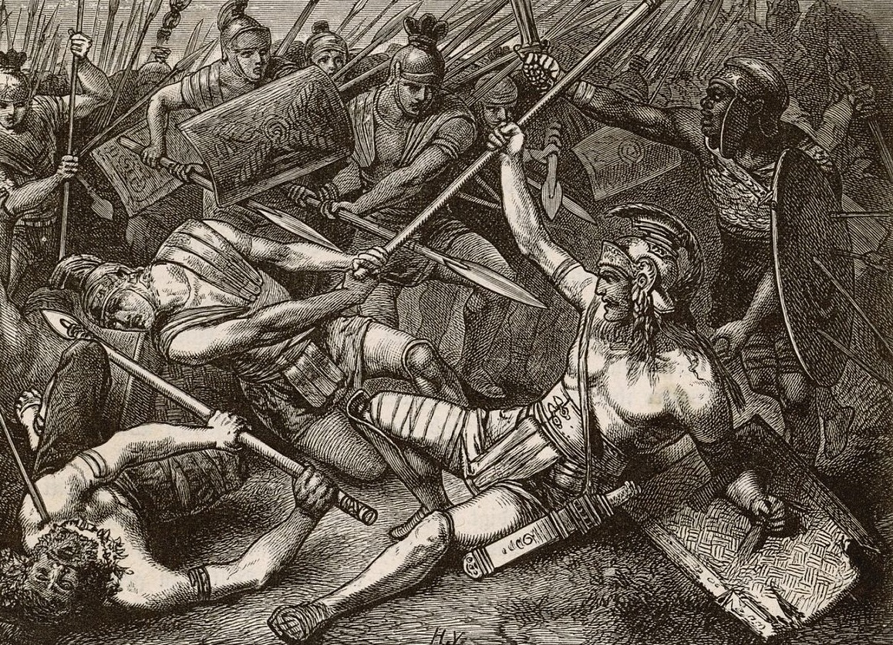
Spartacus’ Slave Revolt
73-71 B.C.
Uprising of over 100,000 slaves led by Spartacus, a Thracian gladiator.

Slide 20
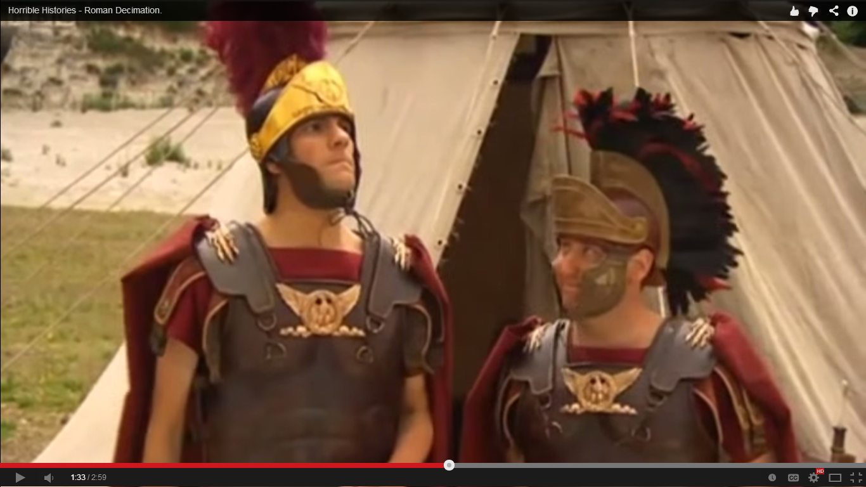
DECIMATION
Horrible Histories: Rotten Romans

Slide 21
DECIMATe
1/10
To Kill a Tenth

Slide 22
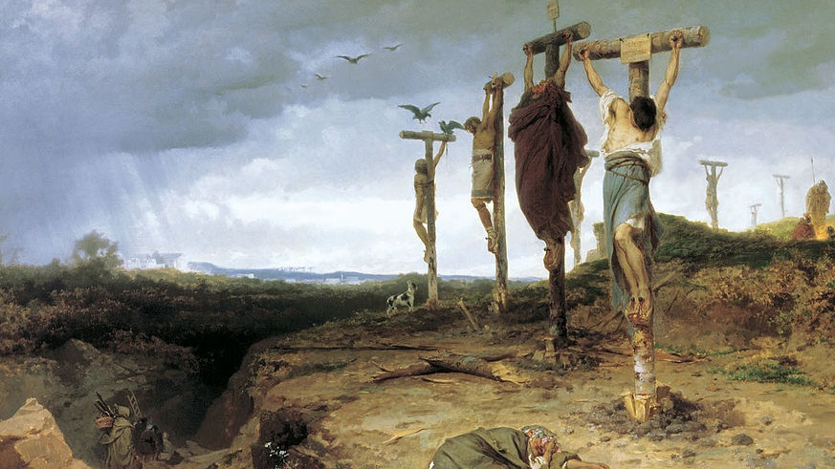
The Aftermath
Crassus crucified 6,000 rebel slaves along the Via Appia.
Fyodor Andreyevich Bronnikov (1878)

Slide 23
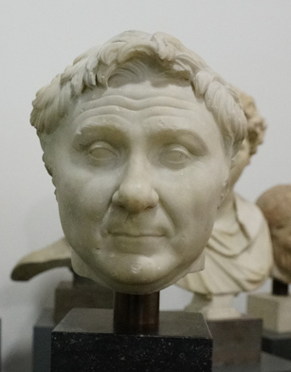
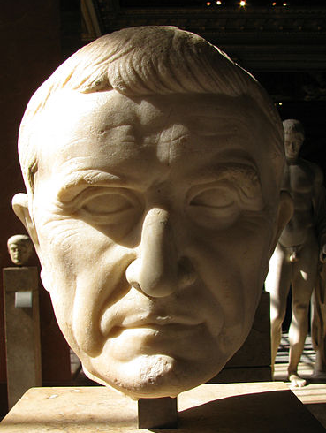
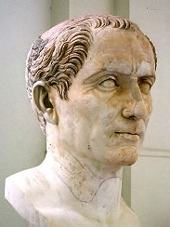
The First Triumvirate
(Rule of Three Men)
Photo by Dion Hinchcliffe (cc 2.0)
G. Pompey (General)
M.L. Crassus (Rich Guy)
Julius Caesar (General)

Slide 24
The First Triumvirate
(Rule of Three Men)
An INFORMAL Pact
PURPOSE: Secure Power

Slide 25
Pompey “the Great”
Successful General
Optimate
Rival of Caesar
Photo by Dion Hinchcliffe (cc 2.0)

Slide 26
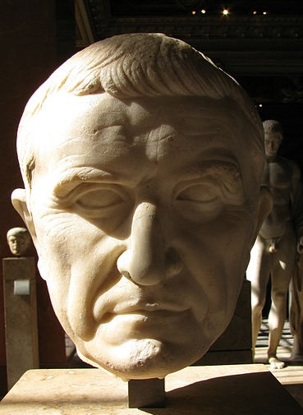
Marcus Licinius Crassus
Richest Man in Rome
Real Estate, etc.

Slide 27
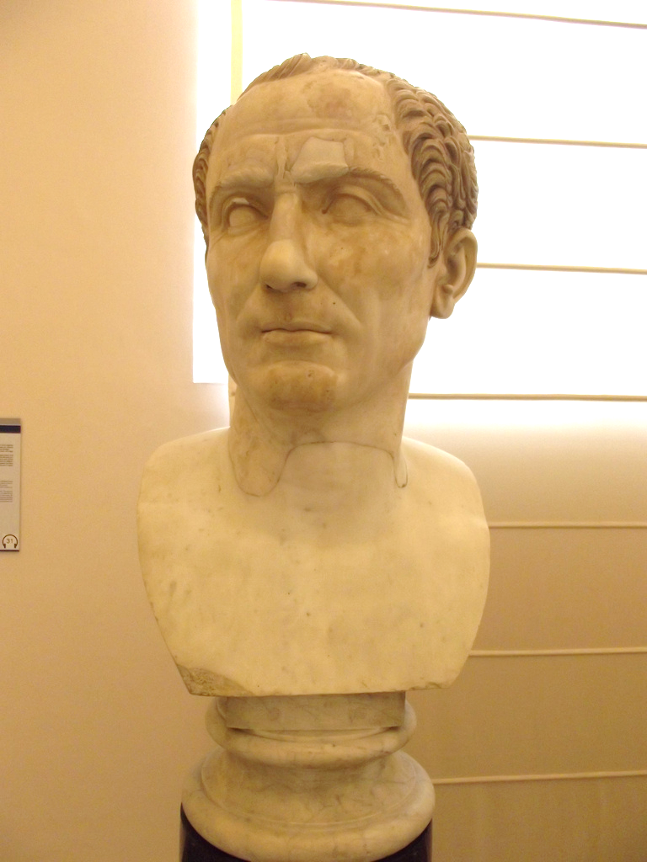
Gaius Julius Caesar
Good Name, Bad Finances
Patrician Family, Not Wealthy
Marius’ Nephew
Photo by Elliott Brown (cc 2.0)

Slide 28
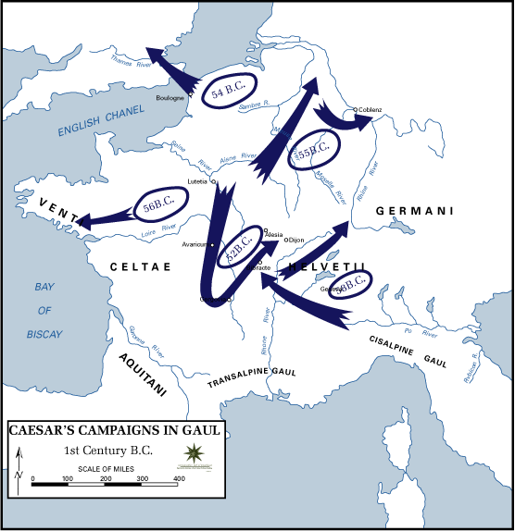
Caesar’s Conquest of Gaul
58-50 B.C.
Caesar gained military glory, popularity, and wealth conquering the Gauls (modern day France).

Slide 29
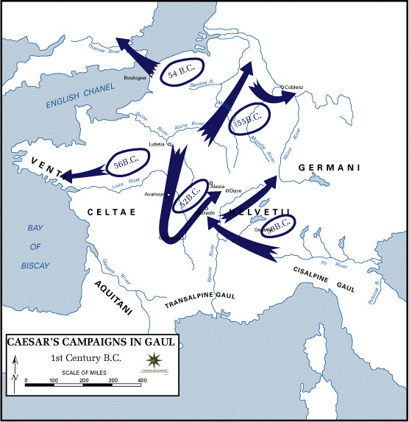
Veni vidi vici

Slide 30
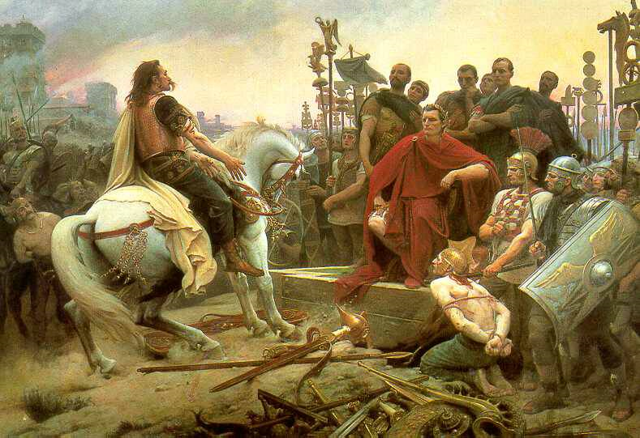
Vercingetorix
Vercingetorix surrenders to Caesar, by Lionel Royer.

Slide 31
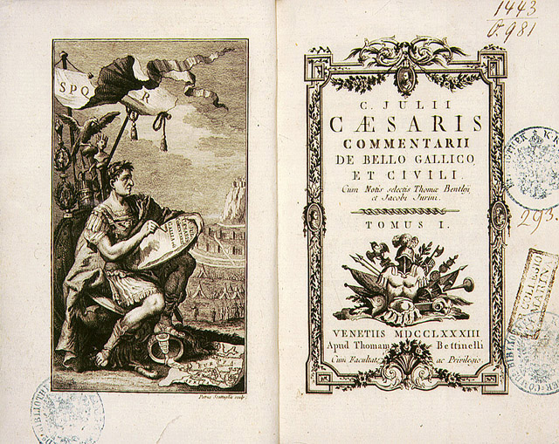
The First Military Memoir
Caesar was the first general to write about his own military campaign.

Slide 32
r.i.p. crassus
Photo by Dion Hinchcliffe (cc 2.0)
G. Pompey (General)
M.L. Crassus (Rich Guy)
Julius Caesar (General)

Slide 33
Caesar’s Civil War
VS.
Photo by Dion Hinchcliffe (cc 2.0)
G. Pompey (General)
Julius Caesar (General)

Slide 34
Crossing the Rubicon
Photo by Adam Barhan (cc 2.0)

Slide 35
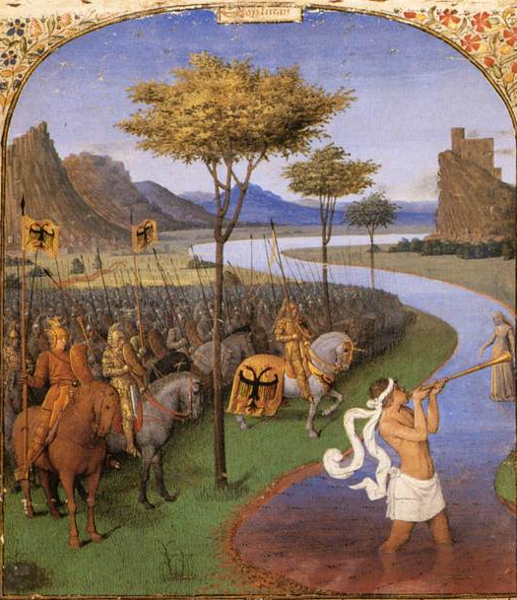
Crossing the Rubicon
POINT OF NO RETURN
By marching into Italy at the head of an army in defiance of the Senate’s orders, Caesar made himself an outlaw and fully committed himself to civil war.
Jean Fouquet, Caesar Crossing the Rubicon

Slide 36
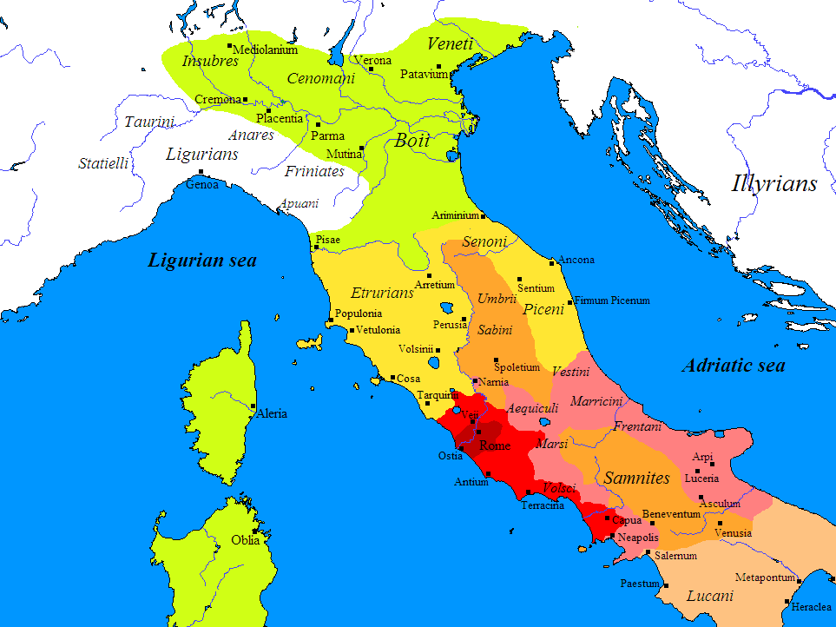
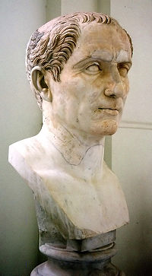
GAUL
Rubicon
ITALY
Rome
The Senate had only granted Caesar imperium (the authority to command troops) in the Gallic provinces. By crossing the Rubicon and entering Italy with an army, Caesar committed treason by exercising imperium where he had no authority to do so.

Slide 37
The Die is Cast
Photo Credit: Amy the Nurse

Slide 38
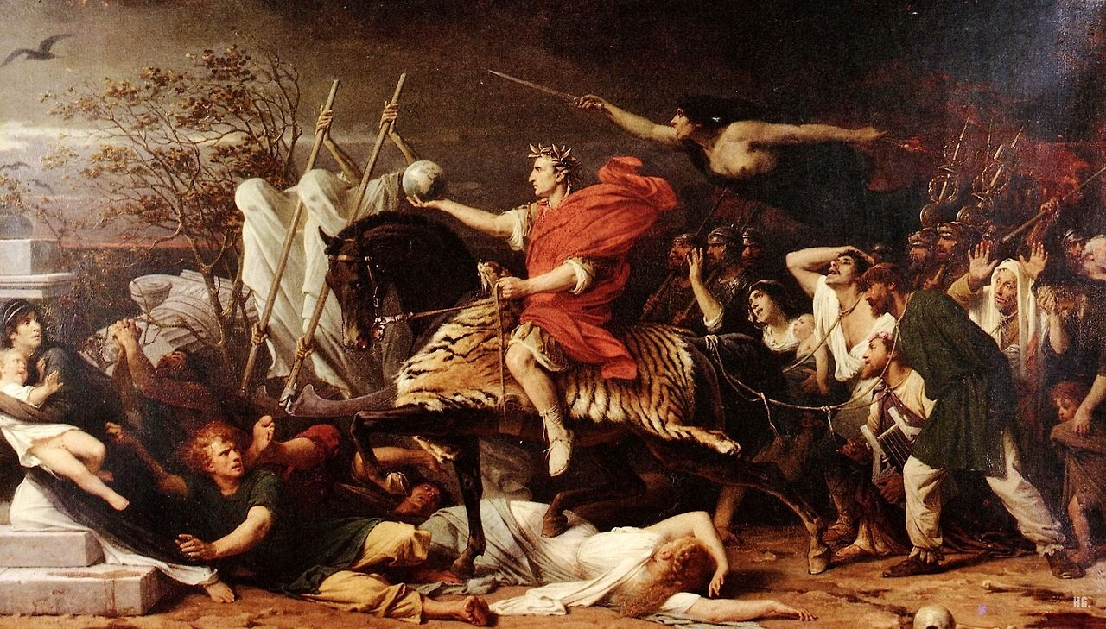
Adolphe Yvon. Caesar (1875)

Slide 39
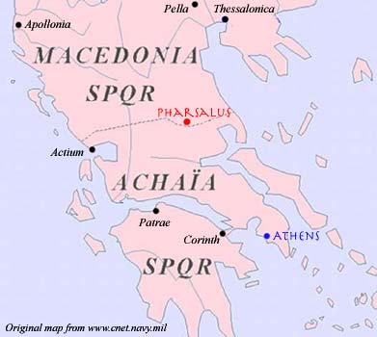
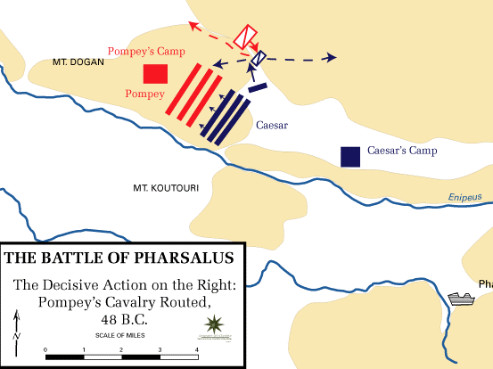
Battle of Pharsalus
Caesar defeats Pompey

Slide 41
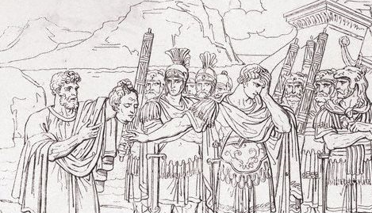
“They would have it thus.”

Slide 42
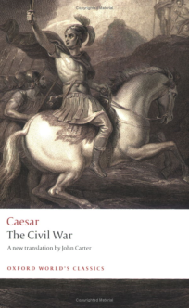
ANOTHER MEMOIR
Caesar wrote another self-glorifying account of his civil war with Pompey.

Slide 43
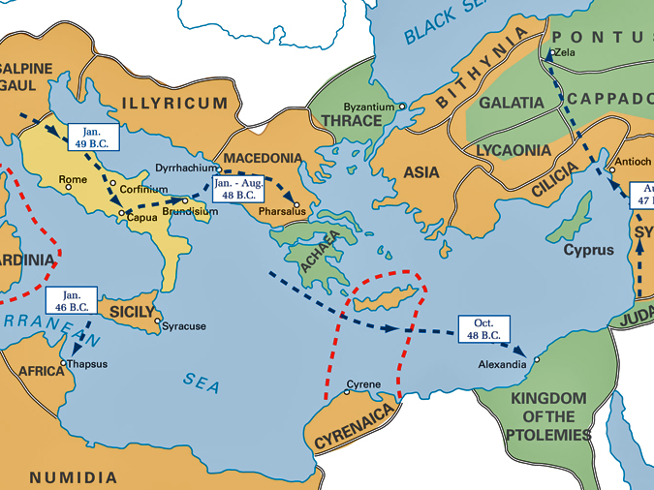
After Pharsalus
Courtesy of the United States Military Academy Department of History.

Slide 44
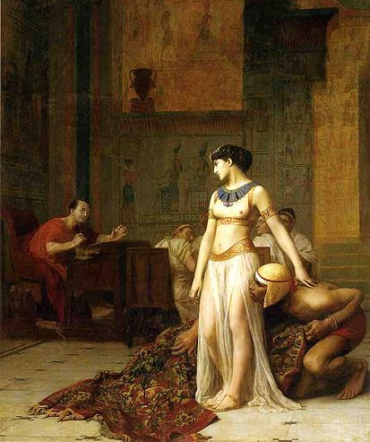
Caesar in Egypt
Cleopatra
Queen of Egypt
Caesar’s Mistress
Jean-Léon Gérôme Cleopatra and Julius Caesar

Slide 45
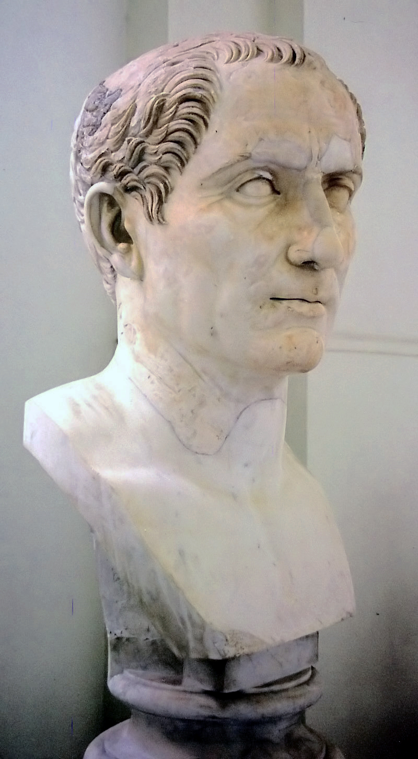
DICTATOR
FOR 10 YEARS

Slide 46
Julian Calendar
Used in Europe until the 16th century.

Slide 47
CLEMENTIA
Proscriptions

Slide 48
DICTATOR
FOR LIFE

Slide 49
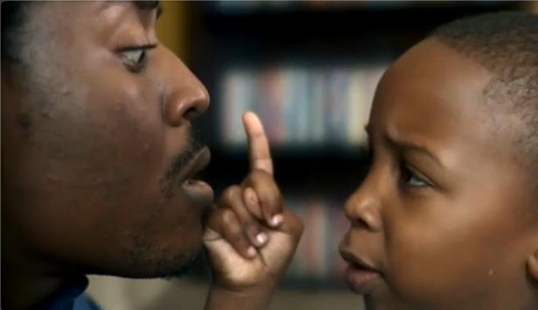
Hands OFF!
http://www.youtube.com

Slide 50
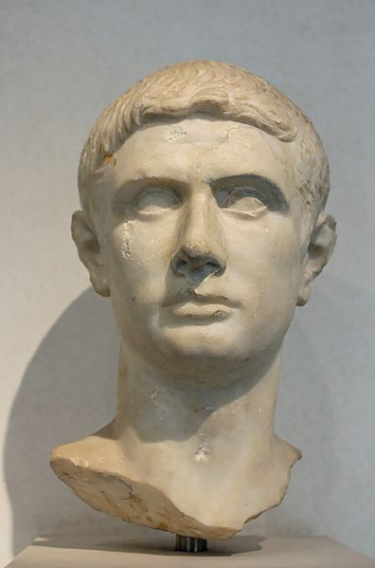
Marcus Junius Brutus
Caesar viewed him like a son.
BRVTVS

Slide 51
Liberatores
Brutus was a leader in a plot to execute Caesar as a tyrant..
BRVTVS
Classical Numismatic Group, Inc. http://www.cngcoins.com

Slide 52
Just as Cute As Caesar…
http://youtu.be/6ovOboVwB7g?t=26s

Slide 53
BEWARE the Ides of March.
3/15/44 B.C.

Slide 54
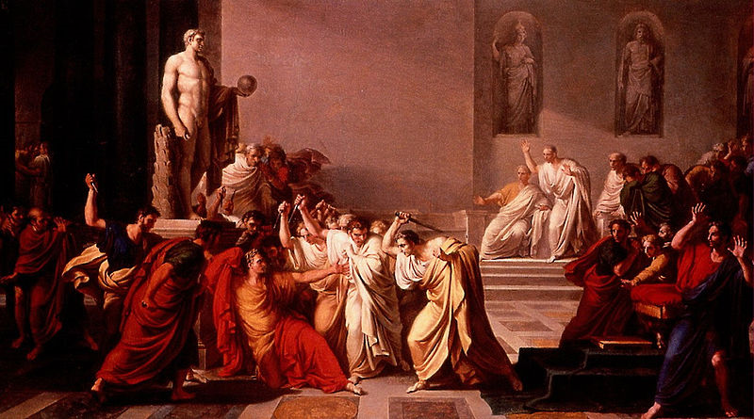
Et tu, Brute?
Morte di Giulio Cesare (Death of Caesar) by Vincenzo Camuccini

Slide 55
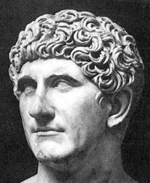
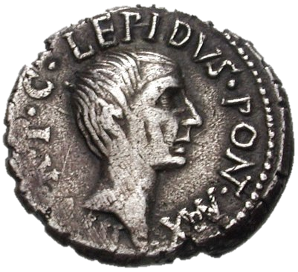
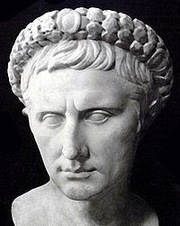
The Second Triumvirate
Marcus Antonius (Caesar’s General)
M. Lepidus (Caesar’s General)
Octavian Caesar (Caesar’s Heir)
Lepidus Coin Credit: CNG coins (cc 2.0)

Slide 56
The Second Triumvirate
A FORMAL Pact
PURPOSE: Avenge Caesar

Slide 57
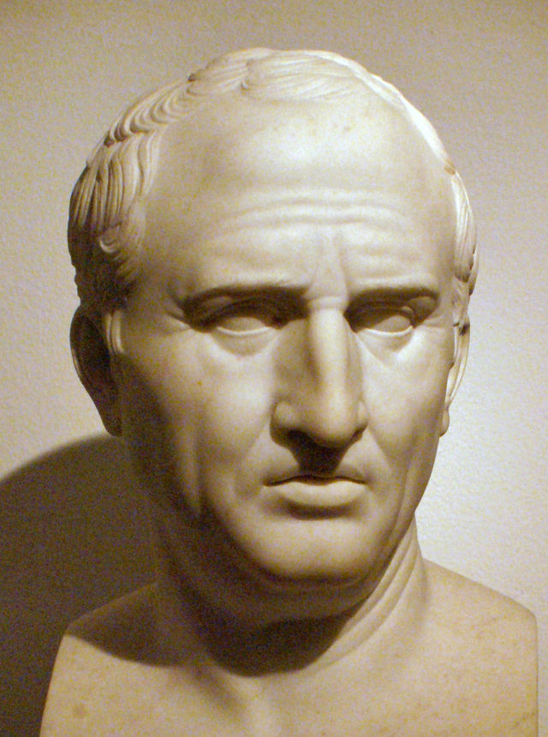
PROSCRIPTIONS
Unlike Caesar, the Second Triumvirate proscribed its enemies.
CICERO

Slide 58
Marcus Tullius Cicero
Roman Orator
Philippics against Antonius
CICERO

Slide 59
EXECUTED
43 B.C.
CICERO

Slide 60
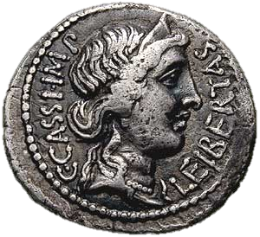
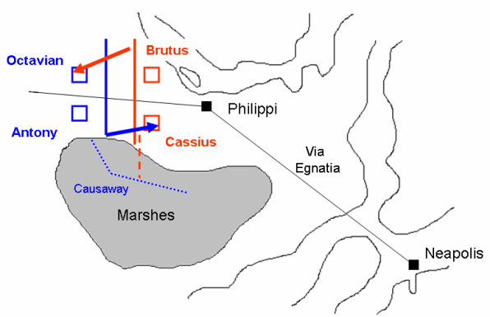
Battle(s) of Philippi
42 B.C.
Octavian & Antony
Brutus & Cassius
Two battles fought at Philippi resulted in the destruction of the armies of the Liberatores. Brutus and Cassius committed suicide in order to avoid capture.
Classical Numismatic Group, Inc. http://www.cngcoins.com

Slide 61
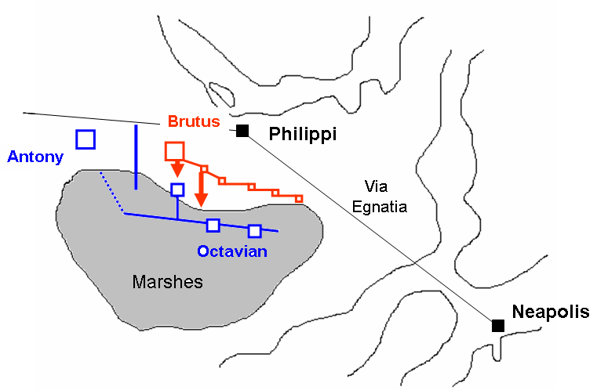

Slide 62
The Second Triumvirate
EXILED
36 B.C.
Marcus Antonius (Caesar’s General)
M. Lepidus (Caesar’s General)
Octavian Caesar (Caesar’s Heir)

Slide 63
The Final War
32-30 B.C.
of the Roman Republic
Octavian
vs.
Antonius
Having vanquished their common enemies, Octavian and Antony turned on each other.

Slide 64
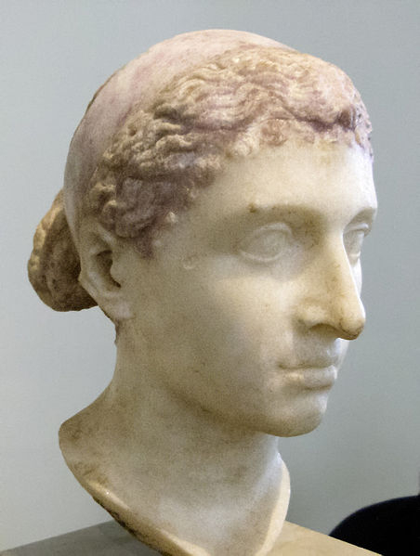
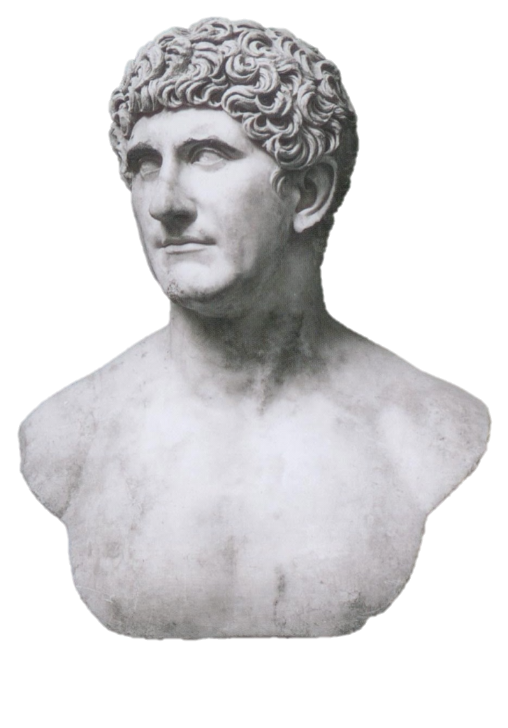
Antony and Cleopatra
Married 32 B.C.

Slide 65
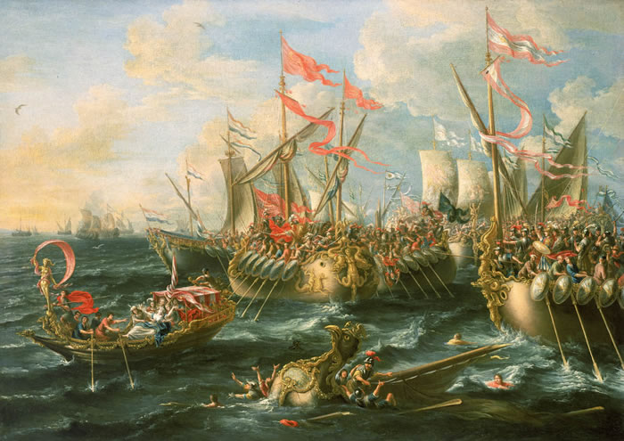
Battle of Actium
31 B.C.
Naval Battle
Octavian defeats Antony & Cleopatra
END CIVIL WARS

Slide 66
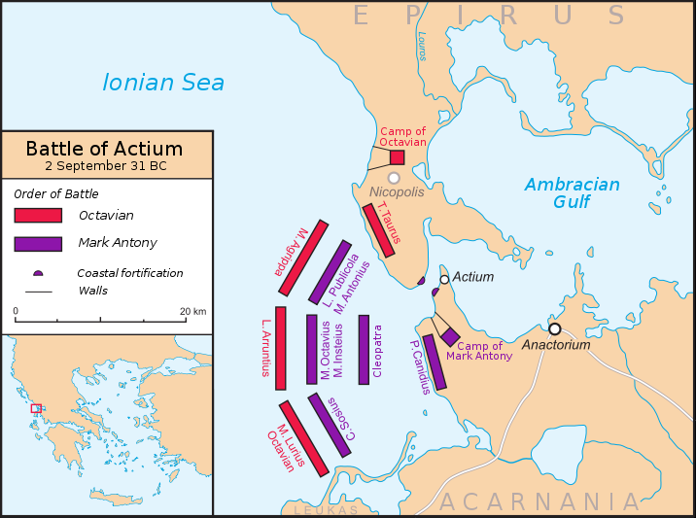
Map Credit: Future Perfect at Sunrise(cc 3.0)

Slide 67
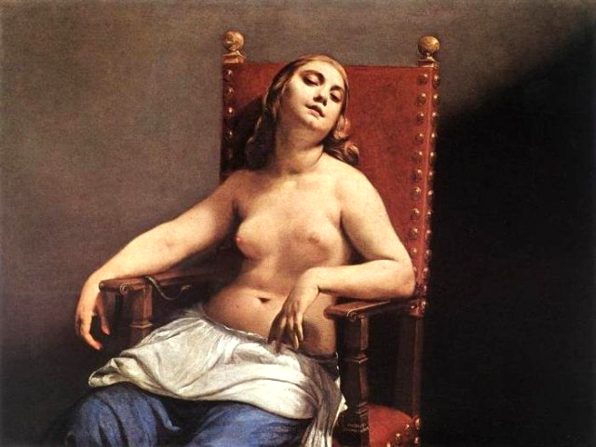
ASP
Guido Cagnacci, The Death of Cleopatra (1660)

Slide 68
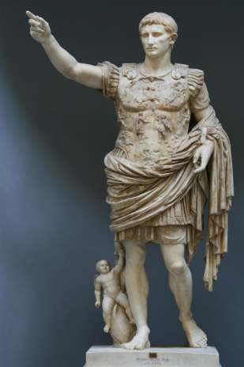
Augustus
Octavian took the name of Augustus (Venerable).
Princeps
(First Citizen)
Imperator
(Commander-in-Chief)
Photo Credit:
Till Niermann
(cc 2.5)

Slide 69
PAX ROMANA
Roman Peace (27 B.C. – 180 A.D.)
Photo Credit:
Till Niermann
(cc 2.5)

Slide 70
The Triumvirates Compared
 | First Triumvirate | Second Triumvirate
Members
Civil War
Last Man Standing
End Result
Pompey
Crassus
Julius Caesar
M. Antonius
Lepidus
Octavian Caesar
Crassus killed – CIVIL WAR (Pompey vs. Caesar)
Lepidus exiled – CIVIL WAR (Octavian vs. Antonius)
Julius Caesar
Octavian Caesar
Caesar assassinated
Another civil war
Roman Empire
Pax Romana

Slide 71
LEARNING. DELIVERED.

