Slide 1
SHUT UP
PRODUCE
SACRIFICE
& HATE
World War II: The American Home Front

Slide 2
USHC 7.2
Evaluate the impact of war mobilization on the home front, including consumer sacrifices, the role of women and minorities in the workforce, and limits on individual rights that resulted in the internment of Japanese Americans.

Slide 3
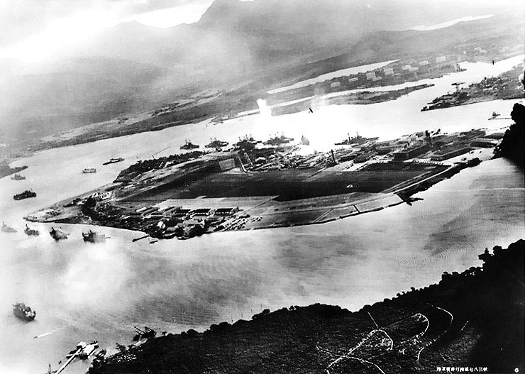
Japan Attacks Pearl Harbor
December 7, 1941

Slide 4
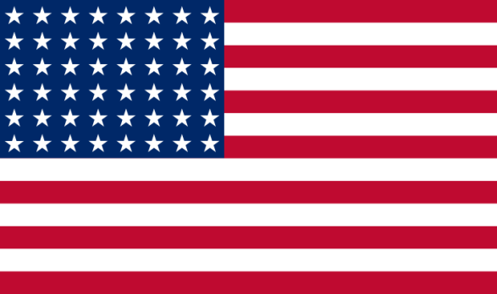
The Situation: 1941
The Allies
The Axis
Neutral
WAR
WAR
WAR
Occupied

Slide 5
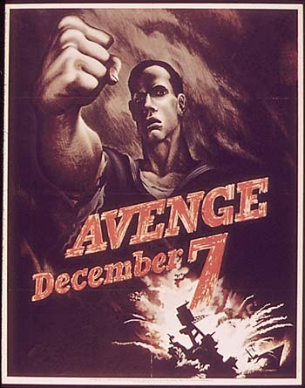
TOTAL War

Slide 6
This Means YOU

Slide 7
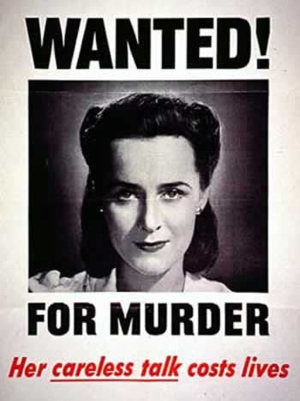
So… SHUT YOUR MOUTH
American women contributed to the war effort by working in munitions factories.
Especially you ladies…

Slide 8
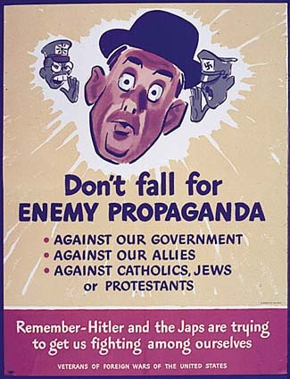
And YOUR EARS
American women contributed to the war effort by working in munitions factories.

Slide 9
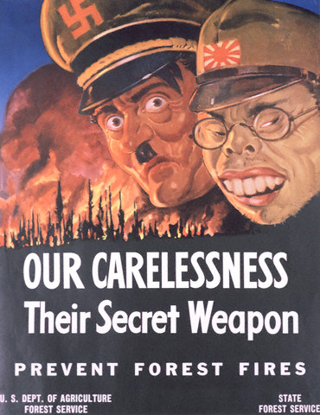
And really… JUST DON’T
American women contributed to the war effort by working in munitions factories.

Slide 10
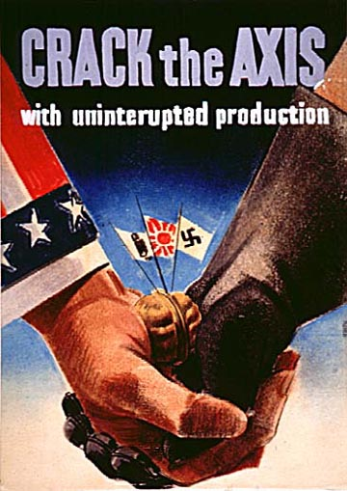
THE WAR ECONOMY
Government Regulation of:
Production
Pricing
Rationing

Slide 11
War Production Board
Peacetime industries converted to war production

Slide 12
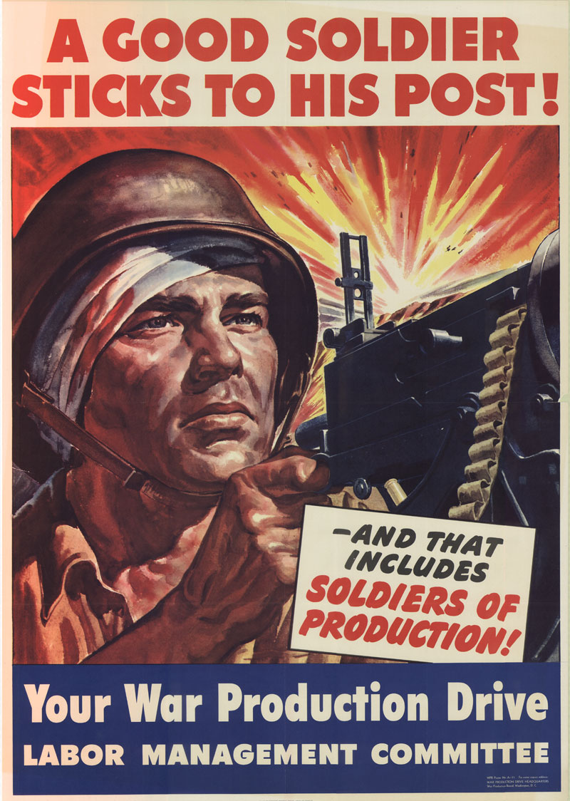

Slide 13
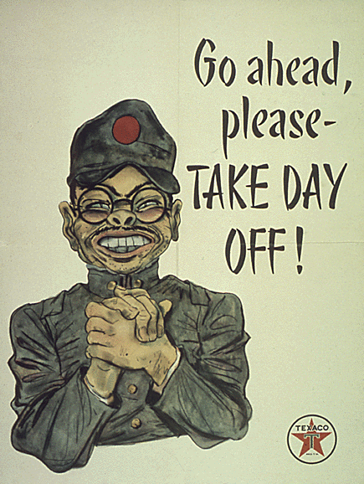

Slide 14
ROSIE the Riveter
Symbolic of Female Munitions Workers

Slide 15
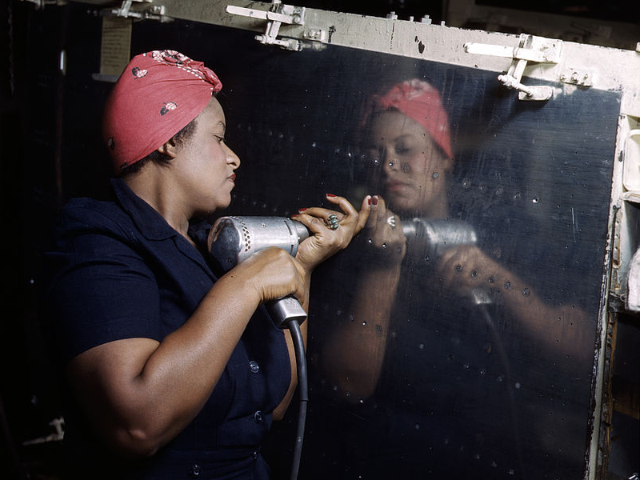
FDR’s Executive Order 8802 prohibited racial discrimination in the defense production industry.

Slide 16
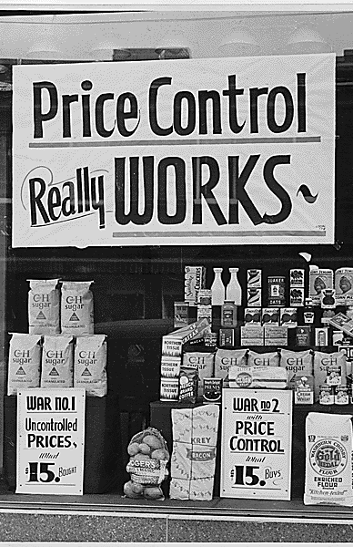
Office of Price Administration
Government-controlled Price Ceilings

Slide 17
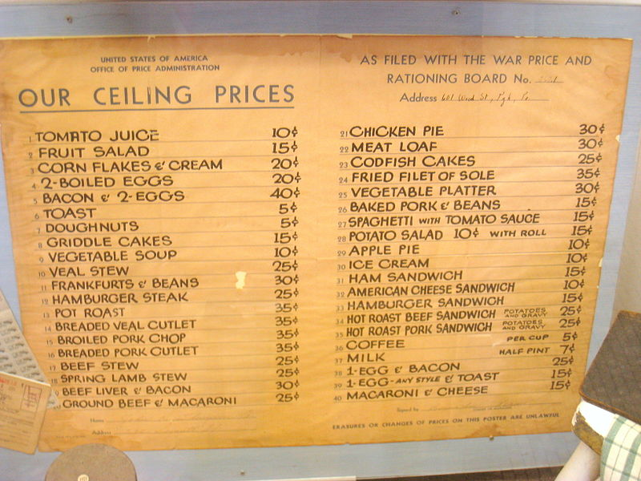

Slide 18
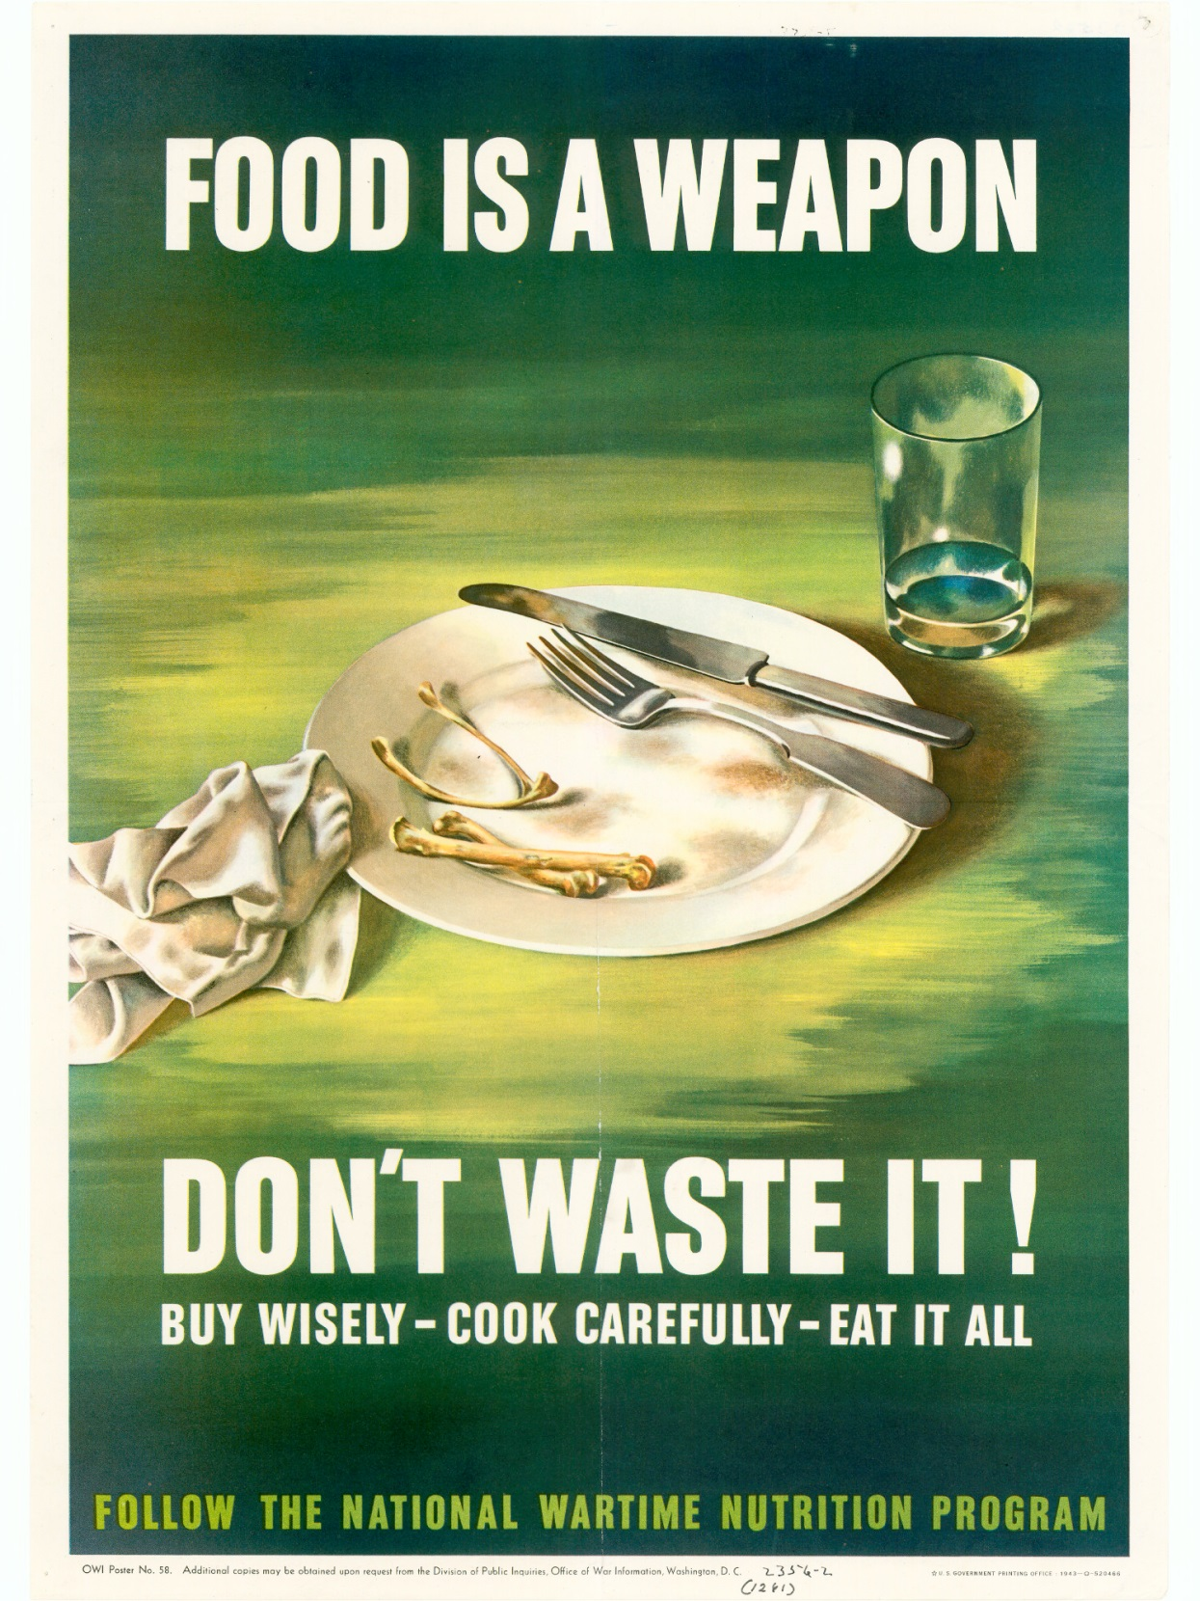
RATIONING

Slide 19
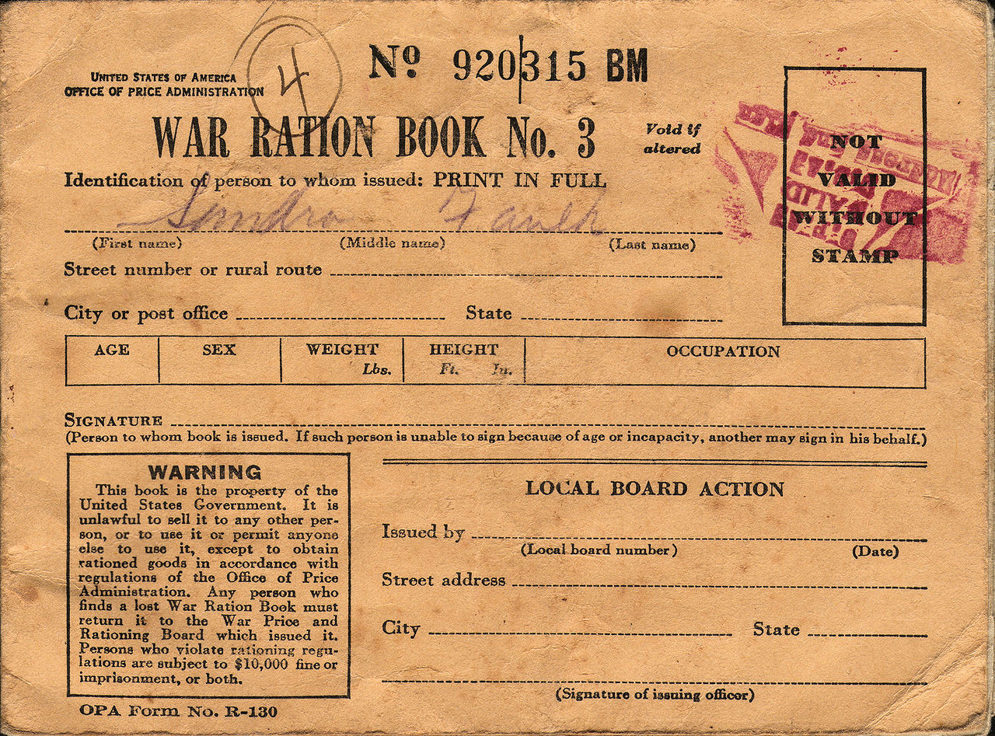

Slide 20
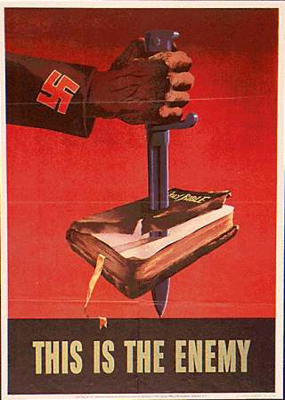

Slide 21
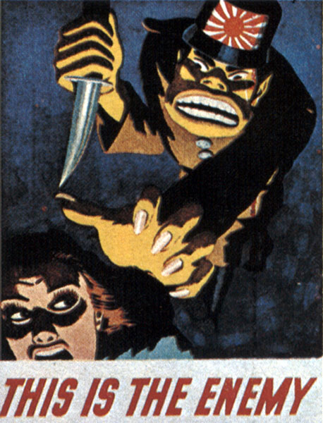

Slide 22
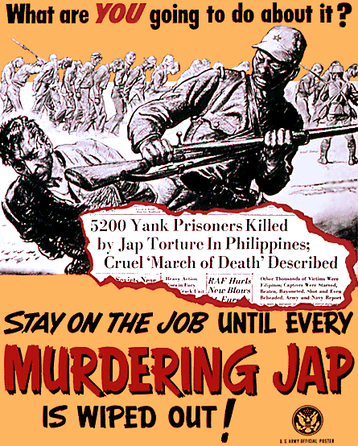

Slide 23
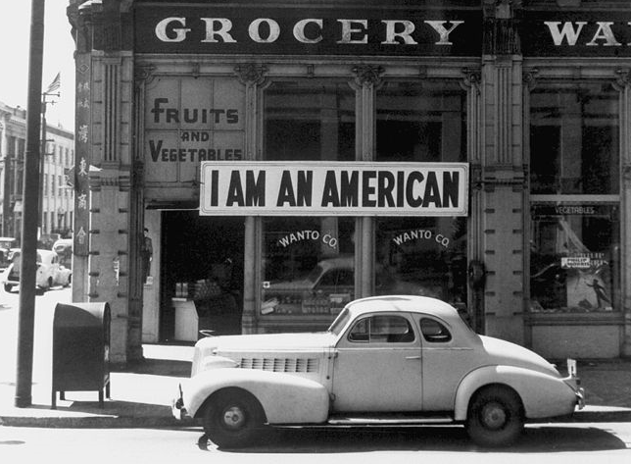

Slide 24
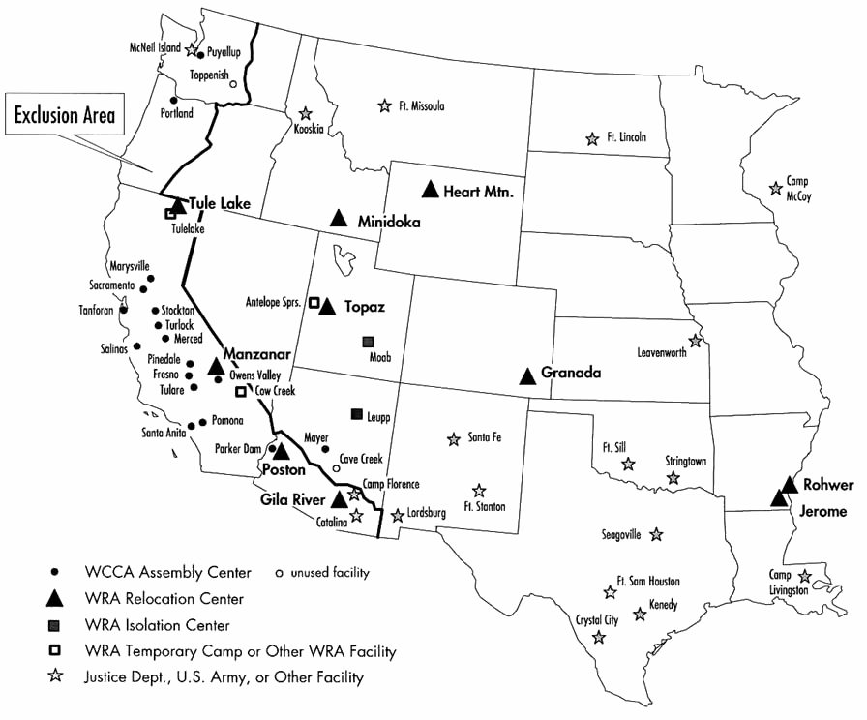
Japanese-American Internment

Slide 25
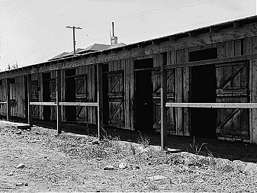
Internment Camps
Former horse stalls converted for temporary occupation by Japanese American internees at Tanforan Assembly Center, San Bruno, California, 1942 (Wikipedia)

Slide 26
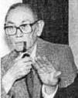
Korematsu v. United States
6-3
Internment of Japanese-Americans DOES NOT violate the Constitution.
Fred Korematsu

Slide 27
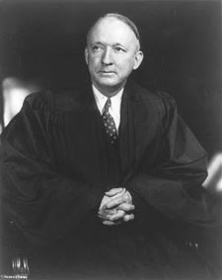
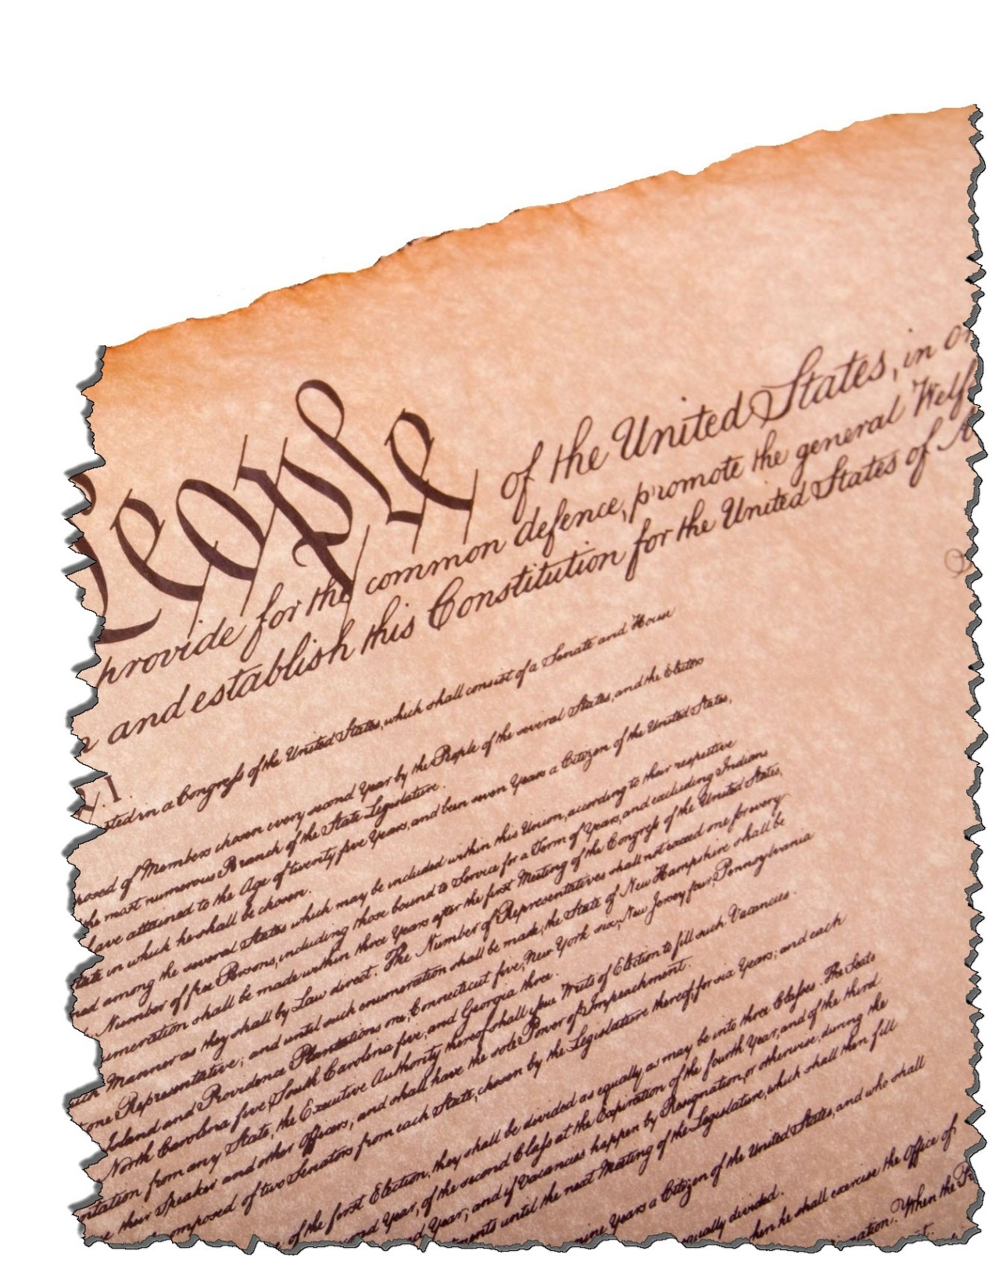
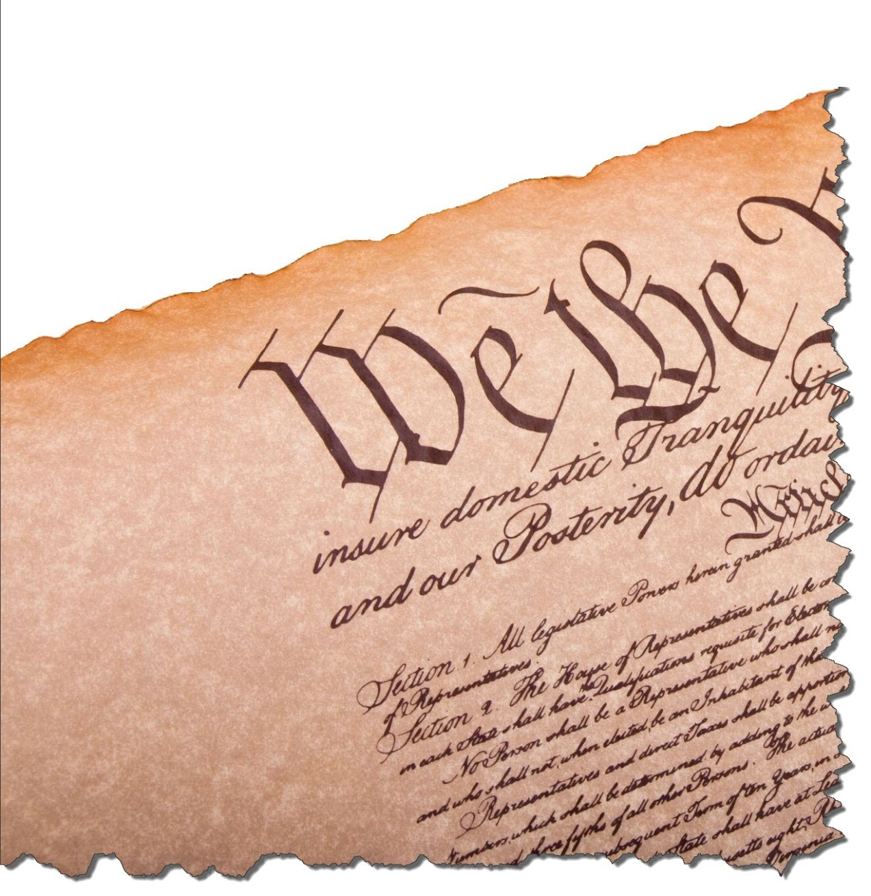
Korematsu v. United States
Justice Hugo Black, a former Klan member, delivered the opinion of the Court.
FAIL

Slide 28
Better Late Than Never
REPARATIONS
President Reagan signs the Civil Liberties Act of 1988

Slide 29
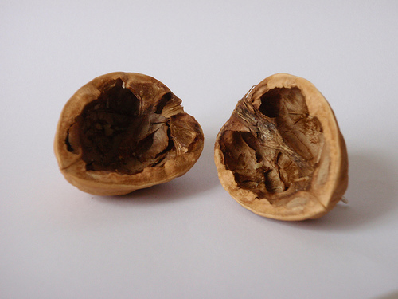
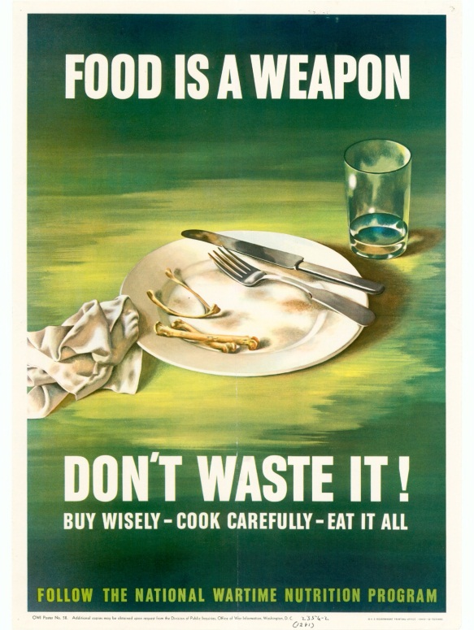
In a Nutshell…
SHUT UP
PRODUCE
SACRIFICE
HATE
Photo by ekurvine

