Slide 1
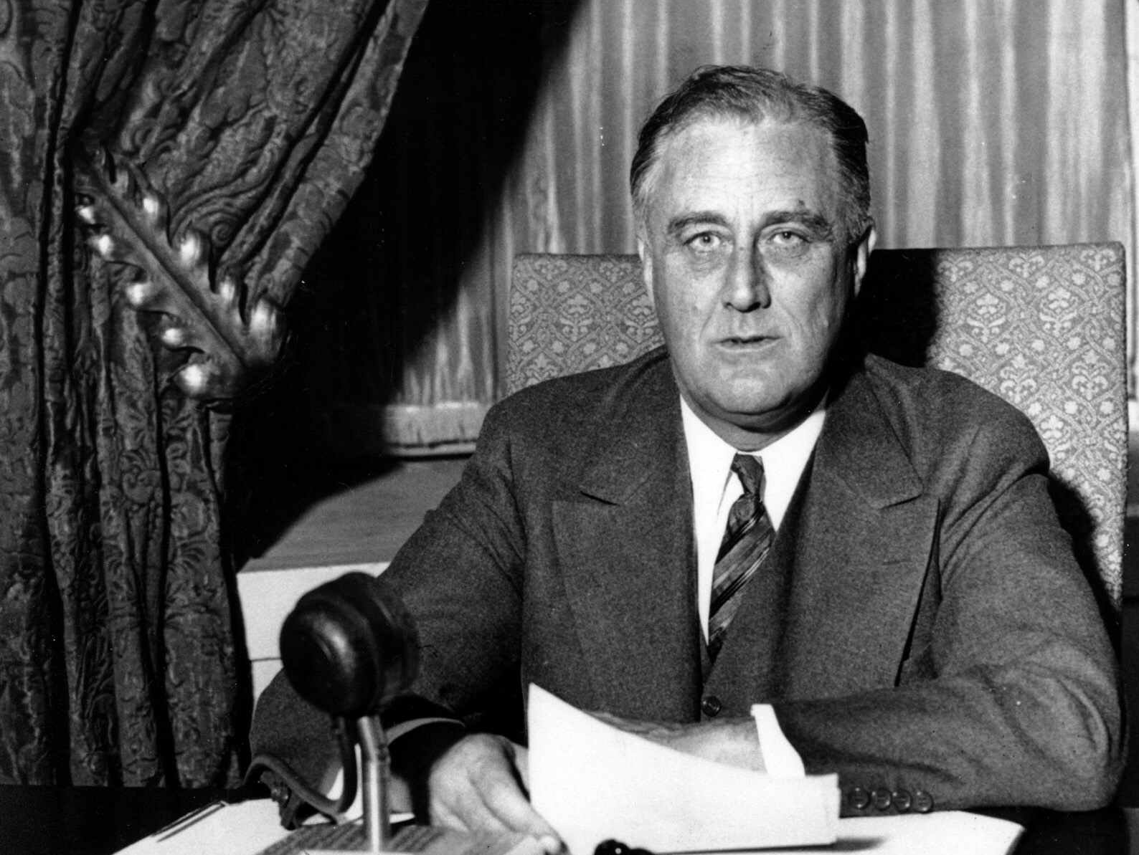


American Neutrality
The U.S. and the European War
(1936-1941)
USHC 7.1
Analyze the decision of the United States to enter World War II, including the nation’s movement from a policy of isolationism to international involvement and the Japanese attack on Pearl Harbor.

Slide 2
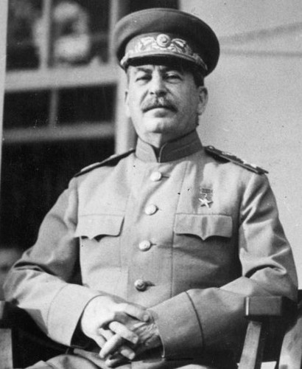
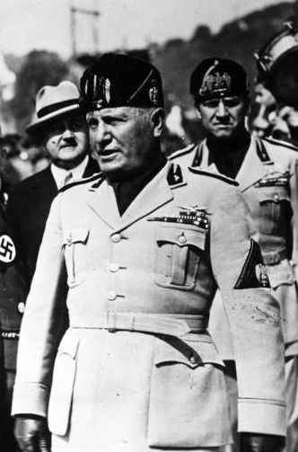
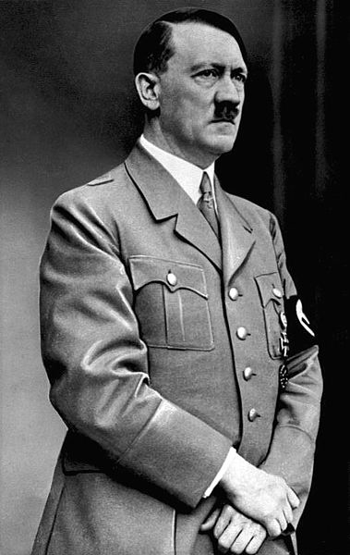
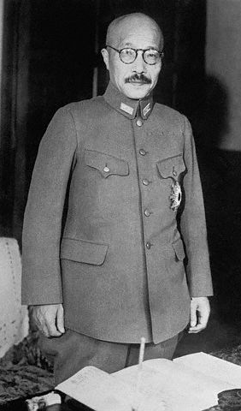
Totalitarian Dictatorships
SOVIET UNION
ITALY
GERMANY
JAPAN
STALIN
MUSSOLINI
HITLER
TOJO

Slide 3
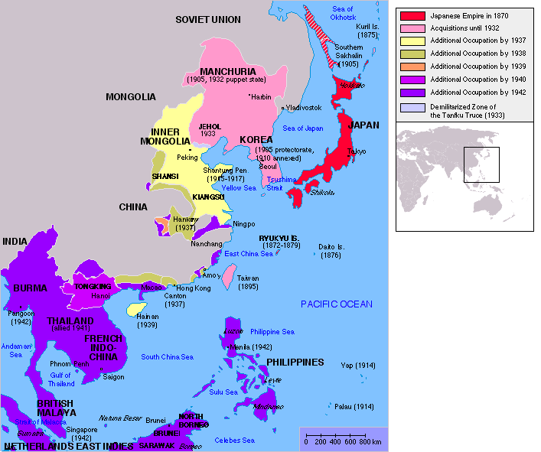
Japanese Expansion
Map Credit: BBC

Slide 4
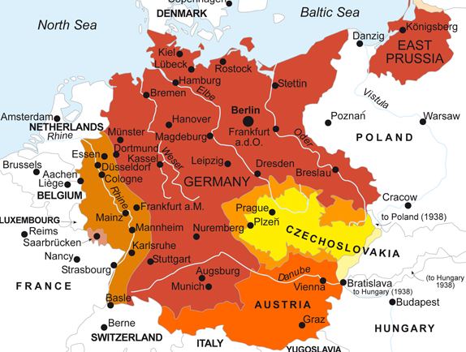
German Expansion
Notes:
Map Credit: http://germanhistorydocs.ghi-dc.org/map.cfm?map_id=2884

Slide 5
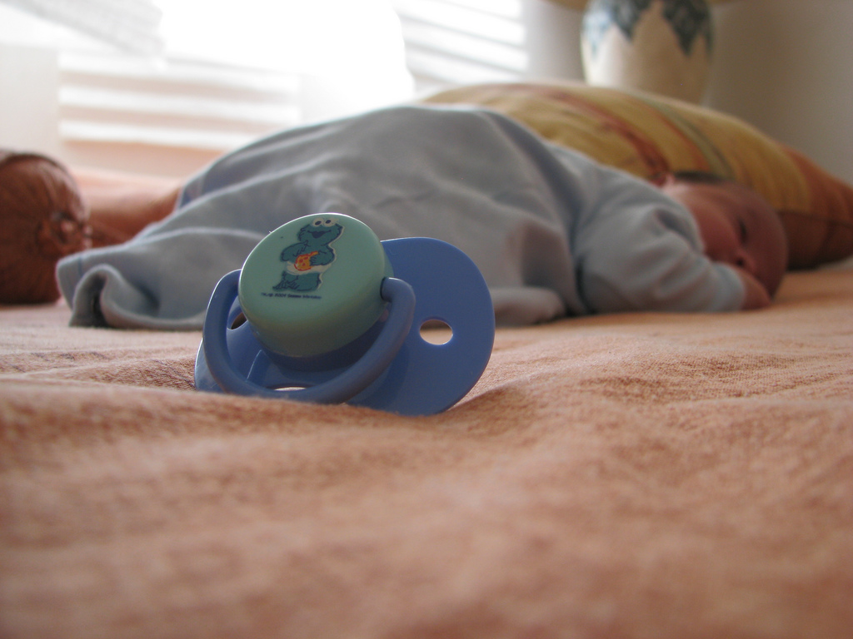
Appeasement
Photo by eperales

Slide 6
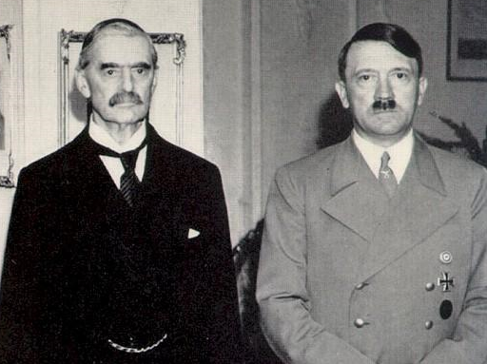
DO NOT INVADE POLAND!

Slide 7
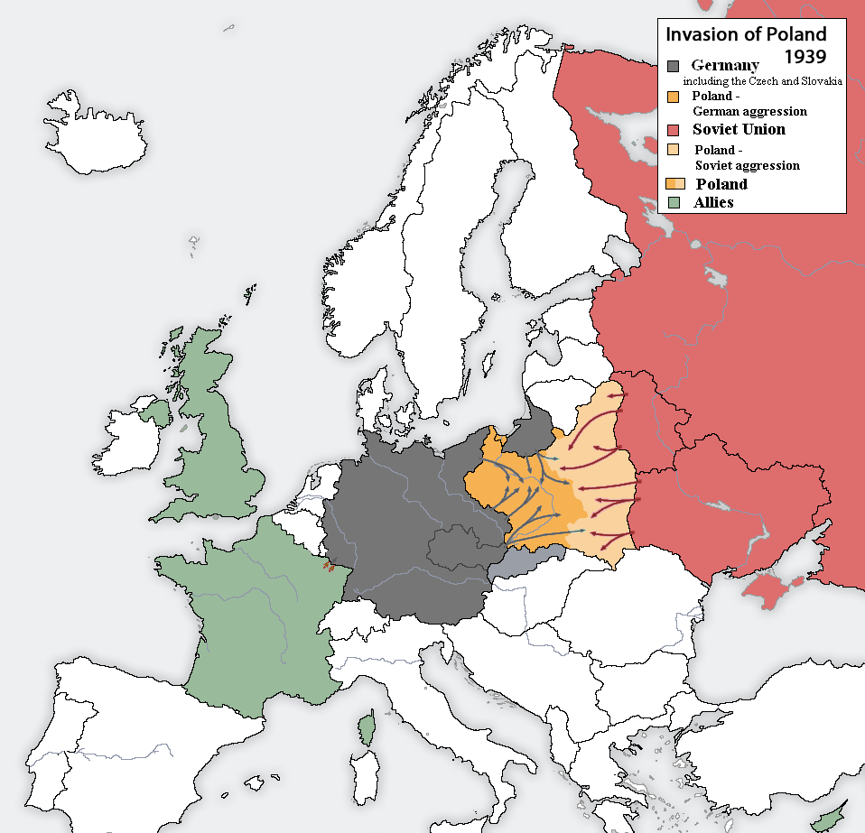
Hitler Invades Poland
September, 1939
Map Credit: Listowy

Slide 8





The Situation: 1939
The Allies
Germany
Neutral
WAR
WAR

Slide 9

Blitzkrieg
(Lightning War)
Panzer

Slide 10
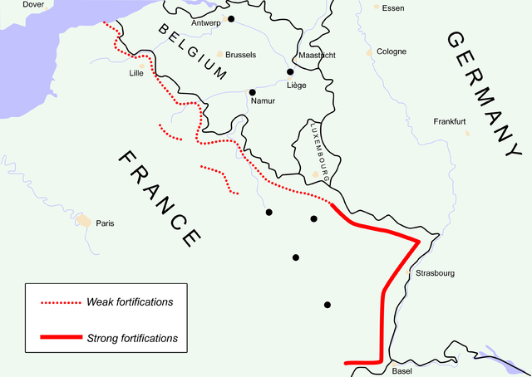
Fall of
France
1940
Made by Niels Bosboom.

Slide 11
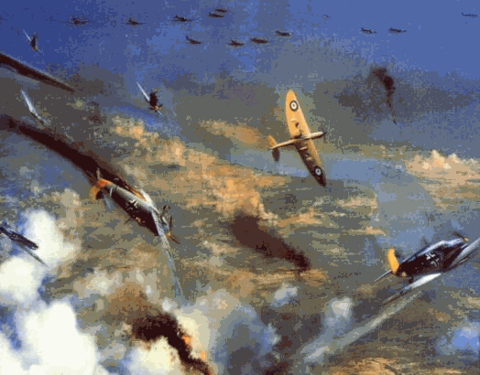
Battle of Britain
1940 Air Battles
Military Targets
Cities/Civilians

Slide 12

The World is Falling Apart

Slide 13
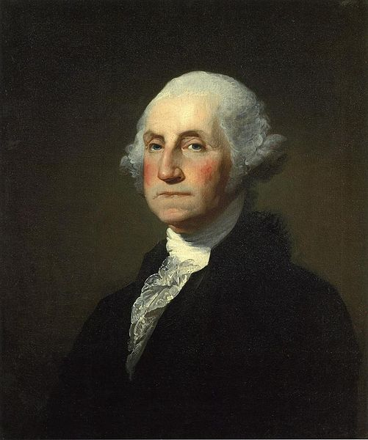
SO???

Slide 14
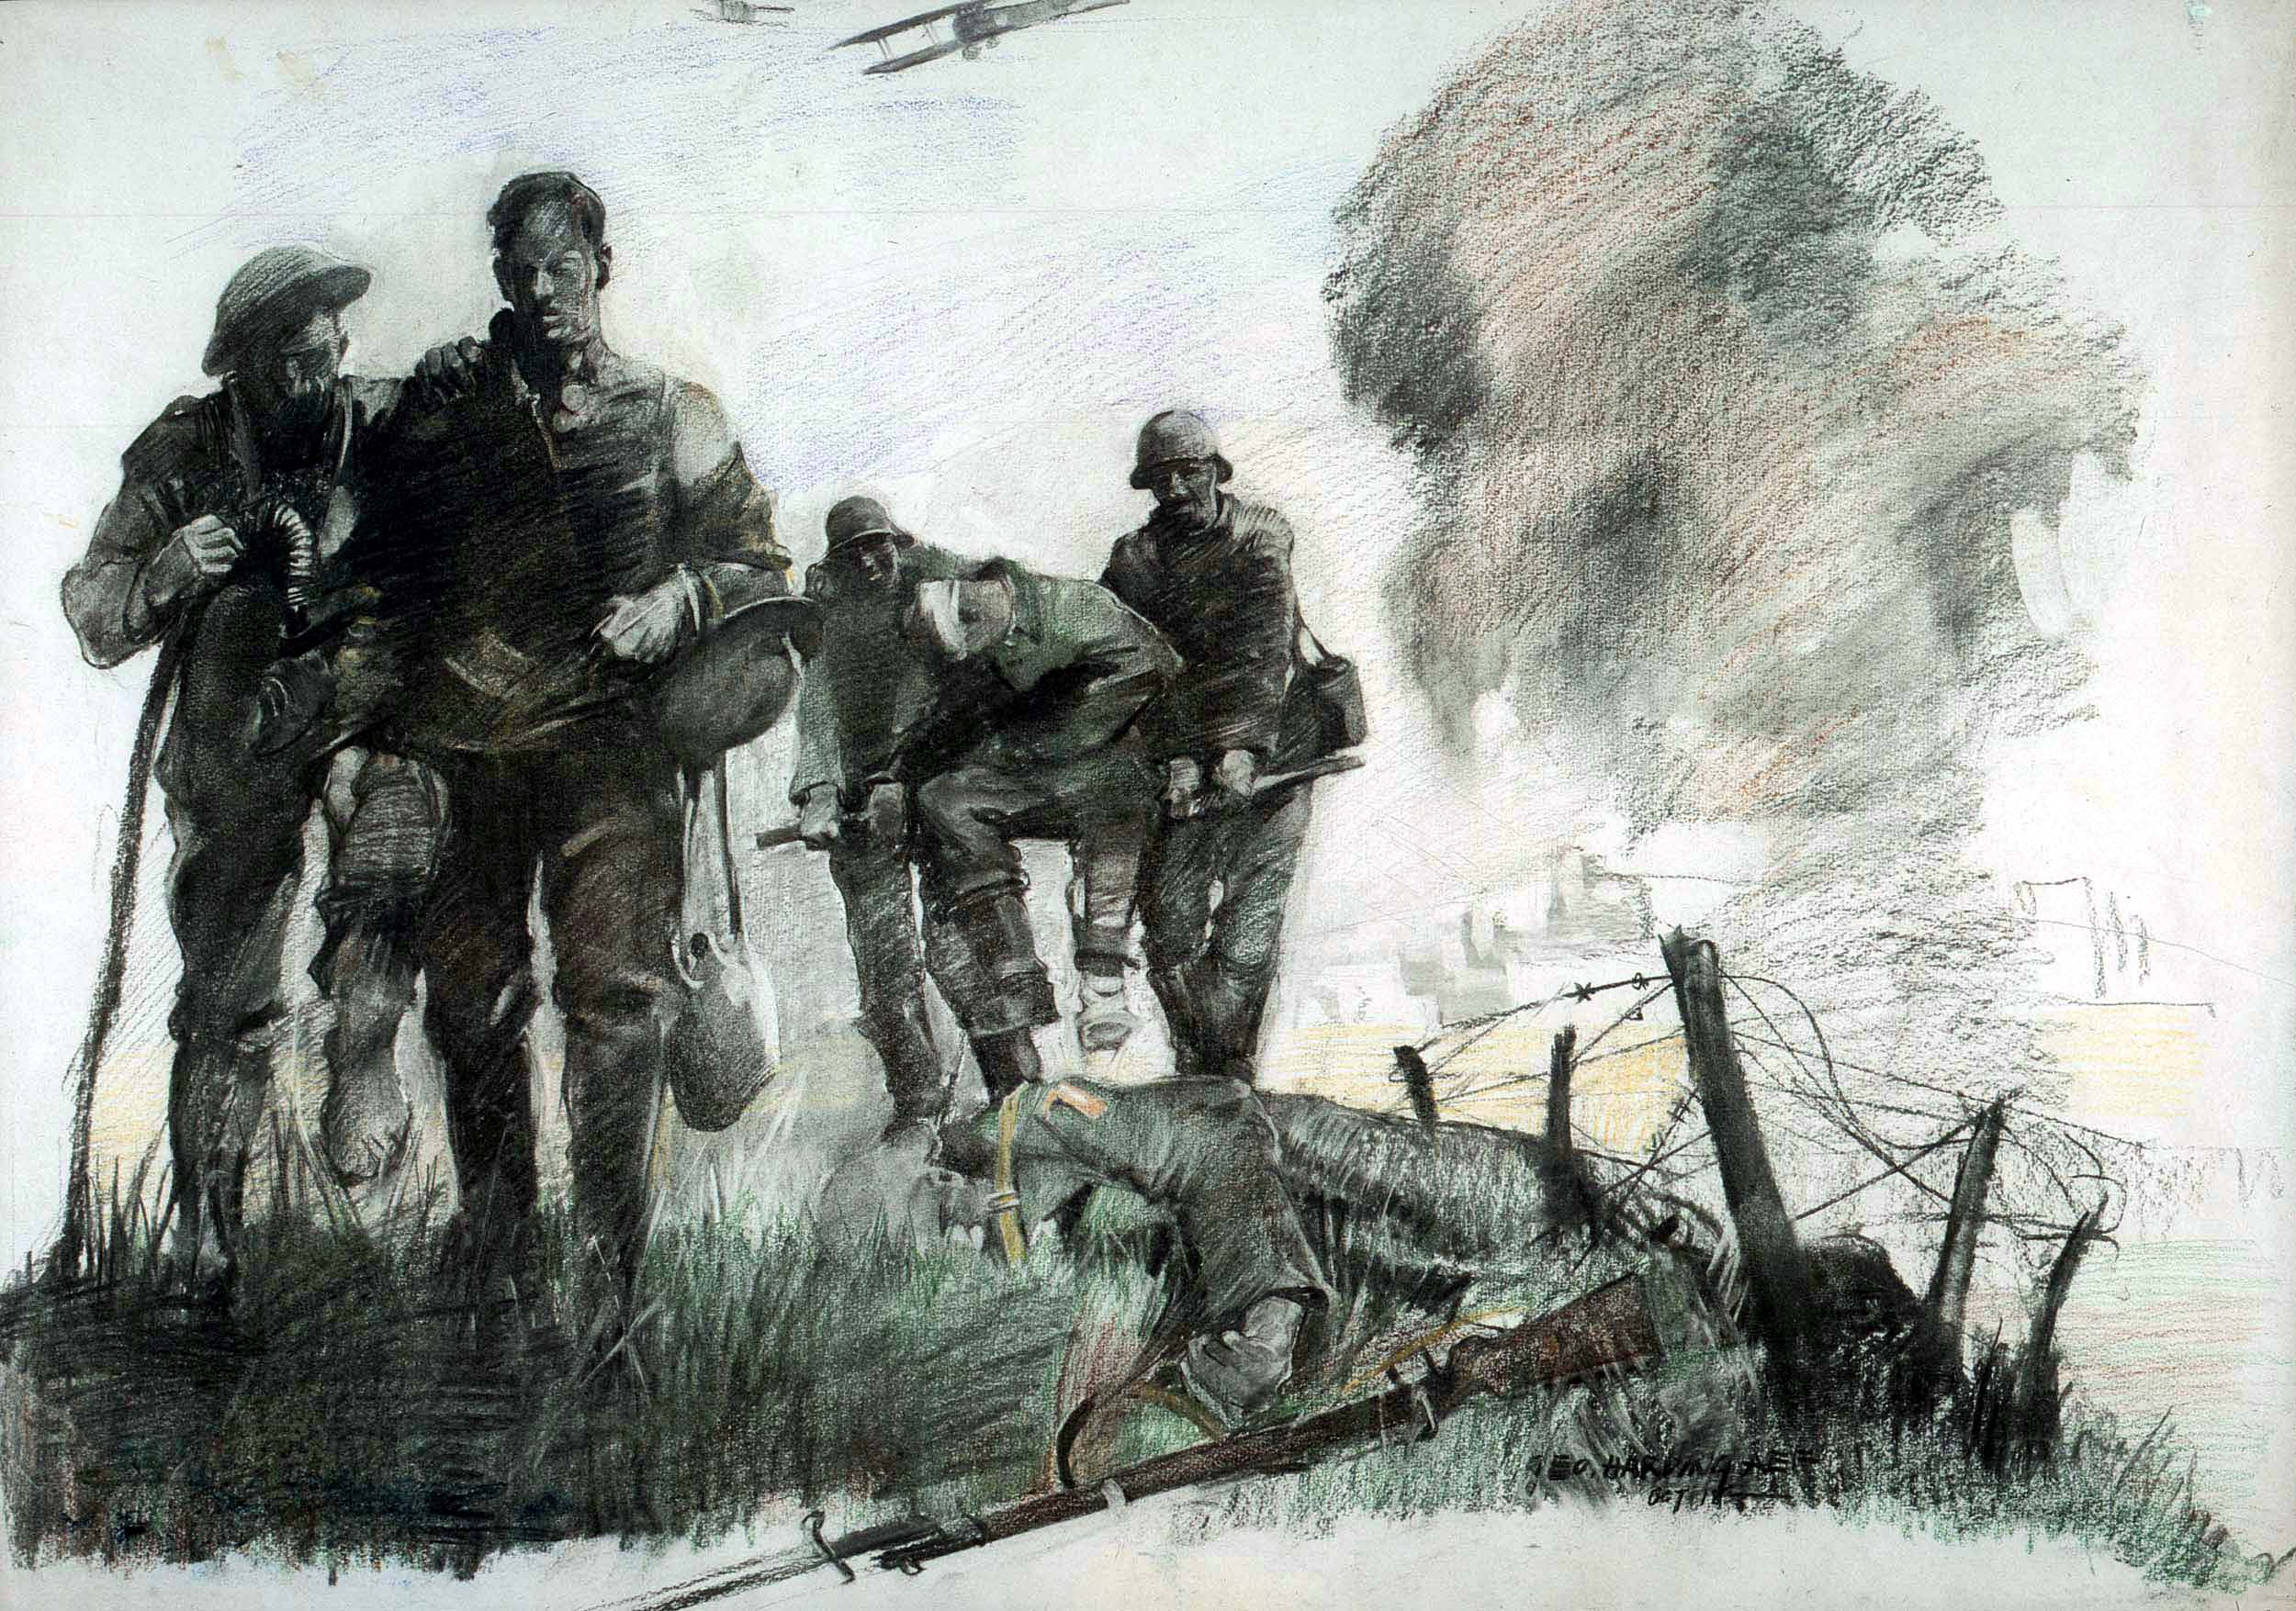
WWI
It SUCKED!
Notes:
American Wounded Making Way To First Aid Station In
The Village Of Marne During German Attack
by George Matthews Harding
Here Harding shows the ever-present human toll of war along with two of the innovations of the Great War, the airplane and barbed wire.
Source: http://www.history.army.mil/html/artphoto/pripos/wwi1.html

Slide 15
“Isolationism”
aka, “Non-Intervention”

Slide 16

Neutrality Acts
1936, 1937, 1939
NO ARMS TO BELLIGERENTS
Photo by *janine*

Slide 17
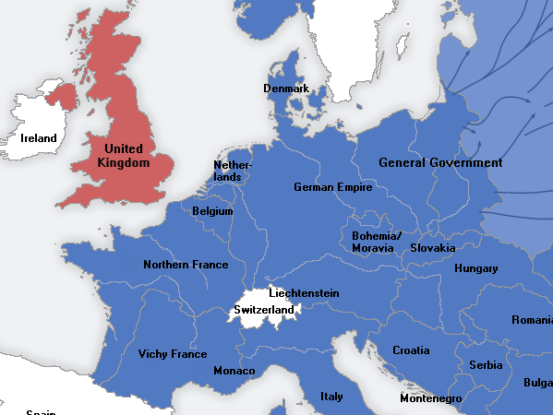
What If Britain Falls?

Slide 18
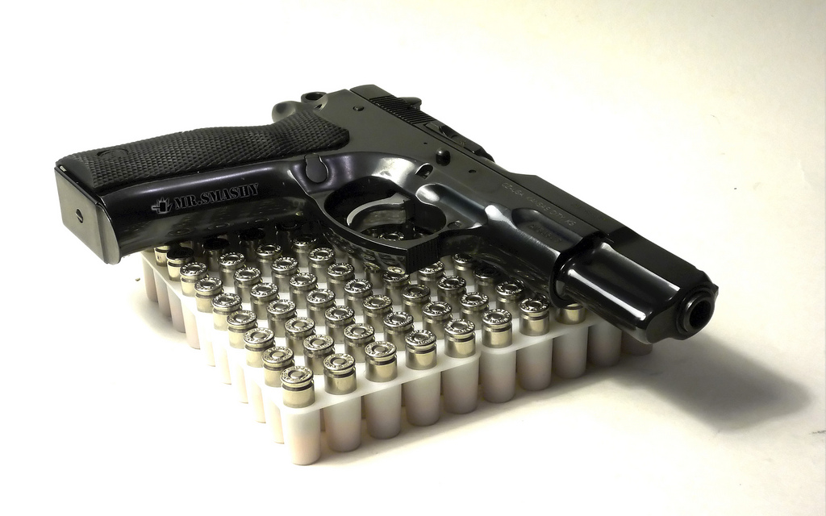
The Arsenal of Democracy
1939-1941
Cash and Carry (1939)
Destroyers for Bases (1940)
Lend-Lease (1941)
Photo by mr.smashy

Slide 19

Cash and Carry
1939
Pay cash and carry
it home, yourself.

Slide 20
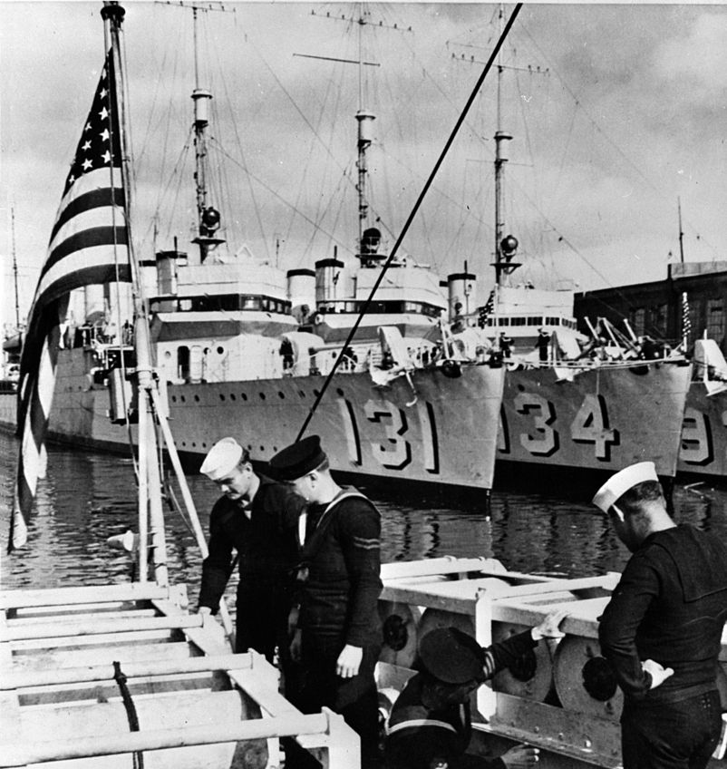
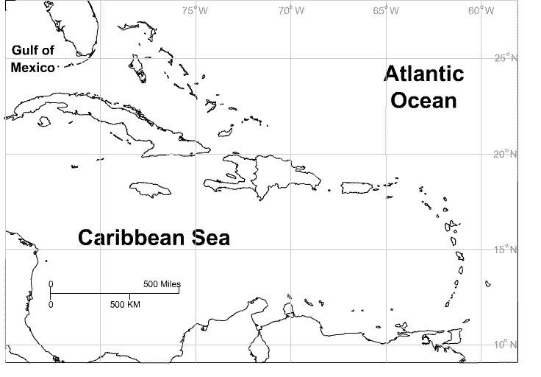
Destroyers for Bases
1940
Destroyers to Britain in exchange for naval bases in the Caribbean
Notes:
Map: http://www.sheppardsoftware.com/carribeanweb/blankmap.htm

Slide 21

Lend-Lease Act
1941
Let the British borrow military equipment
FURTHER READING:
FDR Press Conference
December 17, 1940
Photo by peasap

Slide 22
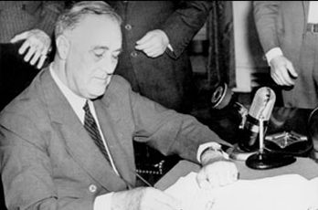
Selective Service Act
1940
FIRST PEACETIME DRAFT
in United States History
President Franklin D. Roosevelt signs the Selective Service Training Act.

Slide 23
But We’re Still NEUTRAL

Slide 24
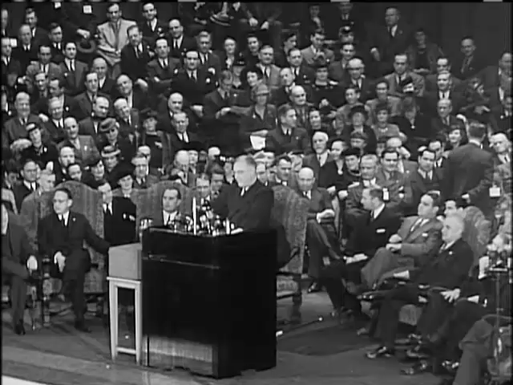

Slide 25
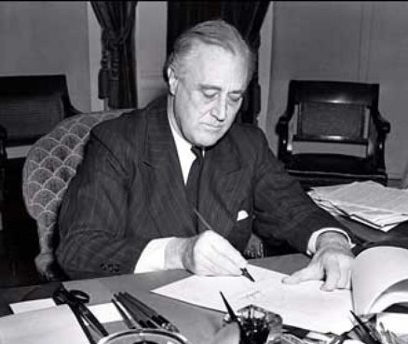
A Campaign Promise
“And while I am talking to you mothers and fathers, I give you one more assurance. I have said this before, but I shall say it again and again and again:
Your boys are not going to be sent into any foreign wars!”
-- FDR (10/30/1940)

Slide 26
The U.S. Enters the War

Slide 27
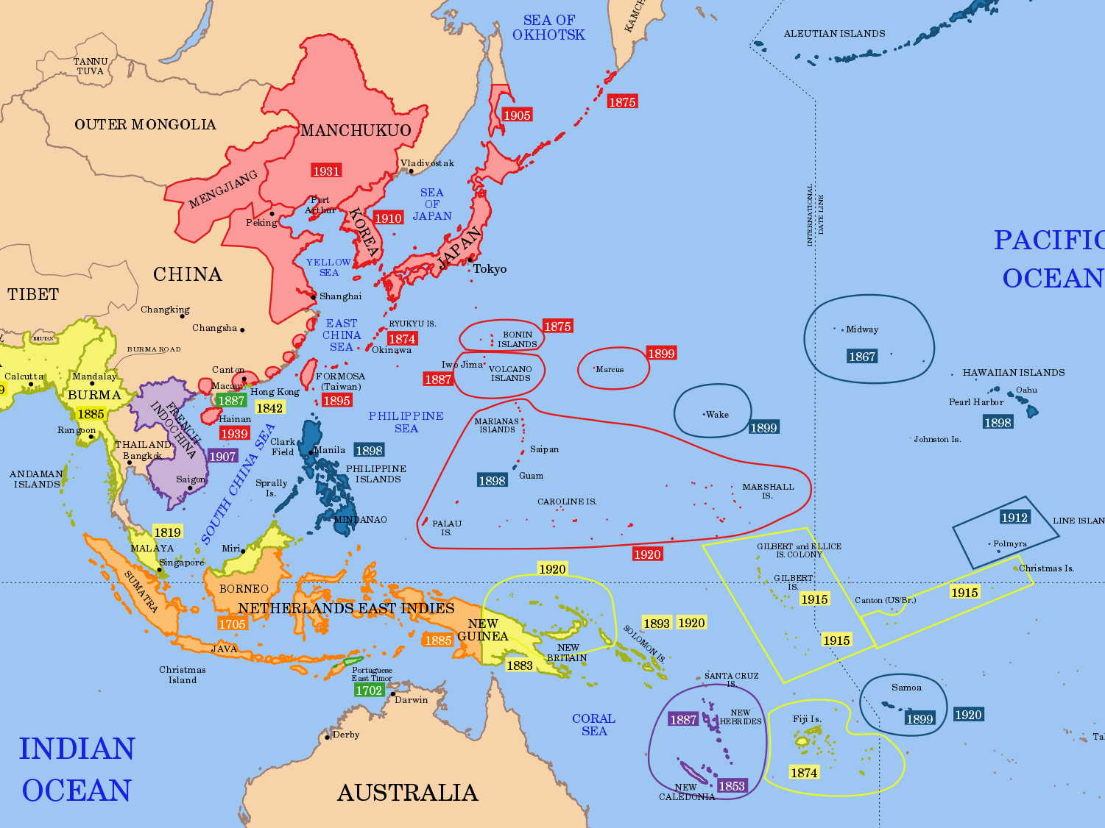
Japanese
Empire
AGGRESSIVE WARFARE

Slide 28
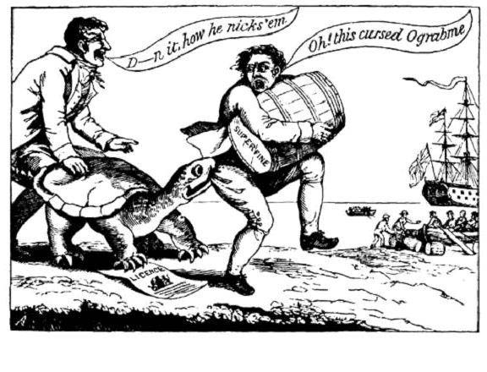
Take THAT, Japan!

Slide 29
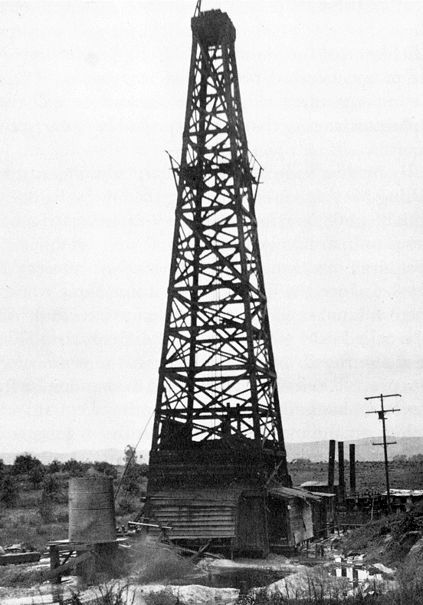
EMBARGO
NO OIL to Japan
By Orange County Archives

Slide 30
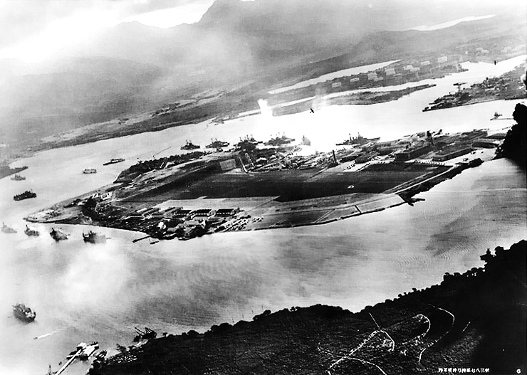
Japan Attacks Pearl Harbor
December 7, 1941

Slide 31
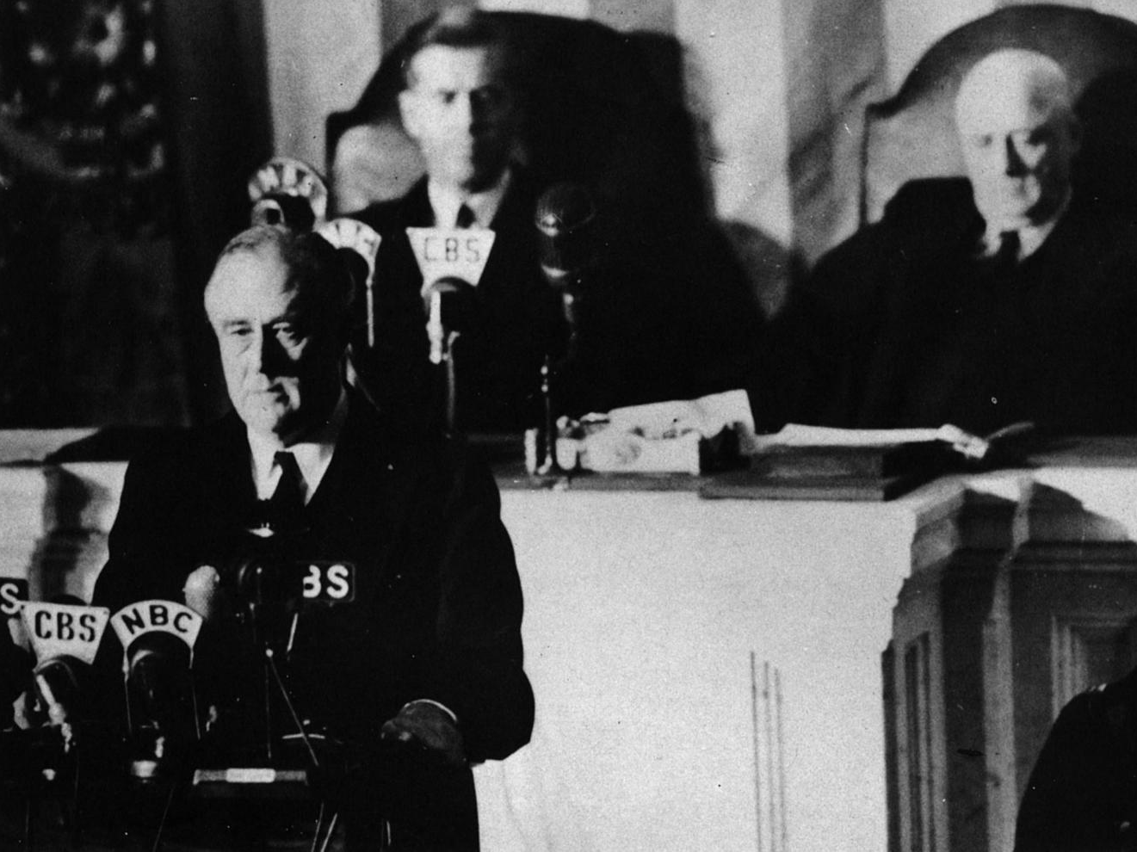

A date which will live in infamy…

Slide 32
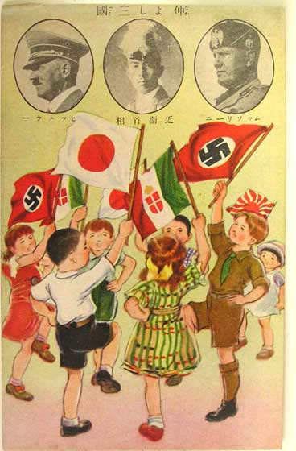
Axis Pact
Japan, Germany, and Italy agree to cooperate in their efforts… They further undertake to assist one another with all political, economic and military means if one of the Contracting Powers is attacked by a Power at present not involved in the European War or in the Japanese-Chinese conflict.

Slide 33



December, 1941
The Allies
The Axis
Neutral
WAR
WAR
WAR
Occupied

Slide 34
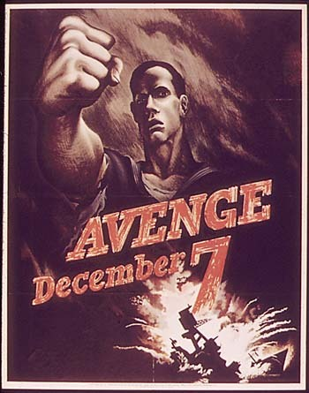
Gentlemen…
Start your PROPAGANDA engines!

Slide 35



