Slide 1
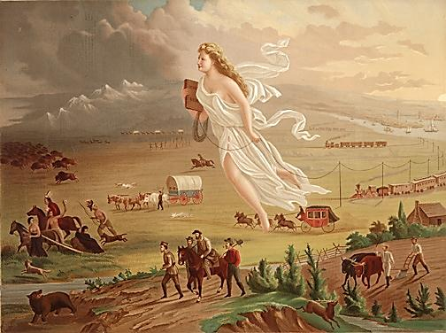

The
Monroe Doctrine
Manifest Destiny
and the
Mexican War
US HISTORY
EOC REVIEW

Slide 2
USHC 2.2
Explain how the Monroe Doctrine and the concept of Manifest Destiny affected the United States’ relationships with foreign powers, including the role of the United States in the Texan Revolution and the Mexican War.

Slide 3
The Monroe Doctrine

Slide 4
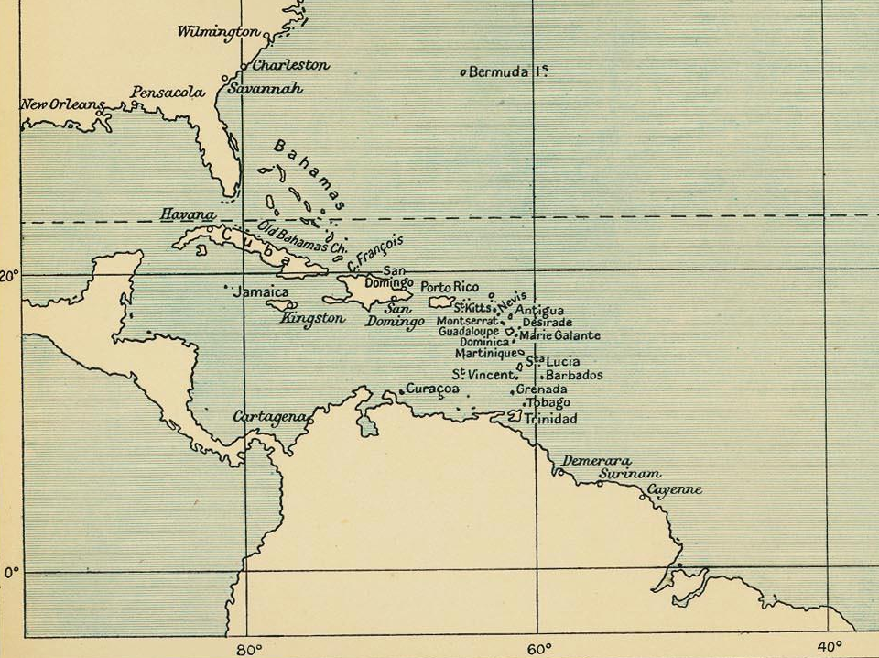
Revolutions in Latin America

Slide 5
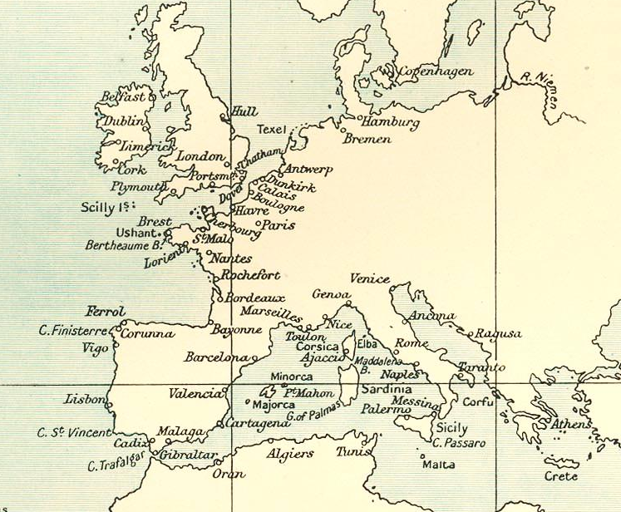
Europe wants colonies back

Slide 6
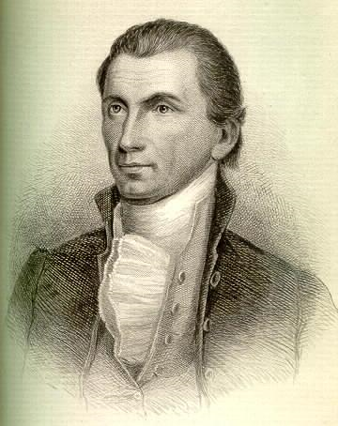
The Monroe Doctrine
“The American continents… are henceforth not to be considered as subjects for future colonization by any European powers. . .”

Slide 7
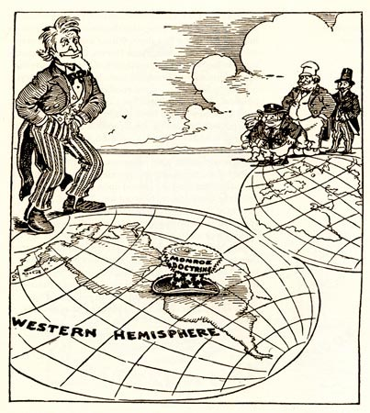
EUROPE: NO NEW COLONIES

Slide 8
You don’t have an army.
LIMITED IMPACT

Slide 9
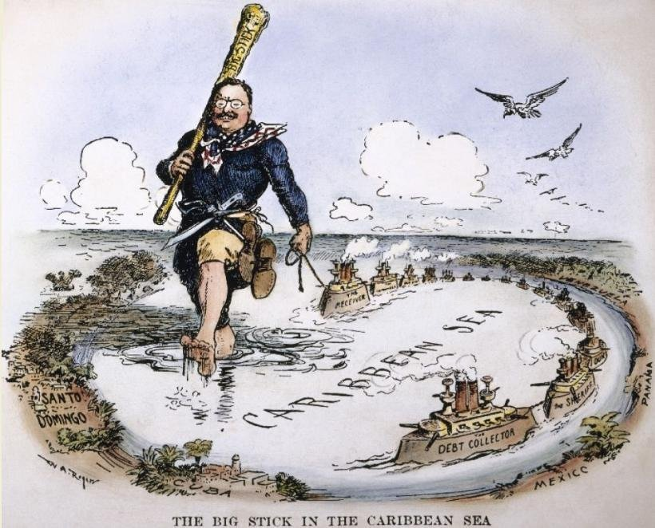
The Legacy:
US intervention in Latin America

Slide 10
John Gast, American Progress, 1872
Notes:
John Gast, American Progress, 1872

Slide 11
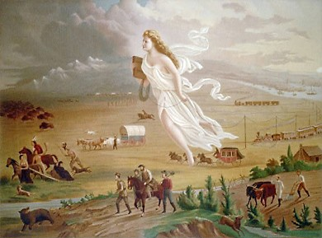
Manifest
Destiny
man⋅i⋅fest (adj)
evident; obvious; apparent; plain
des⋅ti⋅ny (n)
predetermined, usually inevitable or irresistible, course of events.

Slide 12
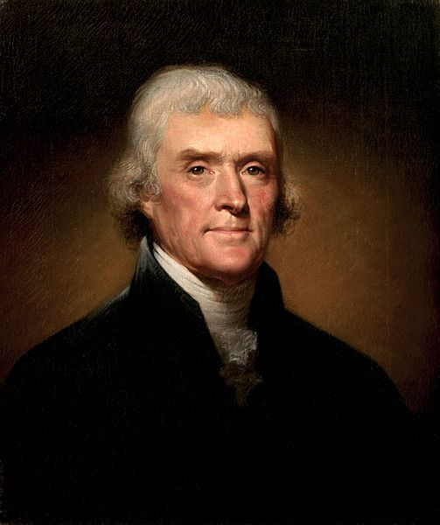
Manifest Destiny
“Kindly separated by nature and a wide ocean from the exterminating havoc of one quarter of the globe… possessing a chosen country, with room enough for our descendants to the thousandth and thousandth generation…”
-- Thomas Jefferson,
First Inaugural Address
March 4, 1801
Jefferson

Slide 13
Manifest Destiny
“I shall need, too, the favor of that Being in whose hands we are, who led our forefathers, as Israel of old, from their native land, and planted them in a country flowing with all the necessaries and comforts of life; who has covered our infancy with his providence, and our riper years with his wisdom and power…”
-- Thomas Jefferson,
Second Inaugural Address
March 4, 1805
Jefferson

Slide 14
WESTWARD EXPANSION:
A God-given Right
John Gast, American Progress, 1872
Notes:
John Gast, American Progress, 1872

Slide 15

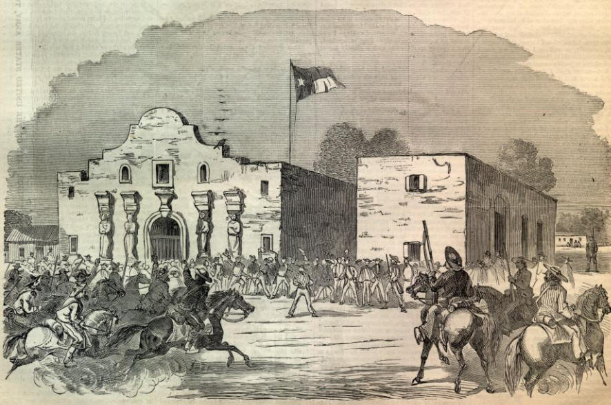
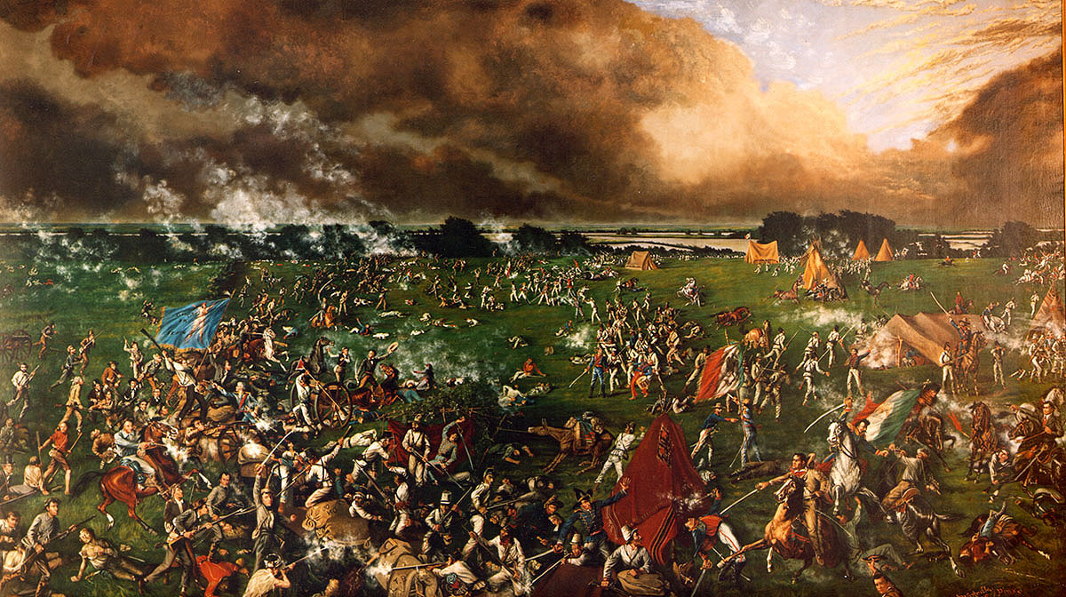
Texas War for Independence
1835-1836
The Alamo (1836)
San Jacinto (1836)
Outnumbered Texans defeated
Prisoners executed
DECISIVE Texas Victory
“Remember the Alamo!”

Slide 16

The “Lone Star” Republic

Slide 17

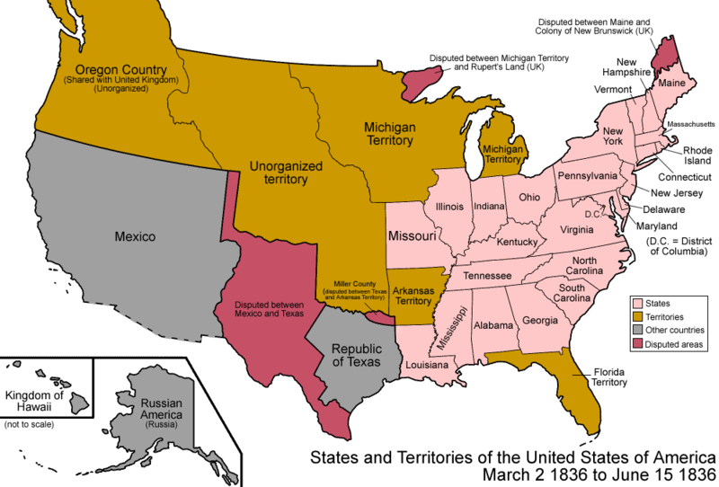
Annexation of Texas
1837 – Texas petitions the U.S. for annexation
United States: NO!
TWO REASONS:
Border Dispute
The Balance
of Power

Slide 18
Border Dispute
The Republic of Texas claimed the Rio Grande as its border with Mexico.
The government of Mexico didn’t recognize this border.
Annexation =
War with Mexico?

Slide 19
A Delicate Balance
Slave States | Year | Free States | Year
Delaware | 1787 | New Jersey | 1787
Georgia | 1788 | Pennsylvania | 1787
Maryland | 1788 | Connecticut | 1788
S. Carolina | 1788 | Massachusetts | 1788
Virginia | 1788 | New Hampshire | 1788
N. Carolina | 1789 | New York | 1788
Kentucky | 1792 | Rhode Island | 1790
Tennessee | 1796 | Vermont | 1791
Louisiana | 1812 | Ohio | 1803
Slave States | Year | Free States | Year
Mississippi | 1817 | Indiana | 1816
Alabama | 1819 | Illinois | 1818
Missouri | 1821 | Maine | 1820
Arkansas | 1836
Expansion = Internal Strife

Slide 20
Meanwhile…
John Gast, American Progress, 1872
Notes:
John Gast, American Progress, 1872

Slide 21
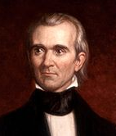
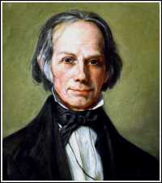
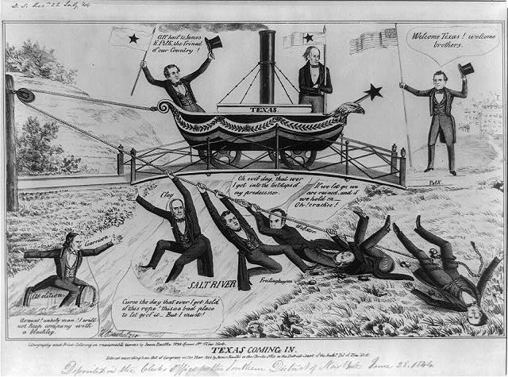
1844 Presidential Election
Main Issue:
Westward Expansion
vs.
James K. Polk
Democrat
Henry Clay
Whig
PRO-EXPANSION
ANTI-EXPANSION
Political Cartoon

Slide 23
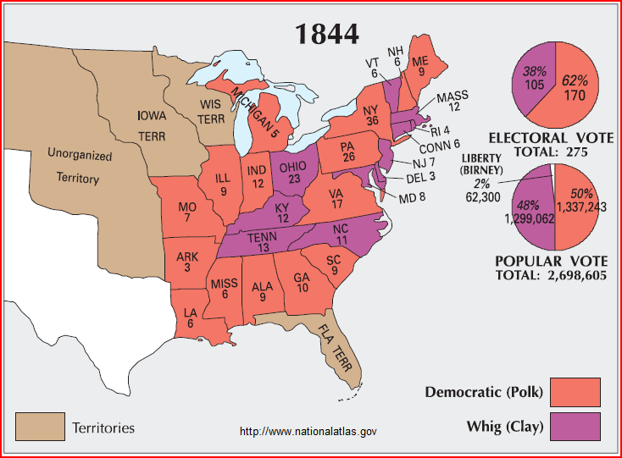
POLK WINS

Slide 24
ANNEXED
1845 by a joint resolution of Congress

Slide 25
The Mexican War

Slide 26
Manifest Destiny
John Gast, American Progress, 1872
Notes:
John Gast, American Progress, 1872

Slide 27
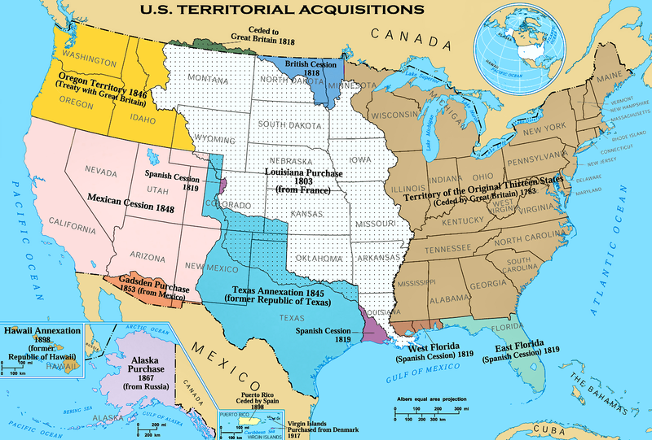

Almost There...
Oregon
Treaty
Louisiana Purchase
Texas
Annexation

Slide 28
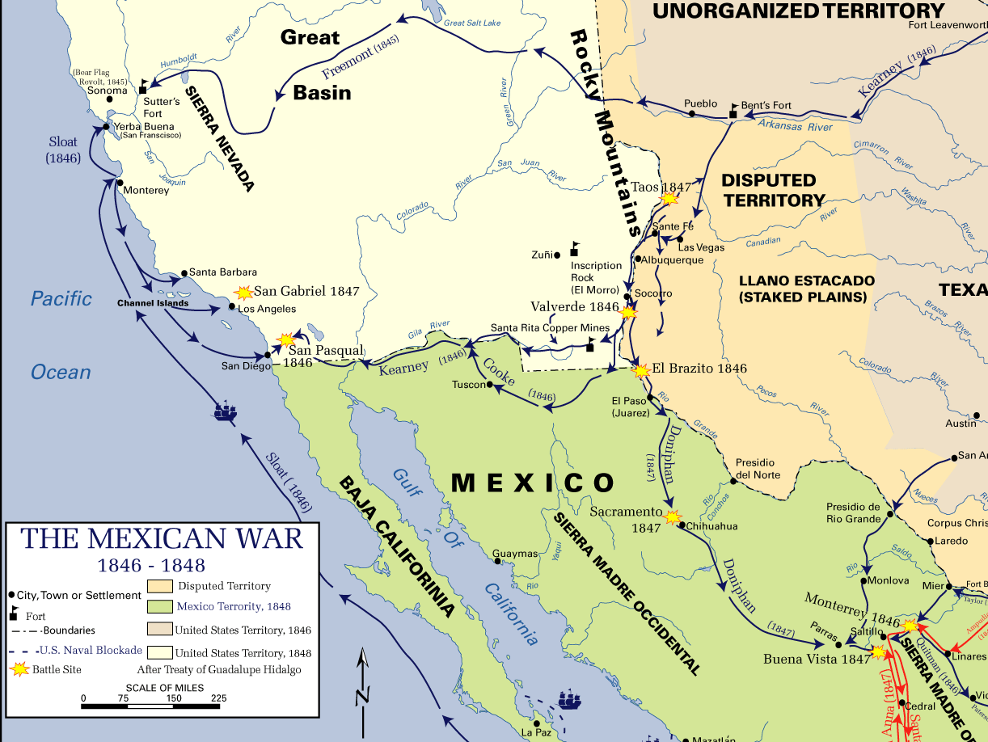
WAR!!!

Slide 29
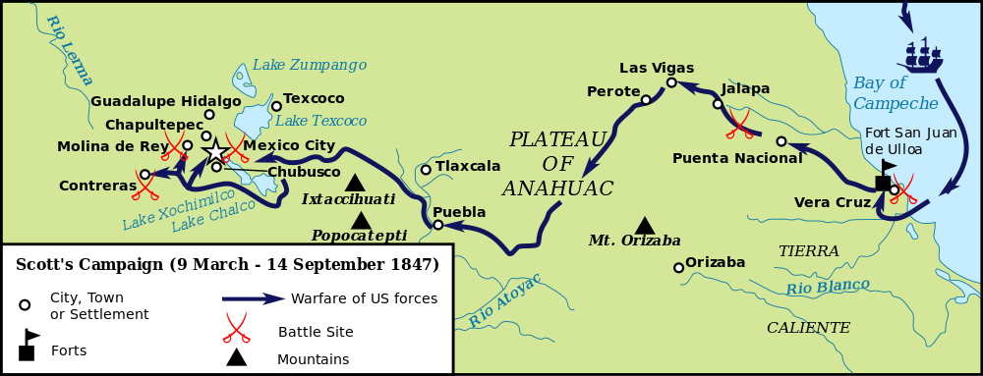
Gen. Scott’s Campaign

Slide 30
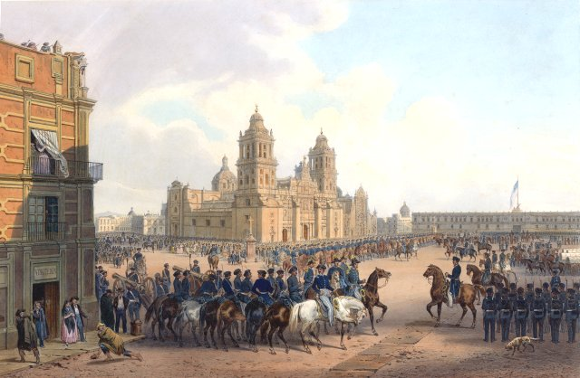

Occupation of Mexico City
BIG WIN
Painting by Carl Nebel

Slide 31
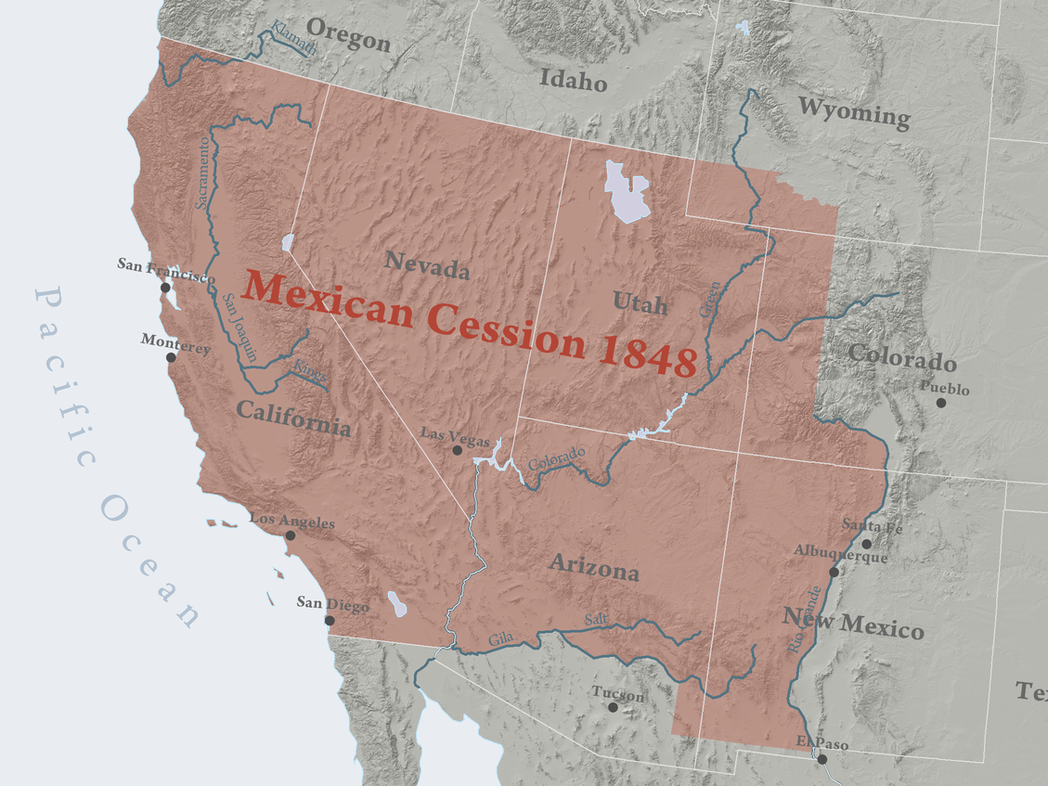
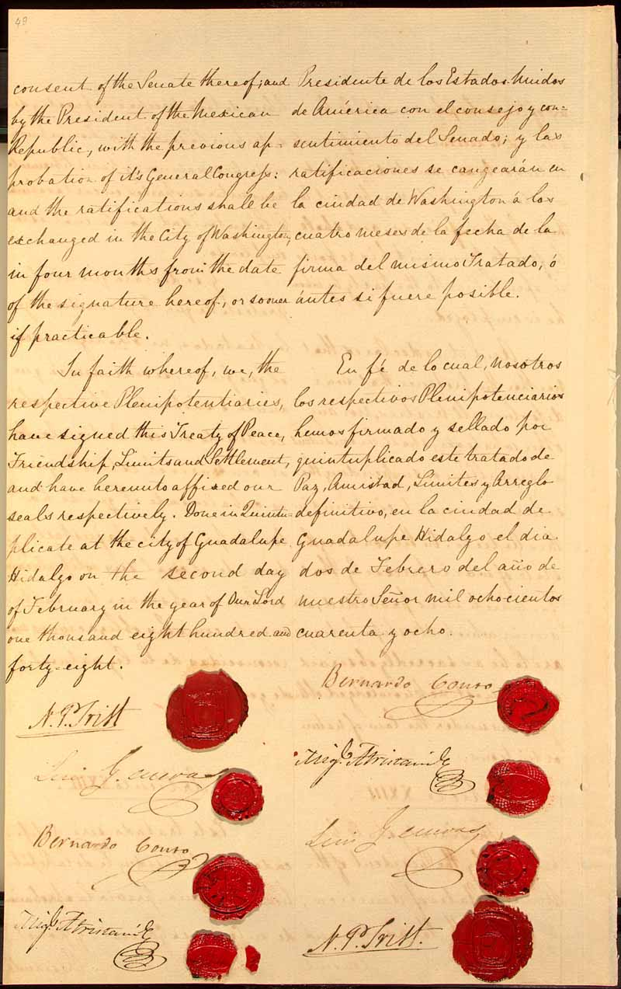
Mexican Cession
1848
Treaty of
Guadalupe Hidalgo

Slide 32
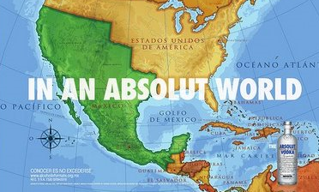
A Continuing Controversy...

Slide 33
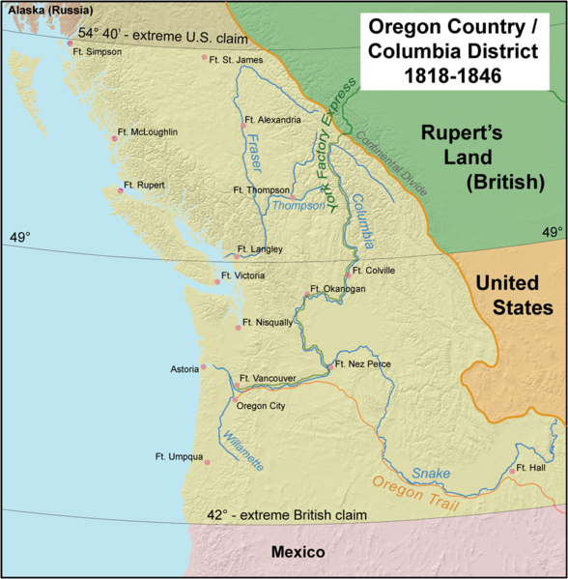
Oregon Treaty
1846
54°40’ (or fight)
U.S. compromises with Britain on Oregon border
49° (Britain Calls Bluff)
Map by Kmusser

Slide 34








