Slide 1
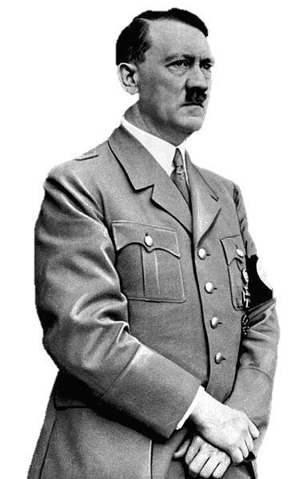
The Rise of Hitler

Slide 2
Questions
Essential
How did Hitler come to power in Germany?
What influenced the development of Hitler’s political ideology?

Slide 3
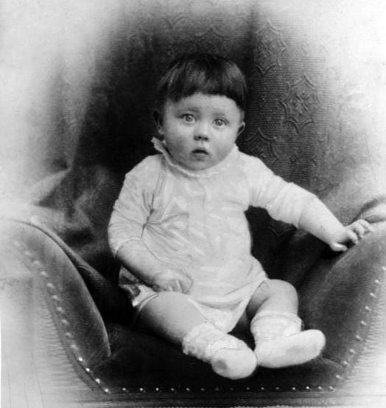
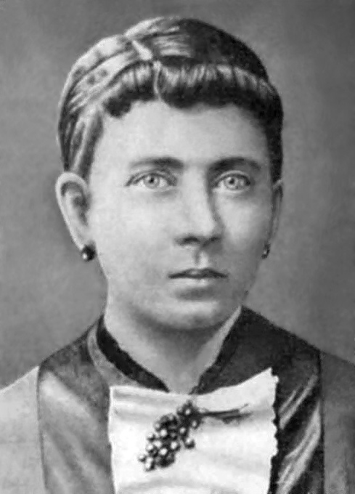
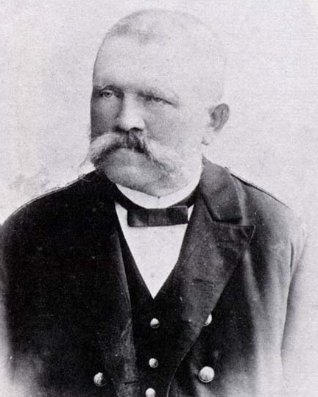
Austria (4/20/1889)

Slide 4
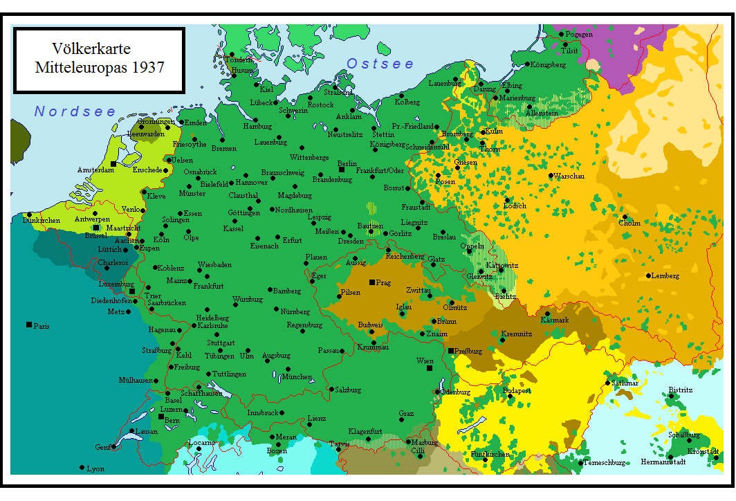
PAN-GERMANISM
Map by Hardcore-Mike (Wikipedia)

Slide 5
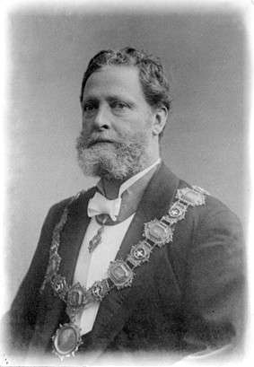
Vienna
A Hotbed of Anti-Semitism
Karl Lueger (Mayor, 1897-1910)

Slide 6
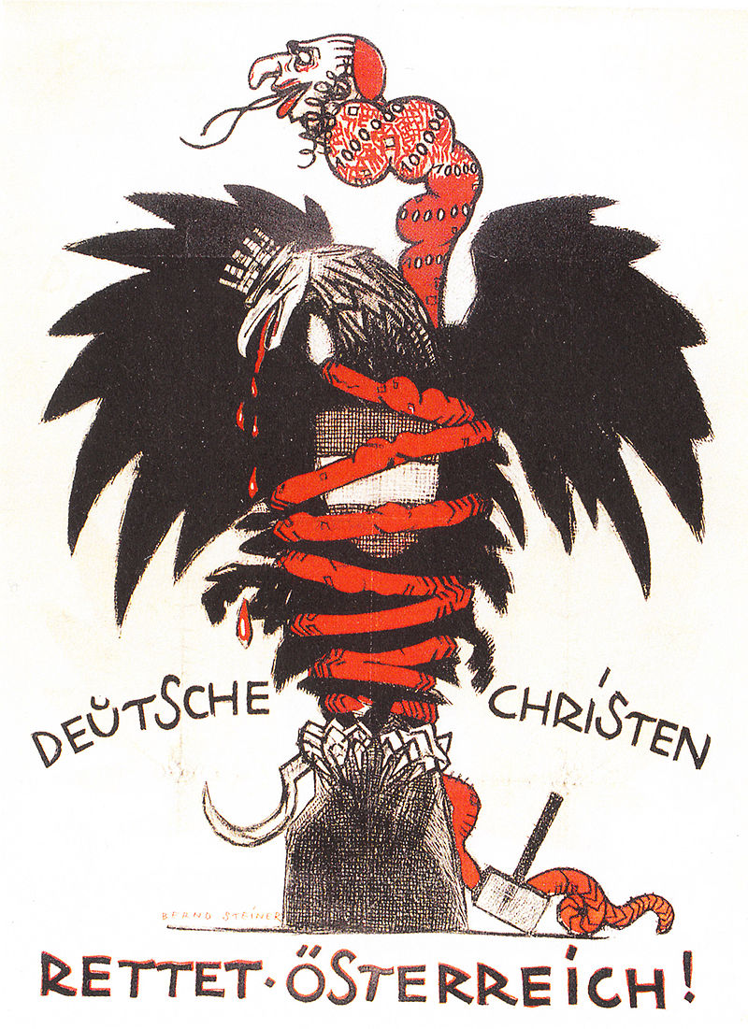
Anti-Semitic Austrian Propaganda (1920)

Slide 7
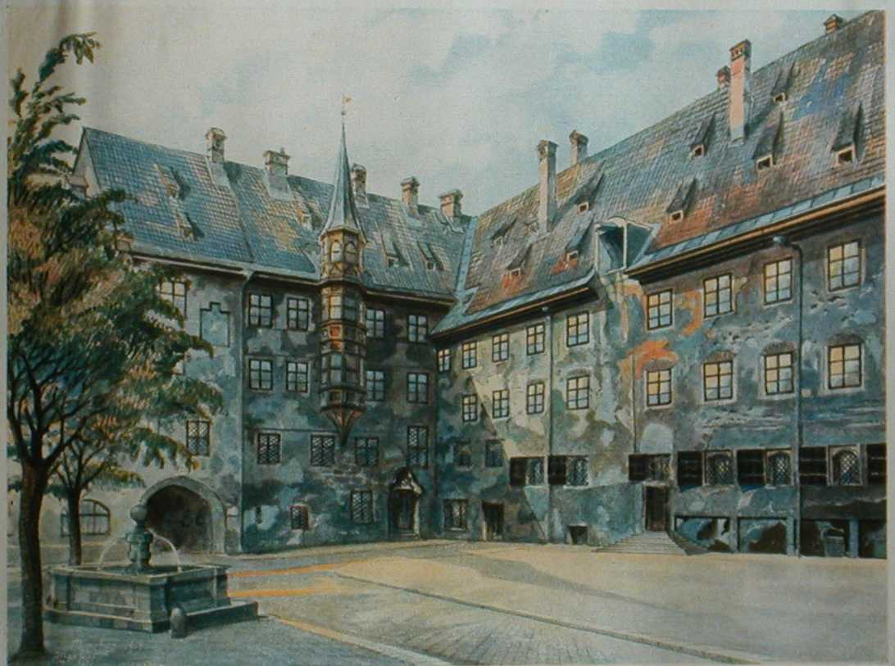
Artist
The Alter Hof in Munich. Watercolour by Adolf Hitler, 1914

Slide 8
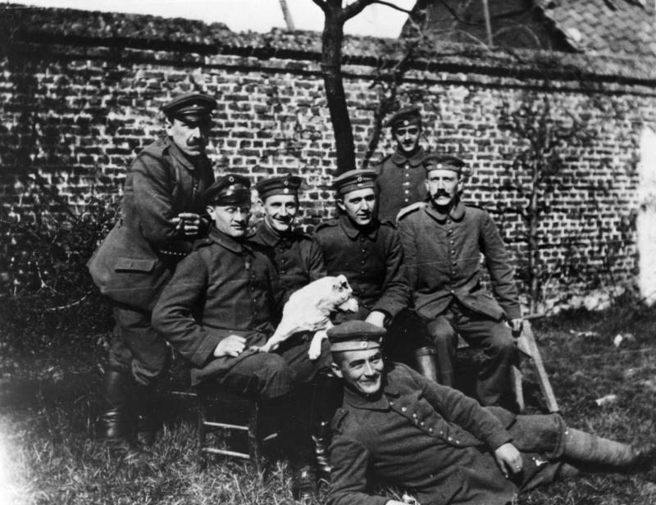
WWI VETERAN

Slide 9
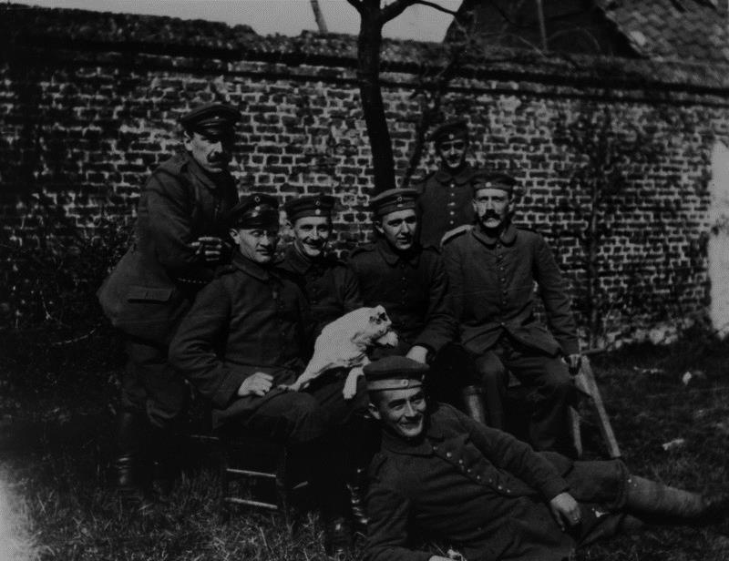
WWI VETERAN
Hitler went to Bavaria to enlist in the German Army.

Slide 10
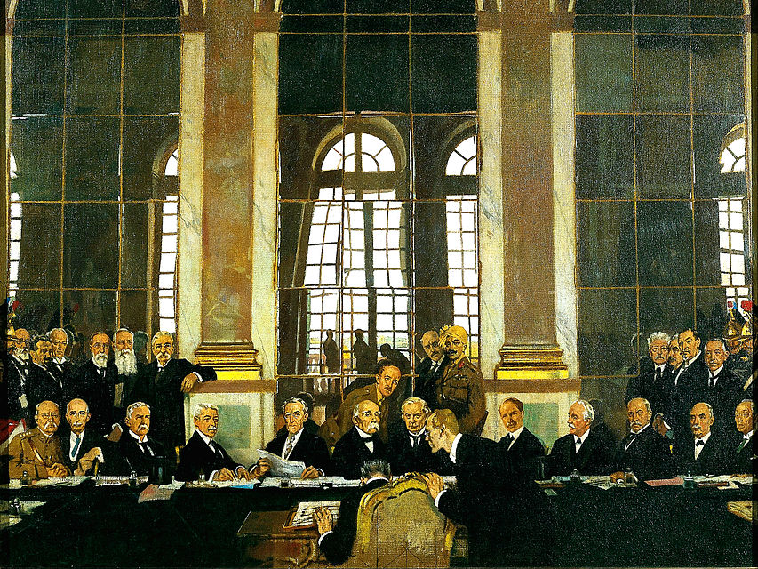
TREATY OF VERSAILLES

Slide 11
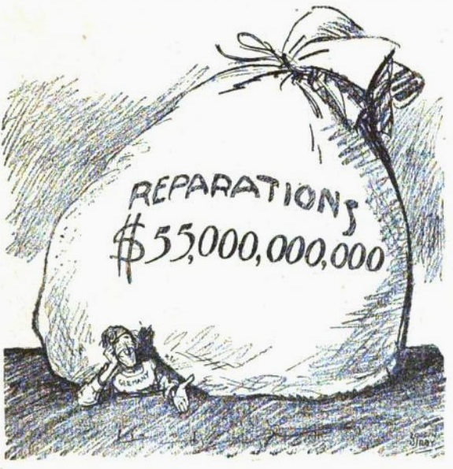
REPARATIONS
1921 American Political Cartoon

Slide 12
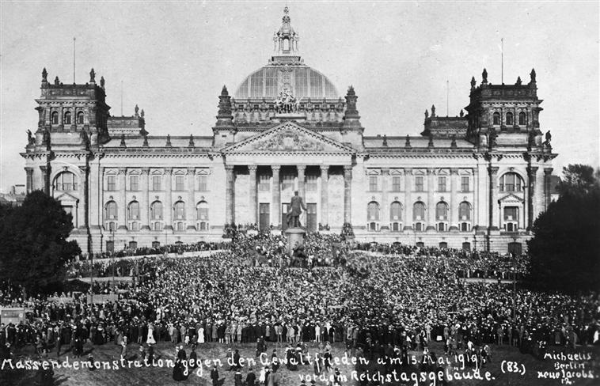
GERMAN ANTI-TREATY DEMOSTRATION

Slide 13
RADICALISM
Parties like the German Workers’ Party blamed the government, Jews, and Marxists for Germany’s defeat.

Slide 14
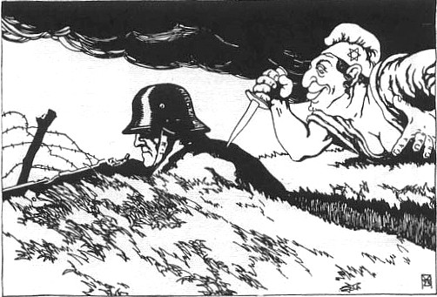
Stabbed in the back?
1919 Austrian Political Cartoon

Slide 15
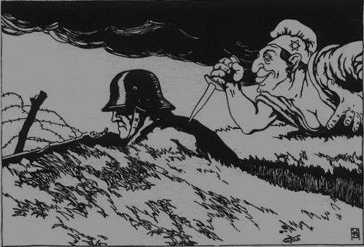
scapegoat
1919 Austrian Political Cartoon

Slide 16
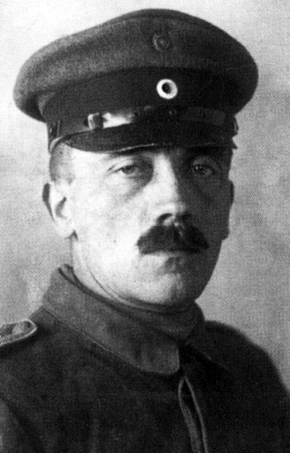
HITLER JOINS THE PARTY
After being tasked by the military to embed himself in [what was then] the German Workers’ Party as a spy, Hitler joined and became an active member.

Slide 17
National Socialist German Workers party
Founded 1920
Nationalism
Anti-Marxism
Anti-Capitalism
Anti-Semitism

Slide 18
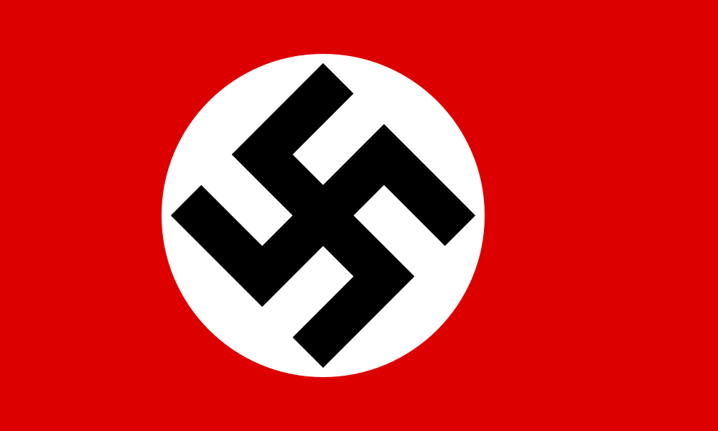
Logo Designed by Hitler

Slide 19
"I myself, meanwhile, after innumerable attempts, had laid down a final form; a flag with a red background, a white disk, and a black swastika in the middle. After long trials I also found a definite proportion between the size of the flag and the size of the white disk, as well as the shape and thickness of the swastika."

Slide 20
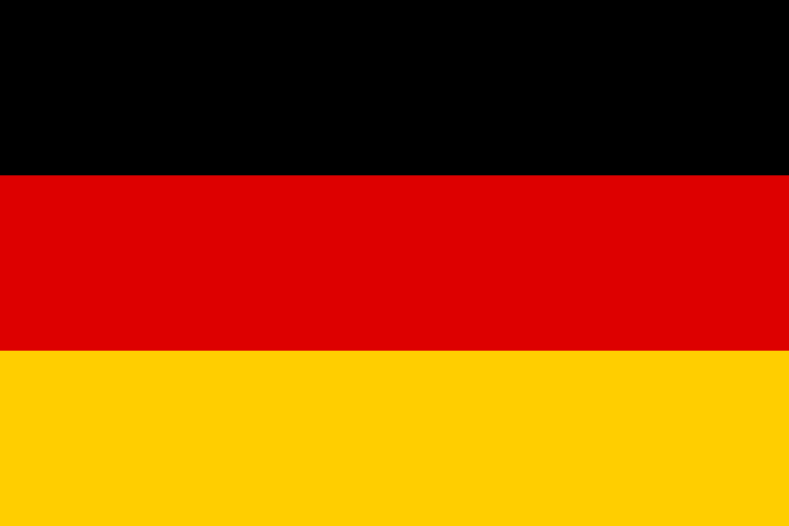
THROWBACK
German Empire
Weimar Republic

Slide 21
symbolism
Socialism
Aryan Race
Nationalism

Slide 22
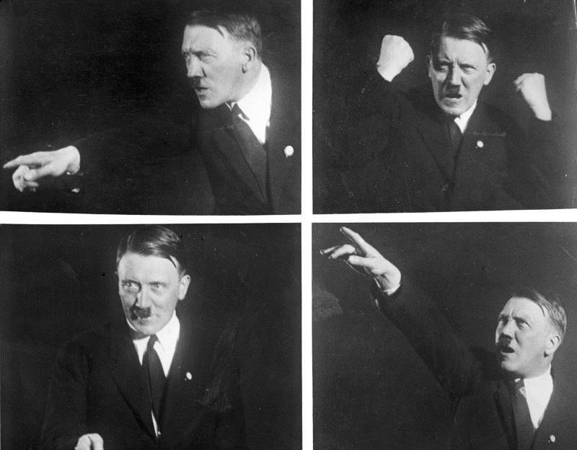
Public Speaker

Slide 23
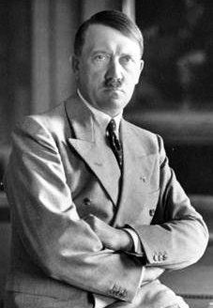
PARTY LEADER
In 1921, Hitler was elected leader of the Nazi Party.

Slide 24
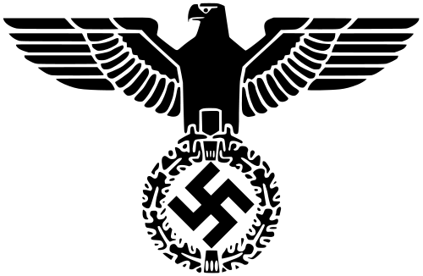
Key Events
(1920s)
1923 | Beer Hall Putsch
1924 | Hitler in Prison
1925 | Mein Kampf Published

Slide 25
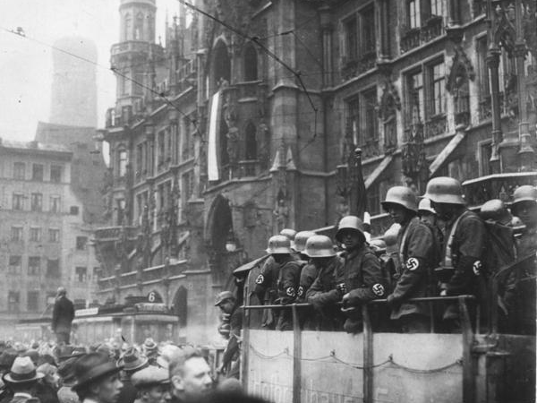
BEER HALL PUTSCH
1923
A failed Nazi attempt to overthrow the government by force
German Federal Archives

Slide 26
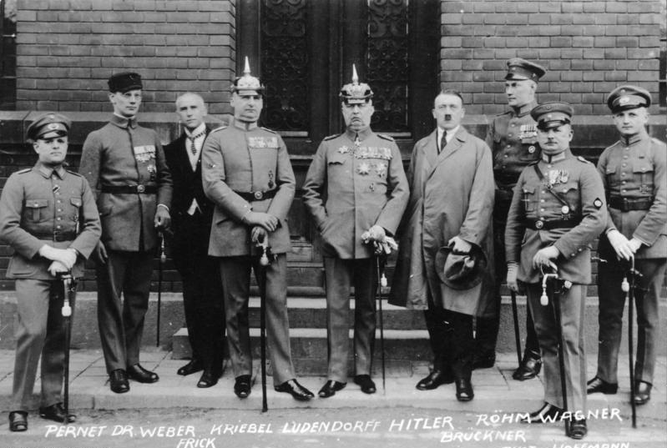
Defendants
German Federal Archives

Slide 27
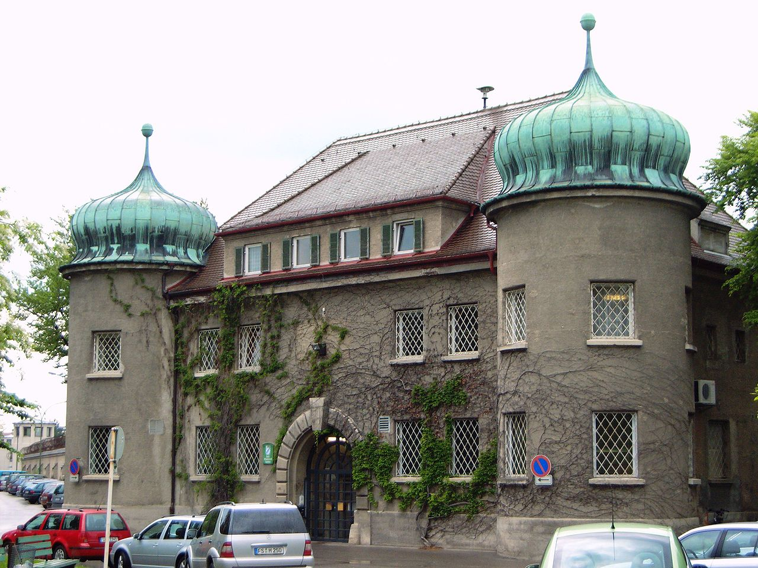
HITLER GOES TO JAIL
Landsberg Prison, Bavaria

Slide 28
264 Days

Slide 29
264 Days
FOR TREASON

Slide 30
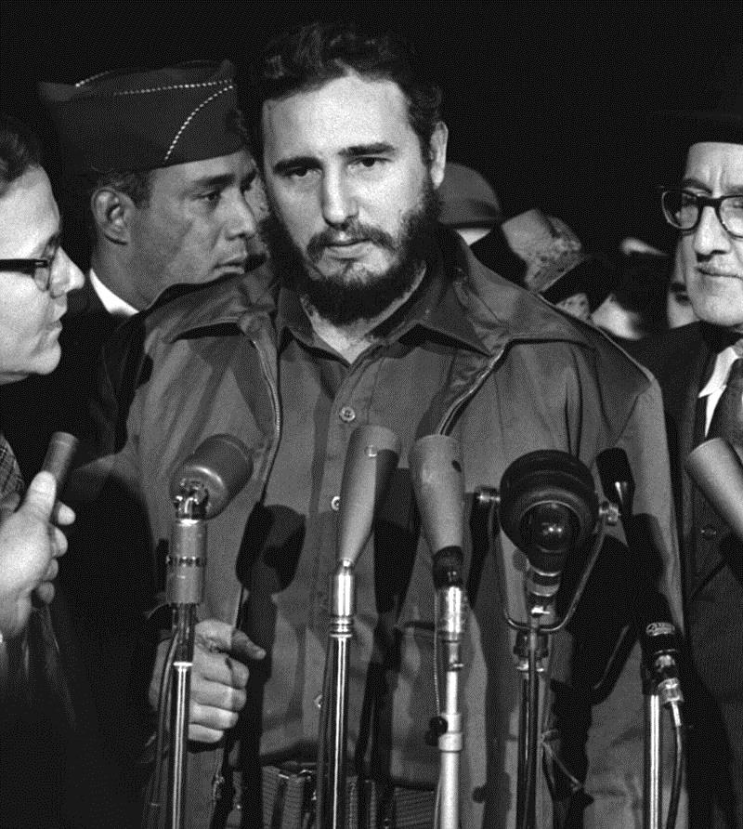
THE LESSONS OF HISTORY
If someone tries to forcibly overthrow the government, DON’T LET THEM OUT OF JAIL!

Slide 31
Change in strategy
Objective: Overthrow the Government

Slide 32
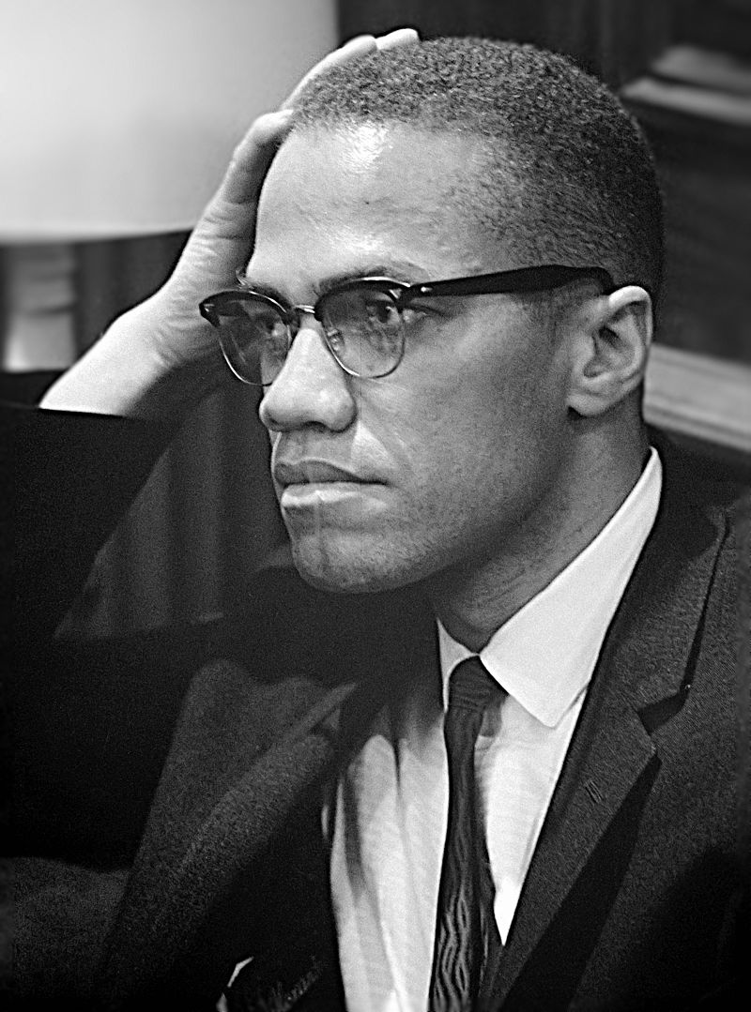
The Ballot or the bullet
If elections don’t work, guns will.
Malcolm X

Slide 33
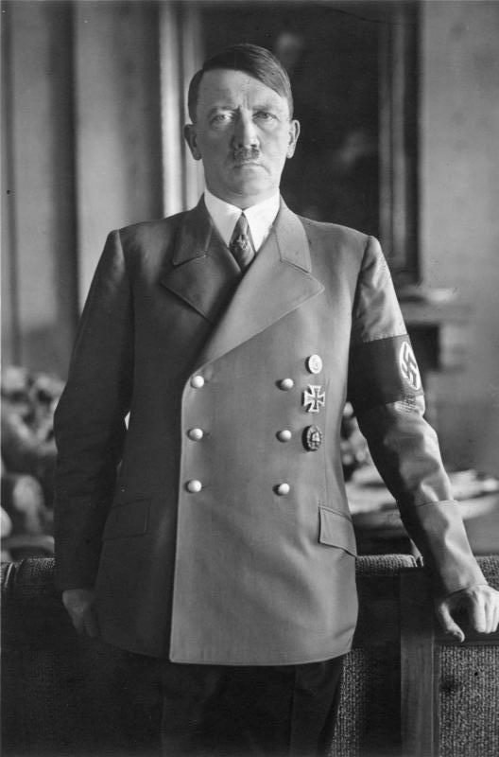
The Bullet or the Ballot
Malcolm X
If guns don’t work, elections will.

Slide 34
Change in strategy
Use the democratic process to seize power

Slide 35
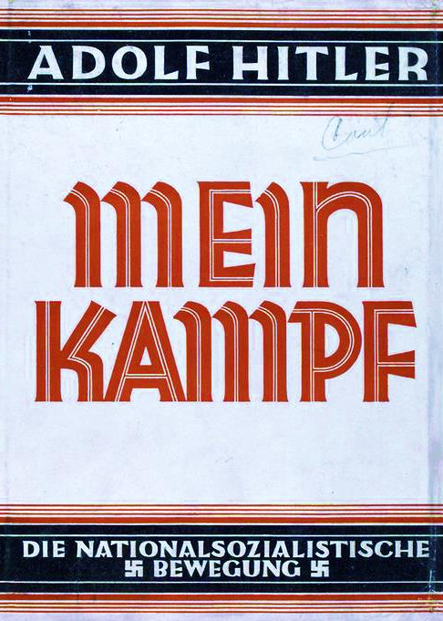
Mein kampf
(My Struggle)
Published in Two Volumes
(1925-1926)
Autobiography
& Political Manifesto

Slide 36
POLITICAL PROPAGANDA

Slide 37
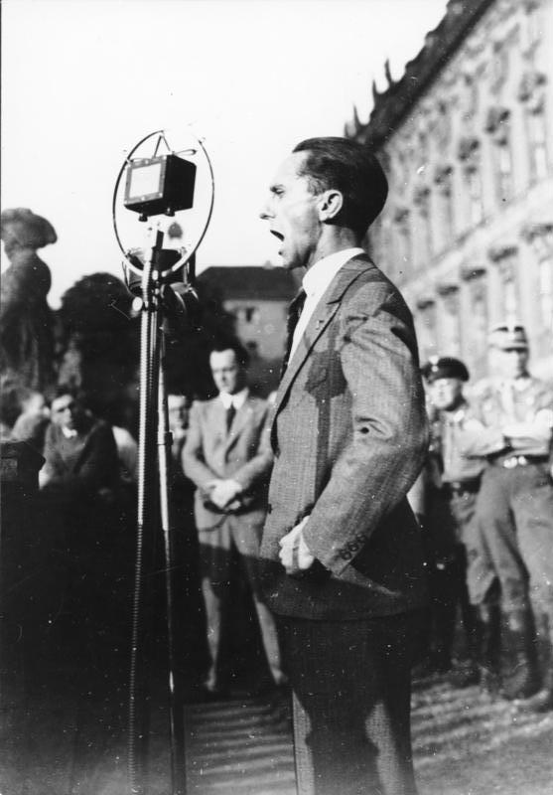
Joseph Goebbels
PROPAGANDIST

Slide 38
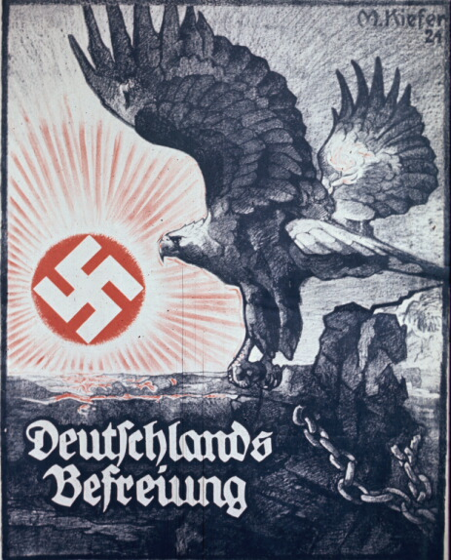
Germany’s Liberation
(1924)
(Published during a period when the Nazi Party was formally banned)
Accessed via the German Propaganda Archive

Slide 39
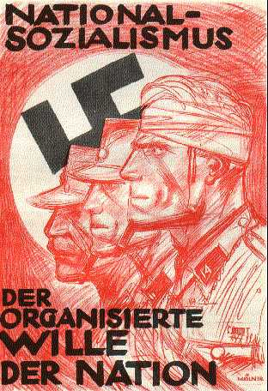
NATIONAL SOCIALISM
(1920s)
The Organized Will of the Nation
Accessed via the German Propaganda Archive

Slide 40
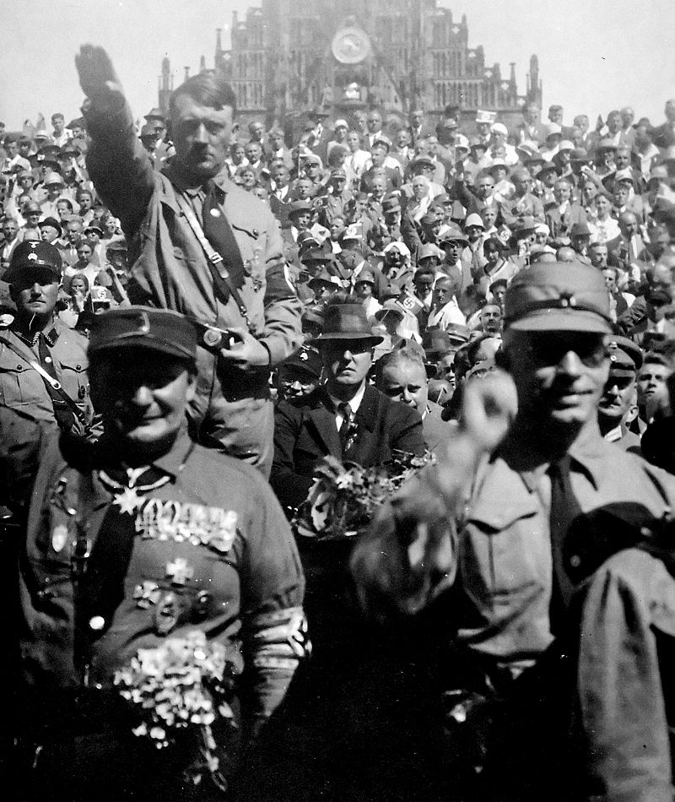
STORMTROOPERS (sa)

Slide 41
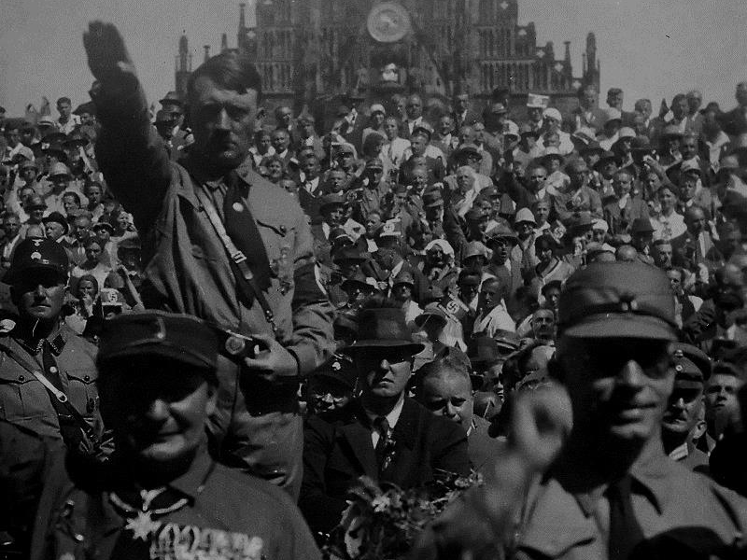
PARAMILITARY WING

Slide 42
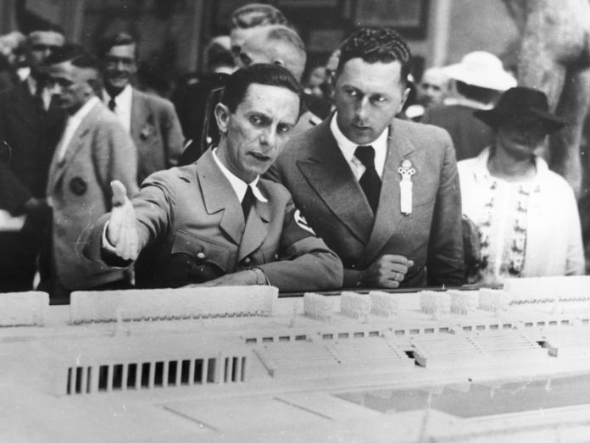
A propagandist is nothing without a good artist.
Goebbels & “Mjölnir”
German Federal Archives

Slide 43
Mjölnir’s idealization of Nazi Storm Troopers was a key element in Nazi propaganda.
Accessed via the German Propaganda Archive

Slide 44
Reichstag Elections (1928-1933)

Slide 45
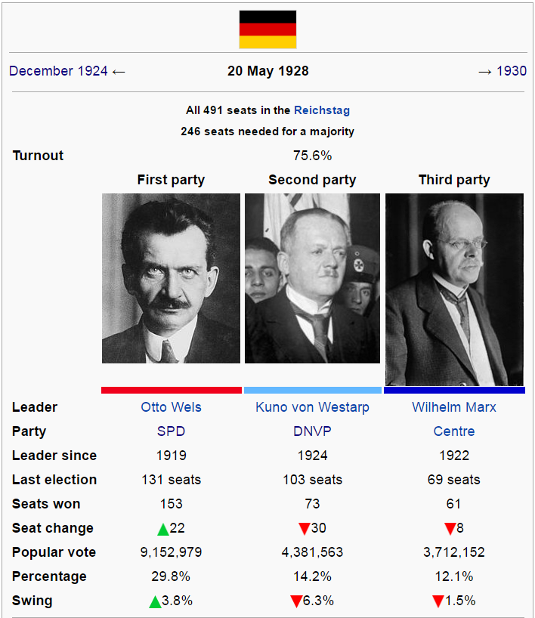
Social Democrats
National Conservatives
Catholic Centre
Courtesy of Wikipedia

Slide 46
9th
Place
2.6% of the Vote
14 of 491 Seats
Malcolm X

Slide 47
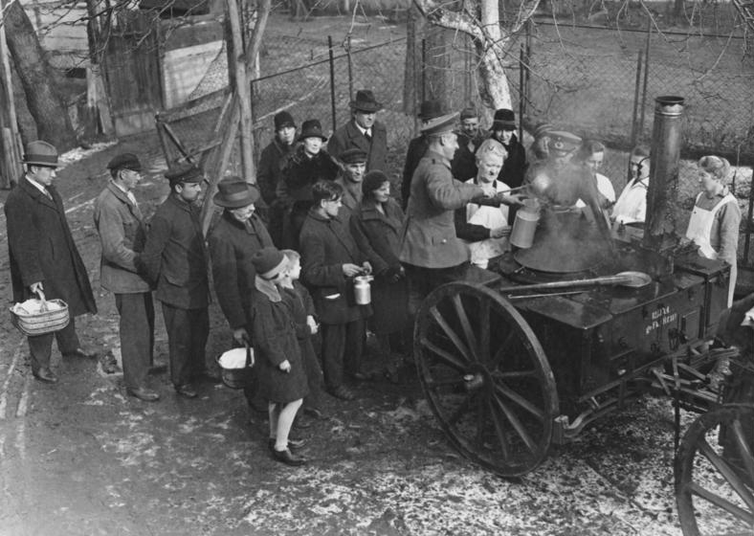
The Great Depression
German Federal Archives
An Intervening Event

Slide 48
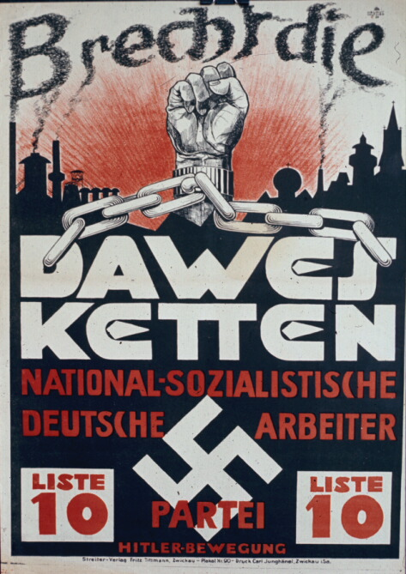
BREAK THE DAWES CHAINS
(1929)
Leave it to Nazis to be unappreciative.
Accessed via the German Propaganda Archive

Slide 49
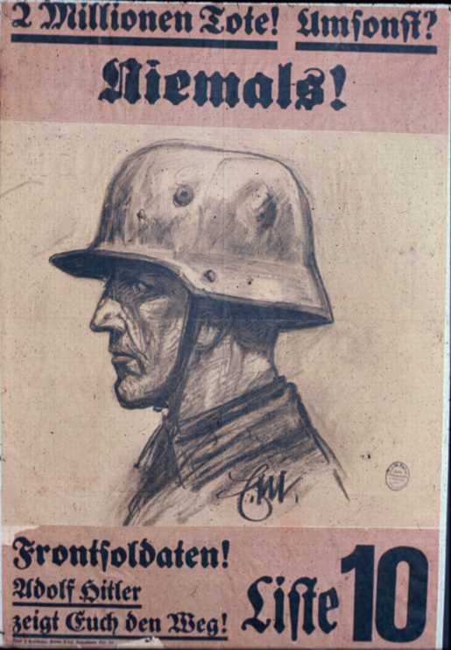
Two Million Dead
in Vain? Never!
(1929)
Front Soldiers! Adolf Hitler is showing you the way!
Accessed via the German Propaganda Archive

Slide 50
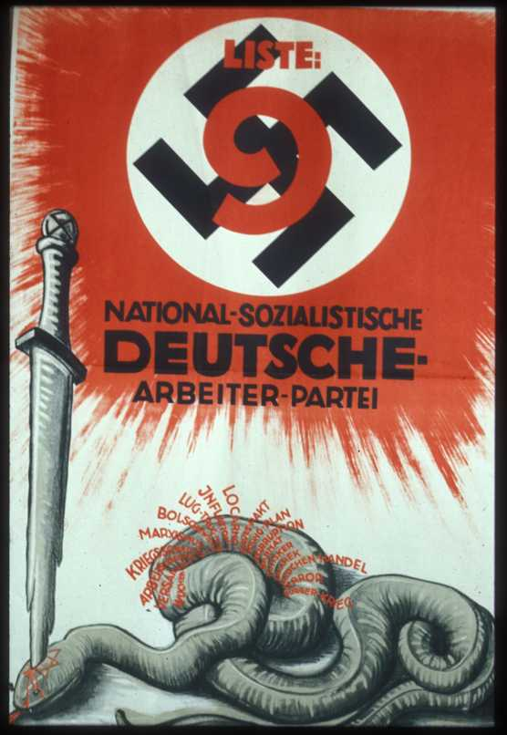
usury
Versailles
unemployment
war guilt lie
Marxism
Bolshevism
lies and betrayal
inflation
Locarno
Dawes Pact
Young Plan
Corruption
Prostitution
Terror
civil war
Accessed via the German Propaganda Archive

Slide 51
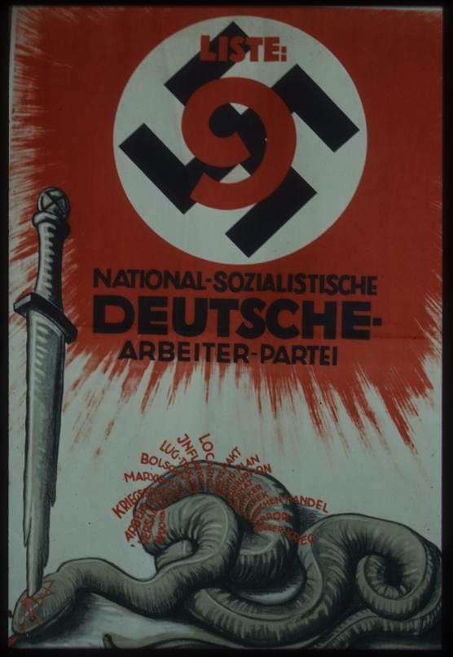
Three Jewish government officials (Barmat, Kutistker, Sklarek) who had been found guilty corruption are featured on this poster, in which a sword stabs through a Star of David on the snake’s head.
Accessed via the German Propaganda Archive

Slide 52
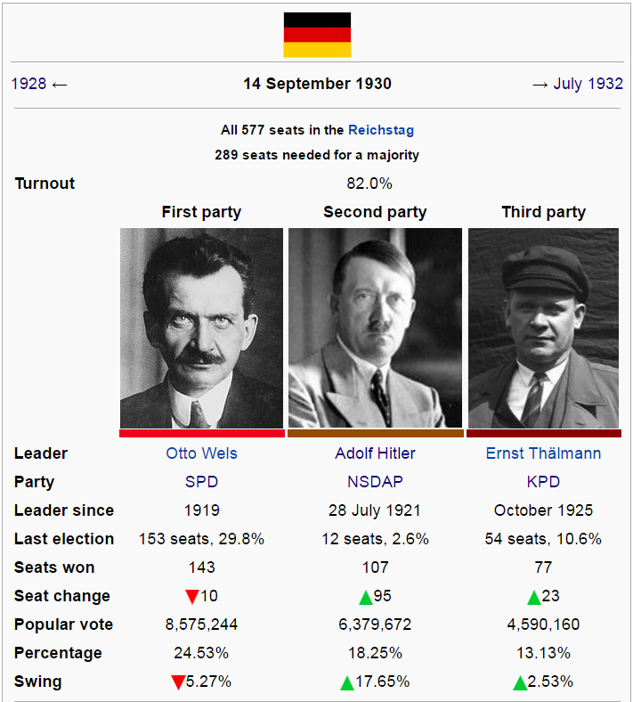
Courtesy of Wikipedia

Slide 53
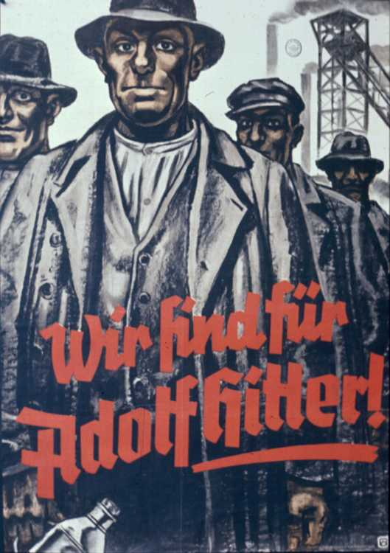
We are for adolf hitler
(1932)
This poster appealed to Hitler’s working class base.
Accessed via the German Propaganda Archive

Slide 54
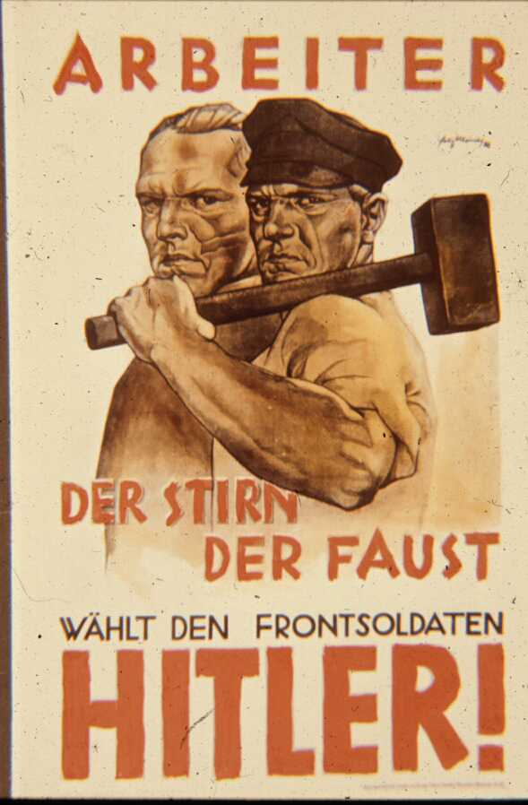
WORKERS
This poster represents an effort to appeal beyond that base..
OF MIND
OF HAND
Vote for Front Soldier
HITLER
Accessed via the German Propaganda Archive

Slide 55
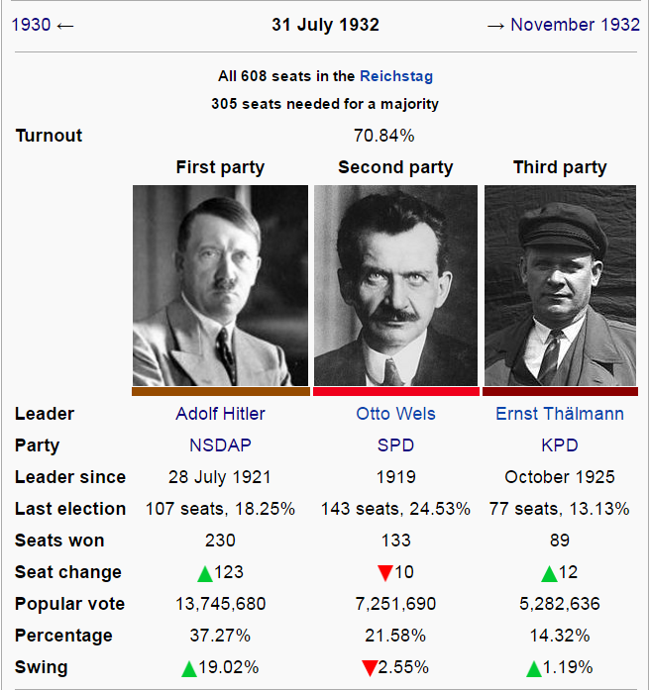
Courtesy of Wikipedia

Slide 56
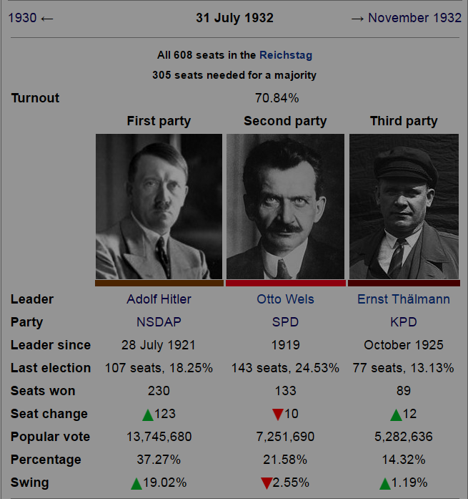
COMMUNISTS
Courtesy of Wikipedia

Slide 57
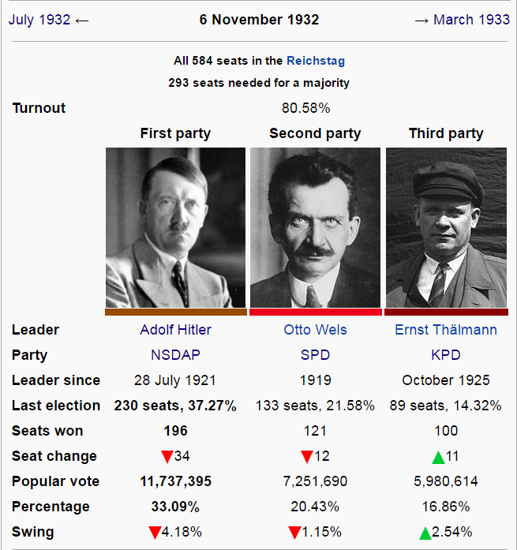
Courtesy of Wikipedia

Slide 58
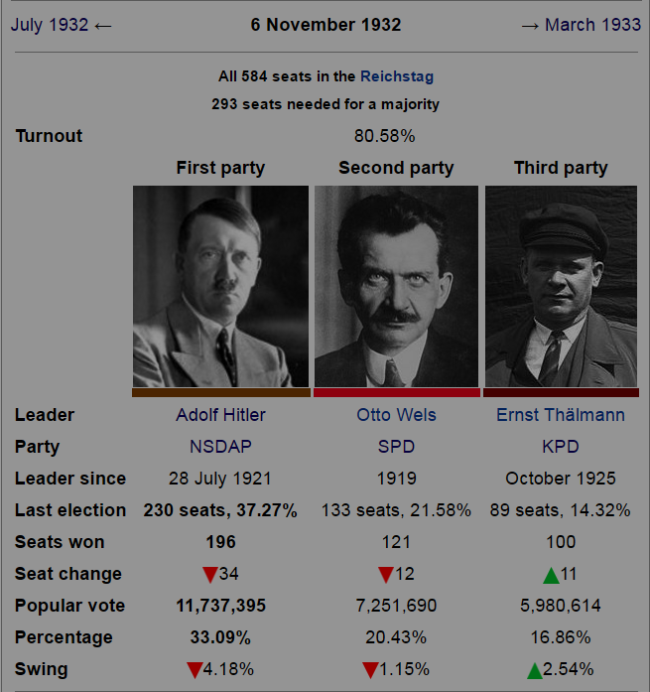
COMMUNISTS
Courtesy of Wikipedia

Slide 59
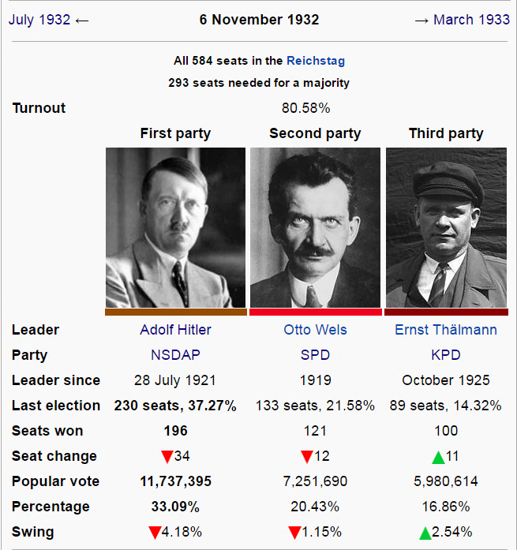
PICK YOUR POISON
National Socialists
Social Democrats
Communists
Courtesy of Wikipedia

Slide 60
Chancellor of Germany
The threat of communism made Hitler more palatable to the center-right.

Slide 61
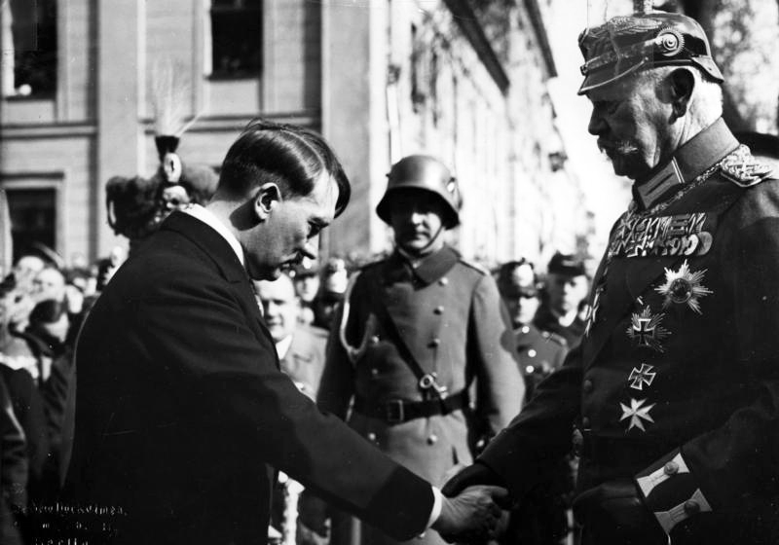
HITLER AND HINDENBURG
German Federal Archives

Slide 62
1933
27 Feb | Reichstag Fire
5 Mar | Federal Elections
23 mar | Enabling Act

Slide 63
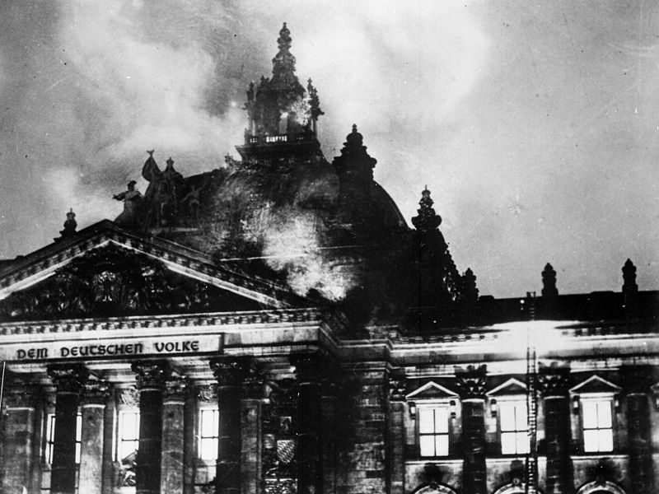
fire

Slide 64
BLAME THE COMMUNISTS

Slide 65
REICHSTAG FIRE DECREE
27 February 1933
Suspension
of Civil Liberties
ARRESTS
of Communist Leaders

Slide 66
Articles 114, 115, 117, 118, 123, 124 and 153 of the Constitution of the German Reich are suspended until further notice. It is therefore permissible to restrict the rights of personal freedom [habeas corpus], freedom of expression, including the freedom of the press, the freedom to organize and assemble, the privacy of postal, telegraphic and telephonic communications. Warrants for House searches, orders for confiscations as well as restrictions on property, are also permissible beyond the legal limits otherwise prescribed.

Slide 67
Courtesy of Wikipedia

Slide 68
ENABLING ACT
Hitler may make laws without the approval of the Reichstag
FOR FOUR YEARS

Slide 69
Political Factions
Hitler’s Coalition
Leftists
Catholic Parties

Slide 70
2/3 (of 2/3)
qUORUM:
A Constitutional amendment required 2/3 of those present to pass, with 2/3 needing to be present.

Slide 71
Political Factions
Hitler’s Coalition
Leftists
Catholic Parties
?
Since communists had been arrested, their seats weren’t counted.

Slide 72
“By its decision to carry out the political and moral cleansing of our public life, the Government is creating and securing the conditions for a really deep and inner religious life. The advantages for the individual which may be derived from compromises with atheistic organizations do not compare in any way with the consequences which are visible in the destruction of our common religious and ethical values.
“[The national Government will allow and confirm to the Christian denominations the enjoyment of their due influence in schools and education.] And it will be concerned for the sincere cooperation between Church and State.

Slide 73
“The struggle against the materialistic ideology and for the erection of a true people's community… serves as much the interests of the German nation as of our Christian faith...The national Government, seeing in Christianity the unshakable foundation of the moral and ethical life of our people, attaches utmost importance to the cultivation and maintenance of the friendliest relations with the Holy See... The rights of the churches will not be curtailed; their position in relation to the State will not be changed.”
-- Hitler’s Speech before the passage of the Enabling Act

Slide 74
A “2/3” Majority
Hitler’s Coalition
Leftists
Catholic Parties
The Social Democrats were the only party to oppose the Enabling Act.

Slide 75
A ONE PARTY STATE
German Federal Archives

Slide 76
DICTATORSHIP
Brought to you by Democracy

