Slide 1
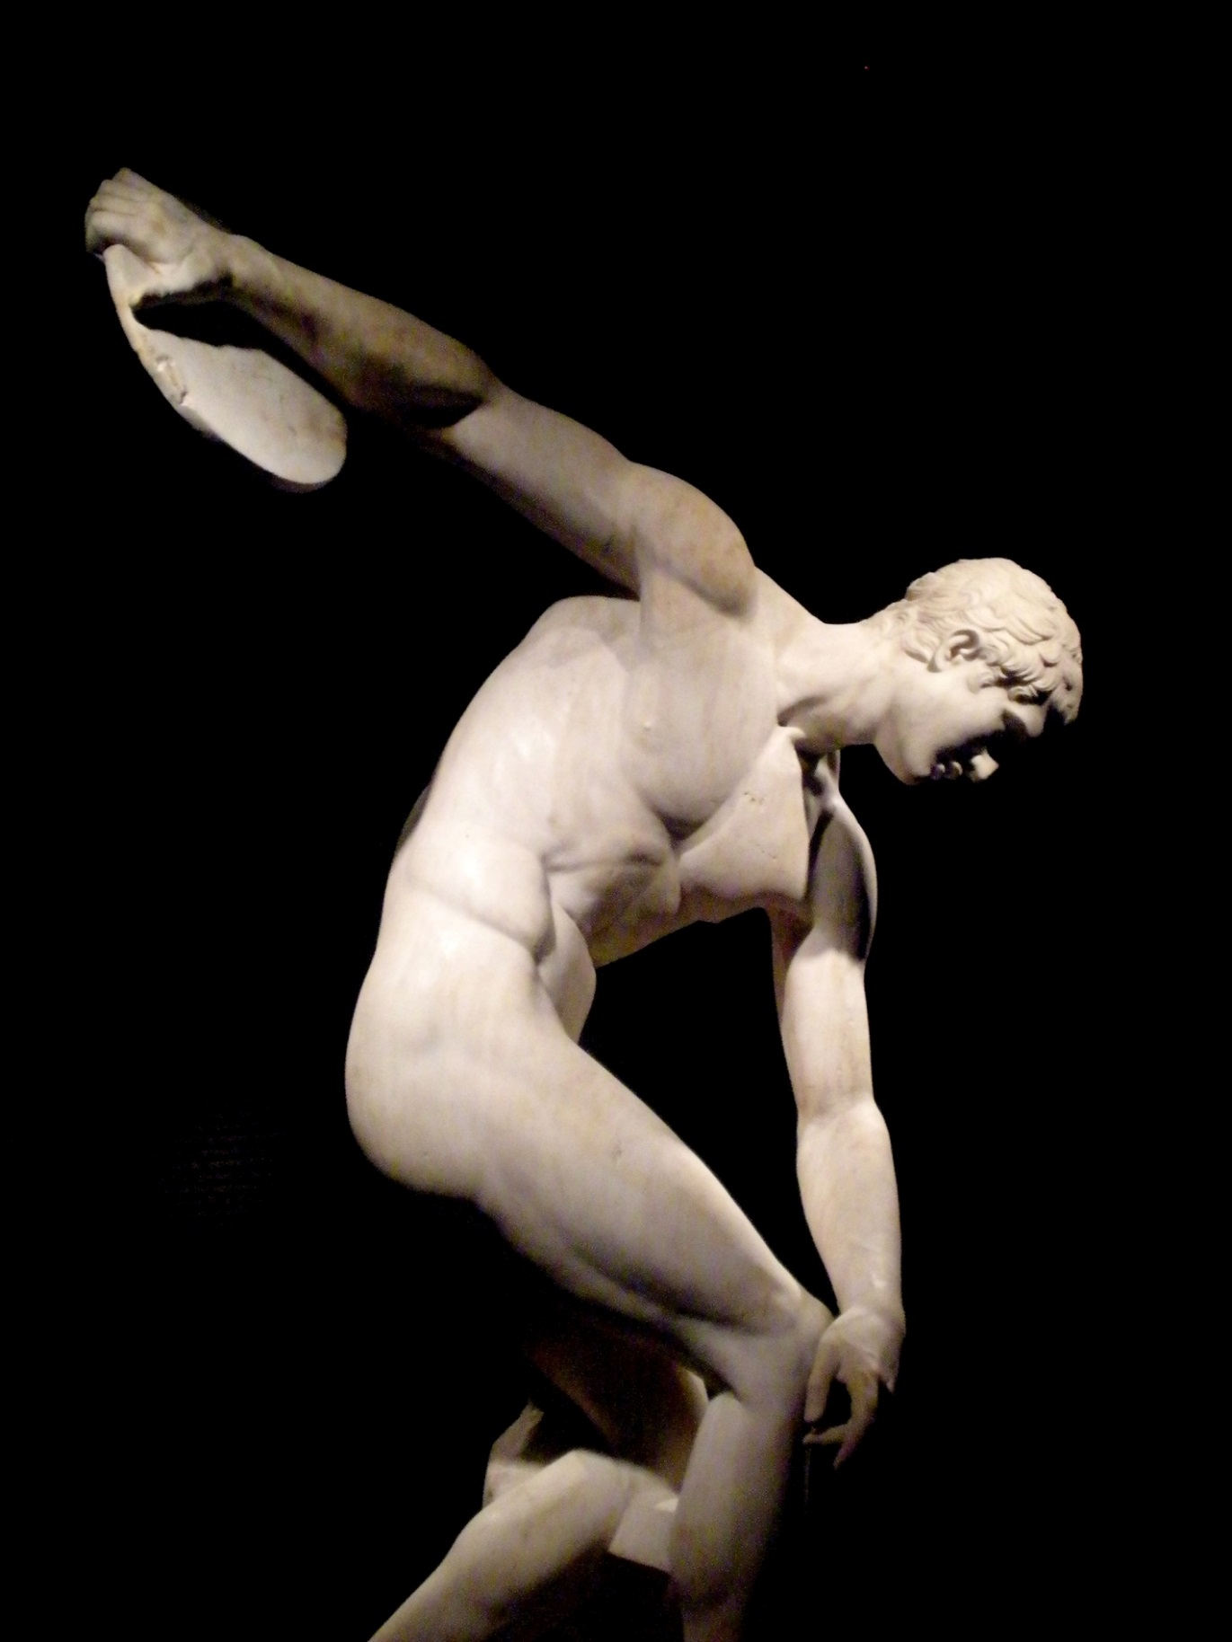
The Ancient Greek Olympics

Slide 2
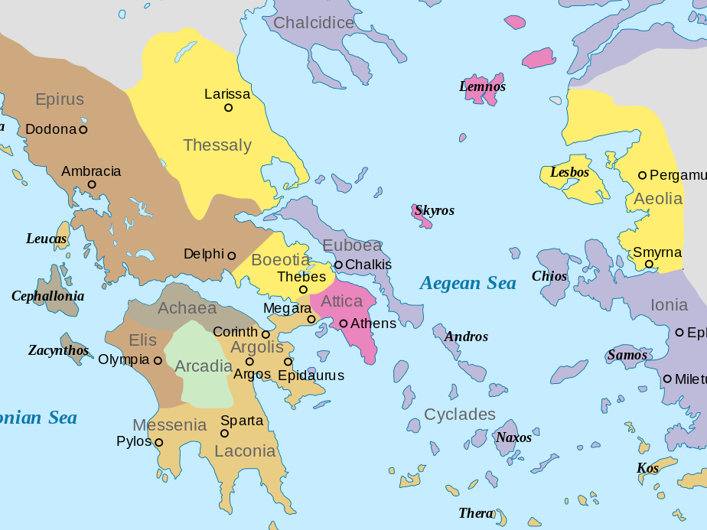
CITY-STATES
Map by Fut.Perf. (Public Domain)

Slide 3
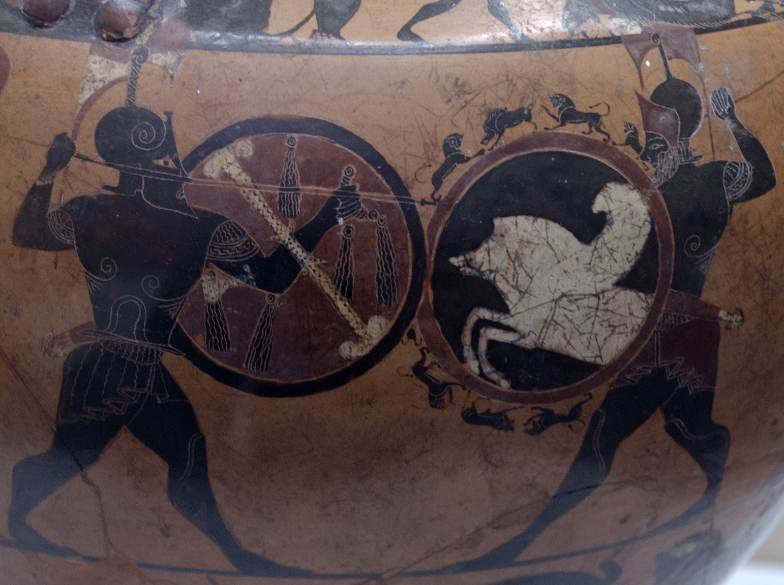
Greek warfare
A VERY PHYSICAL SPORT
Some Rights Reserved by Dan Diffendale

Slide 4
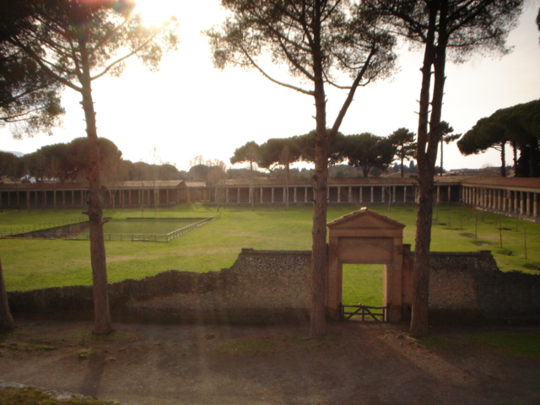
Gymnasium
Every Greek city-state had designated areas for public athletic training.
Pompeii gymnasium, Photo Credit: Kgil

Slide 5
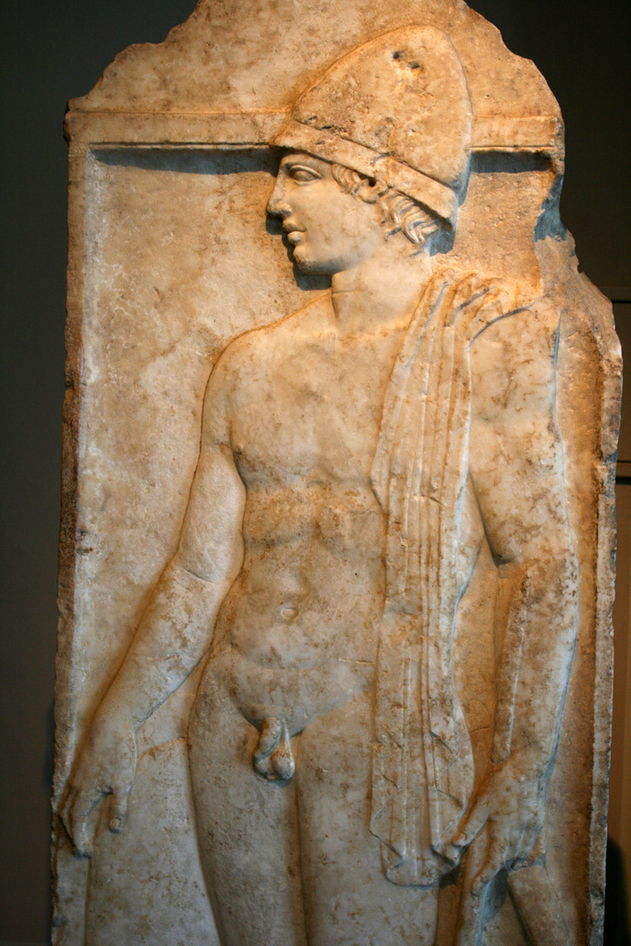
Gymnos
The root of gymnasium is the Greek word for naked.

Slide 6
Olive Oil
The ONLY clothing worn in an ancient Greek gymnasium
Photo Credit: matthewgriff

Slide 7
NO ALLOWED
Sorry, ladies. Sports are for the guys!

Slide 8
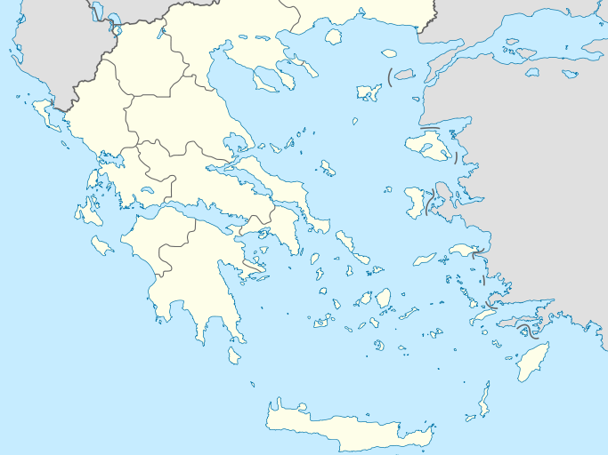
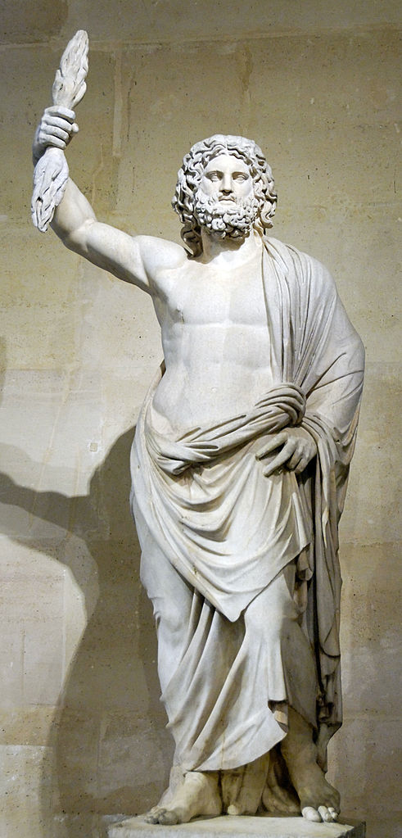
Olympia
A Sanctuary to Zeus

Slide 9
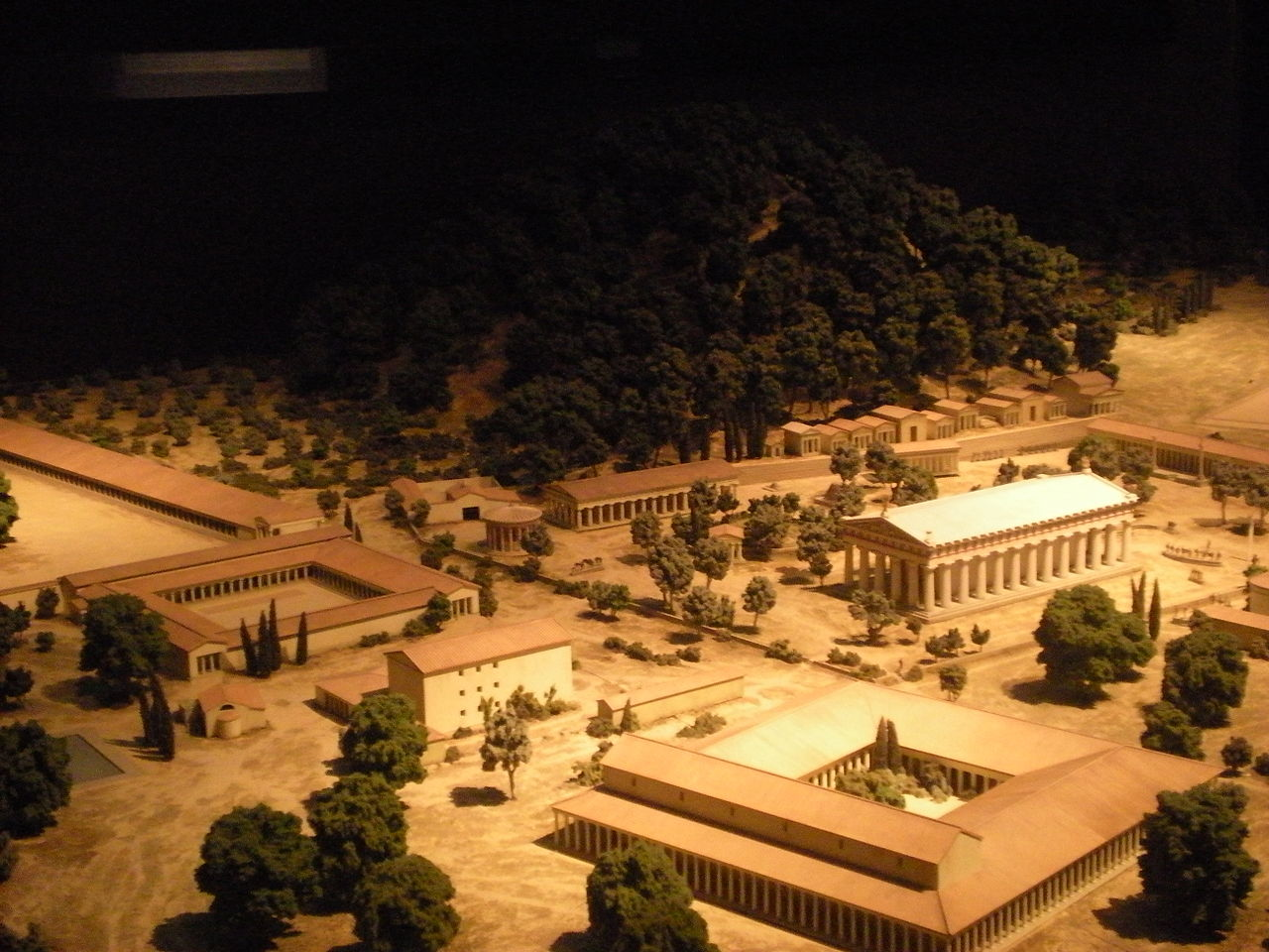
Olympia
The Olympics were both an athletic contest and a religious festival.
A Sanctuary to Zeus

Slide 10
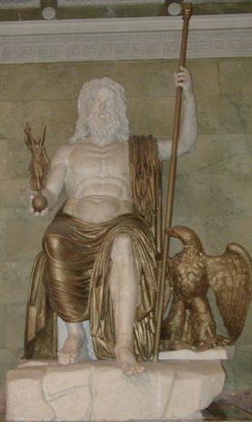
Olympia
7
A Sanctuary to Zeus
The Statue of Zeus at Olympia was one of the Seven Wonders of the Ancient World.
Roman Seated Zeus, marble and bronze (restored), following the type established by Phidias (Hermitage Museum)

Slide 11
4
The Olympics were held every four years.
(just like today)

Slide 12
Agon
A CONTEST or STRUGGLE

Slide 13
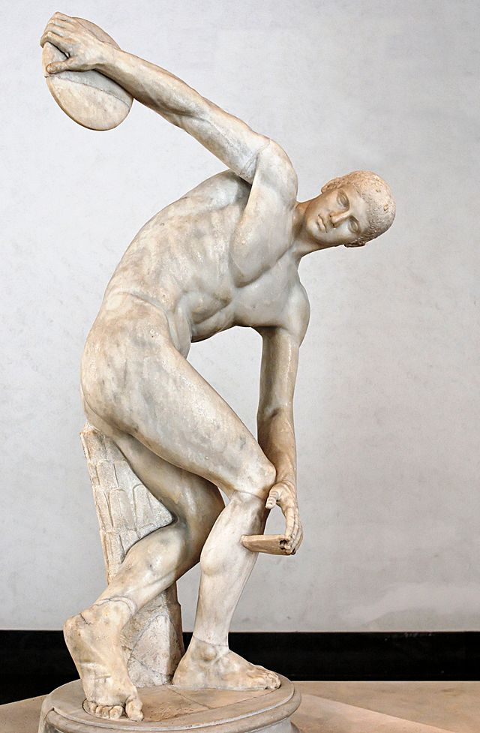
The Olympic Games
Events Included:
Long Jump
Javelin Throw
Discus Throw
Running
Wrestling
Pankration
Boxing
Chariot Race
Hoplite Race

Slide 14
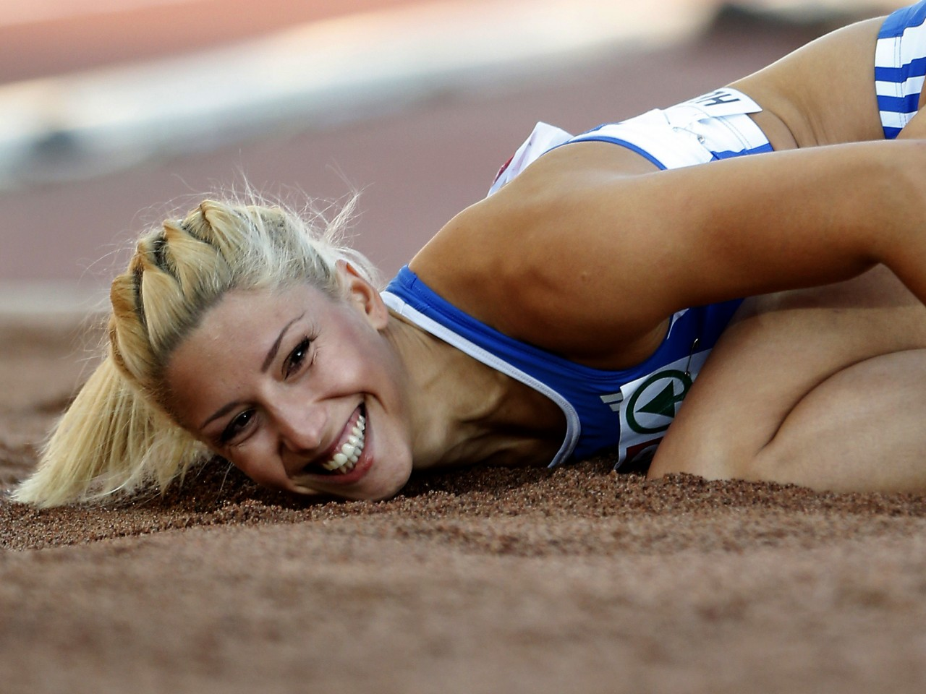
She couldn’t compete in the Olympics because she’s racist.
Controversial Greek long jumper, Voula Papachristou Photo © AP

Slide 15
TRUE STORY

Slide 16
NO ALLOWED
GIRLS
But women in ancient Greece couldn’t compete because they were women.

Slide 17
Married women were not even allowed to watch the Olympic games.
Photo by Mark Roy

Slide 18
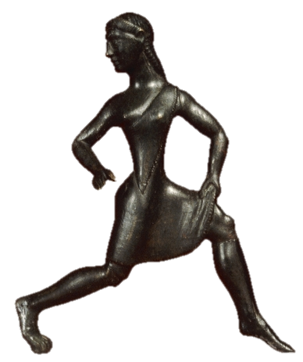
WOMEN
Greek women did not generally train for Athletic competitions, though there were exceptions (most notably Sparta).
Bronze Statuette of a girl runner, probably from Sparta, ca. 500 BC, British Museum.

Slide 19
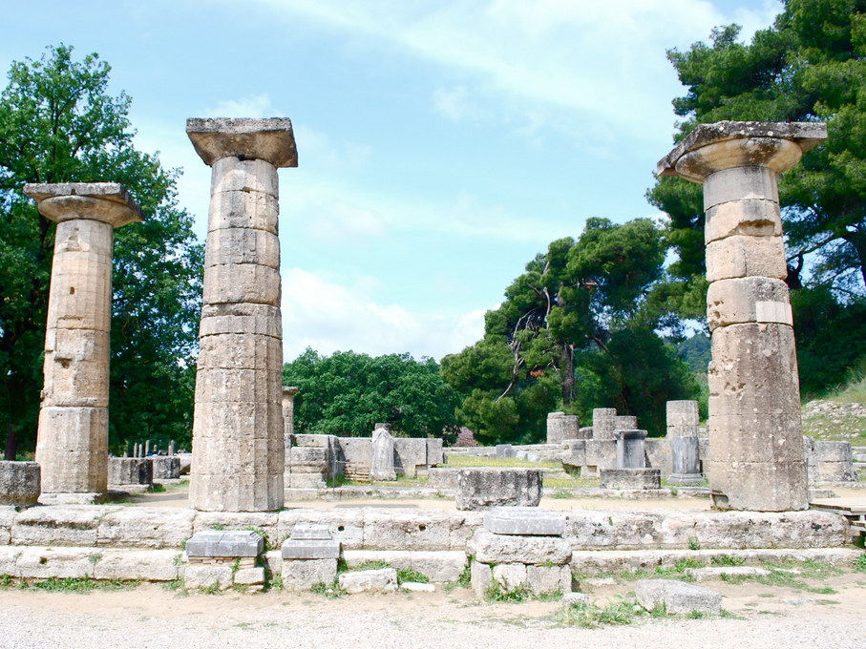
Heraean Games
Separate games for women were held at Olympia to honor Hera.
Ruins of the Temple of Hera at Olympia
Photo by Sarah Murray

Slide 20
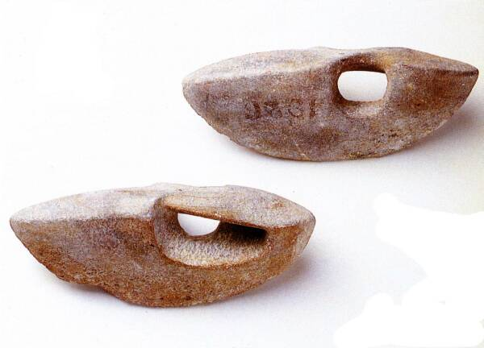

Slide 21
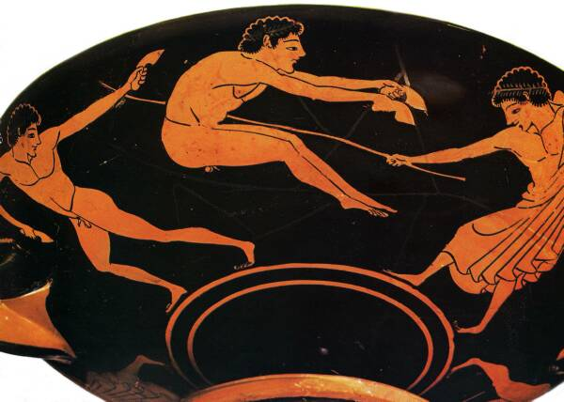

Slide 22
Long Jump
Jumping weights used by Greek athletes in the Olympics
Greek jumpers jumped with the help of handheld weights.
Greek long jumper jumps while a judge watches
Photos and More Info: http://ancientolympics.arts.kuleuven.be

Slide 24
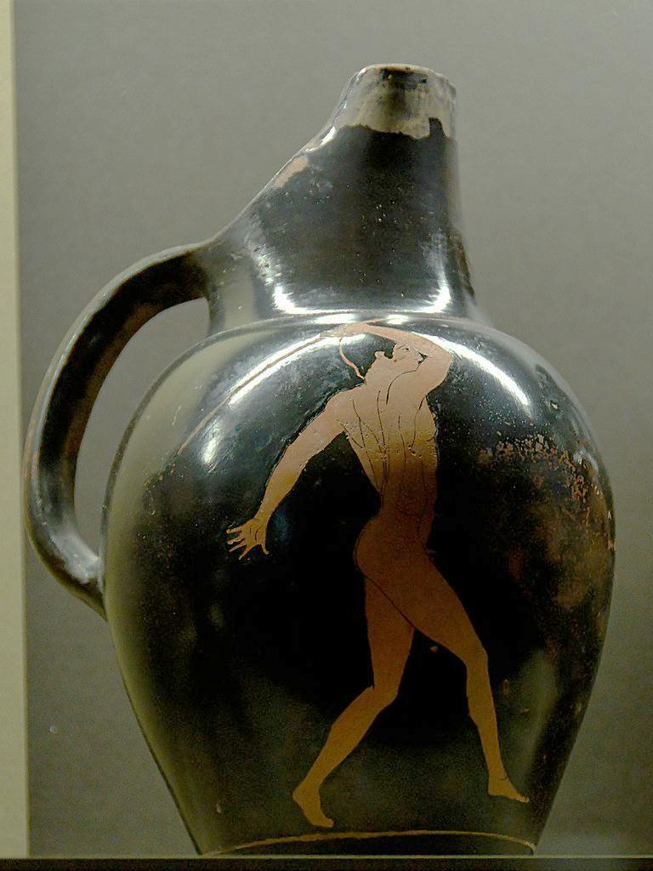
Javelin

Slide 25
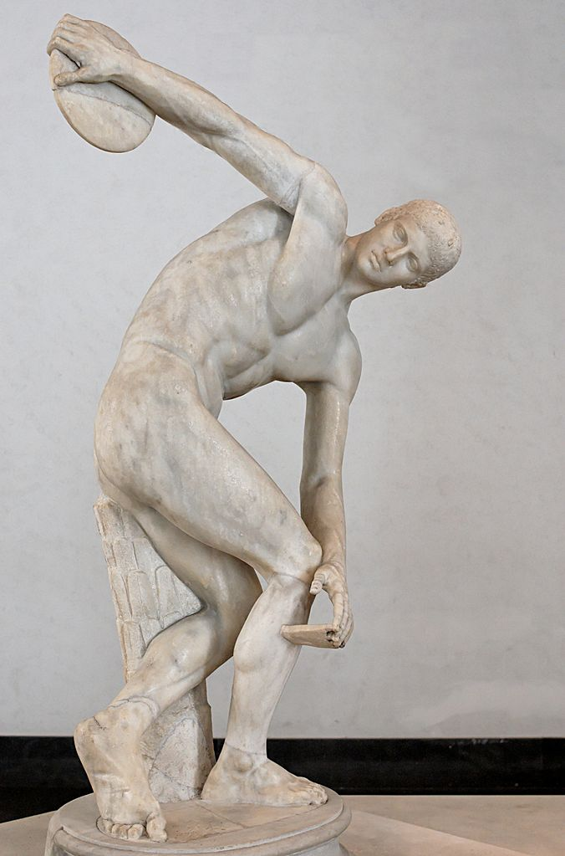
Discus
The Diskobolus of Myron (5th Century B.C.)

Slide 26
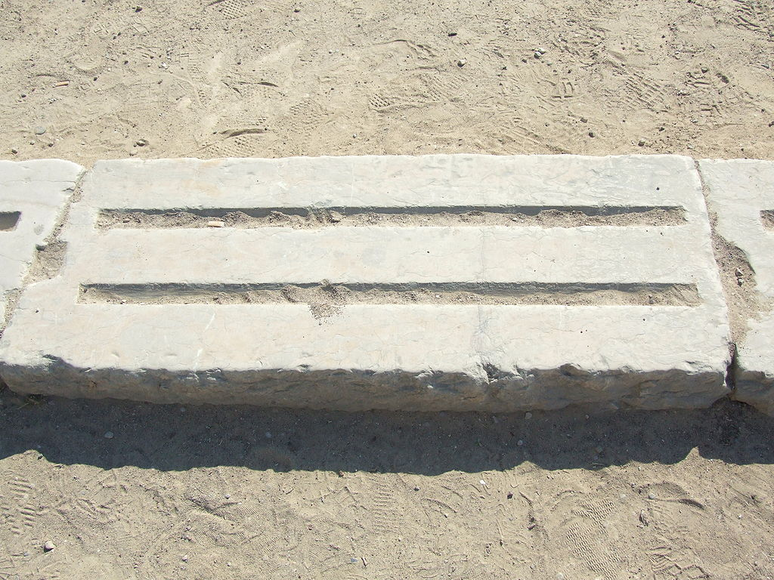
Photo Credit: Jamesscottbrown

Slide 27
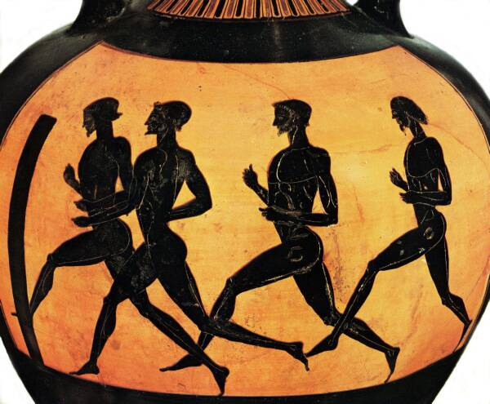
Running
A starting block at Olympia
The ancient Olympics featured both sprints and long-distance races.
Greek sprinters advance toward a turning post

Slide 28
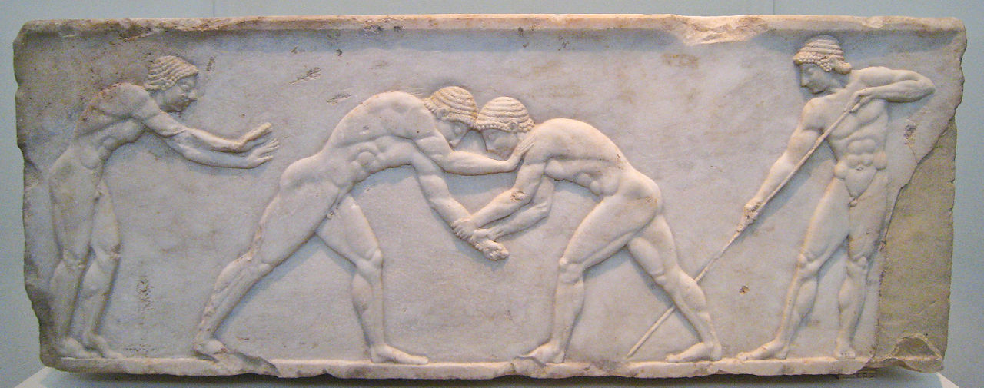
Wrestling
The ultimate contest of strength
CLICK to see the RULES
Photo Credit: Sharon Mollerus

Slide 29
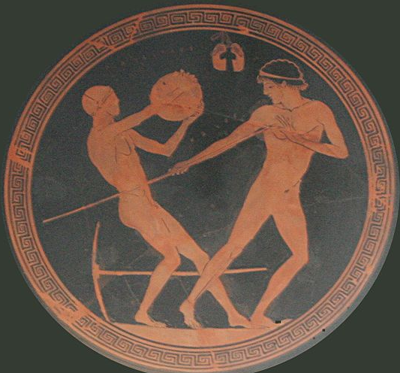
Pentathlon
Root: Pente (Five)
Long Jump
Wrestling
Javelin
Pentathletes competed in five different events to display all-around athleticism.
Running
Discus

Slide 30
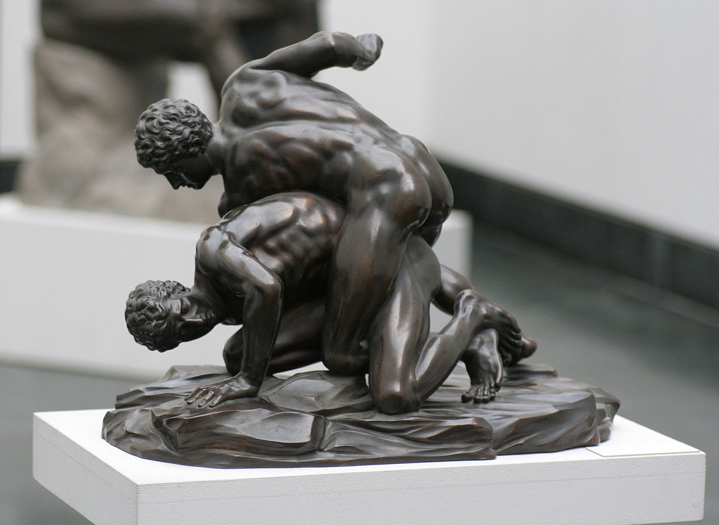
Pankration
“All Powers”
Pan + kratia
Rules:
No Biting
No Gouging
No Time Limit
Three ways to end
A bronze smaller reproduction in Munich of a Roman marble after a 3rd c. BC Greek depiction of pankratists grappling and striking

Slide 31
Due to its extremely violent nature, the pankration has never been featured in the modern Olympic games.
Photo Credit: MatthiasKabel

Slide 32
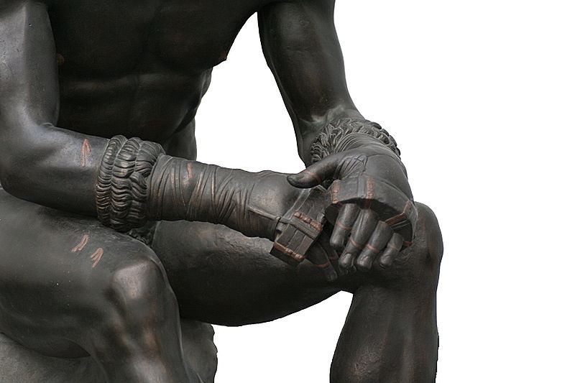

Slide 33
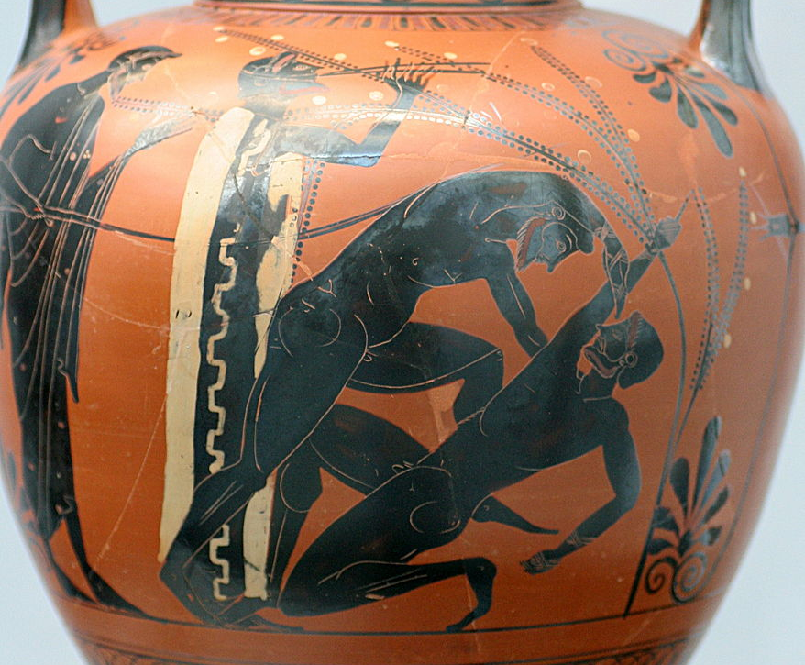

Slide 34
Boxing
Protective Leather
Boxing matches were a Greek tradition dating back to the Minoans and Mycenaeans.
A Boxer Submits

Slide 35
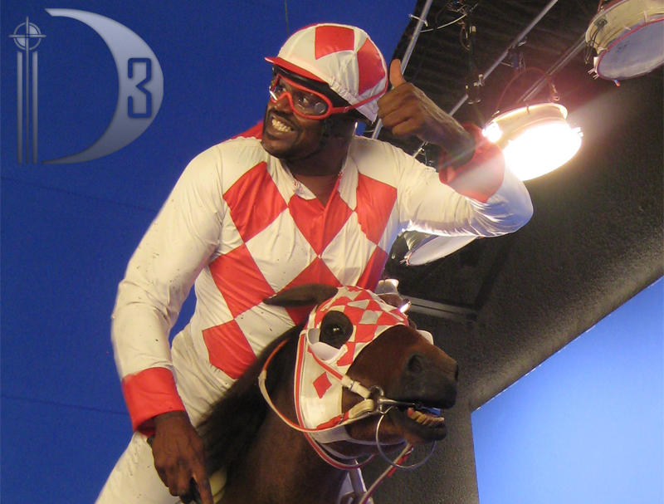

Slide 36
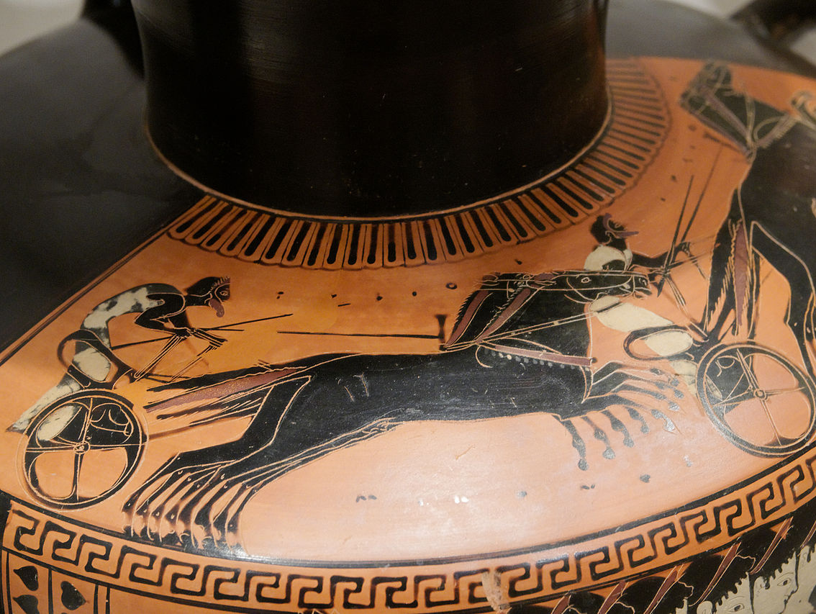
Chariot Race
Photo Credit: Marie-Lan Nguyen

Slide 37
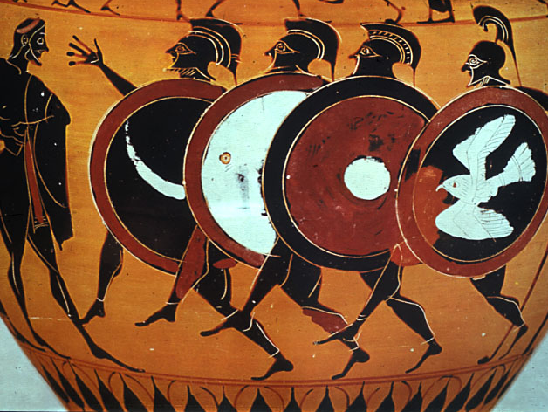
Hoplite Race
Unlike other Olympic events, which featured nude participants, in the hoplitodromos ran around the stadium in full armor.

Slide 38
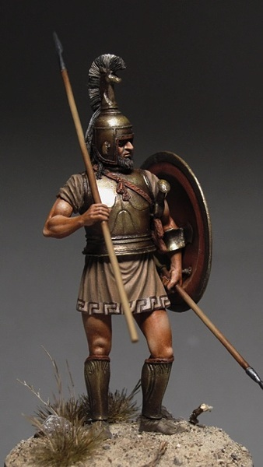
Military Readiness
All of the events in the Olympic games conditioned young men for military service.
Image Source: http://i-am-modelist.com

Slide 39
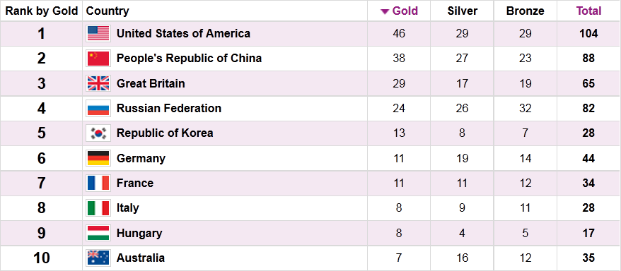
AMERICA
Yes... We’re that good!
Source: http://www.london2012.com

Slide 40
RIVALRY
Map by Fut.Perf. (Public Domain)

Slide 41
PRESTIGE
Greek city-states rewarded their athletes well for bringing honor to the polis at the Olympic games.
Map Credit: Sigma Publications

Slide 42
Leveling
ANYONE could win at the Olympics, regardless of social class.

Slide 43
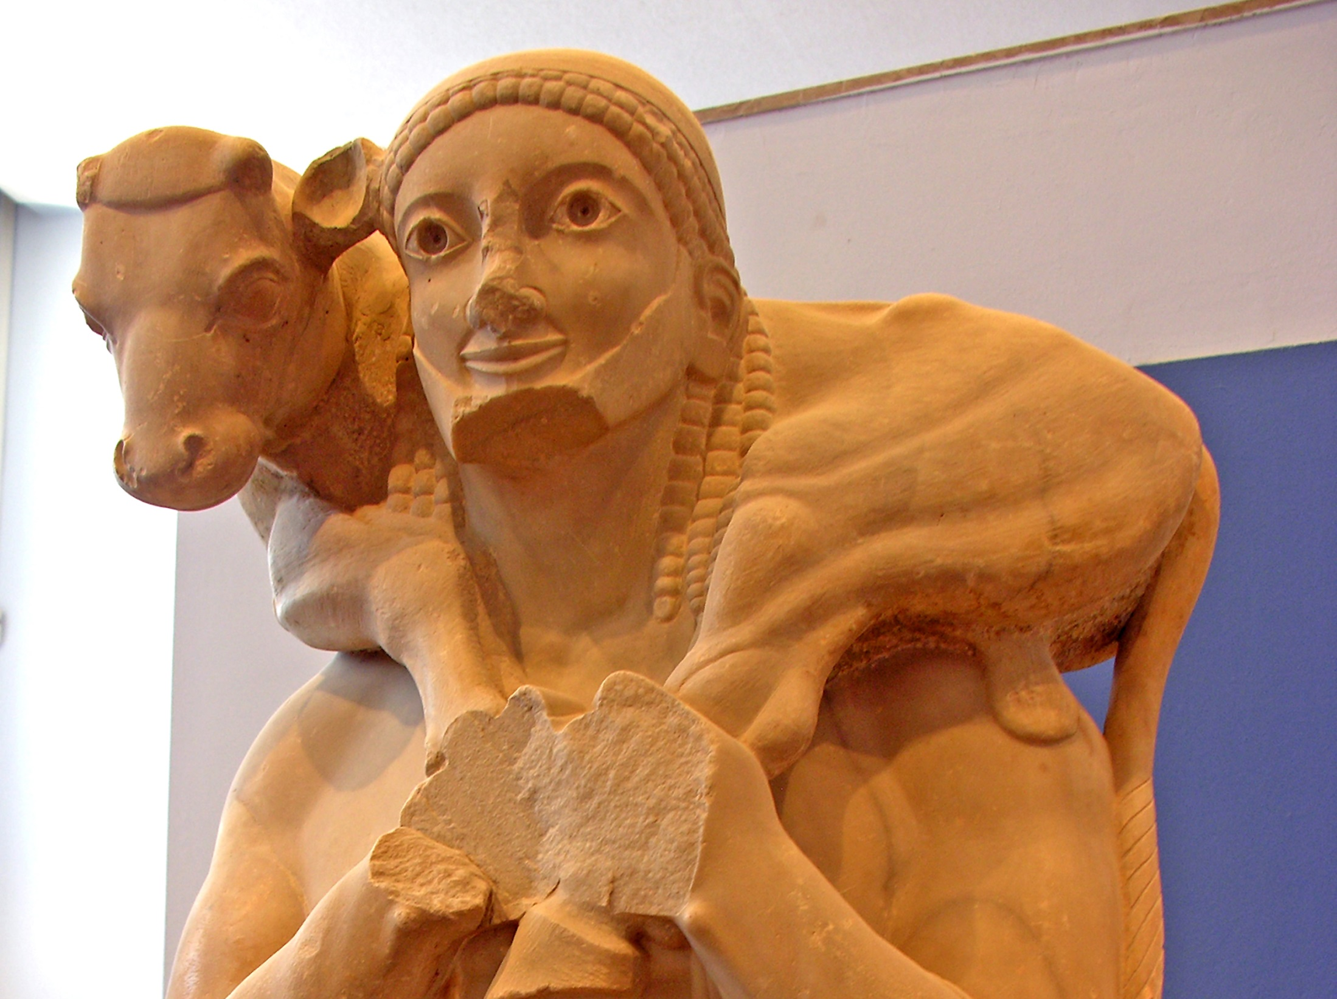
Milo of Croton
The Athlete as Celebrity
The Calf Bearer (Archaic Greek Sculpture)
Photo by Dennis Jarvis

Slide 44
