Slide 1
THE REIGN OF TERROR
1793-1794

Slide 2
Phases of the French Revolution
1789-1791 | Liberal Phase
1792-1794 | Radical Phase
1795-1799 | Directory Phase
1799-1815 | Napoleonic Phase

Slide 3
Phases of the French Revolution
1789-1791 | Liberal Phase
1792-1794 | Radical Phase
1795-1799 | Directory Phase
1799-1815 | Napoleonic Phase

Slide 4
THE CRAZY PART
1793-1794

Slide 5
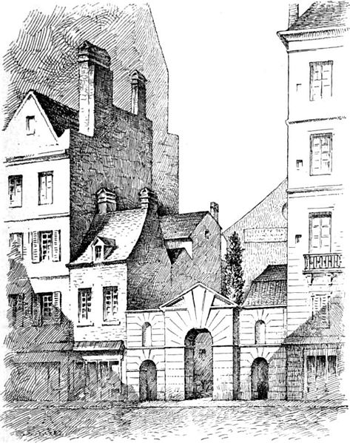
Jacobin Clubs
REPUBLICANISM (OPPOSITION TO THE MONARCHY)
Montagnards
More Radical
Girondins
Less Radical
The door of the Jacobin Club was in the Rue Saint-Honoré, Paris.

Slide 6
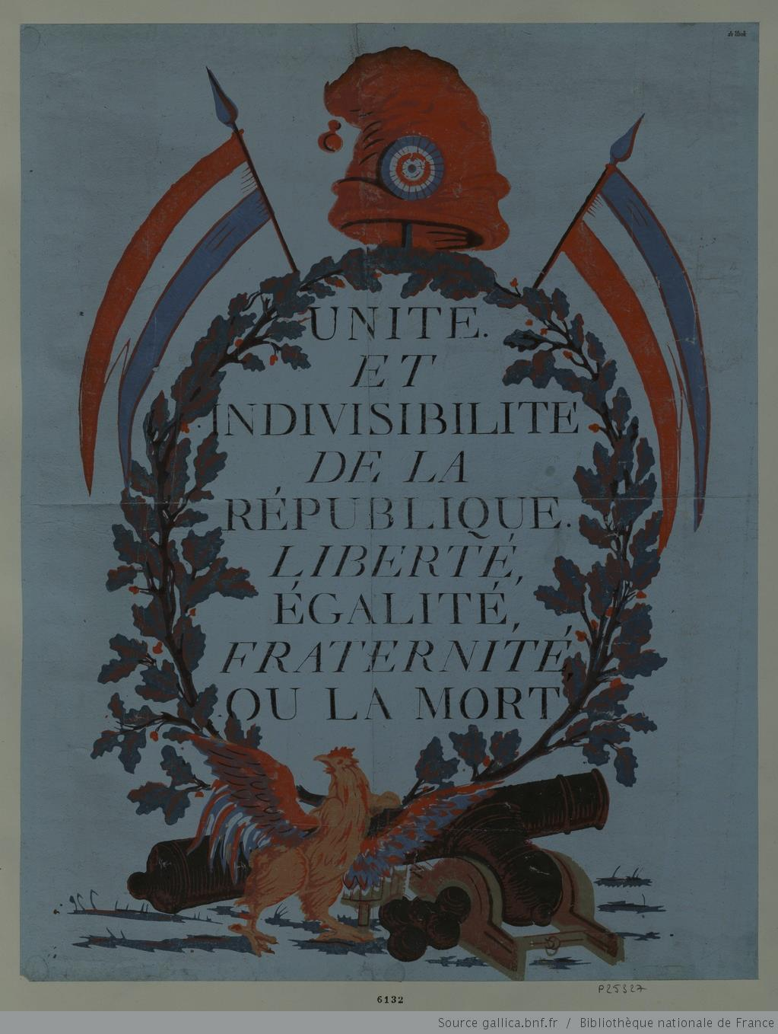
National Motto

Slide 7
KEY EVENTS
1793
January | Execution of Louis XVI
April | Committee on Public Safety Created
September | Reign of Terror Begins
October | Execution of Marie Antoinette

Slide 8
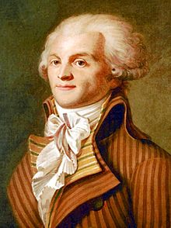
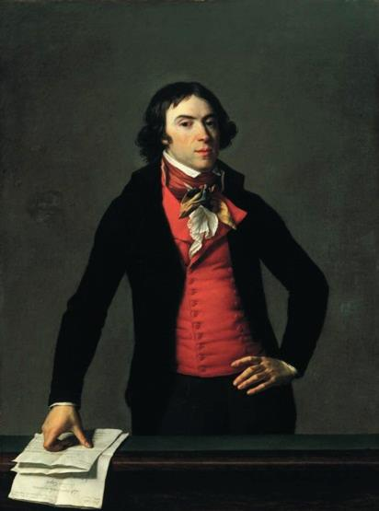
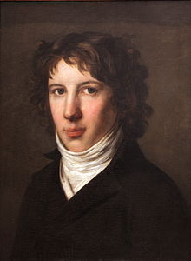
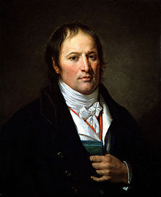
Committee of Public Safety
Executive body in charge of:
Directing the war effort
Suppressing Counter-Revolutionary Activity

Slide 9
Committee of Public Safety
Executive body in charge of:
Directing the war effort
Suppressing Counter-Revolutionary Activity

Slide 10
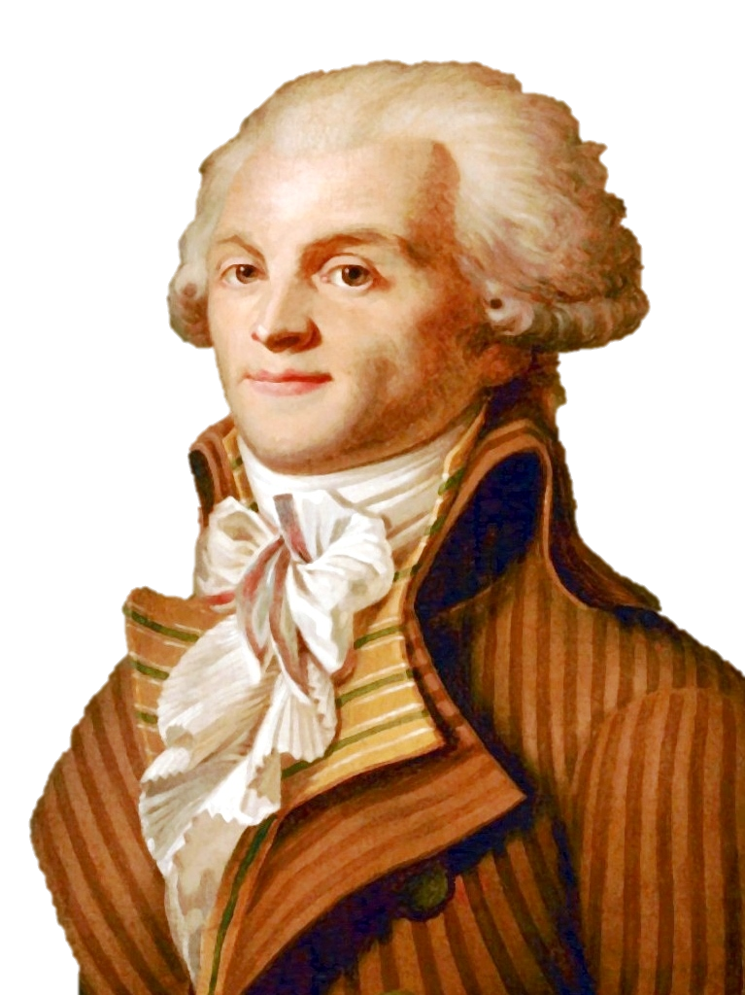
Maximilien Robespierre
“The Incorruptible”
Sought to create a “Republic of Virtue”

Slide 11
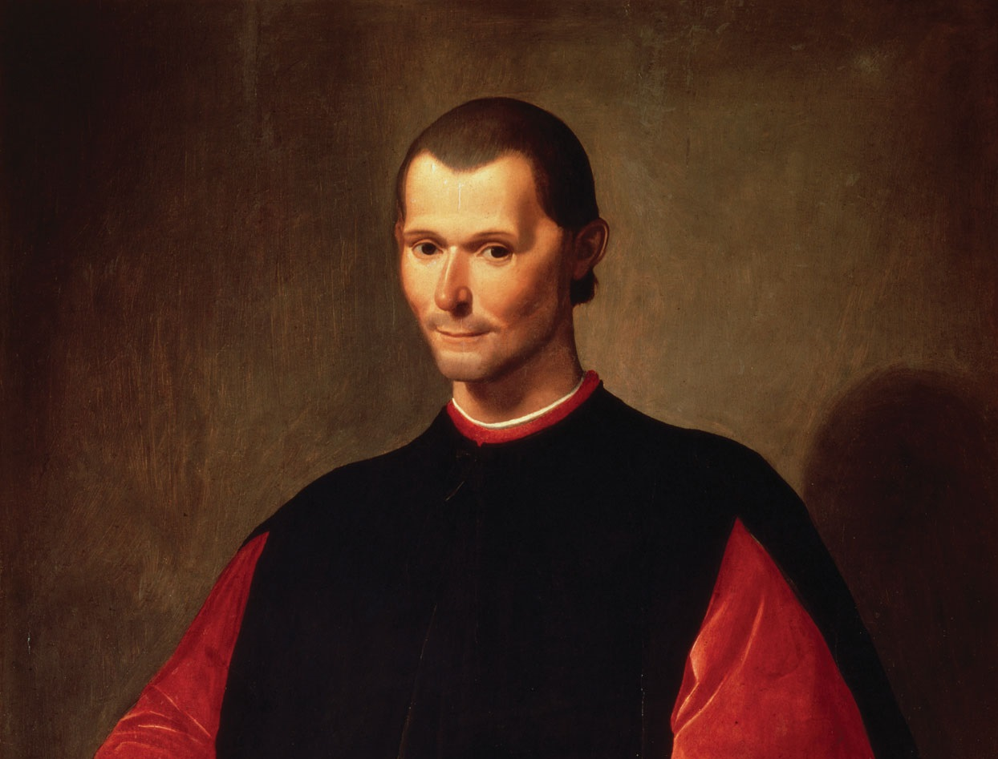
The End Justifies the Means

Slide 12
I’m against capital punishment, but…
Robespierre believed that a period of extreme Terror was necessary in order to avoid a counter-revolution.

Slide 13
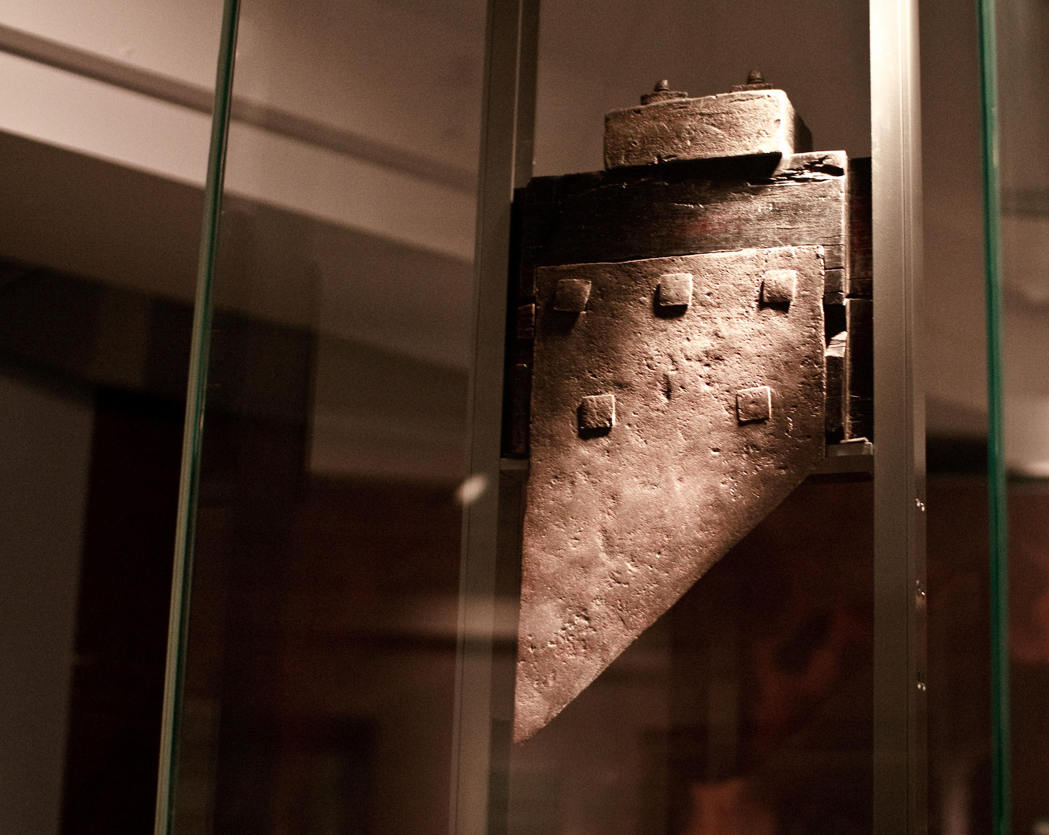
Guillotine
The “National Razor”
Equality in Death
>15,000 Executed
Photo Credit: poppet with a camera

Slide 14
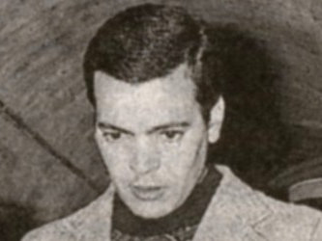
1977
Hamida Djandoubi the so-called “Pimp Killer”

Slide 15
ENEMIES
OF THE PEOPLE

Slide 16
Factions
Left Wing
Right Wing
Jacobins (Republicans) |  | Monarchists
Montagnards (The Mountain) | Girondins (Girondists)
Radical | Moderate | Conservative

Slide 17
Factions
Left Wing
Right Wing
Jacobins (Republicans) |  | Monarchists
Montagnards (The Mountain) | Girondins (Girondists)
Radical | Moderate | Conservative

Slide 18
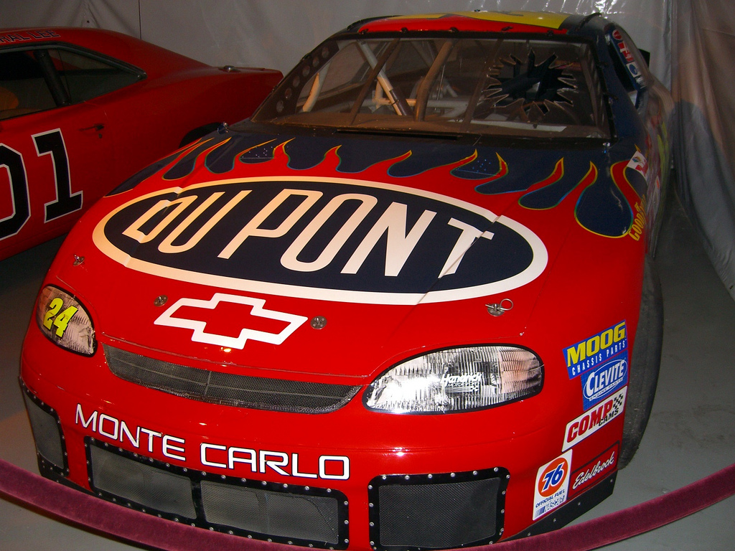
Émigrés
Photo Credit: Humpalumpa

Slide 19
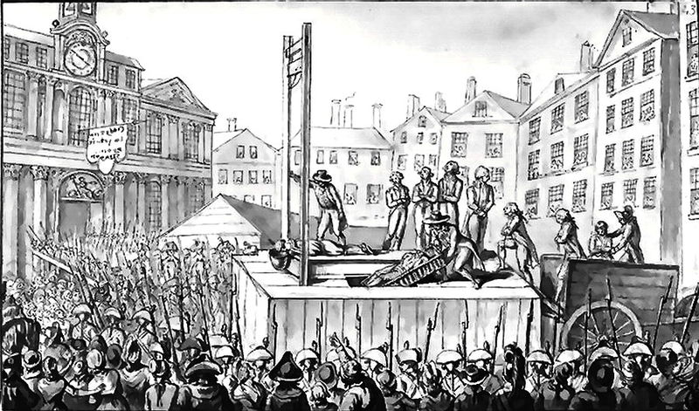
9 émigrés executed by guillotine in 1793

Slide 20
“Tribulation… makes you realize who you are.”
-- Marie Antoinette

Slide 21
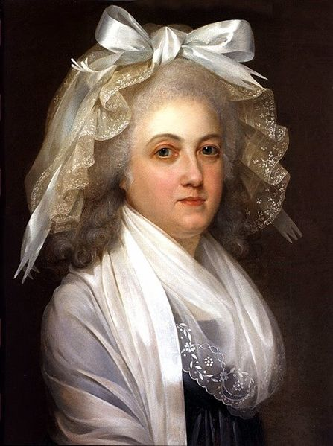
“Tribulation… makes you realize who you are.”
-- Marie Antoinette
Marie Antoinette prisoner in the Temple Tower, attributed to Alexandre Kucharski, ca. 1792. (Private collection)

Slide 22
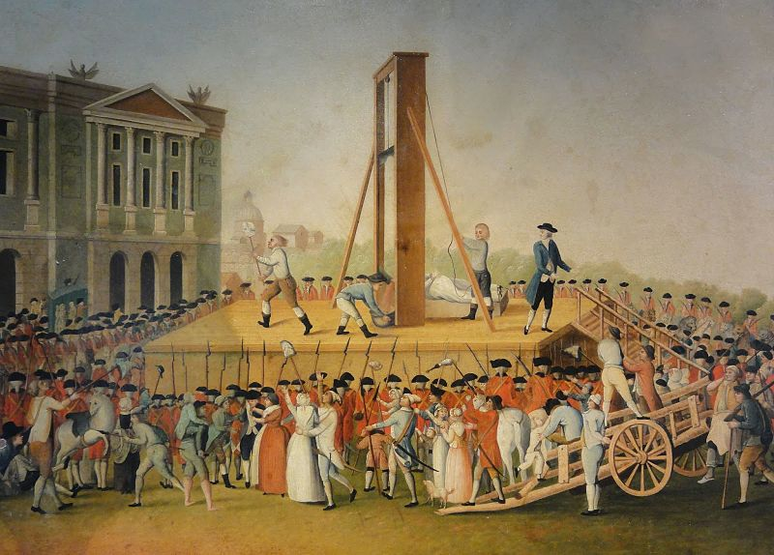
EXECUTED October 1793

Slide 23
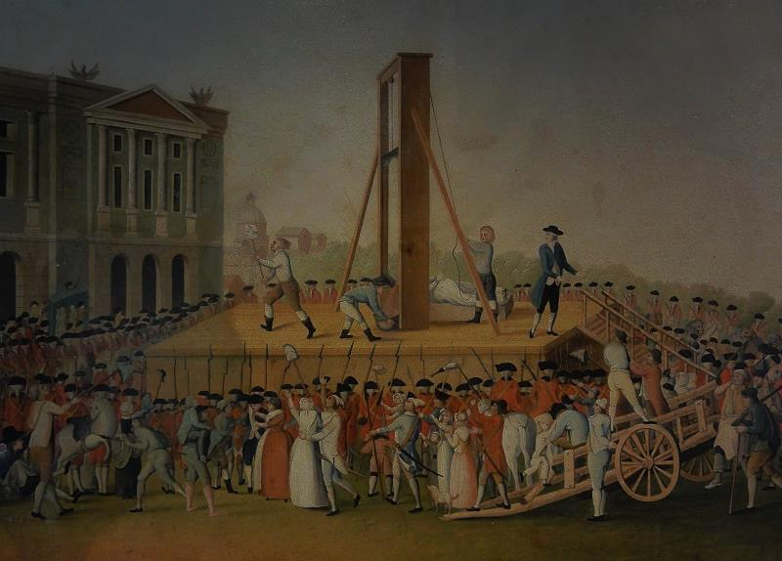
EXECUTED October 1793

Slide 24
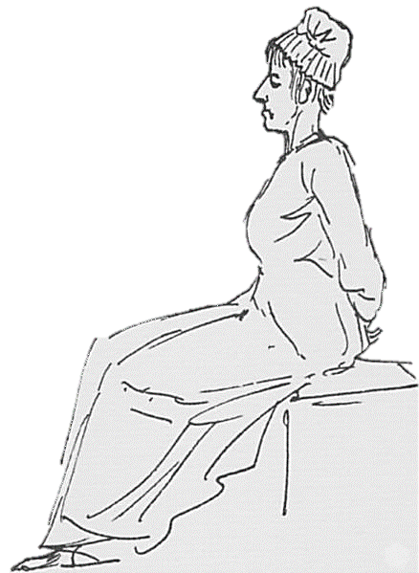
Not Worth a Painting
Jacques-Louis David, Marie Antoinette on the Way to the Guillotine (1793)

Slide 25
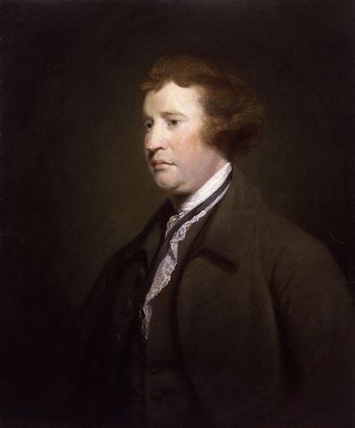
Edmund Burke
British MP

Slide 26
“Little did I dream that I should have lived to see such disasters fallen upon her, in a nation of gallant men, in a nation of men of honor, and of cavaliers! I thought ten thousand swords must have leaped from their scabbards, to avenge even a look that threatened her with insult.

Slide 27
But the age of chivalry is gone; that of sophisters, economists, and calculators has succeeded, and the glory of Europe is extinguished forever.

Slide 28
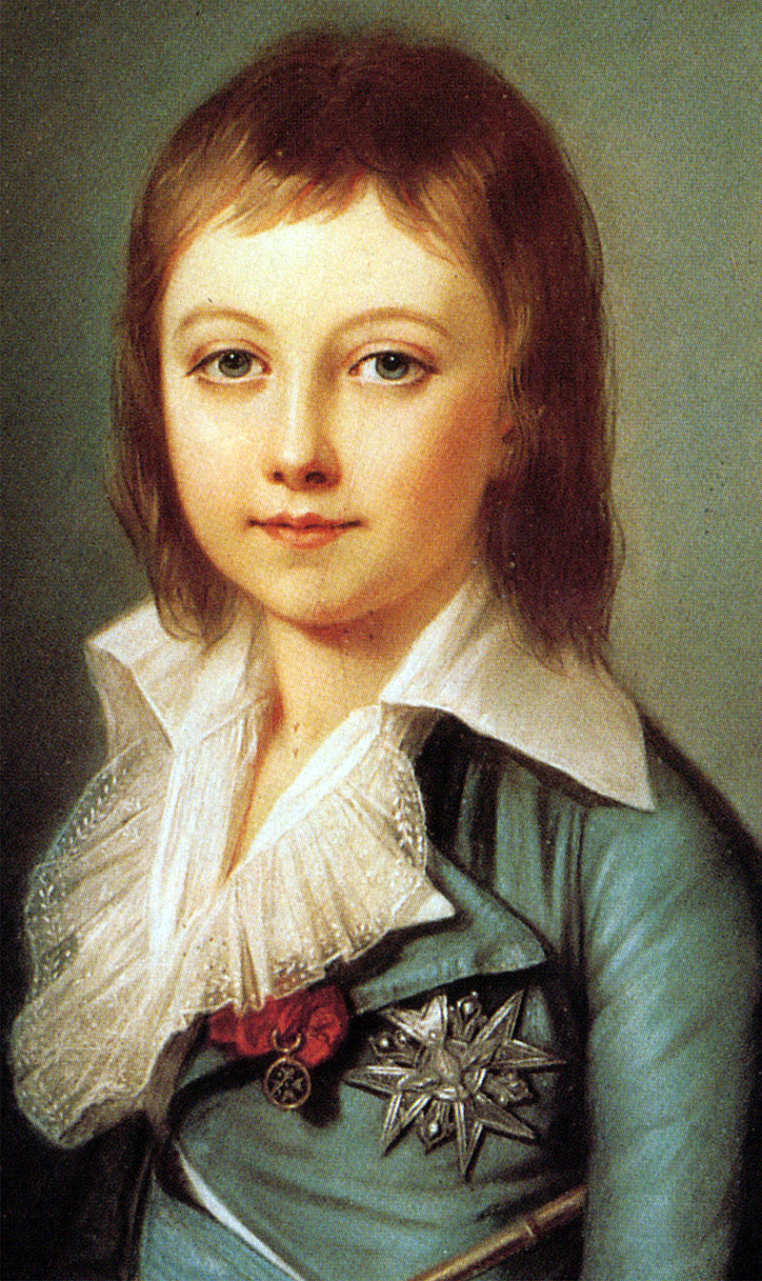
Louis XVII Louis-Charles
Died in prison from illness at the age of 10 in 1795
UNCROWNED

Slide 29
Left Wing
Right Wing
Jacobins (Republicans) |  | Monarchists
Montagnards (The Mountain) | Girondins (Girondists)
Radical | Moderate | Conservative
After eliminating the monarchists, the Montagnards turned on their more moderate republican counterparts, the Girondins.

Slide 30
Left Wing
Right Wing
Jacobins (Republicans) |  | Monarchists
Montagnards (The Mountain) | Girondins (Girondists)
Radical | Moderate | Conservative
After eliminating the monarchists, the Montagnards turned on their more moderate republican counterparts, the Girondins.

Slide 31
Robespierre’s
Republic of Virtue

Slide 32
“It is this virtuous people that spills all its blood to found the republic that is imposing to internal enemies and shakes the thrones of tyrants.”
-- Robespierre
“On the Enemies of the Nation” (1794)

Slide 33
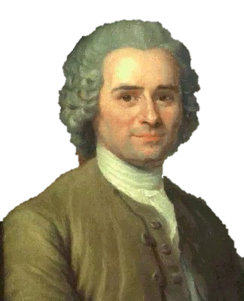
ROUSSEAU
The Social Contract
Government should be an instrument of the GENERAL WILL

Slide 34
DICTATORSHIP
“OF THE PEOPLE”

Slide 35
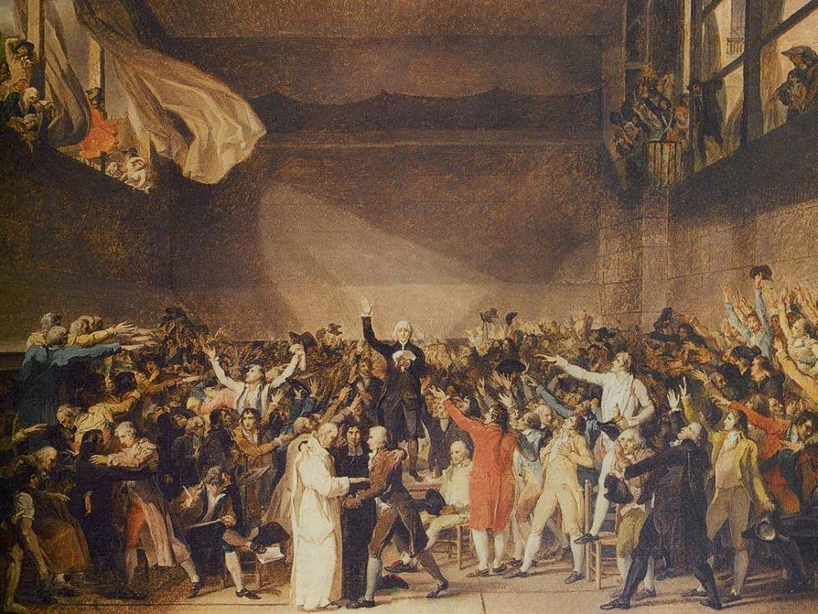
Bye Bye Liberalism

Slide 36
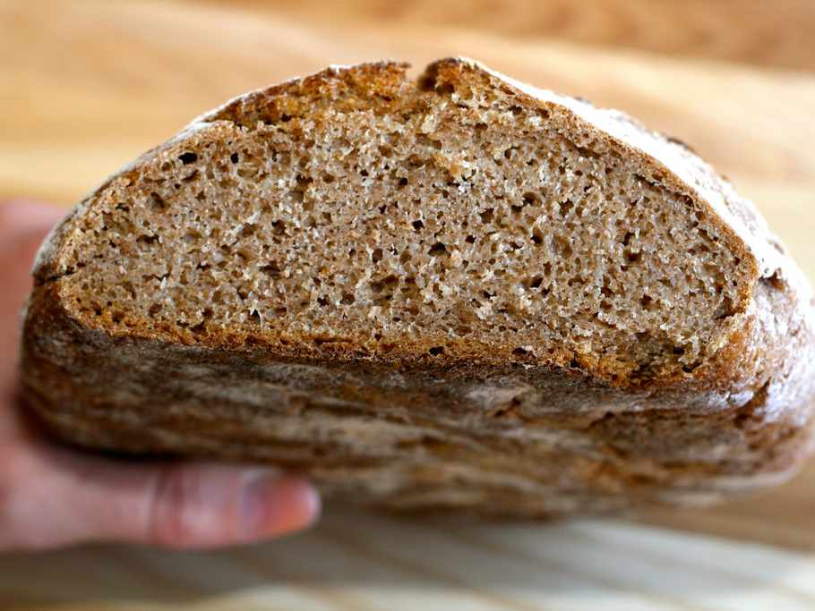
Bread of Equality
No More White Bread
Photo by cheeseslave

Slide 37
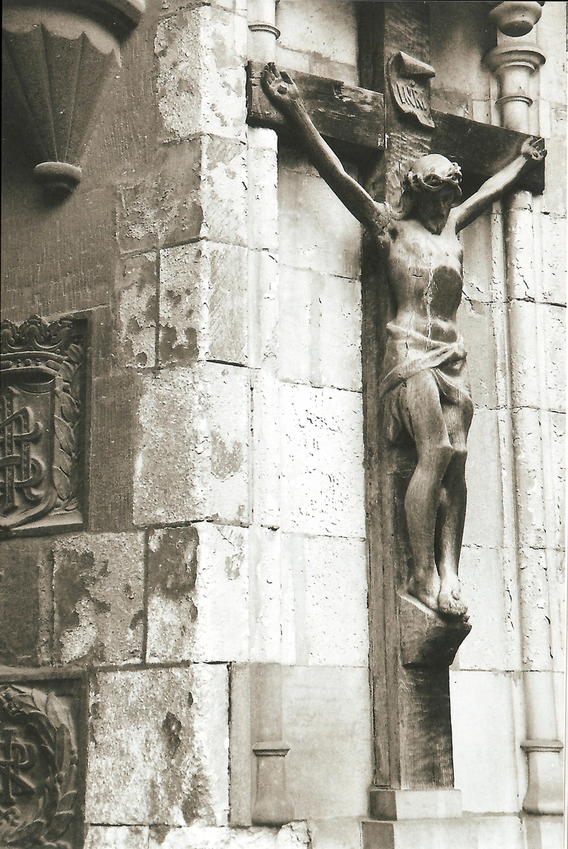
DECHRISTIANIZATION
Photo by Joel Snape

Slide 38
The Festival of the Supreme Being

Slide 39
DECHRISTIANIZATION
The Legacy of
Photo by Joel Snape

Slide 40
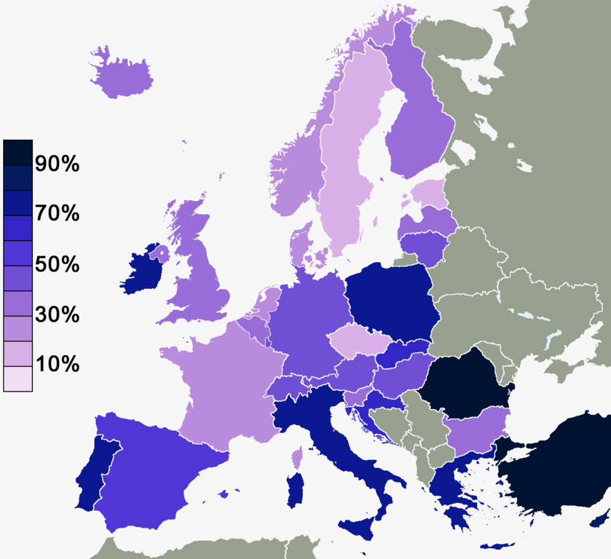
Percentage of Europeans who believe in God
Map Credit: U5K0

Slide 41
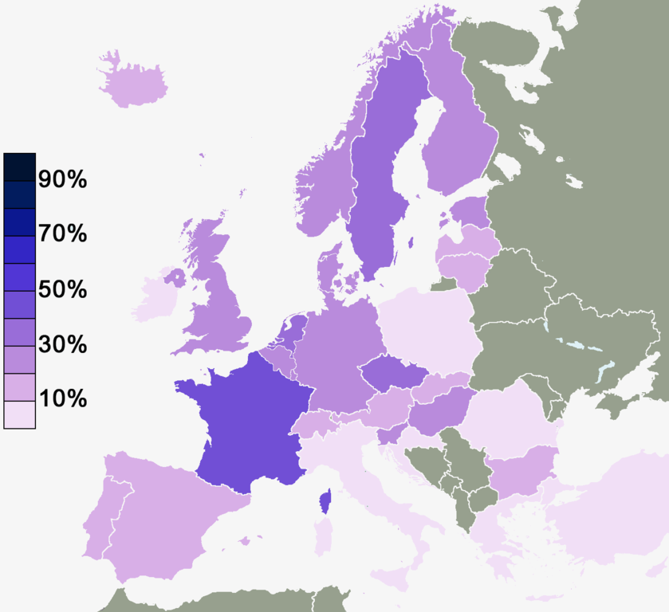
Percentage of Europeans who DO NOT believe in any spirit, God, or life force
Map Credit: U5K0

Slide 42
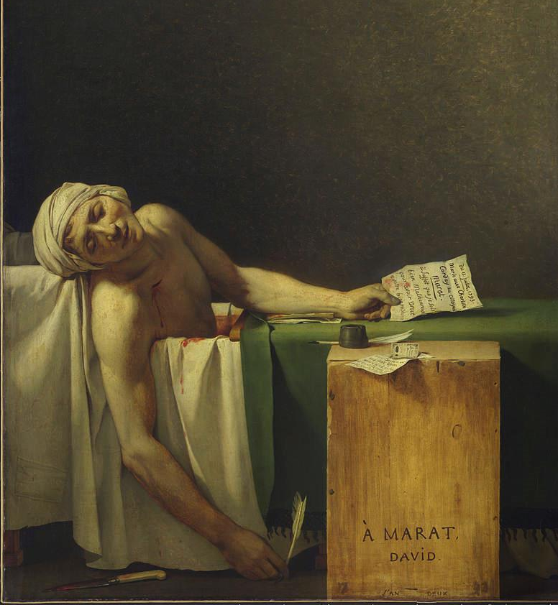
Jean-Paul Marat
Revolutionary Saint

Slide 43
.

Slide 44
DECIMAL
.
TIME

Slide 45
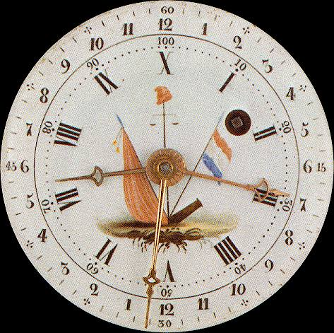
A French Decimal Clock
A revolutionary way to keep time!
10 Hours
100 Minutes
100 Seconds

Slide 46
A French Decimal Clock
What is a SECOND?

Slide 47
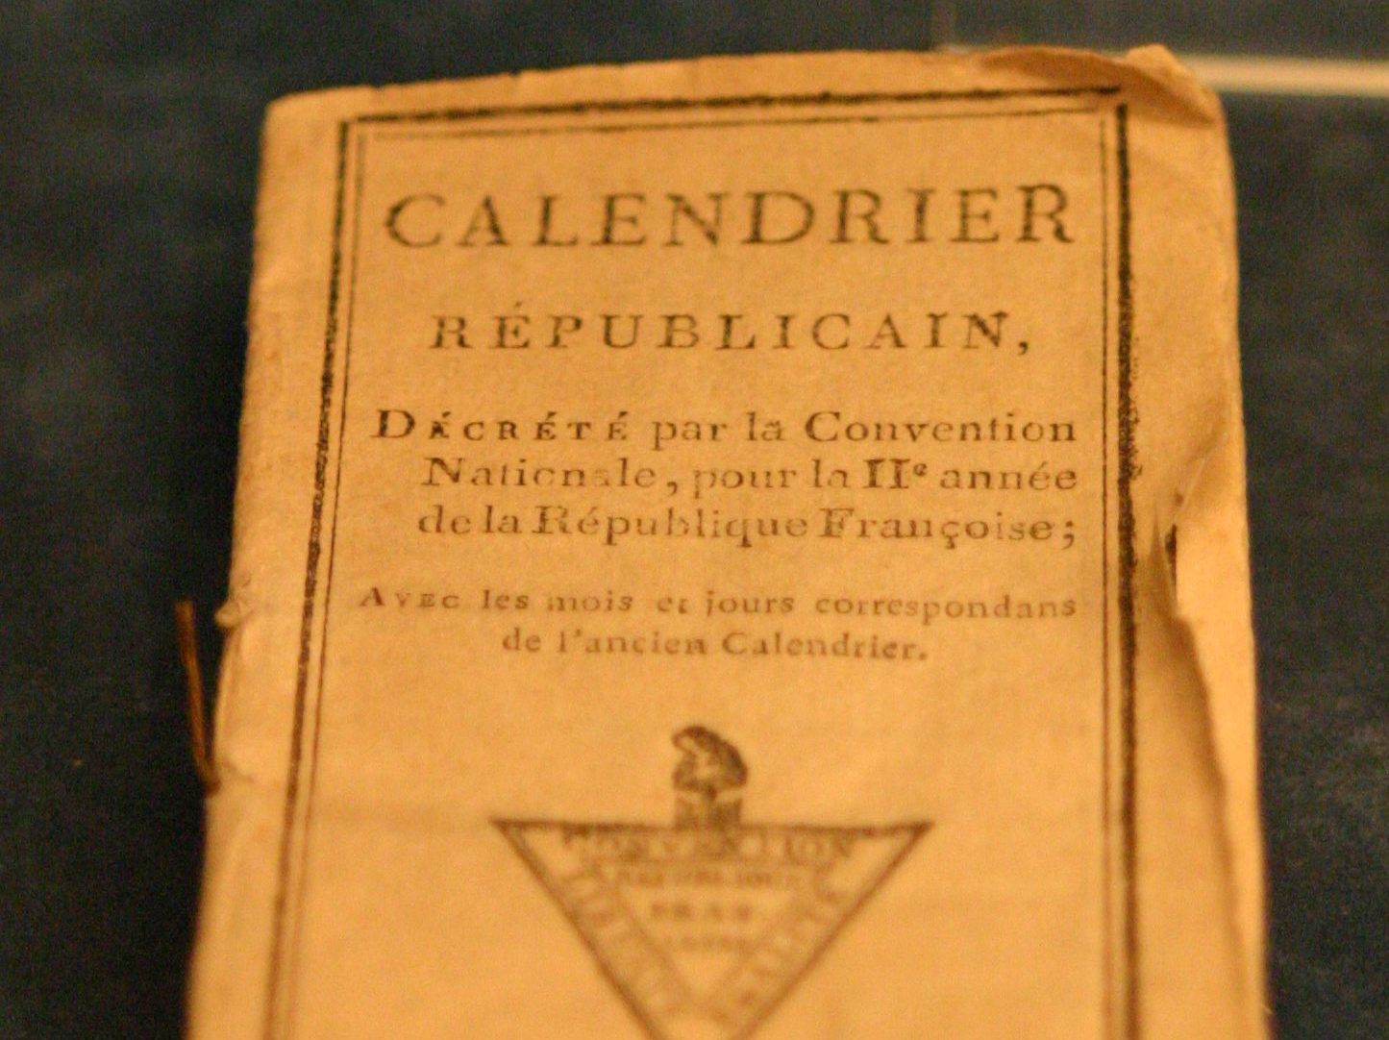
Work by Rama

Slide 48
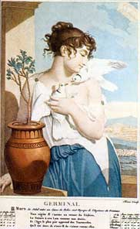
The French Republican Calendar
1793-1805
GOALS:
Eliminate the influence of the Old Regime (Monarchy & Church)
Increase Productivity with a ten day work week
Germinal Mid-March to Mid-April

Slide 49
The French Republican Calendar
1793-1805
New months named for natural occurrences
1792 = Year I
Germinal Mid-March to Mid-April

Slide 50
The French Republican Calendar
1793-1805
MONTH
Primidi | 1 | 11 | 21
Duodi | 2 | 12 | 22
Tridi | 3 | 13 | 23
Quartidi | 4 | 14 | 24
Quintidi | 5 | 15 | 25
Sextidi | 6 | 16 | 26
Septidi | 7 | 17 | 27
Octidi | 8 | 18 | 28
Nonidi | 9 | 19 | 29
Décadi | 10 | 20 | 30
Germinal Mid-March to Mid-April

Slide 51
The Metric System
1795
Meter
Unit | Relation to base
kilometer | 10³ meters
hectometer | 10² meters
decameter | 10¹ meters
METER
decimeter | 10⁻¹ meters
centimeter | 10⁻² meters
millimeter | 10⁻³ meters

Slide 52
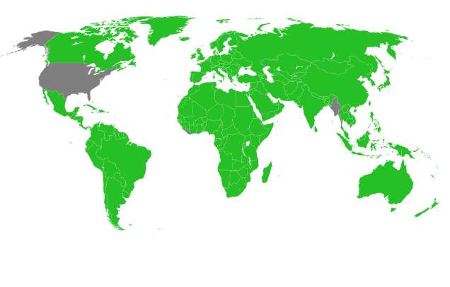
The Metric System Today

Slide 53
Purge
Political
After getting rid of its enemies, the Mountain turned on itself.
Photo Credit: poppet with a camera

Slide 54
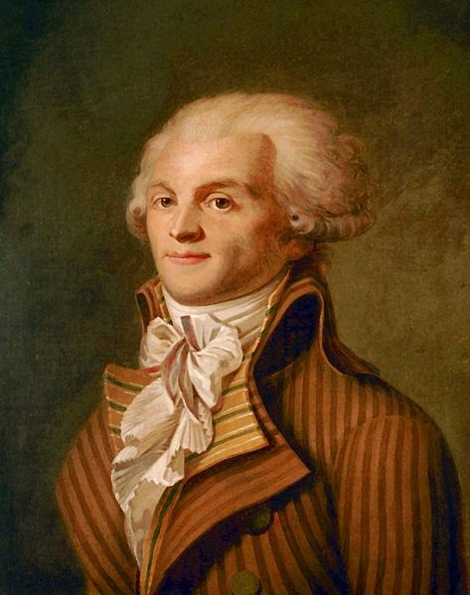
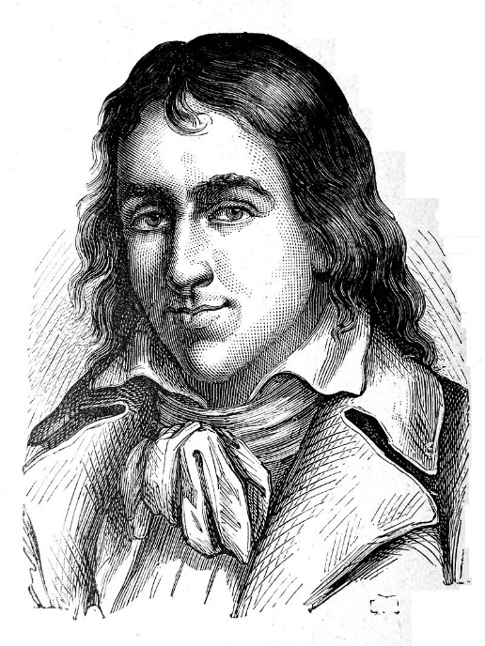
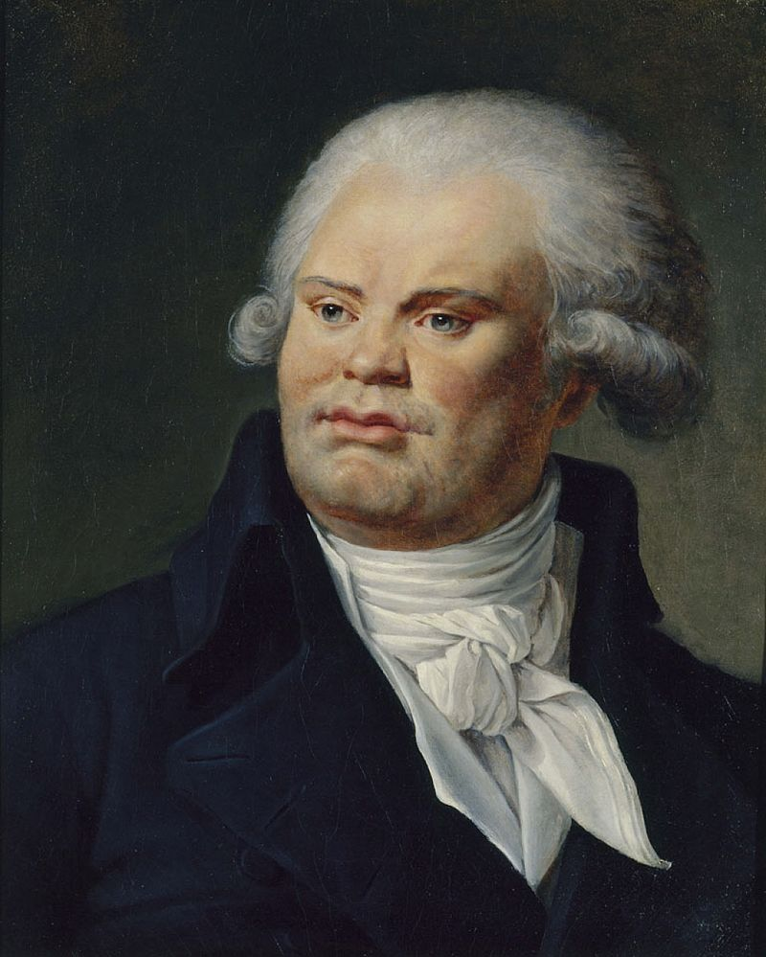
The Purge of the Mountain
March / April 1794
Hébertists
(Too Radical)
Dantonistes
(Not Radical Enough)
Robespierre

Slide 55
TOO HOT
Jacques Hébert and the members of his radical faction were guillotined in March, 1794.
Too radical for Robespierre!
Hébertists
(Too Radical)

Slide 56
TOO COLD
Georges Danton and his followers were guillotined in April, 1794 for advocating an end to the Terror.
Dantonistes
(Not Radical Enough)

Slide 57
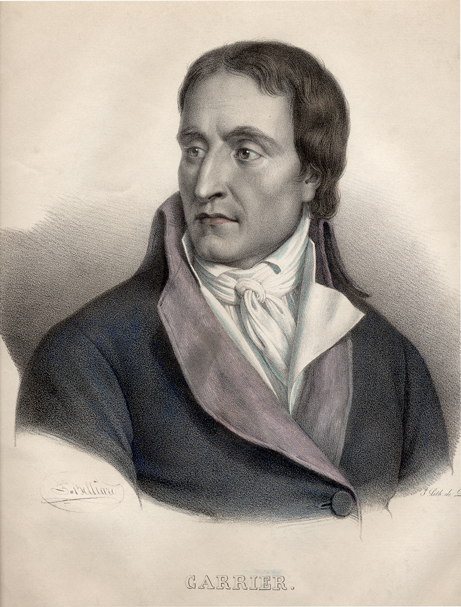
“The monsters! They want to break down the scaffolds - but, citizens, never forget, those who want no guillotines are those who should feel that they are worthy of the guillotine!”
-- Jean-Baptiste Carrier

Slide 58
Who Will Be NEXT?

Slide 59
ENOUGH

Slide 61
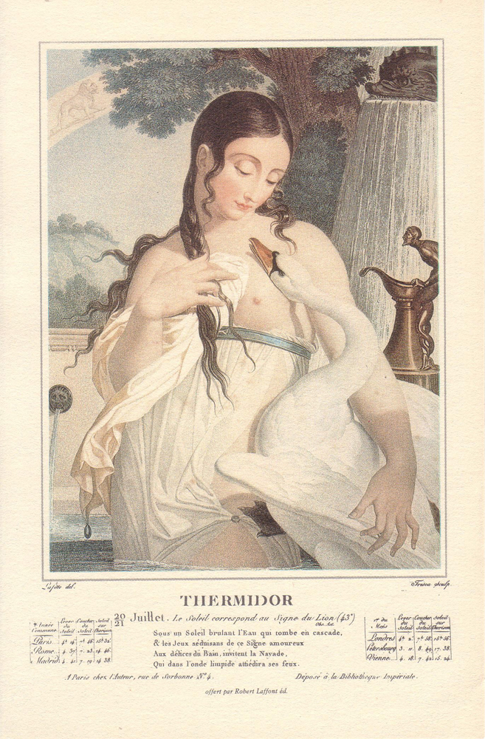
THERMIDOR

Slide 62
Thermidorian Reaction
9 Thermidor Year II
27 July 1794
Icon by Megan Mitchell
From Noun Project

Slide 63
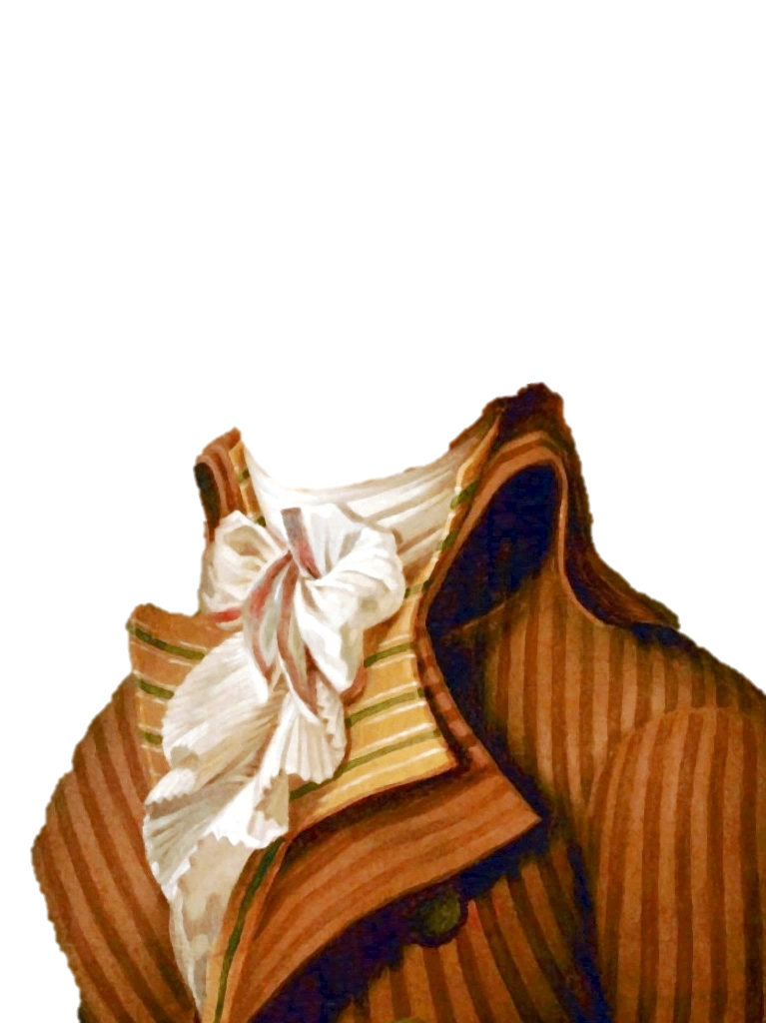
What goes around…
CUTS YOUR HEAD OFF

Slide 64
The End
of the
Reign of Terror

Slide 65
NEXT UP
1789-1791 | Liberal Phase
1792-1794 | Radical Phase
1795-1799 | Directory Phase
1799-1815 | Napoleonic Phase

