Slide 1
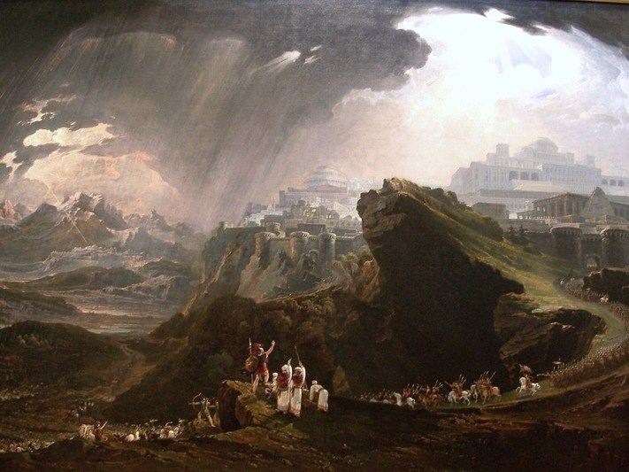
The Conquest of Canaan
John Martin, Joshua Commanding the Sun to Stand Still (1816)

Slide 2
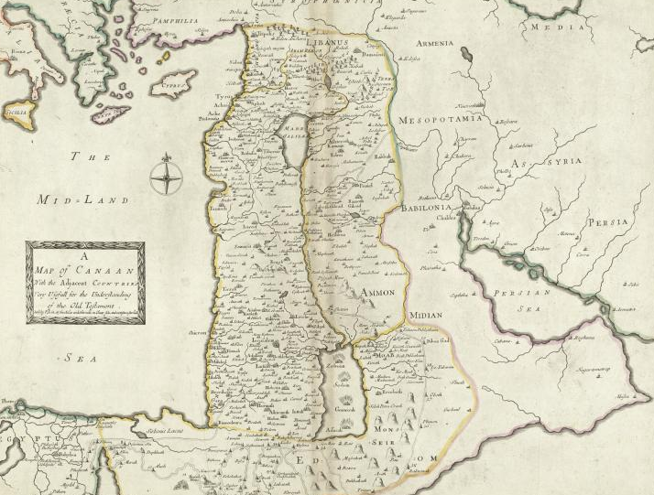
What Constitutes a Nation?
Map Credit: Boston Public Library

Slide 3
Canaan
“The Promised Land”
Map Credit: Boston Public Library

Slide 4
Genesis 9
The sons of Noah who came out of the ark were Shem, Ham and Japheth. (Ham was the father of Canaan). These were the three sons of Noah, and from them came the people who were scattered over the earth.

Slide 5
Semitic
Descended from Shem

Slide 6
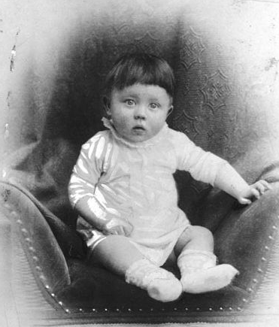
Anti-Semitism

Slide 7
Descendants of Noah
According to the Book of Genesis

Slide 8
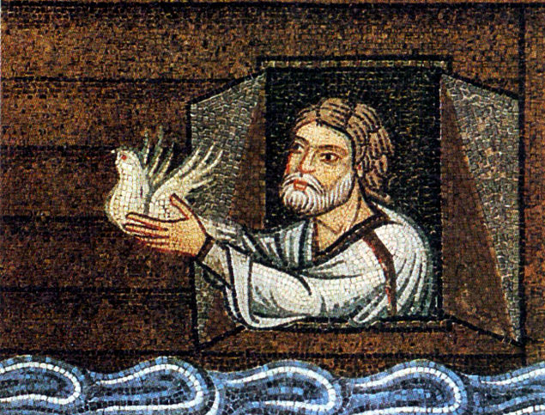
Noah’s Curse

Slide 9
Genesis 9
Noah, a man of the soil, proceeded to plant a vineyard. When he drank some of its wine, he became drunk and lay uncovered inside his tent. Ham, the father of Canaan, saw his father's nakedness and told his two brothers outside. But Shem and Japheth took a garment and laid it across their shoulders; then they walked in backward and covered their father's nakedness. Their faces were turned the other way so that they would not see their father's nakedness.

Slide 10
Genesis 9
When Noah awoke from his wine and found out what his youngest son had done to him, he said,
"Cursed be Canaan! The lowest of slaves will he be to his brothers."
He also said, "Blessed be the LORD, the God of Shem! May Canaan be the slave of Shem.”

Slide 11
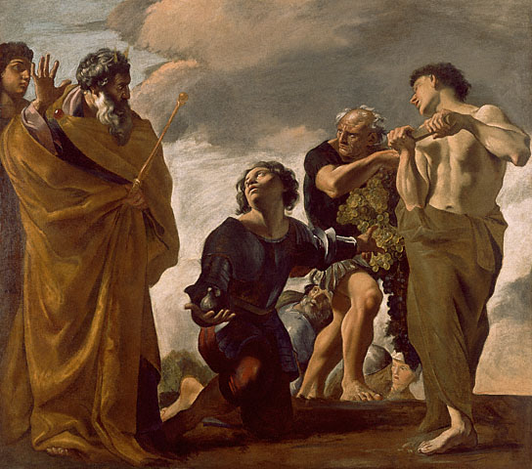
Joshua
Giovanni Lanfranco, Moses and the Messengers from Canaan

Slide 12
“Be strong and courageous…”
Wordle of Joshua, Chapters 1-10

Slide 13
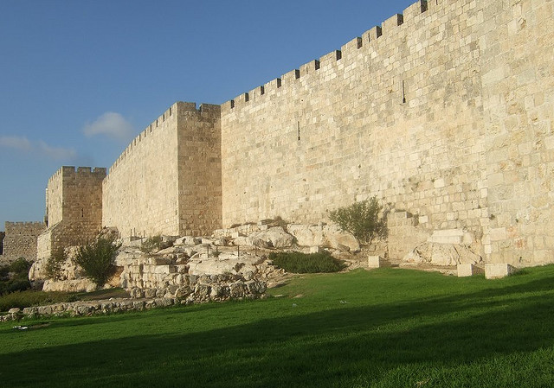
Siege Warfare
When you march up to attack a city, make its people an offer of peace… If they refuse to make peace and they engage you in battle, lay siege to that city. When the LORD your God delivers it into your hand, put to the sword all the men in it…
-- Deuteronomy 20
Photo Credit: JoeRead

Slide 14
However, in the cities of the nations the LORD your God is giving you as an inheritance, do not leave alive anything that breathes…
Some rights reserved by Oxfam International

Slide 15
The Ban
Some rights reserved by Oxfam International

Slide 16
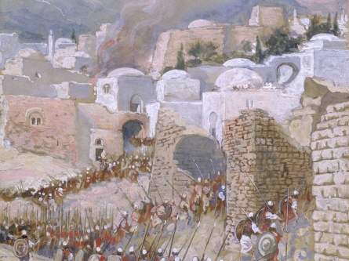
The Walls of Jericho
Now Jericho was tightly shut because of the sons of Israel; no one went out and no one came in.
-- Joshua 6

Slide 17
Reconnaissance
Photo by Edith Soto

Slide 18
Reconnaissance
Photo by Edith Soto

Slide 19
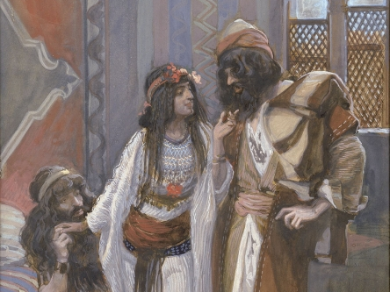
Rahab
The Israelite spies were sheltered by Rahab at a local brothel.

Slide 20
Rahab
Rahab
.
.
.
David
.
.
.
Jesus
According to biblical genealogies, Rahab was an ancestor of King David and Jesus.

Slide 21
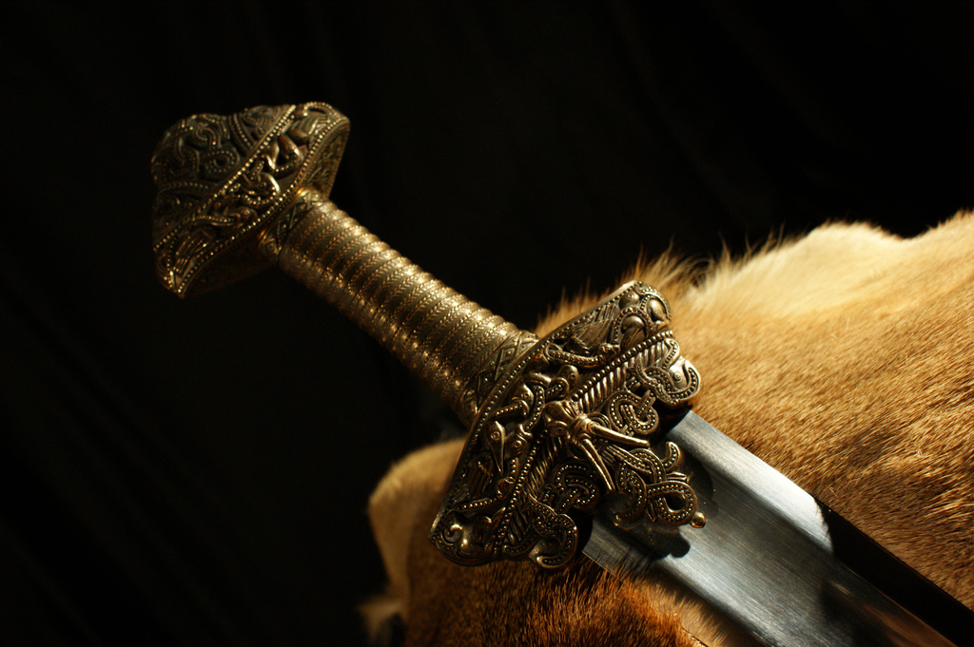
“The city shall be under the ban, it and all that is in it belongs to the LORD; only Rahab the harlot and all who are with her in the house shall live, because she hid the messengers whom we sent…”
“They utterly destroyed everything in the city, both man and woman, young and old, and ox and sheep and donkey, with the edge of the sword.”
Photo by Tor-Sven Berge

Slide 22
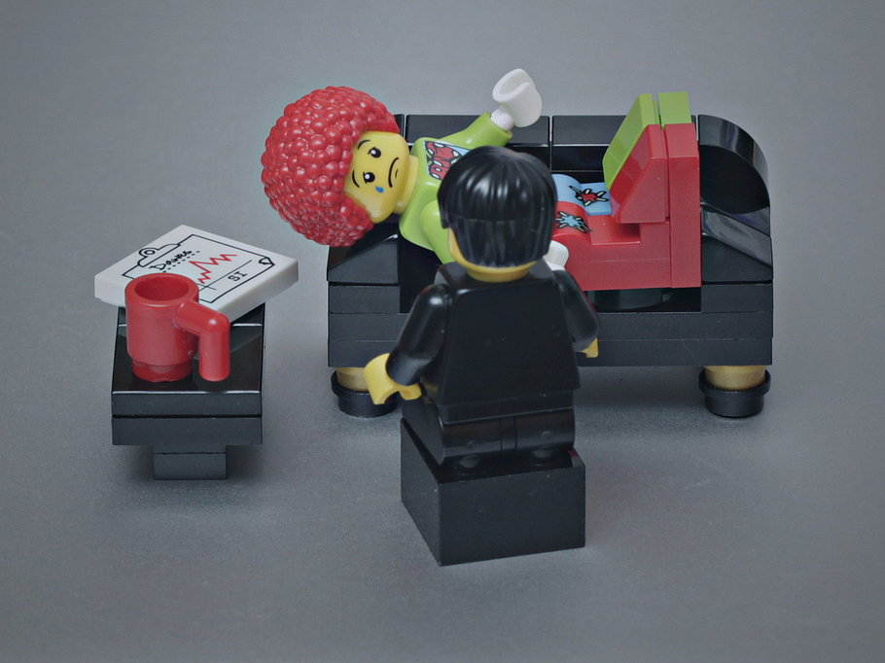
Psychological Warfare
Photo by Pascal

Slide 23
“So the LORD was with Joshua, and his fame was in all the land.”
Photo by Pascal

Slide 24
Map © Bible History Online

Slide 25
NEXT
Map © Bible History Online

Slide 26
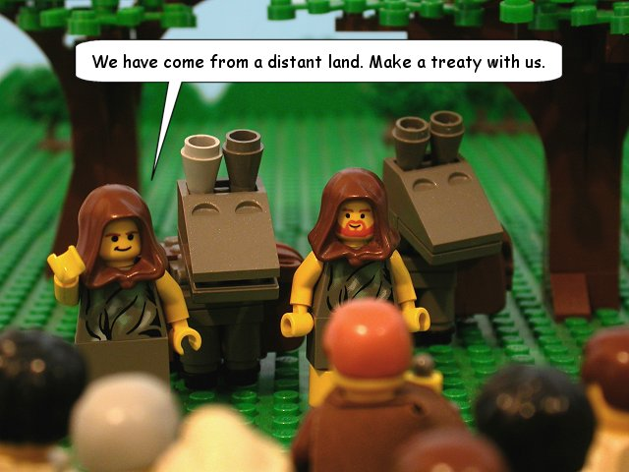
Treaty with Gibeon
Ancient Israelites considered themselves bound by their word, even when they were tricked.
http://www.thebricktestament.com

Slide 27
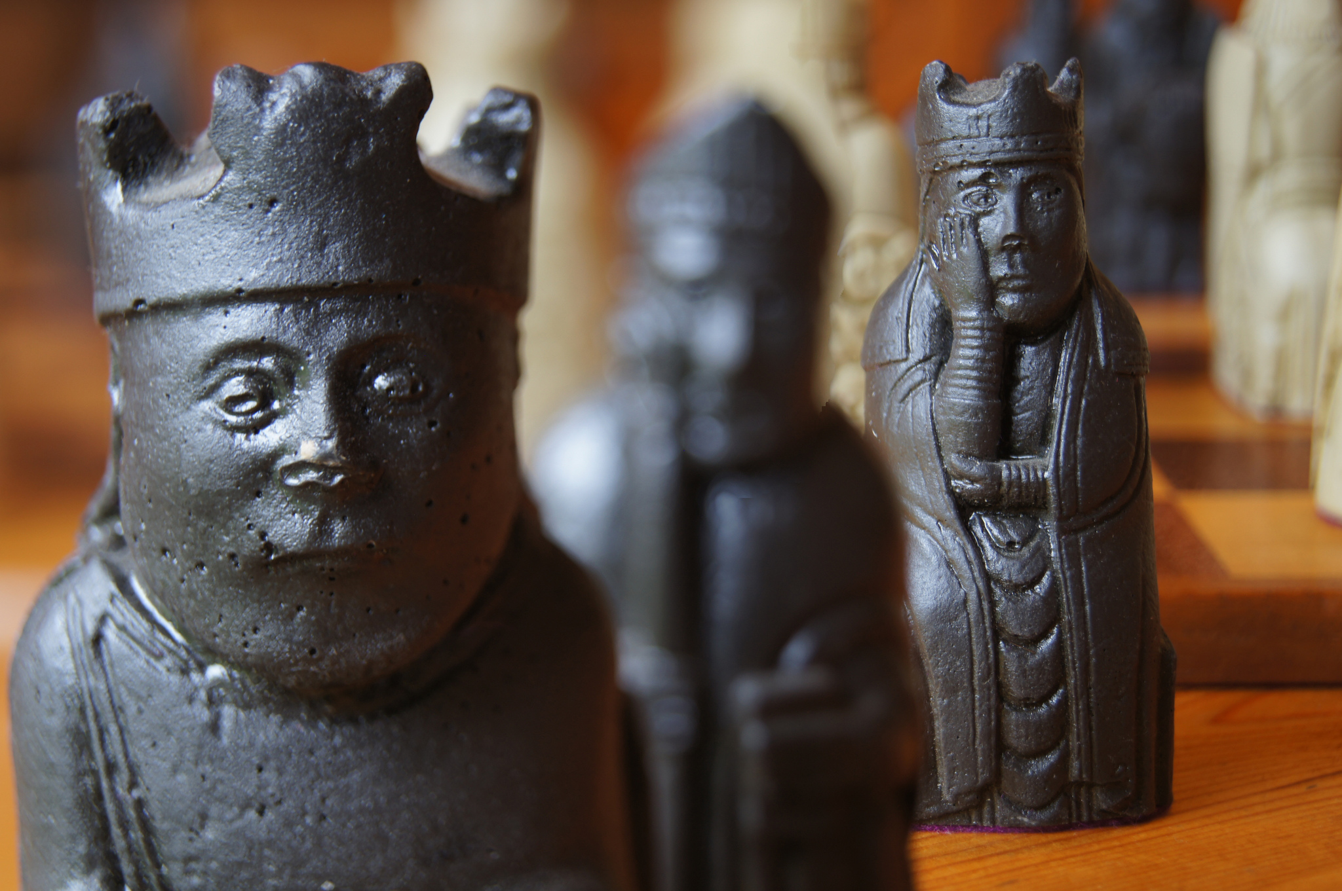
The Amorite Kings
Photo by AvidlyAbide

Slide 28
Five kings united in order to stop Joshua and the Israelites once and for all.
Photo by AvidlyAbide

Slide 29
There was no day like that before it or after it, when the LORD listened to the voice of a man; for the LORD fought for Israel….
John Martin, Joshua Commanding the Sun to Stand Still (1816)

Slide 30
COSMOLOGY

Slide 31
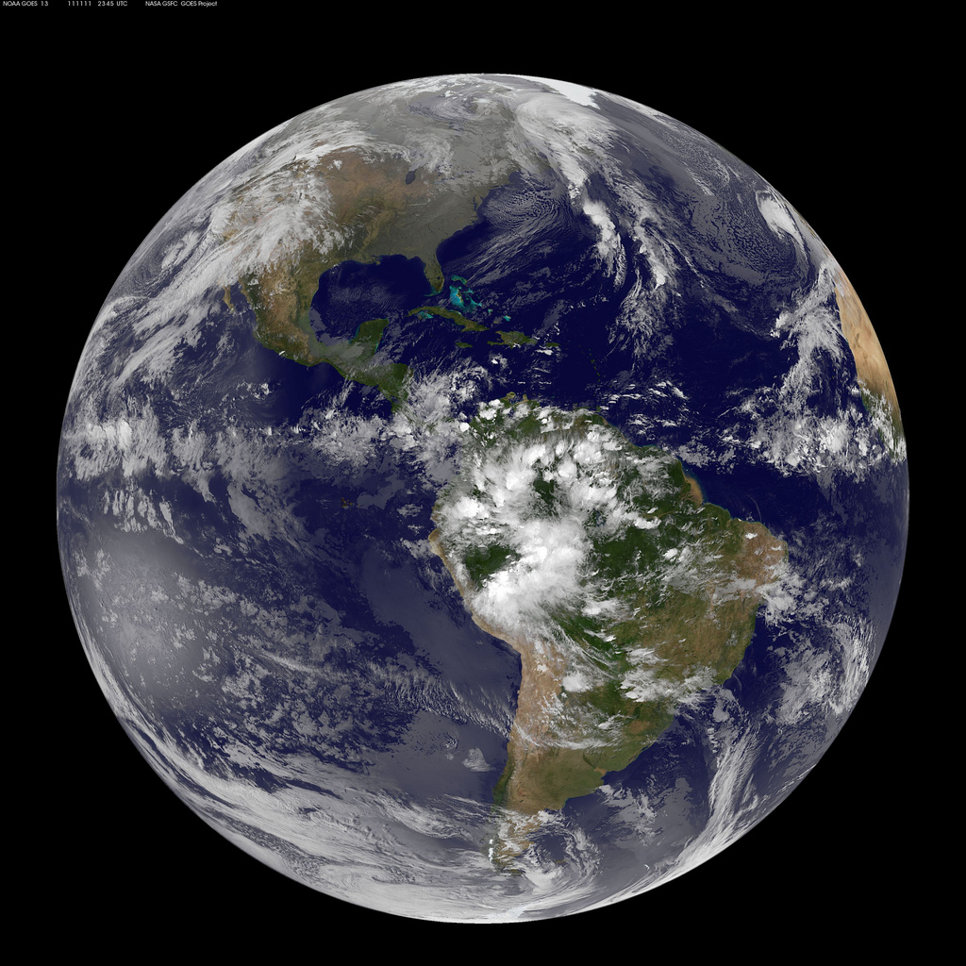
GEOCENTRISM
Photo by NASA

Slide 32
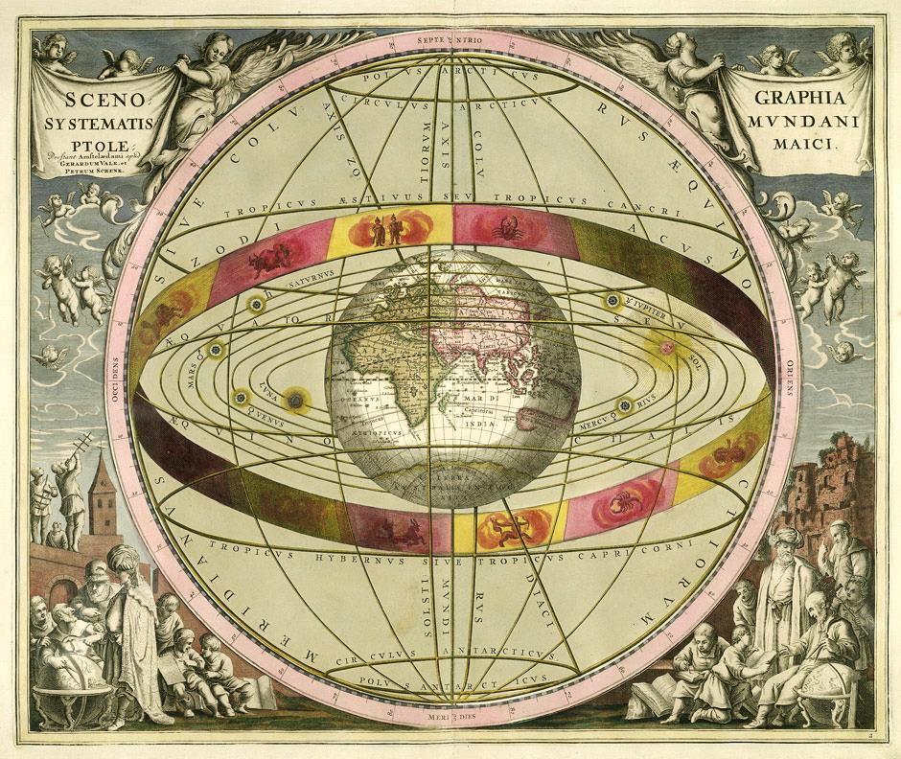
SOURCE

Slide 33
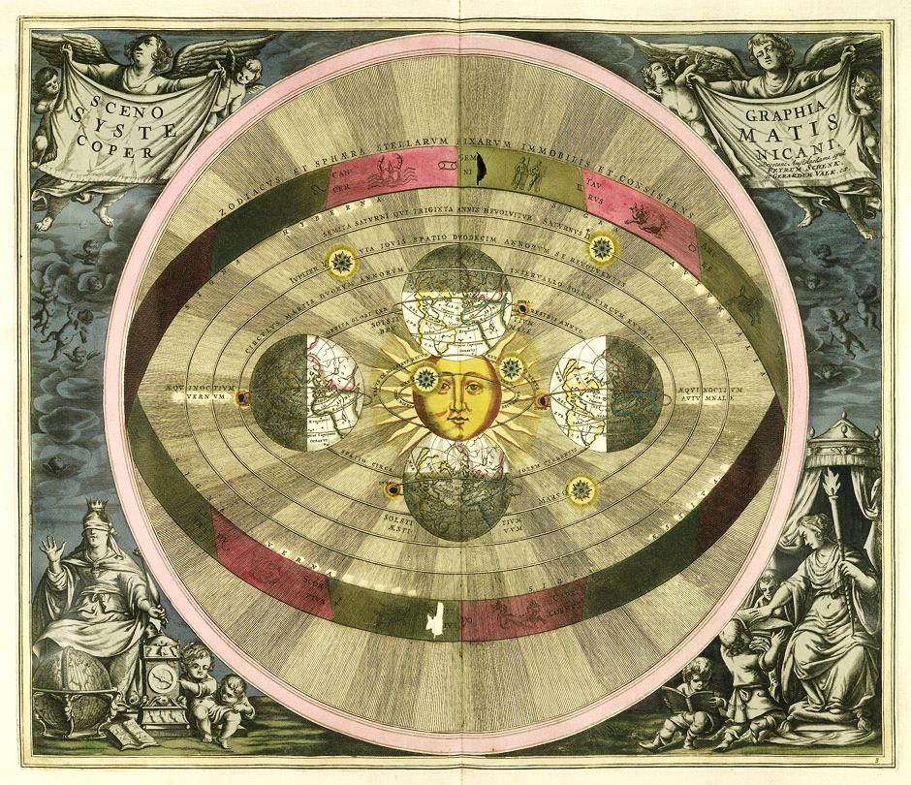
SOURCE

Slide 34
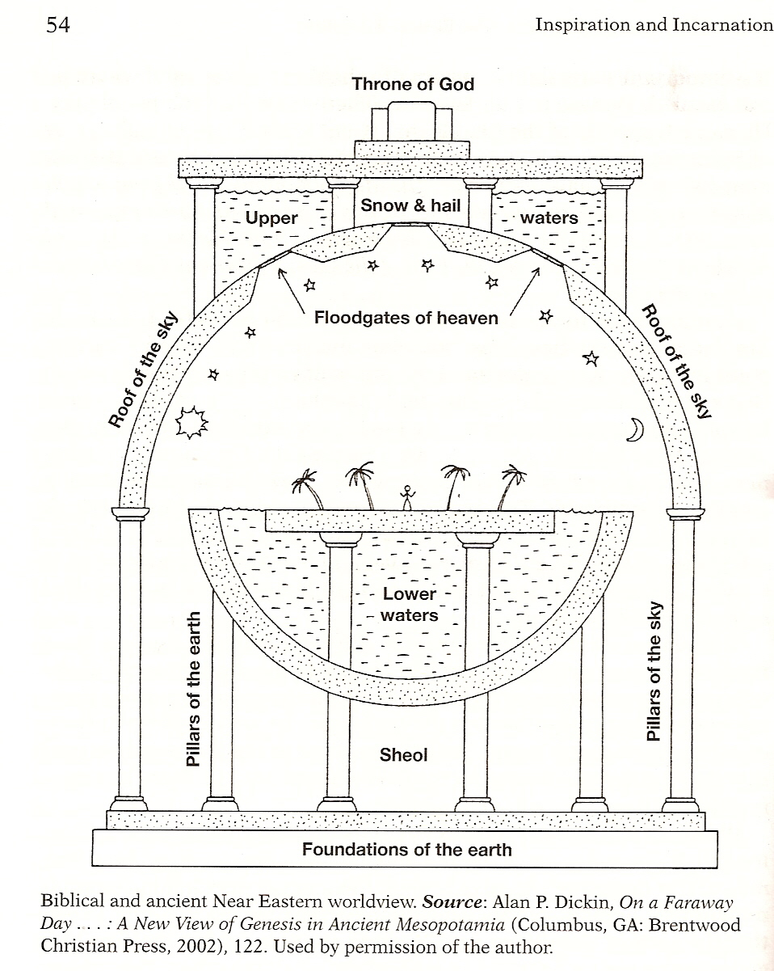

Slide 35
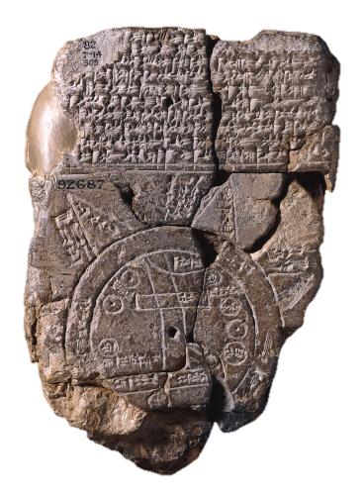
Babylonian Map of the World

Slide 36
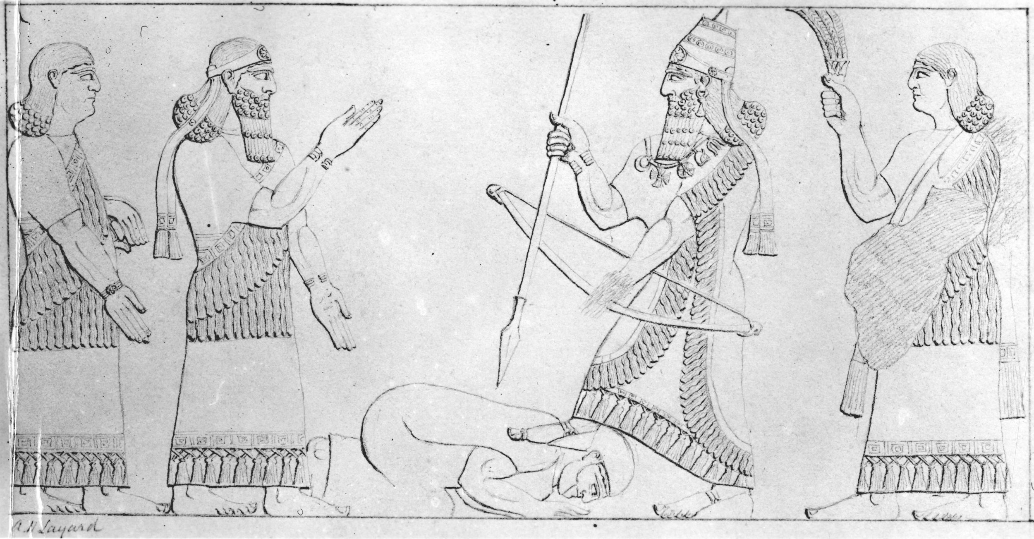
An Assyrian king places his foot on an enemy’s neck.
©Trustees of the British Museum
Used for Educational Purposes

Slide 37
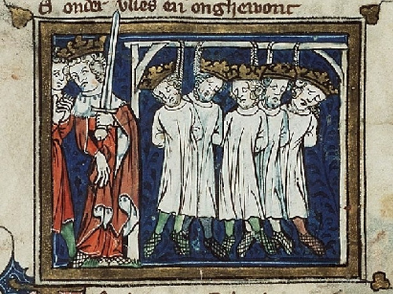

Slide 38
Photo by Andrew Bowden

Slide 39
Now Joshua was old and advanced in years when the LORD said to him, “You are old… and very much of the land remains to be possessed....”
-- Joshua 13
Photo by Andrew Bowden

Slide 40
Joshua’s Farewell Address
Be very firm, then, to keep and do all that is written in the book of the law of Moses… so that you will not associate with these nations, these which remain among you, or mention the name of their gods, or make anyone swear by them, or serve them, or bow down to them… For if you ever go back and cling to the rest of these nations, these which remain among you, and intermarry with them, so that you associate with them and they with you, know with certainty that the LORD your God will not continue to drive these nations out from before you; but they will be a snare and a trap to you, and a whip on your sides and thorns in your eyes…”
-- Joshua 23

