Slide 1
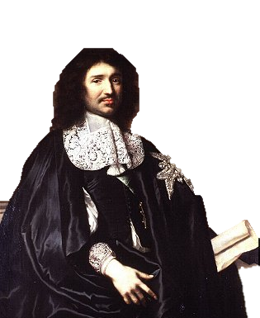
Mercantilism
The Economics of Absolutism

Slide 2
ECONOMICS
The study of the
PRODUCTION
DISTRIBUTION
CONSUMPTION
of goods and services

Slide 3
The Four Economic Questions
?
What should we produce?
How much should we produce?
How should we produce it?
Who should consume it?

Slide 4
The Four Economic Questions
?
COMMAND Economy
MARKET Economy
Mercantilism
Liberalism

Slide 5
Jean-Baptiste Colbert
Louis XIV’s Finance Minister
Associated with Mercantilism
Bourgeoisie Wealthy Merchant’s Son

Slide 6
What is Mercantilism?
A system of political and economic policy, evolving with the modern national state and seeking to secure a nation’s political and economic supremacy in its rivalry with other states.
According to this system, money was regarded as the store of wealth, and the goal of a state was the accumulation of precious metals by exporting the largest possible quantity of its products and importing as little as possible, thus establishing a favorable balance of trade.

Slide 7
The Economic Assumptions of Mercantilism

Slide 8
National Wealth is measured in PRECIOUS METALS
Some rights reserved by sprottmoney

Slide 9
This wealth is FINITE
Some rights reserved by sprottmoney

Slide 10
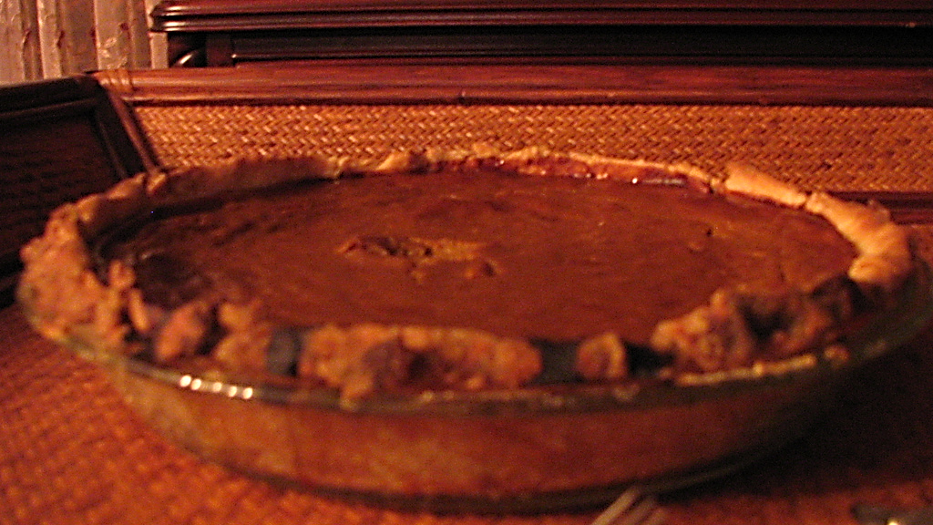
Zero-Sum Game
Some rights reserved by randomduck

Slide 11
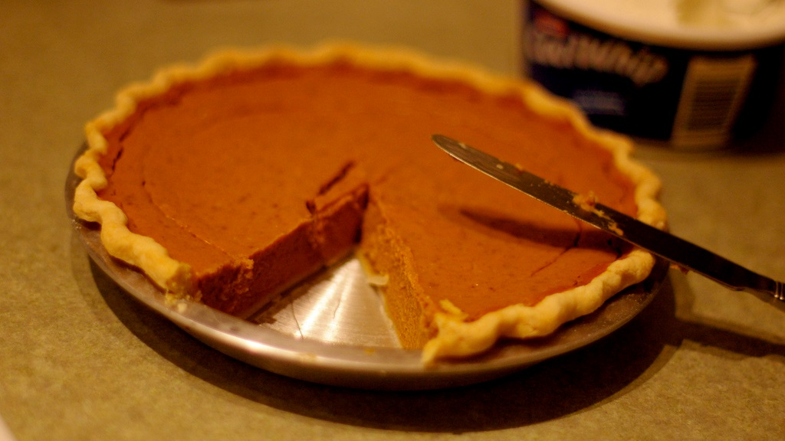
In order for me to get a bigger piece, you have to get a smaller piece.
Some rights reserved by casey.marshall

Slide 12
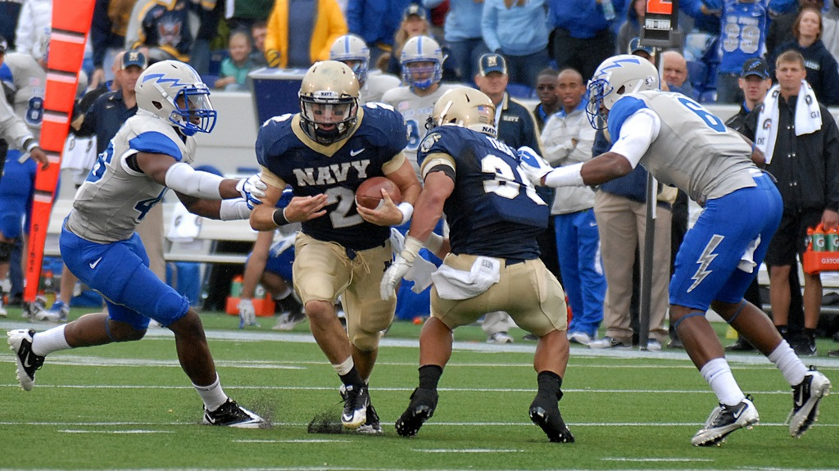
ECONOMIC RIVALRY
Some rights reserved by Official U.S. Navy Imagery

Slide 13
ECONOMICS: A TEAM SPORT
Some rights reserved by Official U.S. Navy Imagery

Slide 14
Favorable Balance of Trade
EXPORTS > IMPORTS

Slide 15
Self-Sufficiency

Slide 16
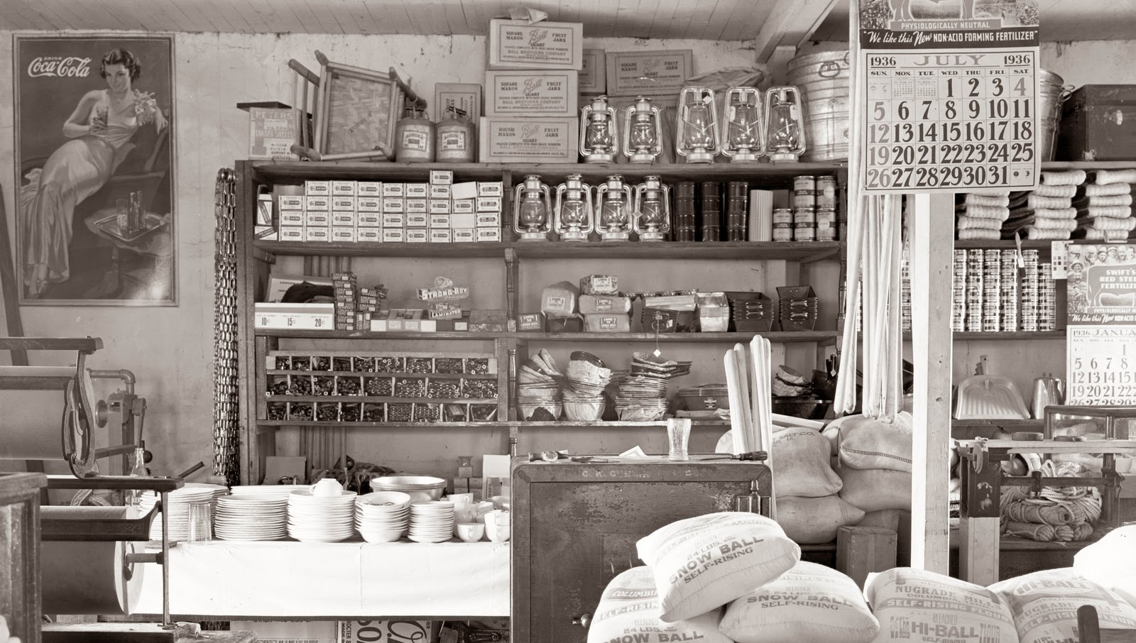
Mercantile Store

Slide 17
Cracker Barrel: Modern Mercantile
Some rights reserved by Lexie<3

Slide 18
The Goal:
DOMESTIC Manufacturing

Slide 19
The Means:
Economic REGULATION

Slide 20
DOMESTIC COMPETITION
Domestic competition in key industries was deemed to be destructive to the team spirit of mercantilism.

Slide 21
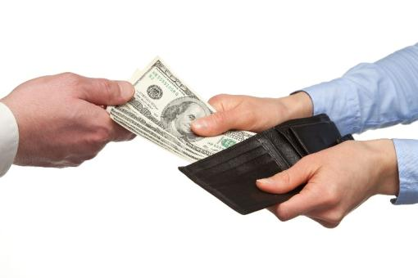
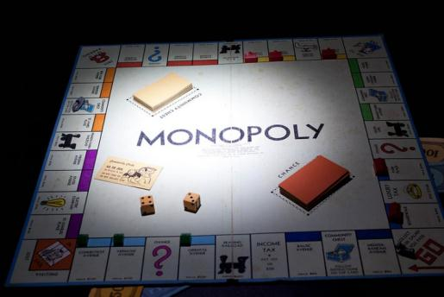
Government Incentives
RISK
A “Hands-on” Approach
Subsidies
Cash Payments
Monopolies
Protective Tariffs
Some rights reserved by Pets4Dawn
Some rights reserved by Steve A Johnson
Notes:
Colbert encouraged the development of French industry through subsidies (cash payments to manufacturers), monopolies (the privilege of being the sole domestic producer of a good), and protective tariffs (taxes on foreign imports designed to give an artificial advantage to domestic producers).

Slide 22
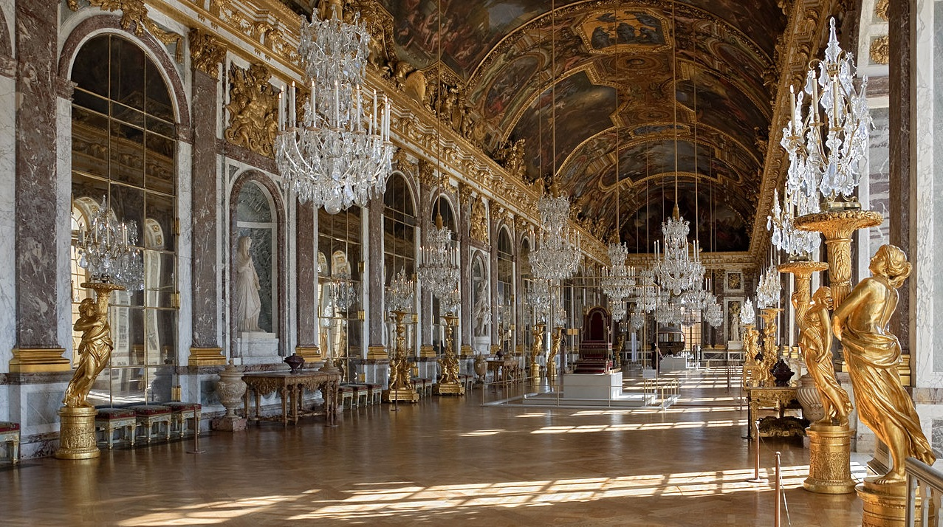
Versailles
MADE IN FRANCE
Photo Credit: Myrabella
Notes:
All of the luxury goods at Versailles were crafted by French artisans and sold by French merchants.

Slide 23
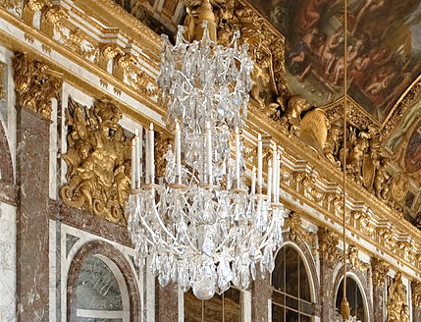
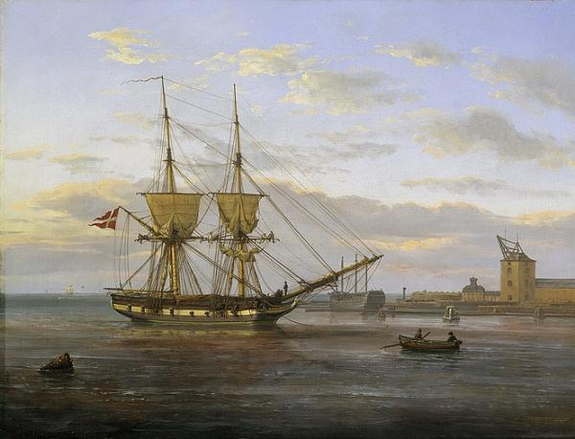
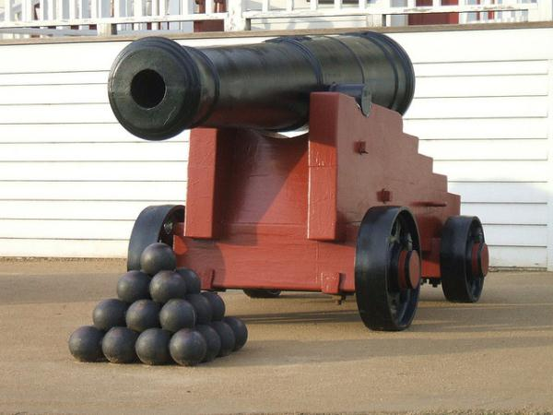
Preferred Industries
Luxury Goods
Shipping
Armaments
Some rights reserved by Myrabella
Some rights reserved by glennwilliamspdx

Slide 24
Colonies
The Backbone of a Self-Sufficient Economy
French Colonies:
Canada (Furs)
Louisiana (Raw Materials)
St. Domingue (Sugar)

Slide 25
PROVIDE RAW MATERIALS
CONSUME FINISHED GOODS

Slide 26
PROVIDE RAW MATERIALS
CONSUME FINISHED GOODS
Colonies were expected to trade exclusively with the mother country. Protective Tariffs discouraged trade with other nations and their colonies.

Slide 27
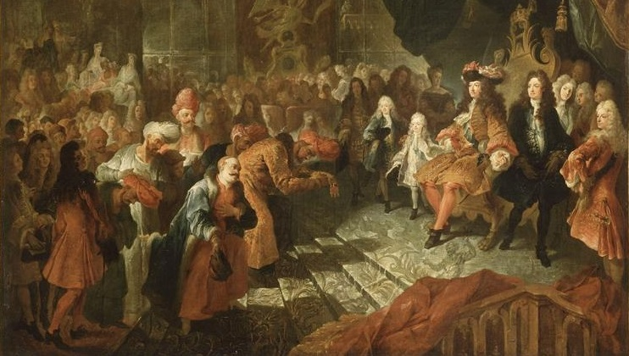
Corruption
The Fruits of Economic Regulation
Those closest to the decision-making authorities enjoy privileges that are not available to others.

Slide 28
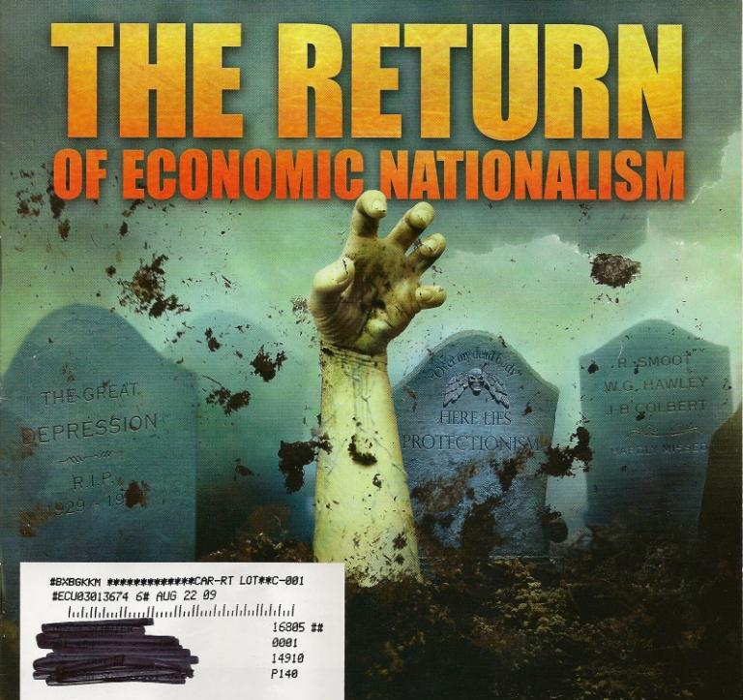
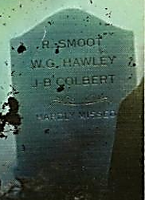
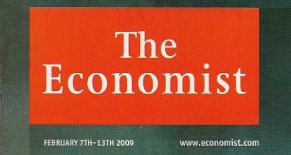
Reproduced for Educational Use Only

Slide 30
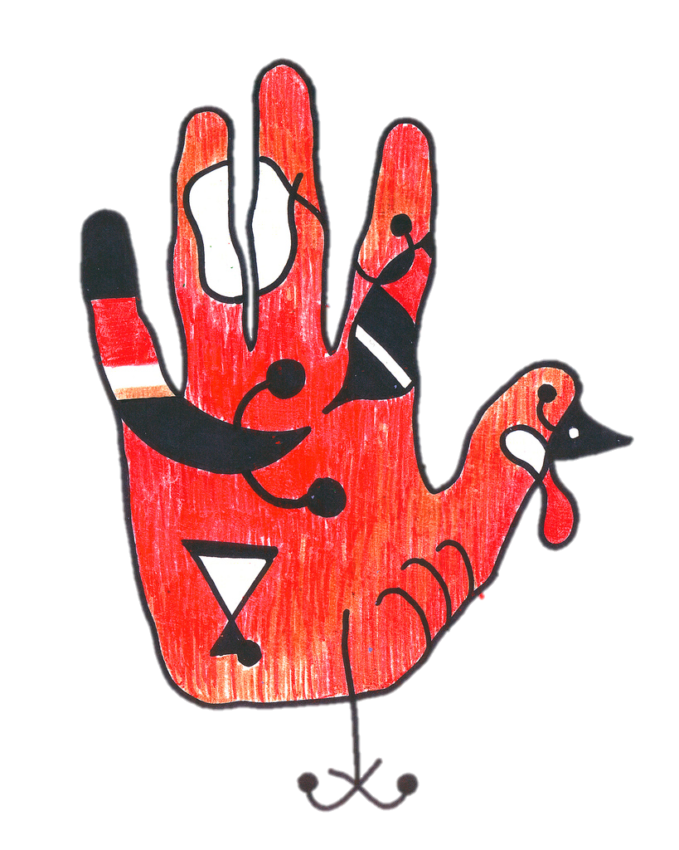
Mercantilism Hand Turkey
AKA “Merc Turk”
Exports > Imports
Bullion
Self-Sufficiency
Regulation
Subsidies
Monopolies
Tariffs
Colonialism
Corruption
Art Credit: brandon schauer
How to Draw a Hand Turkey

