Slide 1
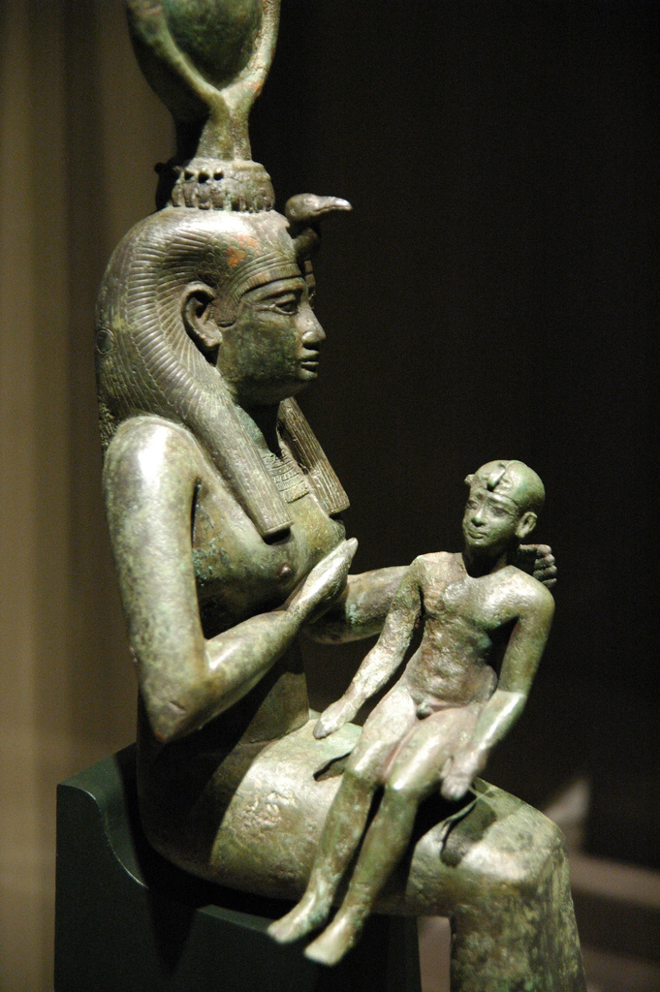
Religion in Ancient Egypt
Some rights reserved by Jeff Kubina

Slide 2
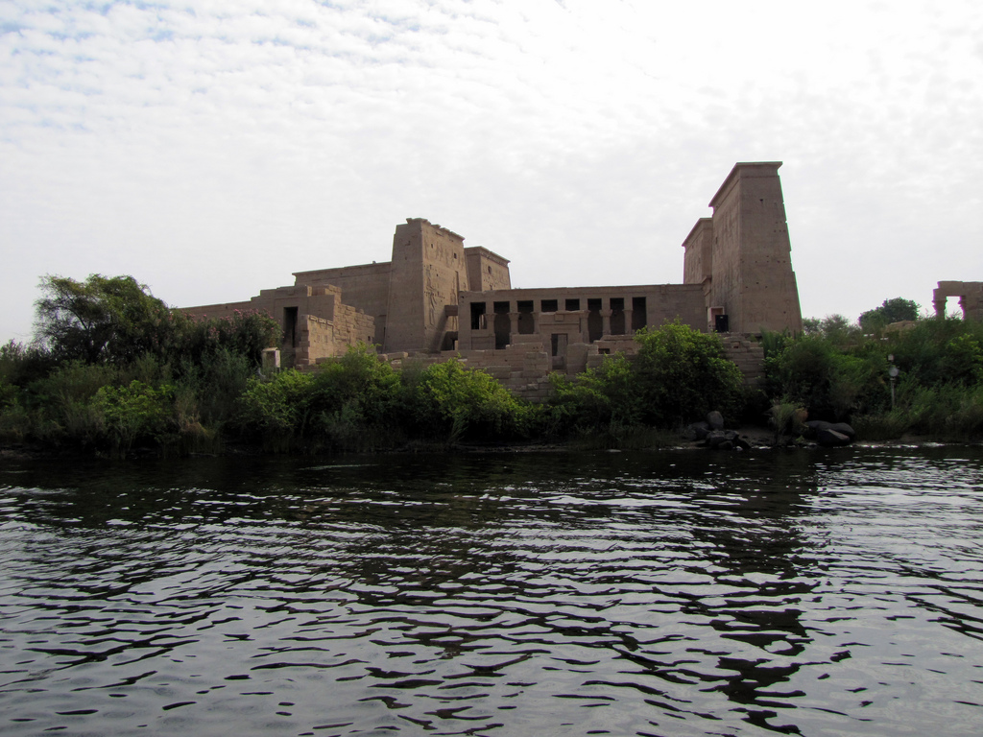
Good River
Good Gods
Some rights reserved by David Berkowitz

Slide 3
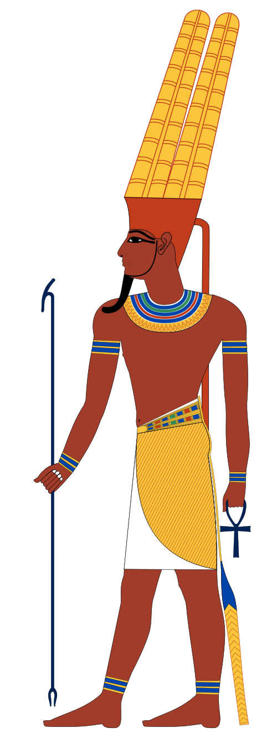
Amun
King of the
Gods
Art Credit: Jeff Dahl

Slide 4
Amun
Patron of Thebes
(Major City)

Slide 5
Benevolence
“You are Amun, the Lord of the silent, who comes at the voice of the poor; when I call to you in my distress You come and rescue me...”

Slide 6
Voice
of the Poor

Slide 7
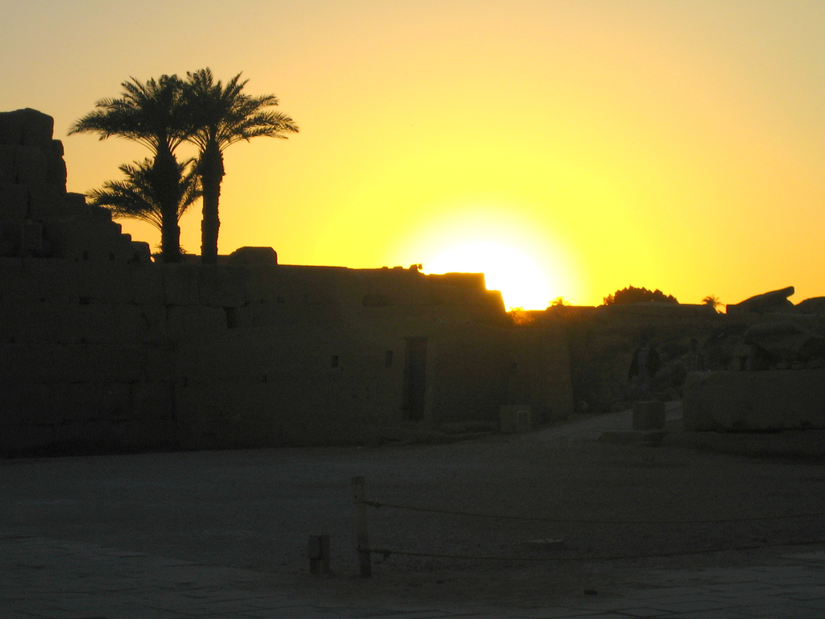
Why?
Some rights reserved by cmgramse

Slide 8
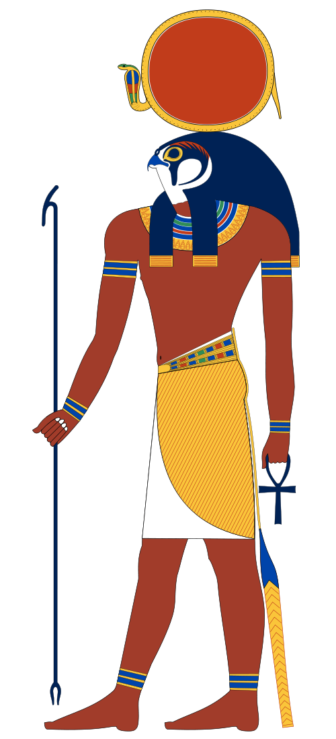
Ra
Sun God
Art Credit: Jeff Dahl

Slide 9
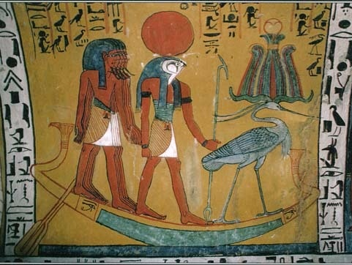
Solar Barge
Image Source: mythencyclopedia.com

Slide 10
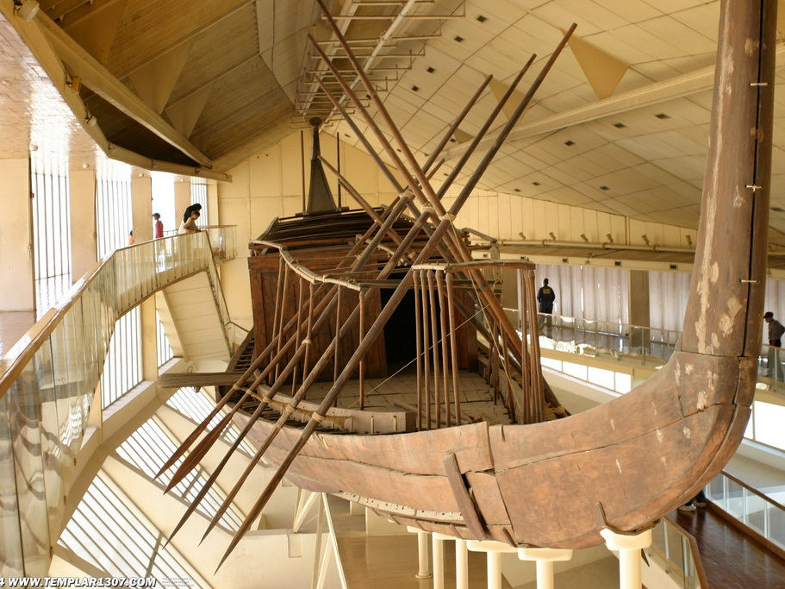
Khufu Ship
Some rights reserved by Templar1307

Slide 11
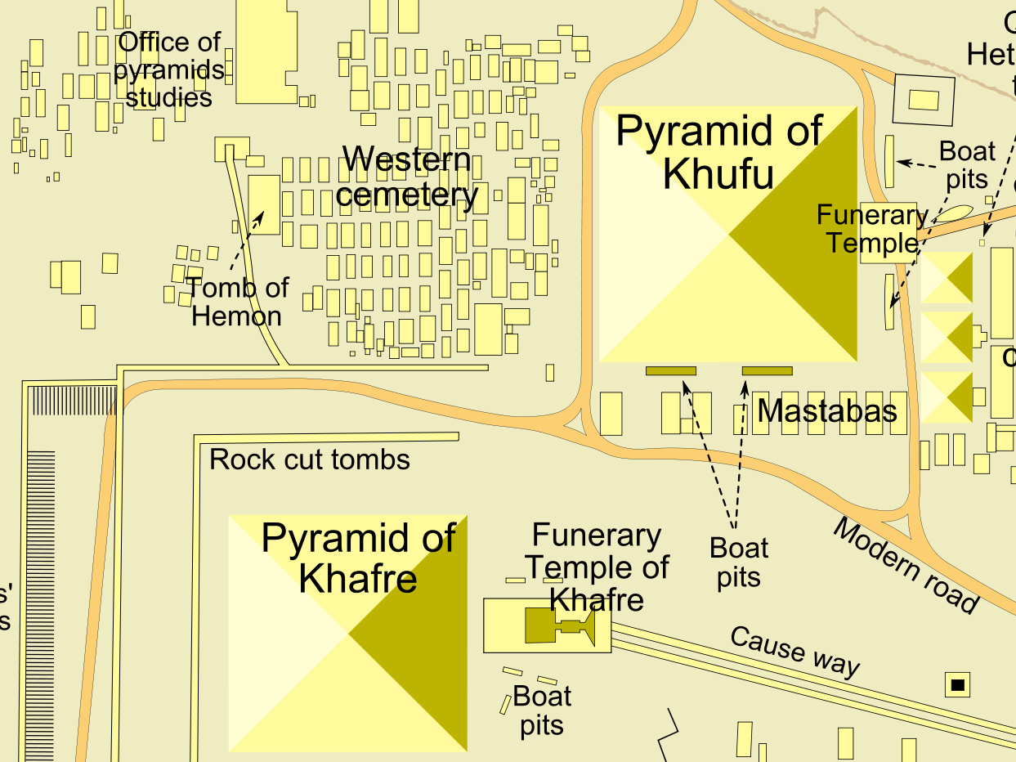
Boat Pits
Ships were buried next to pyramids so that pharaohs could travel with Ra in the afterlife.
Map Credit: MesserWoland

Slide 12
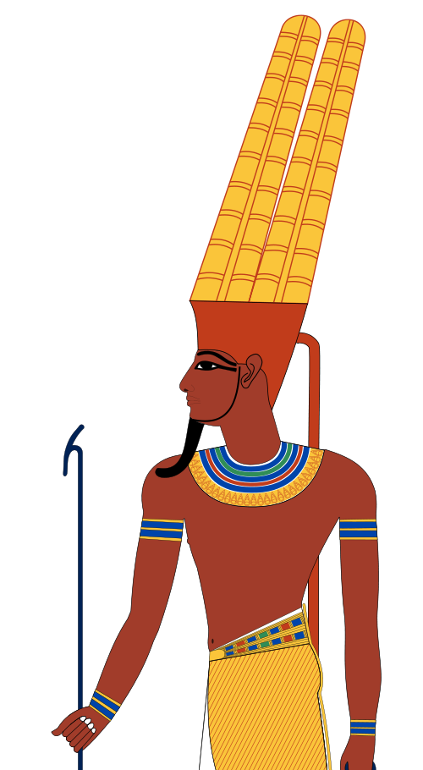
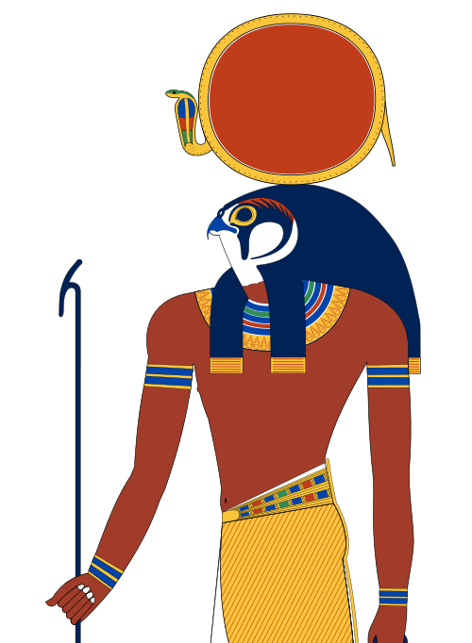
Amun-Ra
Amun and Ra were worshipped together as one god in the Egyptian New Kingdom.
+

Slide 13
P
The gods as
rotectors

Slide 14
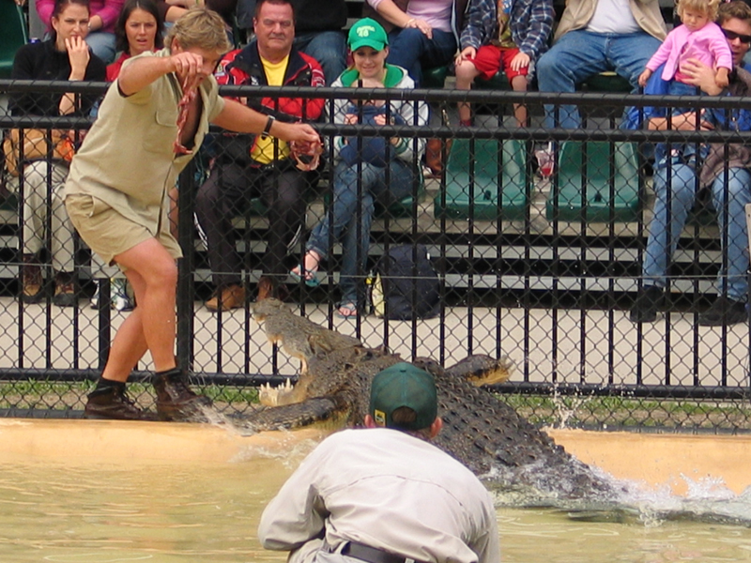
R.I.P. Steve Irwin 1962-2006
Some rights reserved by lovebuzz

Slide 15
Sobek
Crocodile God
Patron of the Military
Art Credit: Jeff Dahl

Slide 16
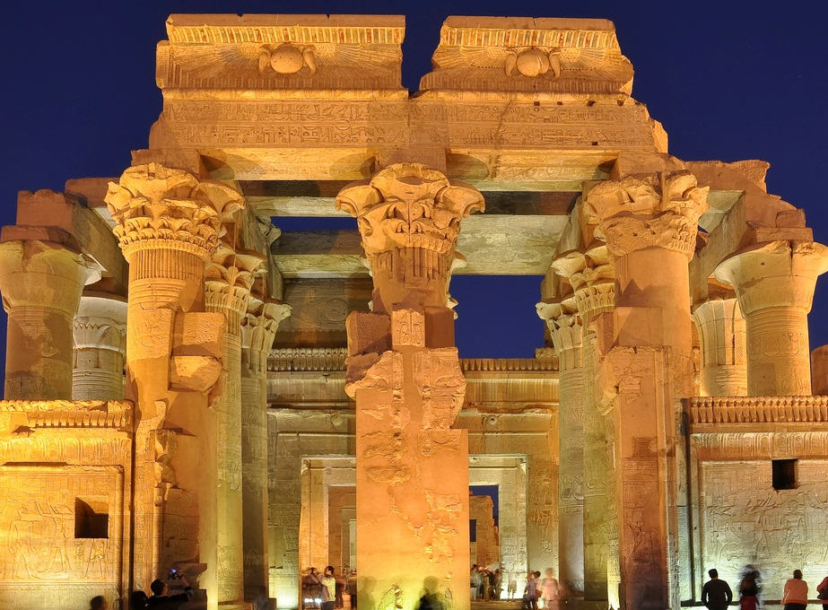
Kom Ombo Temple
Some rights reserved by divya_

Slide 17
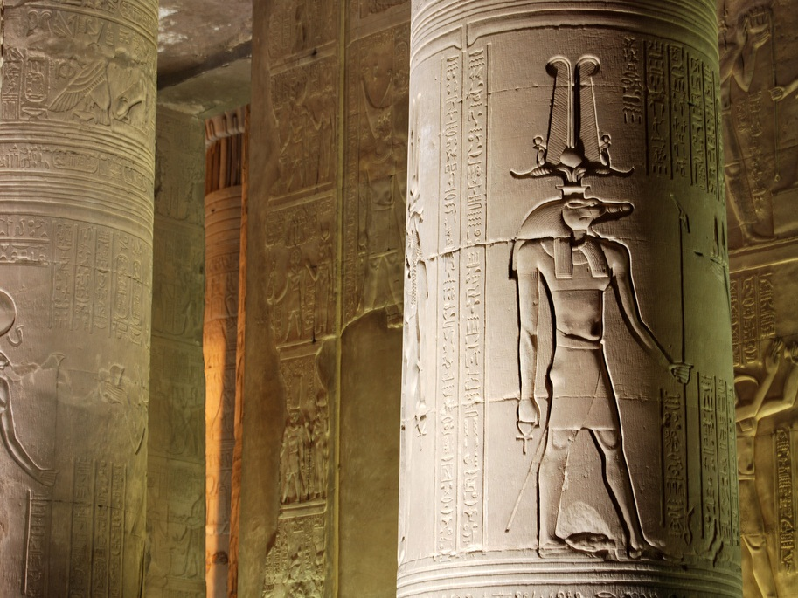
Some rights reserved by Dain Sandoval

Slide 18
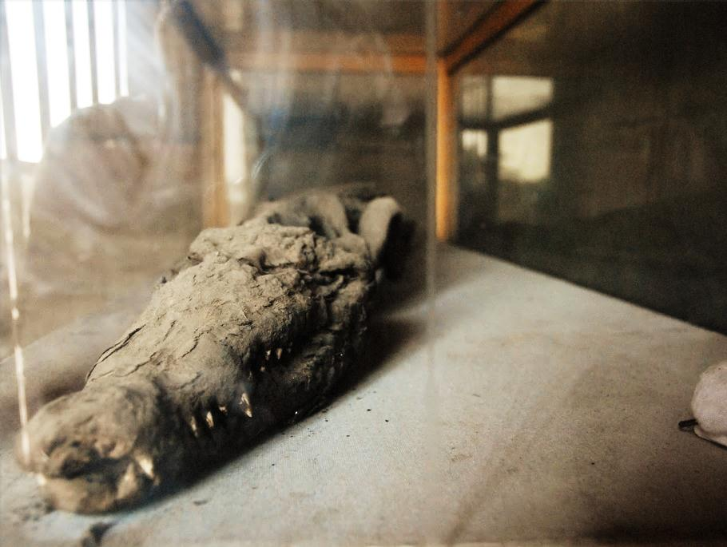
Mummified Crocodile
Some rights reserved by S J Pinkney

Slide 19
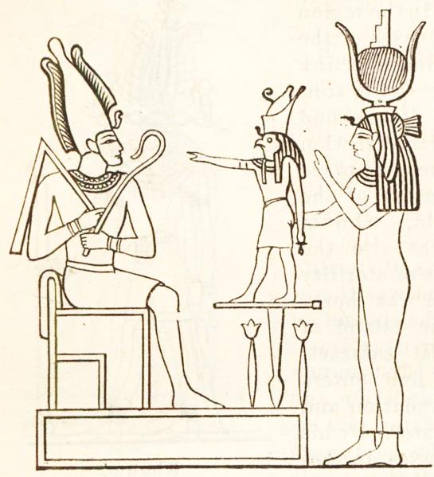
The Myth of Osiris and Isis
CLICK HERE!
To Read the Myth
Some rights reserved by ideacreamanuelaPps

Slide 20
Osiris
King of the
Underworld
Judge
of the Dead
Art Credit: Jeff Dahl
Notes:
Osiris is pictured mummified from toe to chest. His green skin symbolizes rebirth. He wears the white crown of Upper Egypt, decorated with two ostrich feathers. His crook and flail were shepherds' instruments, leading scholars to believe that he originated as a god of herding tribes.

Slide 21
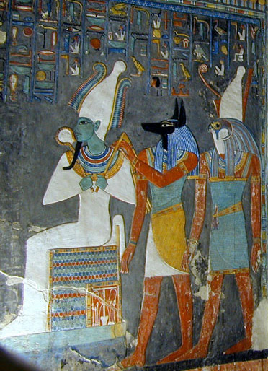

Slide 22
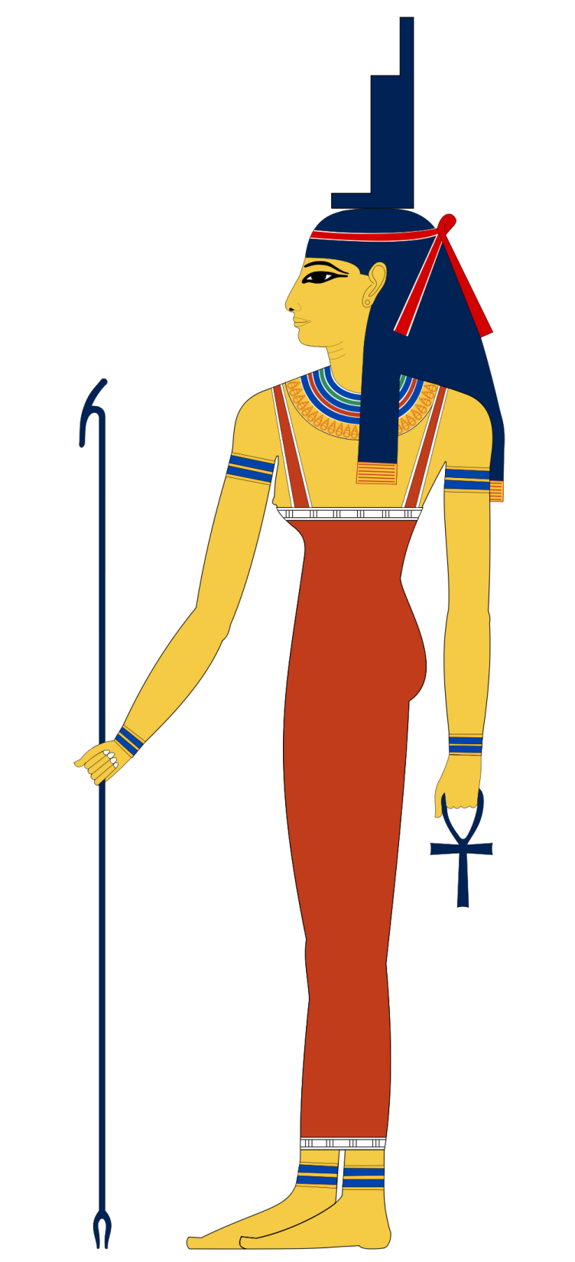
Isis
“Throne”
Goddess of
Motherhood
Fertility
Art Credit: Jeff Dahl
Notes:
Osiris is pictured mummified from toe to chest. His green skin symbolizes rebirth. He wears the white crown of Upper Egypt, decorated with two ostrich feathers. His crook and flail were shepherds' instruments, leading scholars to believe that he originated as a god of herding tribes.

Slide 23
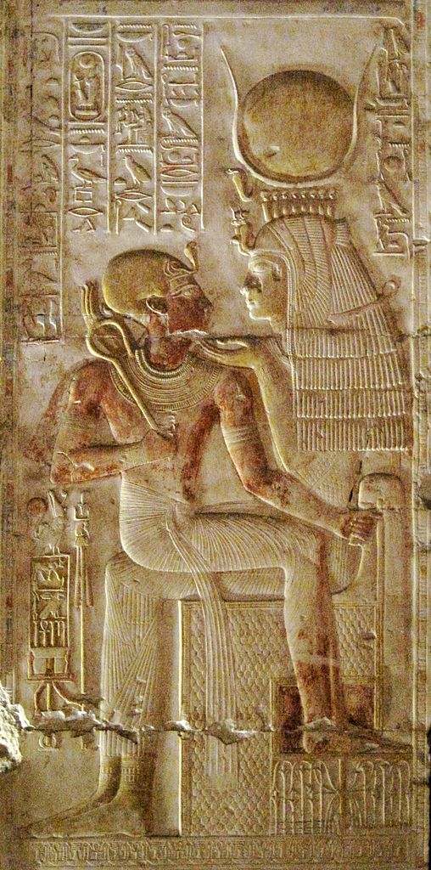
Mother
Isis holds a
pharaoh
on her lap.
Photo Credit: Olaf Tausch

Slide 24
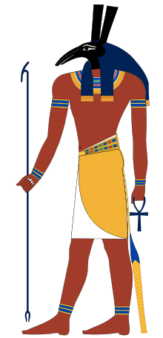
Set
Storms
Chaos
Desert
Foreigners
Art Credit: Jeff Dahl

Slide 25
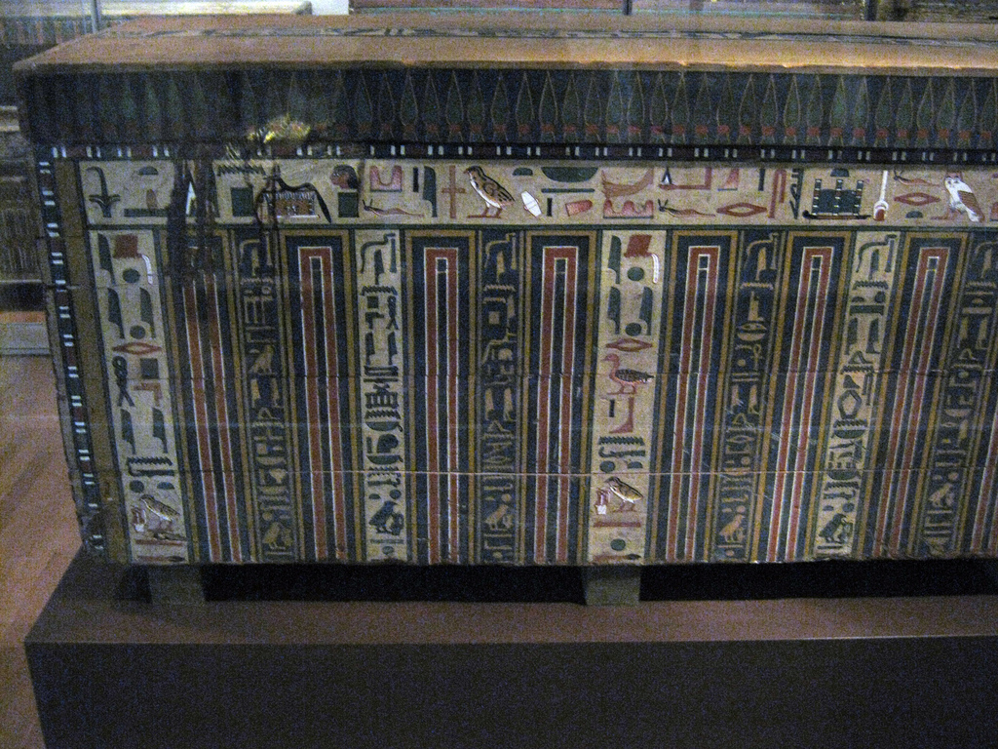
TRAP
Some rights reserved by peterjr1961

Slide 26
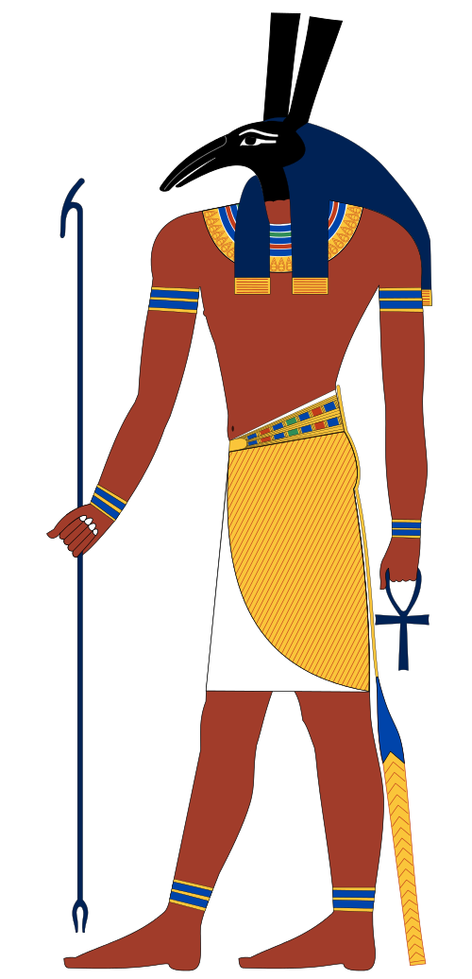
Usurper
Set made himself pharaoh in Osiris’ place.

Slide 27
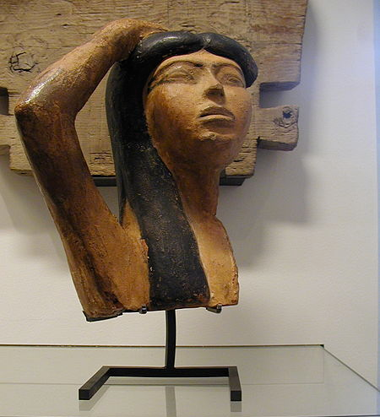
Isis
weeps over the loss of Osiris (Louvre)
Photo Credit: Gérard Ducher

Slide 28
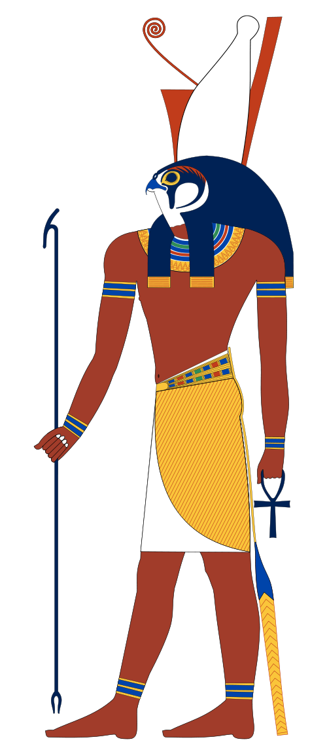
Horus
Son of Isis and Osiris
Patron of Pharaohs
Art Credit: Jeff Dahl

Slide 29
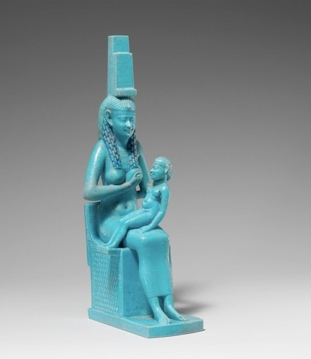
Isis nurses Horus
Some rights reserved by ancientartpodcast.org

Slide 30
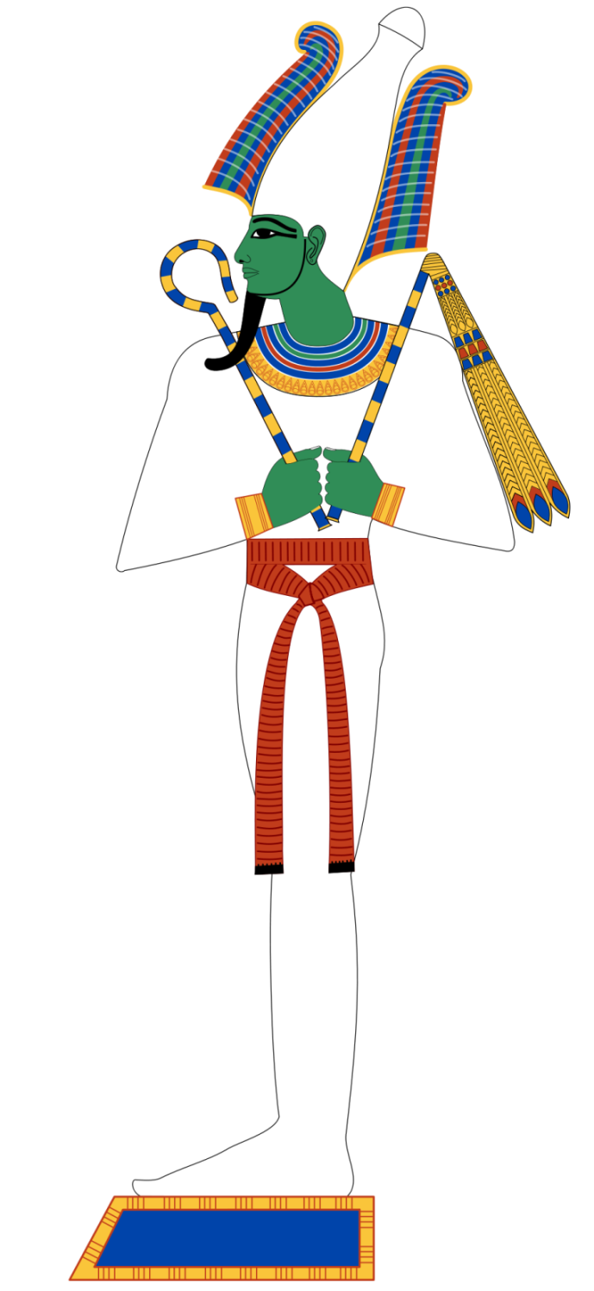
“What is the finest thing possible?”

Slide 31
“To avenge one’s father and mother when ill-treated.”

Slide 32
Vs.

Slide 33
Deposed

Slide 34
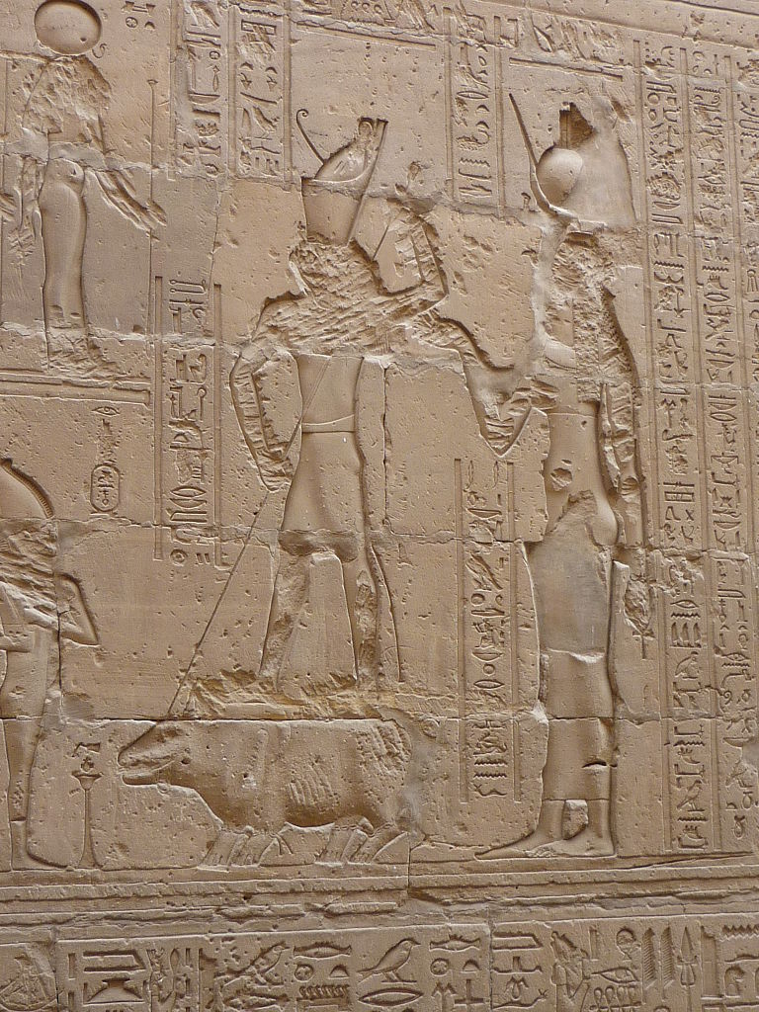
Horus spears Set (portrayed as a hippopotamus) while Isis looks on...
Poto Credit: Rémih

Slide 35
Protector
of Egypt
Patron
of pharaohs

Slide 36
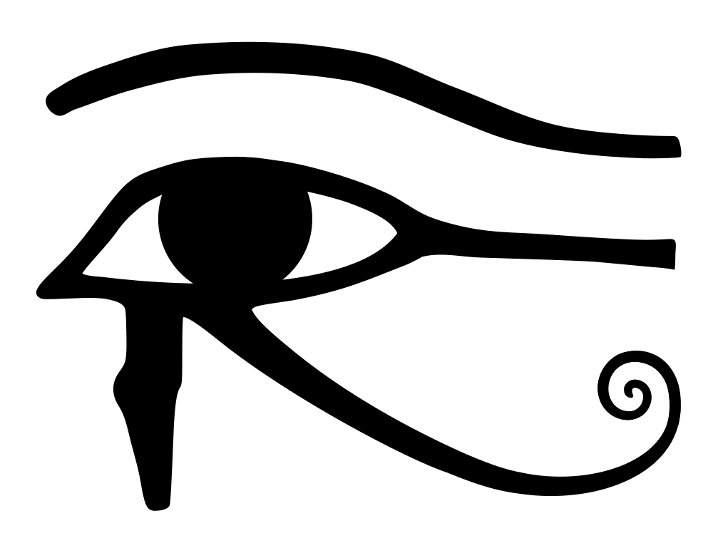
The Eye of Horus

Slide 37
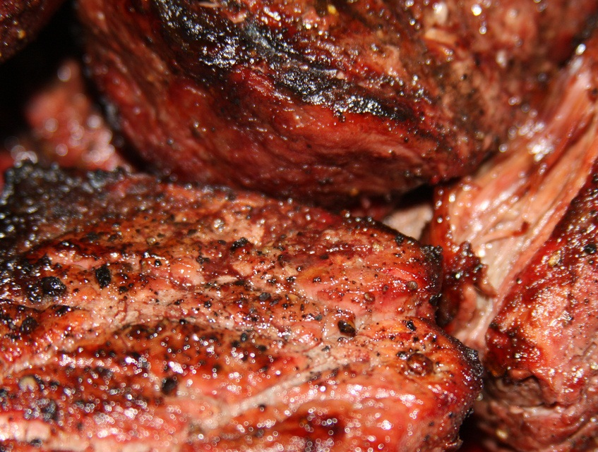
Carne
Some rights reserved by shaynabright

Slide 38
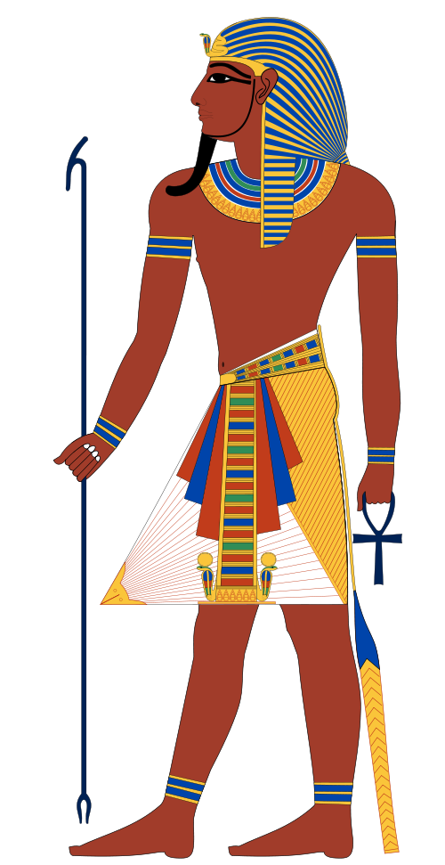
Incarnation of Horus
Art Credit: Jeff Dahl

Slide 39
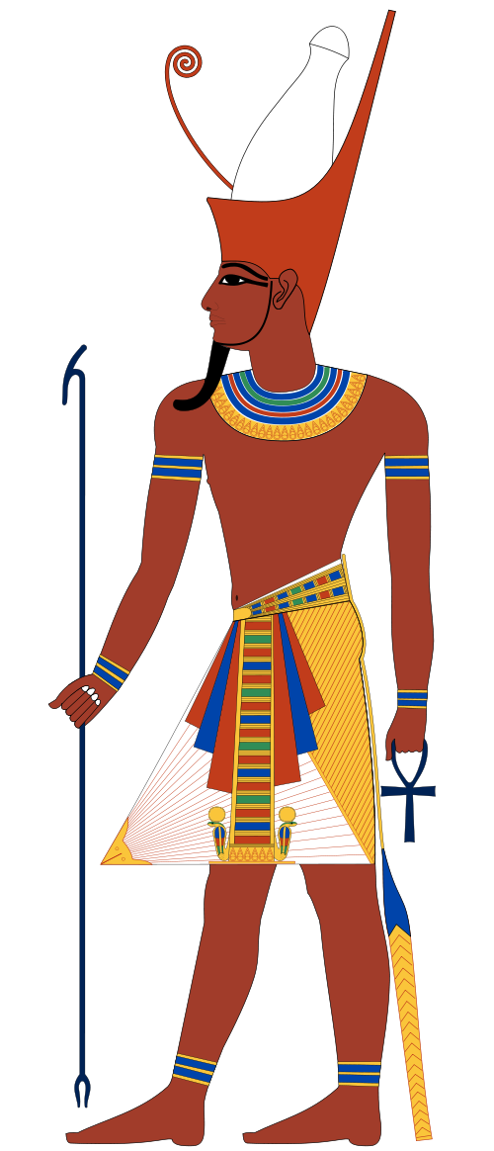
Horus in the Flesh
Art Credit: Jeff Dahl

Slide 40
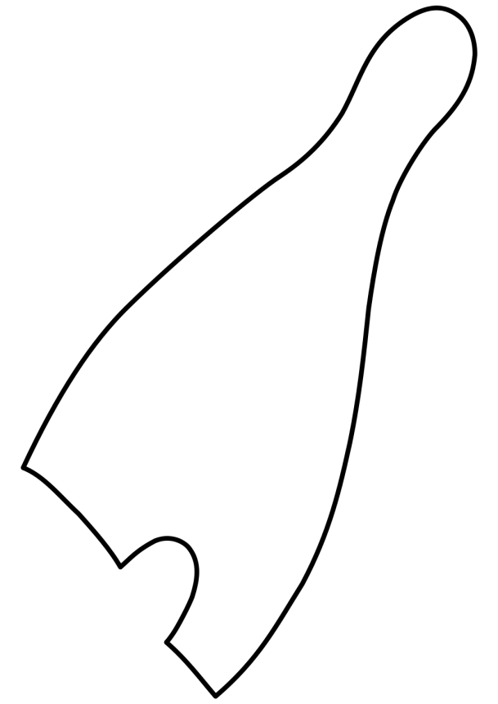
Double Crown
Red Crown
(Lower Egypt)
White Crown
(Upper Egypt)
Art Credit: Jeff Dahl

Slide 41
Ethical Religion

Slide 42
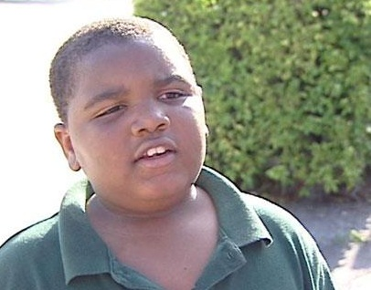
IT’S FUN TO DO BAD THINGS

Slide 43
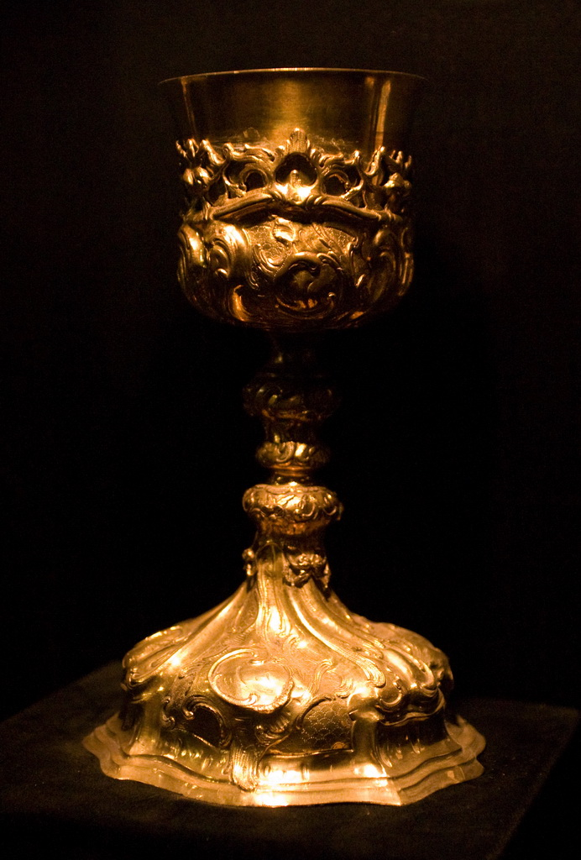
“I know the names of the forty-two gods of those who are with you in this Hall of Justice, who live on those who cherish evil and who gulp down their blood on that day of the reckoning...”
-- Book of the Dead
Some rights reserved by Squiggle

Slide 44
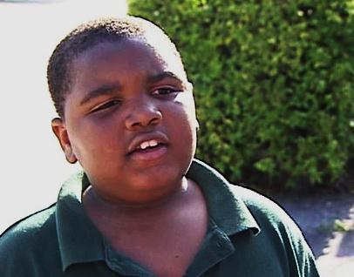
Think Twice

Slide 45
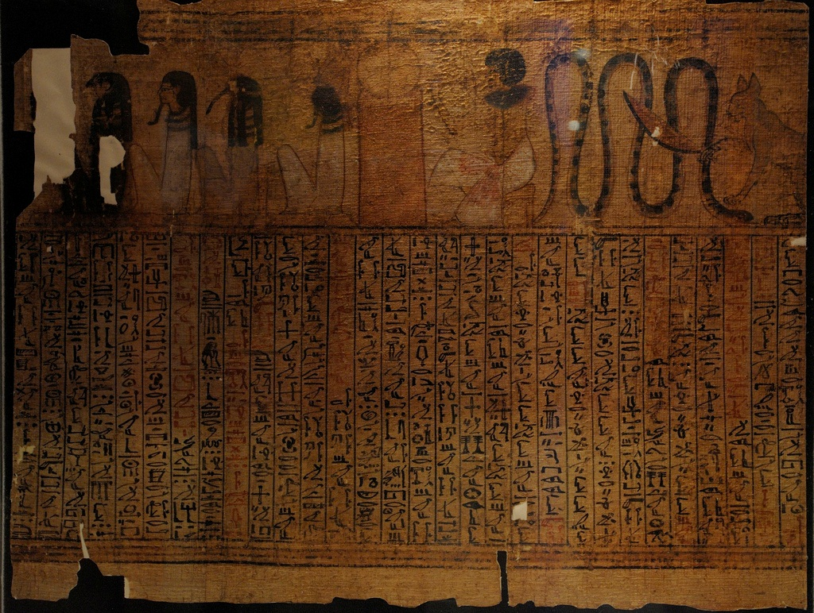
Book of the Dead
Some rights reserved by koopmanrob

Slide 46
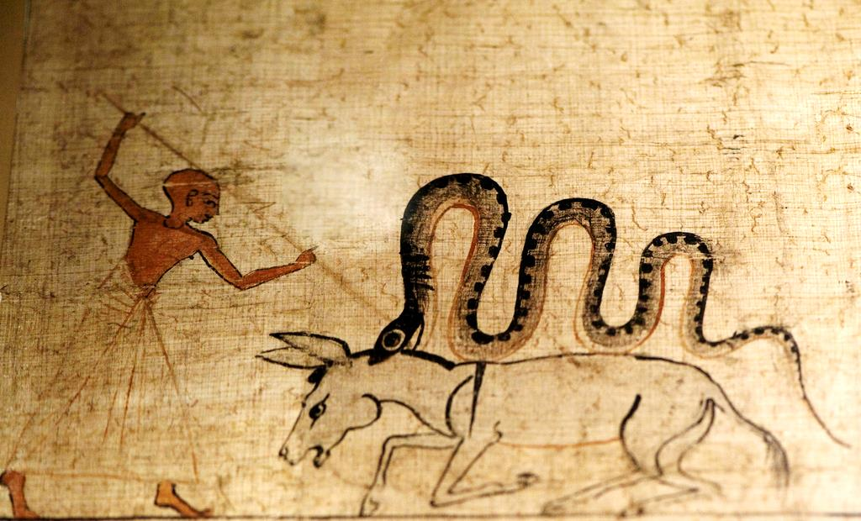
The Book of the Dead contained spells to assist in navigating the
obstacles and dangers of the Underworld.

Slide 47
OMG
© Heidemarie Niemann
Used With Permission

Slide 48
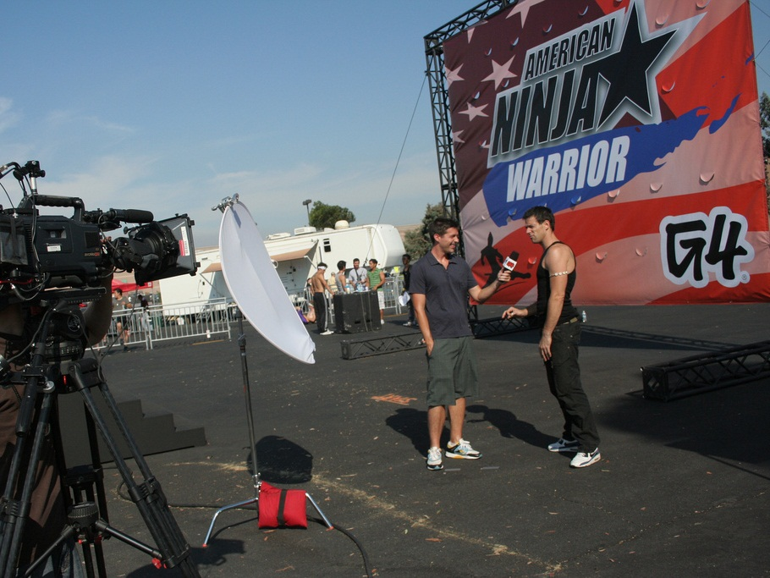
Some rights reserved by slownsilent

Slide 49
Egyptian Ninja Warrior
Some rights reserved by koopmanrob

Slide 50
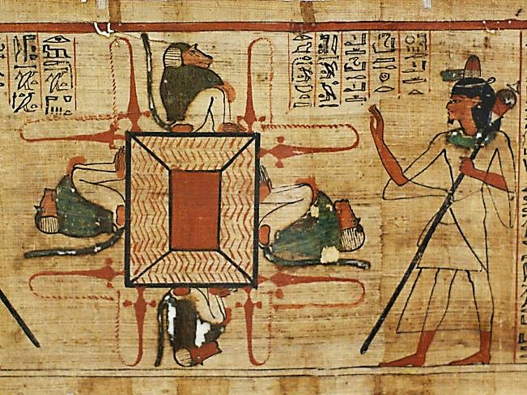
Purification
© HEN-Magonza
Fair Use (Educational)

Slide 51
The Lake of Fire
© Heidemarie Niemann
Used With Permission

Slide 52
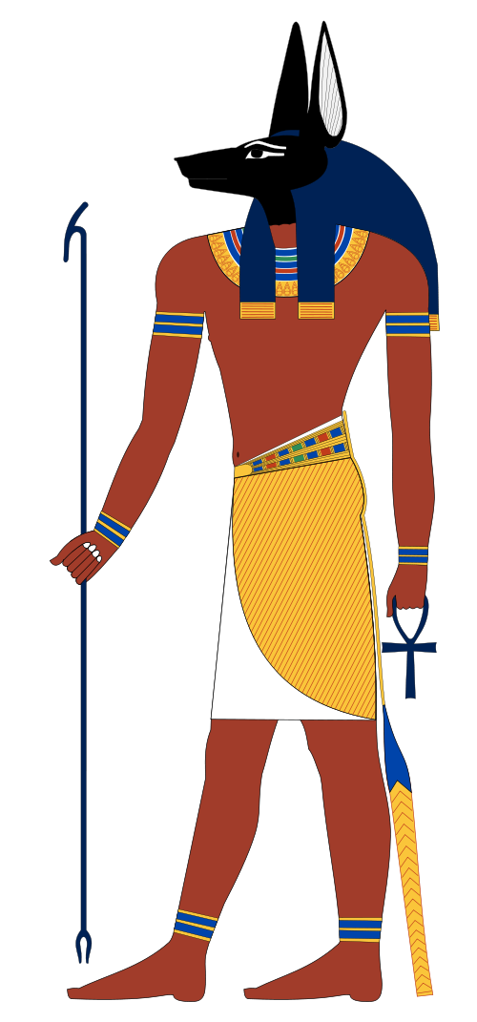
Anubis
God of the Scales
&
Mummification
Art Credit: Jeff Dahl

Slide 53
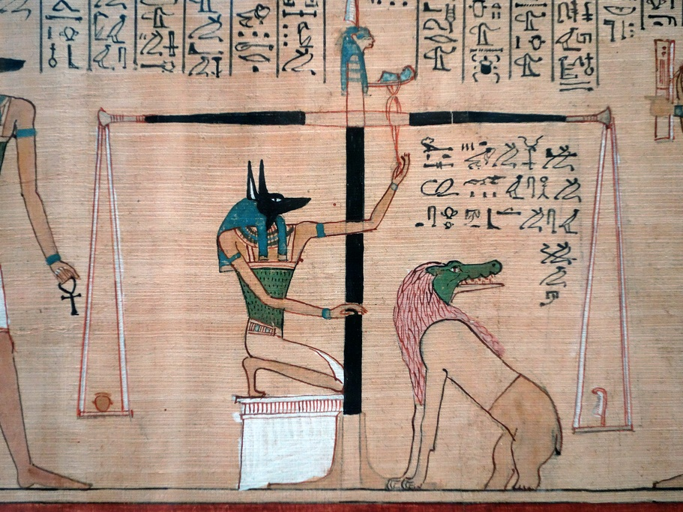
The Weighing of the Heart
Some rights reserved by profzucker

Slide 54
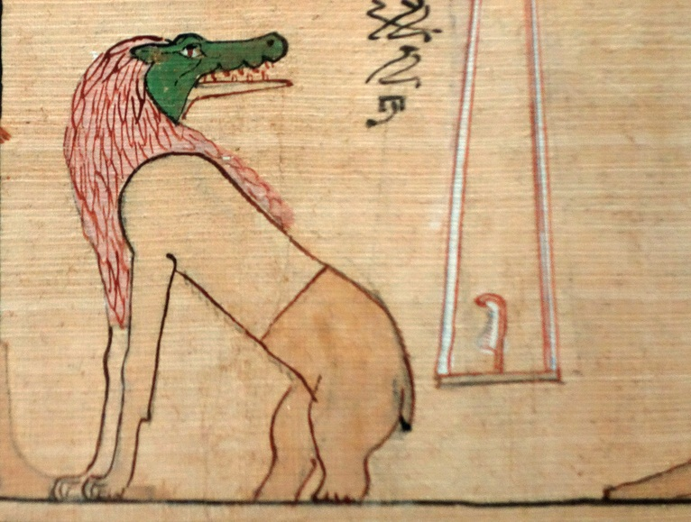
Crocodiles Lions & Hippos
OH MY!!!
Some rights reserved by Steven Zucker
Notes:
Ammit

Slide 55
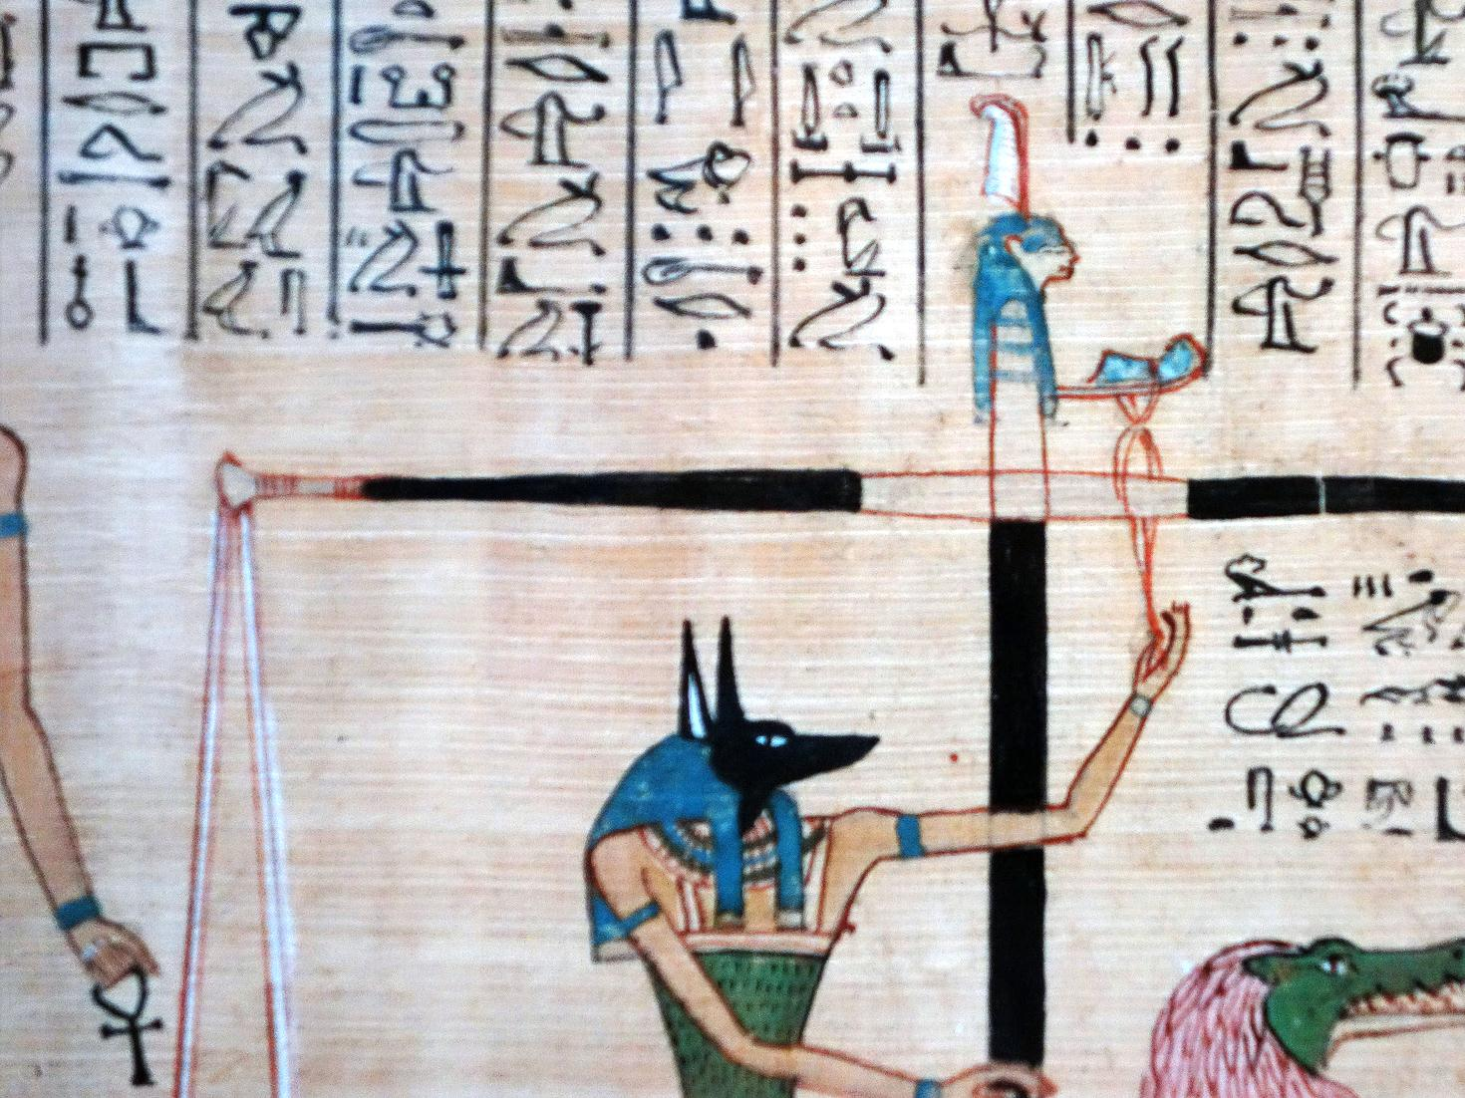
Ma’at

Slide 56
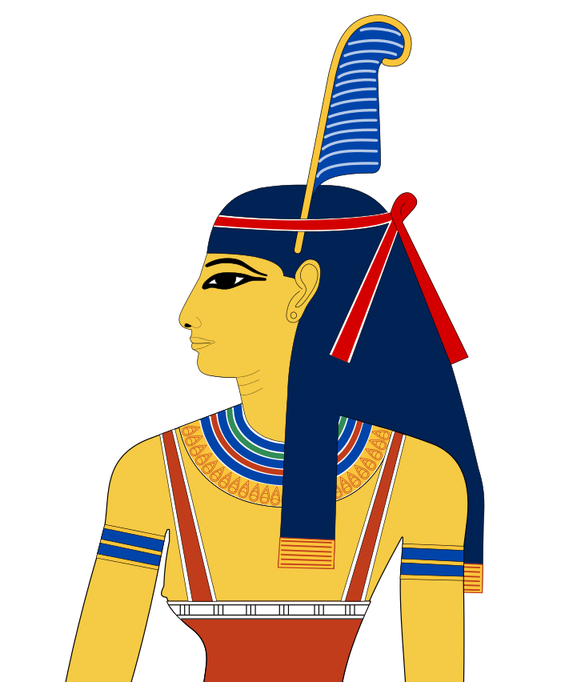
Ma’at
Truth
Balance
Order
Justice
Art Credit: Jeff Dahl

Slide 57
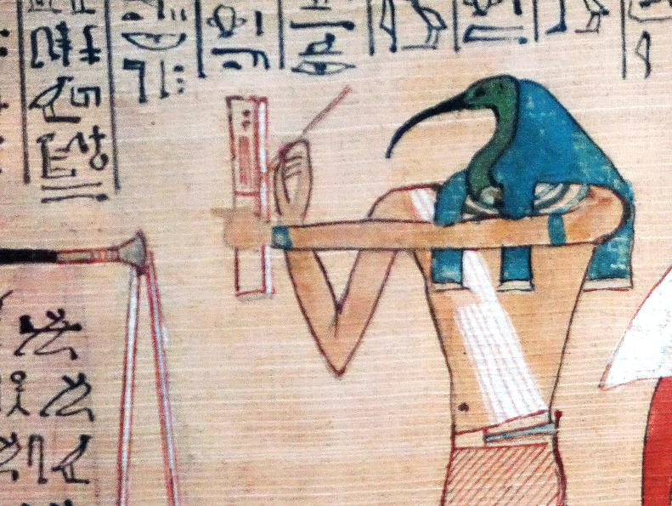
Thoth
Scribe of the Gods
Some rights reserved by profzucker

Slide 58
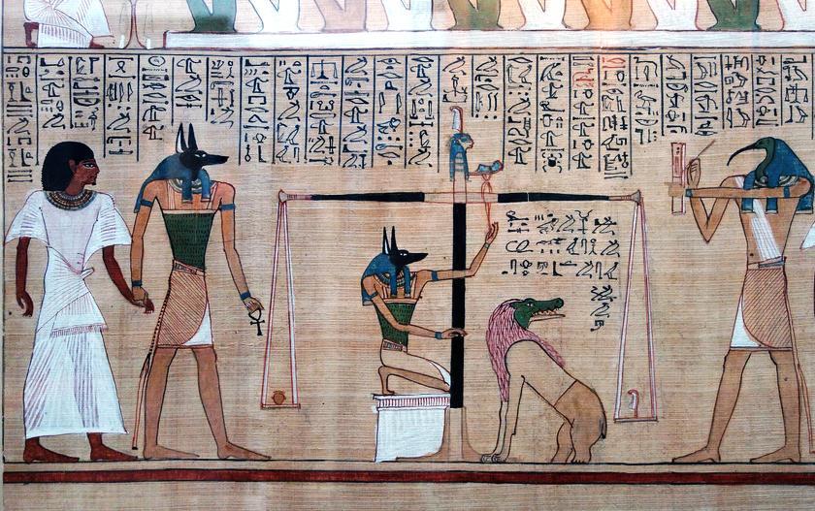
Some rights reserved by profzucker

Slide 59
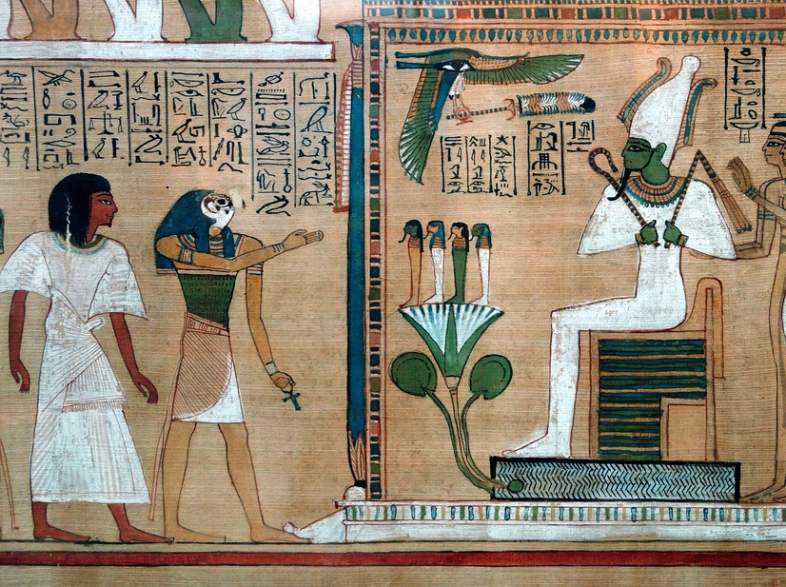
Some rights reserved by profzucker

Slide 60
Judgment
of Osiris
CLICK TO READ
The Declaration of Innocence
Some rights reserved by profzucker

Slide 61
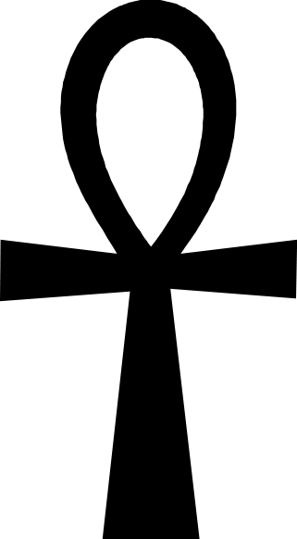
Ankh
A mysterious symbol believed to represent
eternal life

Slide 62
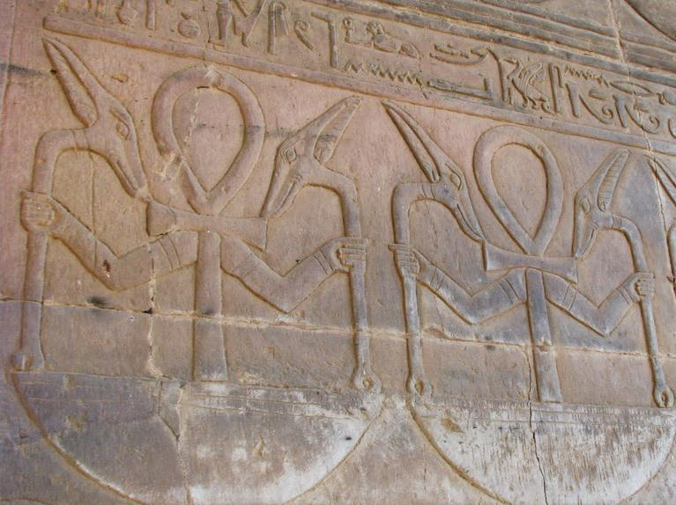
Some rights reserved by Dale Gillard

Slide 63
Resurrection

Slide 64
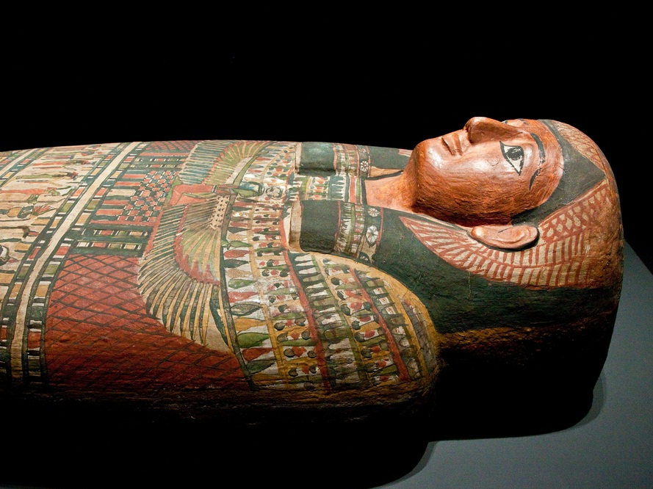
Mummification
Some rights reserved by Quikwhitefox86

Slide 65
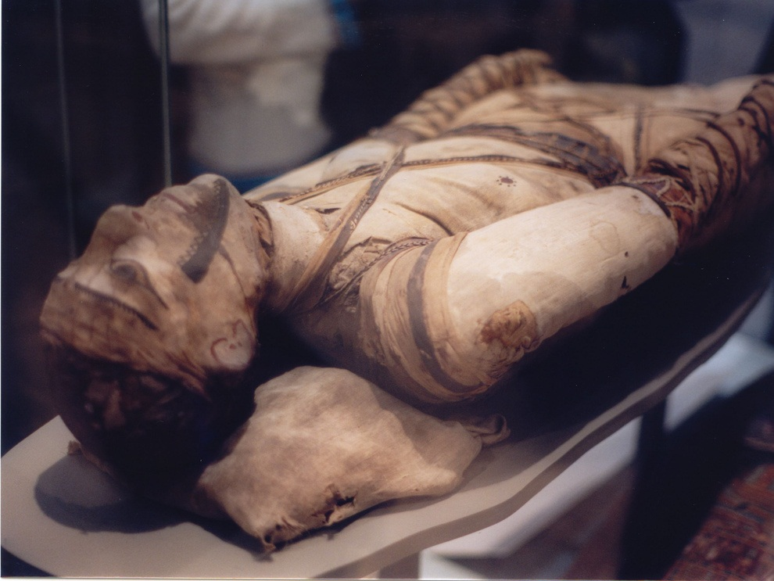
Some rights reserved by chtfj21

Slide 66
Some rights reserved by TZM Photo

Slide 67
Anubis supervises the process.
Some rights reserved by hummeline

Slide 68
Some rights reserved by andrevanb

Slide 69
Canopic Jars
Organ Storage
Some rights reserved by AlbinoFlea

Slide 70
Forgetting Something?
Some rights reserved by auxesis

Slide 71
Discarded
Some rights reserved by elliottzone

Slide 72
Game Time!
CLICK to play!

Slide 73
Review
Identify each of the following god(esse)s. What are the distinguishing features of each?

Slide 74
Review
Identify each of the following god(esse)s. What are the distinguishing features of each?

