Slide 1
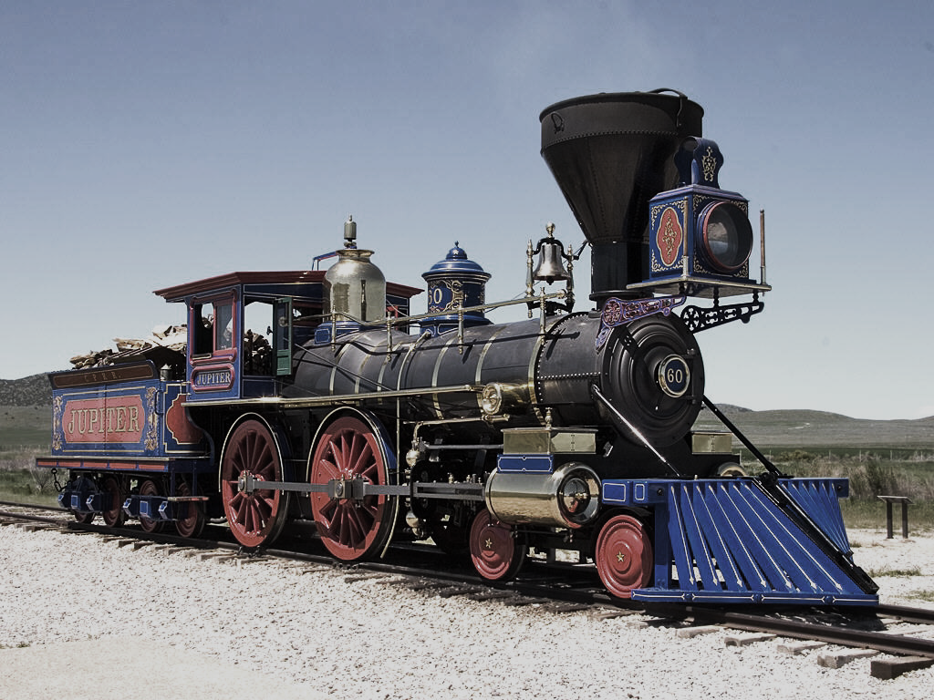
USHC 4.1
US HISTORY EOC REVIEW
Photo Credit: Mr Snrub

Slide 2
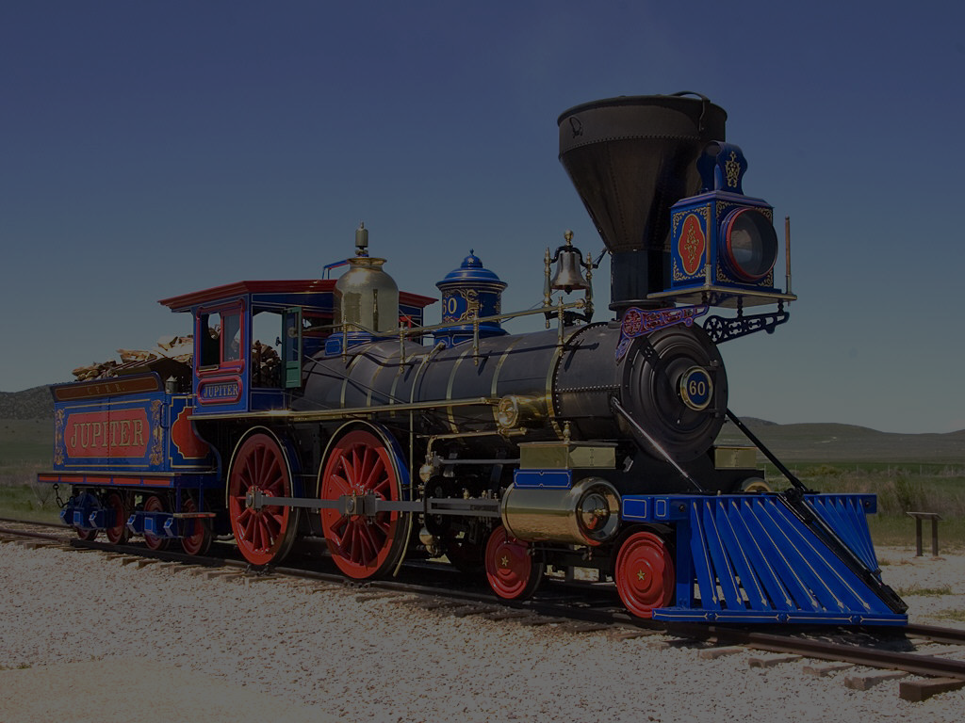
USHC 4.1
Summarize the impact that government policy and the construction of the transcontinental railroads had on the development of the national market and on the culture of Native American peoples.
@TomRichey
Photo Credit: Mr Snrub

Slide 3
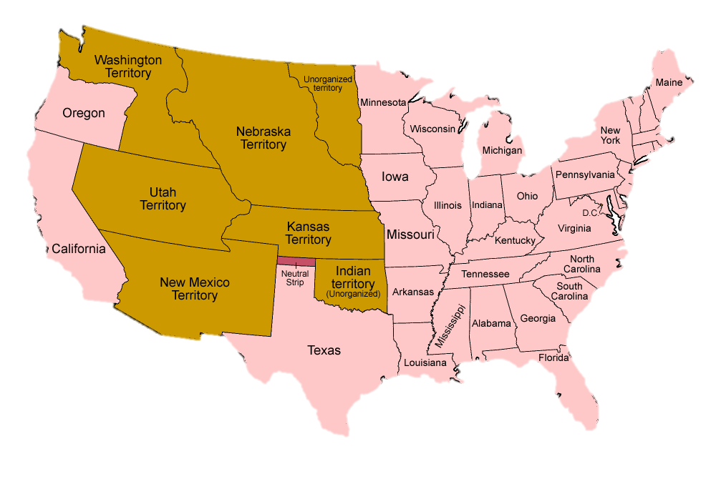
The U.S. in 1860
Map Credit: Golbez

Slide 4
How do we create a national market?
MANUFACTURED GOODS
NATURAL RESOURCES
Map Credit: Golbez

Slide 5
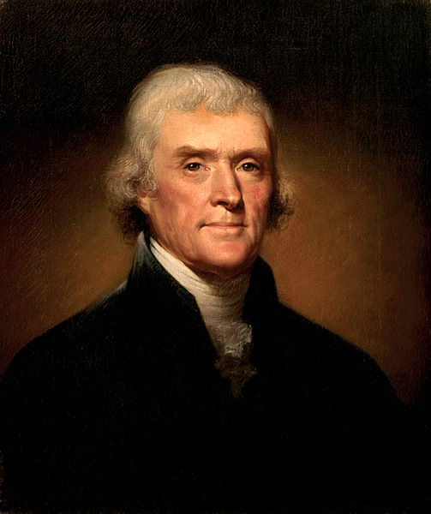
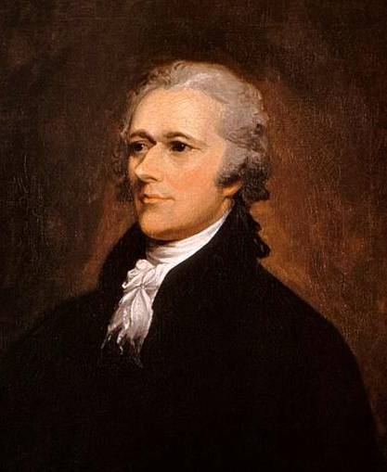
How Are Marketplaces Created?
Jefferson
Laissez-faire
The market will develop on its own.
Hamilton
Government Action
Government needs to assist.

Slide 6
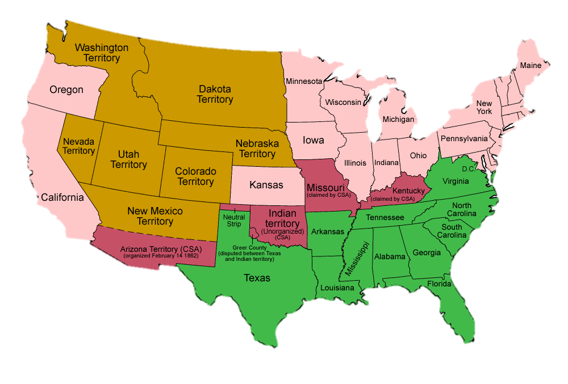
EXIT JEFFERSONIANS
1860-1861
PEACE OUT!
Map Credit: Golbez

Slide 7
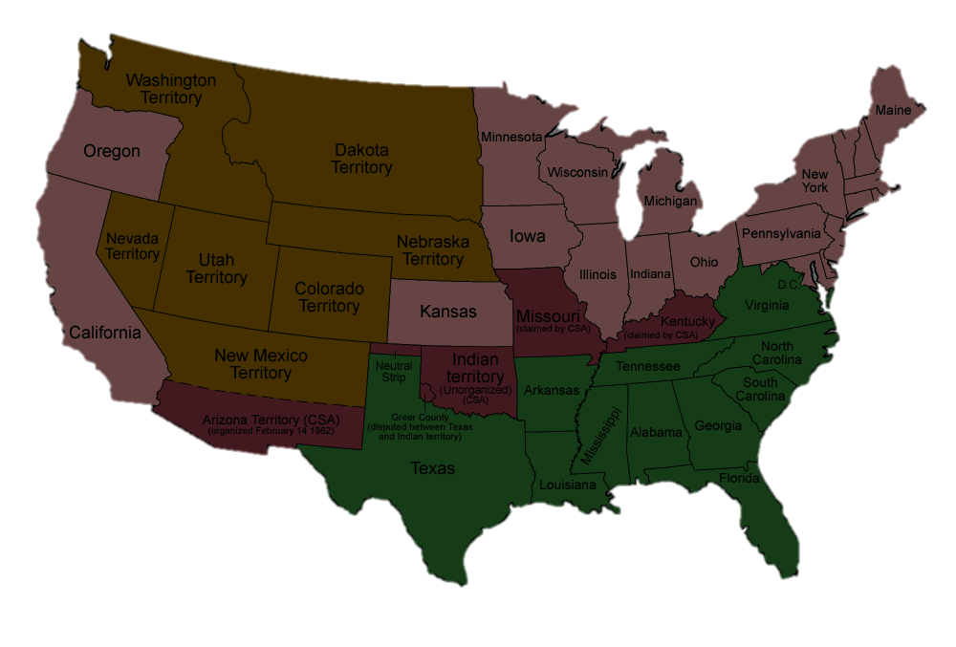
Secession A Hamiltonian Triumph
Secession created a large Republican majority in Congress that was friendly to government intervention in the economy.

Slide 8
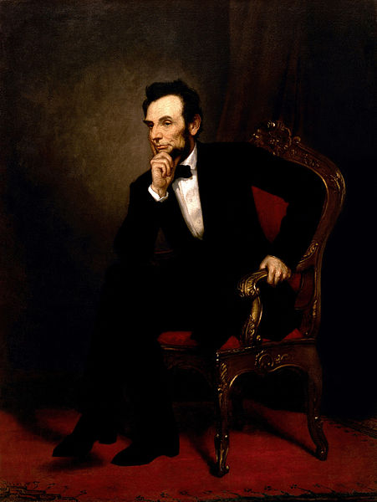
The Party of Lincoln
Free Soil
Industry
Big Business

Slide 9
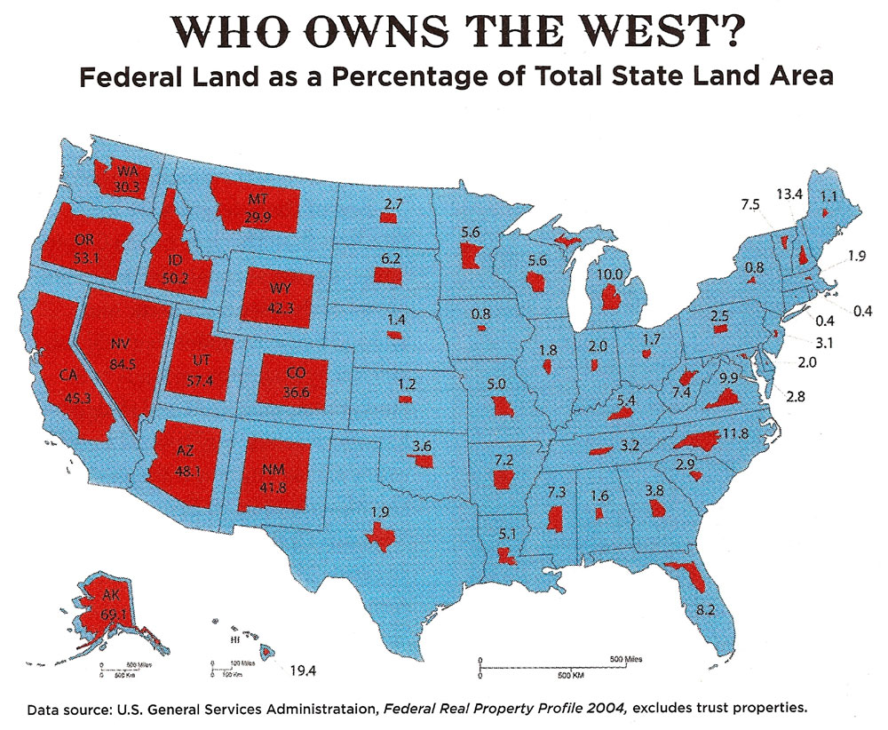
LOTS
of Federal Land

Slide 10
Land grants
To encourage settlement & economic development of the West

Slide 11
Homestead Act
Pacific Railway Act

Slide 12
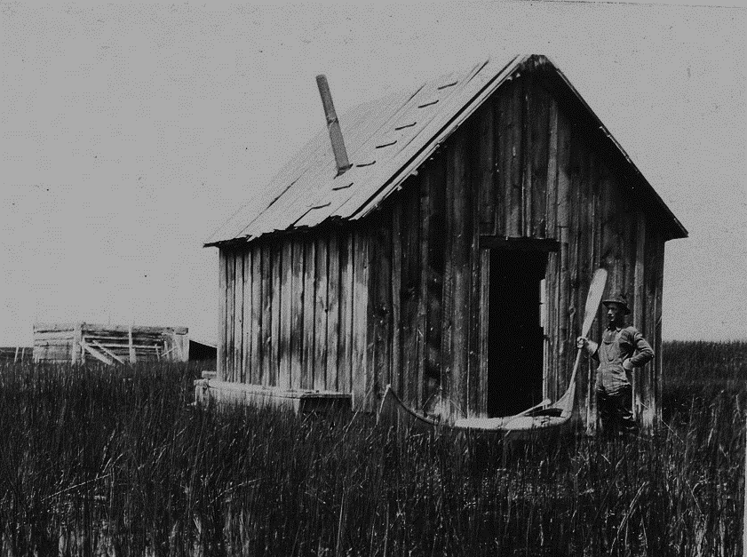
HOMESTEADS

Slide 13
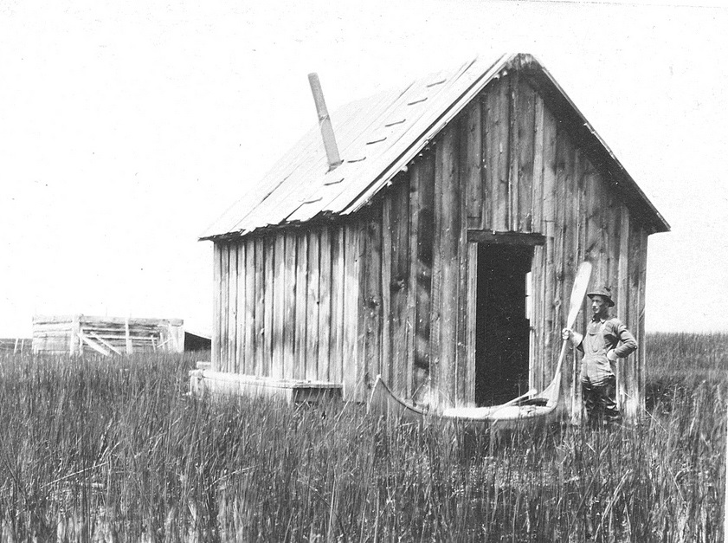
Homestead Act
(1862)
160 Acre homesteads for small farmers
Some rights reserved by USFWS Headquarters

Slide 14
600,000 Families
Map Credit: Golbez

Slide 15
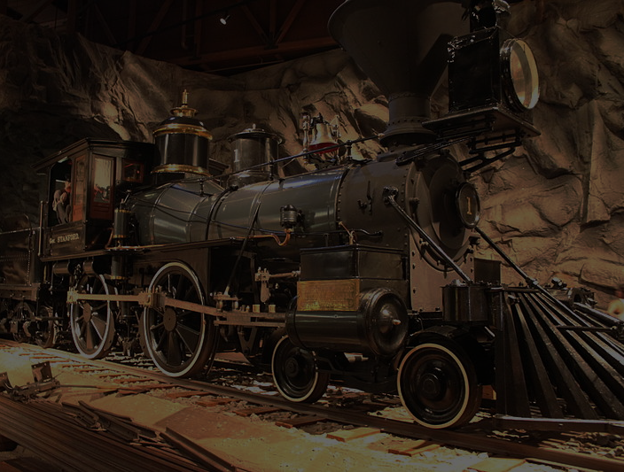
PACIFIC RAILWAY ACT
1862
Government subsidies for corporations constructing railroads
Photo by BenFranske

Slide 16
SUBSIDIES
Financial incentives from authorities intended to encourage desired outcomes

Slide 17
PACIFIC RAILWAY ACT
1st
1862
This marked the first time that the federal government had given money directly to corporations for internal improvements.
Photo by BenFranske

Slide 18
Federal Land Grants
Subsidies
Square mile held or sold by government
CHECKERBOARD PATTERN
Square mile granted to the railroad company
Some rights reserved by Brett Jordan

Slide 19
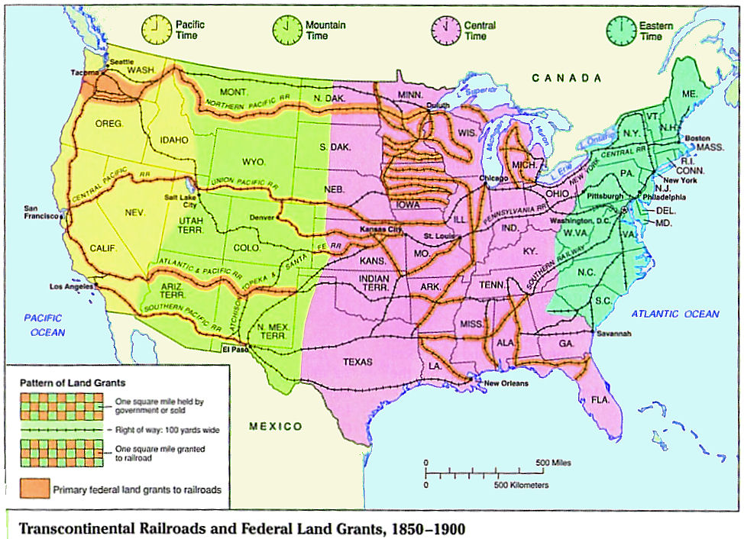
The federal government subsidized several Transcontinental railroads with Land Grants

Slide 20
The First Transcontinental Railroad
Central Pacific RR
http://1.bp.blogspot.com
Union Pacific RR

Slide 21
The National Market
MANUFACTURED GOODS
NATURAL RESOURCES
Map Credit: Golbez

Slide 22
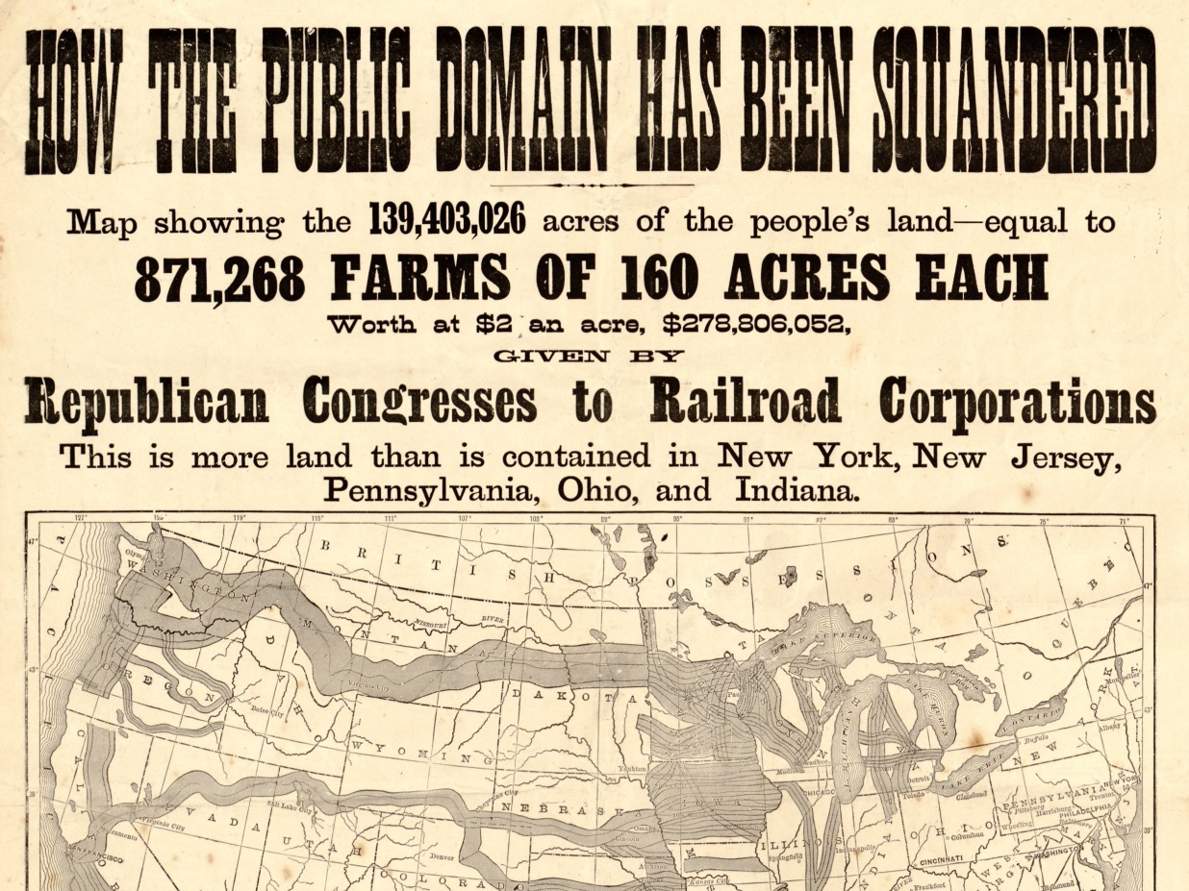

Slide 23
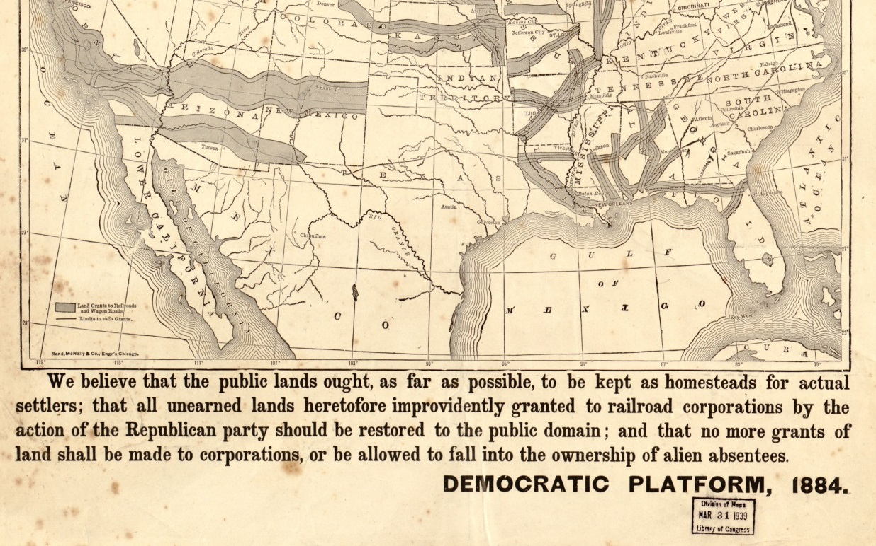
Doc Butler's US History Website

Slide 24
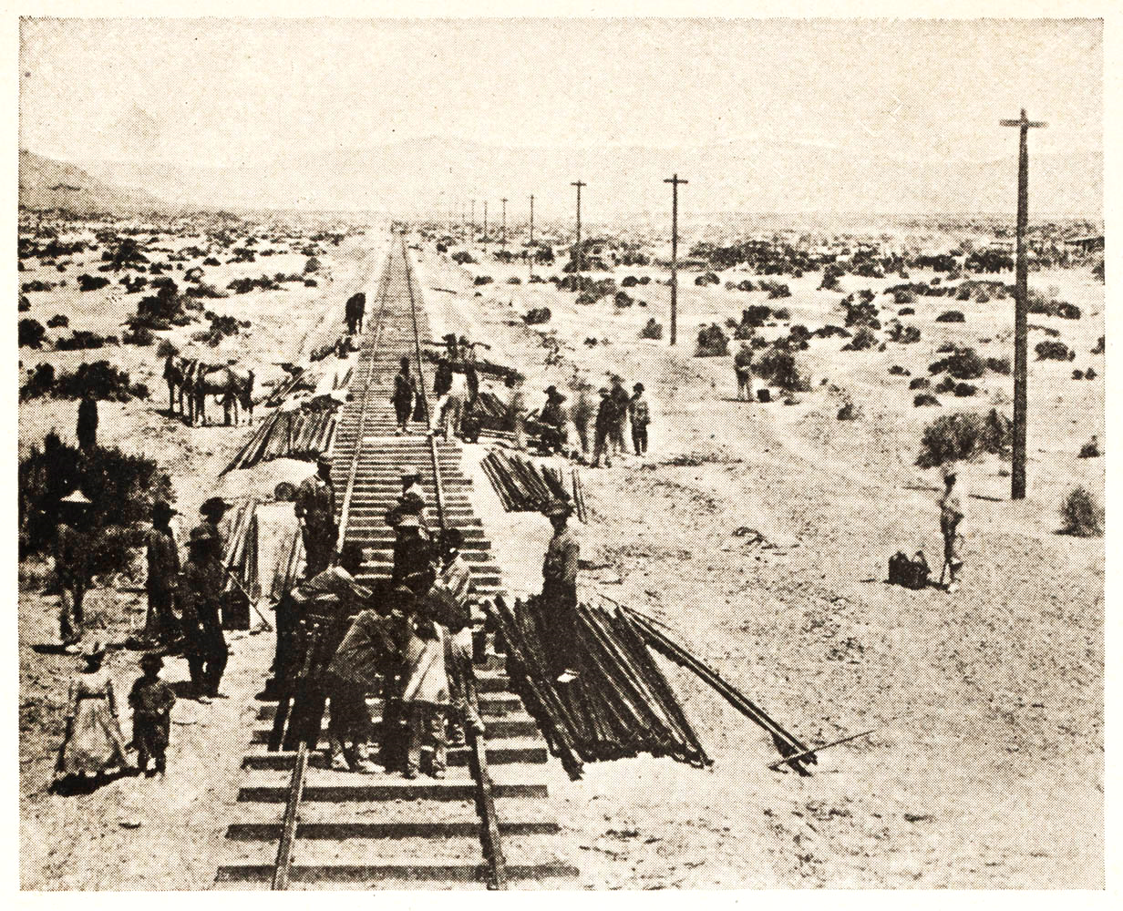
Credit Mobilier Scandal
A Union Pacific executive created a RR construction company to defraud the government.

Slide 25
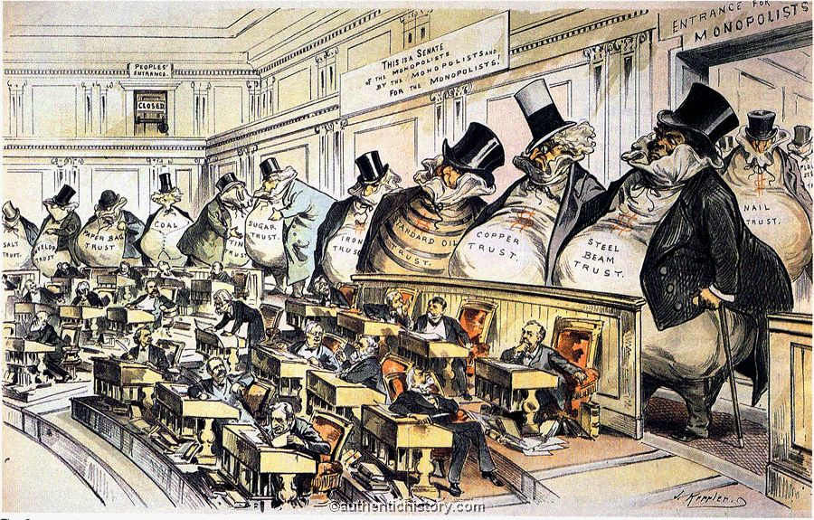
The Public Perception

Slide 26
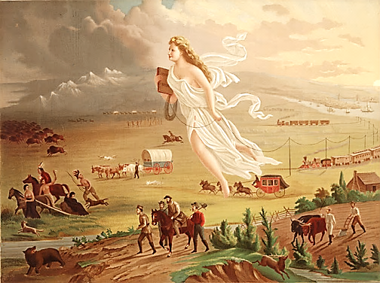
There’s still stuff in my way!

Slide 27
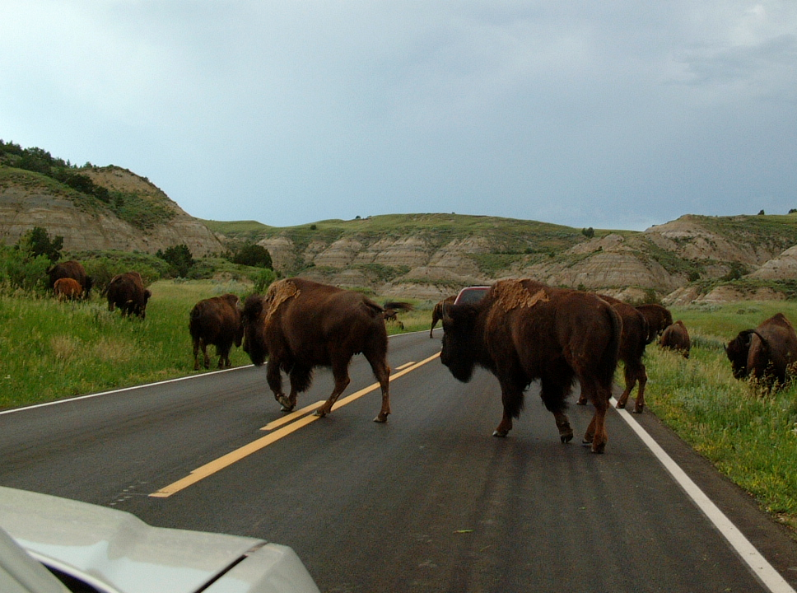
If this car were a train...
Some rights reserved by Seth W.

Slide 28
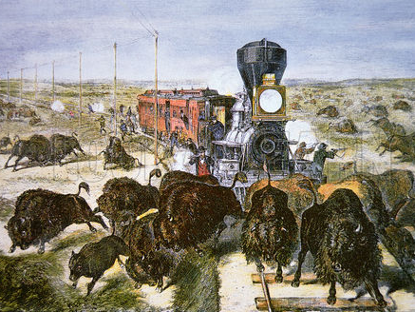
This just isn’t going to work...

Slide 29
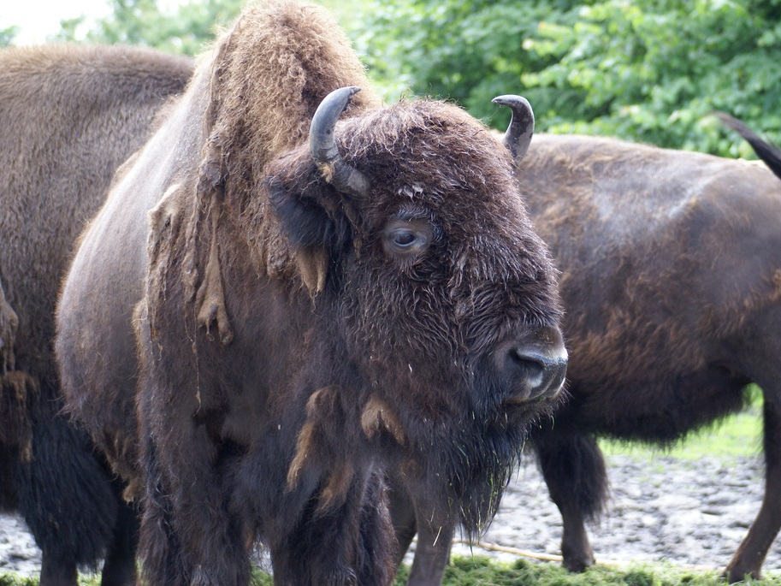
BYE, SON!
Some rights reserved by viralbus

Slide 30
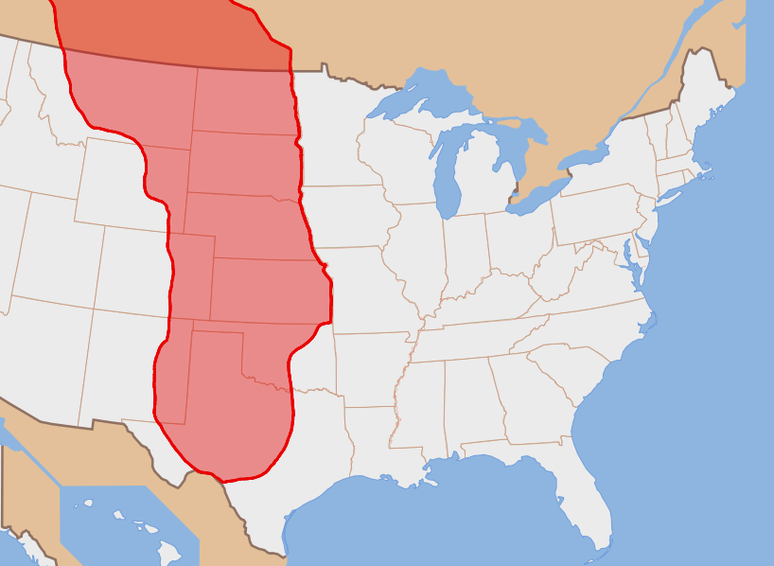
Prior to 1870, MILLIONS of buffalo roamed the Great Plains.

Slide 31
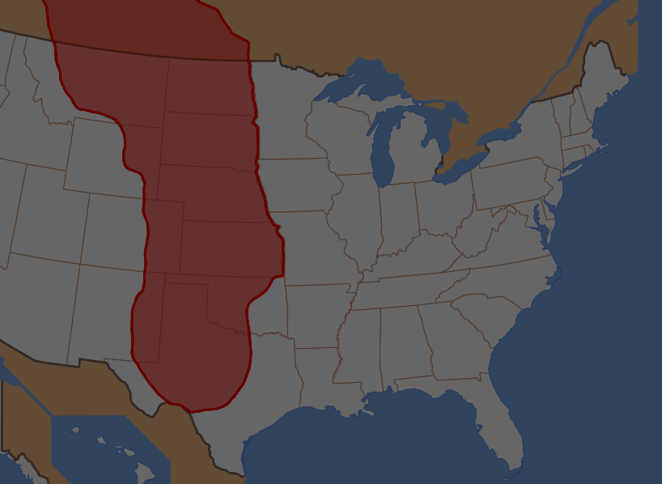
By 1900, they were nearly EXTINCT.

Slide 32
Plains Indians
The extermination of the buffalo made it impossible for the Plains Indians to continue their way of life.

Slide 33
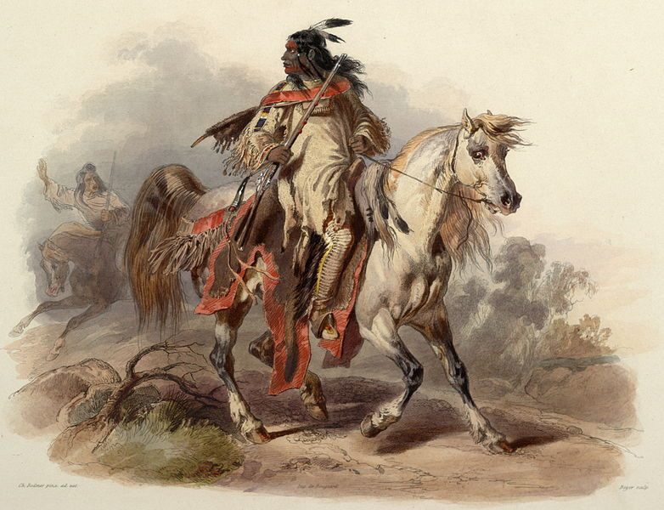
The Indians were also in the way

Slide 34
By 1890, all tribes had been placed on reservations
Some rights reserved by SG_Design

Slide 35
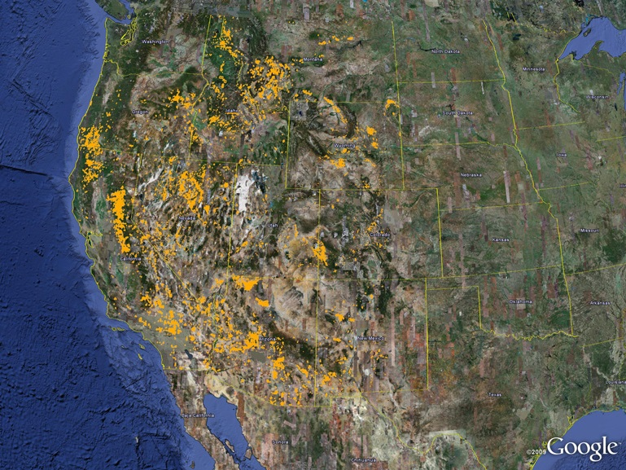
GOLD CLAIMS in the U.S.

Slide 36
THE INDIAN WARS

Slide 37
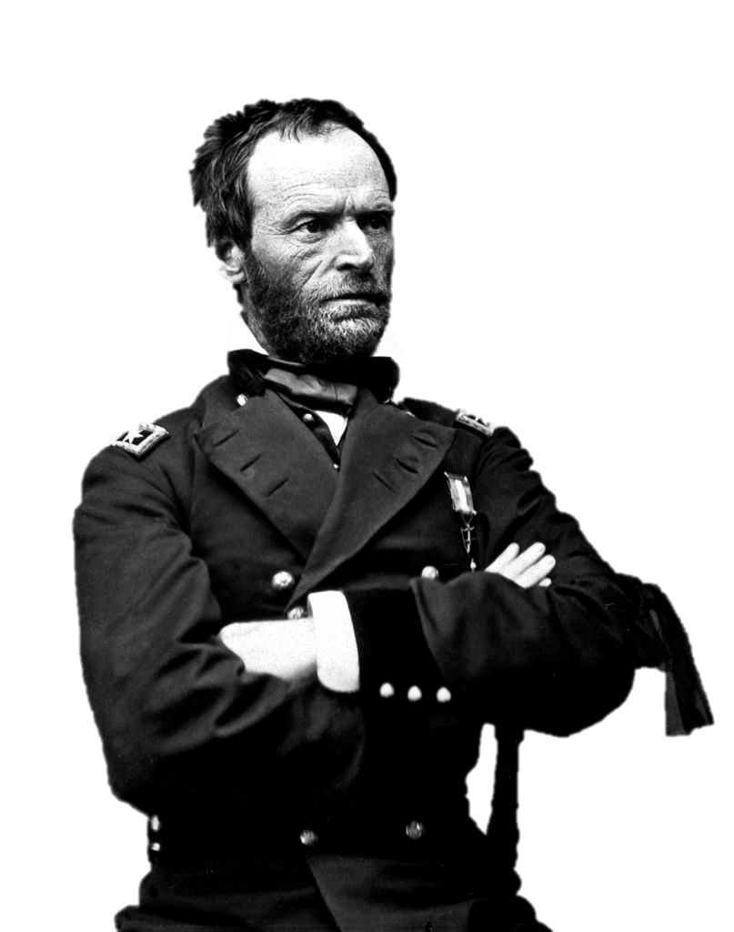
“Hostilities between the races will continue till the Indians are all killed or taken to a Country where they can be watched.”
William T. Sherman
June 10, 1867

Slide 38
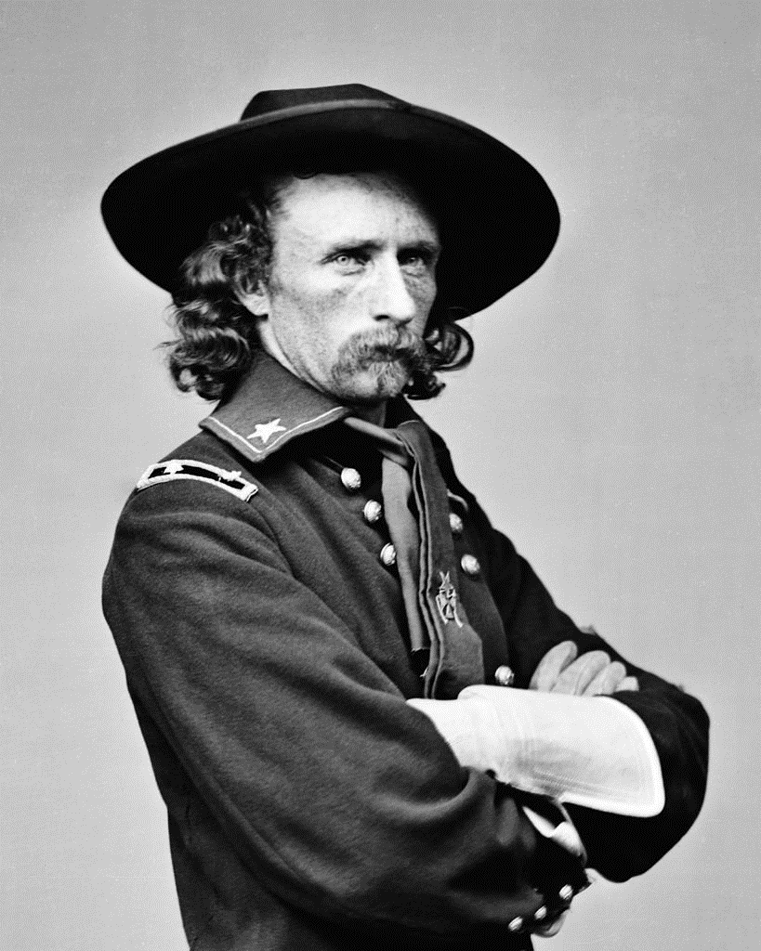
Custer’s “Last Stand”
Battle of the Little Bighorn (Montana - 1876)

Slide 39
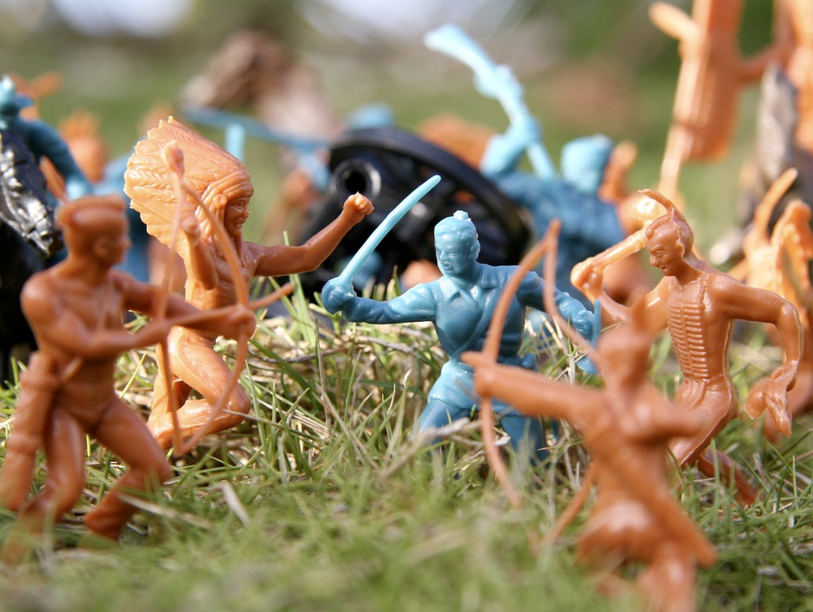
Custer was celebrated by several generations as an American hero.
Some rights reserved by puuikibeach

Slide 40
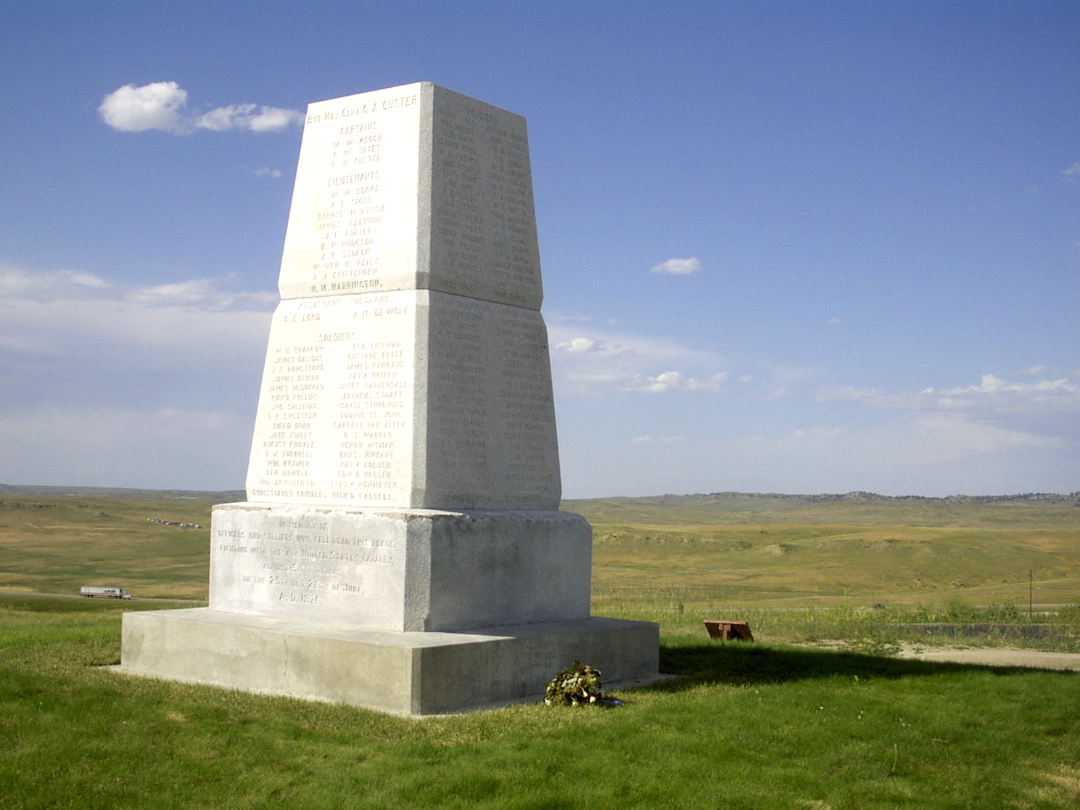
U.S. ARMY Memorial
Erected 1881

Slide 41
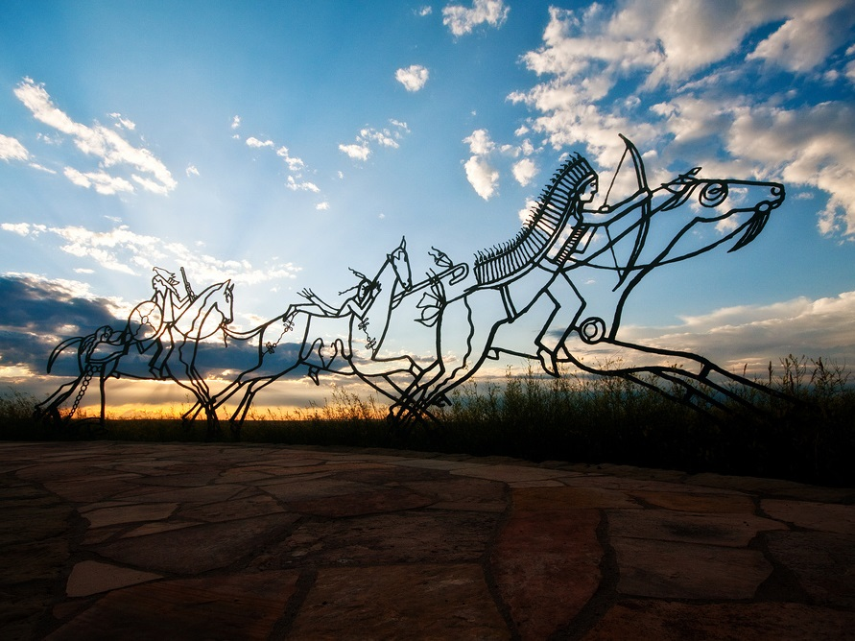
Indian Memorial
Erected 2003
Some rights reserved by Nomadic Lass

Slide 42
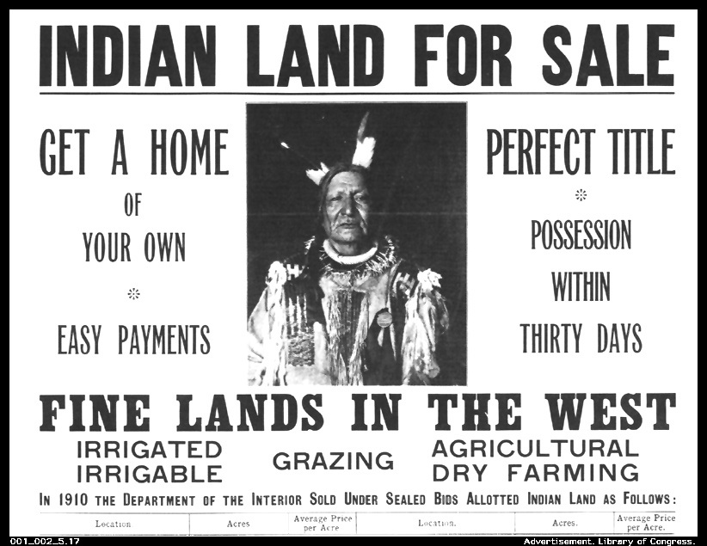

Slide 43
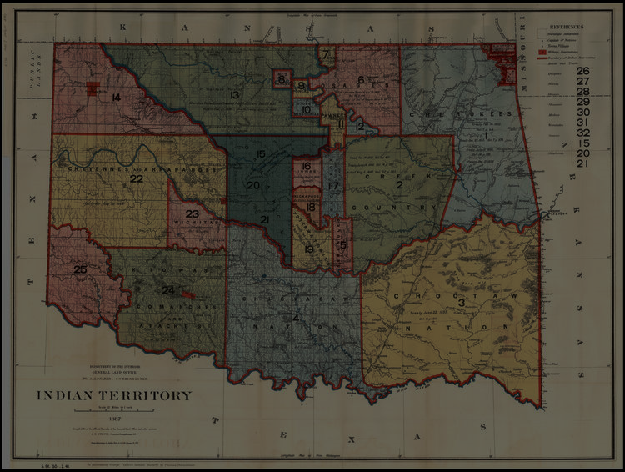
Dawes Act
(1887)
Reservations were broken up and tribal lands were distributed to individual Indian families.

Slide 44
Dawes Act
(1887)
Surplus lands in Indian Territory were opened to white settlement.

Slide 45
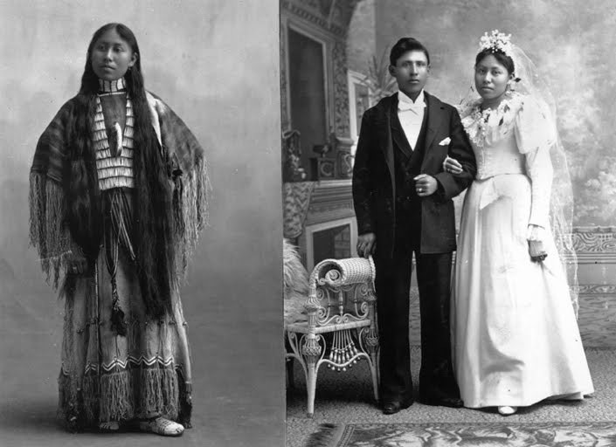
GOAL: ASSIMILATION

Slide 46
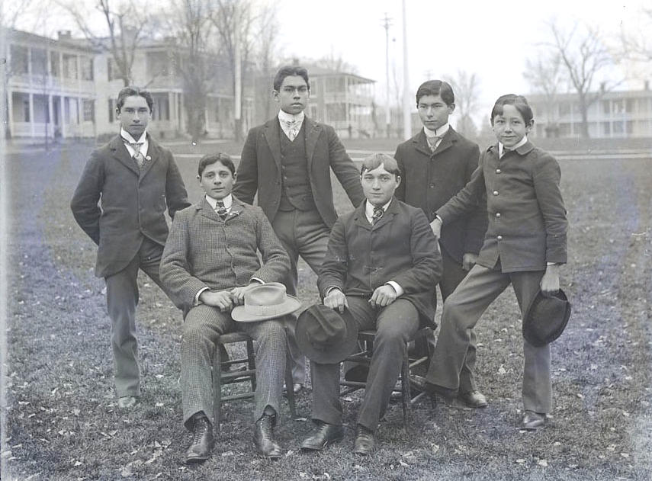
Carlisle Indian School (PA), 1879-1918

Slide 47
Wounded Knee Massacre
1890
The last armed conflict between the U.S. Army and Native Americans

Slide 48
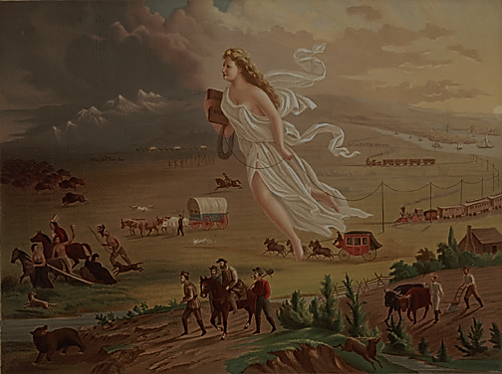
MANIFEST DESTINY

Slide 49
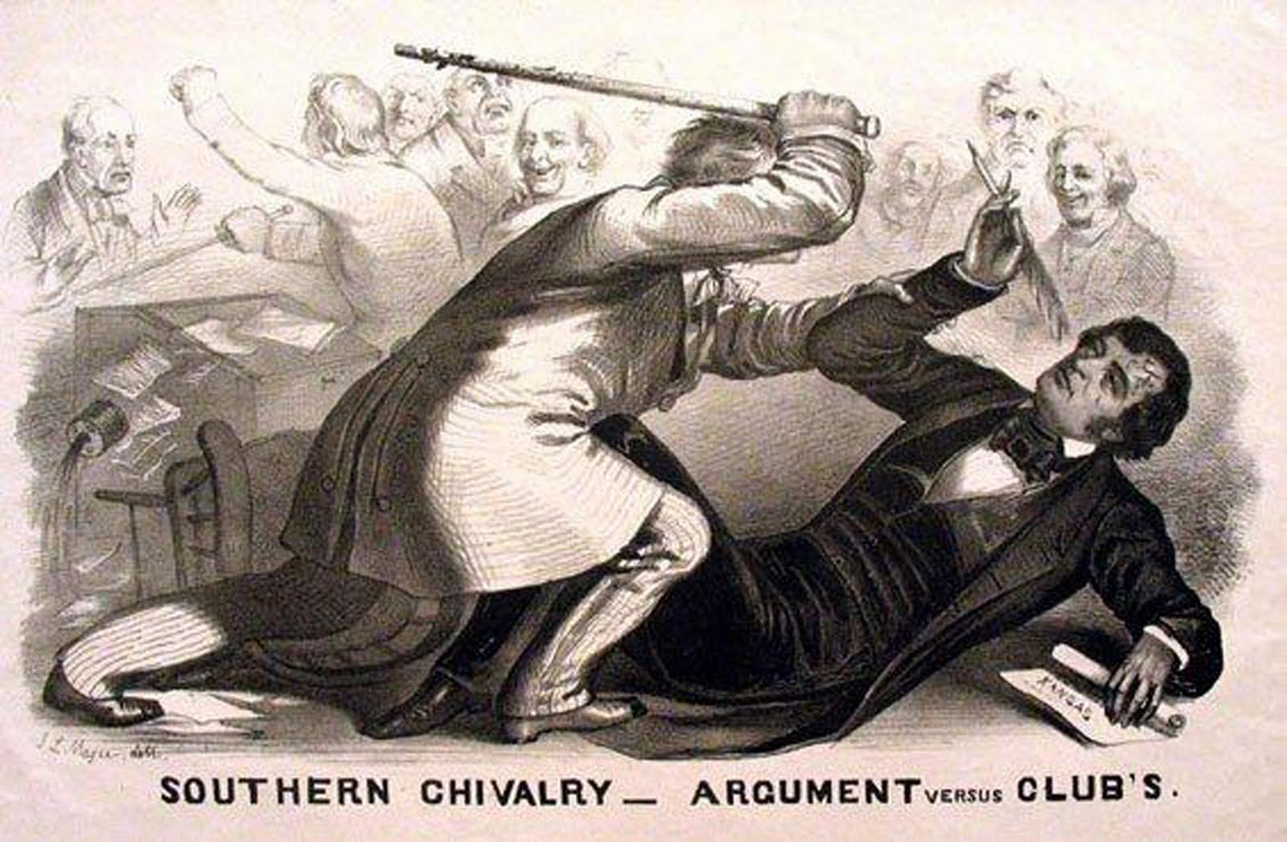
BEAT
the EOC
eocreview.com

Slide 50
LEARNING.
DELIVERED.

