Slide 1
Antebellum America
Sectionalism & Reform
USHC 2.3 & 2.4

Slide 2
Antebellum
“Before the [Civil] War”
1820 - 1860
Missouri Compromise
Civil War

Slide 3
SECTIONALISM
 | NORTH | SOUTH | WEST
Economy
Political Leaders
Political Issues
Developing Agricultural
Industry
Agriculture
Daniel Webster
John C. Calhoun
Henry Clay
Slavery (Anti)
Tariff (Pro)
Slavery (Pro)
Tariff (Anti)
Economic Development

Slide 4
Antebellum Reform
Movement | Key Figures | Information
Second Great Awakening | ______________
Abolitionism
Temperance | ______________
Women’s Rights
Religious Revival
Baptists / Methodists
William Lloyd Garrison
Anti-Slavery
Anti-Alcohol
Elizabeth Cady Stanton
Women should vote

Slide 5
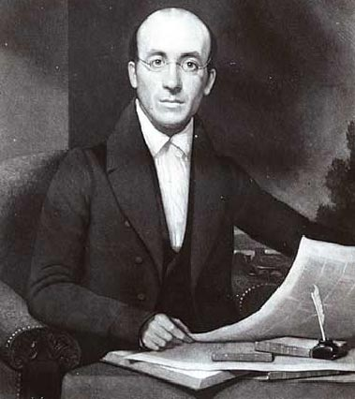
Abolitionism
William Lloyd Garrison
American Anti-Slavery Society
The Liberator (1831-1865)
Boston, MA, Newspaper
NOTE:
Abolition was a radical movement – especially in its early years.

Slide 6
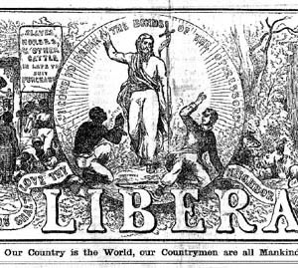

Slide 7
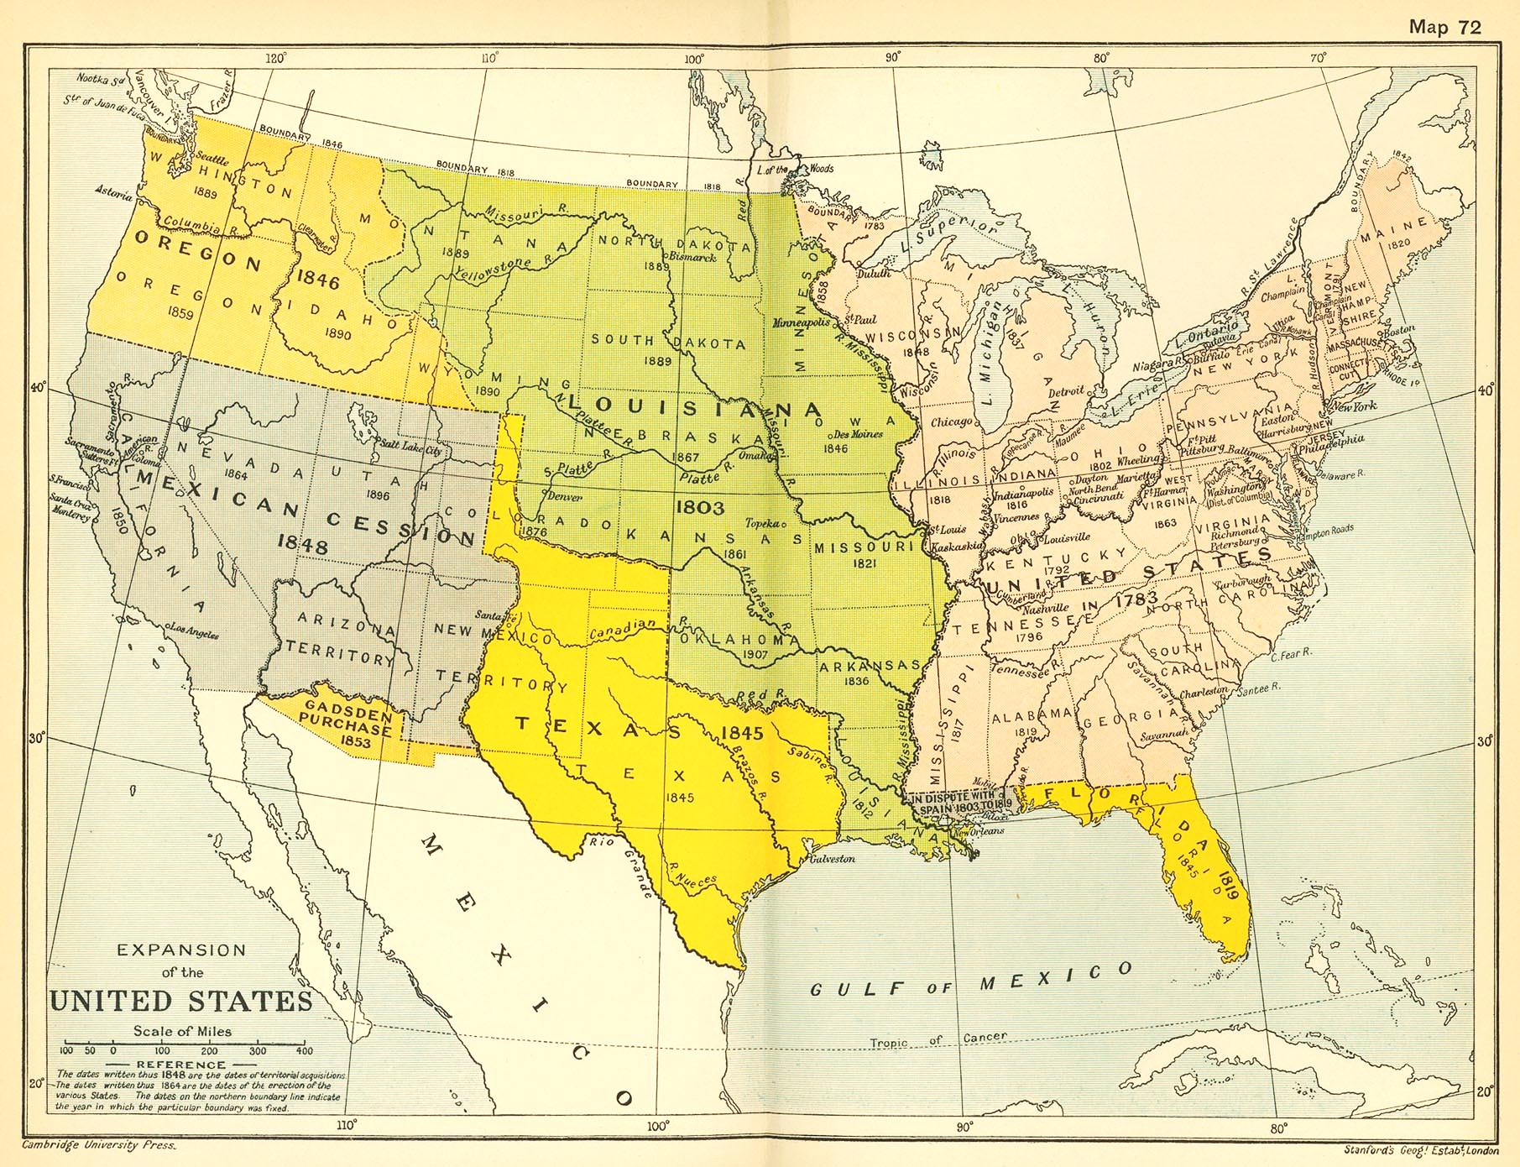
Reform Movements
Strongest HERE
Weakest HERE

Slide 8
The harder the North pushed…

Slide 9
The harder the South pushed back.

