Slide 1
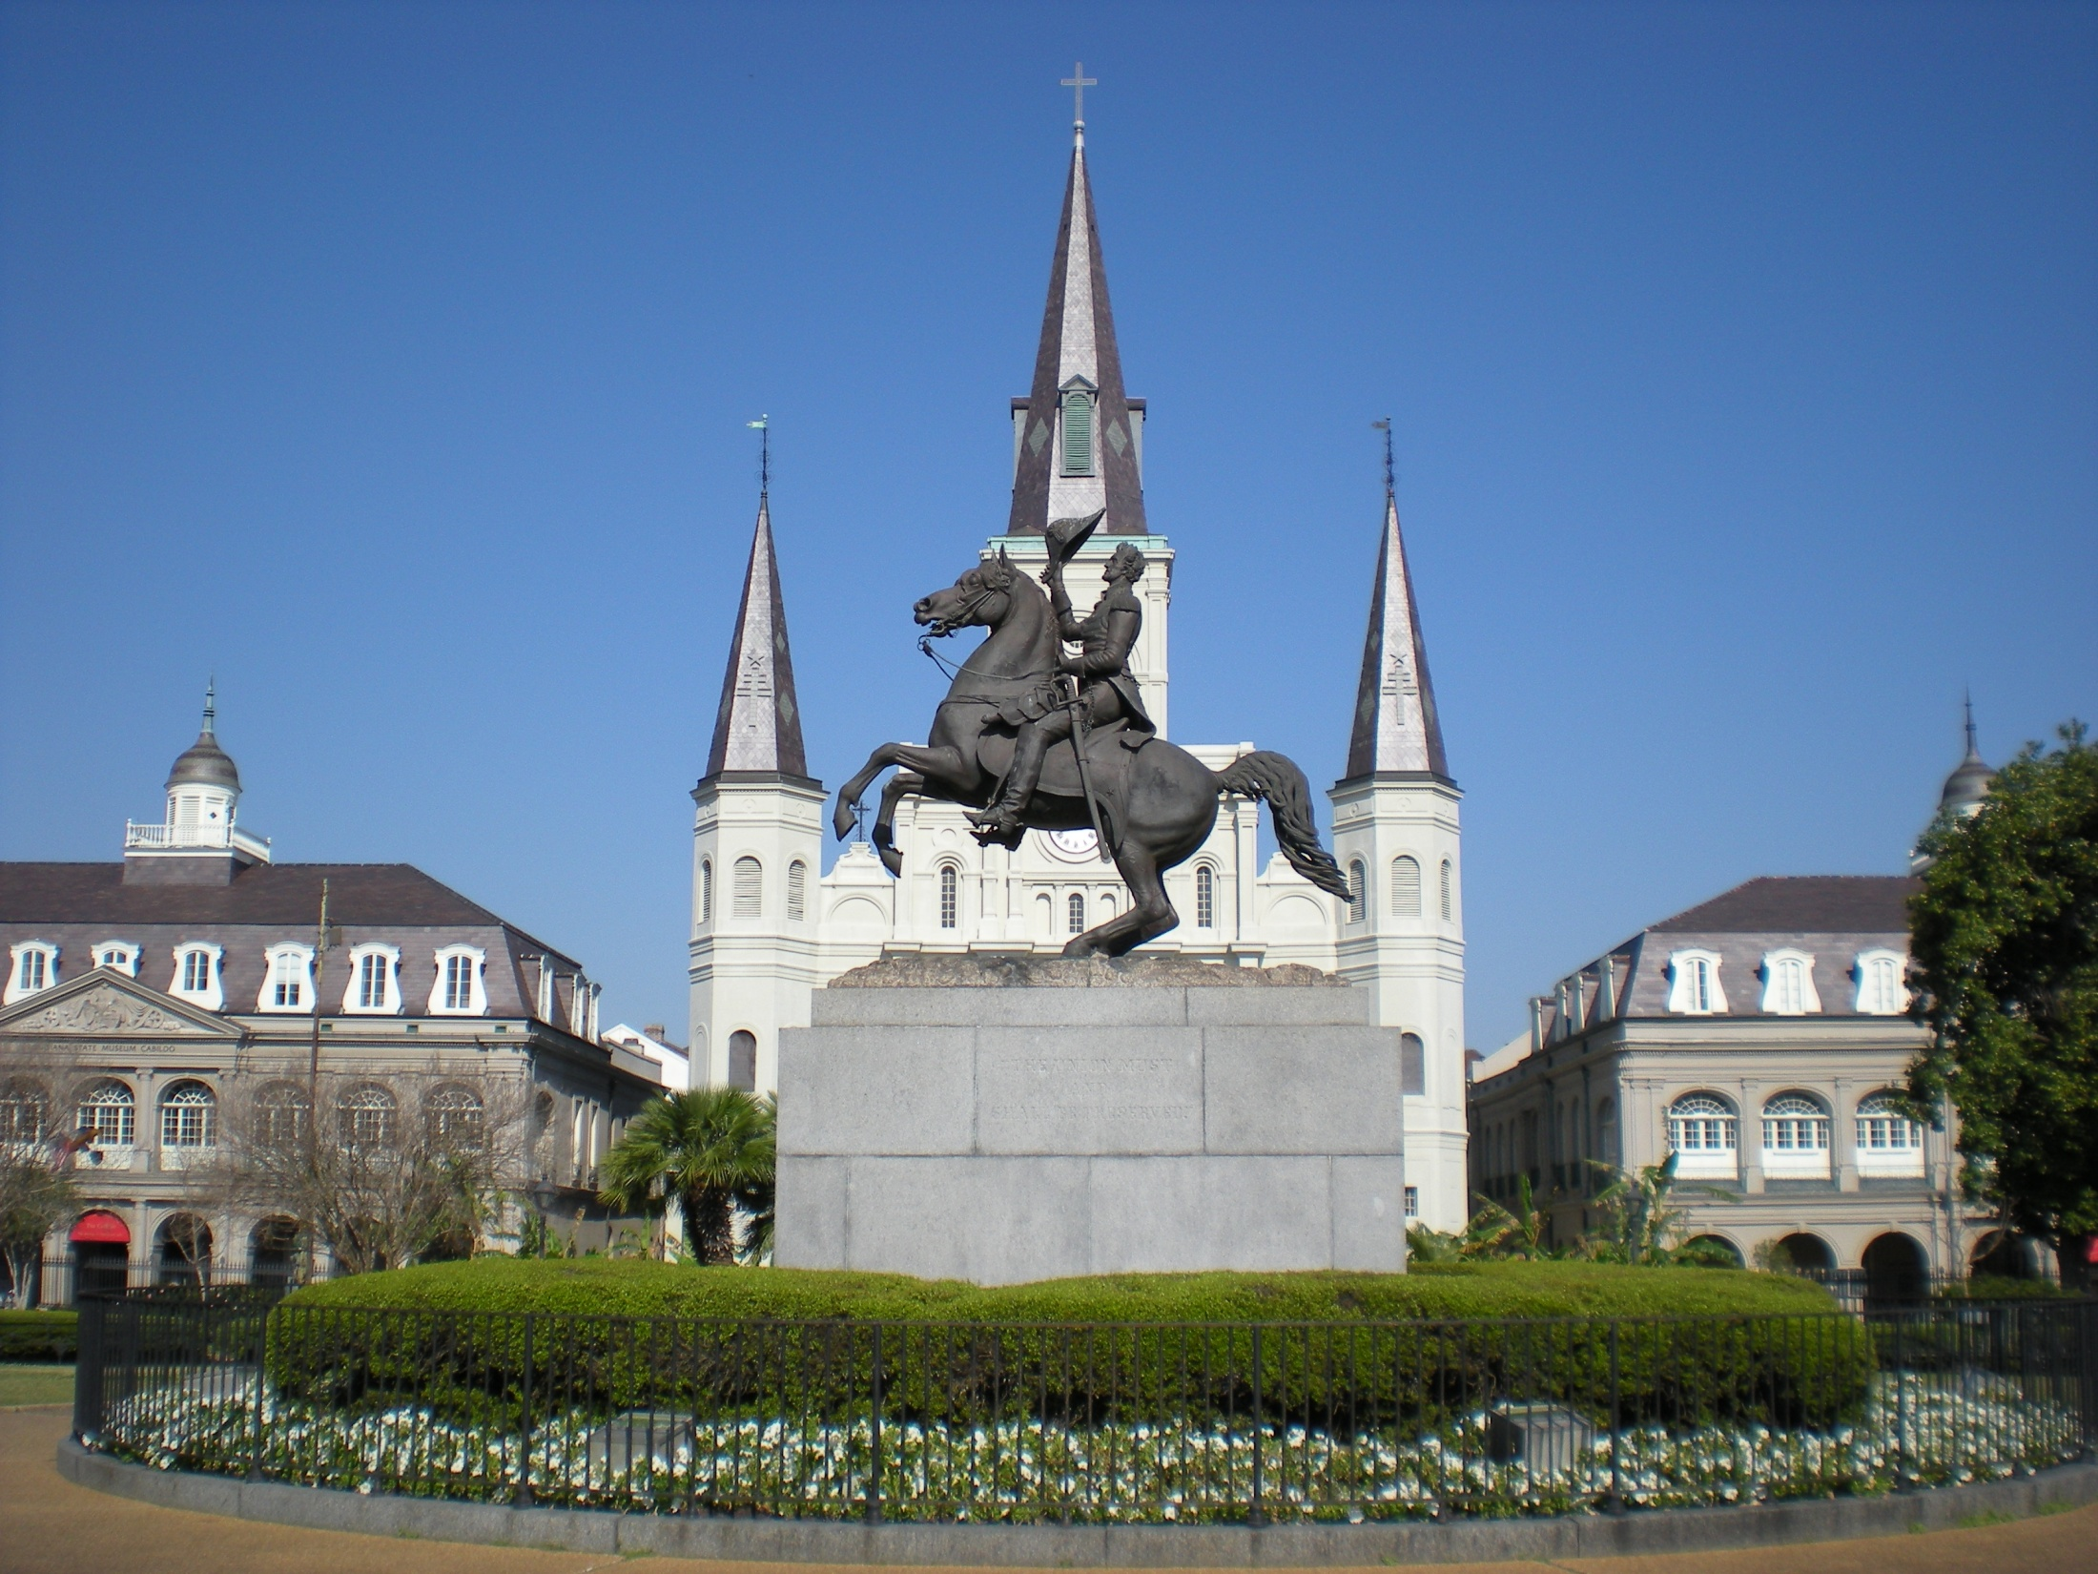
Territorial Acquisitions
USHC 2.1

Slide 2
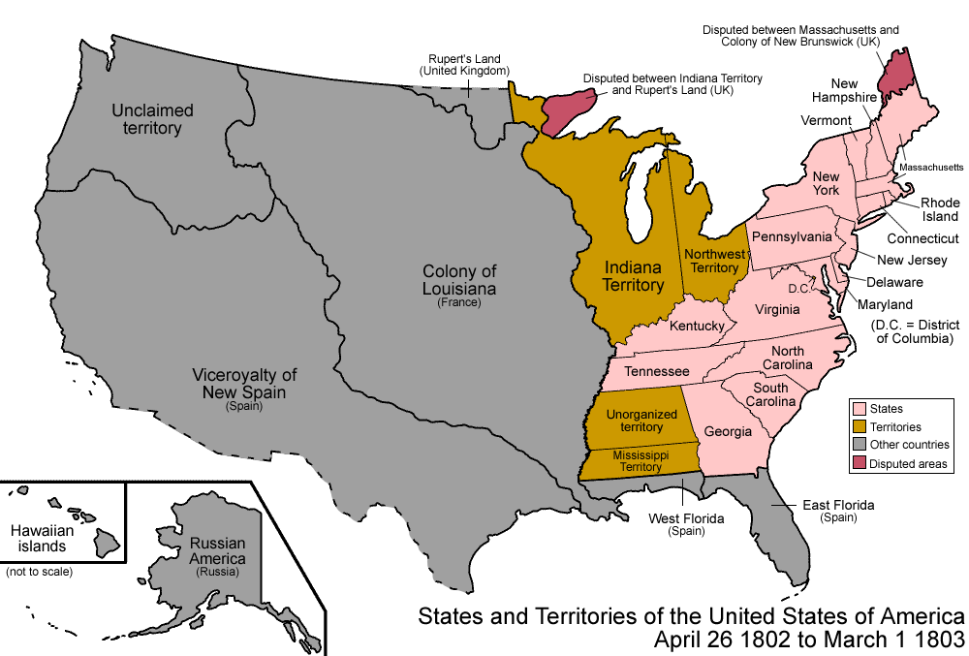
The Louisiana Purchase (1803)

Slide 3
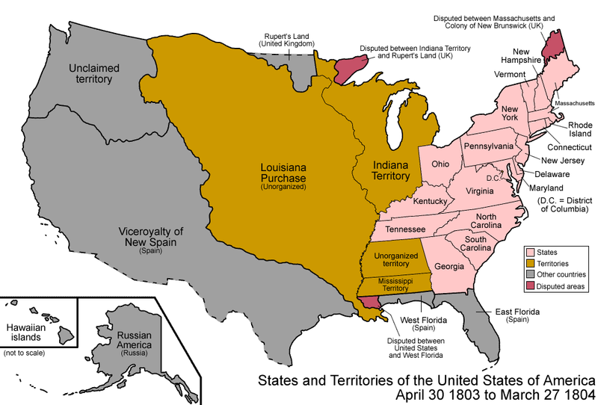
The Louisiana Purchase (1803)

Slide 4
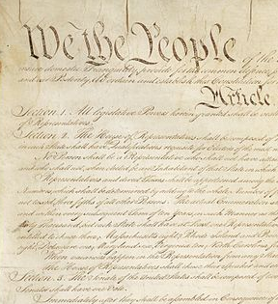
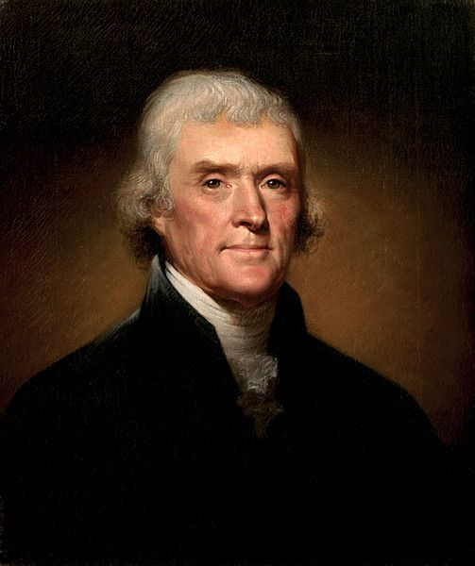
Jefferson’s Dilemma

Slide 5
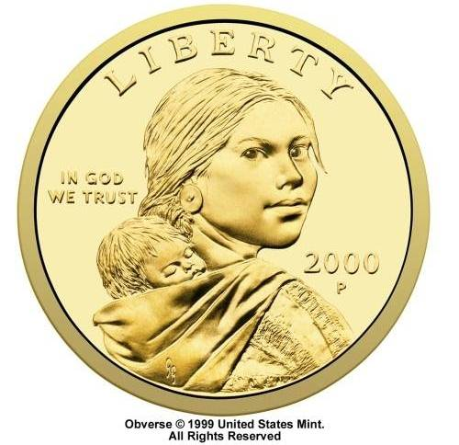

The Lewis and Clark Expedition
NORTHWEST PASSAGE?

Slide 6
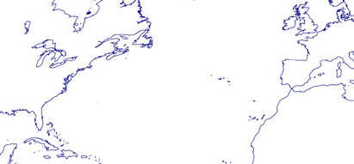
The United States Economy
Early 19th Century
Agriculture + Trade = Prosperity
Notes:
Jefferson’s agrarian economic model depended on trade with Europe.

Slide 7

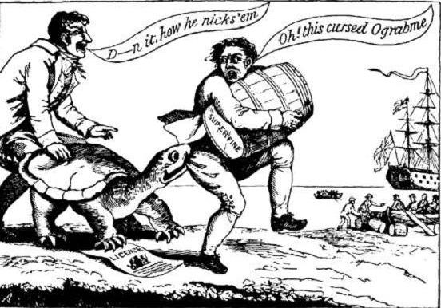
Embargo Act of 1807
TRADE
NEW ENGLAND
OBJECTIVES:
Economic Coercion
Avoid War
(Get Britain to stop impressing American sailors without going to war)
RESULT: FAILURE

Slide 9
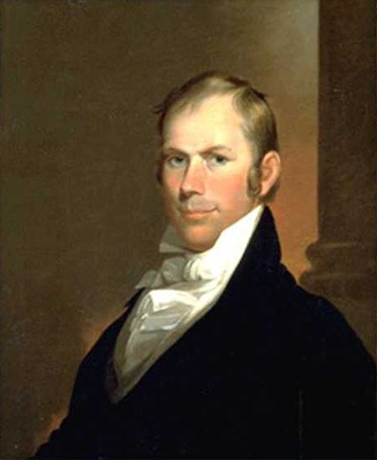
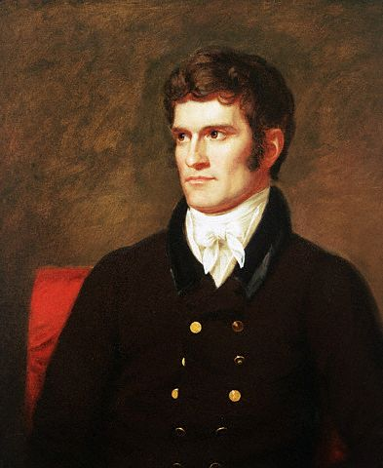
The “War Hawks”
Henry Clay (KY)
John C. Calhoun (SC)

Slide 10
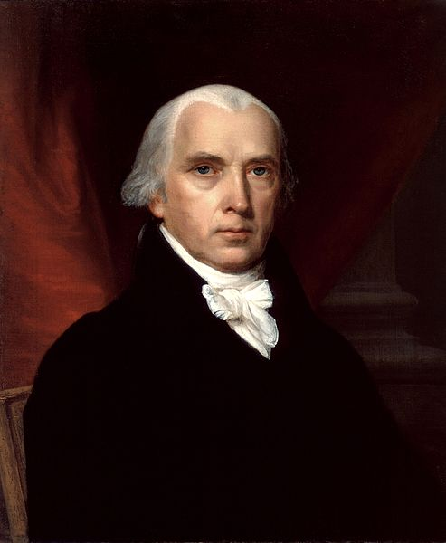
Madison’s War Message to Congress (1812)
James Madison
Fourth President of the U.S.
PROVOCATIONS
Impressment of Sailors
Cutting off Trade
Arming Native Americans on the western frontier

Slide 11
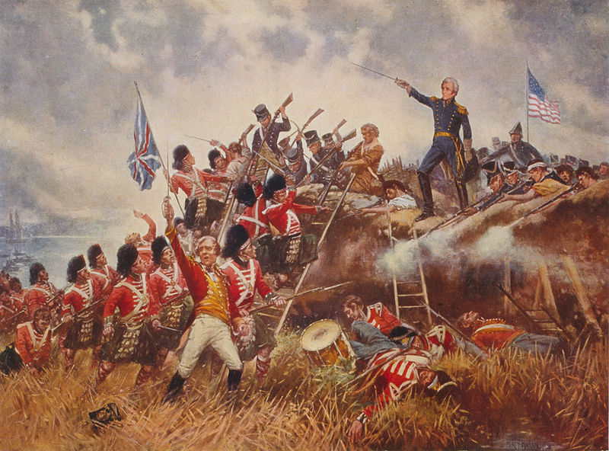
Battle of New Orleans
January 8, 1815
CONSEQUENCES
Gen. Andrew Jackson
Surge of national pride
AMERICA!
Andrew Jackson:
National Hero
Although the Battle of New Orleans took place after the Treaty of Ghent was signed, the Battle of New Orleans was important because the decisive victory gave Americans a sense of national pride.

Slide 12
Jackson Square
New Orleans
The Champion of the Common [White] Man

Slide 13
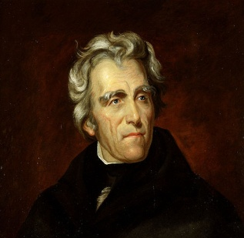
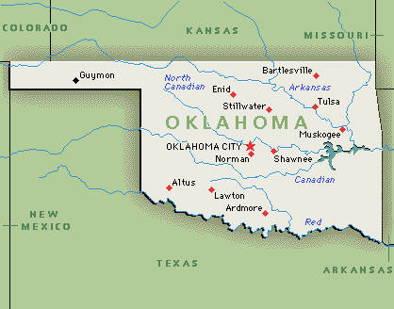
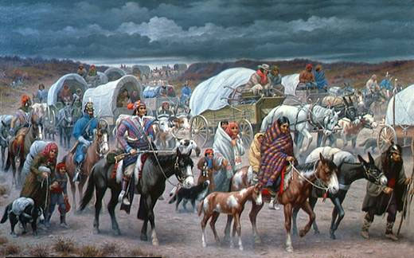
Indian Removal
Trail of Tears

Slide 14
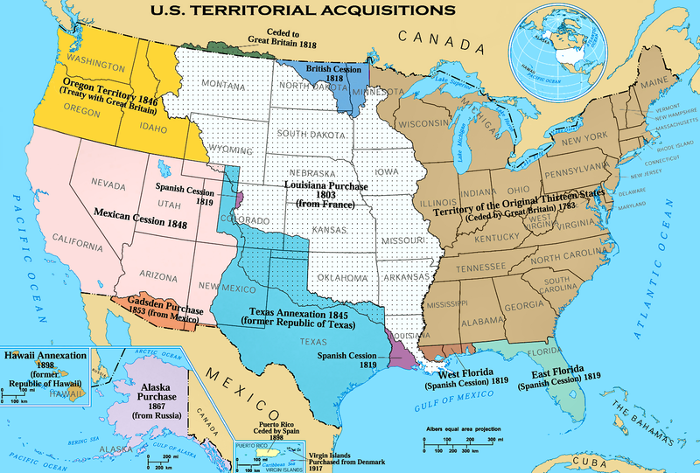
Oregon
Treaty
(1846)
Louisiana Purchase
(1803)
Mexican Cession
(1848)
Texas
Annexation
(1845)

Slide 15








