Slide 1
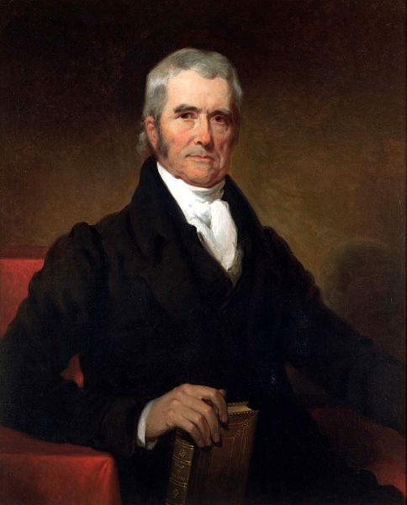
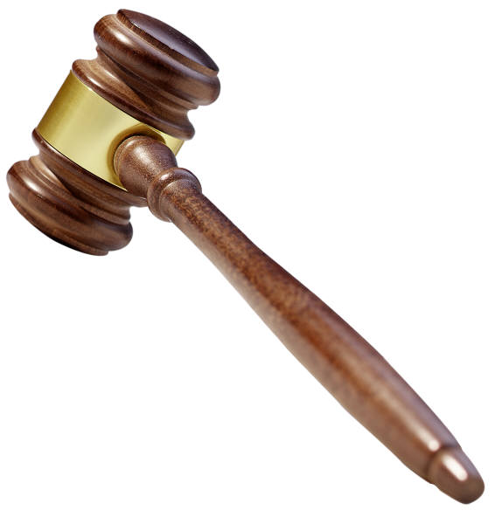
The Marshall Court
Revenge of the Federalists

Slide 2
USHC 1.7
Summarize the expansion of the power of the national government as a result of Supreme Court decisions under Chief Justice John Marshall, such as the establishment of judicial review in Marbury v. Madison and the impact of political party affiliation on the Court.

Slide 3
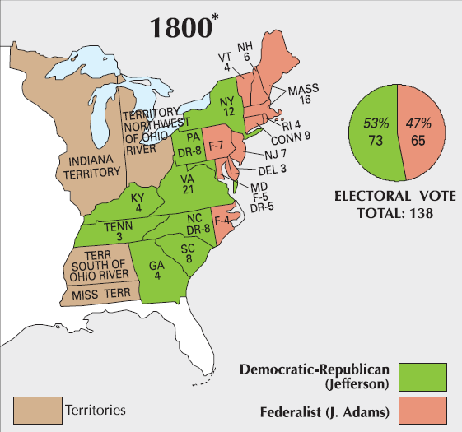

Slide 4
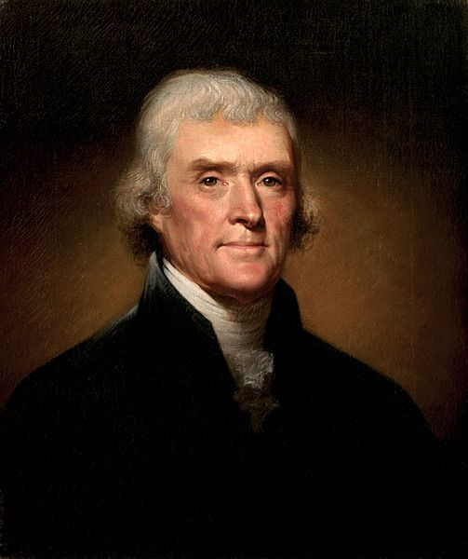
"I shall... by the establishment of republican principles... sink federalism into an abyss from which there shall be no resurrection.”
– Thomas Jefferson

Slide 5
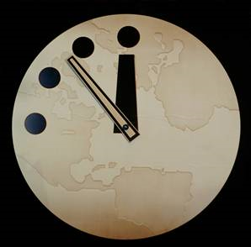
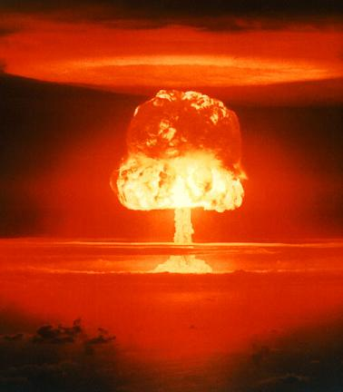
The Doomsday Clock
After their devastating
defeat in the Election of
1800, “doomsday” was quickly approaching for
John Adams and the Federalist Party.

Slide 6

LAME DUCK
John Adams surrounded by Jeffersonian Storm Troopers
Photo by Gaetan Lee

Slide 7


“Lame Duck” Session
1801
ELECTION
SUCCESSOR’S TERM
In a “lame duck” session, the outgoing Congress meets and passes laws before the newly-elected members of Congress can take their seats.
Photo by Stuart Chalmers

Slide 8

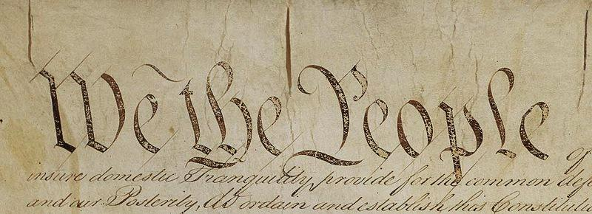
From Article III,
Section 1
The judicial power of the United States, shall be vested in one Supreme Court, and in such inferior courts as the Congress may from time to time ordain and establish.

Slide 9
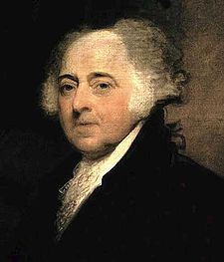

The Judiciary Act of 1801
The “Midnight Judges” Act
Sixteen new federal circuit judges
Sixteen federal judges
with life tenure would
be able to undermine
Jefferson and the Republicans from the bench.

Slide 10
John Marshall
Federalist
Secretary of State (Adams Administration)
Chief Justice
of the Supreme Court
“Midnight” Appointment
John Marshall
Chief Justice

Slide 11
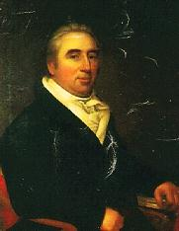
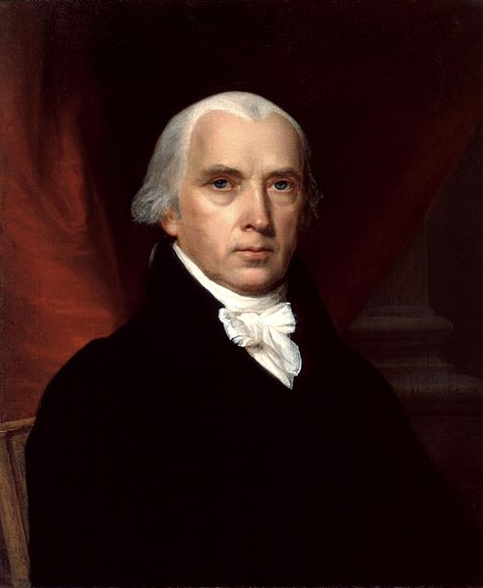
Marbury v. Madison
(1803)
vs.
William Marbury
(Midnight Judge)
James Madison
(Secretary of State)
William Marbury
(Midnight Judge)
James Madison
(Secretary of State)

Slide 12
Marbury v. Madison
(1803)
Writ of
MANDAMUS
as per Judiciary Act of 1789
vs.
William Marbury
(Midnight Judge)
James Madison
(Secretary of State)

Slide 13
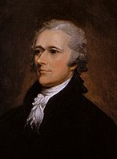
From The Federalist No. 78
The judiciary, from the
nature of its functions, will always be the least dangerous to the political rights of the Constitution...

Slide 14
Marbury v. Madison
(1803)
Marshall’s Dilemma
???
John Marshall
Chief Justice

Slide 15
Marbury v. Madison
(1803)
Marshall’s Decision
Judiciary Act of 1789 is UNCONSTITUTINAL
John Marshall
Chief Justice

Slide 16
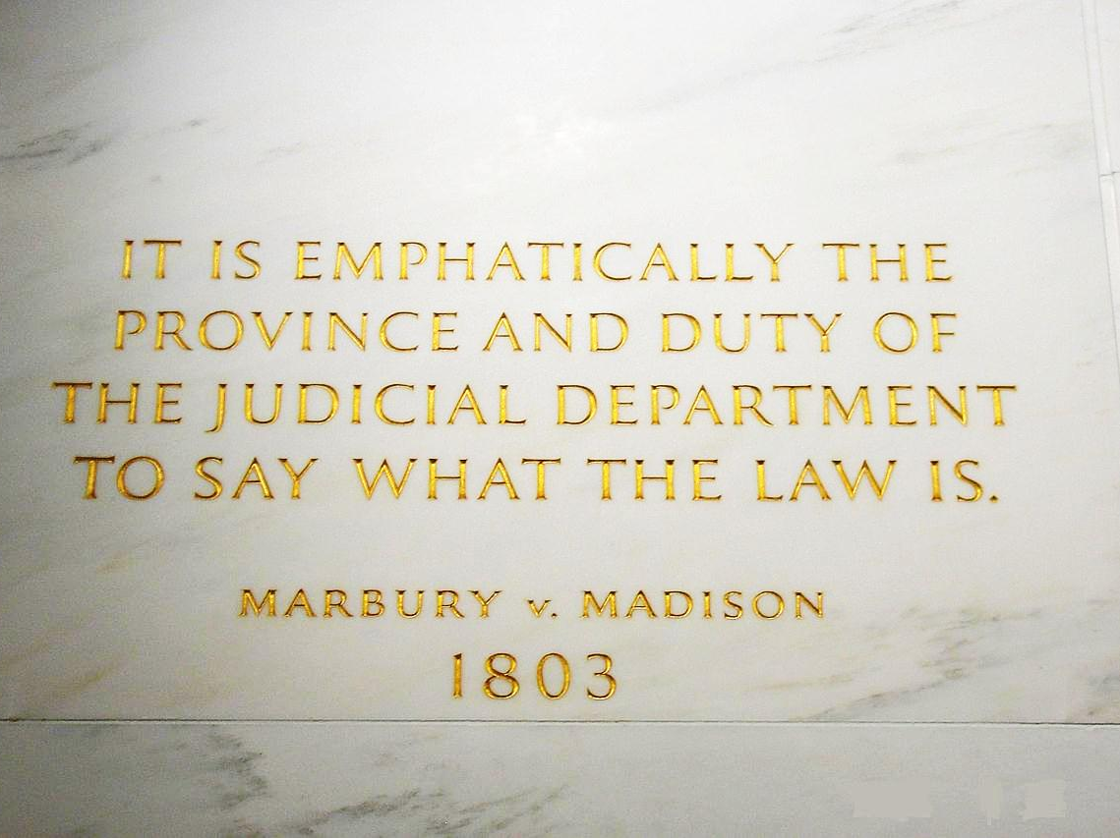
JUDICIAL REVIEW

Slide 17
JUDICIAL REVIEW
Marshall:
The Supreme Court can declare laws to be unconstitutional.
  (in this case, a federal law passed by Congress)
John Marshall
Chief Justice

Slide 18
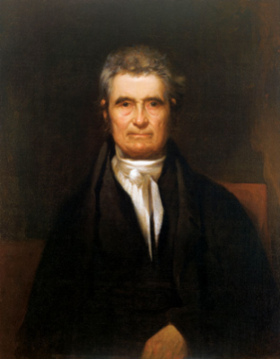
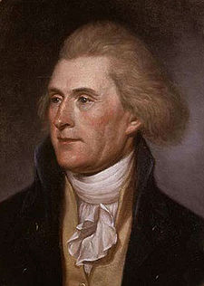
Comparing
Jefferson & Marshall
Marshall
(Federalist)
Jefferson
(Republican)
Strong Central Government
 | Federalism
 | Strict / Loose Construction?
 | National Bank?
 | Favored Economic Pursuit?
Marbury v. Madison: | Who interprets the Constitution? | Kentucky Resolution:
States’ Rights
Loose
STRICT
Constitutional
Unconstitutional
Commerce
Agriculture
SUPREME COURT
STATES

Slide 19
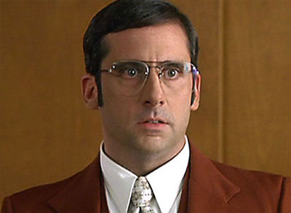
I LOVE BANK.

Slide 20

McCulloch v. Maryland
1819
BUS vs. Maryland
Maryland had placed a tax on the Bank of the United States. The B.U.S. sued Maryland in protest.
John Marshall
Chief Justice

Slide 21
McCulloch v. Maryland
1819
THE DECISION:
The Marshall Court ruled
in the Bank’s favor.
John Marshall
Chief Justice
FEDERALISM
ELASTIC CLAUSE
SUPREMACY CLAUSE
IMPLIED POWERS

Slide 22
McCulloch v. Maryland
1819
“The power to tax involves the power to destroy.”
  John Marshall
  McCulloch v. Maryland
John Marshall
Chief Justice

Slide 23
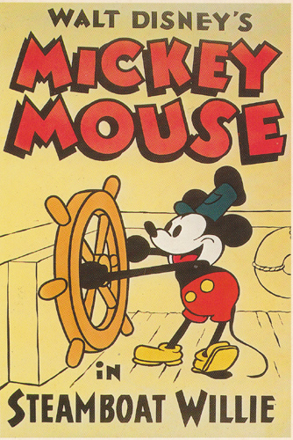
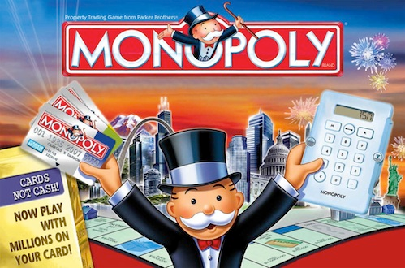
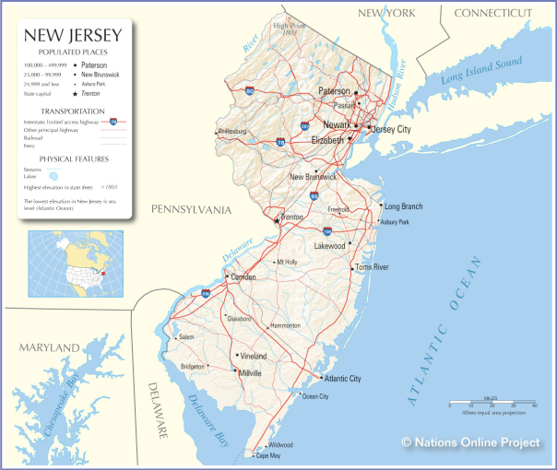
Gibbons v. Ogden
1824
FEDERALISM
John Marshall
Chief Justice
COMMERCE CLAUSE

Slide 24
From Article I,
Section 8
[The Congress shall have Power] To regulate Commerce with foreign Nations, and among the several States...

Slide 25
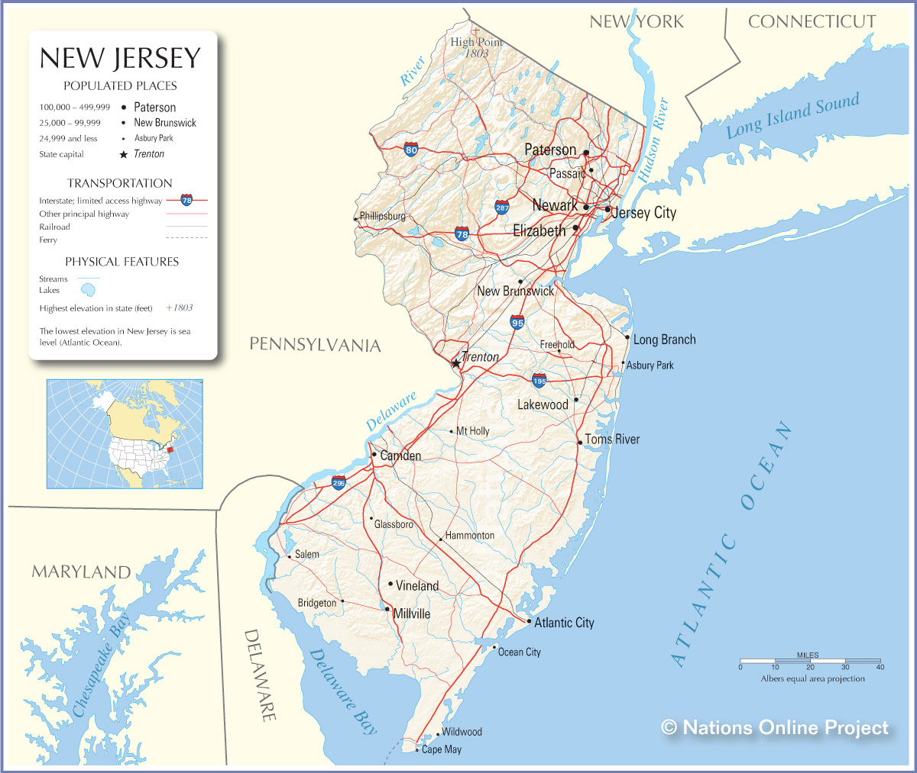
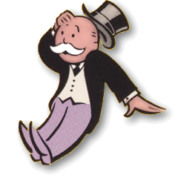
Gibbons
(& Vanderbilt)

Slide 26


GAME TIME!!!
The Marshall Court:
Using Marbury v. Madison, McCulloch v. Maryland, and Gibbons v. Ogden as guides, determine whether Chief Justice John Marshall would “Like” or “Dislike” the following items.
NOTE: This exercise is based on the Facebook news feed. At no point does the author assert that the format is original. NOT INTENDED FOR COMMERCIAL USE

Slide 27


The “Elastic Clause”
The Constitution The Congress shall have Power…To make all Laws which shall be necessary and proper for carrying into Execution the foregoing Powers, and all other Powers vested by this Constitution in the Government of the United States, or in any Department or Officer thereof. (Art I, Sec 8.18)
1787 · Comment · Like
John Marshall
likes this.

Slide 28
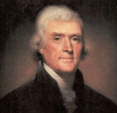

Strict Construction
Thomas Jefferson Resolved, That the several States composing, the United States of America… by a compact under the style and title of a Constitution for the United States… constituted a general government for special purposes — delegated to that government certain definite powers, reserving, each State to itself, the residuary mass of right to their own self-government…
1798 · Comment · Like
John Marshall
dislikes this.

Slide 29
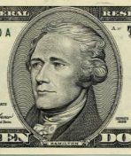

Loose Construction
Alexander Hamilton Every power vested in a Government is in its nature sovereign… which are not precluded by restrictions and exceptions specified in the constitution, or not immoral, or not contrary to the essential ends of political society.
23 Feb 1791 · Comment · Like
John Marshall
likes this.
http://press-pubs.uchicago.edu/founders/documents/a1_8_18s11.html

Slide 30
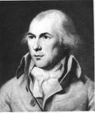
States’ Rights
James Madison The powers delegated by the proposed Constitution to the federal government are few and defined. Those which are to remain in the State governments are numerous and indefinite.
1788 · Comment · Like
John Marshall
dislikes this.
http://en.wikisource.org/wiki/The_Federalist_Papers/No._45

Slide 31
The National Bank
Alexander Hamilton A National Bank is an Institution of primary importance to the prosperous administration of the Finances, and would be of the greatest utility in the operations connected with the support of the Public Credit....
1790 · Comment · Like
John Marshall
likes this.
http://en.wikipedia.org/wiki/Second_Report_on_Public_Credit

Slide 32
