Slide 1
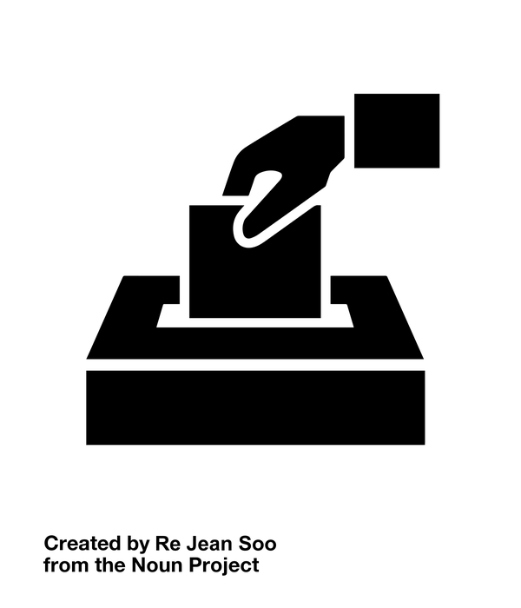
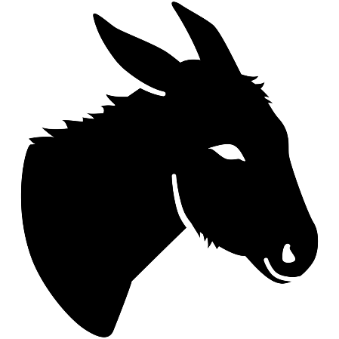
LINKAGE INSTITUTIONS

Slide 2
DEMOCRATIC REPUBLIC
In a democratic republic, the people influence the government primarily through elections.

Slide 3
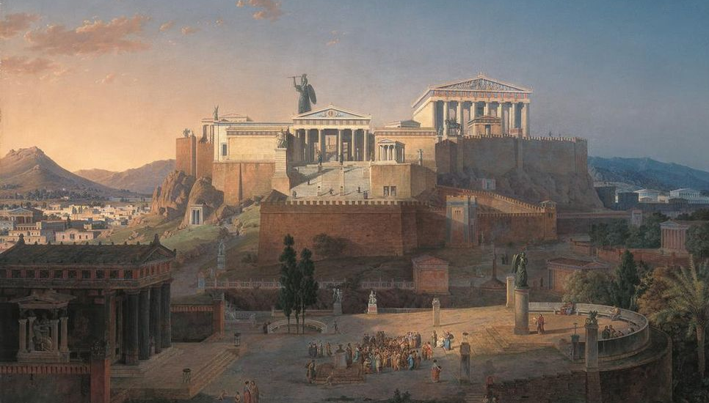
DIRECT DEMOCRACY
The Acropolis of Athens by Leo von Klenze

Slide 4
WE DON’T HAVE TIME
Photo by flik

Slide 5
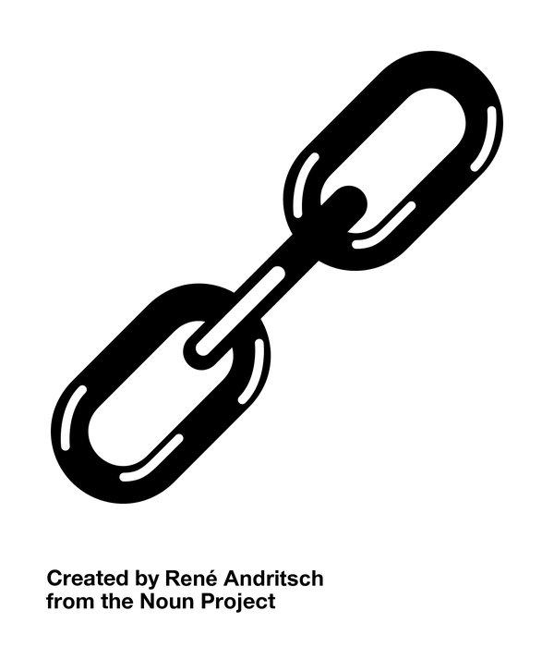
WE NEED A LINK

Slide 6
LINKAGE INSTITUTIONS

Slide 7
LINKAGE INSTITUTIONS
Elections

Slide 8
LINKAGE INSTITUTIONS
Elections
The Media

Slide 9
LINKAGE INSTITUTIONS
Elections
The Media
Political Parties

Slide 10
LINKAGE INSTITUTIONS
Elections
The Media
Political Parties
Interest Groups

Slide 11
ELECTIONS
We influence the government through periodic elections.

Slide 12
disconnected

Slide 13
?!?!?!
How can we effectively participate?

Slide 14
HOW DO WE CONNECT?
?

Slide 15
The media
We know what’s going on.

Slide 16
POLITICAL PARTIES
Coalition Building

Slide 17
POLITICAL PARTIES
Candidate Recruitment
WANNA RUN???
We can provide support!

Slide 18
BRANDING
Although candidates who are part of the same party may differ on some issues, they generally share some common ground on key issues.

Slide 19
INTEREST GROUPS
Issue Advocacy

Slide 20
INTEREST GROUPS
Issue Advocacy

Slide 21
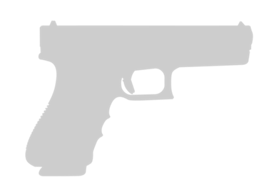
INTEREST GROUPS
Issue Advocacy

Slide 22
INTEREST GROUPS
Issue Advocacy

Slide 23
INTEREST GROUPS
Issue Advocacy

Slide 24
LINKAGE INSTITUTIONS

Slide 25
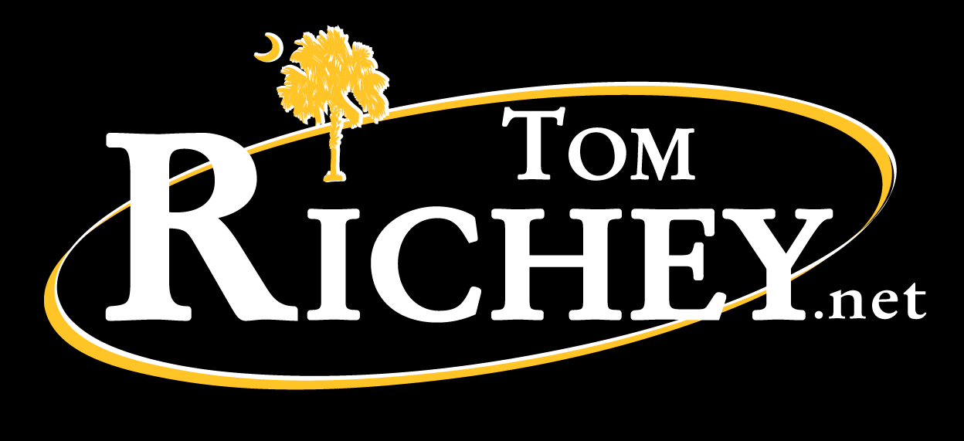

Slide 26
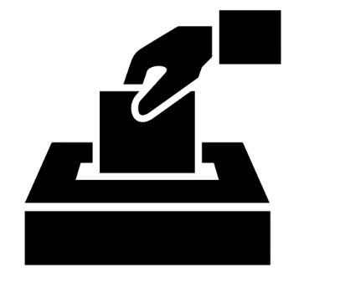
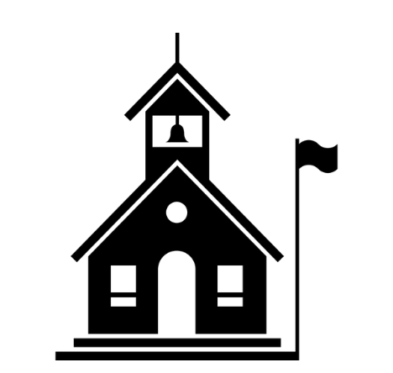
All Icons Accessed at The Noun Project www.thenounproject.com
Created by Alex Berkowitz
Created by Martha Ormiston
Public Domain Icons
Created by Andrew Nolte
Created by Adrijan Karavdic
Created by Gabriele Malaspina

