Slide 1
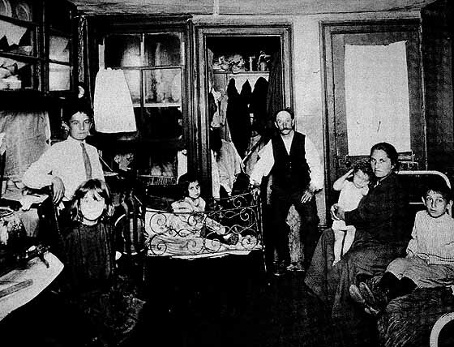

Immigration & Urbanization
US HISTORY
EOC REVIEW

Slide 2
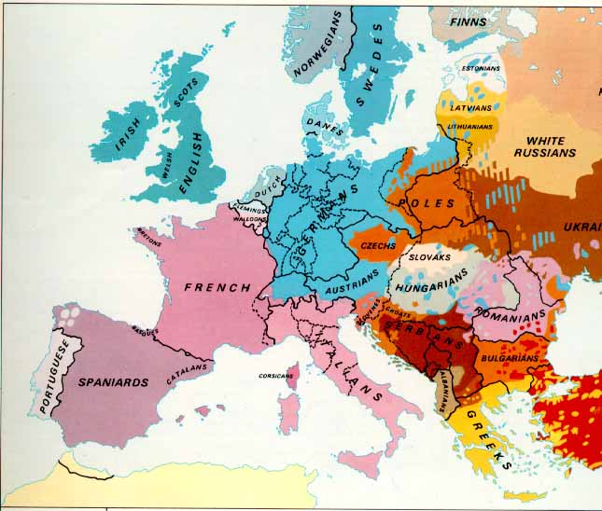
New Immigrants (1890-1920)
Southern Europe
  Italy
  Greece
Eastern Europe
  Russia
  Poland
Catholic, Orthodox, Jewish
Non-English-speaking countries
Republican Traditions

Slide 3
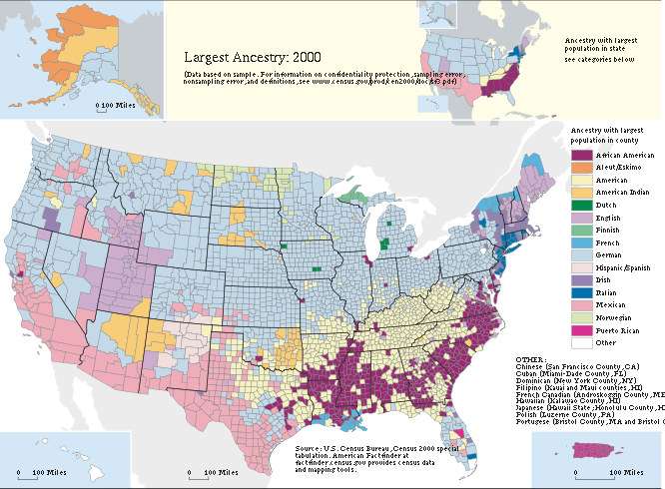

Slide 4
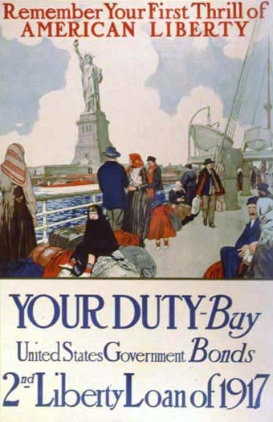
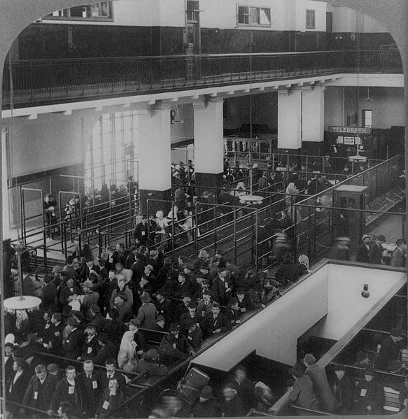
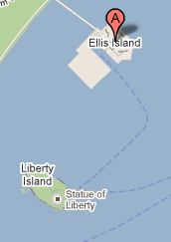
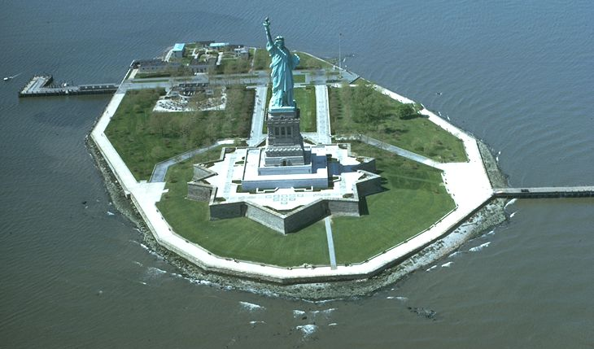
Ellis Island
New York City
The Statue of Liberty on nearby Liberty Island
Immigrants being processed, 1904

Slide 5
NATIVISM
Group | Good | Bad ^{[166]}
English | 66% | 6%
Irish | 62% | 7%
Jews | 59% | 9%
Germans | 57% | 11%
Italians | 56% | 10%
Poles | 53% | 12%
Japanese | 47% | 18%
Blacks | 46% | 16%
Chinese | 44% | 19%
Mexicans | 25% | 34%
Koreans | 24% | 30%
Vietnamese | 20% | 38%
Puerto Ricans | 17% | 43%
Haitians | 10% | 39%
Cubans | 9% | 59%
1982 Opinion Poll:
"Thinking both of what they have contributed to this country and have gotten from this country, for each one tell me whether you think, on balance, they've been a good or a bad thing for this country."
See Wikipedia for more public opinion figures on immigration in the United States.

Slide 6
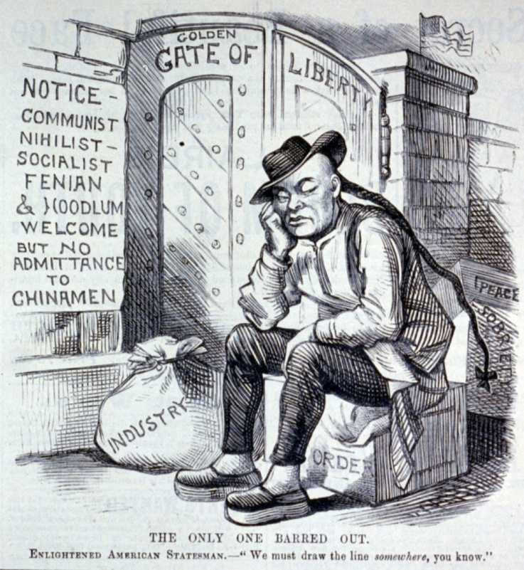
Chinese Exclusion Act (1882)
First US Law to restrict immigration based on nationality or race
Remained on the books in various forms until 1943

Slide 7

Immigration Restrictions
Emergency Quota Act
(1921)
National Origins Act
(1924)
First restriction of immigration from Europe
3%
Of people from that country living in the U.S. in 1910
Established permanent immigration caps
2%
Of people from that country living in the U.S. in 1890

Slide 8
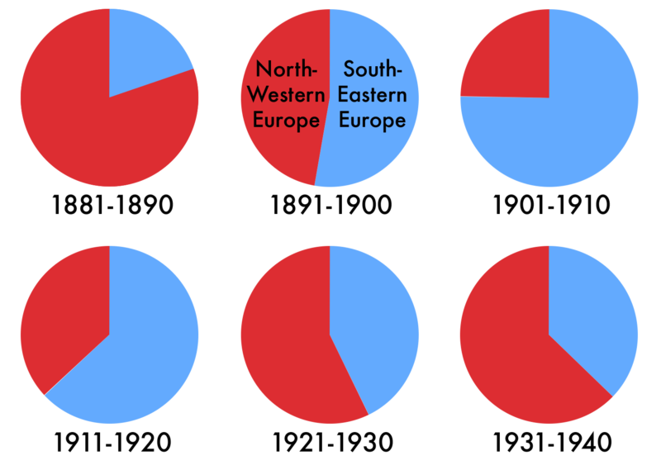
Effect of Immigration Legislation
Highest quotas for Britain, Germany, and Ireland

Slide 9
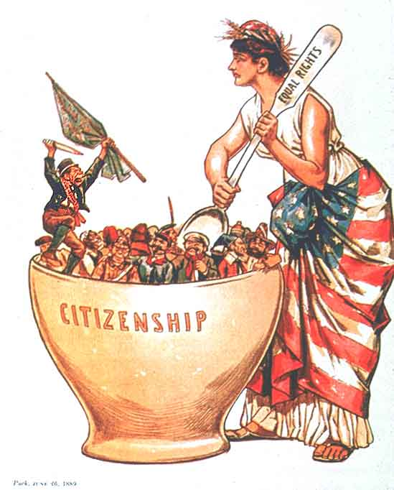

Melting Pot
Notes:
http://legalworldonline.com/OSCommerce/images/melting%20pot.jpg, http://regentsprep.org/regents/ushisgov/themes/immigration/melting_pot.gif, http://jackiemontgomery.files.wordpress.com/2009/05/meltingpot.jpg

Slide 10
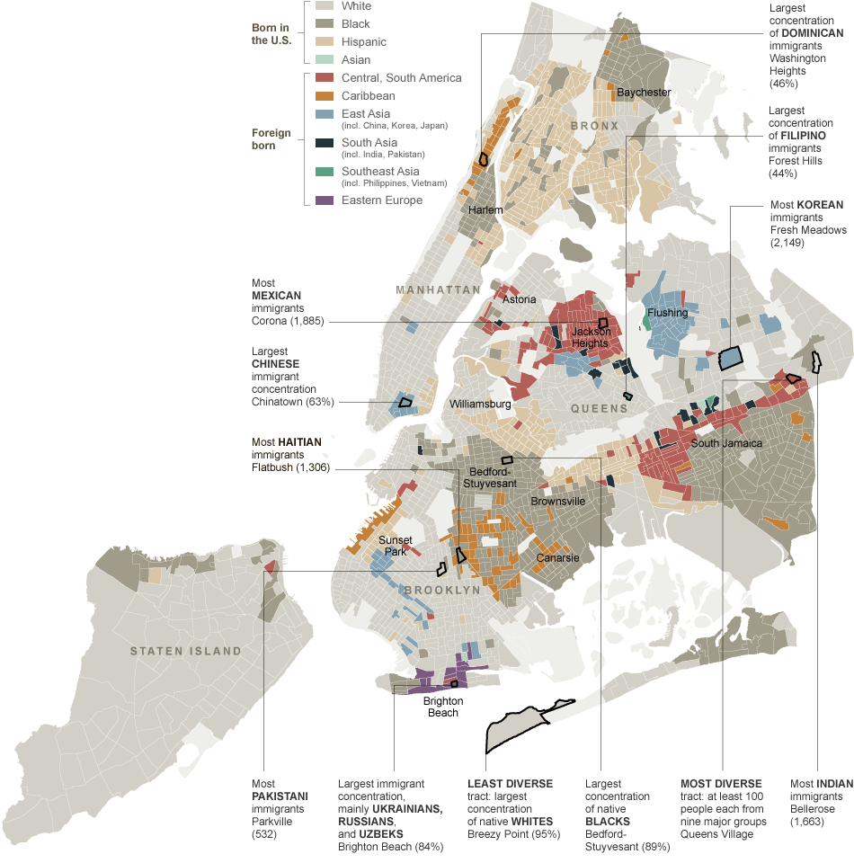
NYC Today
Ethnic Neighborhoods
Source:
New York Times

Slide 11
MUCKRAKERS
Muckrakers were journalists and photographers who exposed the abuses of wealth and power.
They felt it was their job to write and expose corruption in industry, cities and government.
Objectives: Create public outcry / Encourage Government Reforms

Slide 12
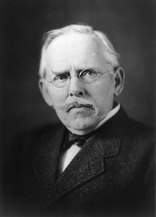
Jacob Riis
Photographer
How the Other Half Lives
  Documented living conditions in New York City’s tenements.
  Sweatshops
LINK:
http://www.authentichistory.com/1865-1897/progressive/riis/index.html

Slide 13


Slide 14
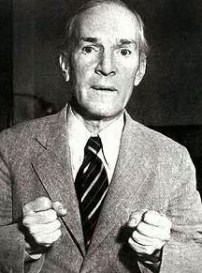
The Jungle
Chronicled abuses in Chicago’s meatpacking industry
THESIS:
Gov. Regulation Needed
Upton Sinclair

Slide 15
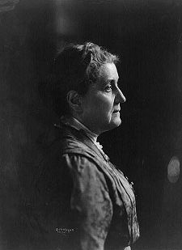
Jane Addams
“Settlement House” Movement
Hull House
  Chicago, IL
Education, Job Training, Child Care, etc.
Social and economic opportunities for the working class
Jane Addams

Slide 16



