Slide 1
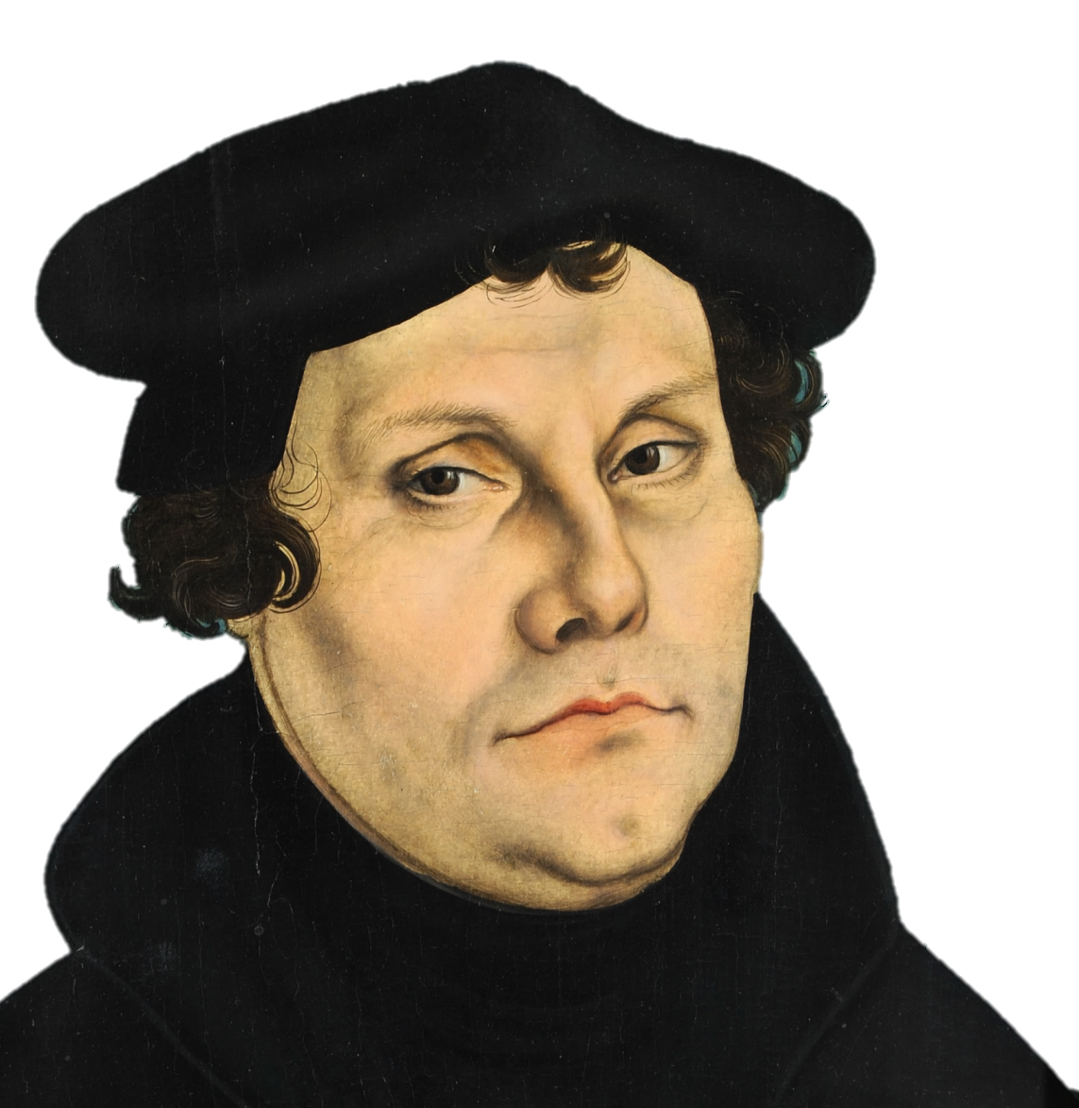
Martin Luther
and the Origins of the Reformation

Slide 2
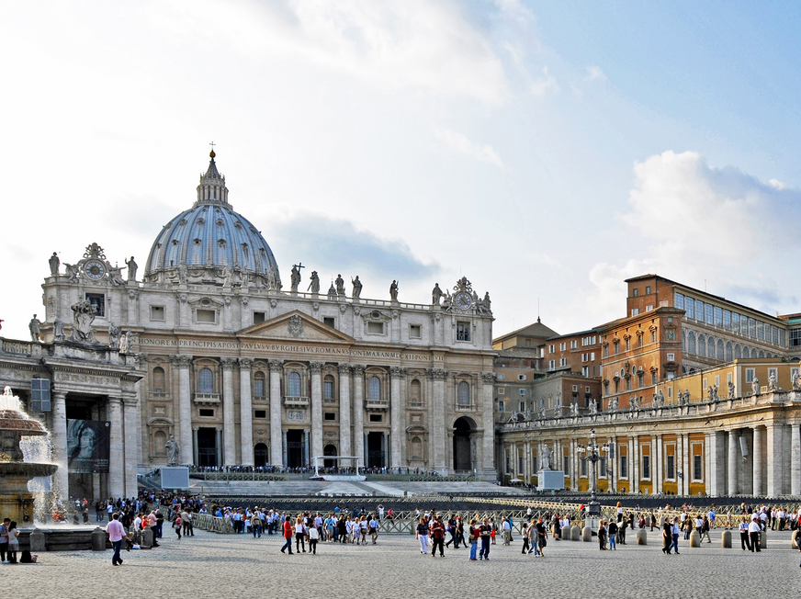
St. Peter’s Basilica
Vatican City,
Rome
Photo by Dennis Jarvis

Slide 3
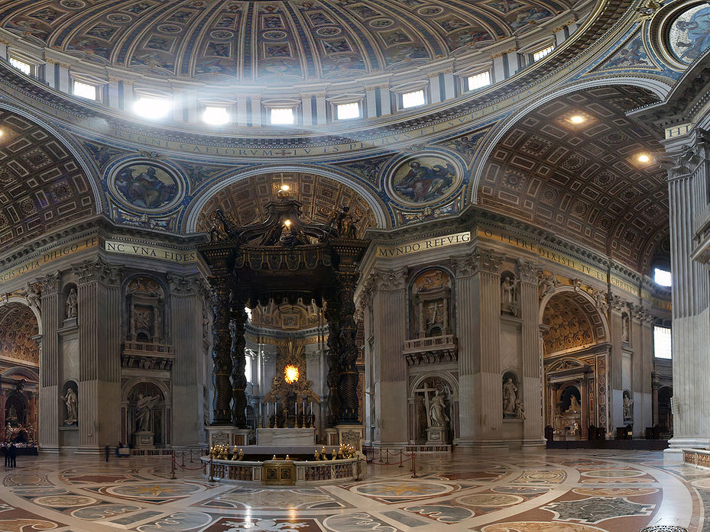
This was not cheap.
Photo by Patrick Landy

Slide 4
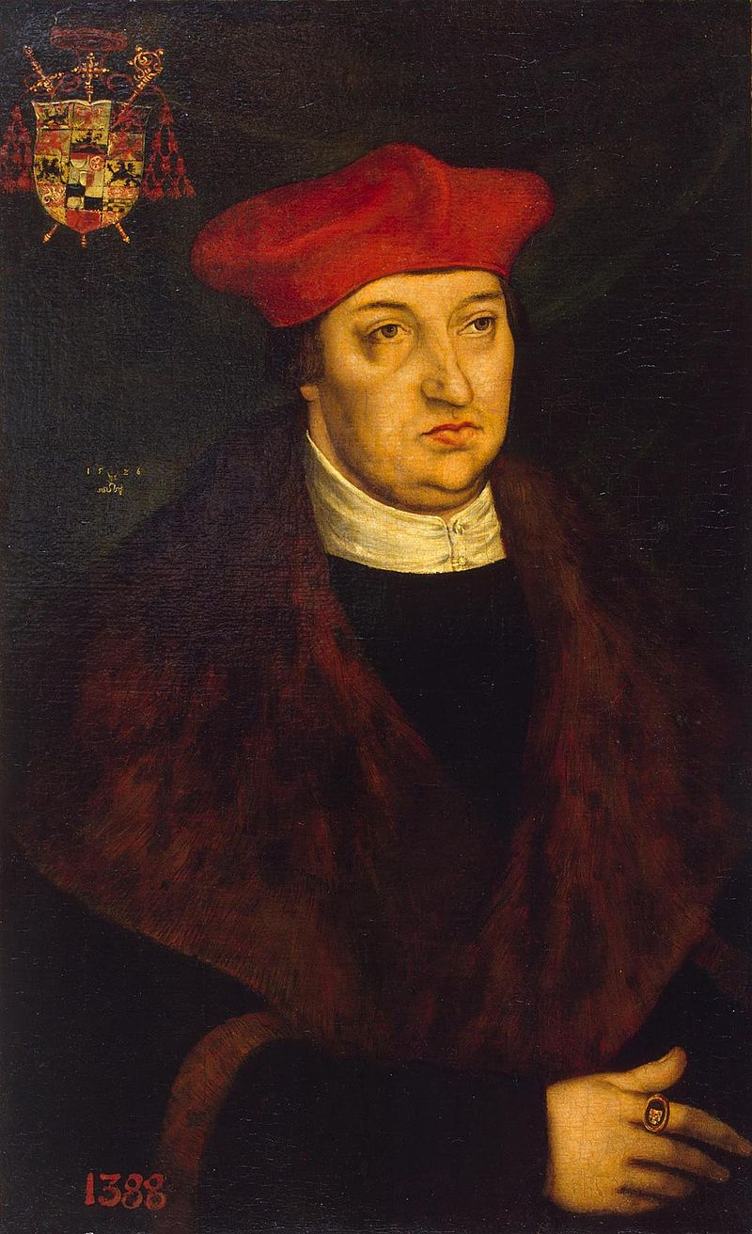
Albrecht von Brandenburg
Archbishop of Mainz & Magdeberg
Purchased Office

Slide 5
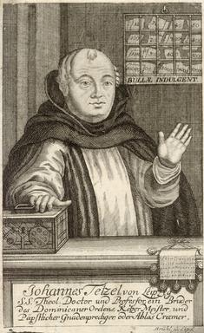
Johann Tetzel
SALE OF INDULGENCES
$$$
Tetzel

Slide 6
Purgatory
Imagine a
Waiting Room
for heaven
(a very painful waiting room)
Image of a fiery purgatory in the Très Riches Heures du Duc de Berry
Notes:
According to the Catechism of the Catholic Church, “Purgatory is the state of those who die in God’s friendship, assured of their eternal salvation, but who still have need of purification to enter into the happiness of heaven.”

Slide 7
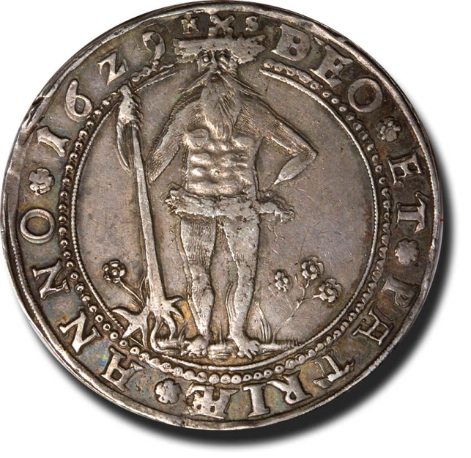
"As soon as a coin in the coffer rings...
“A soul from Purgatory springs.”

Slide 8
Martin Luther
German Monk & Theologian

Slide 9
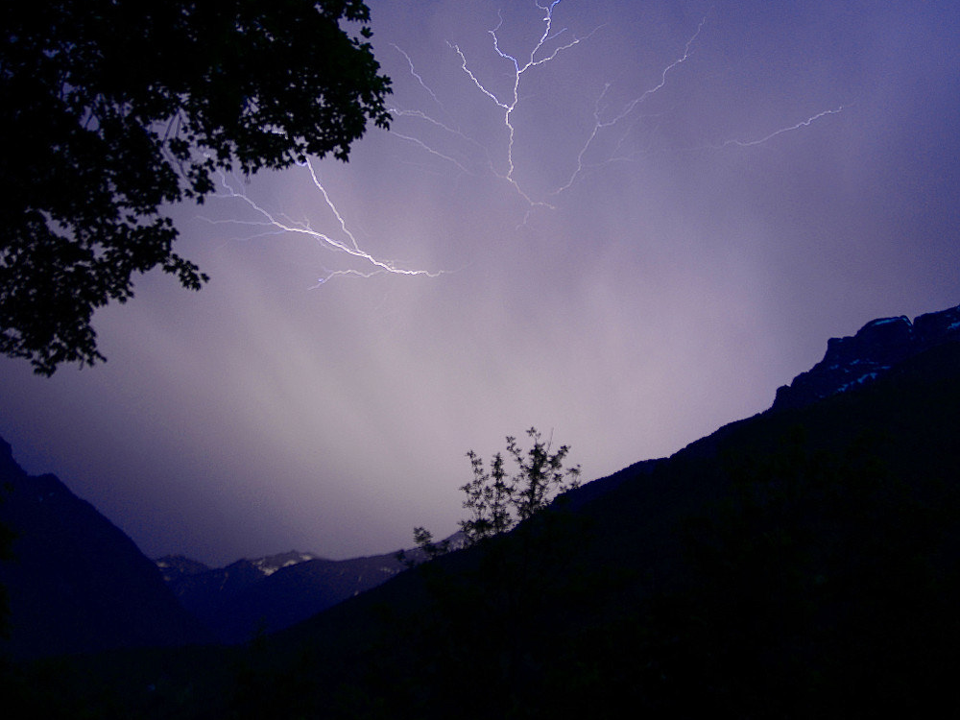
Conversion
Photo by Alexander Boden

Slide 10
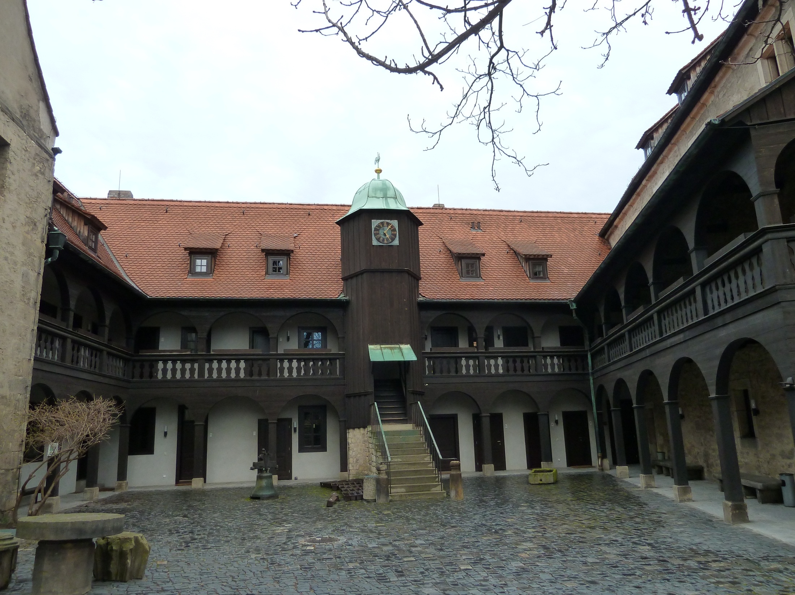
Augustinian Monastery
Erfurt, Germany
Photos courtesy of Caleb Heavner (TCTC 2012)

Slide 11
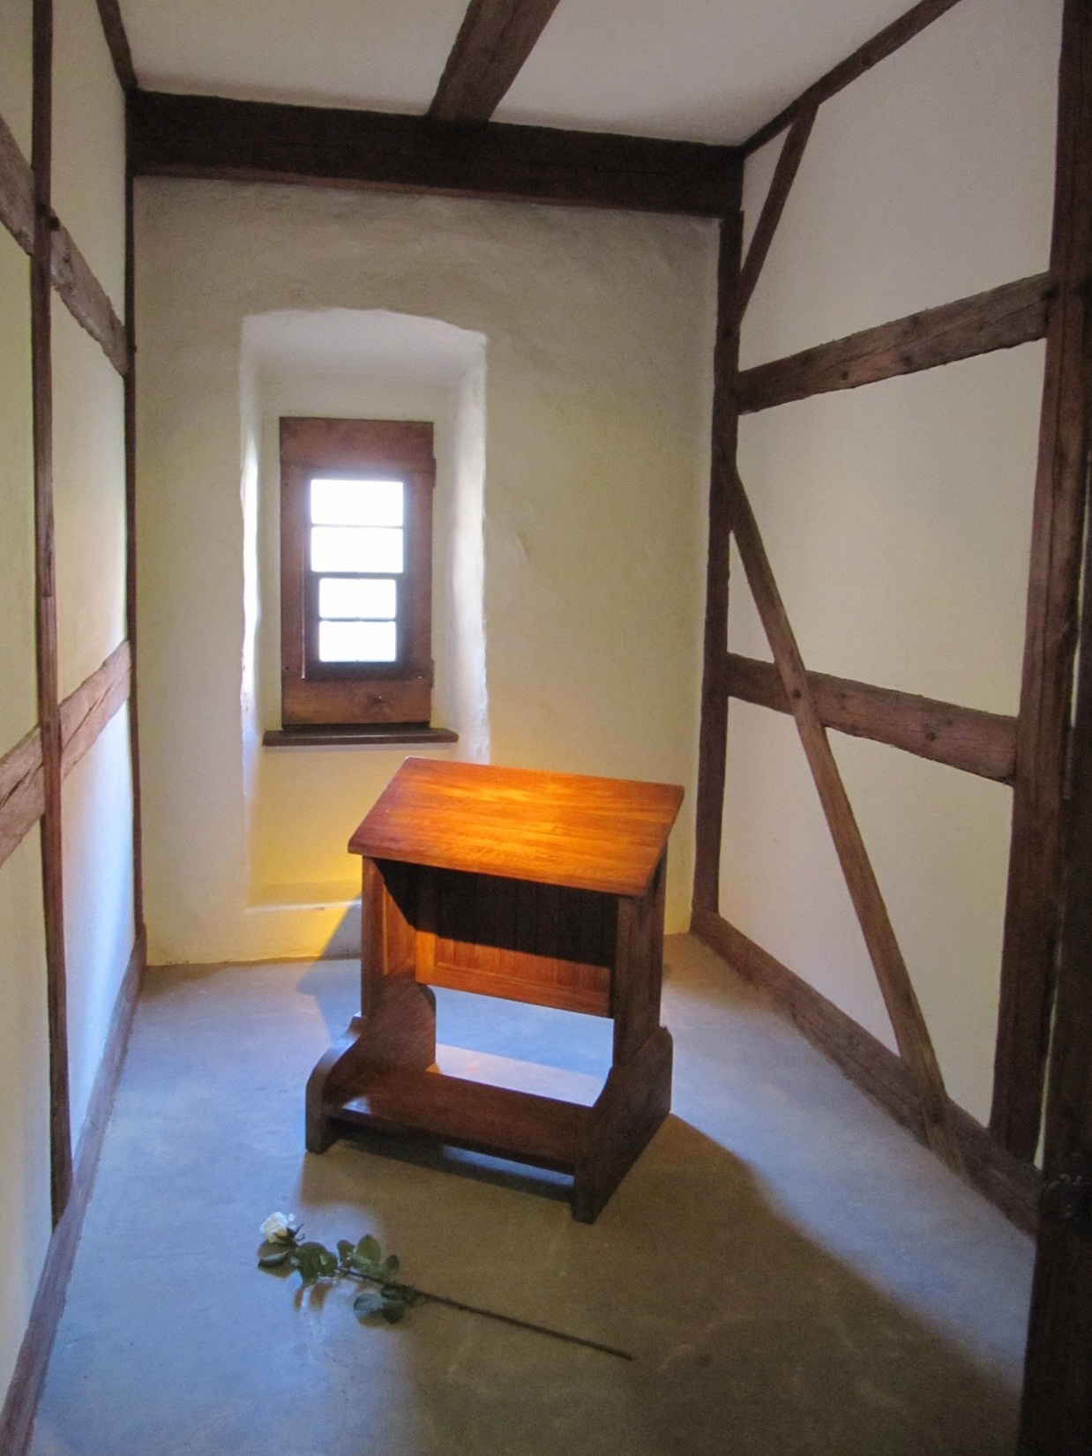
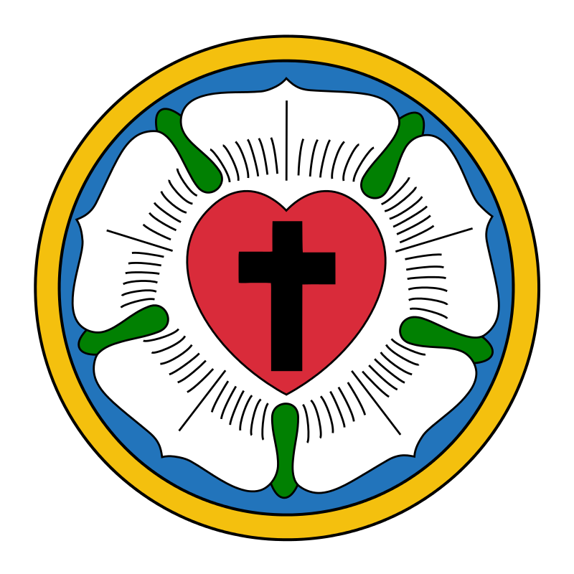
A Monk’s Cell
Photos courtesy of Caleb Heavner
Art by Jed

Slide 12
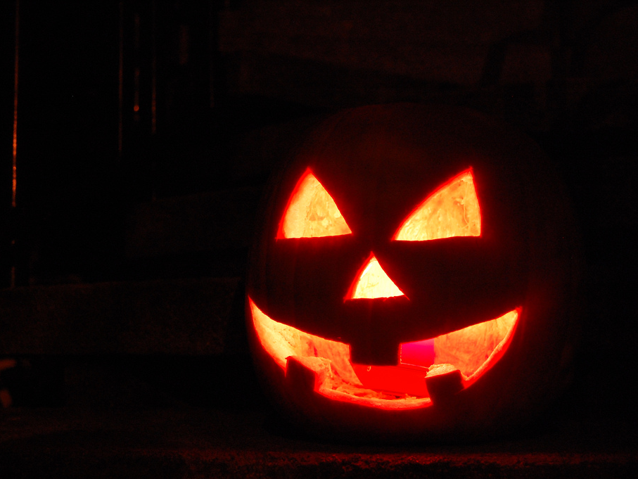
All Hallows' Eve
1517
Photo by Andrea

Slide 13
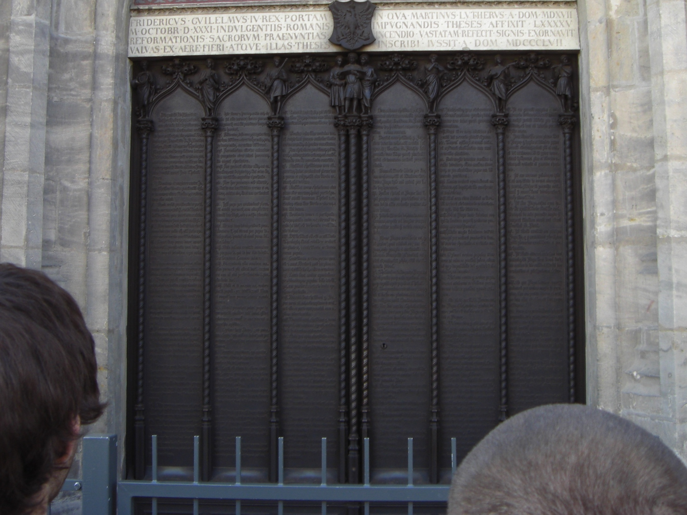
95 Theses
All Saints’ Church
Wittenberg
View Document
Photos courtesy of Caleb Heavner (TCTC 2012)

Slide 14
In addition to criticizing the sale of indulgences, Luther’s theses assailed established Catholic doctrines about papal authority.
View Document
Photos courtesy of Caleb Heavner (TCTC 2012)

Slide 15
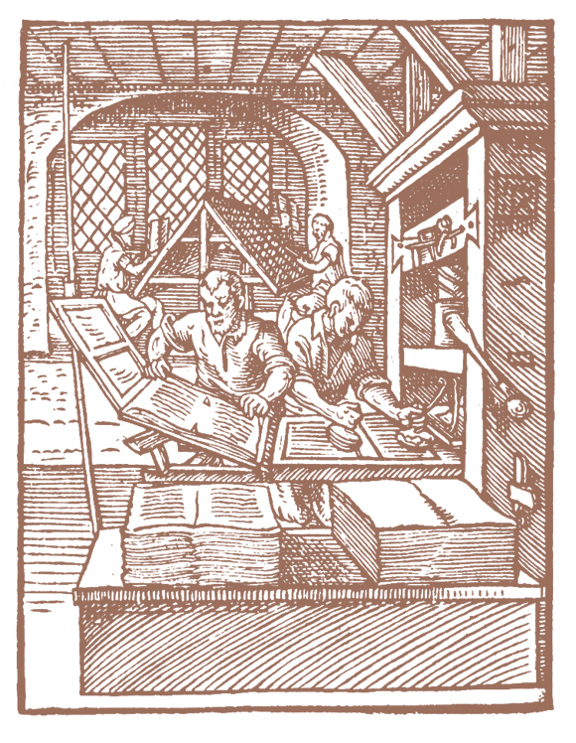
Printing Press
Luther’s writings circulated throughout Europe thanks to the recent invention of the Printing Press.

Slide 16
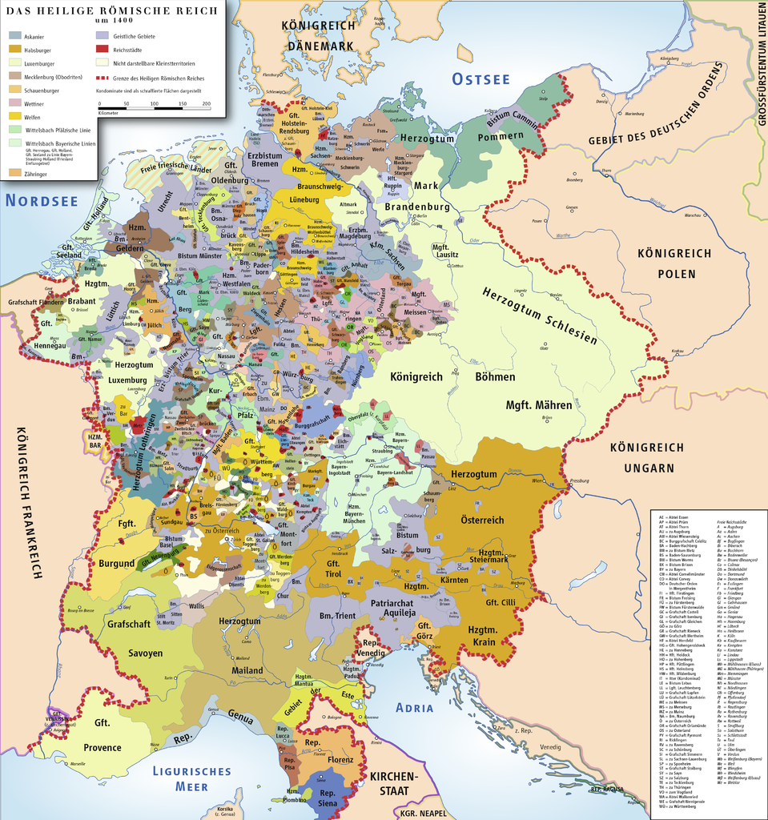
Holy Roman Empire
An association of German principalities
Map by Ziegelbrenner

Slide 17
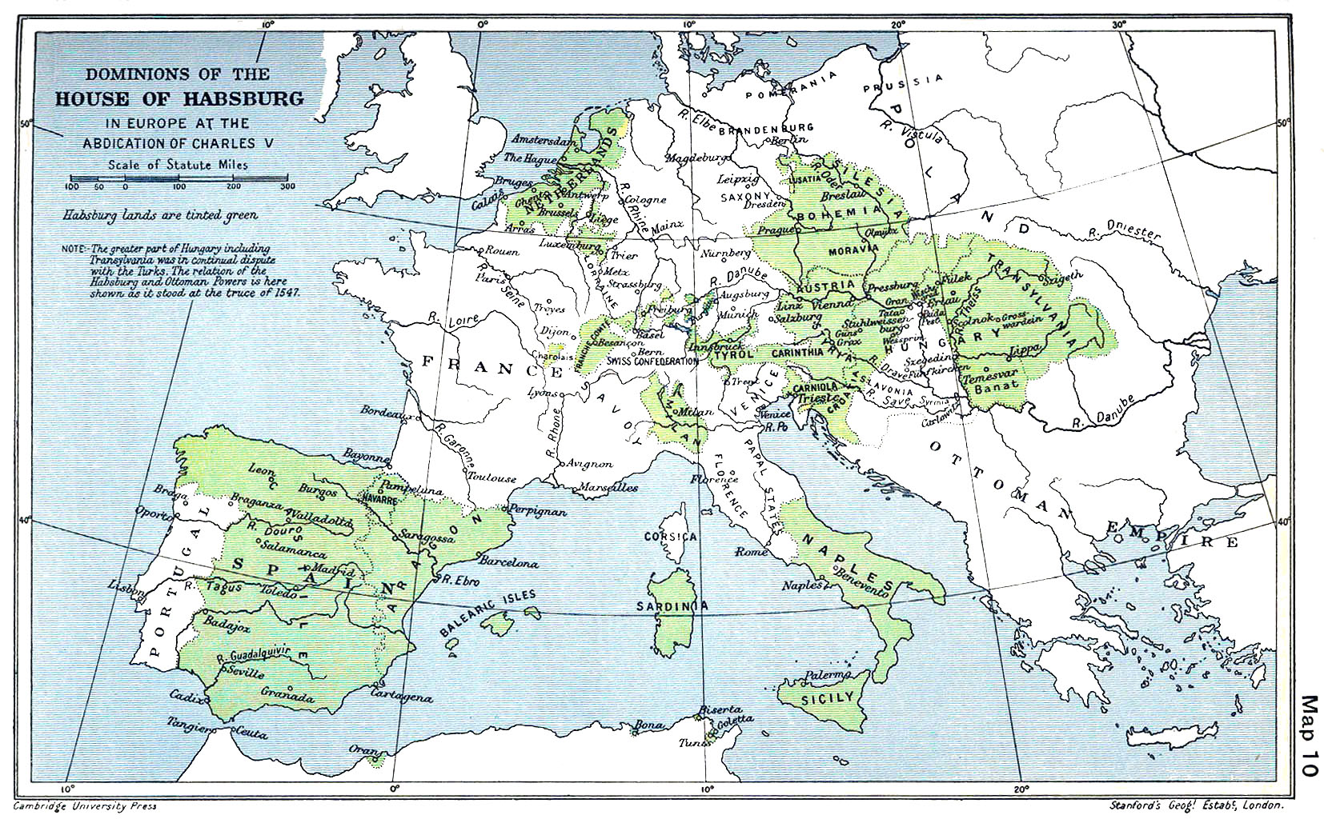
House of Habsburg
or Hapsburg

Slide 18
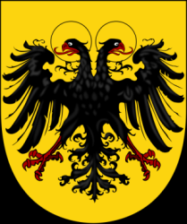
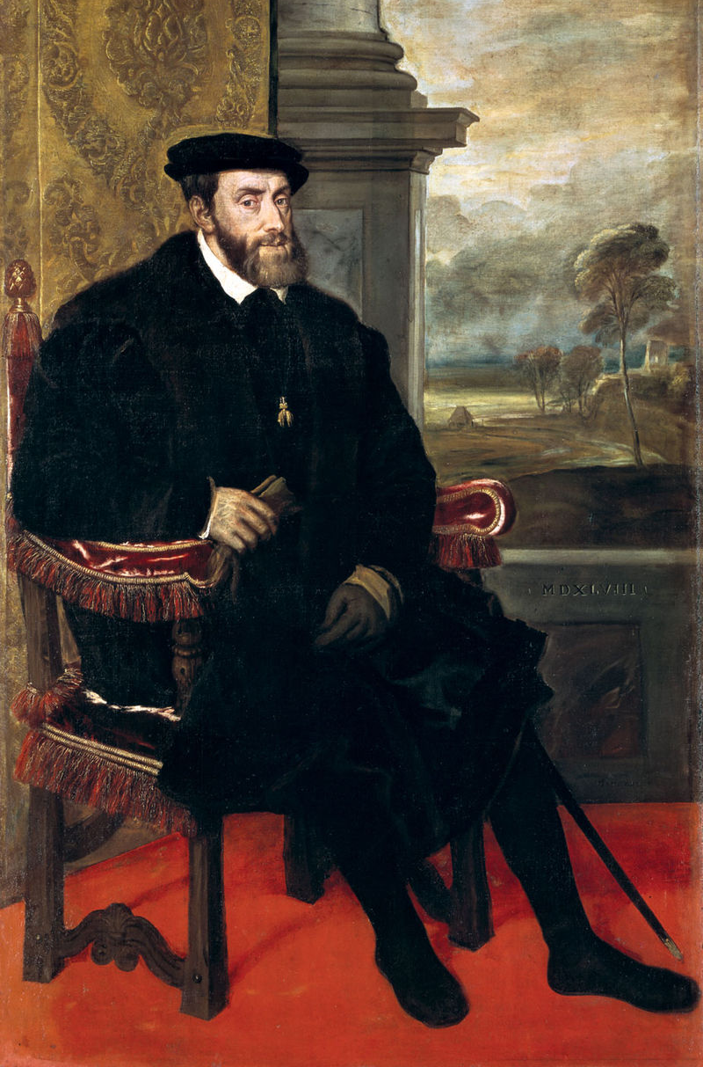
Charles V
Habsburg Dynasty
King of Spain
Holy Roman Emperor
Archduke of Austria
Duke of Burgundy
Devout Catholic
Titian, Charles V (1548)

Slide 19
That CHIN, tho!

Slide 20
The Politics of Reformation
Diet of Worms (1521)
German Peasants’ War (1524-1525)
Peace of Augsburg (1555)

Slide 21
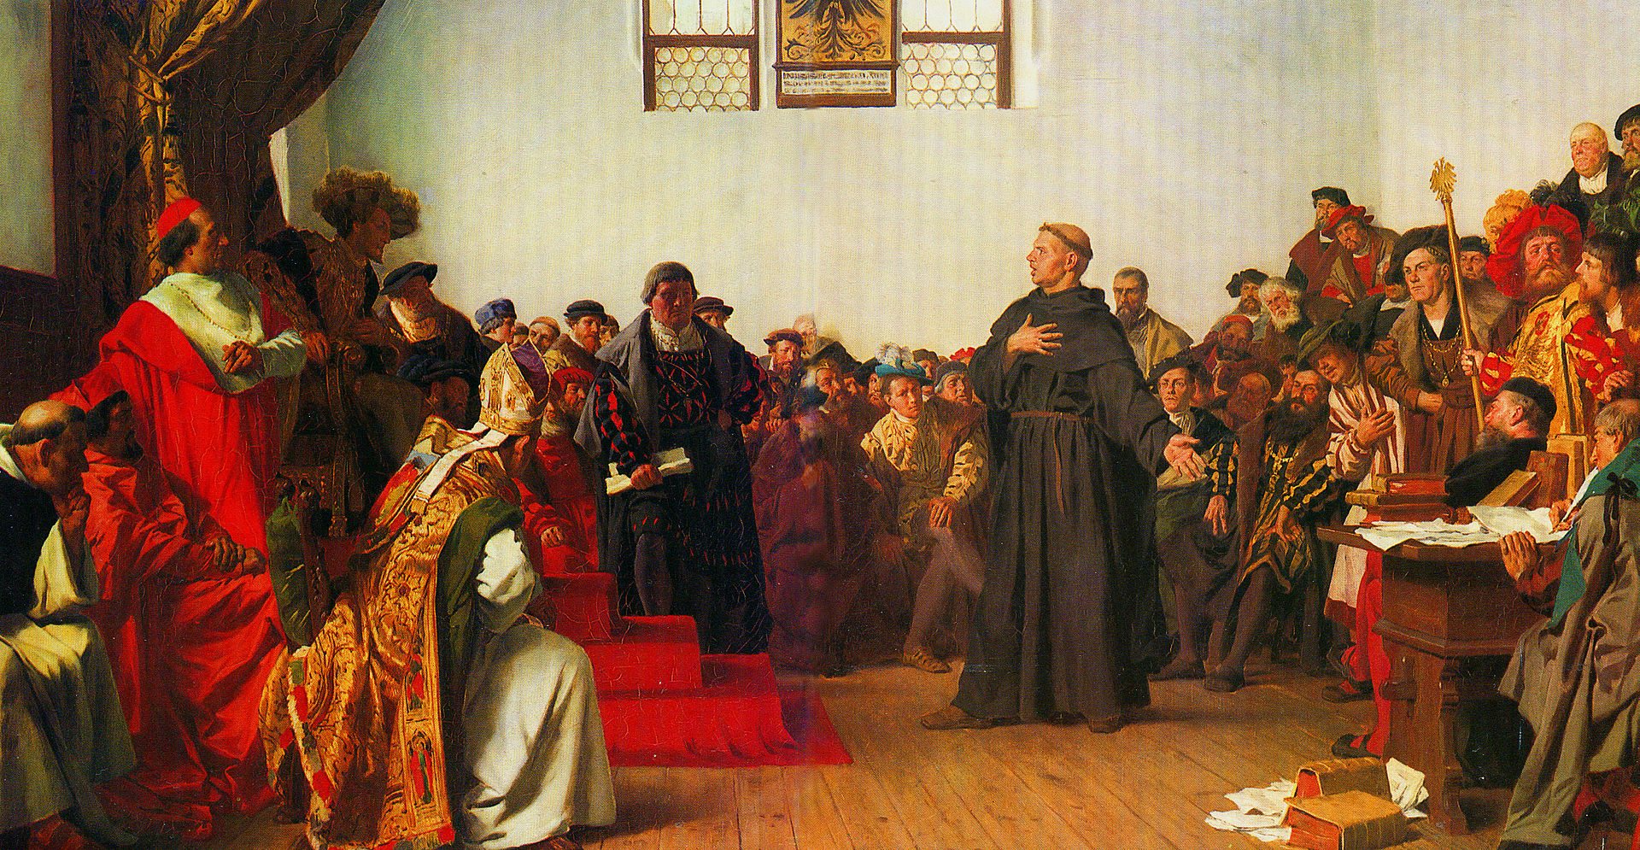
Diet of Worms
(1521)
Luther defends his doctrines before Emperor Charles V.

Slide 22
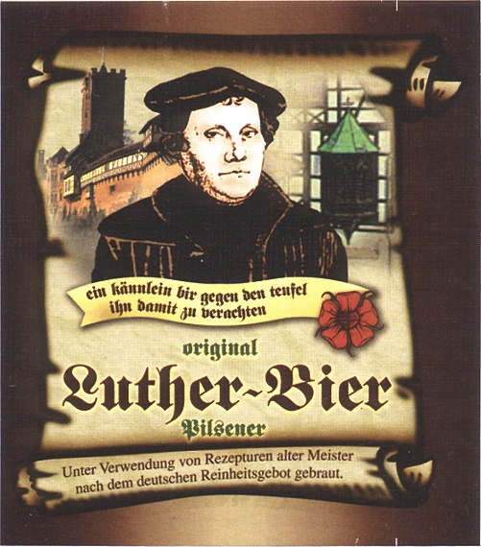

Slide 23
Diet of Worms
(1521)
OUTLAWED

Slide 24
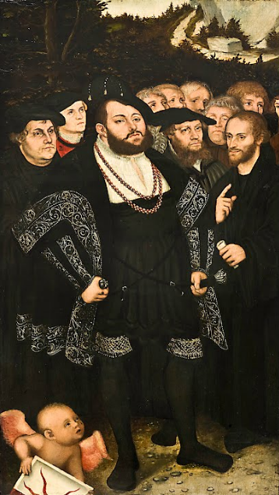
Frederick of Saxony
Luther relied on his patron, Frederick, Elector of Saxony, for protection from his enemies.
Lucas Cranach the Younger Luther and the Wittenberg Reformers

Slide 25
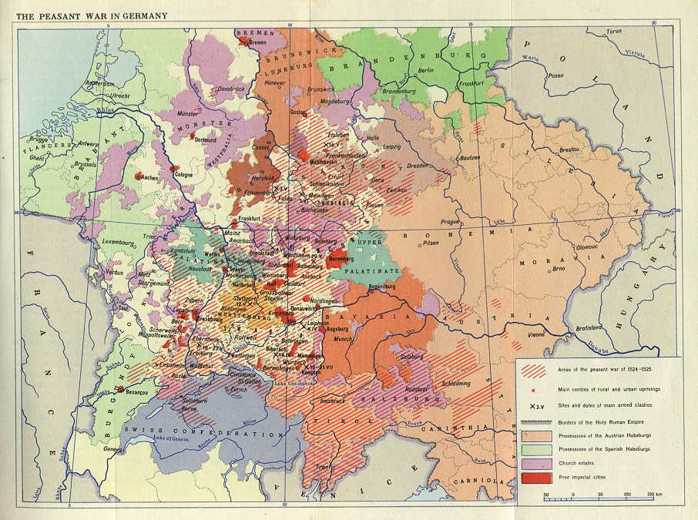
German Peasants’ War
(1524-1525)
Over 100,000 KILLED

Slide 26
Against the Peasants
Martin Luther condemned the peasants’ revolt.

Slide 27
Peace of Augsburg (1555)
Religion Determined by Local Ruler
Cuius regio, eius religio
Whoever reigns, his religion
Catholic OR Lutheran

Slide 28
Peace of Augsburg
(1555)
Mostly Protestant
Northern rulers tended to choose Protestantism while Southern rulers tended to choose Catholicism.
Mostly Catholic
Map by Ziegelbrenner

