Slide 1
The Rebirth of Classicism

Slide 2
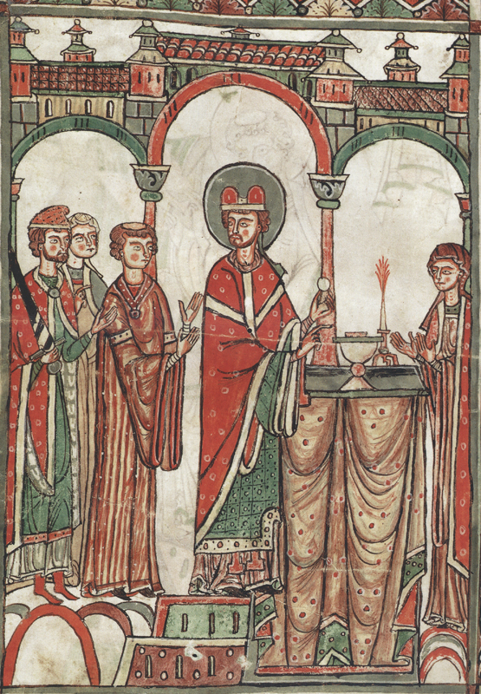
Western Europe

Slide 3
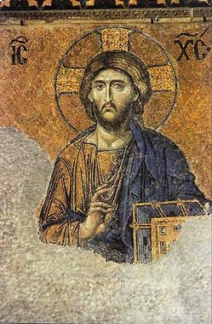
Eastern Europe
Deësis Mosaic (Hagia Sophia)

Slide 4
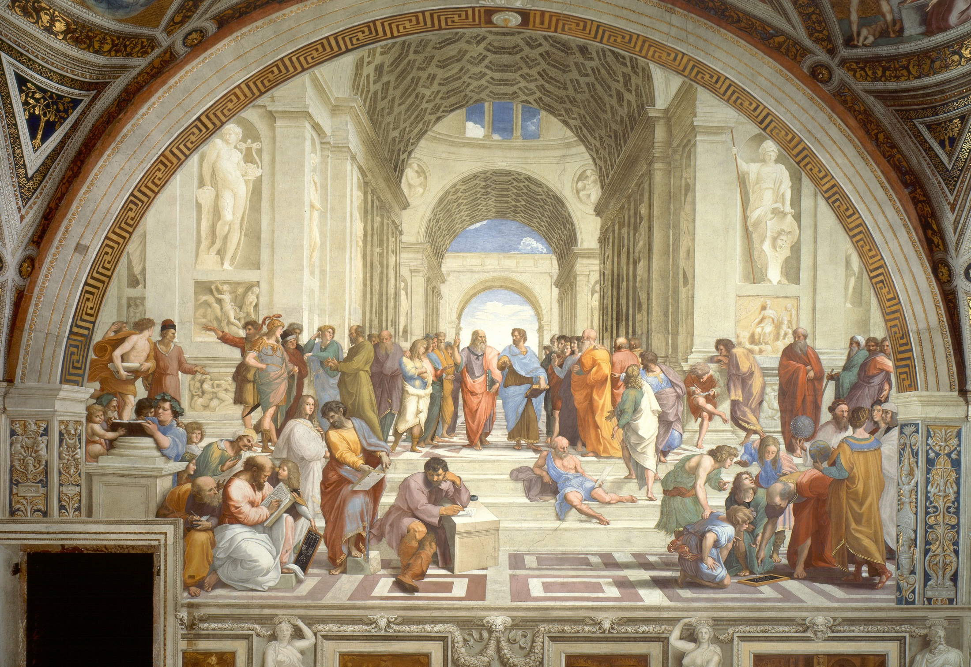
Raphael, The School of Athens (1511)

Slide 5
Characteristics of Renaissance Art
Vivid, Bright Colors
Perspective
Depth, Realism
Balance
Classical Themes
Greek, Roman, & Biblical figures predominate

Slide 6
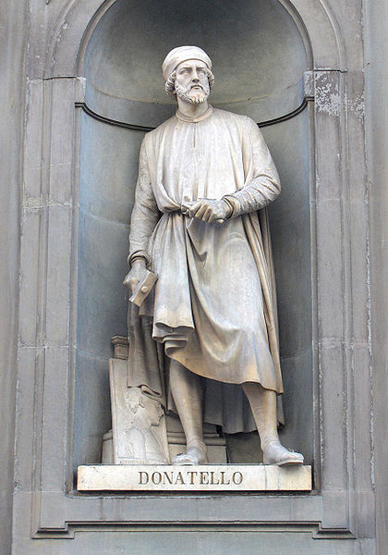
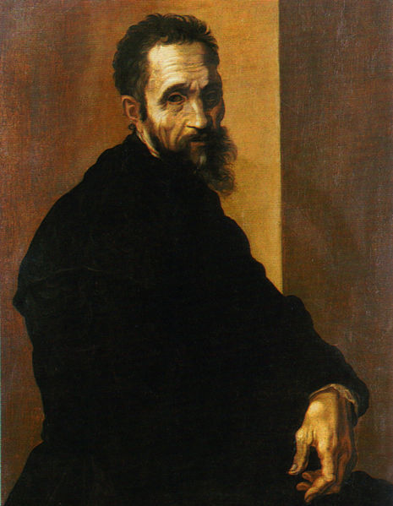
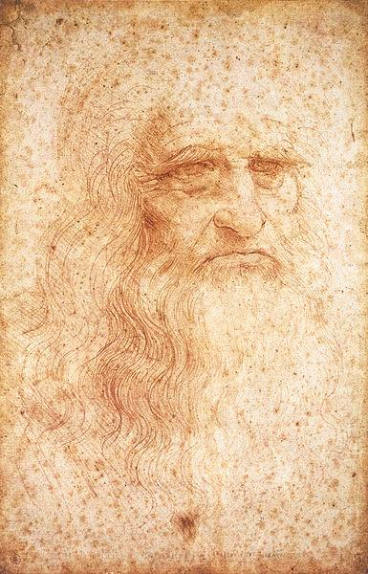
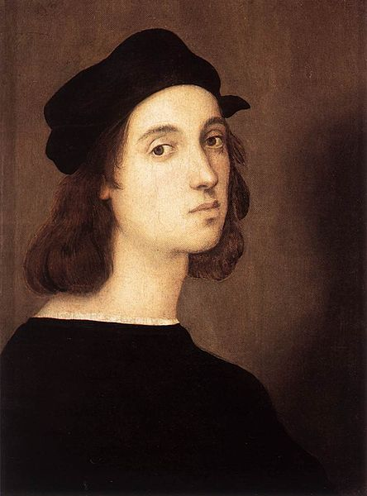
The Masters
of the Italian Renaissance

Slide 7
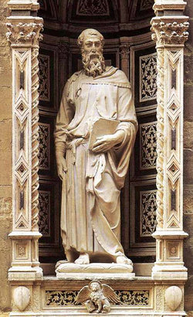
Donatello, St. Mark (1413)

Slide 8
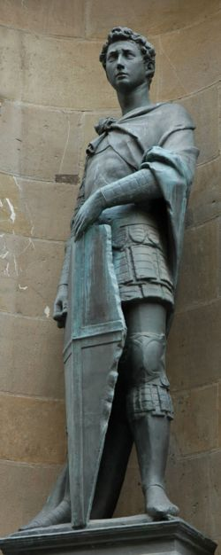
Donatello, St. George (1417)

Slide 9
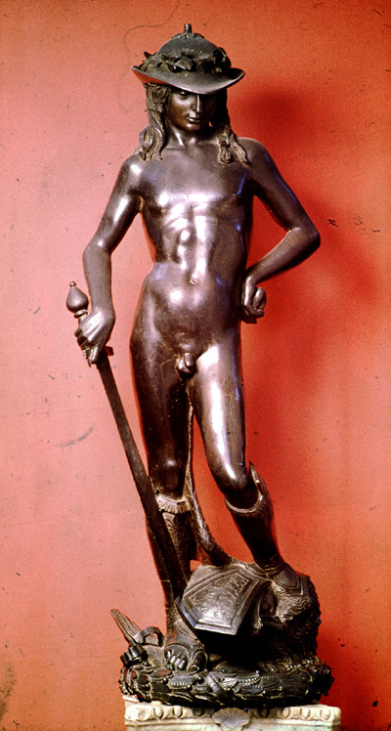
Donatello, David (1430)
Donatello’s David was the first free-standing nude statue since the classical period.
Compare to Michelangelo’s David

Slide 10
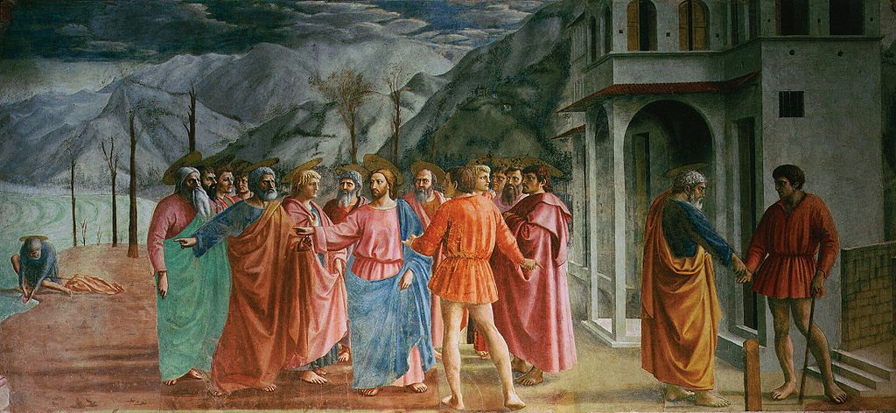
Note the use of chiaroscuro.
Masaccio, The Tribute Money (c. 1420)

Slide 11
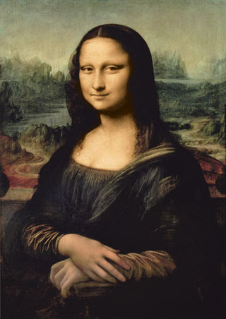
Leonardo da Vinci, Mona Lisa (c. 1503-1519)

Slide 12
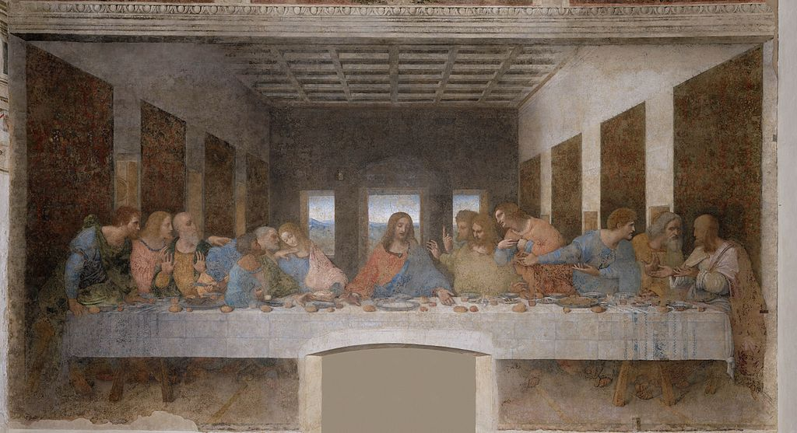
Leonardo da Vinci, The Last Supper (1498)

Slide 13
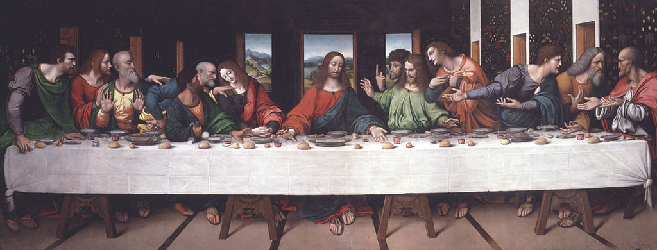
Giampietrino, The Last Supper (c. 1520)

Slide 14
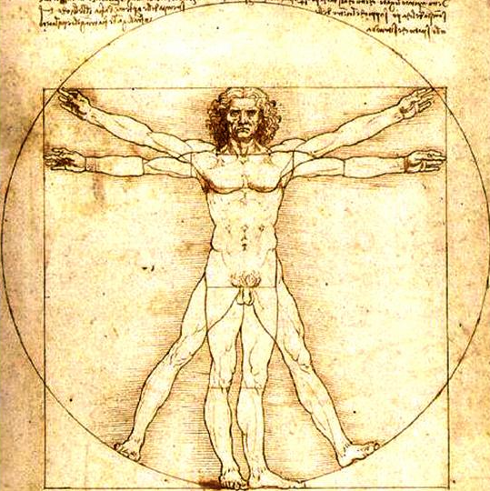
Leonardo Da Vinci, Vitruvian Man (1487)

Slide 15
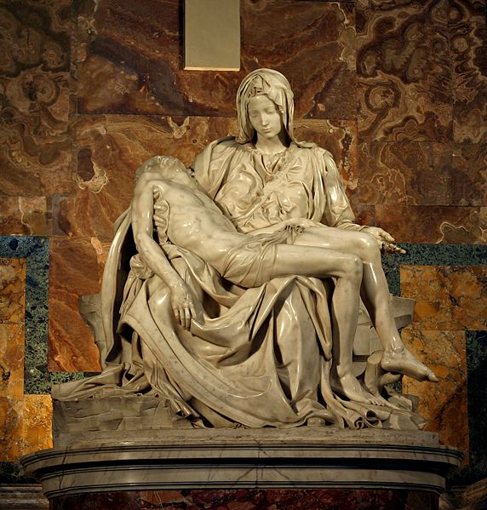
Michelangelo, Pieta (1499)

Slide 16
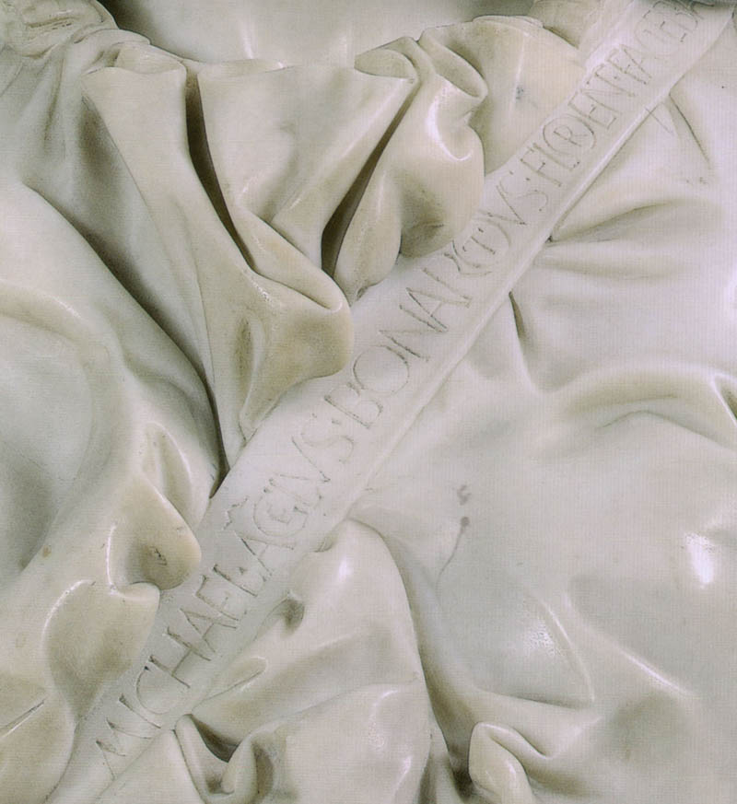
The Pride of the Artist
Michael. Agelus. Bonarotus Florent Faciebat

Slide 17
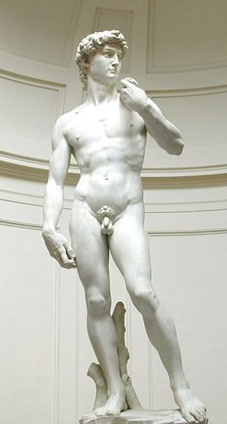
Michelangelo, David (1504)
Note David’s contrapposto stance, a common feature of Greco-Roman sculpture
Compare to Donatello’s David

Slide 18
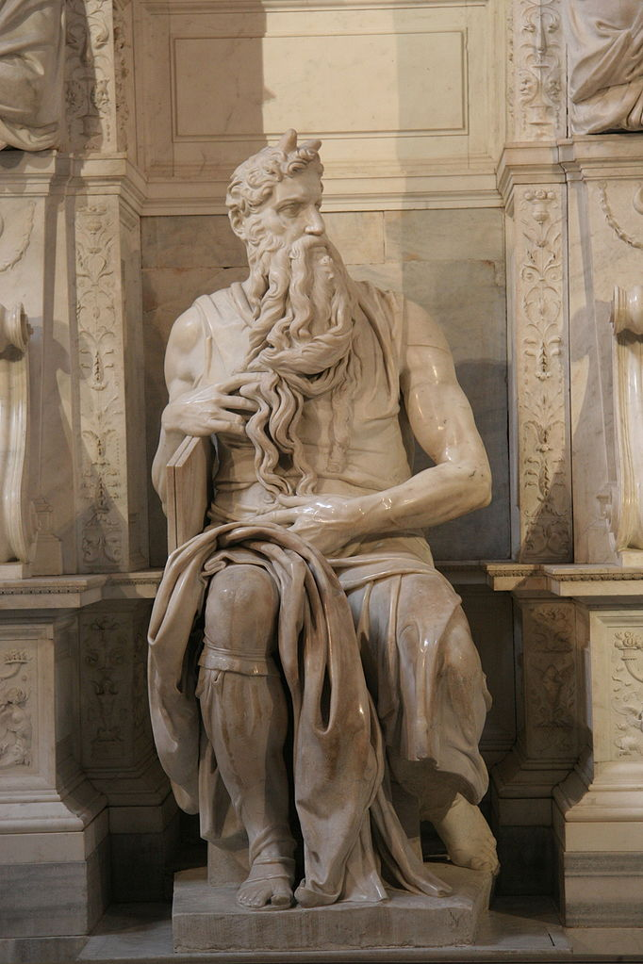
Michelangelo, Moses (1515)

Slide 19
Moses was commonly pictured with horns during the Middle Ages because of a mistranslation in the Latin Vulgate
Photo by Prasenberg

Slide 20
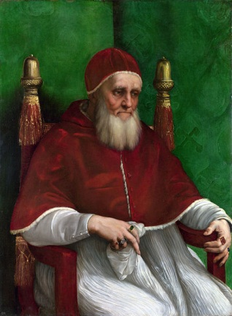
Patronage
The Moses statue was commissioned by Pope Julius II, an enthusiastic patron of the arts.

Slide 21
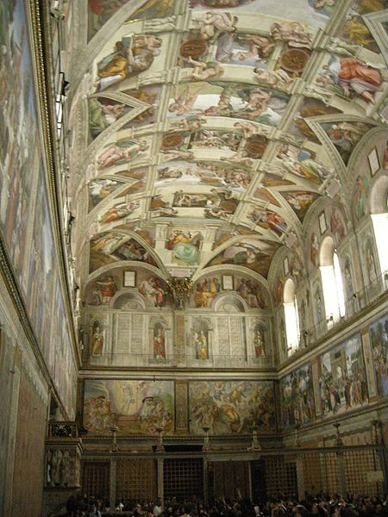
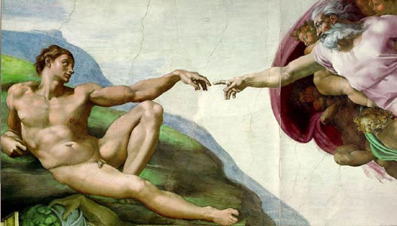
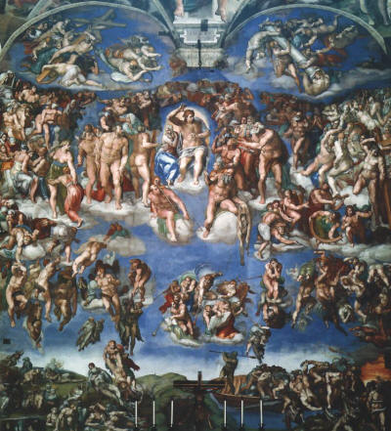
Sistine Chapel (Vatican City, Rome)

Slide 22
Michelangelo, The Creation of Adam (1511)

Slide 23
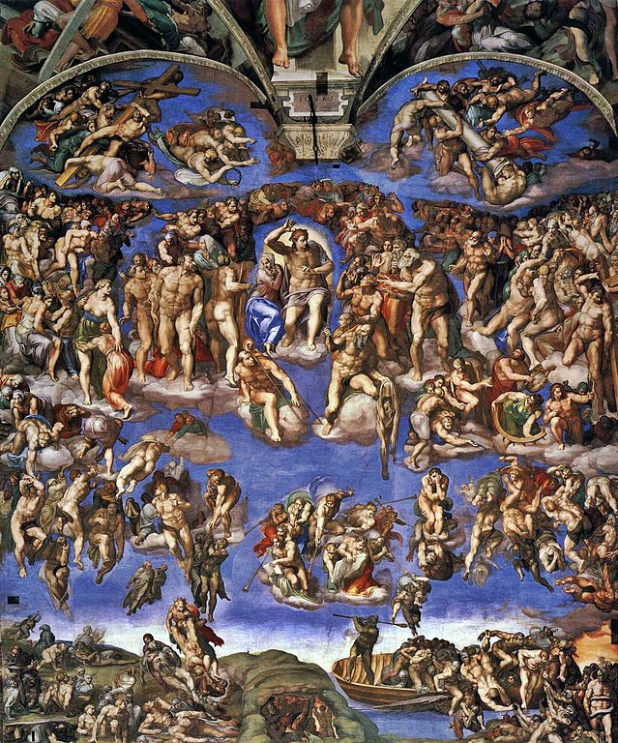
Michelangelo, Last Judgment (1541)

Slide 24
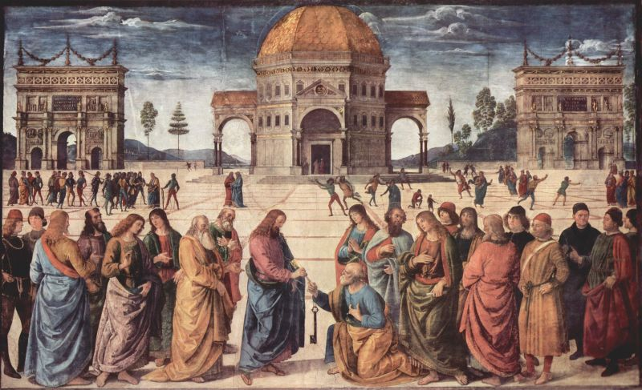
Pietro Perugino, The Delivery of the Keys, (c. 1482)

Slide 25
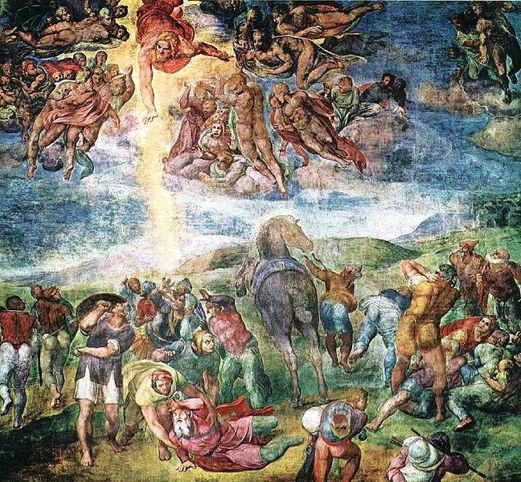
Michelangelo, The Conversion of Saul (1545)

Slide 26
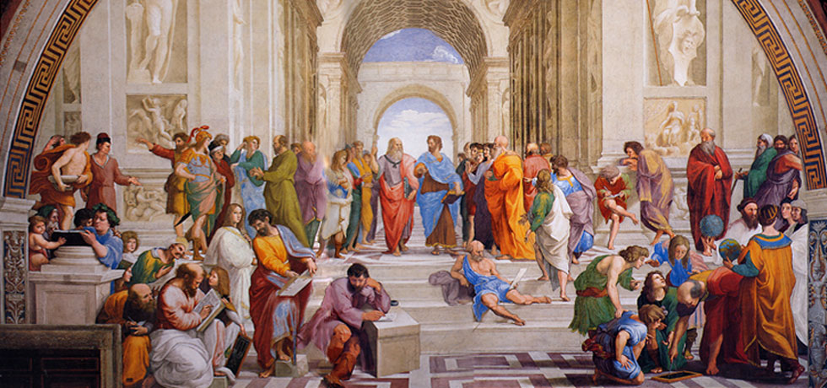
Raphael, The School of Athens, (1510)
ID the Figures

Slide 27
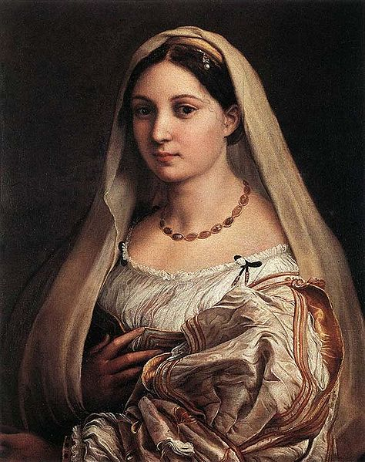
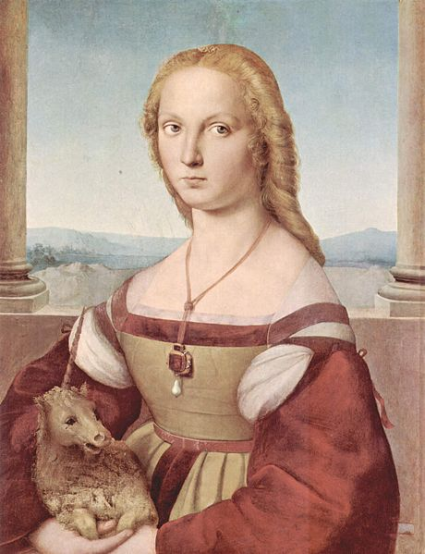
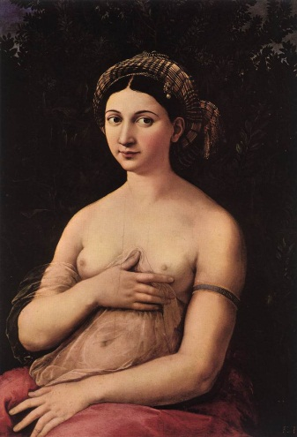
Paint a picture… It’ll last longer.
Raphael painted several portraits of females during his brief career.
Raphael

Slide 28
Raphael, La fornarina (1520)

Slide 29
Raphael, La velata (1515)

Slide 30
Raphael, Young Woman with Unicorn (c. 1506)

Slide 31
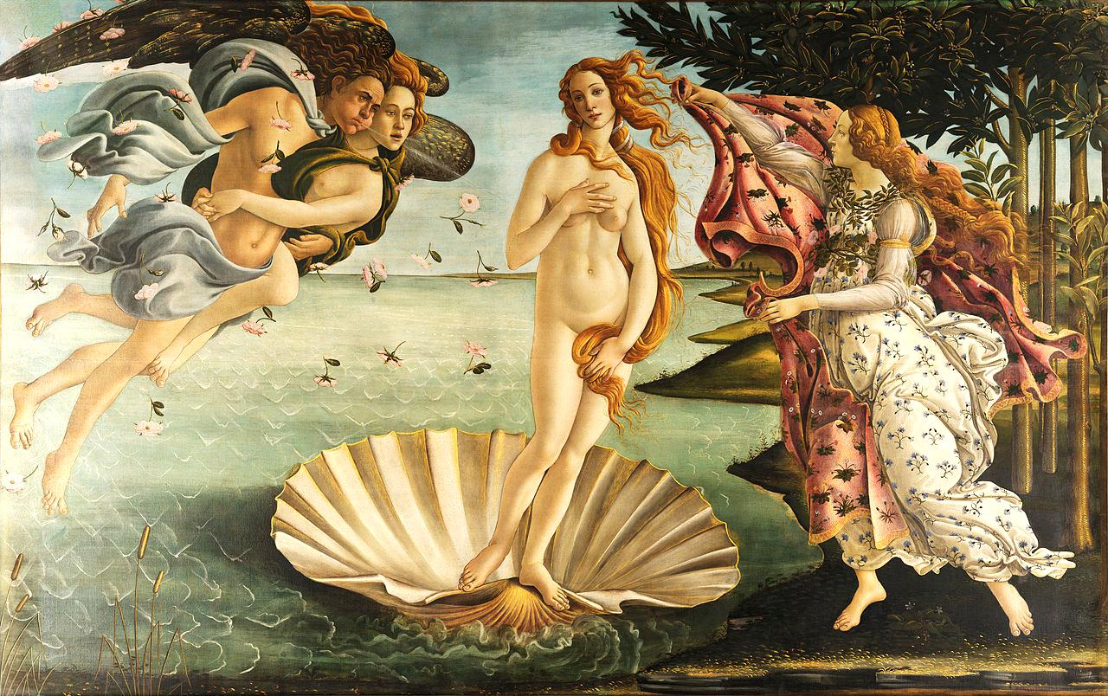
Sandro Botticelli, The Birth of Venus (1486)

Slide 32
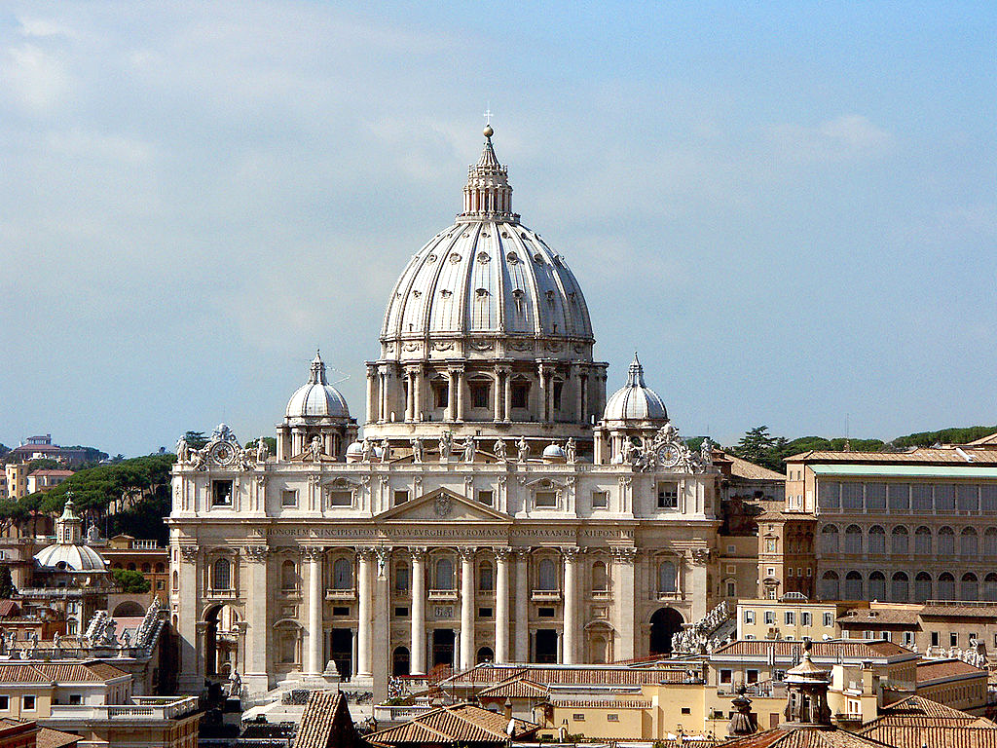
Renaissance Architecture
CLASSICAL
Symmetry
Proportion
Domes
Columns
St. Peter’s Basilica (Vatican City)

Slide 33
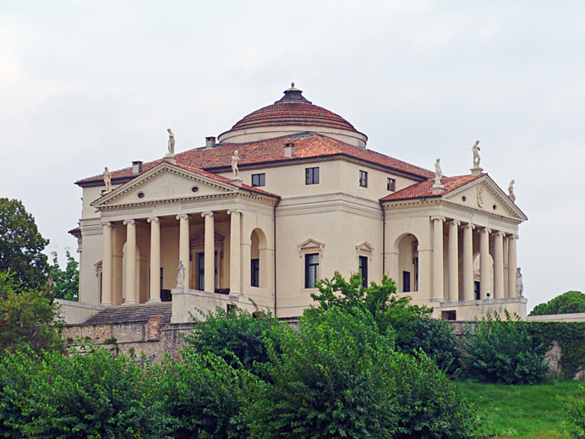
Renaissance Architecture
Villa Capra "La Rotonda" in Vicenza.

Slide 34
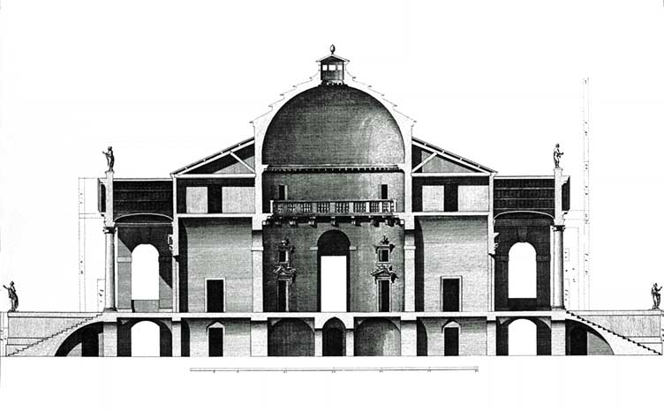

Slide 35
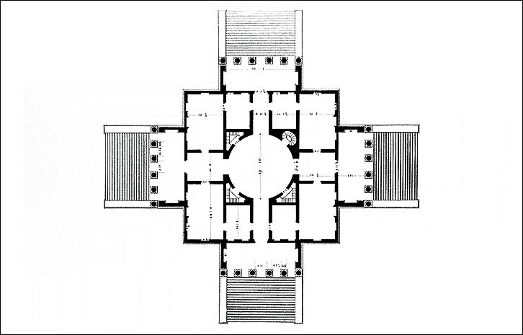

Slide 36
REVIEW

Slide 37
Characteristics of Renaissance Art
Vivid, Bright Colors
Perspective
Depth, Realism
Balance
Classical Themes
Greek, Roman, & Biblical figures predominate

Slide 38
Renaissance Architecture
CLASSICAL
Symmetry
Proportion
Domes
Columns
St. Peter’s Basilica (Vatican City)

