Slide 1
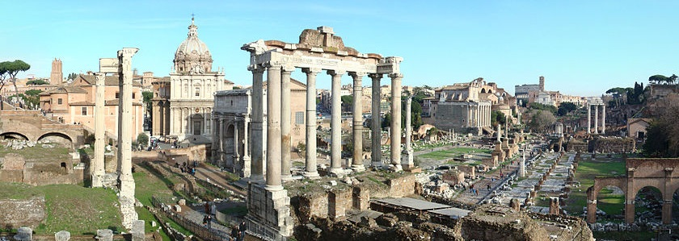
The Relevance of the Romans
Roman Influences on Western Culture
Notes:
Color Palette: http://www.colourlovers.com/palette/711624/Julius_Ceasar

Slide 2
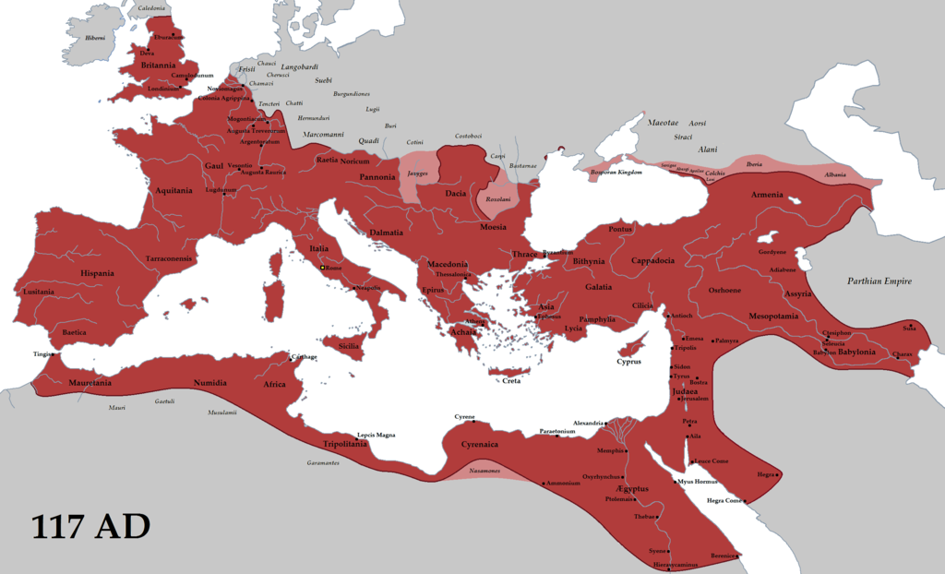
The Roman Empire
Map Credit: Tataryn77

Slide 3
The Roman Empire
A Long Time Ago…
Map Credit: Tataryn77

Slide 4
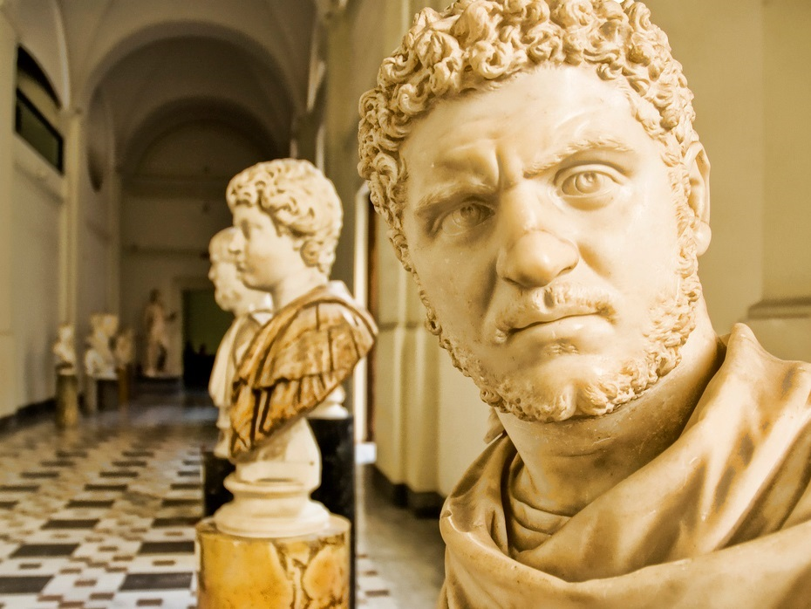
Why Should I care???
Photo by Stuck in Customs

Slide 5
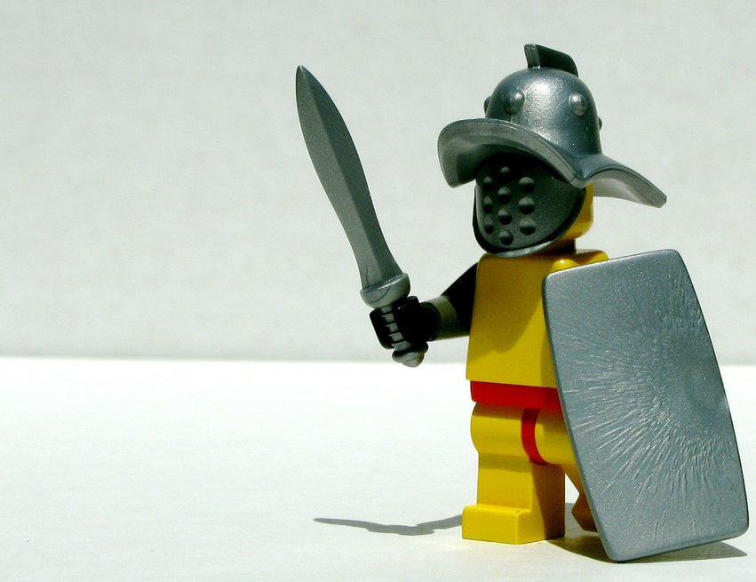
Because we should A L L C A R E!
By Dunechaser

Slide 6
Because we should A L L C A R E!
Alphabet
Language
Law
Calendar
Architecture
Religion
Entertainment
By Dunechaser

Slide 7
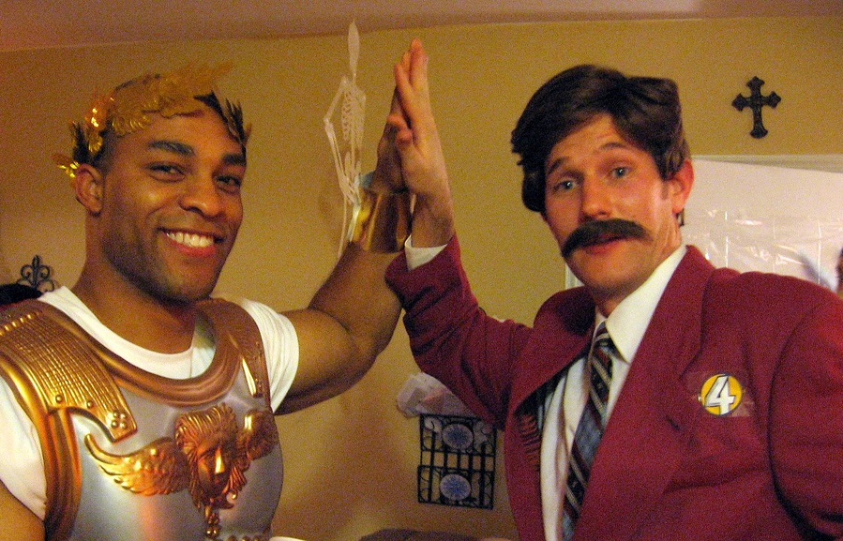
Ron Cares
When in Rome…
Photo by imnewtryme

Slide 8
The Latin Alphabet

Slide 9
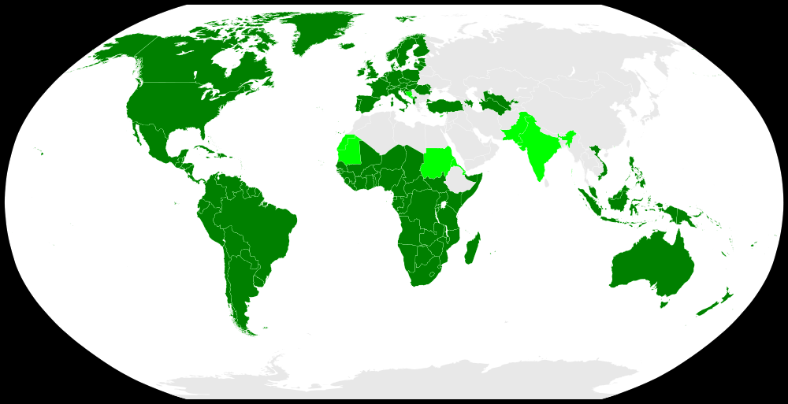
The Latin Alphabet Today
Official Script
Co-official Script
All Western (and westernized) nations use the Latin alphabet.

Slide 10
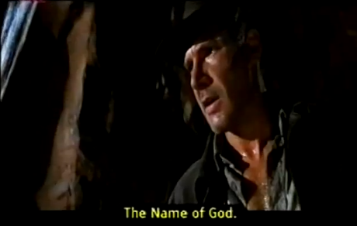
Classical Latin Alphabet
A B C D E F G H I K L M N O P Q R S T V X Y Z
Which letters are missing?

Slide 11
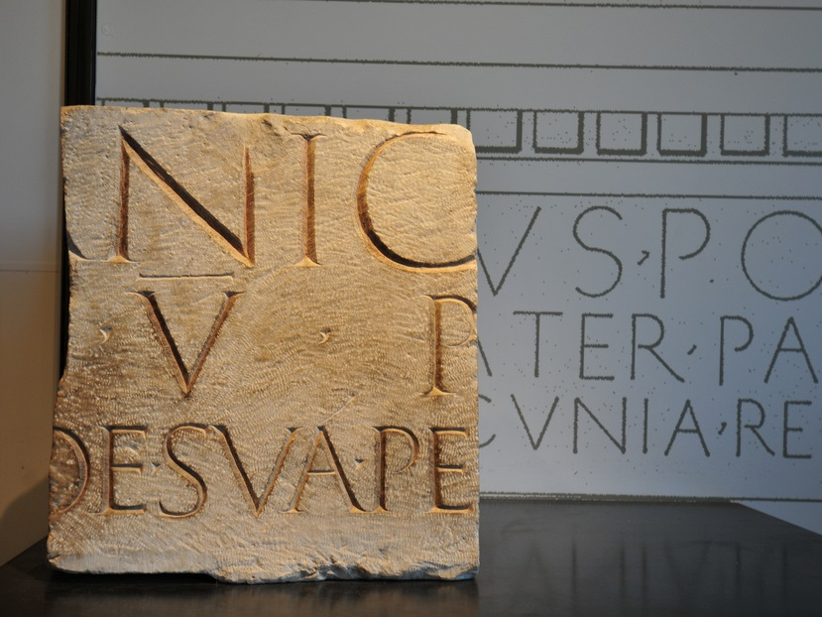
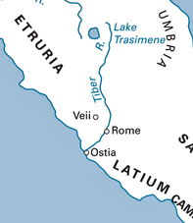
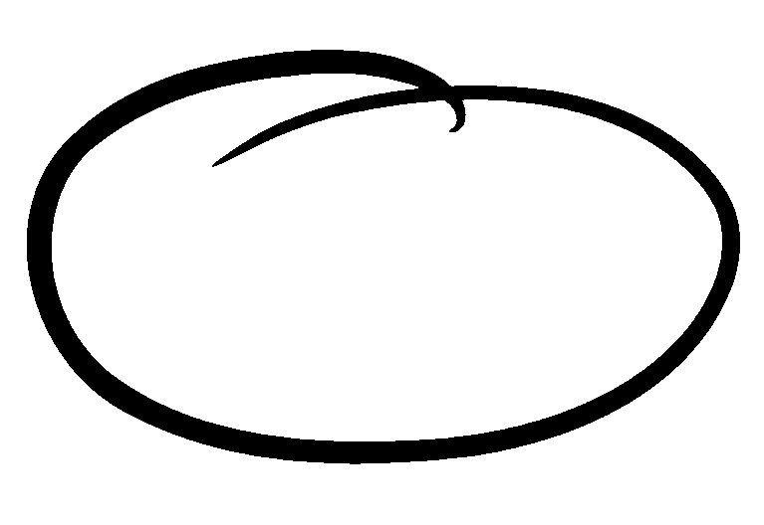
Language
LATIN
Photo by pjsugi
Notes:
RIGHTS TO PHOTO REQUEST (Pending)

Slide 12
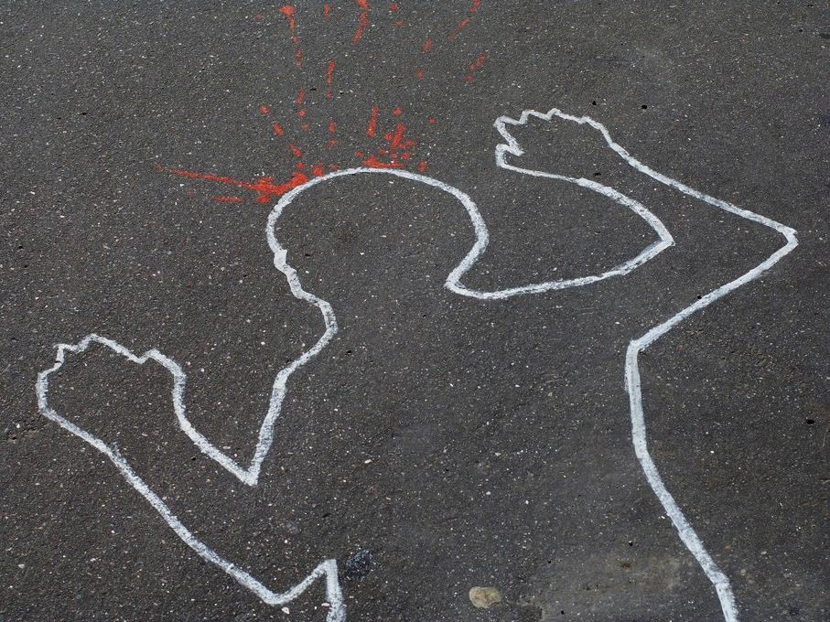
Latin is no longer spoken, but still influences many languages, including ours.
Photo by stickerHelsinki

Slide 13
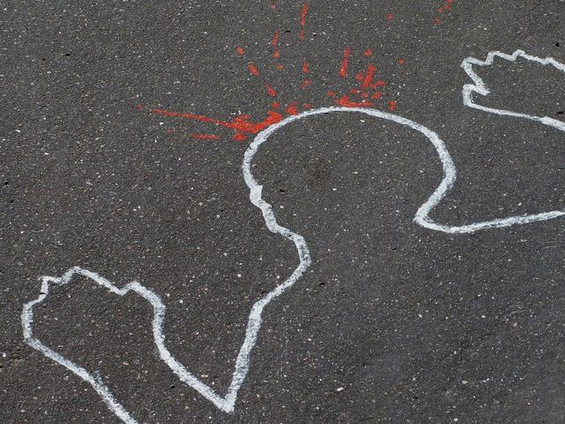
CLICK for a list of words in English derived from Latin!
Photo by stickerHelsinki

Slide 14
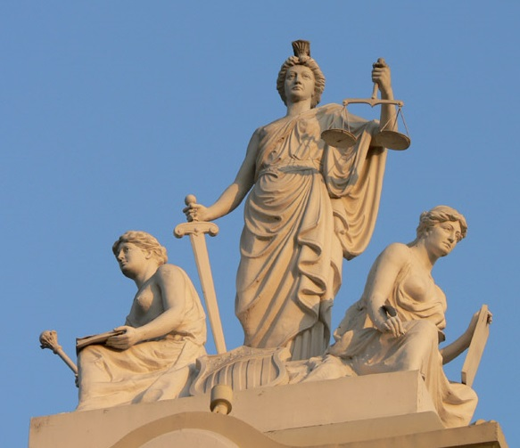
Laws
Photo by: S.C. Asher

Slide 15
Republic
The Romans had one first.

Slide 17
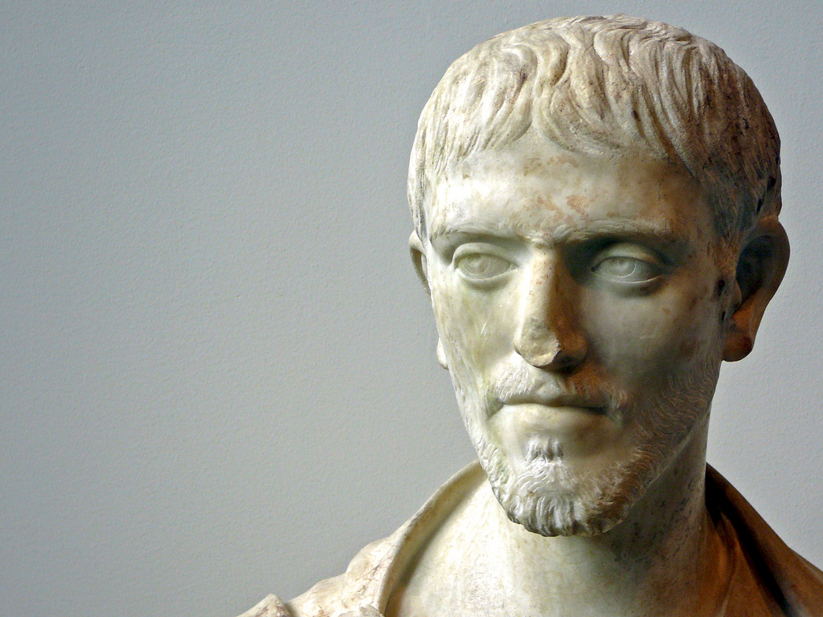
Been there. Done that.
Photo by campra

Slide 18
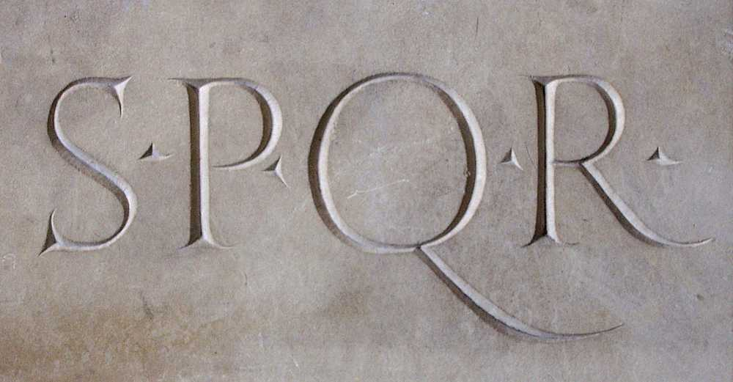
The Senate
Senatus Populusque Romanus
“The Senate and the People of Rome”
Photo Credit: Lamré

Slide 19
Calendar
January
February
March
April
May
June
July
August
September
October
November
December

Slide 20
Kalends
Photo by moneboh

Slide 21
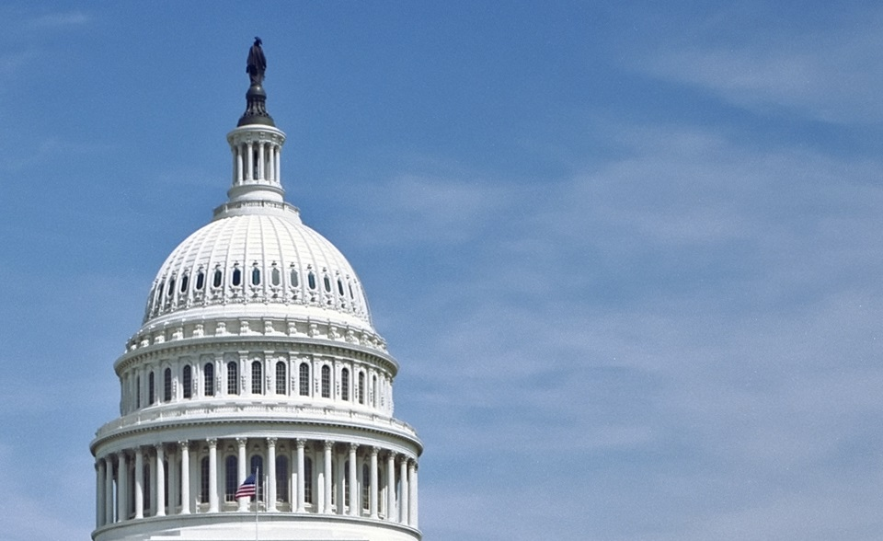
Architecture
Neoclassicism
U.S. CAPITOL DOME

Slide 22
SUPREME COURT BUILDING
Photo by IslesPunkFan

Slide 23
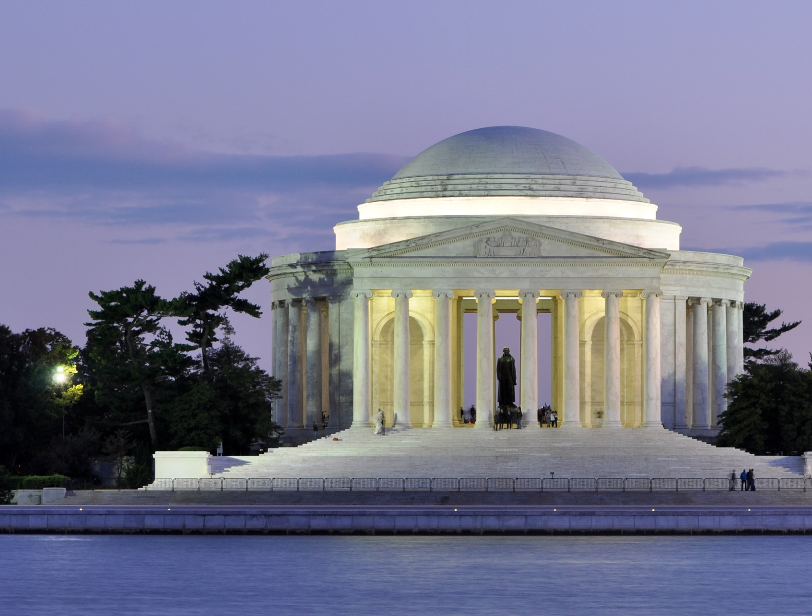
Jefferson Memorial
Photo by: Joe Ravi

Slide 24
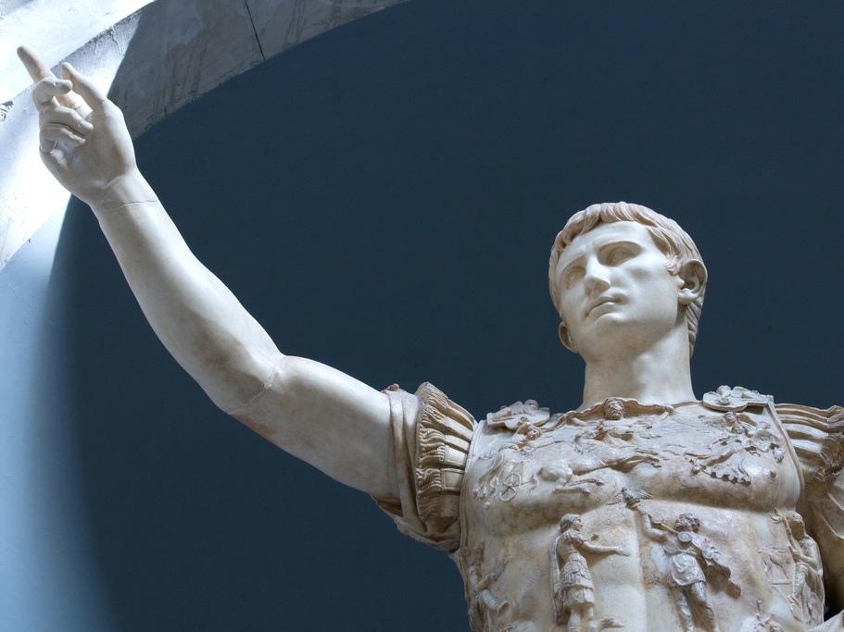
That looks familiar...
Photo by Swiv

Slide 25
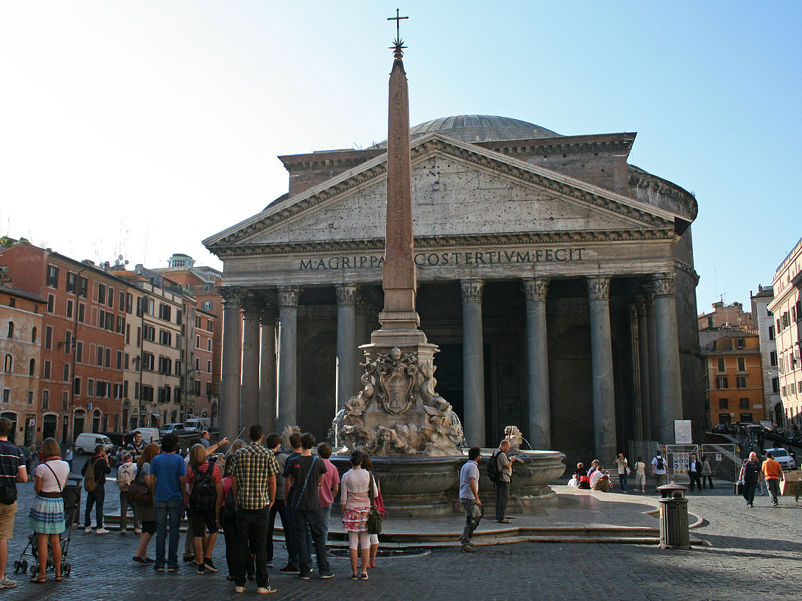
The Roman Pantheon
Photo by: Jean-Pol GRANDMONT

Slide 26
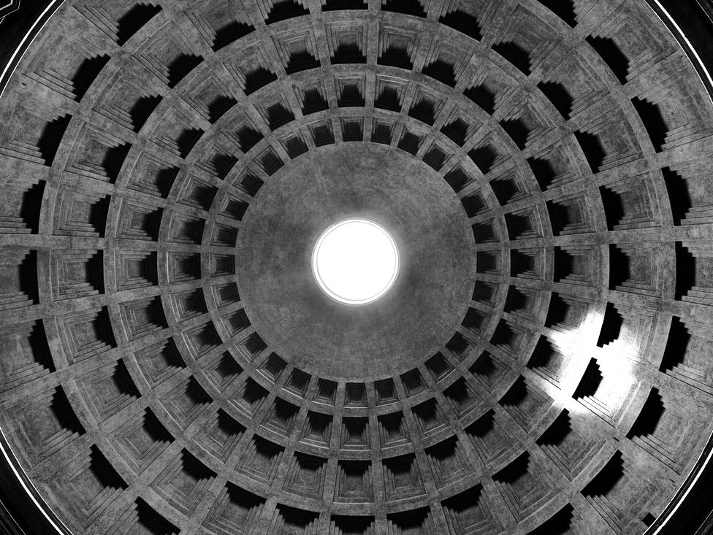
Pantheon Ceiling
Photo by José Garrido

Slide 27
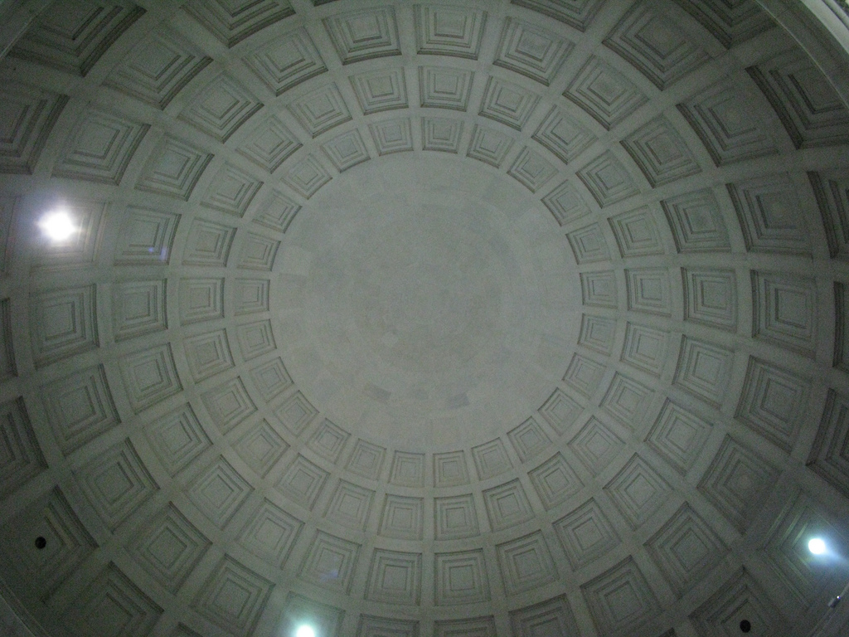
Jefferson Memorial Ceiling

Slide 28
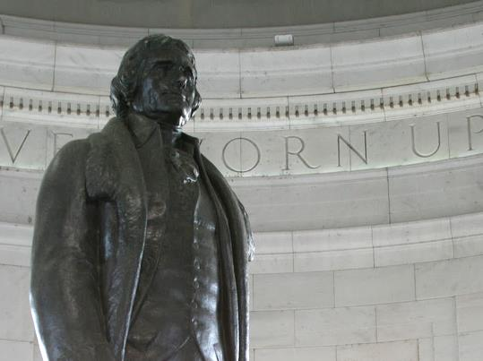
It’s no accident. I totally dig the Romans.
Photo by gamillos

Slide 29
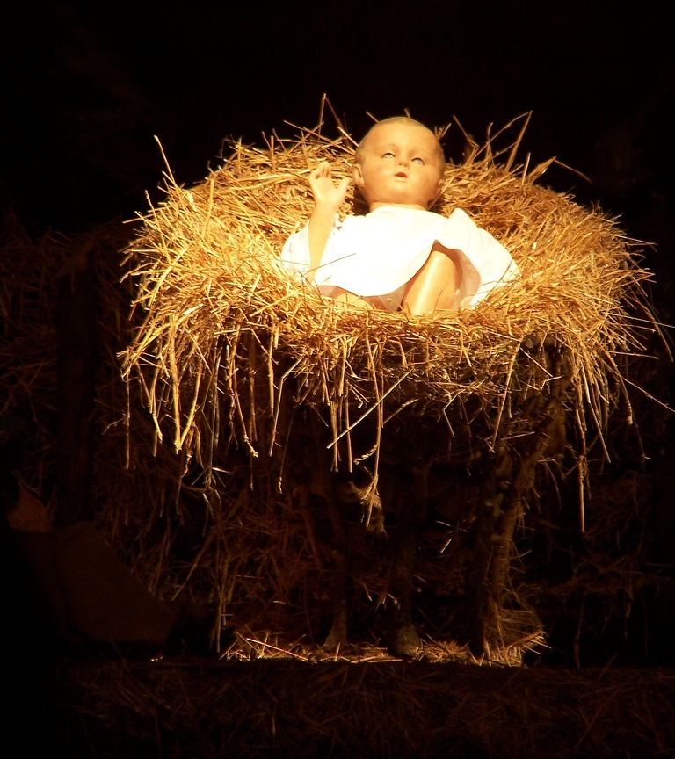
Religion
Photo by wrenoud

Slide 30
World Religions
1/3
Of humanity professes Christianity.

Slide 31
The Roman Empire
Map Credit: Tataryn77

Slide 32
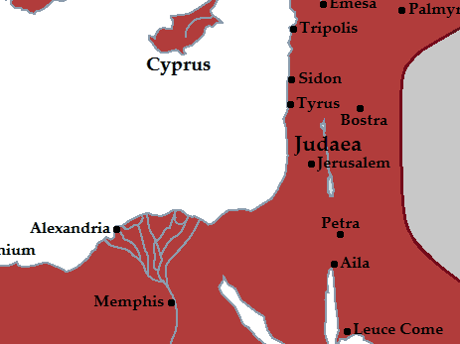
In those days Caesar Augustus issued a decree that a census should be taken of the entire Roman world...And everyone went to their own town to register.

Slide 33
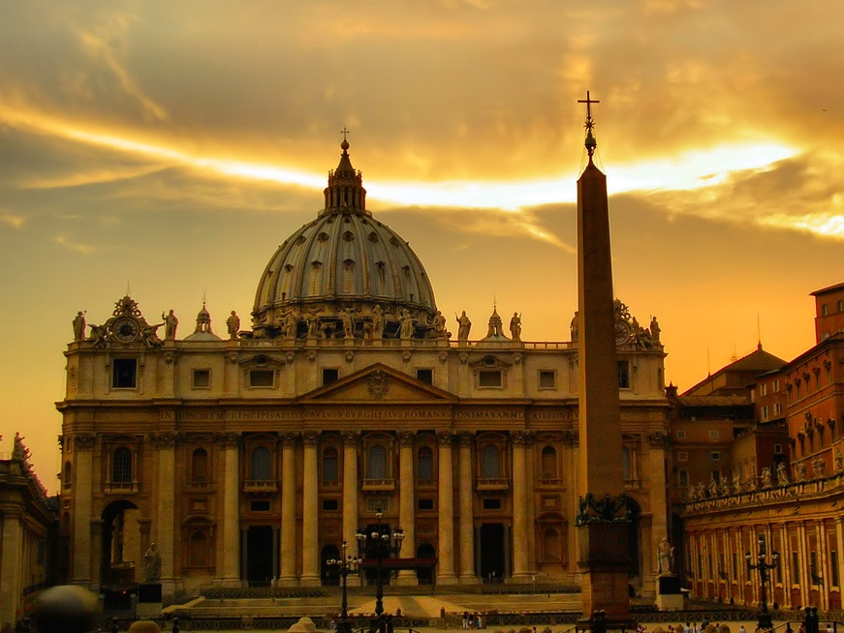
Saint Peter's Basilica, Vatican City
Photo by Giampaolo Macorig

Slide 34
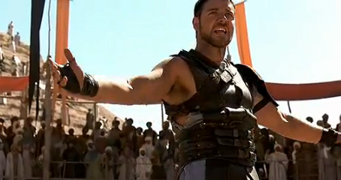
Entertainment

Slide 35
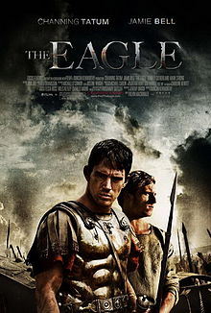
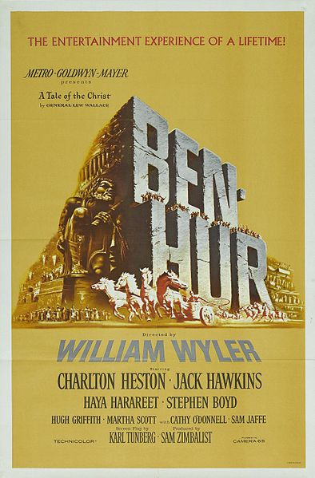
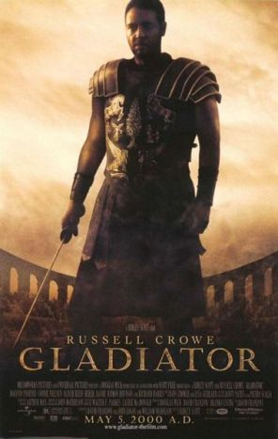
Entertainment
Romans are still quite popular on film.

