Slide 1
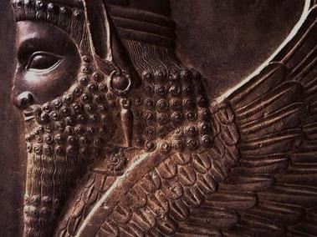
The Persian Empire

Slide 2
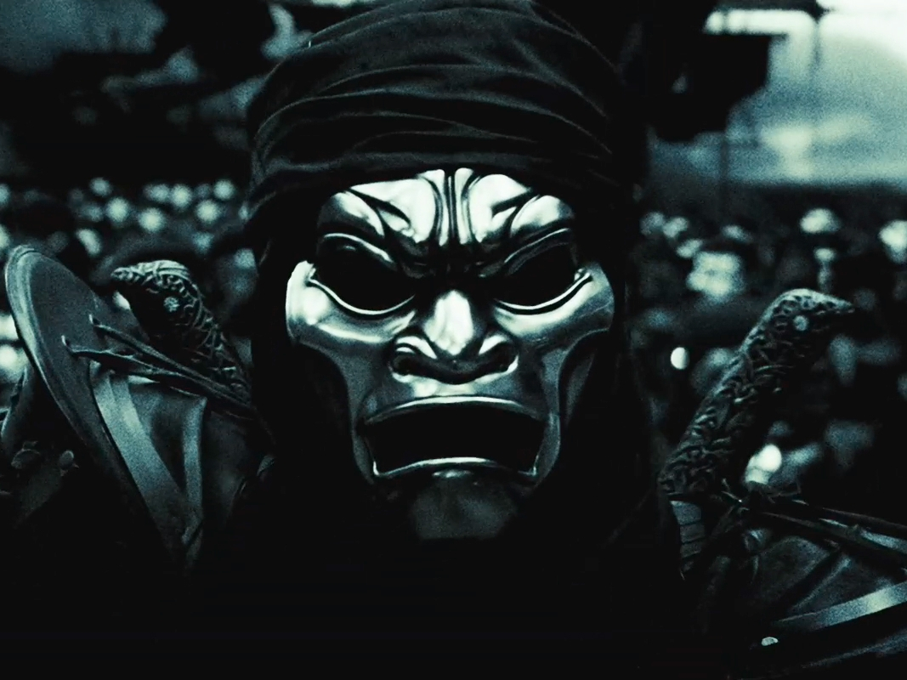
The Persian Myth
Thanks a lot, 300!
Screenshot from 300, accessed at: http://www.awadallah.com/blog/category/fun
Notes:
Screenshot from 300, accessed at: http://www.awadallah.com/blog/category/fun/

Slide 3
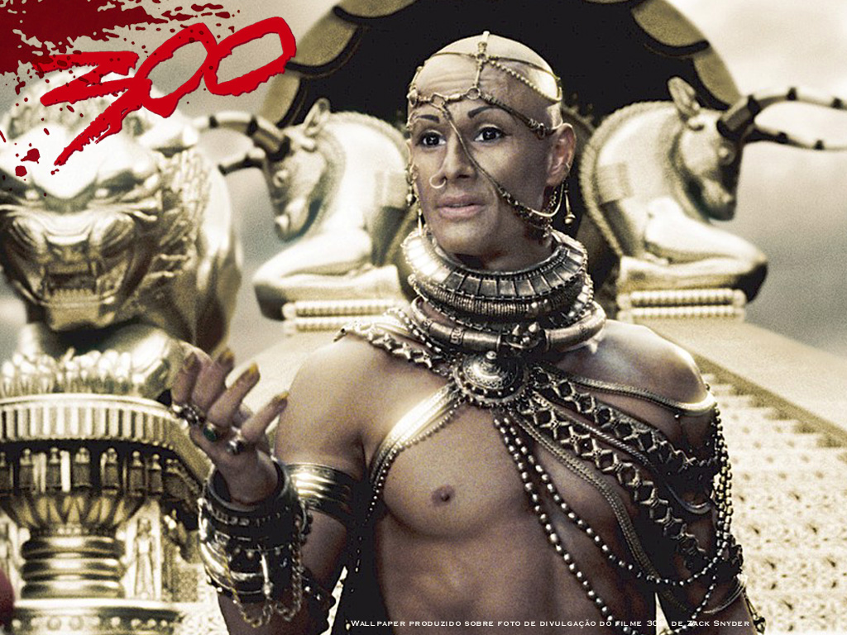
I’m actually quite civilized once you get to know me…

Slide 4
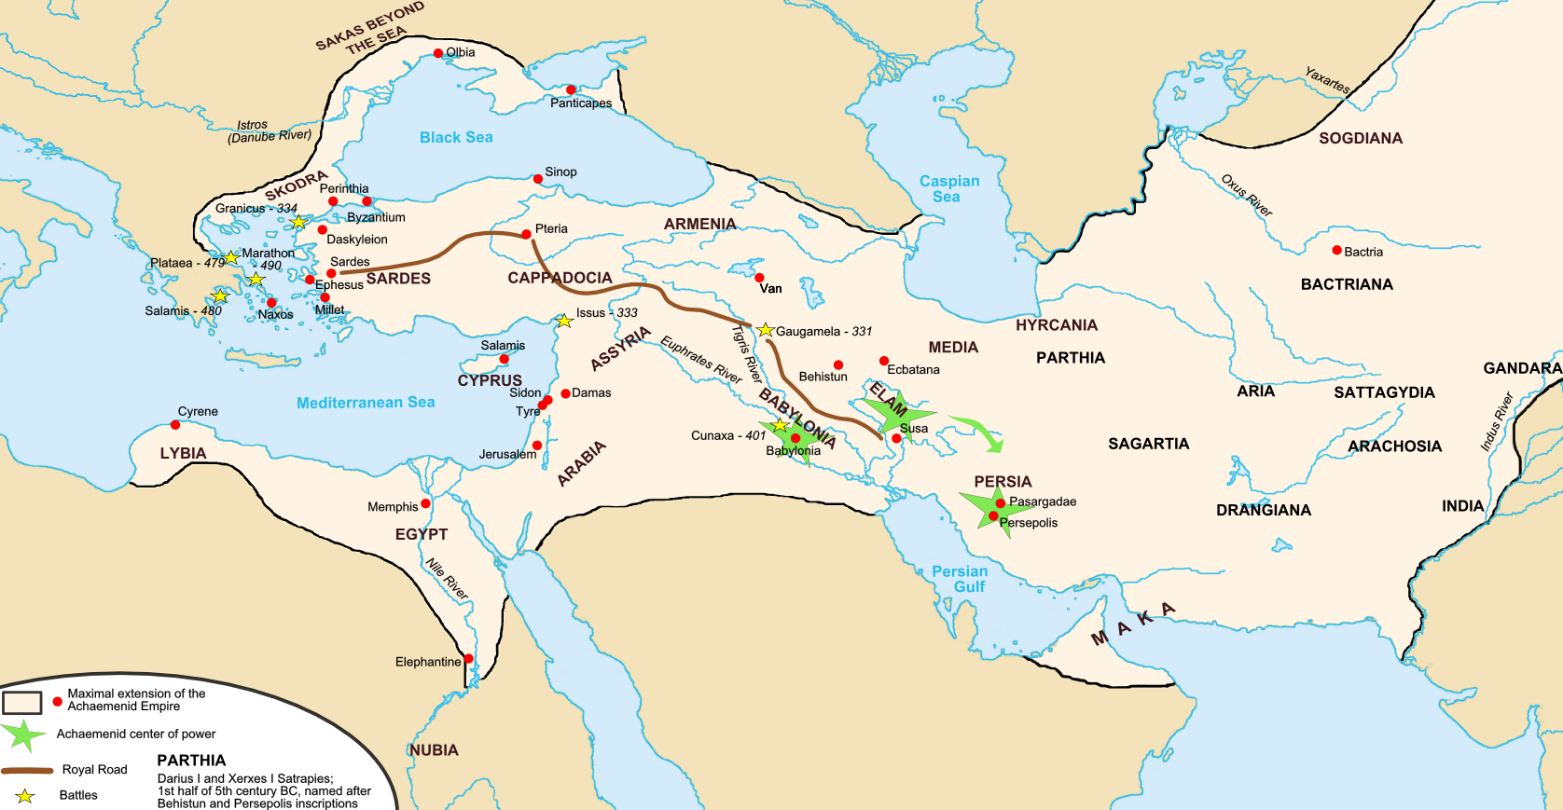
Persian Empire
Detail on Next Slide
At its greatest territorial extent
Map Credit: Fabienkhan

Slide 5
Royal Road
Trade
Troops
Map Credit: Fabienkhan

Slide 6
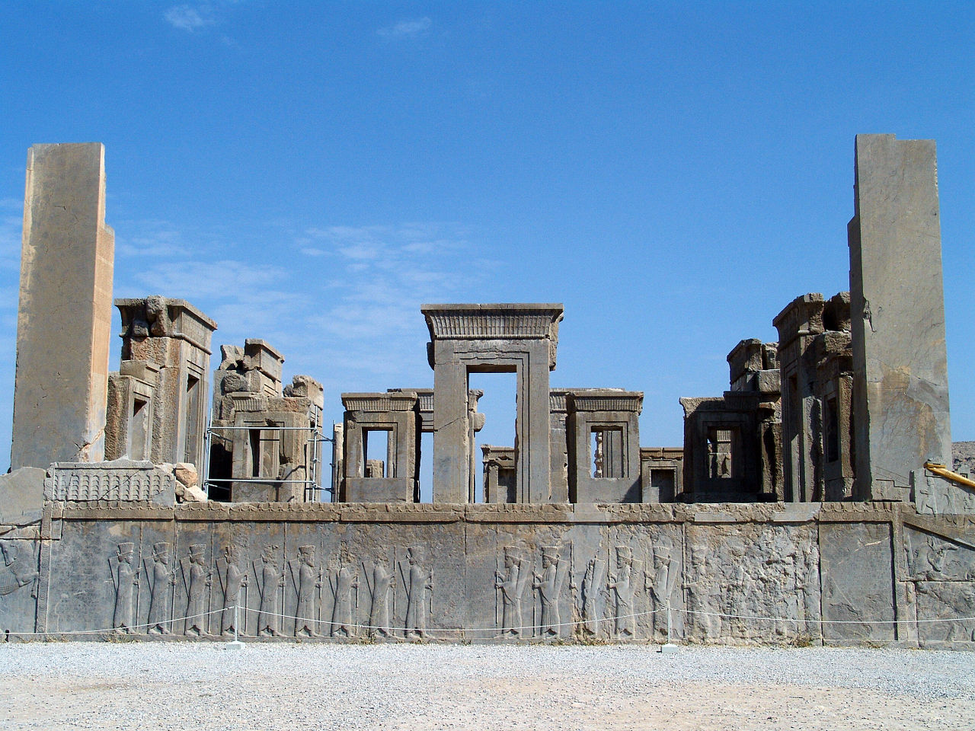
The Ruins of Persepolis
Photo Credit: درفش کاویانی

Slide 7
Cyrus the Great
King of Persia
559-530 B.C.
Conqueror of Babylon

Slide 8
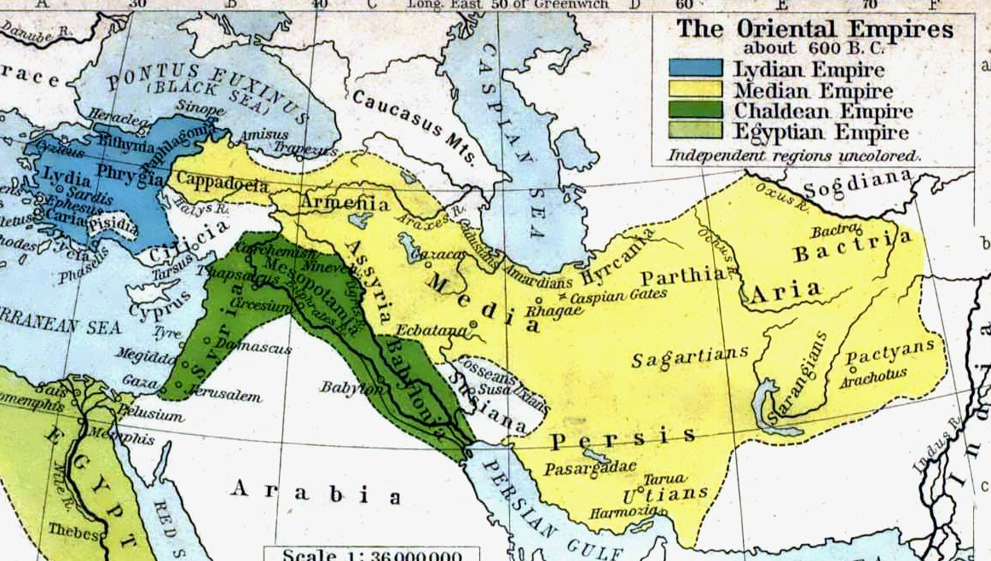
Conquests of Cyrus the Great
NOTE: The conquest of Egypt was completed by Cyrus’ son, Cambyses.

Slide 9
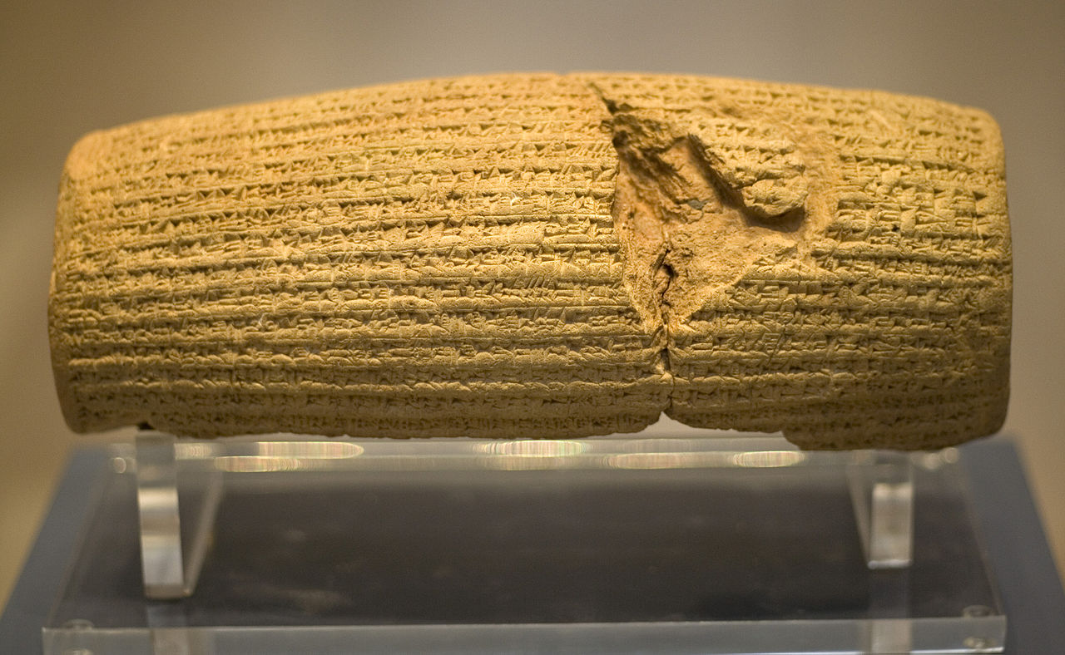
Cyrus Cylinder
“I sought the safety of the city of Babylon... The population of Babylon... had endured a yoke not decreed for them.
I soothed their weariness; I freed them from their bonds.”
Photo Credit: Prioryman

Slide 10
Cyrus Cylinder
CONQUEST = LIBERATION
Photo Credit: Prioryman

Slide 11
Cyrus Cylinder
Repatriation
of conquered peoples displaced by the Babylonians
Three R’s
Religious Toleration
Encouraged local faith customs
Rebuilding
of temples destroyed by the Babylonians
Photo Credit: Prioryman

Slide 12
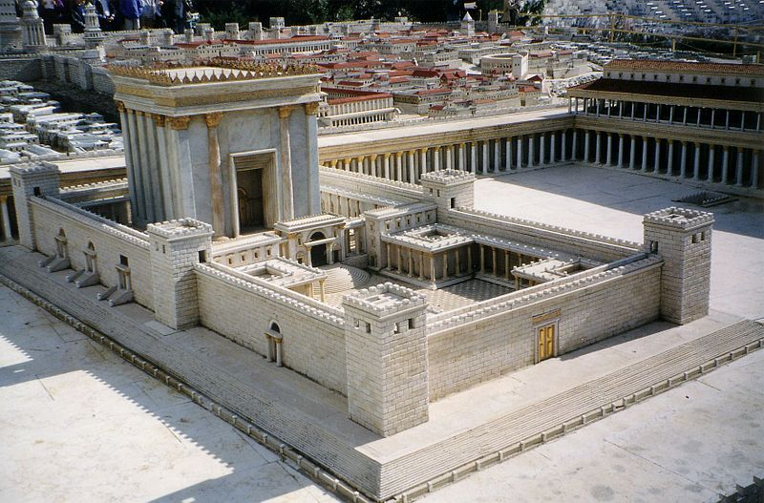
Second Temple
Cyrus allowed the Jews to return to Jerusalem and rebuild their temple.

Slide 13
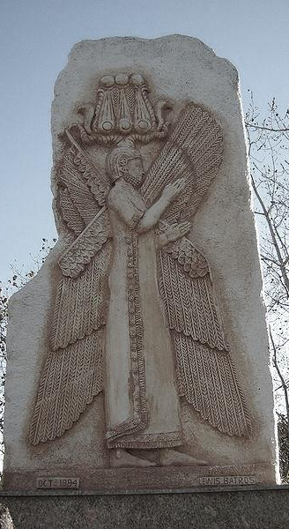
A Messiah
God's Message to his anointed, to Cyrus, whom he took by the hand to give the task of taming the nations, of terrifying their kings:
"I'll go ahead of you, clearing and paving the road. I, God, the God of Israel, who calls you by your name. It's because of my dear servant Jacob, Israel my chosen, That I've singled you out, called you by name, and given you this privileged work.”
- Isaiah 45

Slide 14
Slavery
was rare in the Persian Empire, where slavery as a punishment for debtors was illegal.

Slide 15
Women’s Rights
Persian women could:
own property
supervise workers
initiate divorce
Further Reading
Notes:
the range of occupations in which women worked is remarkable: wood-workers, stone-workers, artisans, wine-makers, furniture-makers, treasury clerks, store keepers, carriers, grain-handlers. Most trades included both male and female workers, often mixed in the same work teams. Female managers controlled teams of female workers but also mixed teams of males and females.
Women brought a dowry into marriage, and that dowry formed part of the marital property owned in common by the husband and wife. But either party could divorce the other, with or without cause, and in that case the dowry returned to the wife.
New mothers and pregnant women received higher rations and sons were clearly preferred over daughters. If they delivered boys, both the mother and the nurse or the physician received higher rations. The extra payments were given out for one month only. Consistently mothers of boys received twice the amount compared to mothers of baby girls.

Slide 16
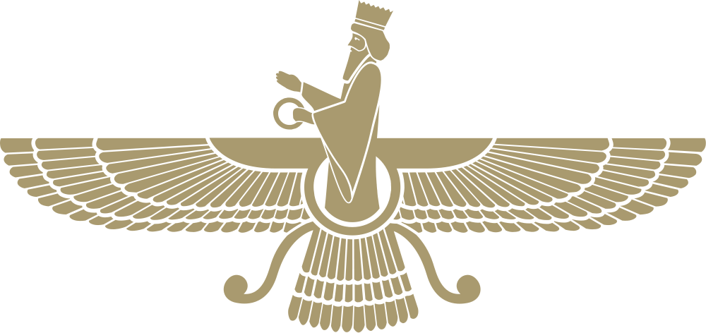
Zoroastrianism
The Religion of Ancient Persia

Slide 17
Zoroaster
(aka, Zarathustra)
Founder & Prophet of Zoroastrianism
Zoroaster holding a star-studded globe in Raphael’s painting, The School of Athens

Slide 18
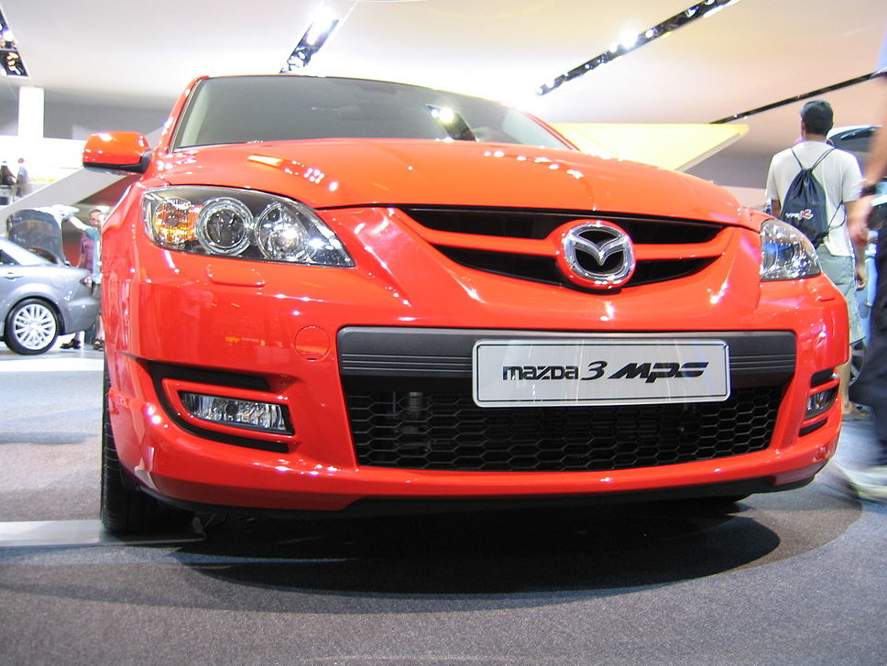
Photo Credit: Robin Corps

Slide 19
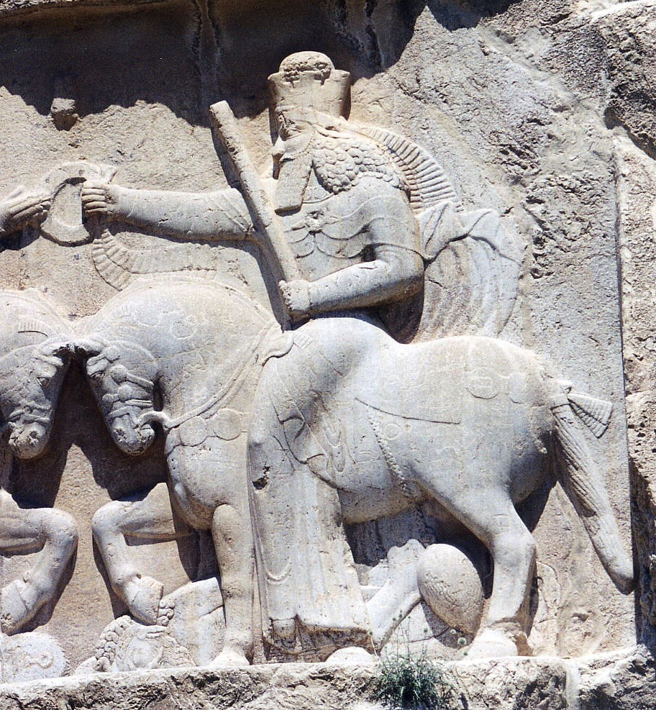
Ahura Mazda
WISDOM
LIGHT
Photo Credit: Ginolerhino

Slide 21
Dualism
An eternal struggle between forces of good and evil
vs.

Slide 23
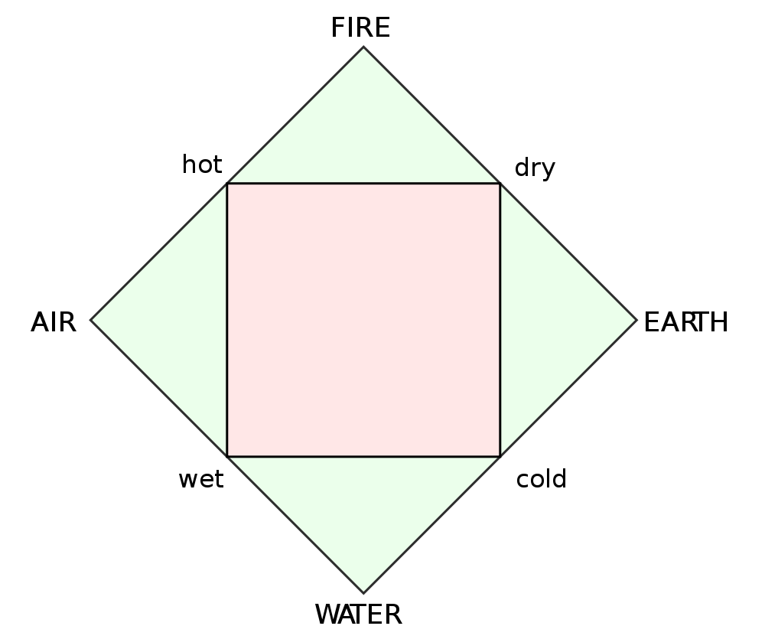
Classical Elements

Slide 24
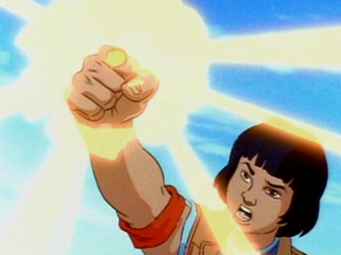
Heart is NOT an element.
Notes:
Screenshot from Captain Planet, accessed at: http://questionableliterarymerit.tumblr.com/post/9429831402/captain-planet-rant-why-everybody-gotta-be-hating-on

Slide 25
The Purest Elements

Slide 26
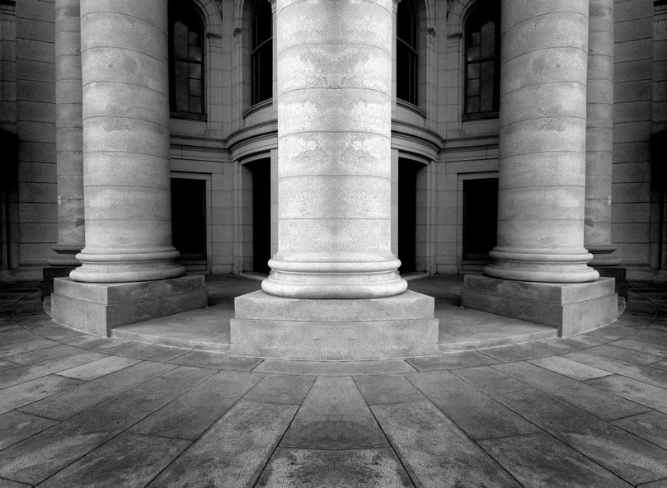
The Pillars of Zoroastrianism
Thoughts
Words
Deeds

Slide 27
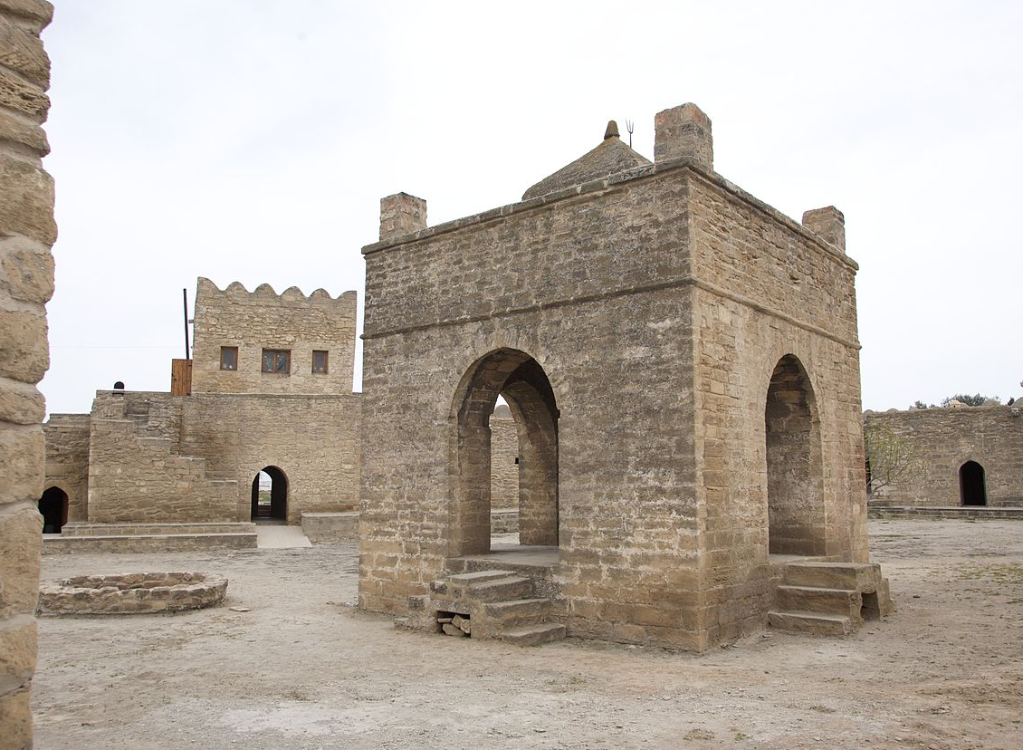
Fire Temples
.
Photo Credit: Nick Taylor
Notes:
Fire makes civilization possible (light, warmth, energy)

Slide 29
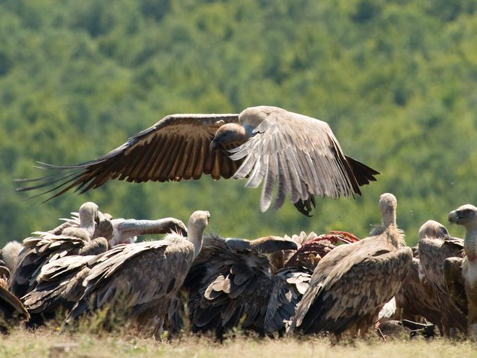
Carcass
It’s What’s for Dinner!

Slide 30
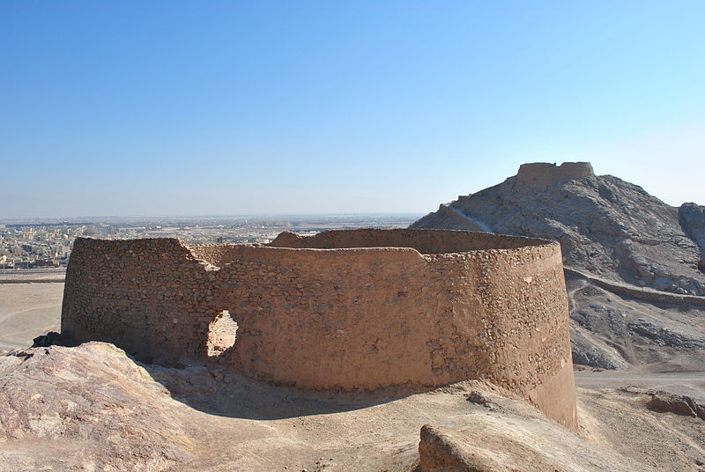
Towers of Silence

Slide 31
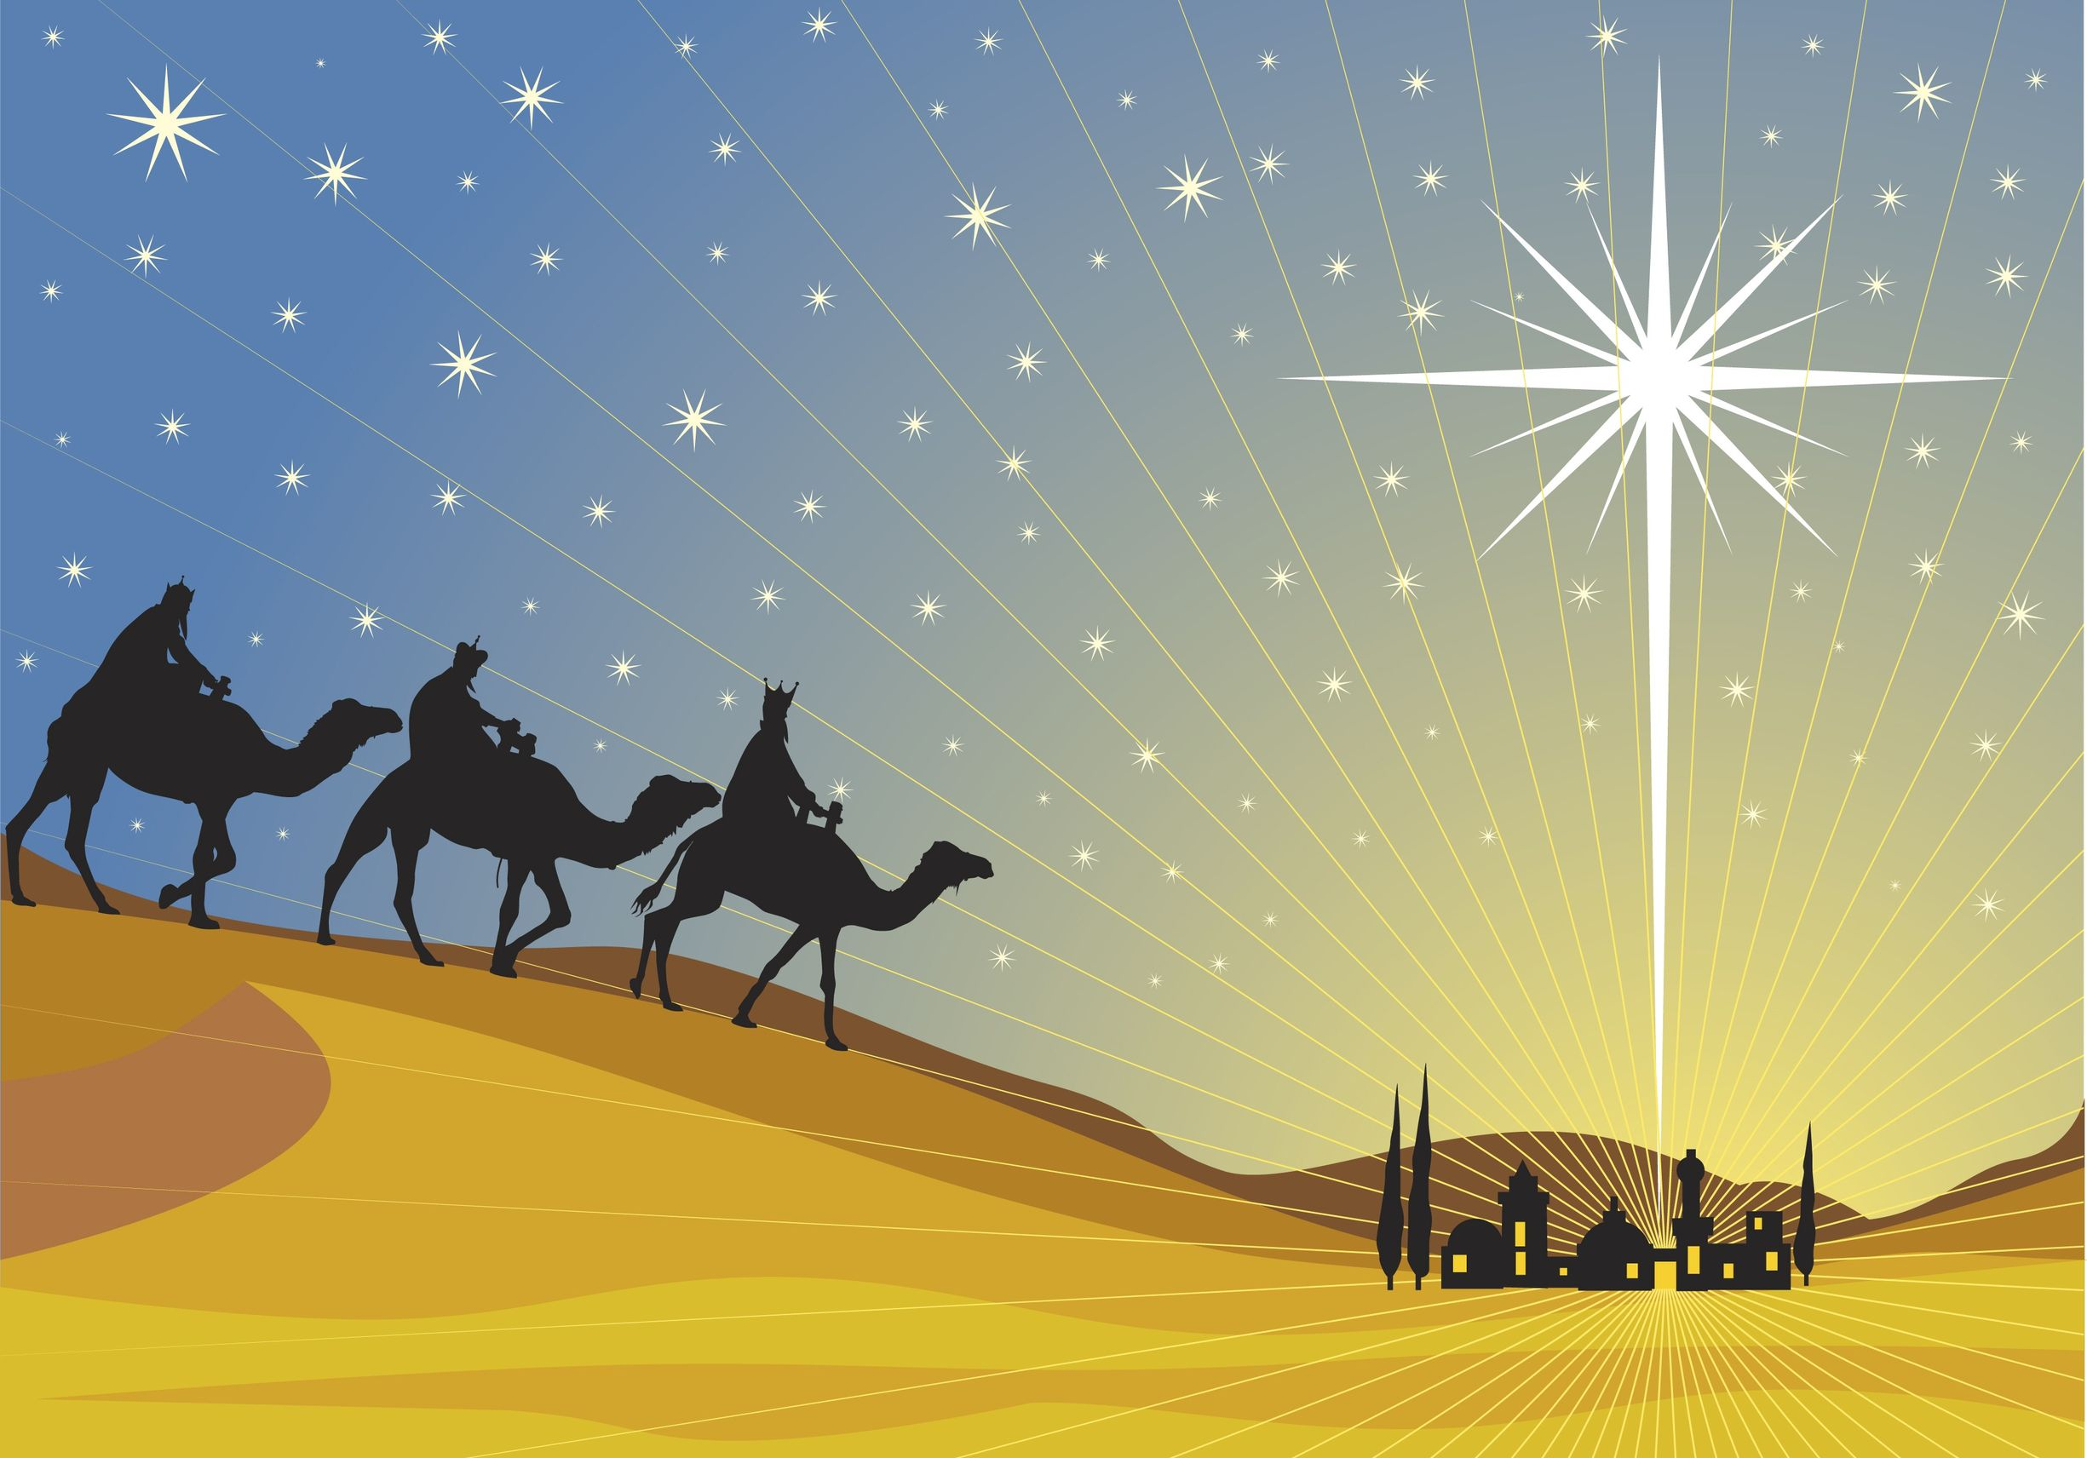
Zoroastrians?
Naci Yavuz

Slide 32
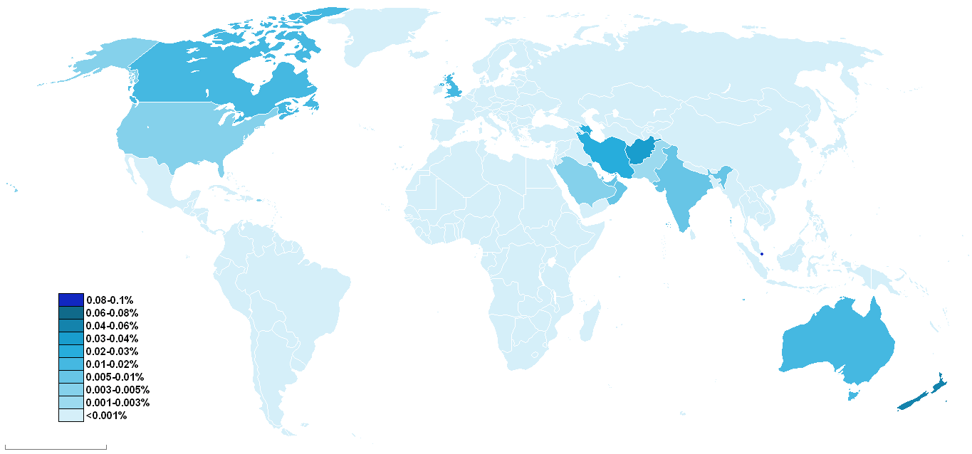
Zoroastrianism Today
Over 125,000 Zoroastrians are spread across the globe.

Slide 33
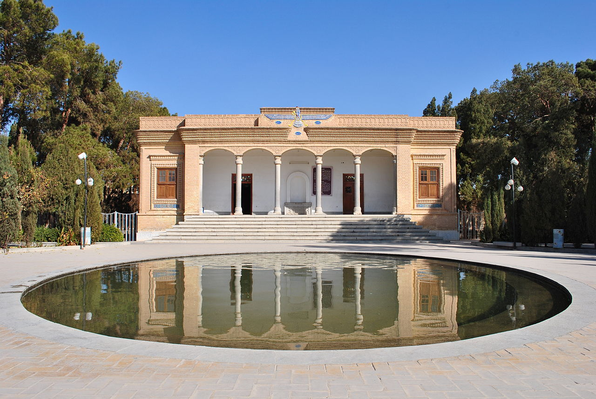
A Modern Fire Temple
Photo Credit: Zenith21
Yezd Atash Behram (“Fire of Victory” Temple) in Yazd, Iran

