Slide 1
Revolutions of 1848

Slide 2
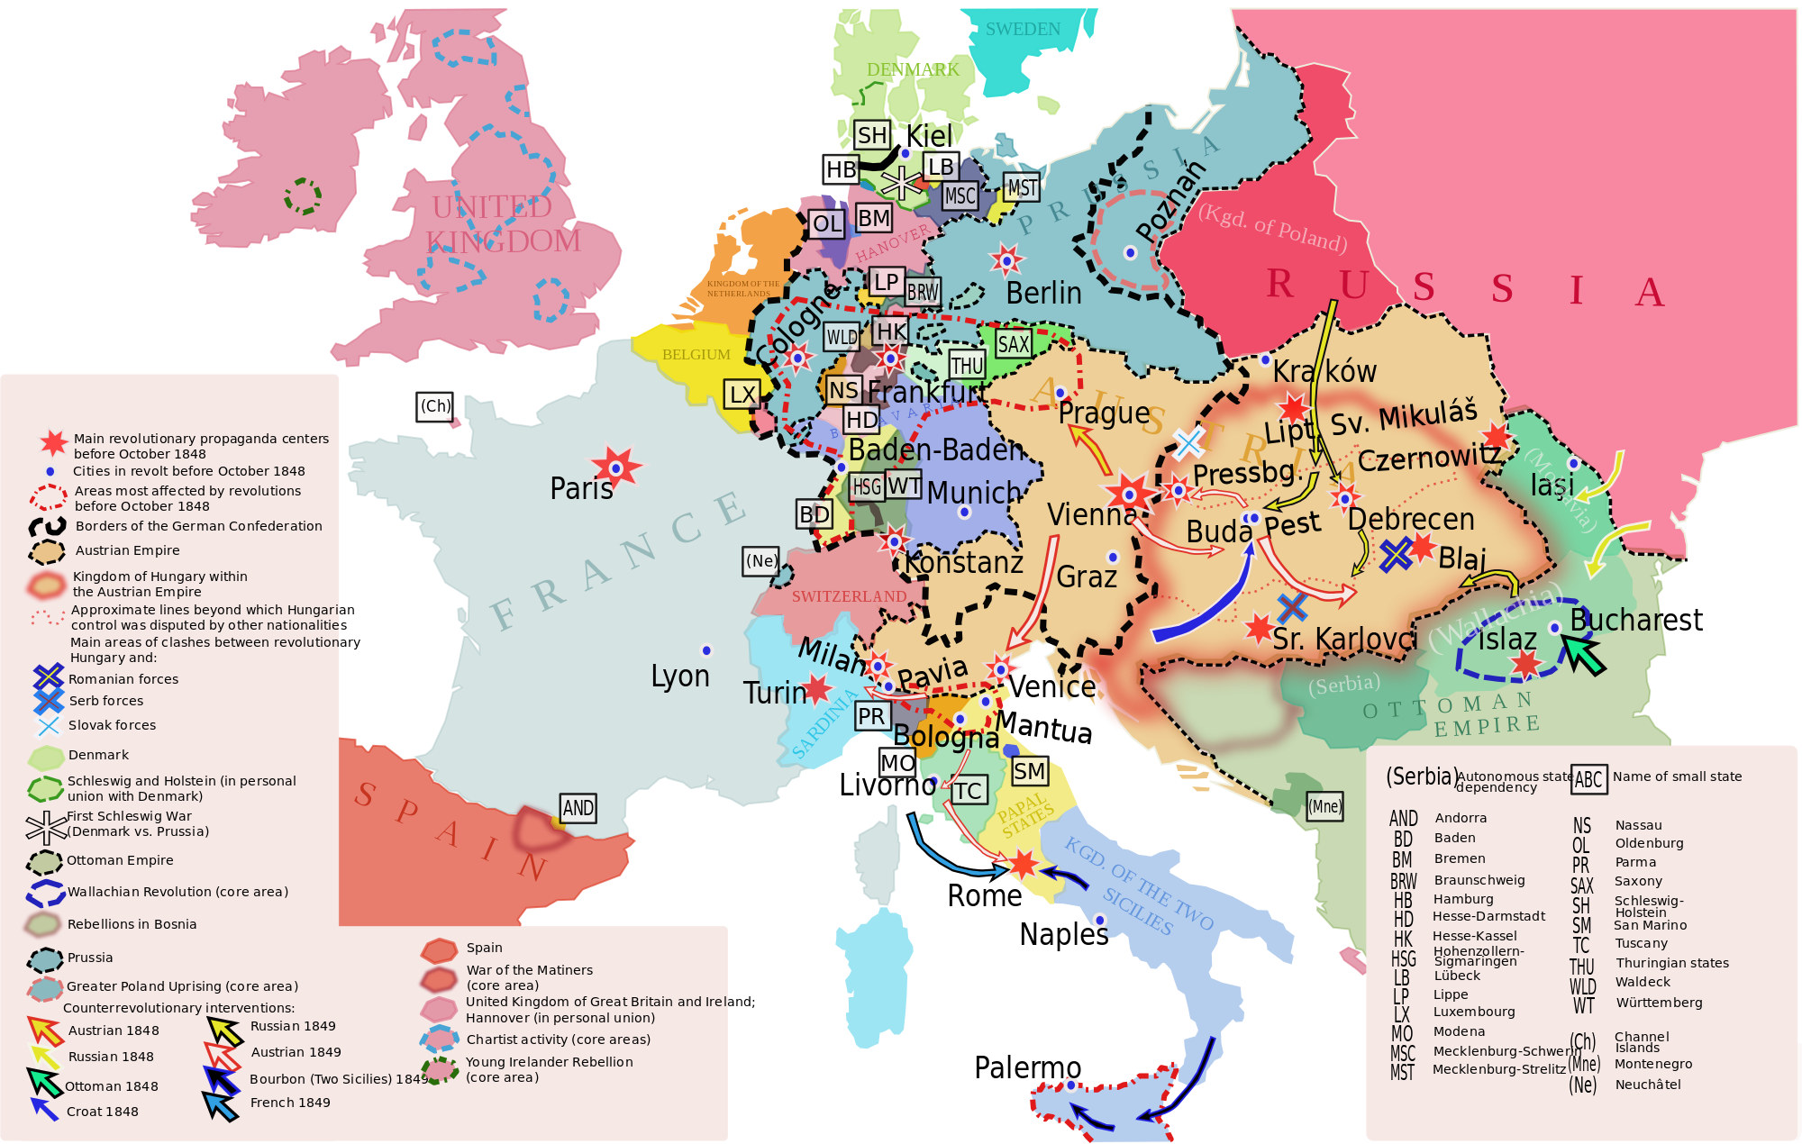
OBLIGATORY MAP of Europe in 1848
Map Credit: Dahn (Wikipedia)

Slide 3
Revolutions of 1848
Several European nations were swept by a series of simultaneous revolutions.
These revolutions generally failed and conservatives regained power.
Britain and Russia did not experience the revolutions that otherwise swept over the continent.

Slide 4
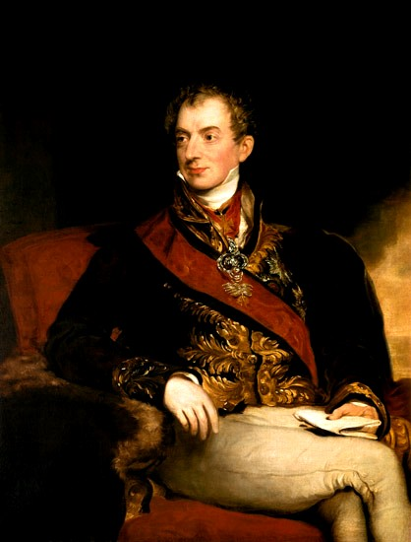
END
Age of Metternich
1815-1848

Slide 5
The Revolutionaries
The Group | The Goals
Liberals
Nationalists
Radicals
Limit Church Influence & State Power
Republican Government
Economic Freedom & Civil Liberties
National unity based on common language, culture, religion, and shared history
Democrats
Universal Male Suffrage
Socialists
Worker ownership of the means of production

Slide 6
CONFLICTING PHILOSOPHIES
These “isms” don’t all play well together.

Slide 7
CONSERVATIVES Moderates Radicals

Slide 8
Which group will the moderates support?

Slide 9
When Conservatives are too Conservative

Slide 10
CONSERVATIVES Moderates Radicals

Slide 11
When RADICALS are too RADICAL

Slide 12
CONSERVATIVES Moderates Radicals

Slide 13
Map Credit: Dahn (Wikipedia)

Slide 14
FRANCE

Slide 15
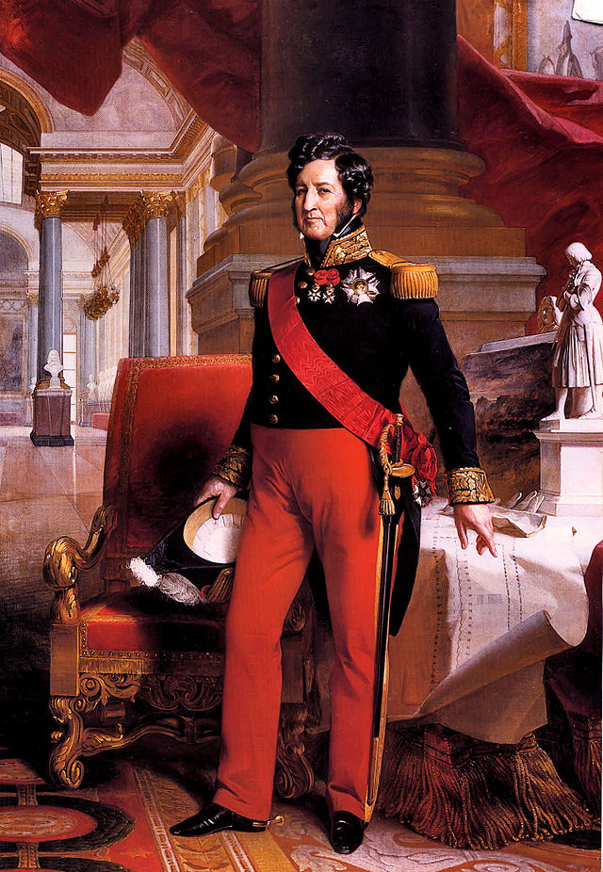
Louis Philippe
“Citizen King”
Constitutional Monarch

Slide 16
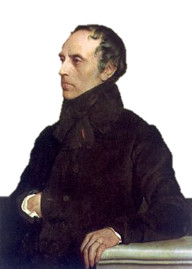
François Guizot
Louis Philippe’s Prime Minister
Conservative Liberal

Slide 17
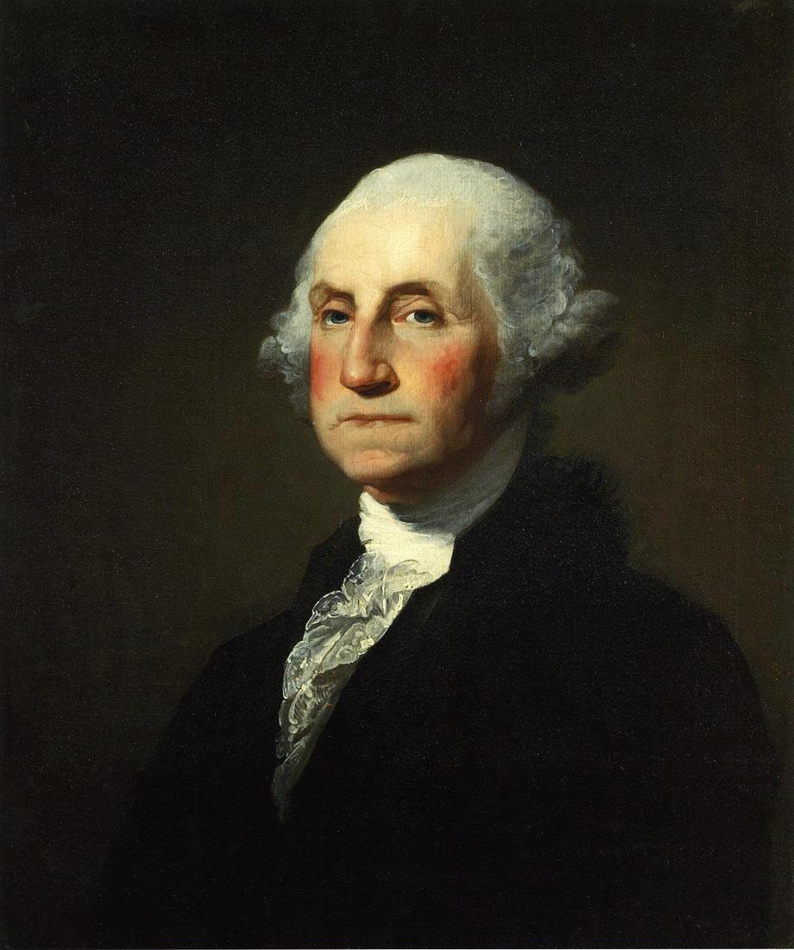
Republican Banquets
Icon Created by Ricardo Luciano
from the Noun Project

Slide 18
2/22/1848
Icon Created by Marcela Abbade
from the Noun Project

Slide 19
Guizot says NO!

Slide 20
BYE!

Slide 21
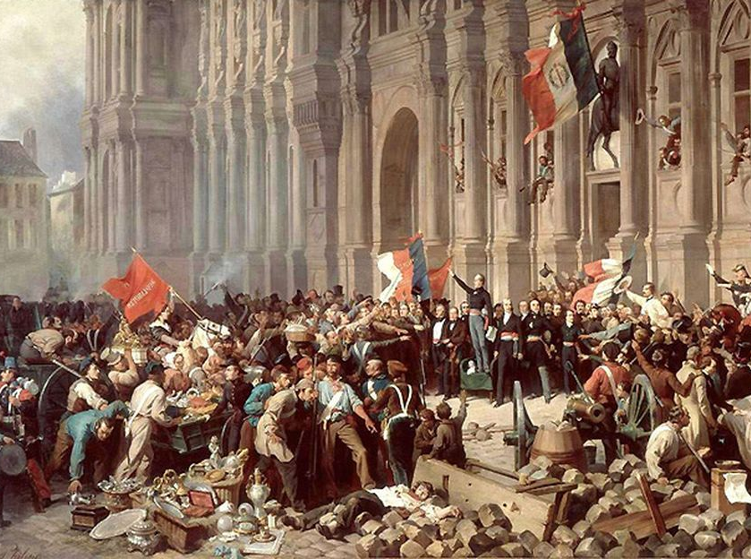
Provisional government

Slide 22
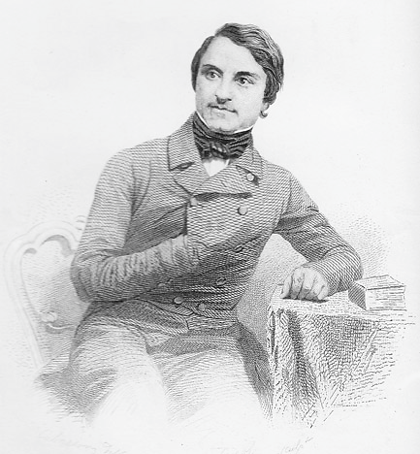
Louis Blanc
French Socialist and member of the Provisional Government.

Slide 23
EMPLOYMENT is a fundamental RIGHT

Slide 24
VISIONARY
Use Government to implement Socialist policies.

Slide 25
NATIONAL WORKSHOPS
Photo by Tim Fields

Slide 26
Government-Sponsored public works programs for the unemployed
Photo by Tim Fields

Slide 27
Government-Sponsored public works programs for the unemployed
Implemented on a limited basis by the Provisional Government to placate the socialist faction
Photo by Tim Fields

Slide 28
TENSION
vs.
Moderate (Liberal)
Republicans
RADICAL (Socialist)
Republicans

Slide 29
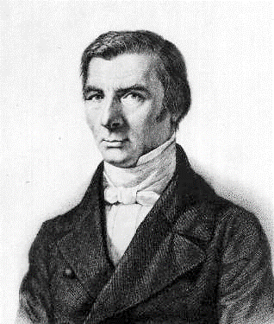
Frederic Bastiat
French Classical Liberal

Slide 30
The law (1850)
Attack on
Louis Blanc & Socialism

Slide 31
"I do not dispute their right to invent social combinations, to advertise them, to advocate them, and to try them upon themselves, at their own expense and risk…

Slide 32
"But I do dispute their right to impose these plans upon us by law – by force – and to compel us to pay for them with our taxes."

Slide 33
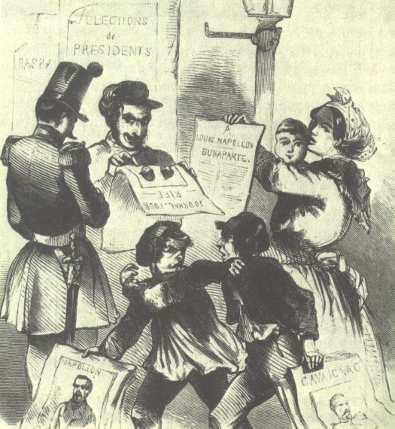
1848 Presidential Election
Republicans
vs. Conservatives

Slide 34
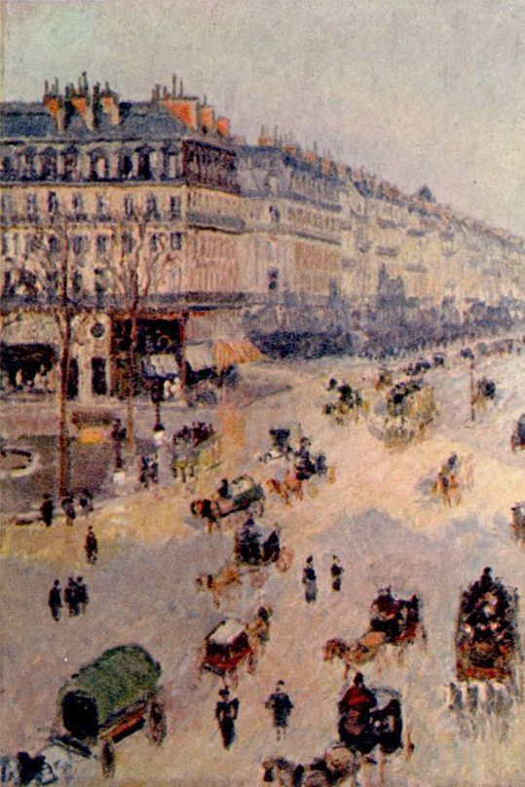
URBAN rural
vs.
Conservative rural voters didn’t want to be taxed to pay for socialist programs.

Slide 35
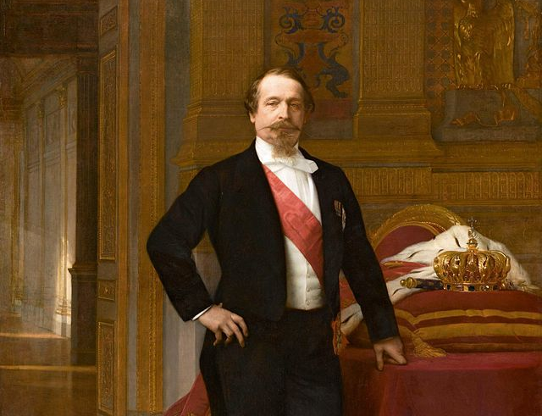
Louis-Napoleon

Slide 36
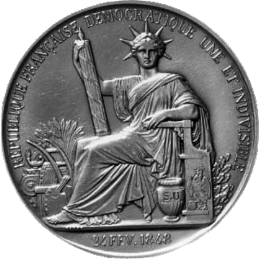
SECOND FRENCH Republic
1848-1852
Napoleon III ruled France until France was defeated in the Franco-Prussian War.

Slide 37
The apple doesn’t fall far from the tree.
Photo by Reza

Slide 38
Napoleon iii

Slide 39
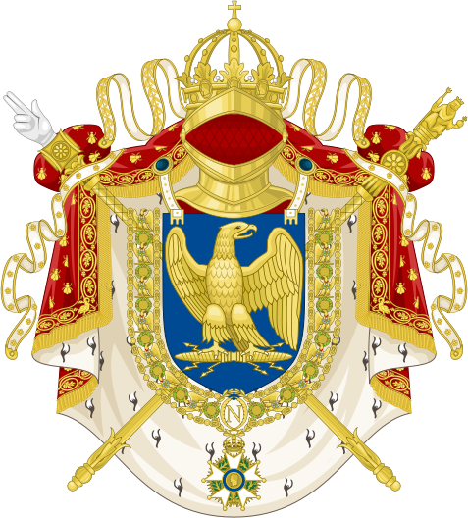
SECOND FRENCH EMPIRE
1852-1870
Napoleon III ruled France until France was defeated in the Franco-Prussian War.
Art Credit: Spedona & Katepanomegas

Slide 40
TYPICAL
1848
Divided revolutionaries unable to agree on a program.
Conservatives and moderates fear excesses of radicals.
Counter-revolutionary conservatives regain power.

Slide 41
GERMAN STATES

Slide 42
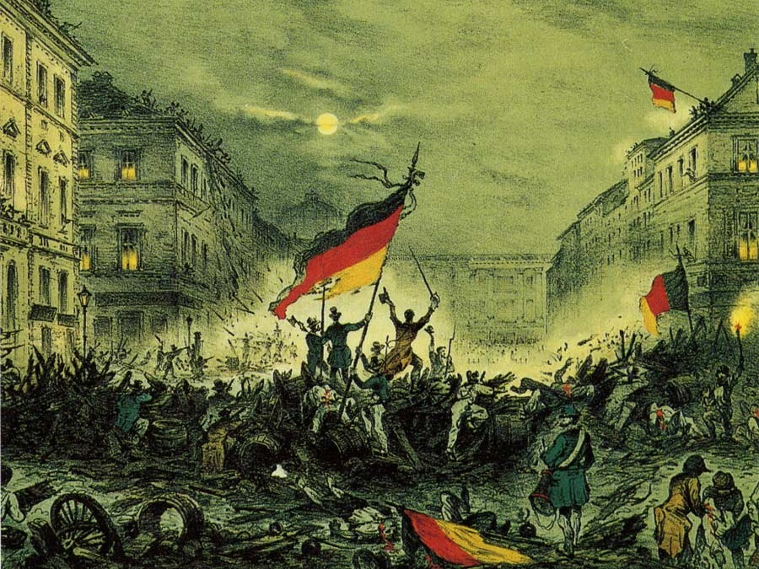
Upheaval in the German States
Nationalists, Liberals, & Radicals

Slide 43
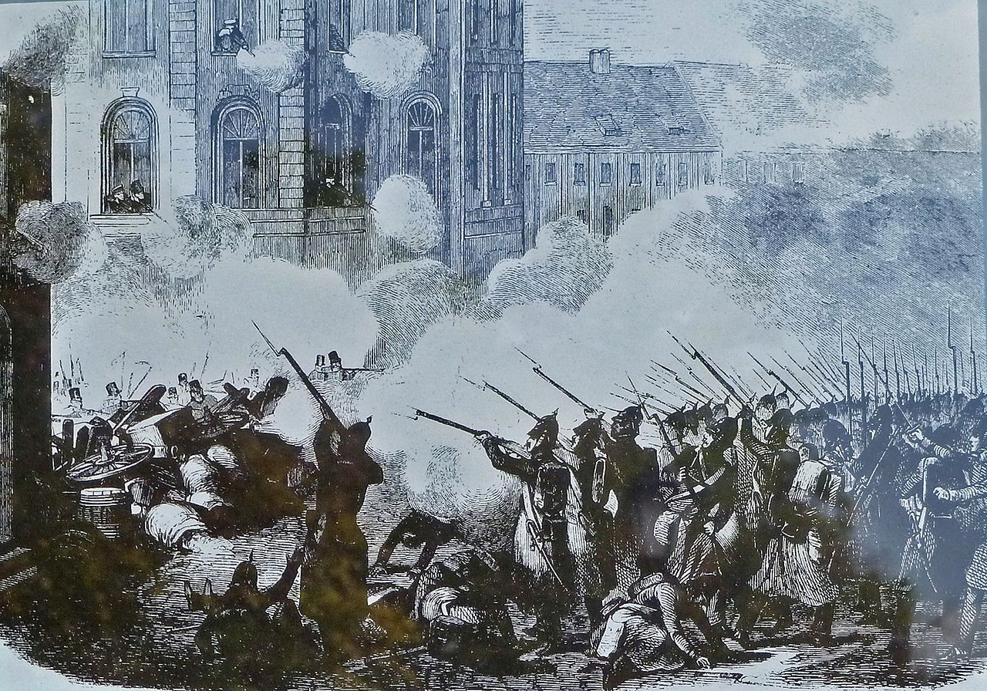
VIOLENT UPRISINGS
Photo by JoJan

Slide 44
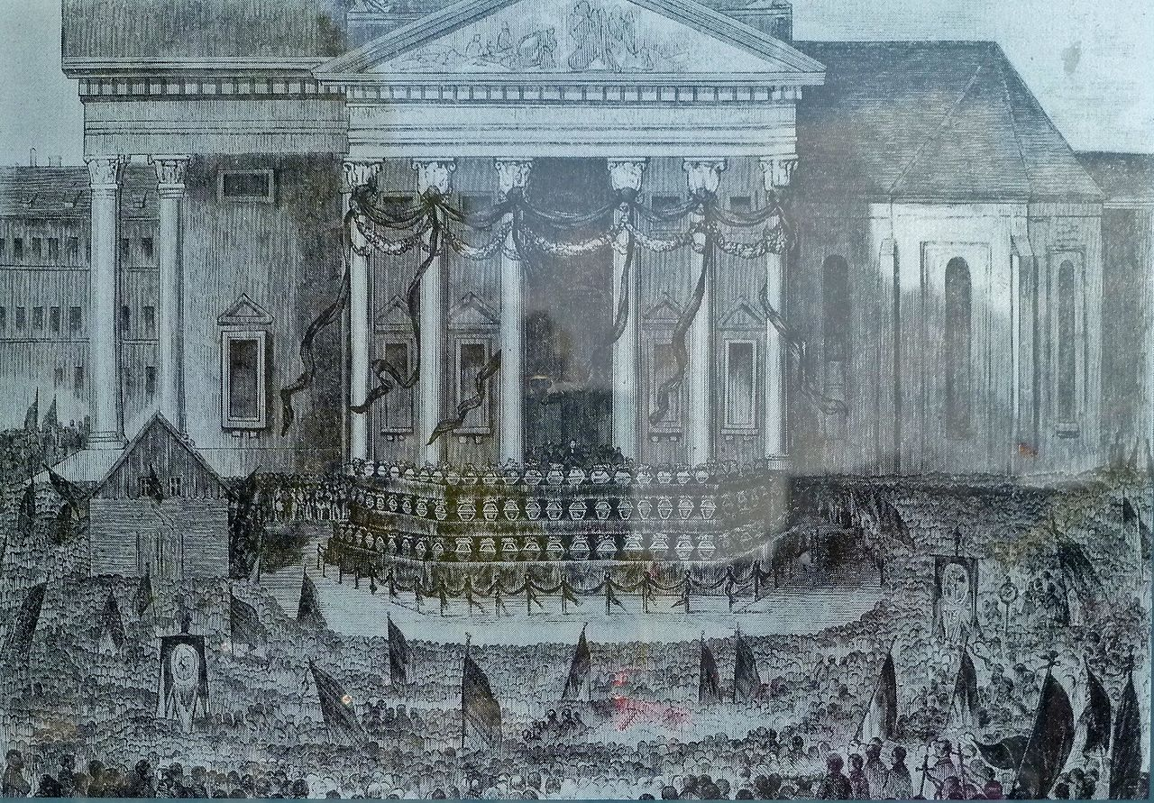
DEAD PEOPLE
Photo by JoJan

Slide 45
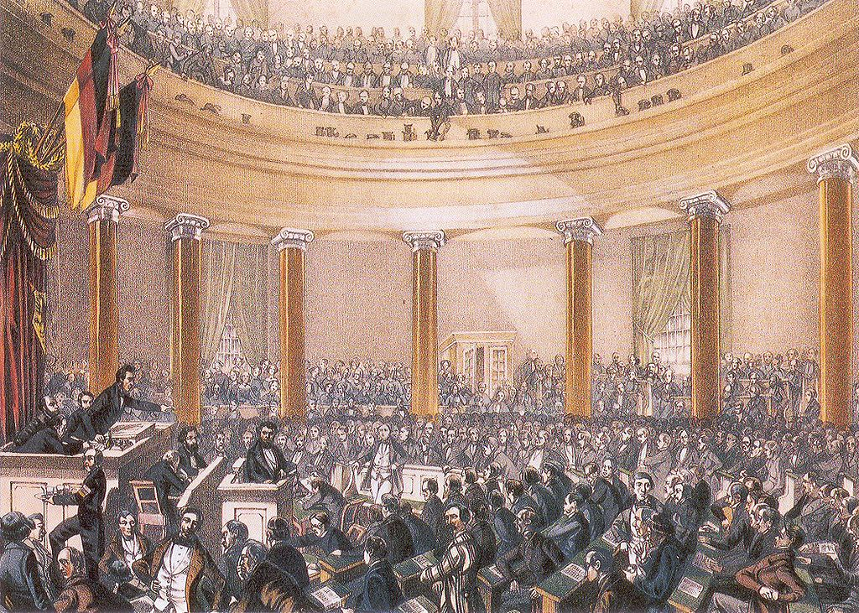
Frankfurt Parliament (1848)

Slide 46
PAN-GERMAN PARLIAMENT

Slide 47
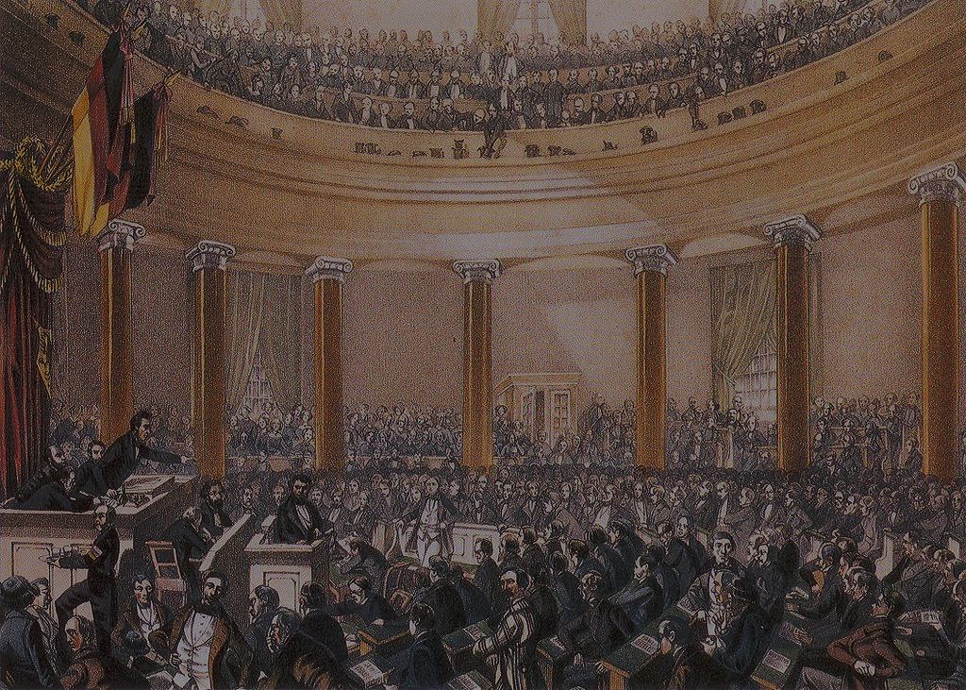
The Frankfurt Parliament drafted a
Constitution for a unified Germany.

Slide 48
FAIL

Slide 49
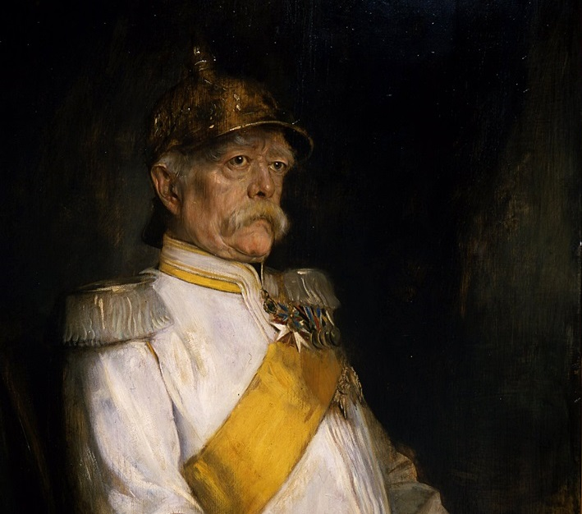
Conservatives divided and conquered the revolutionaries, who could not agree on an agenda.

Slide 50
BLOOD & IRON

Slide 51
AUSTRIAN EMPIRE

Slide 52
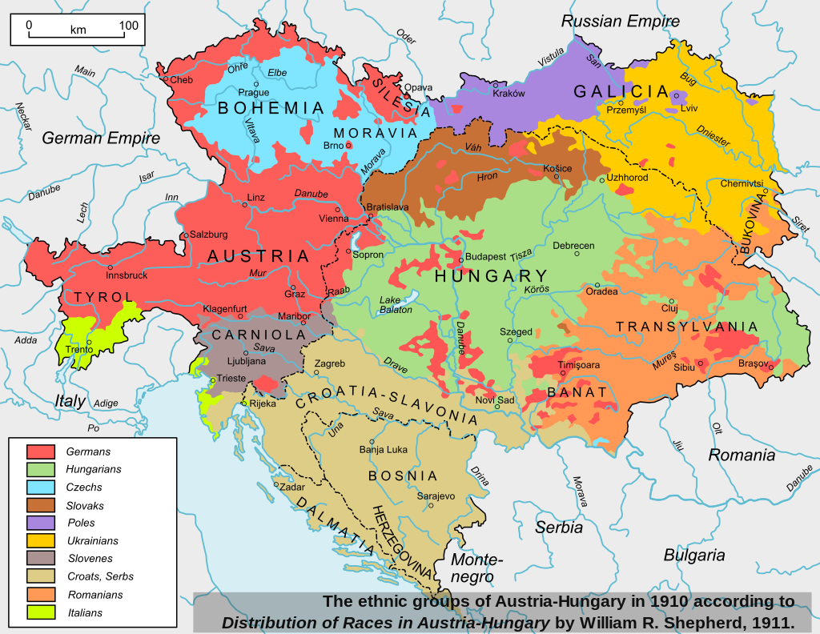
NATIONALISM
LIBERALISM &

Slide 53
The academic Legion

Slide 54
Student Revolutionaries in Vienna

Slide 55
bye
Metternich in Exile
1848-1851

Slide 56
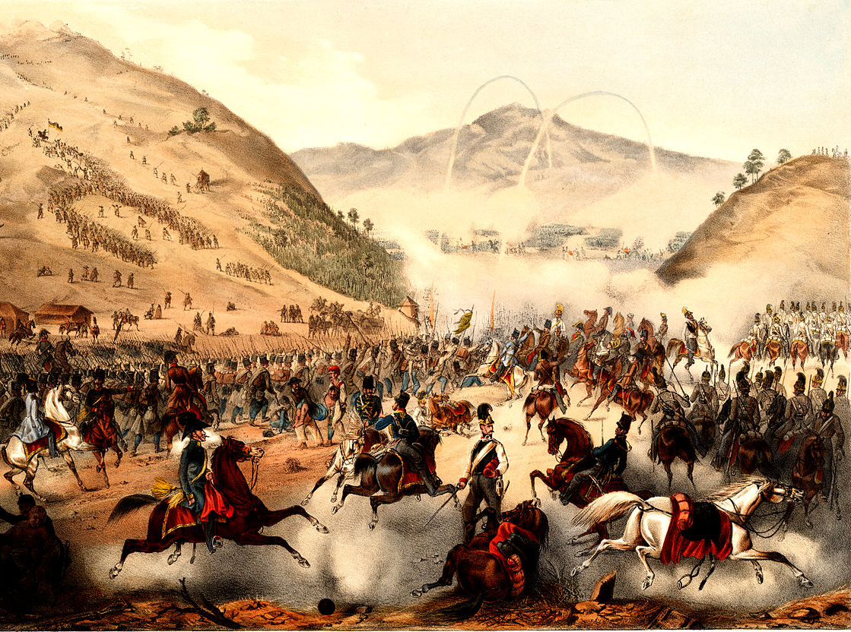
HUNGARIAN REVOLUTION of 1848

Slide 57
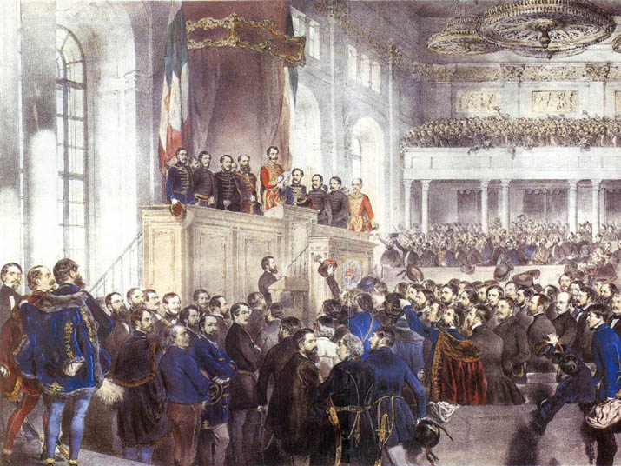
Hungarian parliament

Slide 58
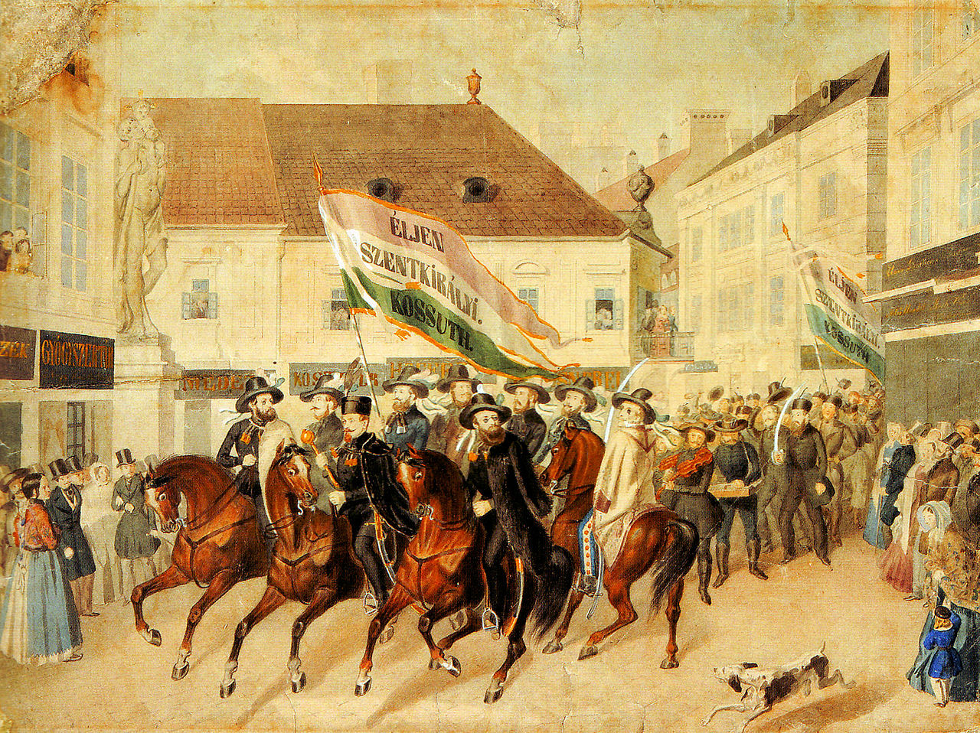
Campaigning

Slide 59
HUNGARIAN TRICOLOR
Republican Nationalism

Slide 60
Russian intervention

Slide 61
Nicholas I
The tsar of Russia assisted the Hapsburg counter-revolution.

Slide 62
I MUST BREAK YOU

Slide 63
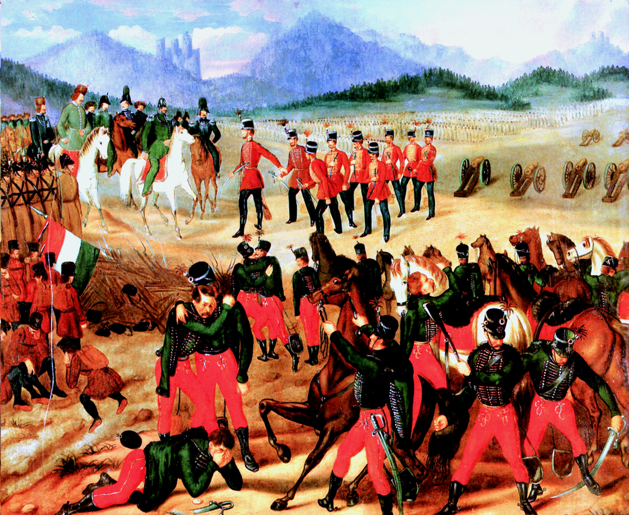
Hungarian surrender

Slide 64
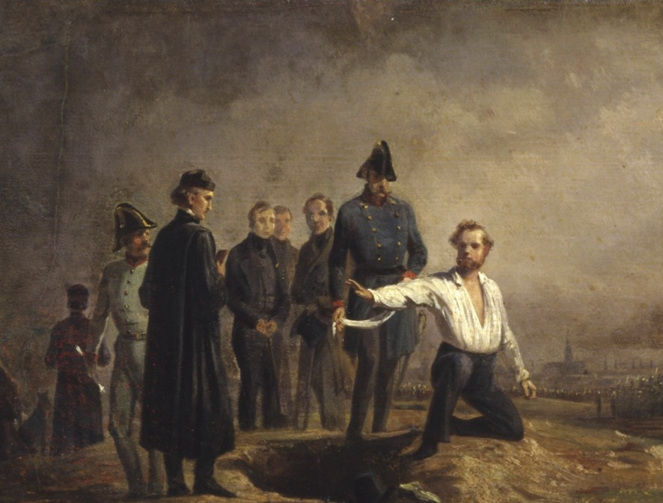
FUTILITY
Painting by Carl Steffeck of the execution of Robert Blum, 1848

Slide 65
I’m back

Slide 66
ITALY

Slide 67
AUSTRIANS
POPE
Foreign dominance
bourbons

Slide 68
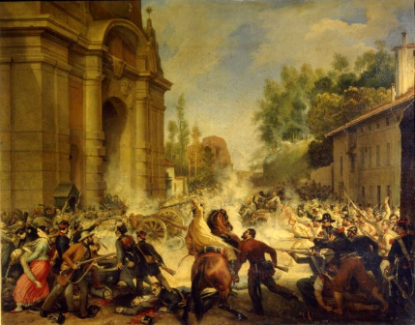
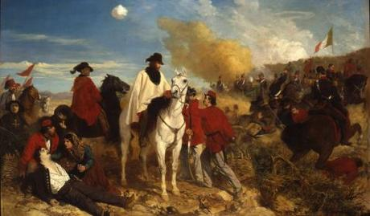
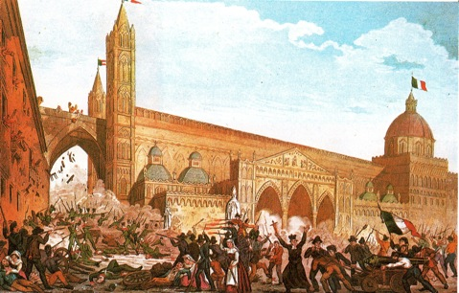
Three
Revolutions
(unsuccessful)

Slide 69
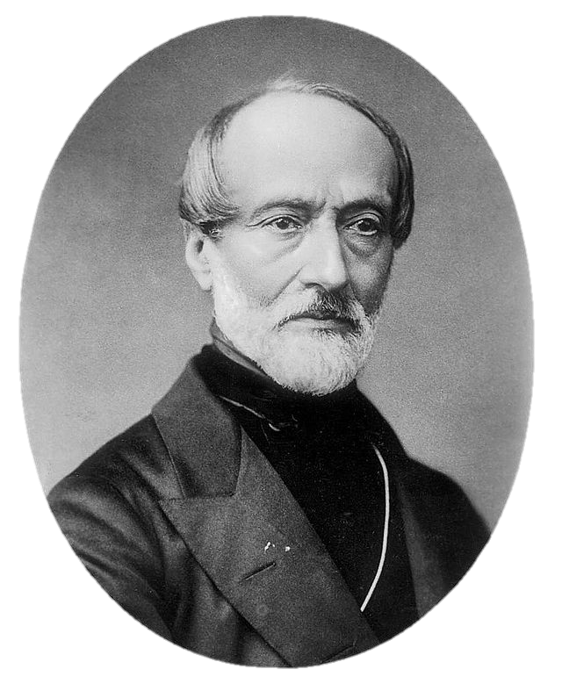
Giuseppe Mazzini
Romantic Nationalist
Activist for Italian Unification

Slide 70
Roman republic (1849)
Mazzini and his allies created a short-lived republic in Rome.
God and the People

Slide 71
ITALIAN TRICOLOR
The current flag of Italy uses the same tricolor design.

Slide 72
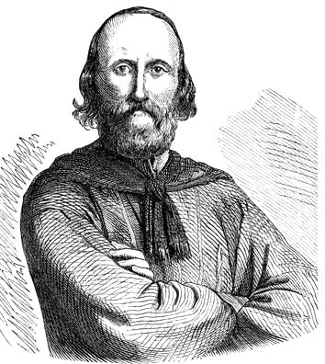
Giuseppe GARABALDI
Commander of the Italian Legion

Slide 73
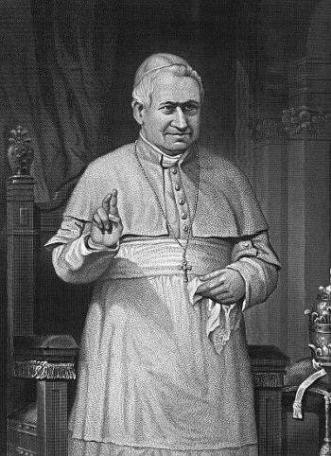
HELP!
The pope left Rome and called for help from Catholic countries.

Slide 74
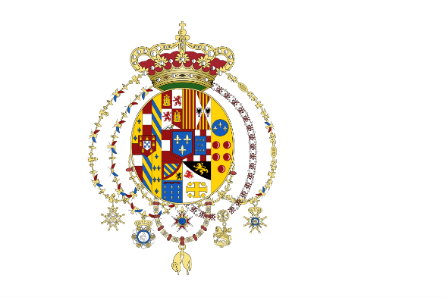
Counter-Revolution

Slide 75
Dovunque saremo, colà sarà Roma.
(Wherever we may be, there will be Rome.)

Slide 76
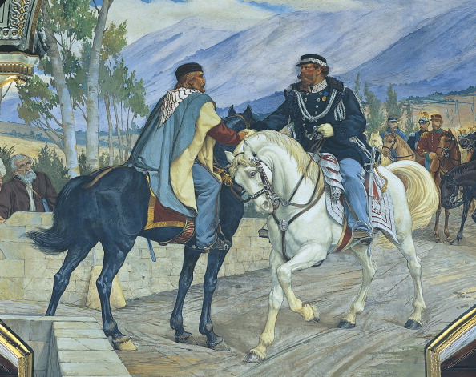
PRAGMATIC NATIONALISM

Slide 77
After the fall of the short-lived Roman Republic, Garibaldi abandoned Mazzini’s republican idealism and later fought to make Victor Emmanuel II the king of a united Italy.

Slide 78
Chartists
Britain

Slide 79
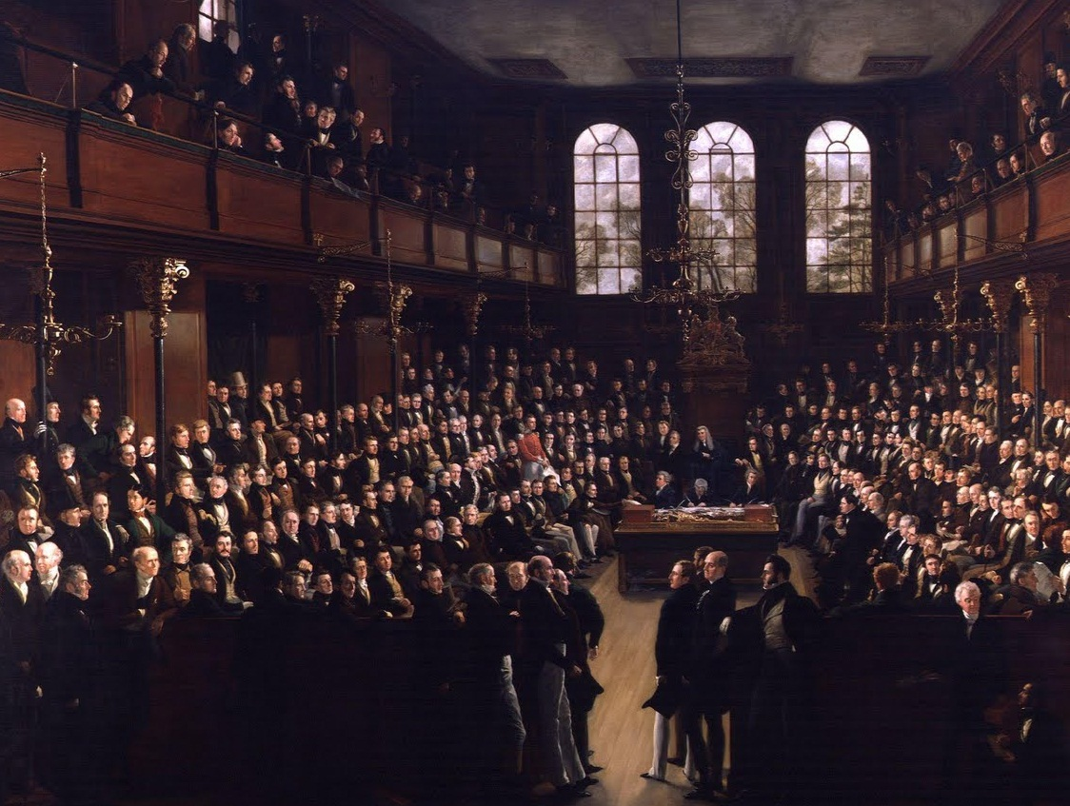
PARLIAMENTARY REFORM
Openness to

Slide 80
REFORM ACT of 1832

Slide 81
Reform measures
Passed by Parliament in lieu of Chartist proposals
MINES ACT 1842
CORN LAWS REPEALED 1846
TEN HOUR ACT 1847

Slide 82
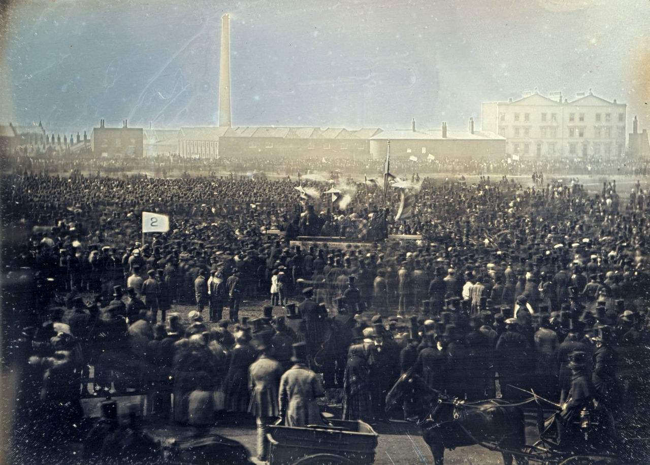
Great Chartist Meeting
April, 1848

Slide 83
REFORM FROM above
RADICAL AGITATION

Slide 84
RUSSIA

Slide 85
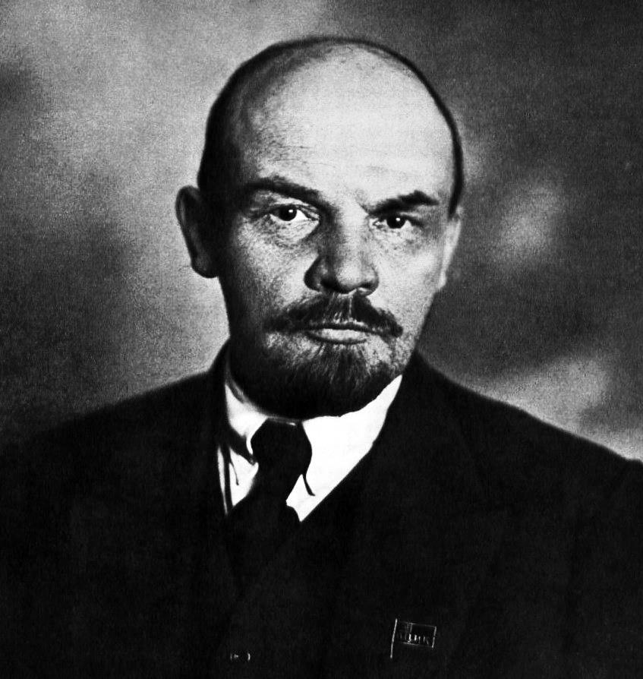
Y U NO REVOLT???

Slide 86
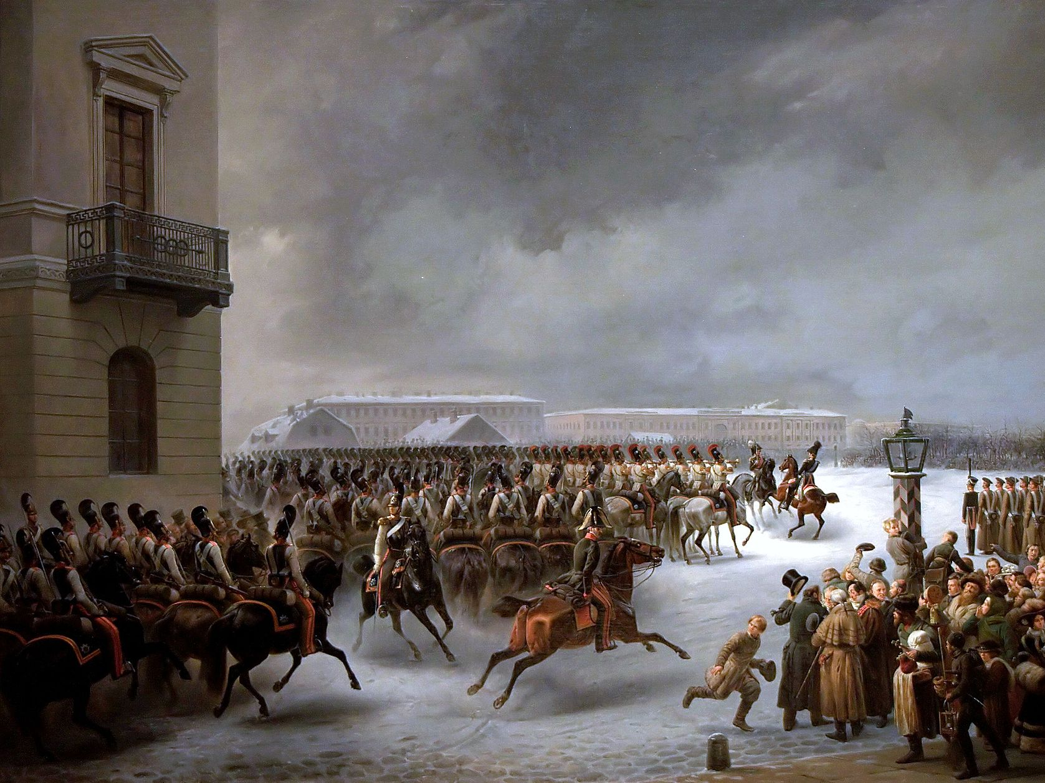
Decembrist Revolt
1825

Slide 87
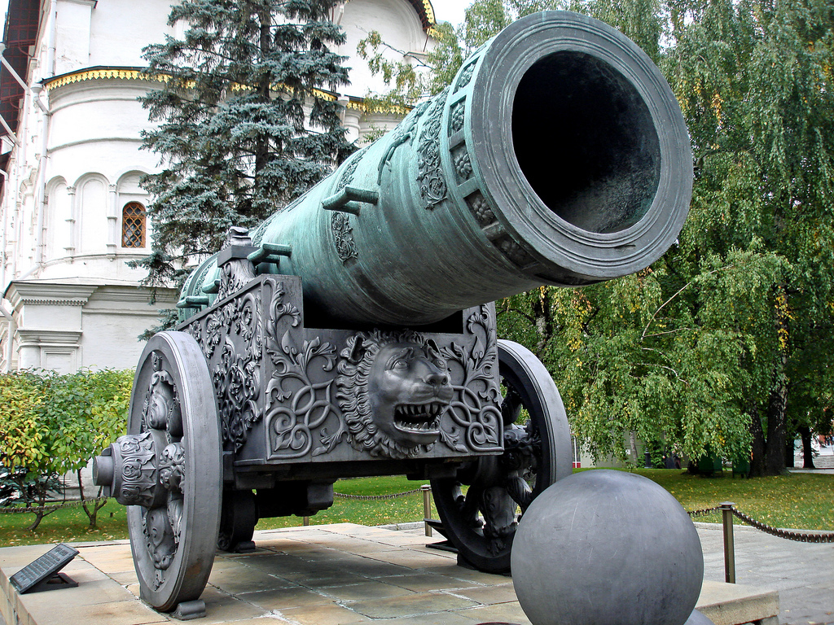
GRAPESHOT
“Tsar Cannon” Photo by Dennis Jarvis

Slide 88
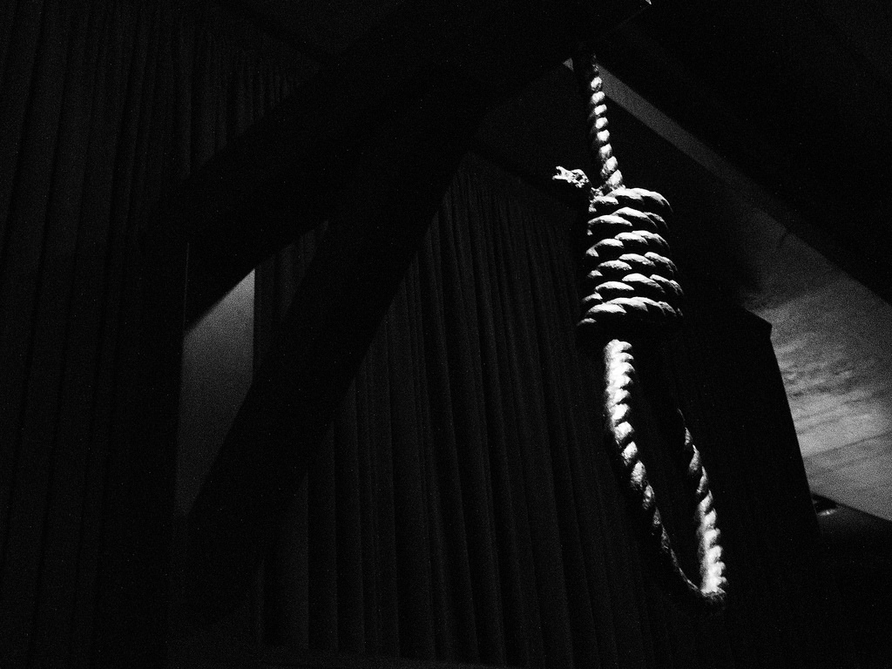
5
Five leaders of the revolt were hanged in the last public execution in tsarist Russia.
Photo by Global Panorama

Slide 89
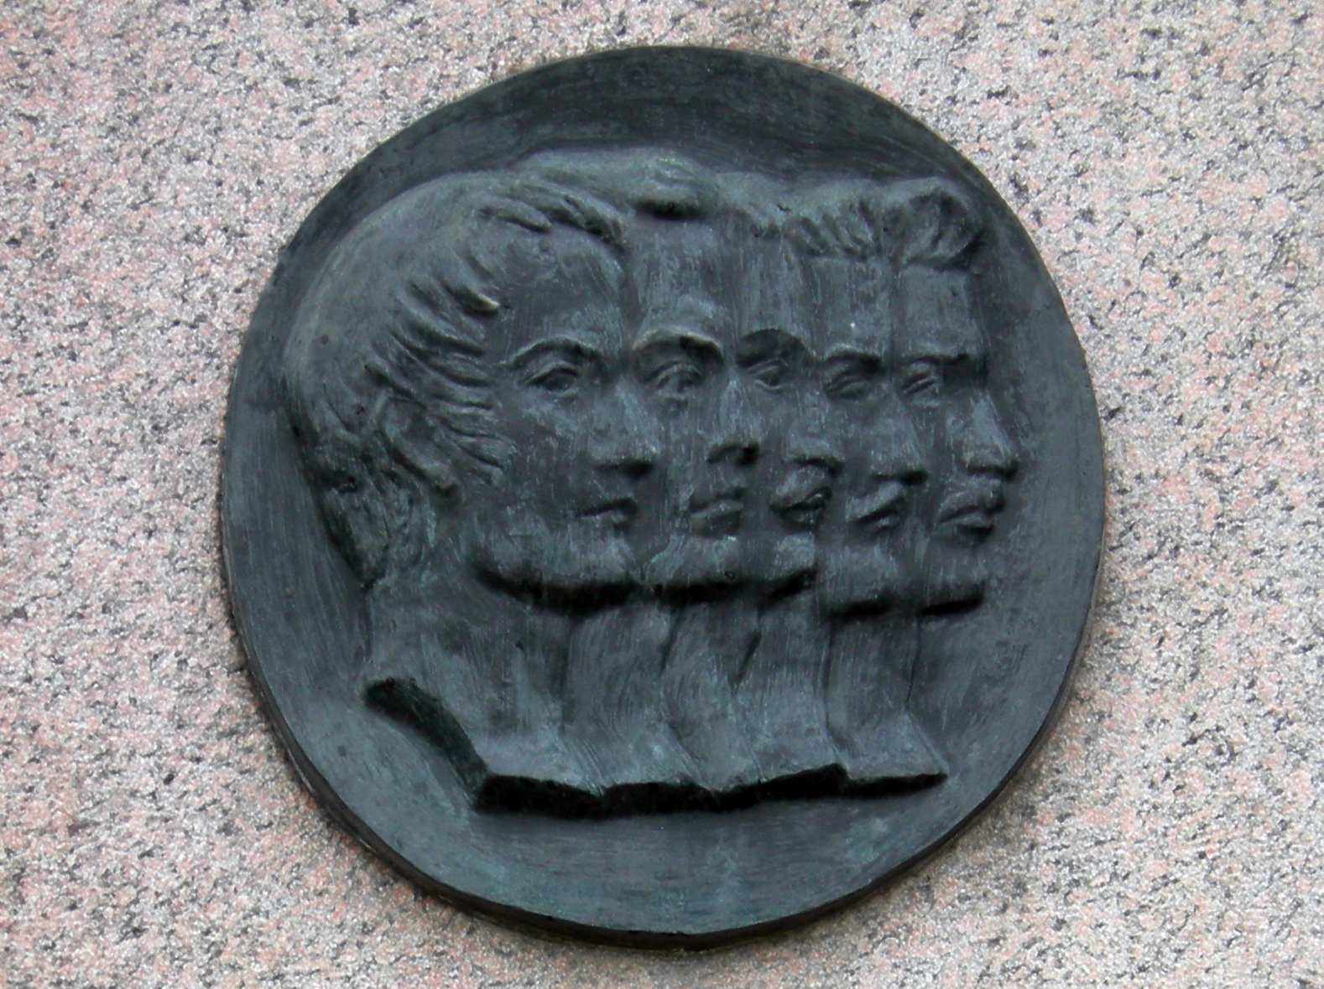

Slide 90
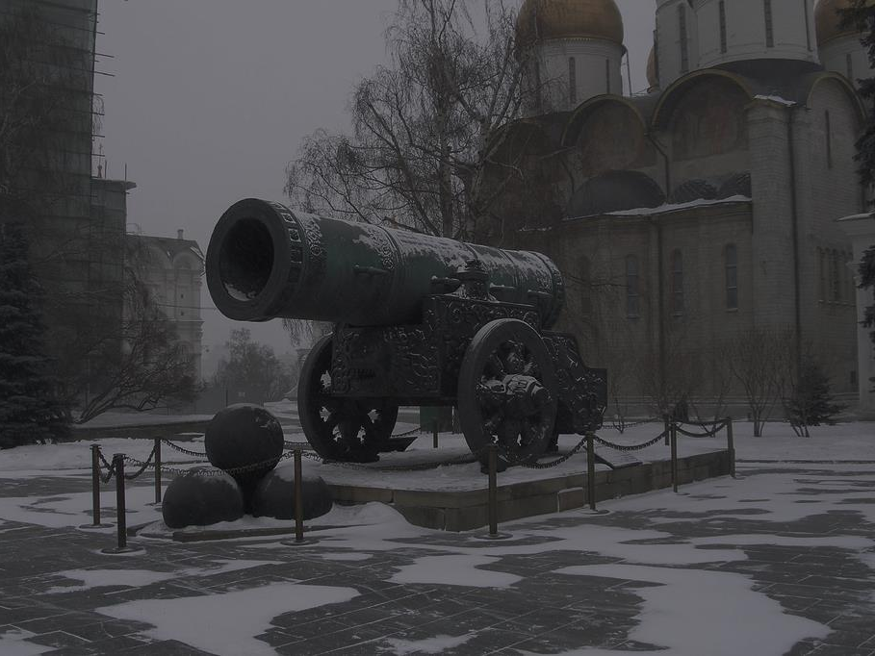
Tsarist repression put down rebellious impulses.
Photo by Vyacheslav Argenberg

Slide 91
For the time being

Slide 92
Revolutions of 1848
Several European nations were swept by a series of simultaneous revolutions.
These revolutions generally failed and conservatives regained to power.
Britain and Russia did not experience the revolutions that otherwise swept over the continent.

Slide 93
END
Age of Metternich
1815-1848

Slide 94
BEGIN Age of Bismarck

Slide 95
END
The Politics of Peace

Slide 96
BEGIN The Politics of Power

Slide 97
PRAGMATISM
Pragmatists would replace idealists as leaders of the unification movements in Germany and Italy.

