Slide 1
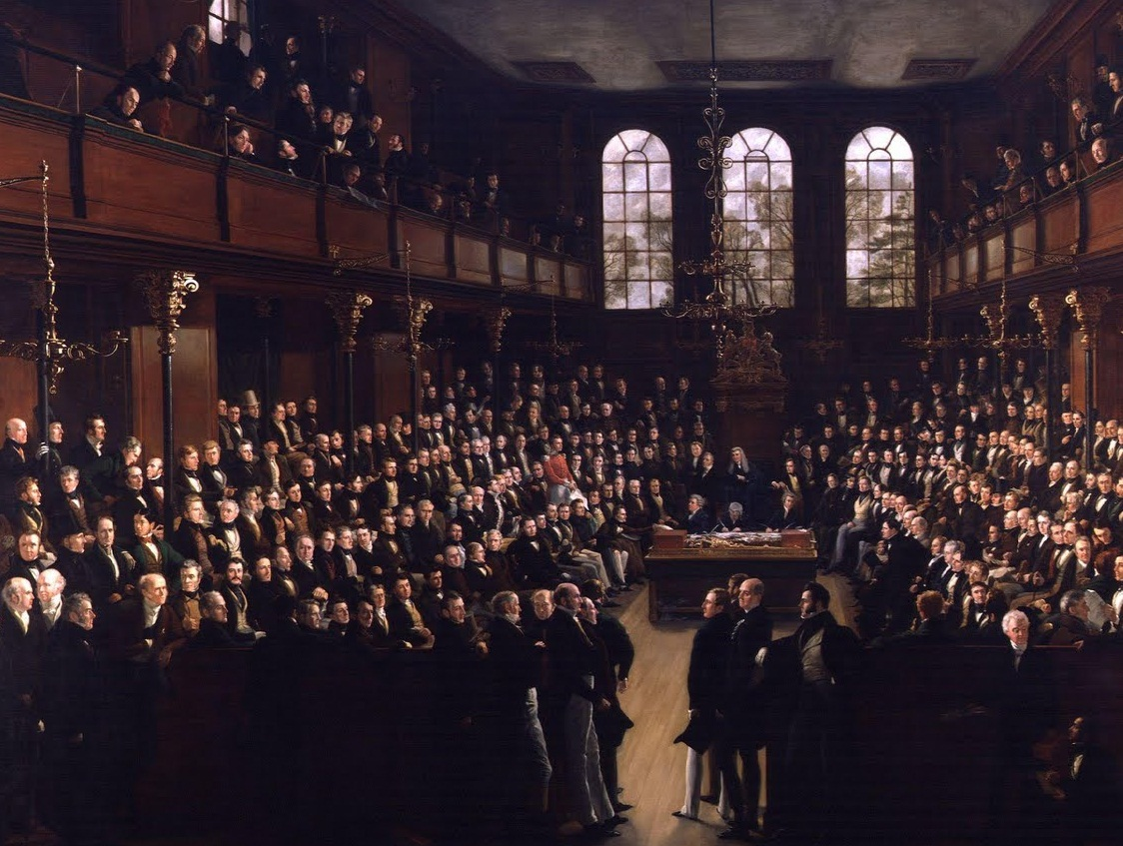
REFORM IN BRITAIN
1815-1848

Slide 2
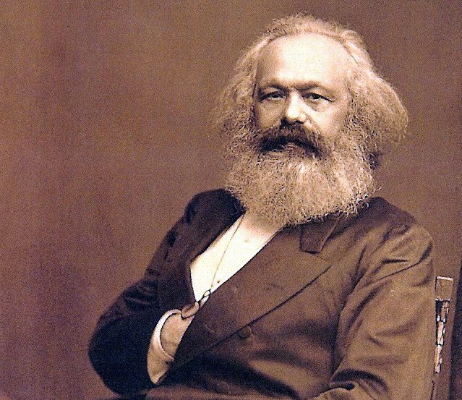
Karl Marx
believed that England was ripe for a proletarian revolution.

Slide 3
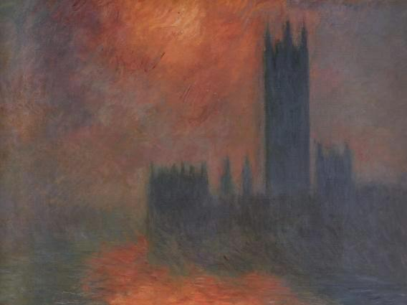
PARLIAMENT
House of LORDS | House of COMMONS
Hereditary Nobility & Church Leaders | “Elected” (LIMITED Suffrage)
http://en.wikipedia.org/wiki/Houses_of_Parliament_series_(Monet)

Slide 4
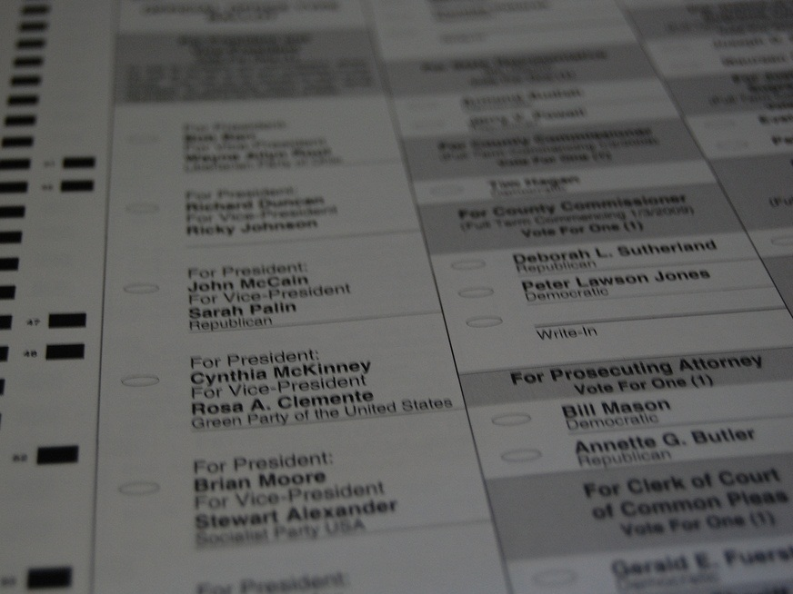
PROPERTY REQUIREMENTS
TO VOTE & HOLD OFFICE
Photo by stu_spivack

Slide 5
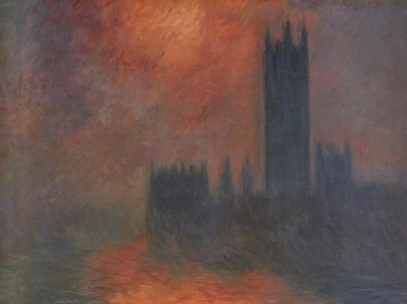
House of Commons
Dominated by LANDOWNERS

Slide 6
ROTTEN BOROUGHS
Photo by Donald Lee Pardue

Slide 7
bor·ough
ˈbərō
A district, town, or administrative unit
Photo by Donald Lee Pardue

Slide 8
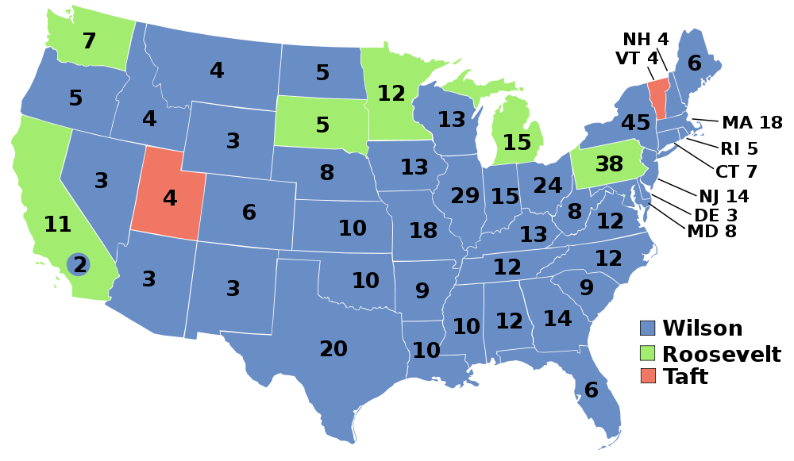
1912 Presidential Election
Which states had the most electoral votes in 1912?

Slide 9
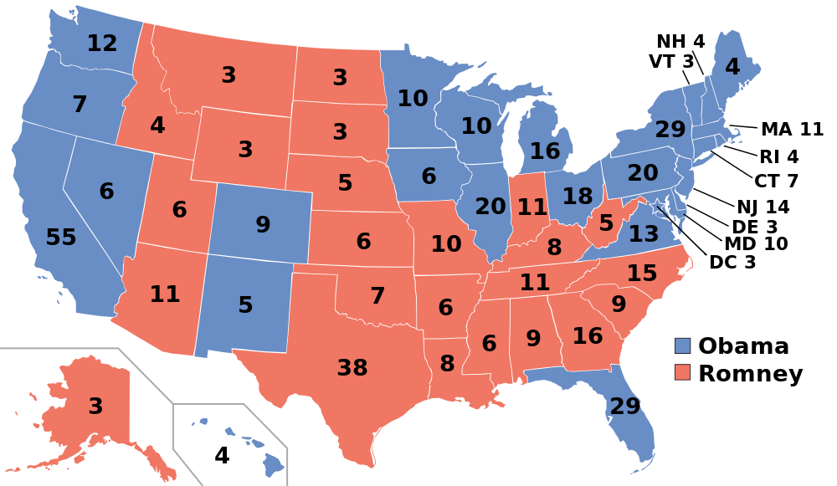
2012 Presidential Election
Where had the U.S. population shifted by 2012?

Slide 10
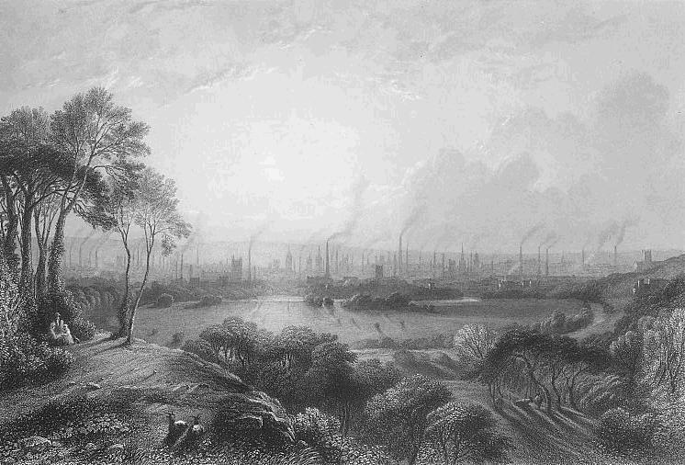
Parliamentary districts did not reflect the population shifts caused by the Industrial Revolution.

Slide 11
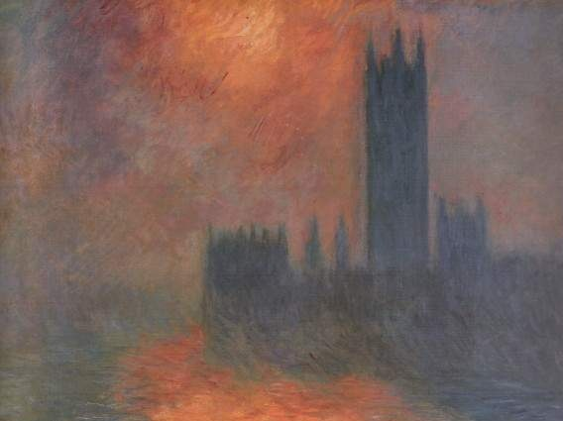
POLITICAL PARTIES
TORIES (Conservatives) | WHIGS (Liberals)
Landed Gentry | Businessmen
http://en.wikipedia.org/wiki/Houses_of_Parliament_series_(Monet)

Slide 12
Rotten Boroughs
allowed the Tories to control Parliament.
http://en.wikipedia.org/wiki/Houses_of_Parliament_series_(Monet)

Slide 13
AND ENRICH THEMSELVES
Photo by epSos .de

Slide 14
Corn Laws
(1815)
Protective Tariff on foreign wheat
“Corn”

Slide 15
PRICES
“Corn”

Slide 16
The Corn Laws
enriched the landed gentry at the expense of everyone else.
Photo by Andrew Wilkinson

Slide 17
1 / 12
of adult males could vote before 1832.
Photo by stu_spivack

Slide 18
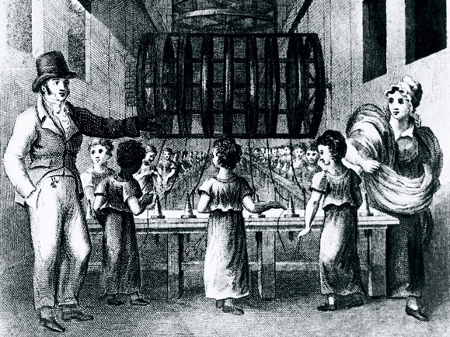
I really need to VOTE!

Slide 19
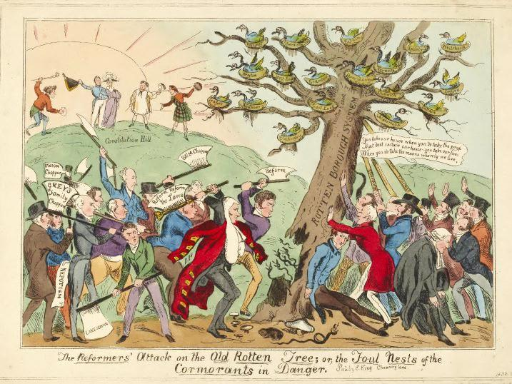
http://www.britishmuseum.org

Slide 20
Reform ACT of 1832
Redistricting to reflect population shifts
Rotten Boroughs

Slide 21
Reform ACT of 1832
Suffrage for the urban middle class
(lowered property requirements)

Slide 22
1 / 6
of adult males could vote after the 1832 Act.
Photo by stu_spivack

Slide 23
5 / 6
STILL COULD NOT
Photo by stu_spivack

Slide 24
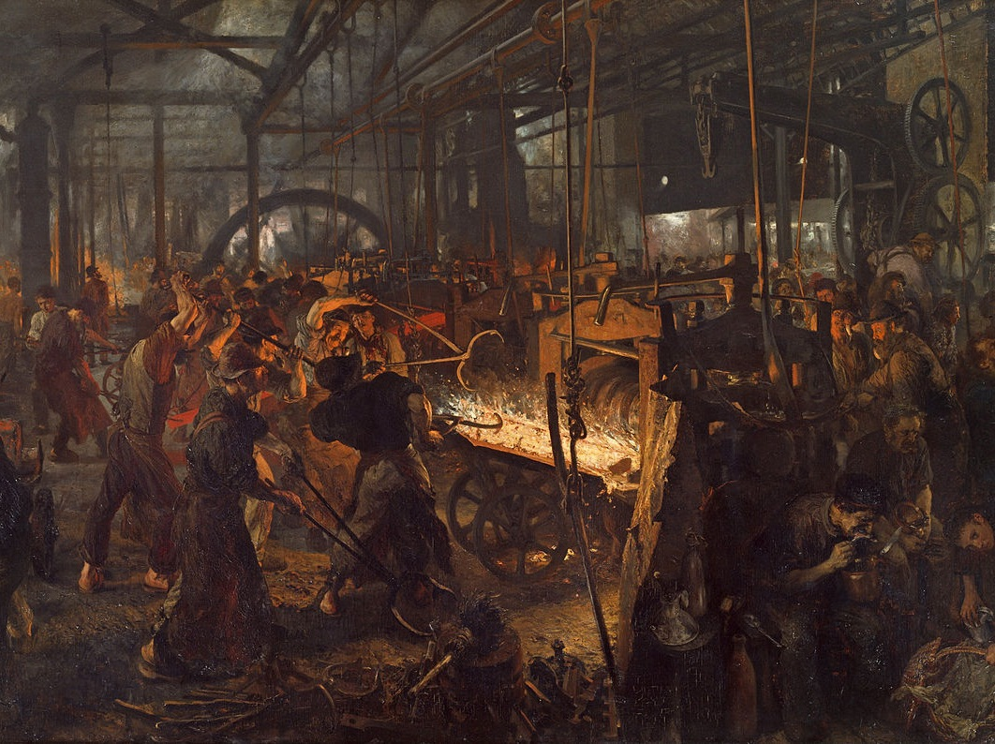
NO SUFFRAGE for the WORKING CLASS

Slide 25
CONSERVATIVE LEADERS
Resisted Working Class Agitation.

Slide 26
“Peterloo” MASSACRE
1819
The cavalry charged into a working class protest, killing 15 and injuring hundreds.

Slide 27
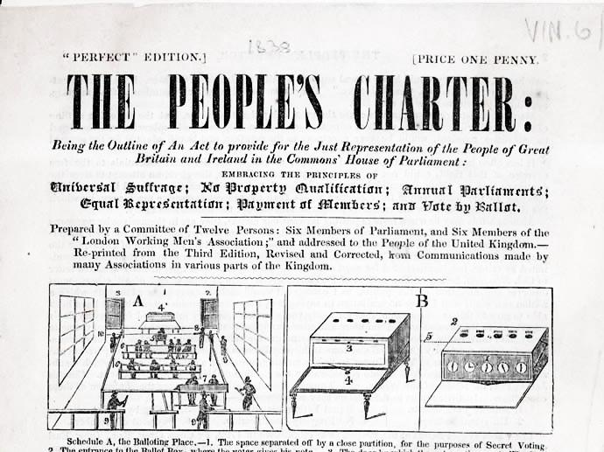

Slide 28
CHARTISTS
1838-1850
Working class activists who supported the People’s Charter

Slide 29
SIX POINTS of CHARTISm
UNIVERSAL MALE SUFFRAGE
EQUAL-SIZED electoral districts
Voting by SECRET BALLOT
NO PROPERTY QUALIFICATION
PAY for members of Parliament
ANNUAL ELECTIONS of Parliament

Slide 30
DEMOCRATIC REFORM

Slide 31
SIX POINTS of CHARTISm
UNIVERSAL MALE SUFFRAGE
EQUAL-SIZED electoral districts
Voting by SECRET BALLOT
NO PROPERTY QUALIFICATION
PAY for members of Parliament
ANNUAL ELECTIONS of Parliament

Slide 32
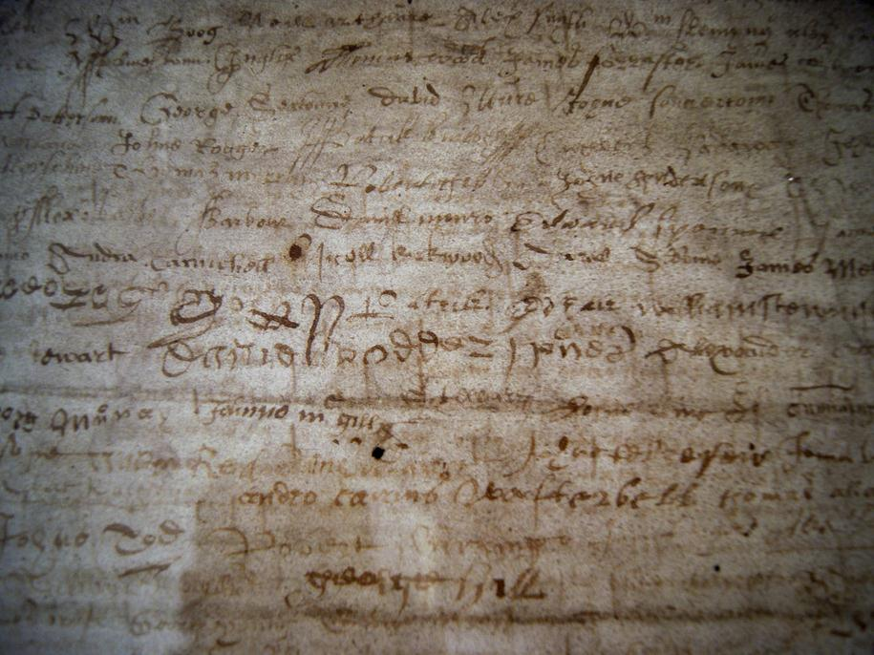
1.3 million
Signatures on the 1839 People’s Charter
Photo by Ian Stannard

Slide 33
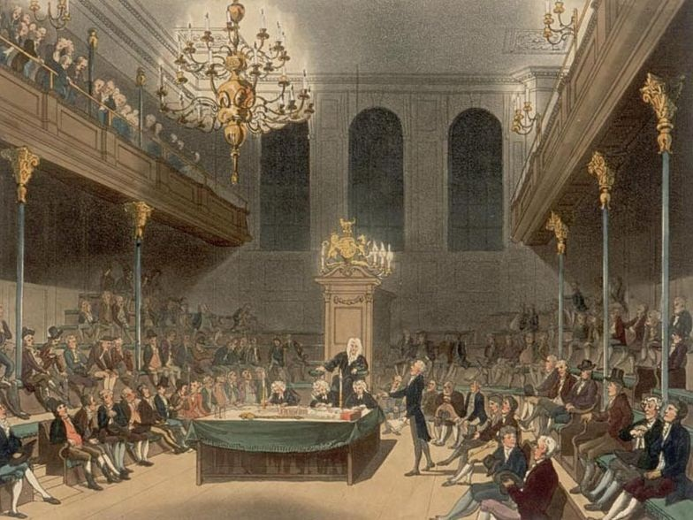
The House of Commons did not accept the petition.

Slide 34
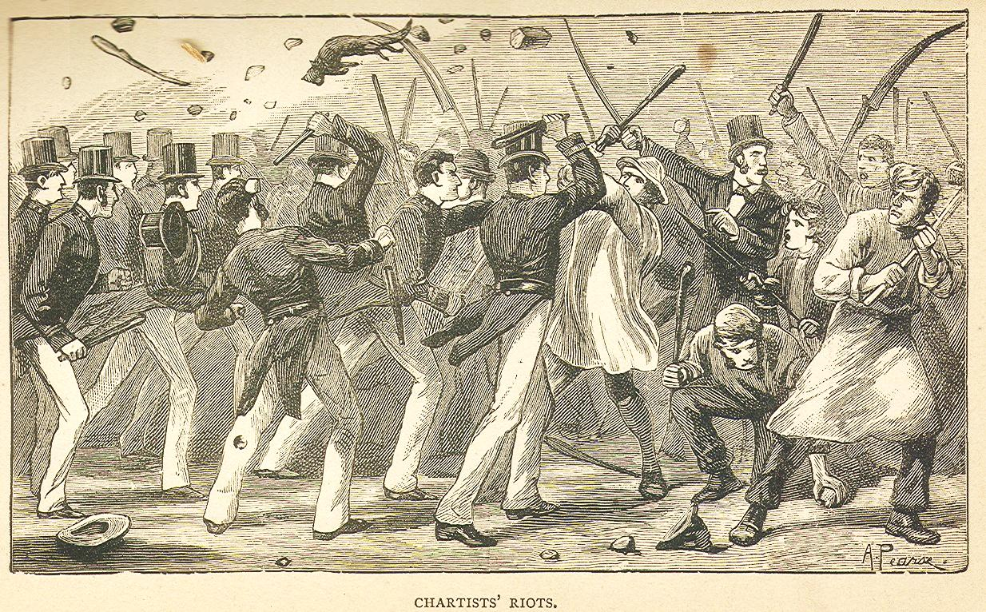
DEMONSTRATIONS
1838-1848

Slide 35
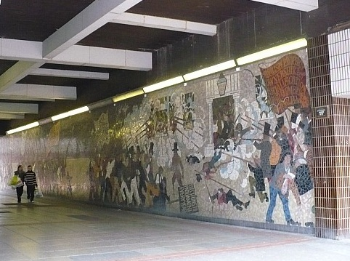
Chartist Mural in Newport
1978-2013
Photo by Robin Drayton

Slide 36
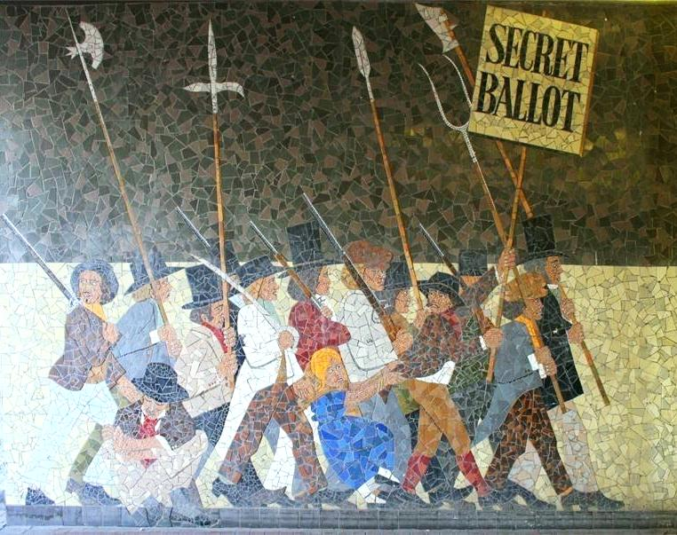
Photo Source: South Wales Chartist Network

Slide 37
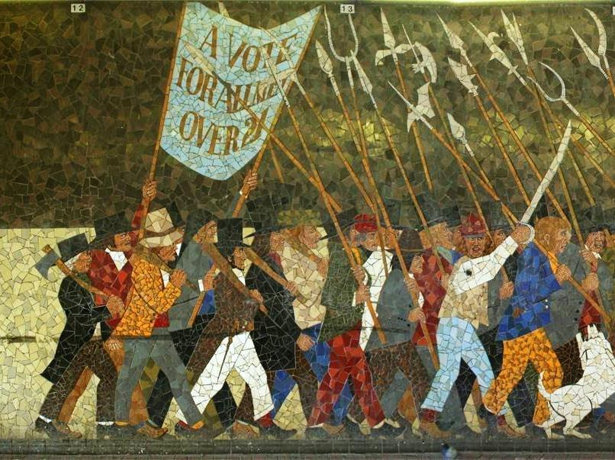
Photo Source: South Wales Chartist Network

Slide 38
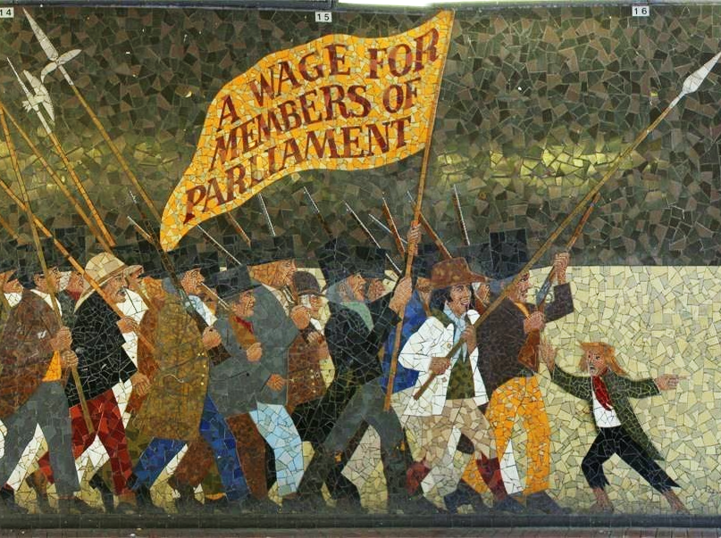
Photo Source: South Wales Chartist Network

Slide 39
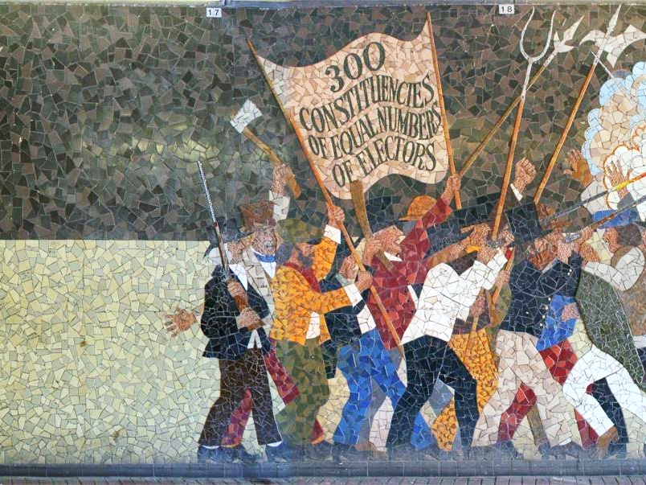
Photo Source: South Wales Chartist Network

Slide 40
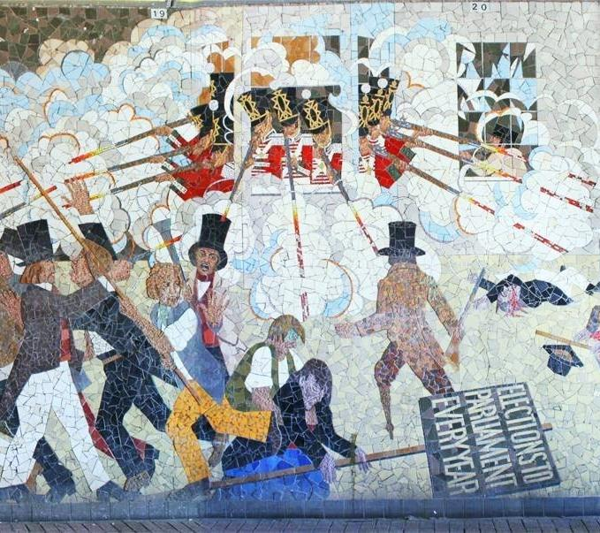
Photo Source: South Wales Chartist Network

Slide 41
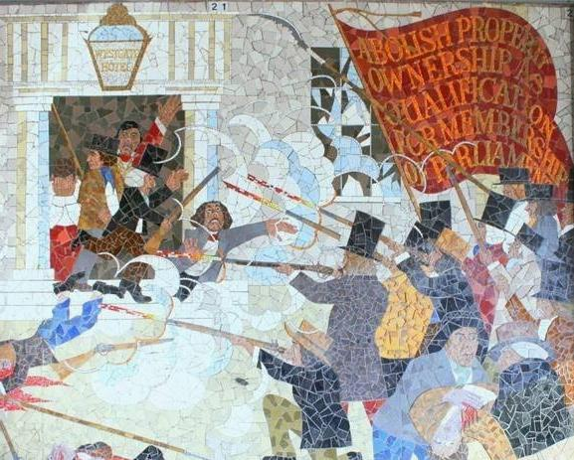
Photo Source: South Wales Chartist Network

Slide 42
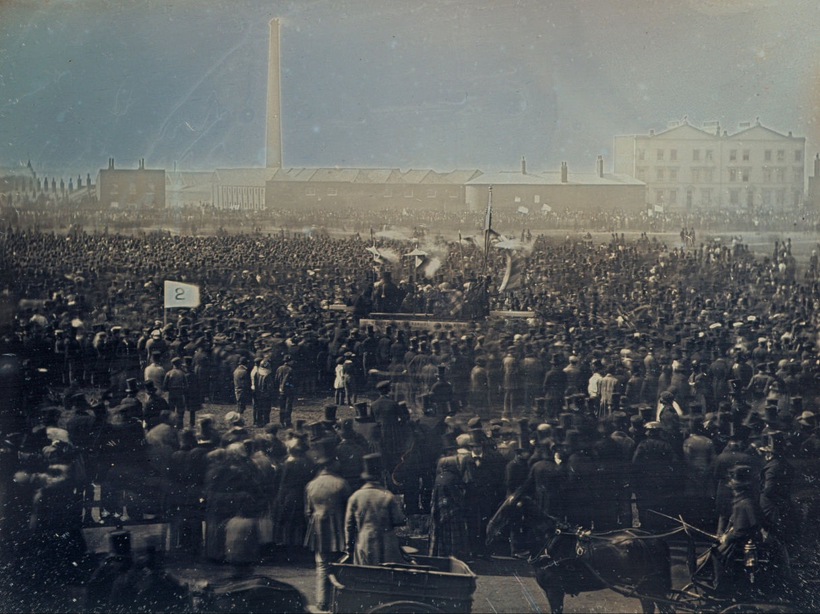
GREAT CHARTIST MEETING
(1848)

Slide 43
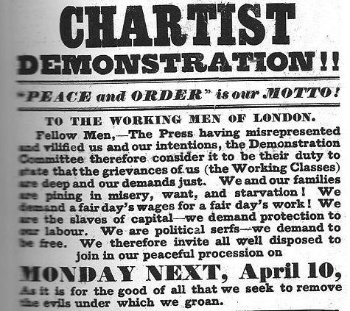
Chartists

Slide 44
Attendance estimates:
Chartists: 300,000
Government: 15,000
Sun. Observer 50,000

Slide 45
SIX POINTS of CHARTISm
UNIVERSAL MALE SUFFRAGE
EQUAL-SIZED electoral districts
Voting by SECRET BALLOT
NO PROPERTY QUALIFICATION
PAY for members of Parliament
ANNUAL ELECTIONS of Parliament

Slide 46
Short term
NOT ACTED UPON
LONG term
All but annual elections eventually took effect.

Slide 47
FREE TRADE

Slide 48
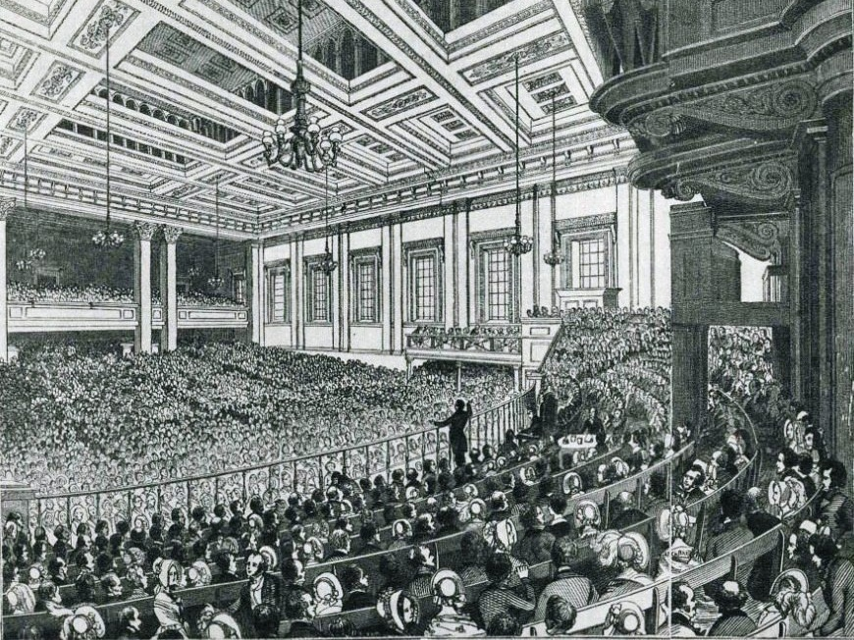
ANTI-CORN LAW LEAGUE
Both liberals and radicals opposed the Corn Laws.

Slide 49
ANTI-CORN LAW LEAGUE
Radical Opposition | LIBERAL Opposition
Lower Grain Prices
Cheaper Food | Pay Workers Less

Slide 50
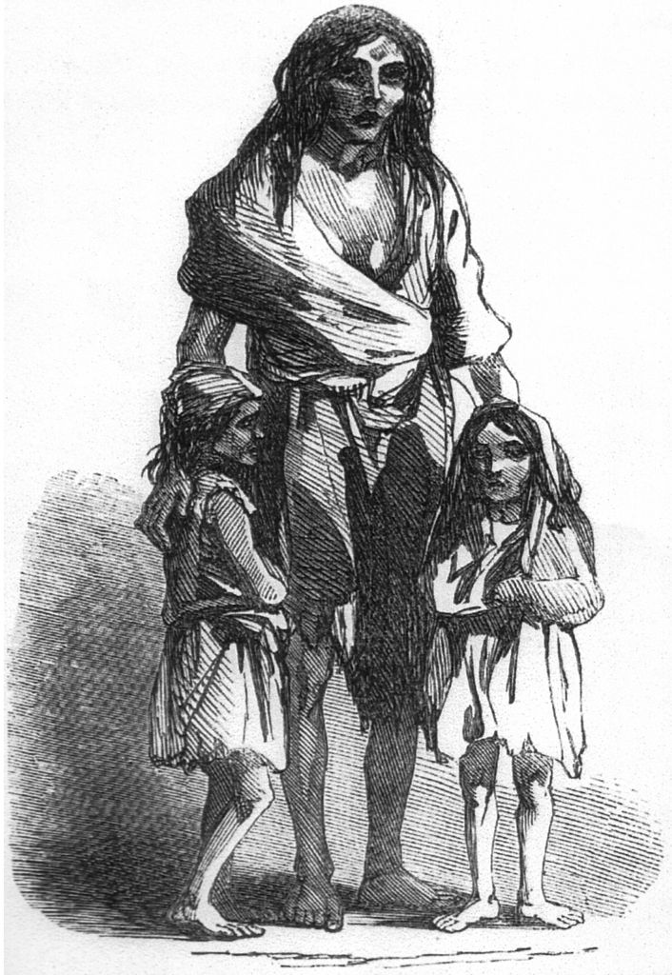
IRISH POTATO FAMINE
1845-1852

Slide 51
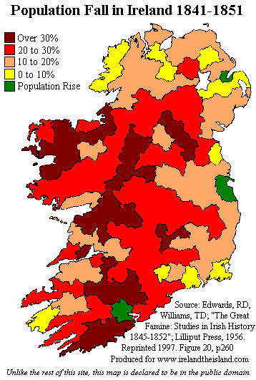
IRISH POTATO FAMINE
1845-1852

Slide 52
HOW can Parliament keep the price of “corn” artificially high when people are STARVING?

Slide 53
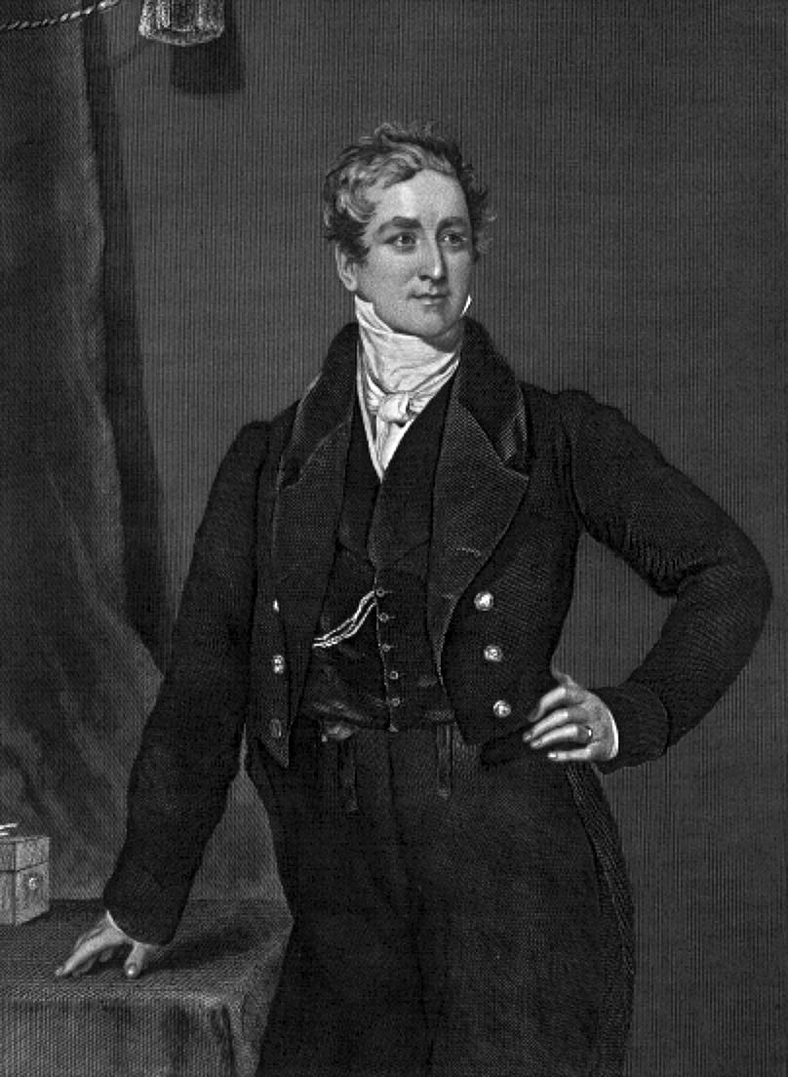
Sir Robert PEEL
Peel’s administration
“re-peeled”
the Corn Laws (get it?).

Slide 54
REFORM FROM above
RADICAL AGITATION

Slide 55
Reform measures
Passed by Parliament in lieu of Chartist proposals
MINES ACT 1842
CORN LAWS REPEALED 1846
TEN HOUR ACT 1847

Slide 56
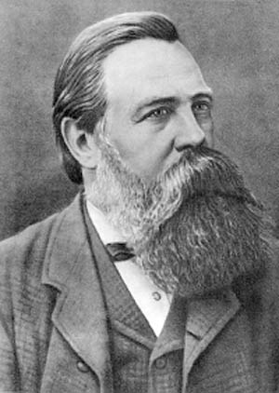
ENGELS TO BRITISH WORKERS
“In order to divert you from the People’s Charter, the only goal important to you, they spawn all sorts of projects for superficial reforms.”
-- Friedrich Engels, Marxist

Slide 57
Reform > Revolution
Parliament’s willingness to pass modest reforms saved Britain from the revolutionary upheavals that happened on the continent.

Slide 58
ULTIMATELY Workers just want more money
Photo by William Warby

Slide 59
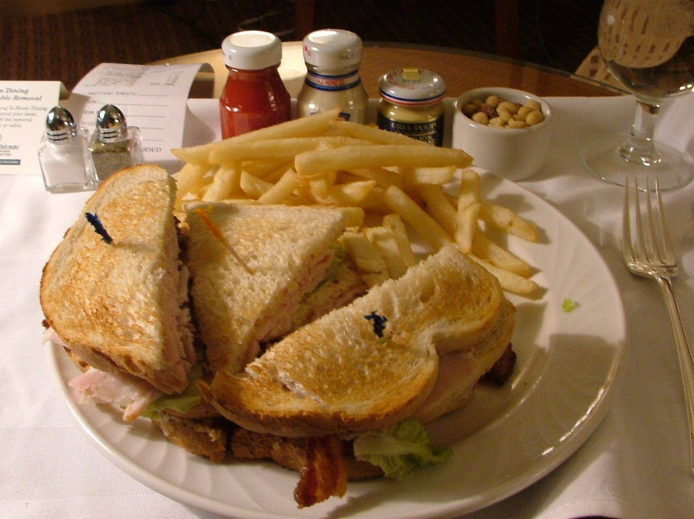
AND FOOD
Photo by Rebecca Partington

Slide 60
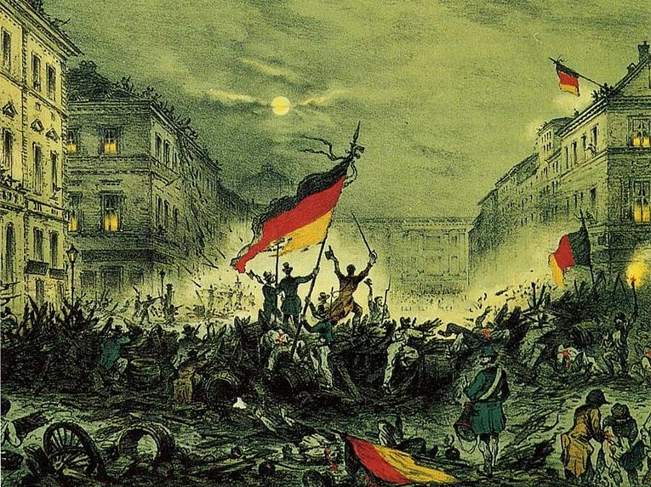
NOT A REVOLUTION
Photo by William Warby

Slide 61
HMPH

