Slide 1
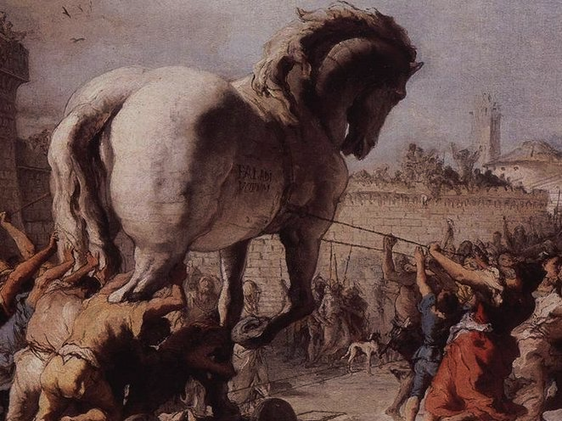
The Trojan War and Homer’s Iliad

Slide 2
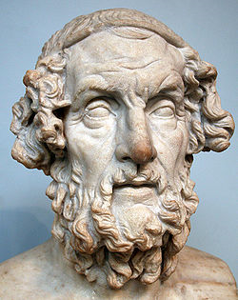
Homer
Epic Poet (c. 700 B.C.)
The Iliad | The Odyssey
An epic about the Trojan War | An epic poem about Odysseus’ long voyage home from Troy
Homer?
Oral traditions from the Mycenaean period, finally written down (hundreds of years later)

Slide 3
A WEDDING
All of the gods were invited to the wedding of Achilles’ parents, Thetis and Peleus…
EXCEPT FOR ONE.

Slide 4
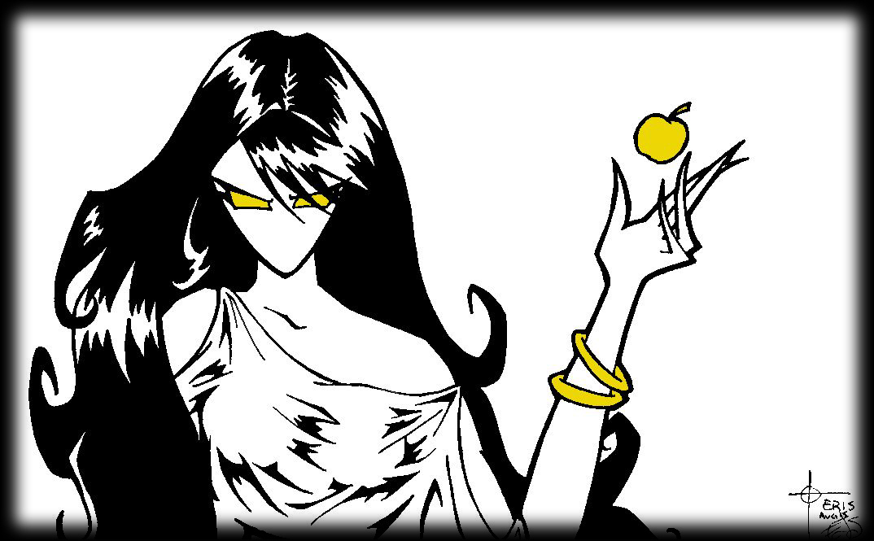
Eris
Image Credit: http://istarwyn.deviantart.com/art/ERIS-21802466

Slide 5
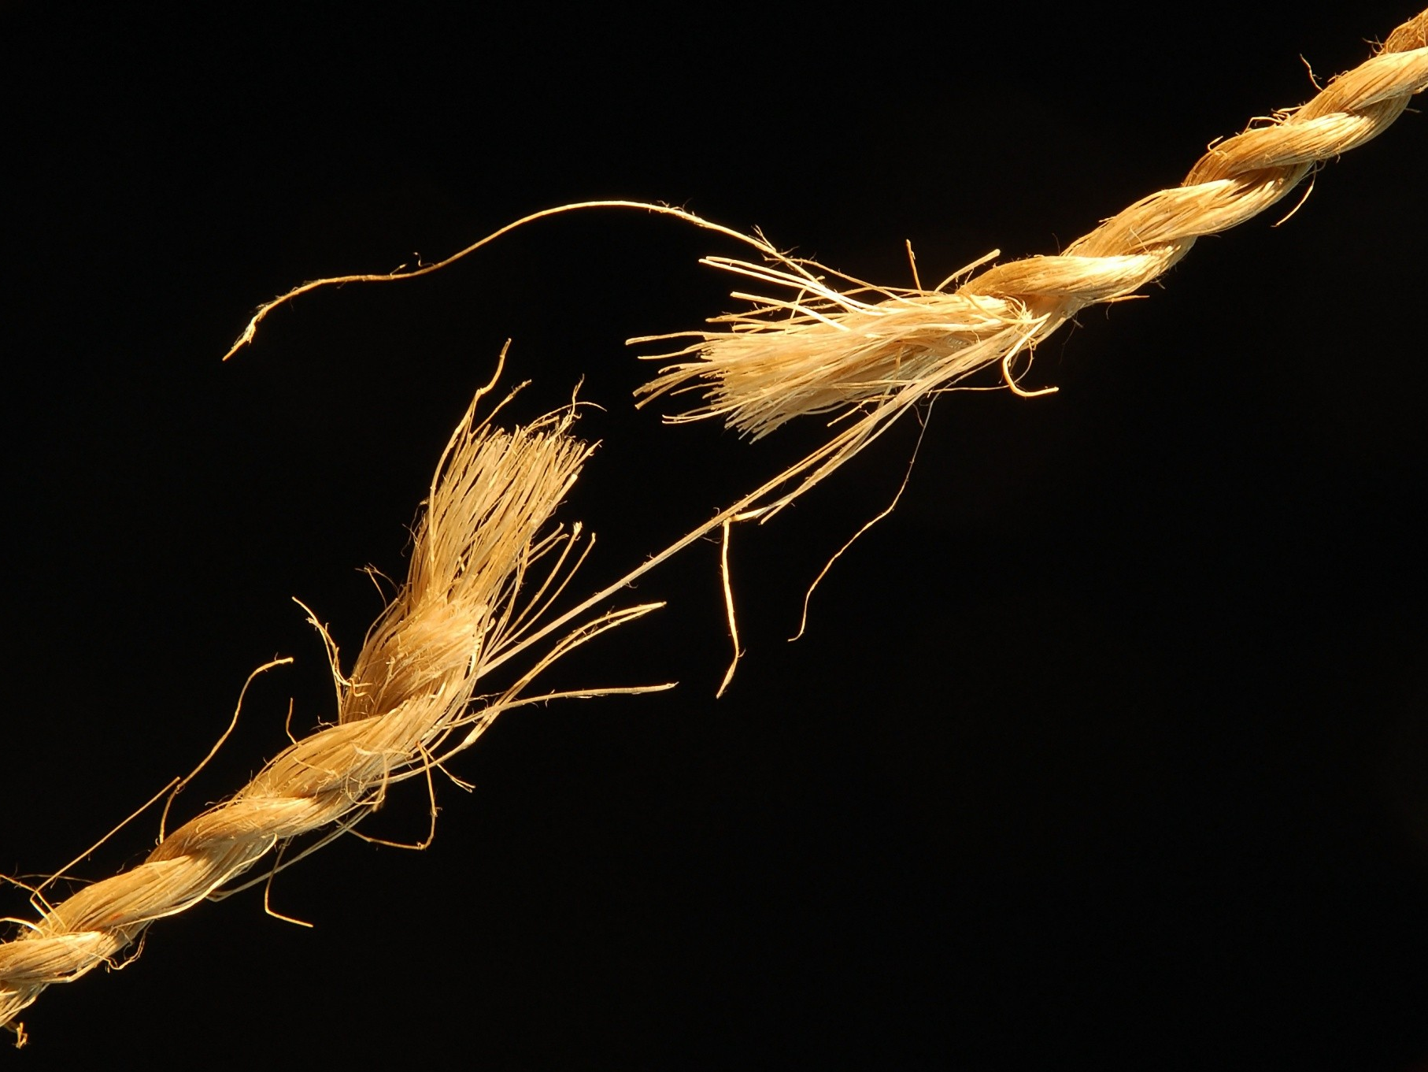
Eris
Goddess of DISCORD
Photo Credit: http://www.nationalgeographic.nl/fotografie/foto/broken-rope

Slide 6
καλλίστῃ

Slide 7
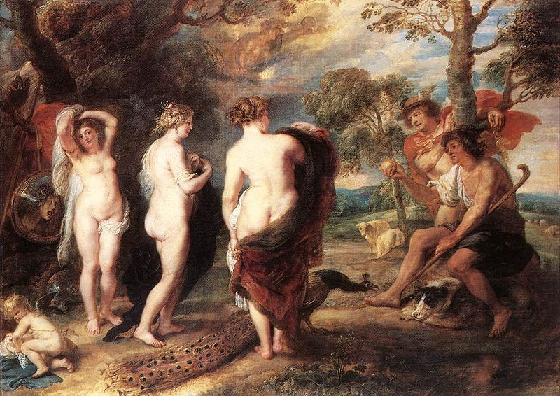
The Judgment of Paris
Paris
Athena
Aphrodite
Watch on YouTube
Hera
The Judgment of Paris, Peter Paul Rubens, ca 1636 (National Gallery, London)

Slide 8
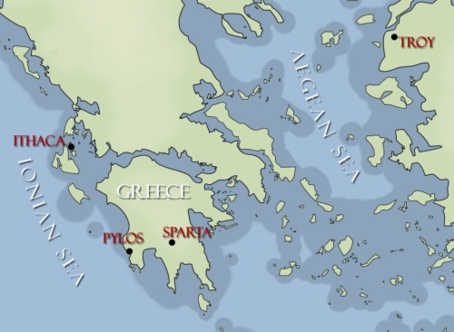
Notes:
Source: http://www.bookdrum.com/images/books/50602_m.jpg

Slide 9
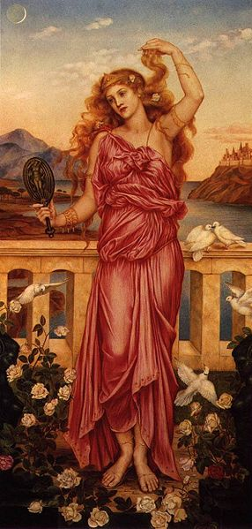
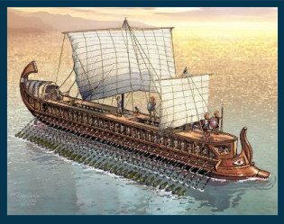
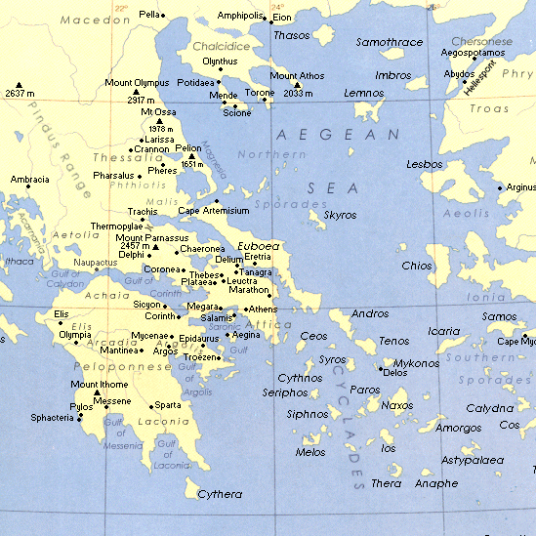
Helen of Troy
“The face that launched a thousand ships”
X 1000
Helen of Troy by Evelyn de Morgan (1898, London)

Slide 10
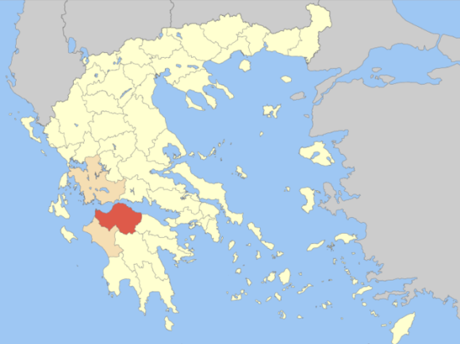
The Trojan War
(13th c. BC?)
Trojans
Priam King of Troy
Hector | Paris
Helen Queen of Sparta Princess of Troy
Achaeans
Agamemnon King of Mycenae
Menelaus King of Sparta Agamemnon’s Brother
Achilles | Odysseus
NEED TO KNOW
SUITOR

Slide 11
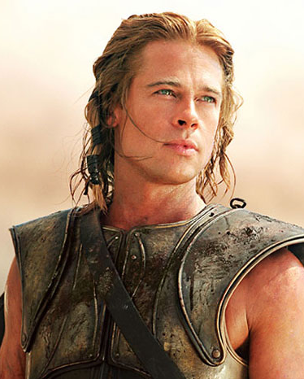
Achilles
The Protagonist of the Iliad
“Sing, Goddess, of the rage of Peleus' son Achilles, the accursed rage that brought great suffering to the Achaeans.”
-- Opening lines of The Iliad
Brad Pitt as Achilles

Slide 12
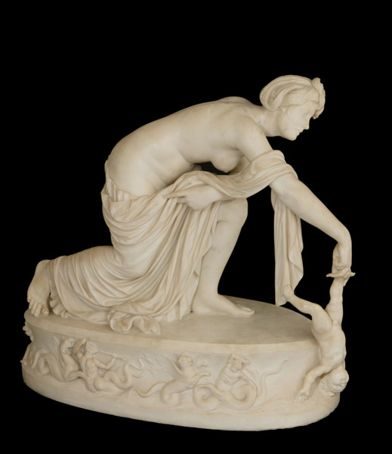
The Legend of Achilles
Post-Homeric legends portrayed Achilles as invincible, except for his heel.
Thetis dips baby Achilles into the River Styx

Slide 13
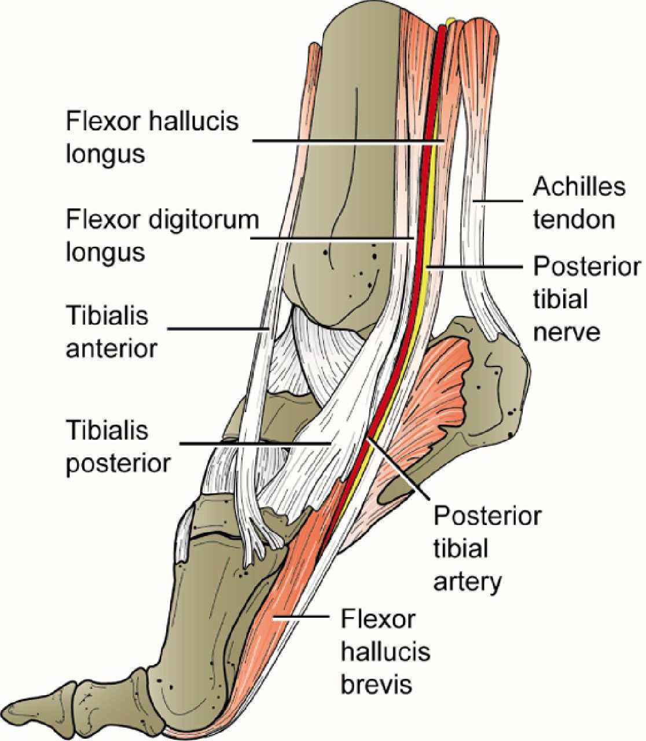
Achilles Tendon
“Achilles Heel”
A Person’s Weakness
Picture Credit:
Oxford Medicine
Notes:
http://oxfordmedicine.com/doc/10.1093/med/9780199228881.001.0001/graphic310-full.jpg

Slide 14
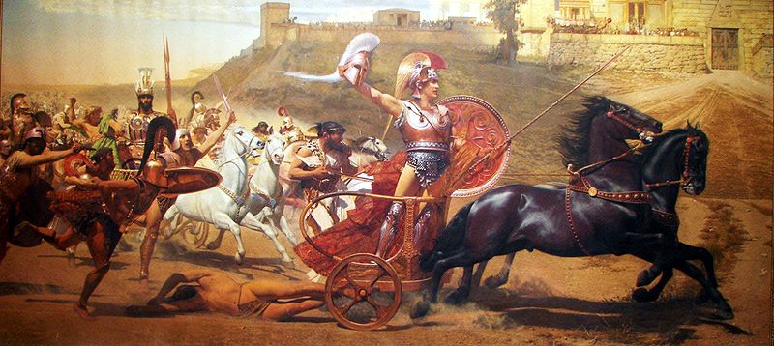
Achilles vs. Hector
The Climactic Confrontation of the Iliad
Triumphant Achilles dragging Hector's lifeless body in front of the Gates of Troy (from a panoramic fresco on the upper level of the main hall of the Achilleion).

Slide 15
Ecclesiastes 6:3
A man may have a hundred children and live many years; yet no matter how long he lives, if he cannot enjoy his prosperity and does not receive proper burial, I say that a stillborn child is better off than he.

Slide 16
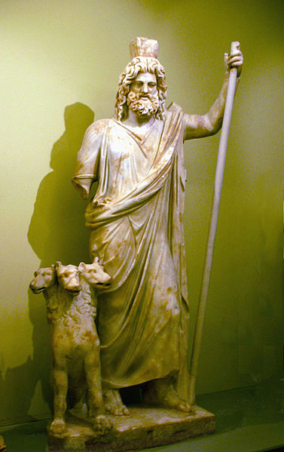
Hades
Lord of the Underworld
Ancient Greeks believed that the dead went to the Hades, the underworld named for the Lord of the Dead.
Hades, pictured with Cerberus

Slide 17
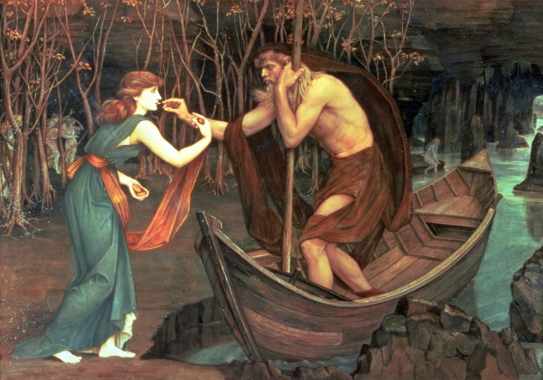
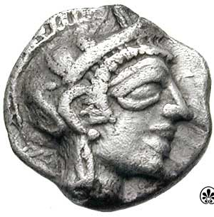
Charon’s Obol
The ancient Greeks placed a coin in the mouth of the deceased to pay the boatman for passage across the river Styx to Hades.

Slide 18
John Roddam Spencer Stanhope, Charon and Psyche (1883)

Slide 19
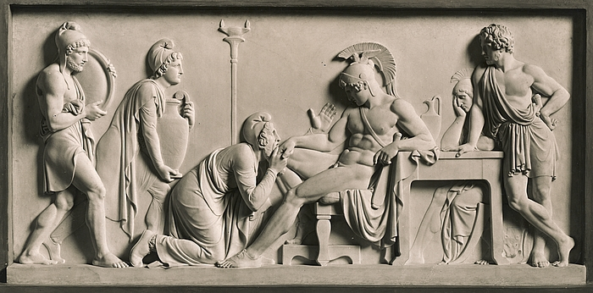
Respect for the Dead
Homer’s Iliad ends when Achilles gives Hector’s body to Priam to receive the proper funeral ceremonies.
Bertel Thorvaldsen, Priam Pleads with Achilles for Hector's Body (1868-1870)

Slide 20
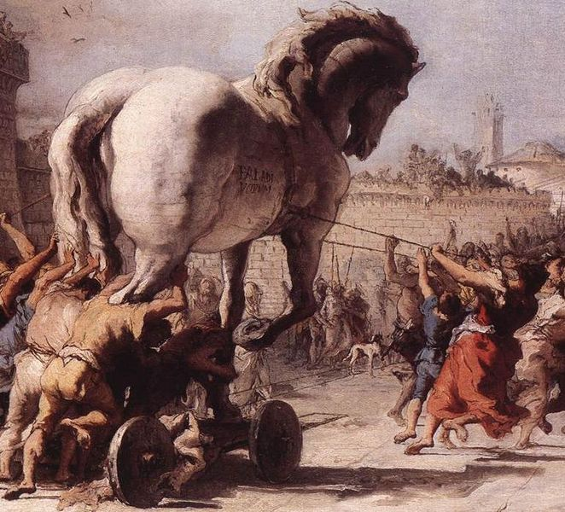
The Trojan Horse
“Beware of Greeks bearing gifts…”

Slide 21
The Great Roman Epic
The story of the Trojan Horse appears in Virgil’s Aeneid, not in Homer’s works.

Slide 22
A Historical Core ???

Slide 23
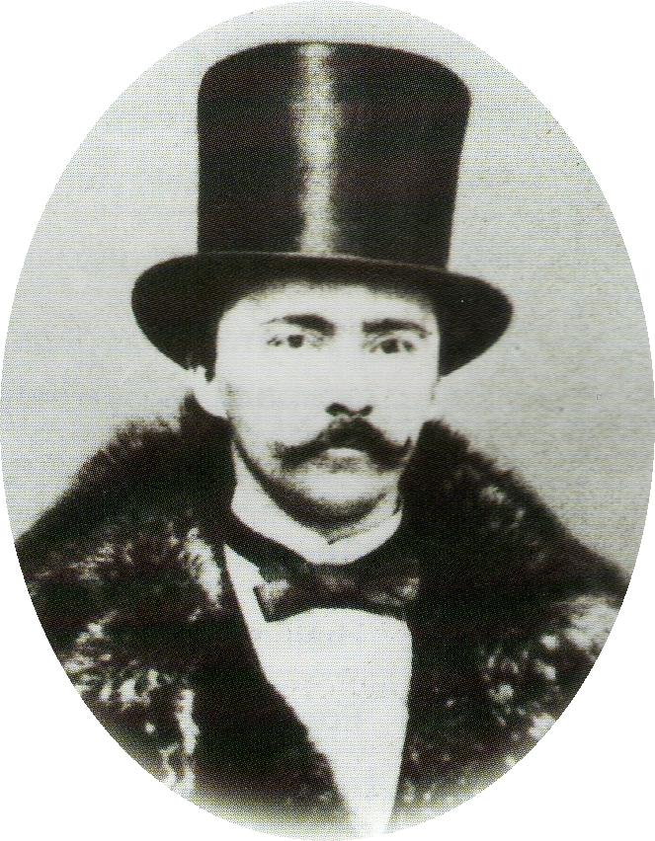
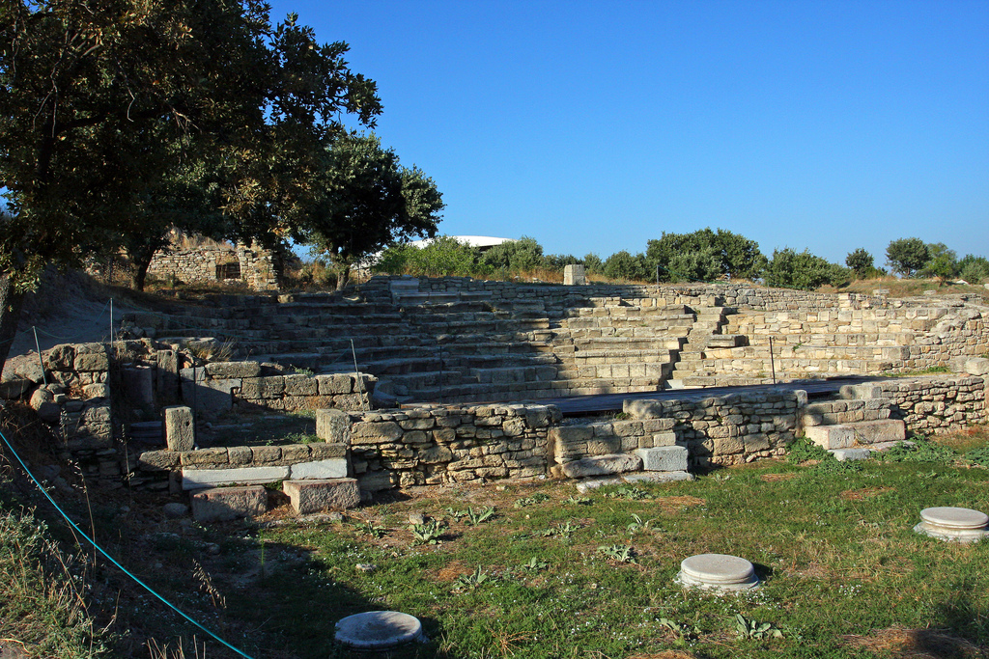
Heinrich Schliemann
19th c.
Excavated Troy(?)
Schliemann believed that the events in Homer’s Iliad were based on actual, historical events.

Slide 24
The Ruins of Troy?
Photo Credit: Hillarie

Slide 25
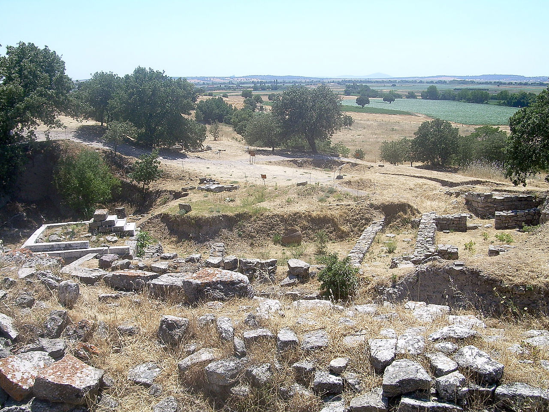
The Ruins of Troy?
Photo Credit: Cherryx

Slide 26
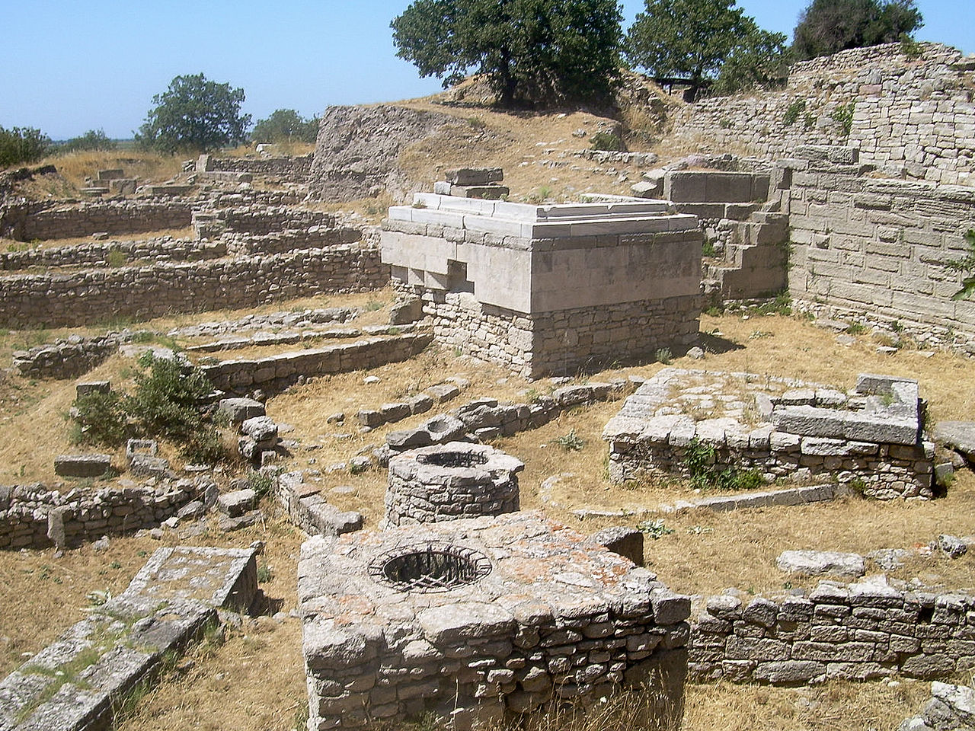
The Ruins of Troy?
Photo Credit: Cherryx

Slide 27
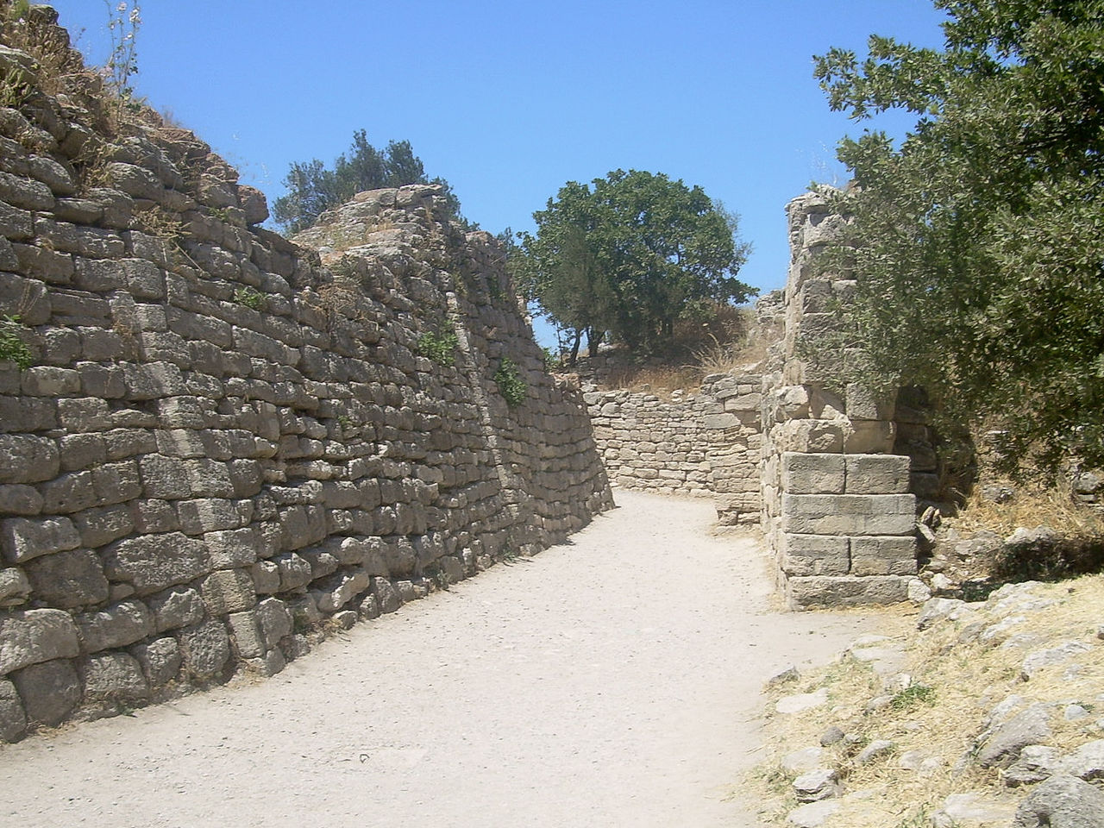
The Walls of Troy?
Photo Credit: Cherryx

Slide 28
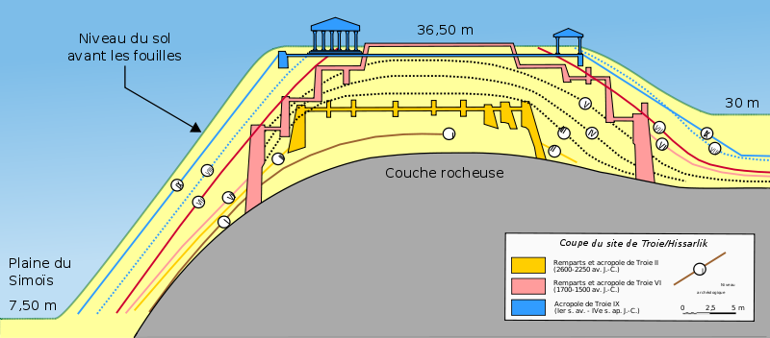
The Digging Continues...
...and the French are taking note!

