Slide 1
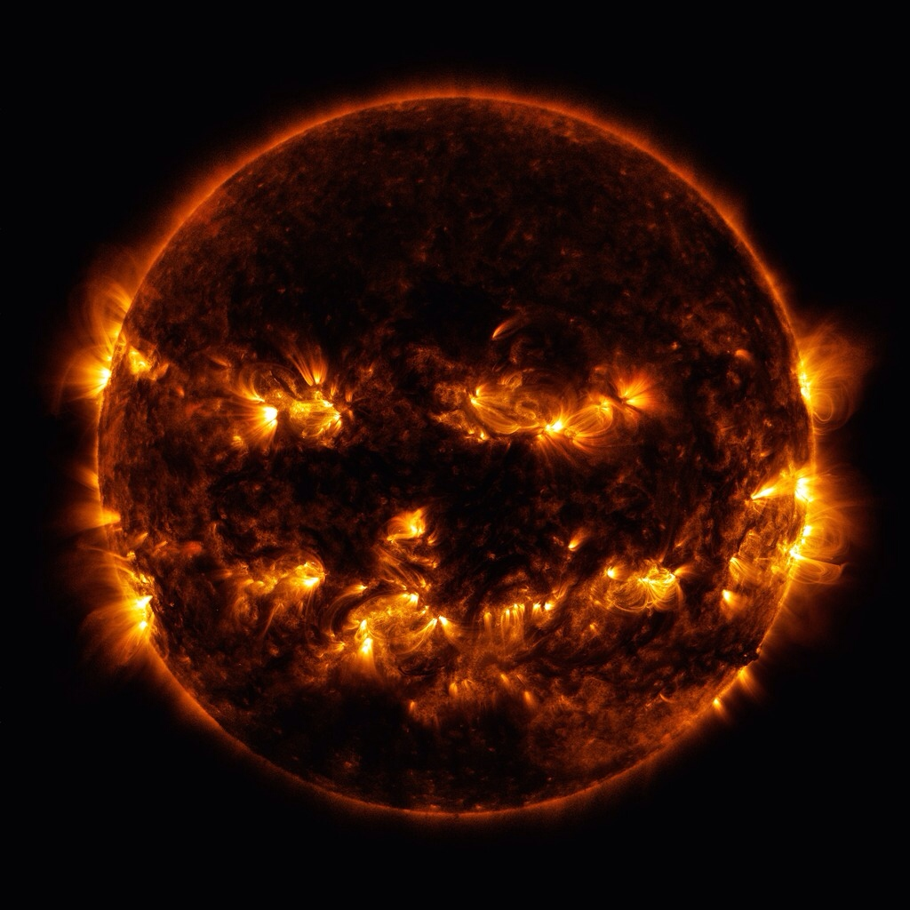
Copernicus & Galileo
A Scientific Revolution
Photo Credit: NASA

Slide 2
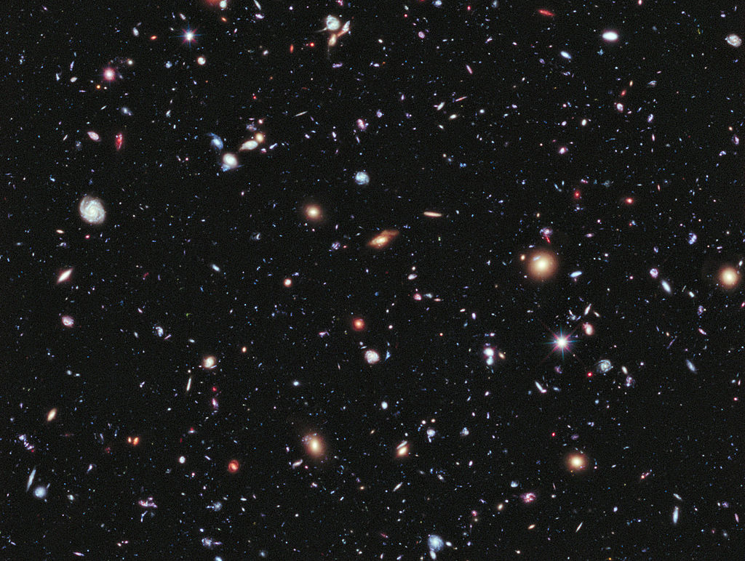
COSMOLOGY

Slide 3
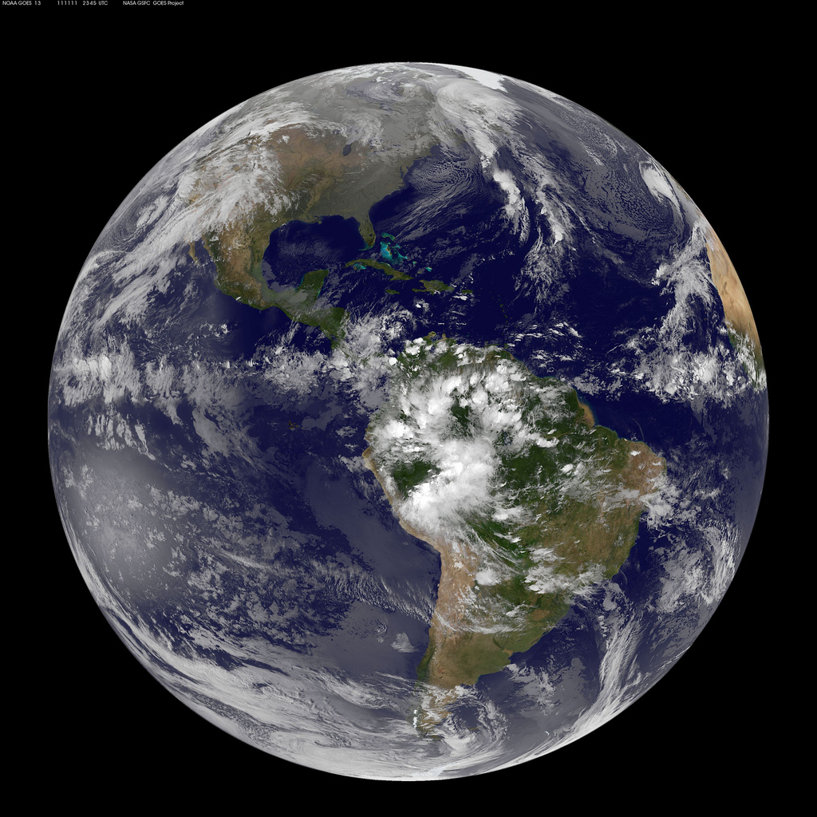
Geocentrism
The belief that the earth is at the center of the Universe
Photo by NASA

Slide 4
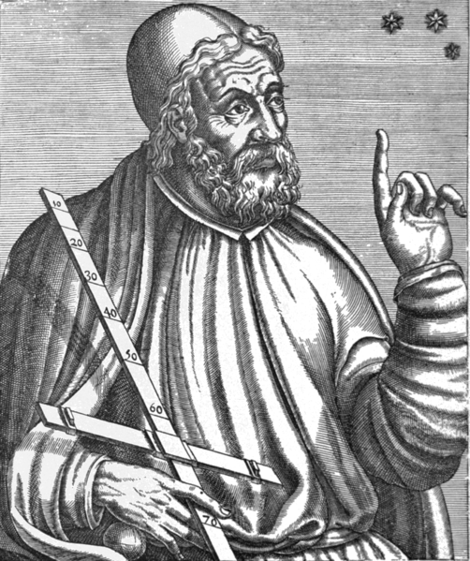
Reverence for Ancient Authorities
Ptolemy (2nd c. AD)
Greco-Egyptian mathematician & astronomer

Slide 5
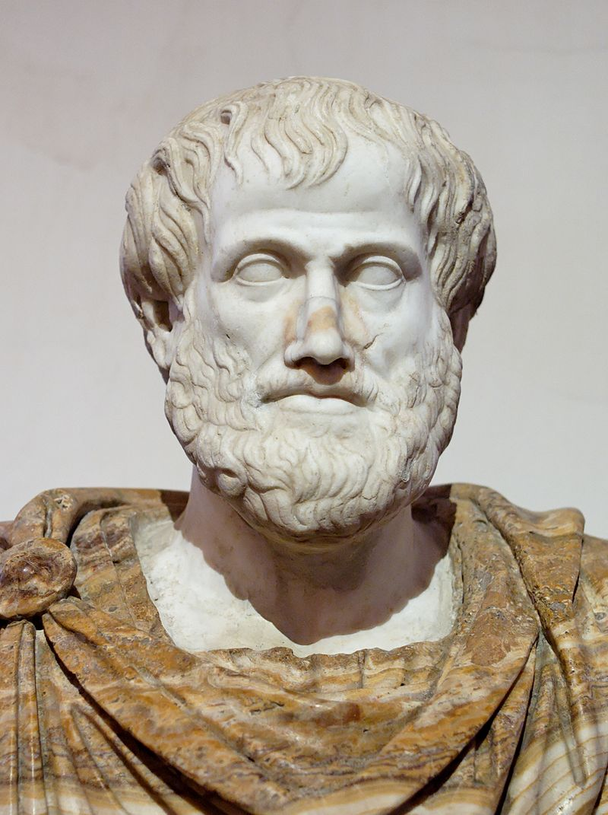
Reverence for Ancient Authorities
Aristotle (4th c. BC)
Greek philosopher and scientist – THE authority on physics

Slide 6
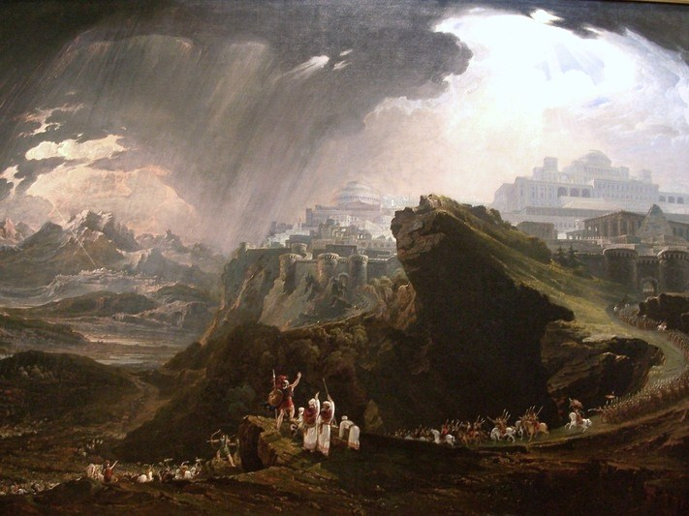
The Bible
John Martin, Joshua Commanding the Sun to Stand Still (1816)

Slide 7
There was no day like that before it or after it, when the LORD listened to the voice of a man; for the LORD fought for Israel.”
-- Joshua 10
John Martin, Joshua Commanding the Sun to Stand Still (1816)

Slide 8
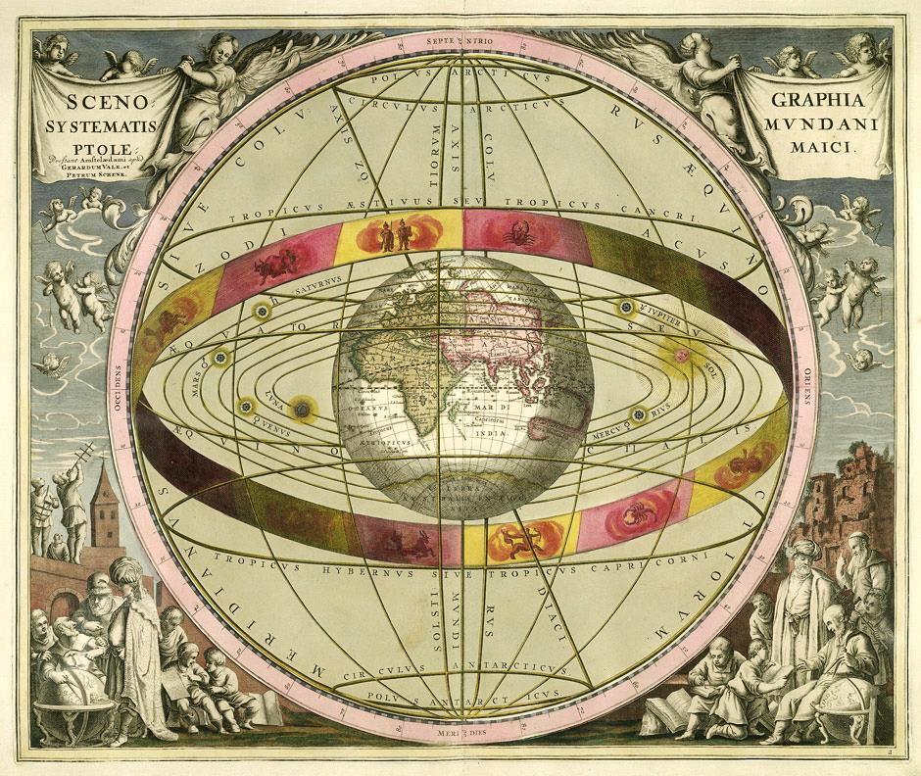
SOURCE

Slide 9
SCIENTIFIC REVOLUTION
Fresh Inquiries into Natural Philosophy

Slide 10
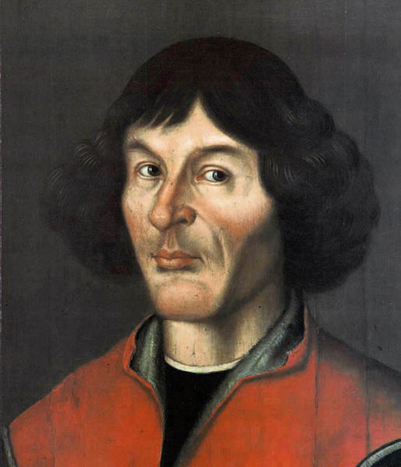
Nicolaus Copernicus
16th century
Polish Priest & Astronomer
On the Revolutions of the Heavenly Spheres
(1543 – Posthumous)

Slide 11
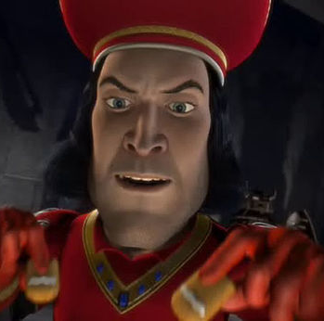
LORD FARQUAAD CONFIRMED
Image Subject to Copyright (Fair Use)

Slide 12
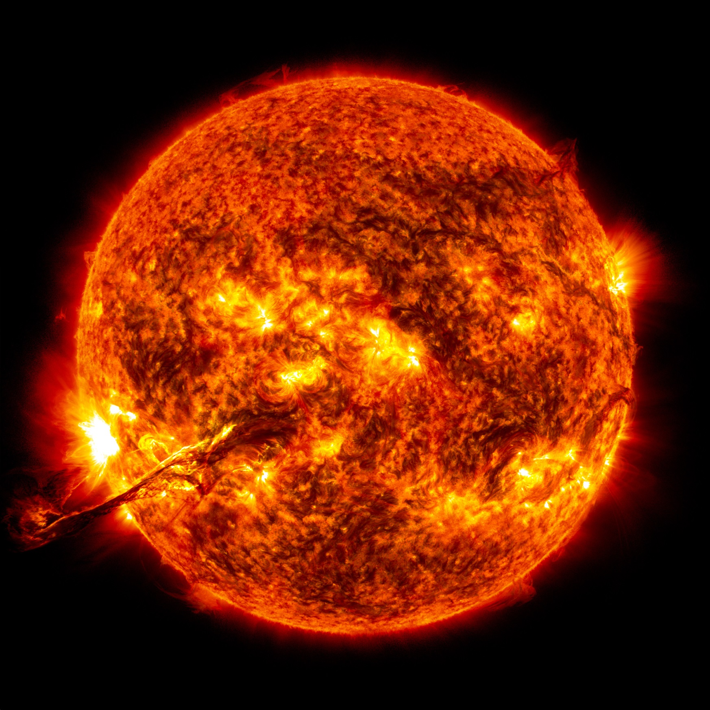
Heliocentrism
The earth revolves around the sun.
Photo by NASA

Slide 13
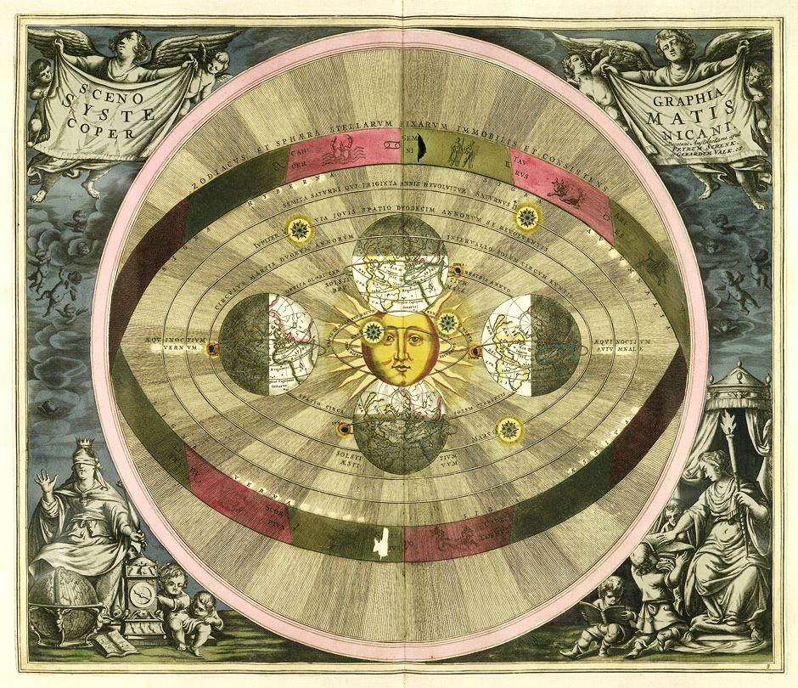
SOURCE

Slide 14
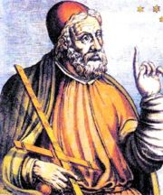
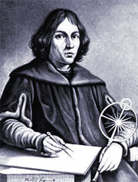
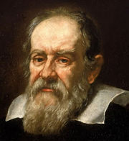
The Center of the Universe?
Ptolemy (Roman) Egypt
Copernicus 16th c. Poland
Galileo 17th c. Italy
GEOcentric
Theory
HELIOcentric Theory
CONFIRMED Heliocentric Theory

Slide 15
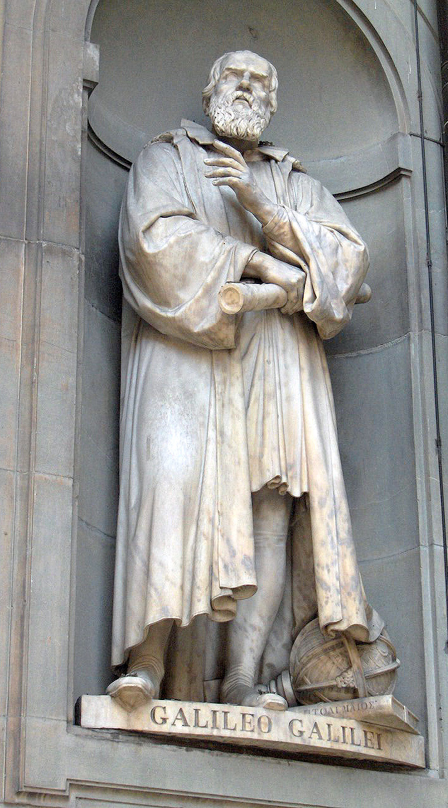
Galileo Galilei
Italian Astronomer and Physicist
Photo by JoJan

Slide 16
Aristotelian Physics
Free Falling Objects
Heavy vs. Light Objects | Acceleration?
Heavy objects fall faster than lighter objects
Objects fall at a constant rate (no acceleration)
Logic

Slide 17
Galilean Physics
Free Falling Objects
Heavy vs. Light Objects | Acceleration?
Heavy objects fall at the same rate as lighter objects
Objects accelerate as they fall due to gravity
Empiricism

Slide 18
The Leaning Tower of Pisa
Galileo performed his experiments here.
Photo by Dimitry B.

Slide 19
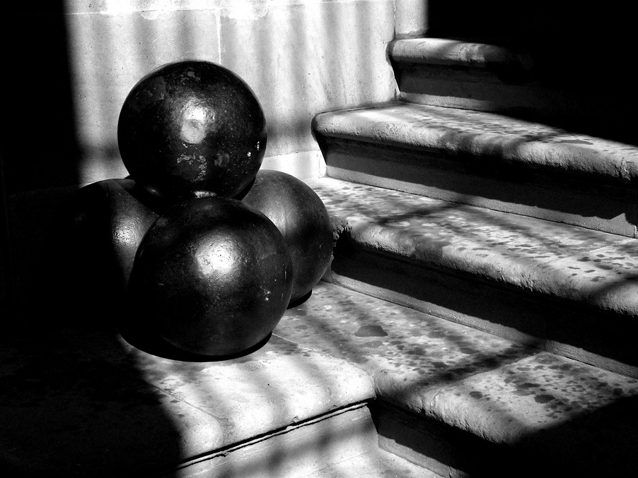
Cannon Ball vs Musket Ball
Photo by ben britten

Slide 20
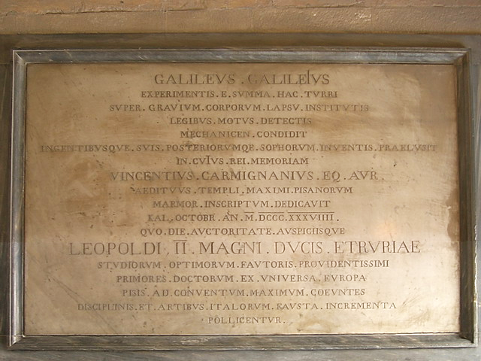
Photo by Lonewolf1976

Slide 21
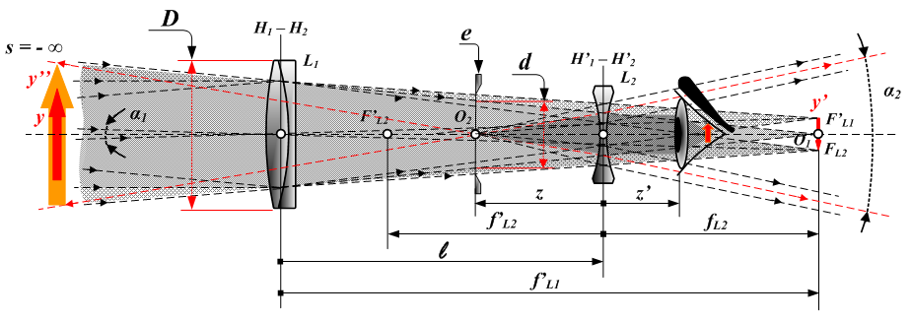
Refracting Telescope
Galileo’s improved telescope allowed him to see things in space that others had not been able to see.
Art Credit: Tamasflex

Slide 22
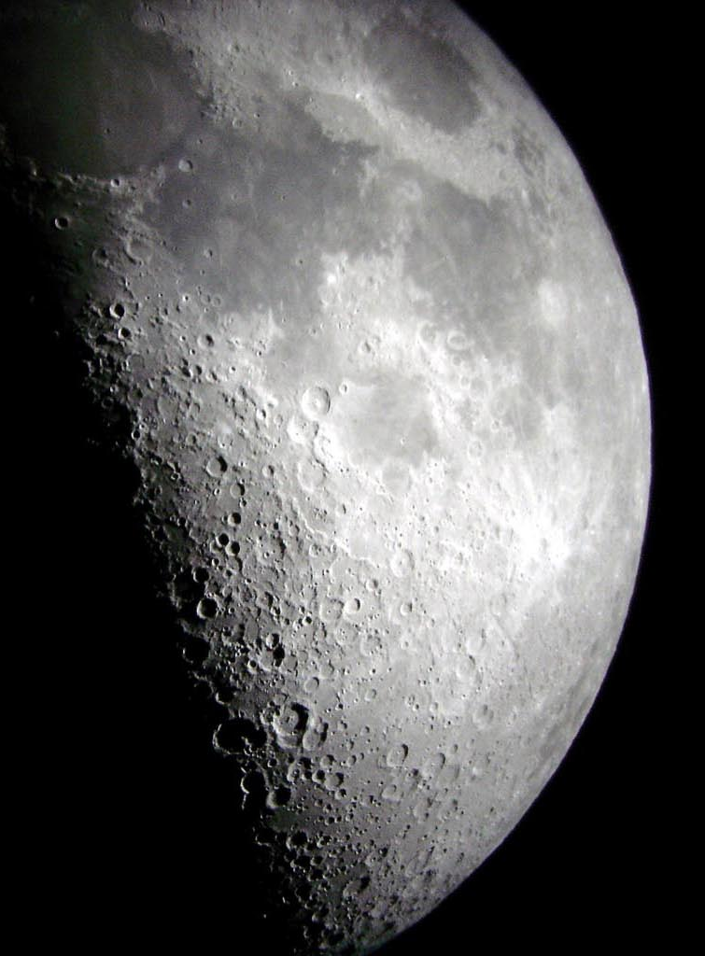
Lunar Mountains and Craters
The moon’s surface was not smooth as was traditionally believed.
Photo by Brian

Slide 23
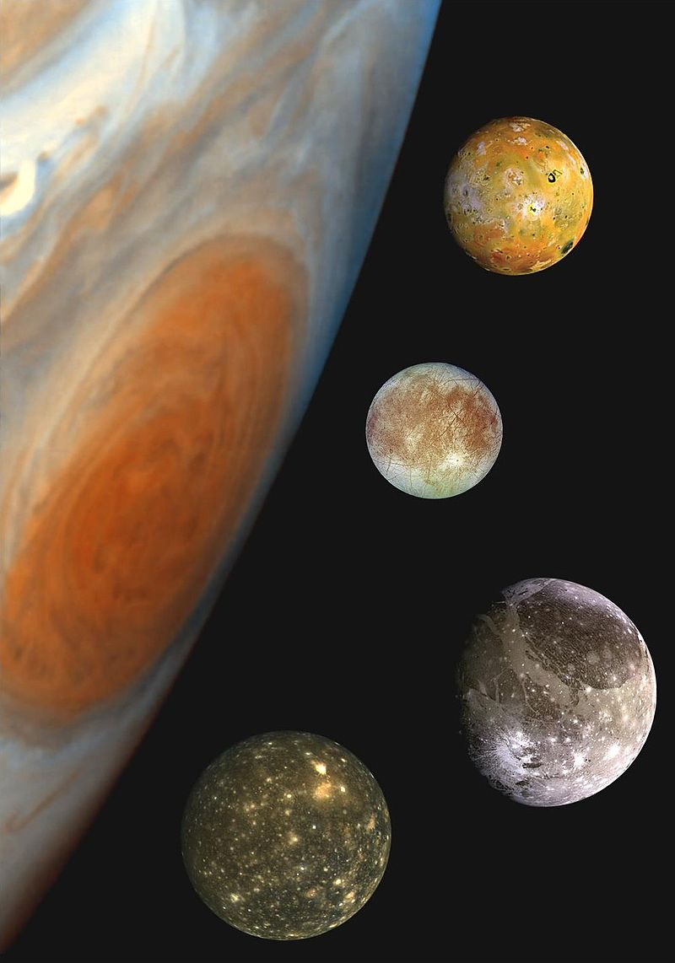
Galilean Moons
Galileo discovered four moons orbiting Jupiter, proving that objects orbited planets other than earth.

Slide 24
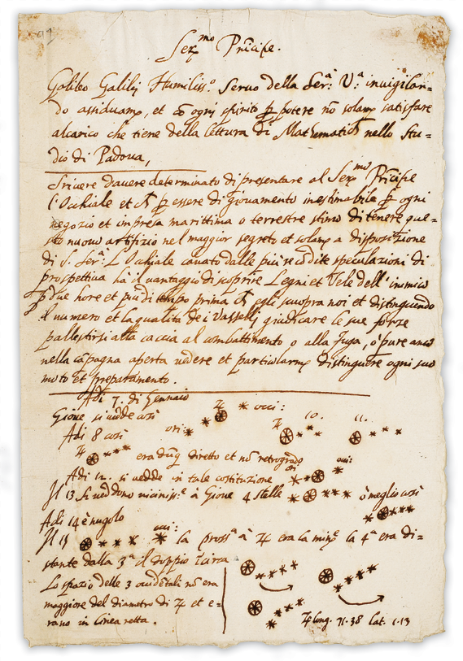

Slide 25
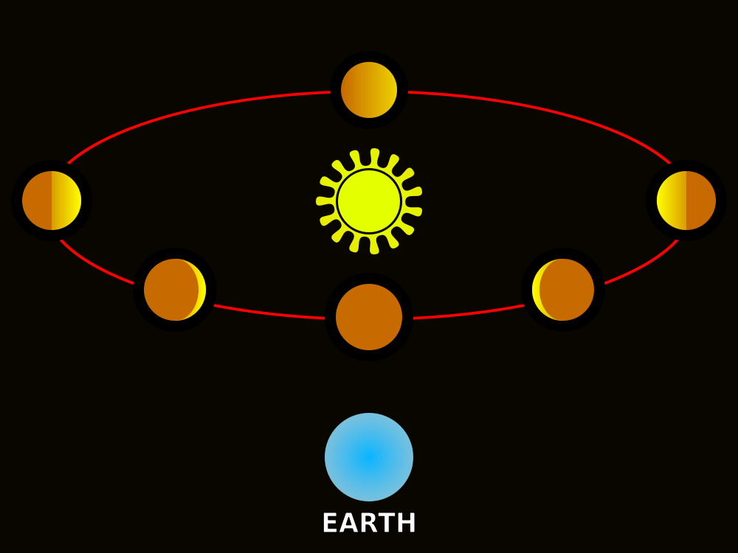
The Phases of Venus

Slide 26
Technology
DRIVING SCIENCE
Art Credit: Tamasflex

Slide 27
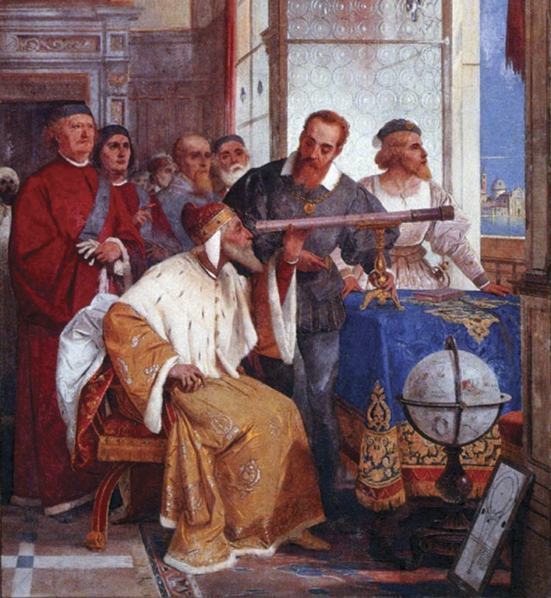
Empiricism

Slide 28
FACT Not Theory

Slide 29
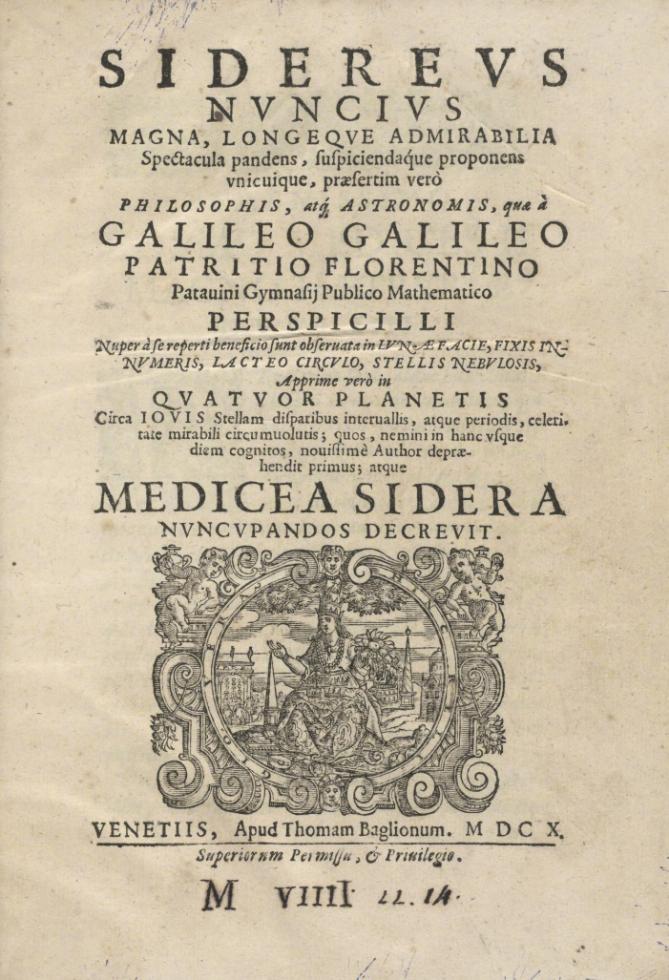
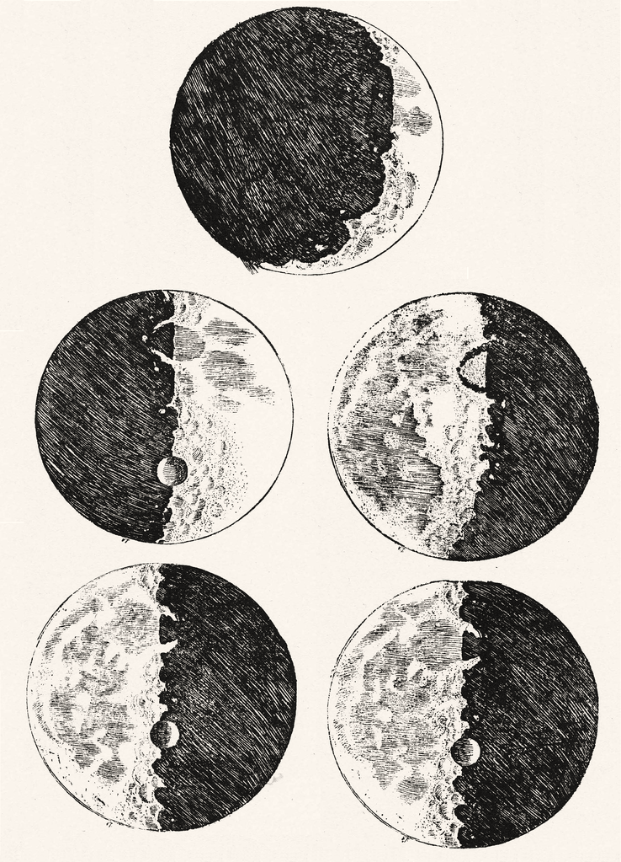
Sidereus Nuncius (1610)
The Starry Messenger

Slide 30
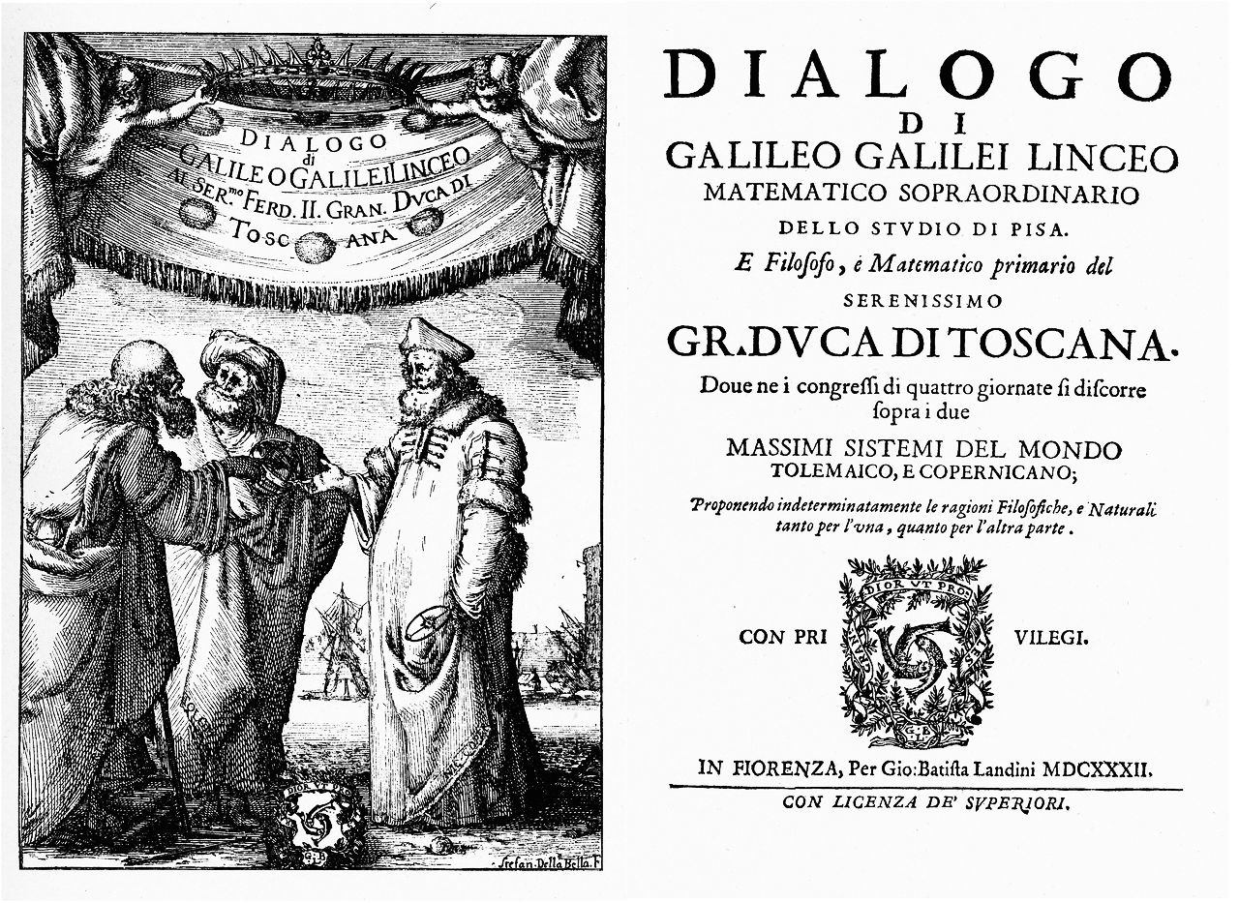

Slide 31
I know u didn’t
Aristotle believed that heavenly bodies were perfect spheres made up of the fifth element.

Slide 32
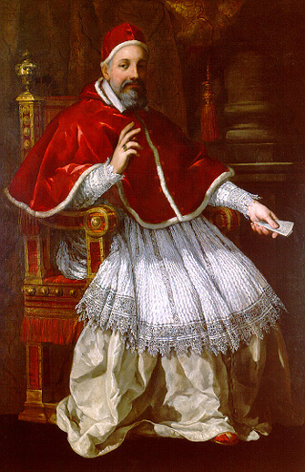
I know u didn’t
The Catholic Church continued to support biblical cosmology.

Slide 33
The Bible
John Martin, Joshua Commanding the Sun to Stand Still (1816)

Slide 34
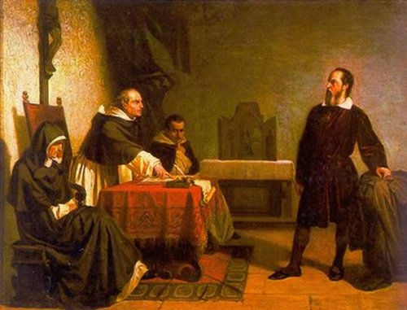
Galileo vs. the Inquisition

Slide 35
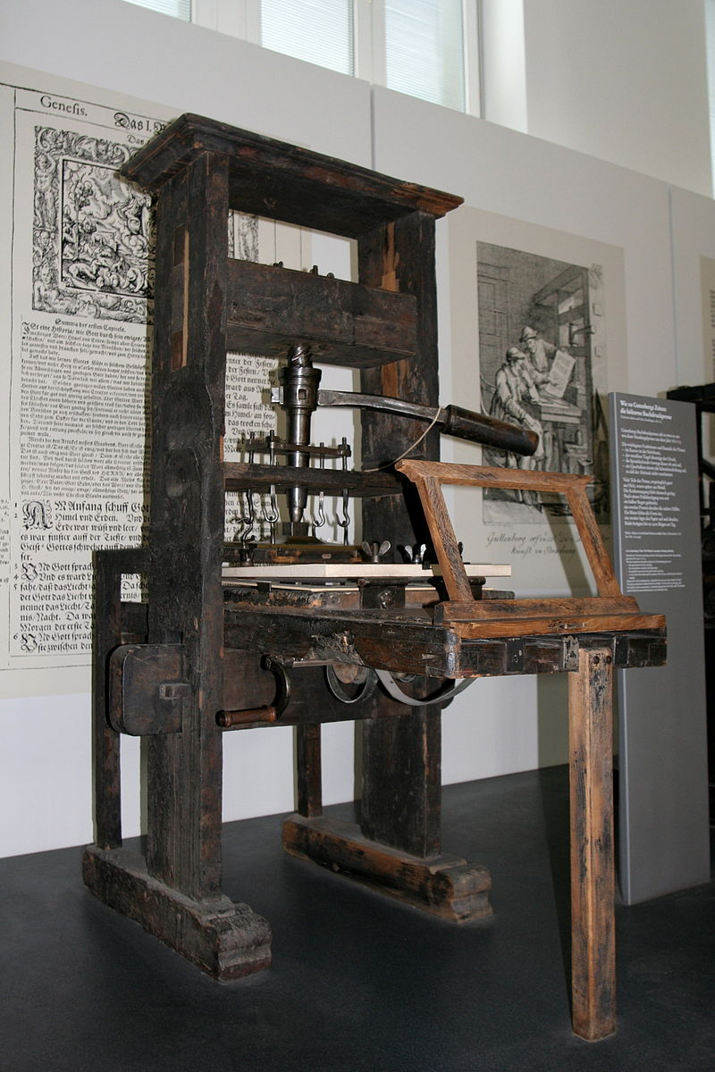
Photo by MatthiasKabel

Slide 36
Science vs. the Church?
Galileo recanted under pressure from the Church and remained under house arrest in his later years.

Slide 37
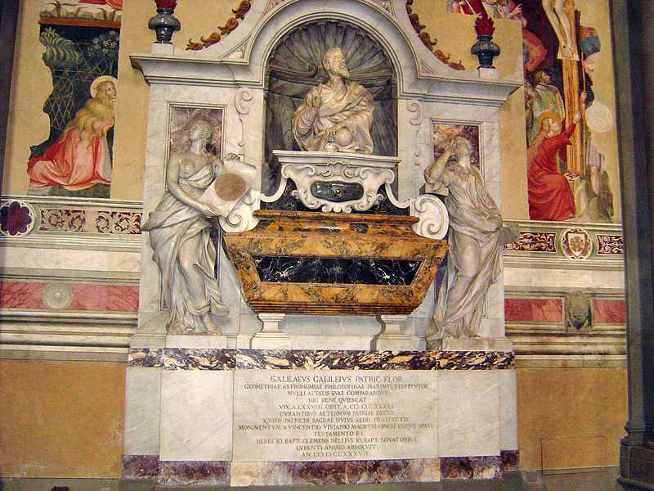
Tomb of Galileo Florence, Italy
Photo by stanthejeep at en.wikipedia

Slide 38
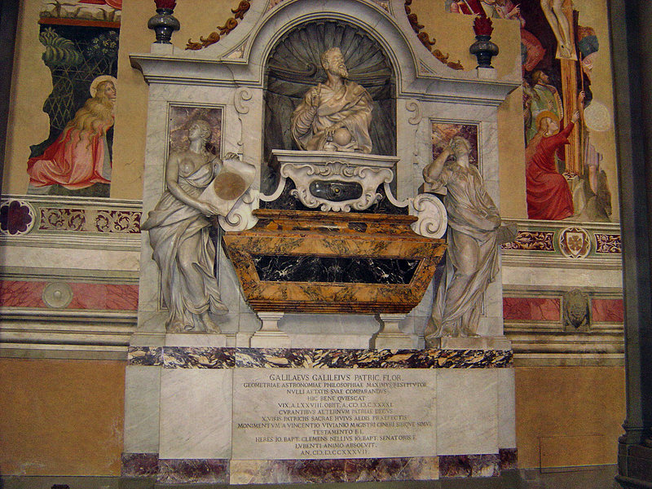
Very Obviously Catholic
Photo by stanthejeep at en.wikipedia

Slide 39
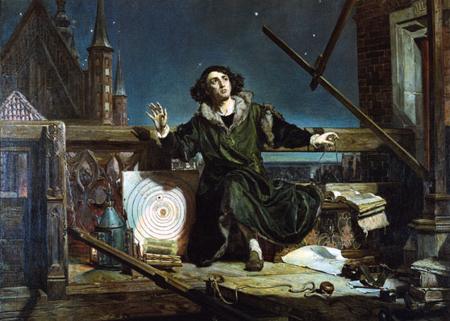
Conversations with God
Astronomer Copernicus, or Conversations with God, by Matejko (19th c)

Slide 40
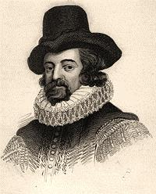
Science vs. Religion?
“A little philosophy inclineth man’s mind to atheism; but depth in philosophy bringeth men’s minds about to religion."
-- Sir Francis Bacon

Slide 41
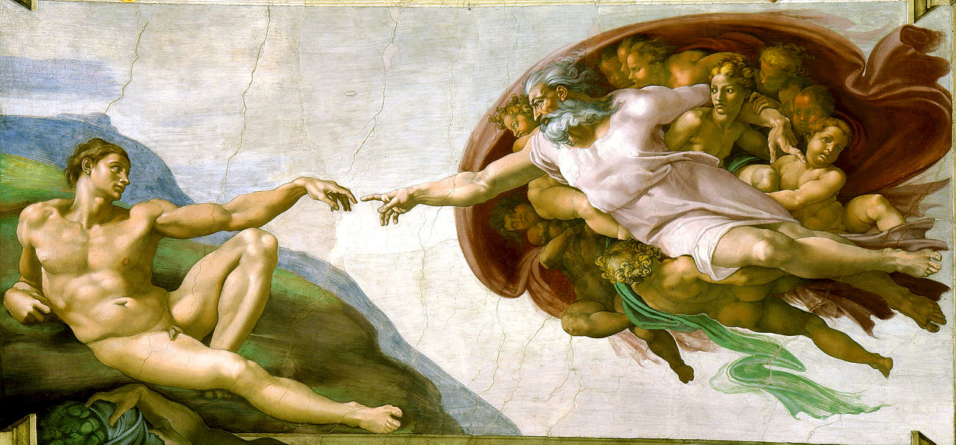
Our Place in the Universe

Slide 42
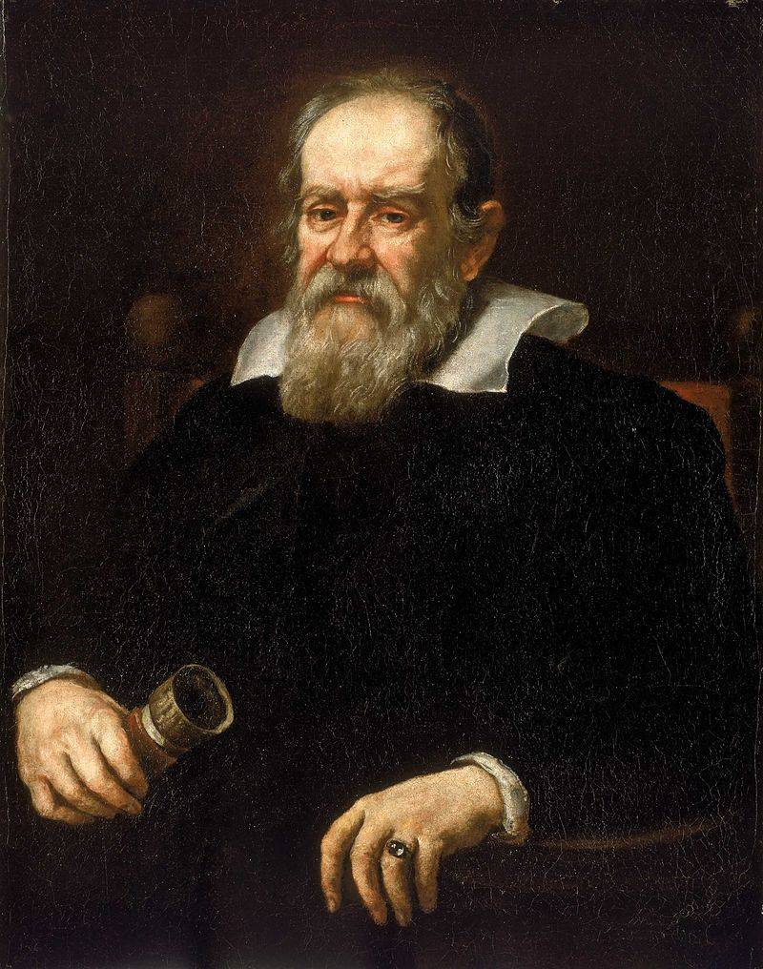
Legacies

Slide 43
Johannes Kepler
German Mathematician and Astronomer
Laws of Planetary Motion

Slide 44
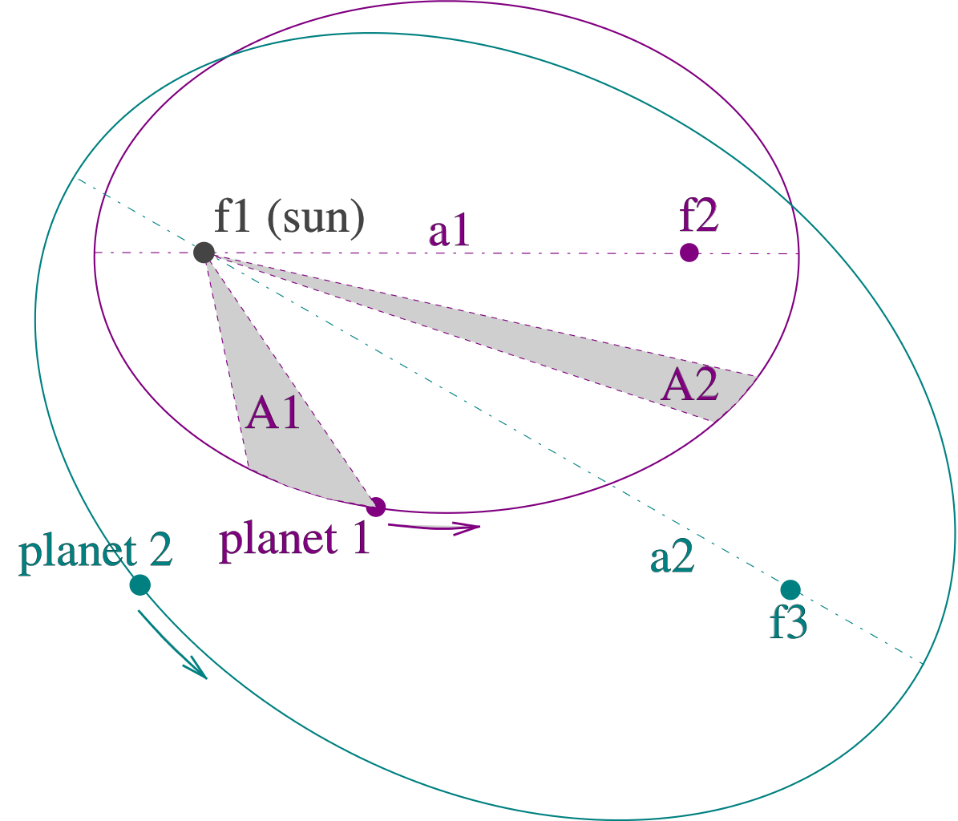
Elliptical Orbits
Art Credit: Hankwang

Slide 45
Elliptical Talk Soon Come

Slide 46
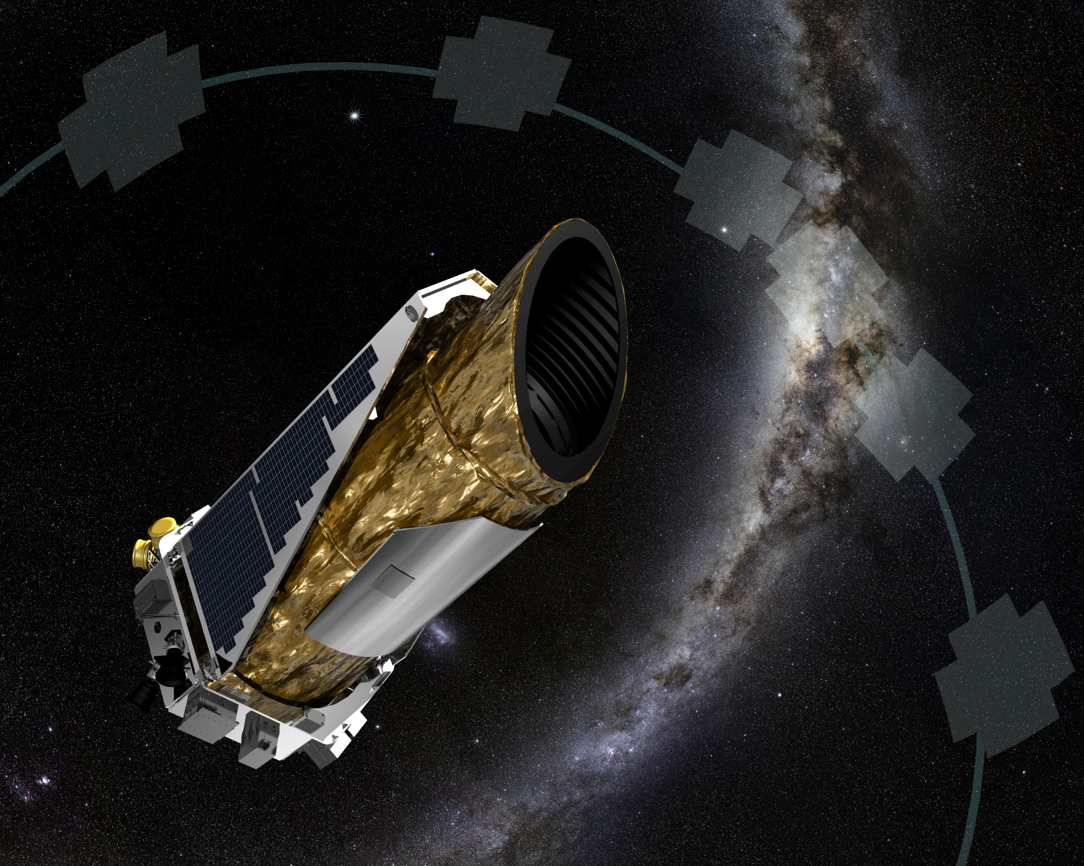
Kepler
Space Telescope
Photo Credit: NASA

Slide 47
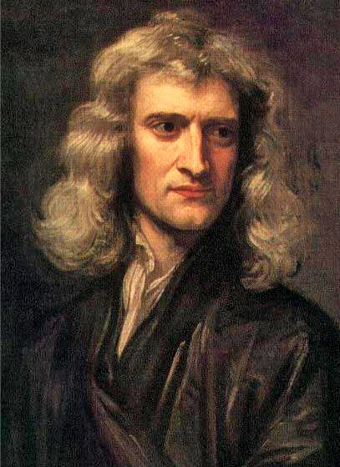
Universal Gravitation
Newton’s Law of
Dependent on Kepler’s Laws

Slide 48
