Slide 1
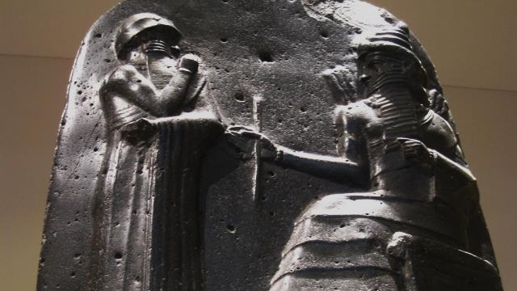
Hammurabi’s Code
Photo by erin & camera

Slide 2
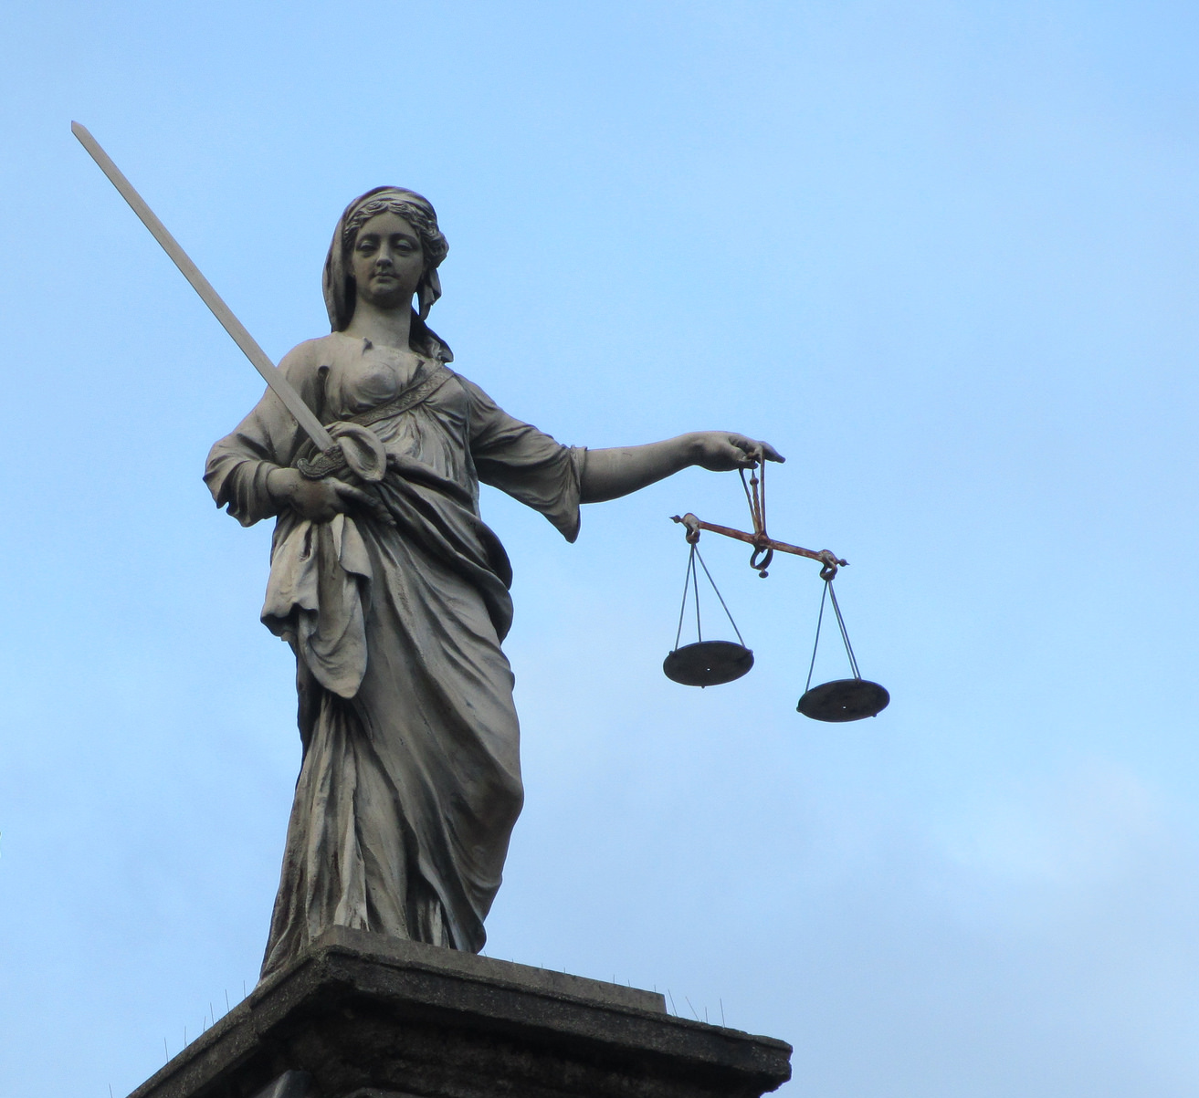
Why do we need Laws?
Photo by Jason Rosenberg

Slide 3
THE RULE OF LAW

Slide 4
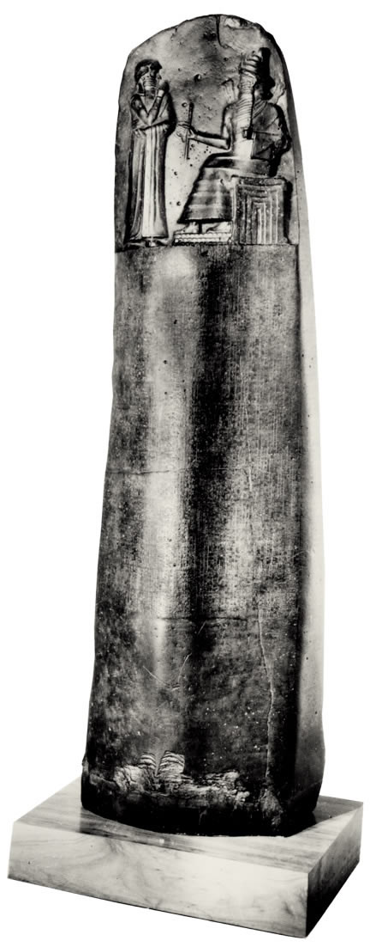
Laws
Law codes attempt to establish the RULE OF LAW by:
Defining Criminal Acts
Punishing Violators

Slide 5
HAMMURABI’S CODE
c. 1772 B.C.

Slide 6
HAMMURABI’S CODE
The oldest known code of laws in human history

Slide 7
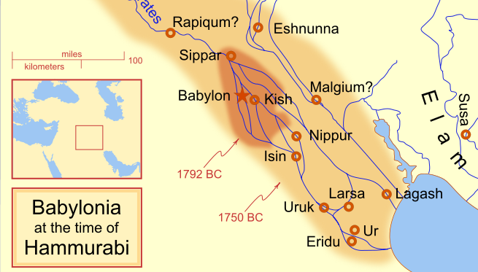
Map by MapMaster

Slide 8
PREAMBLE
to bring about the rule of righteousness
to destroy the wicked and the evil-doers;
so that the strong should not harm the weak;
so that I should rule…
and enlighten the land,
to further the well-being of mankind…
Notes:
The stated purposes of Hammurabi’s Code were, “to bring about the rule of righteousness in the land, to destroy the wicked and the evil-doers; so that the strong should not harm the weak; so that I should rule… and enlighten the land, to further the well-being of mankind… to give the protection of right to the land, I did right and righteousness in . . . , and brought about the well-being of the oppressed.”

Slide 9
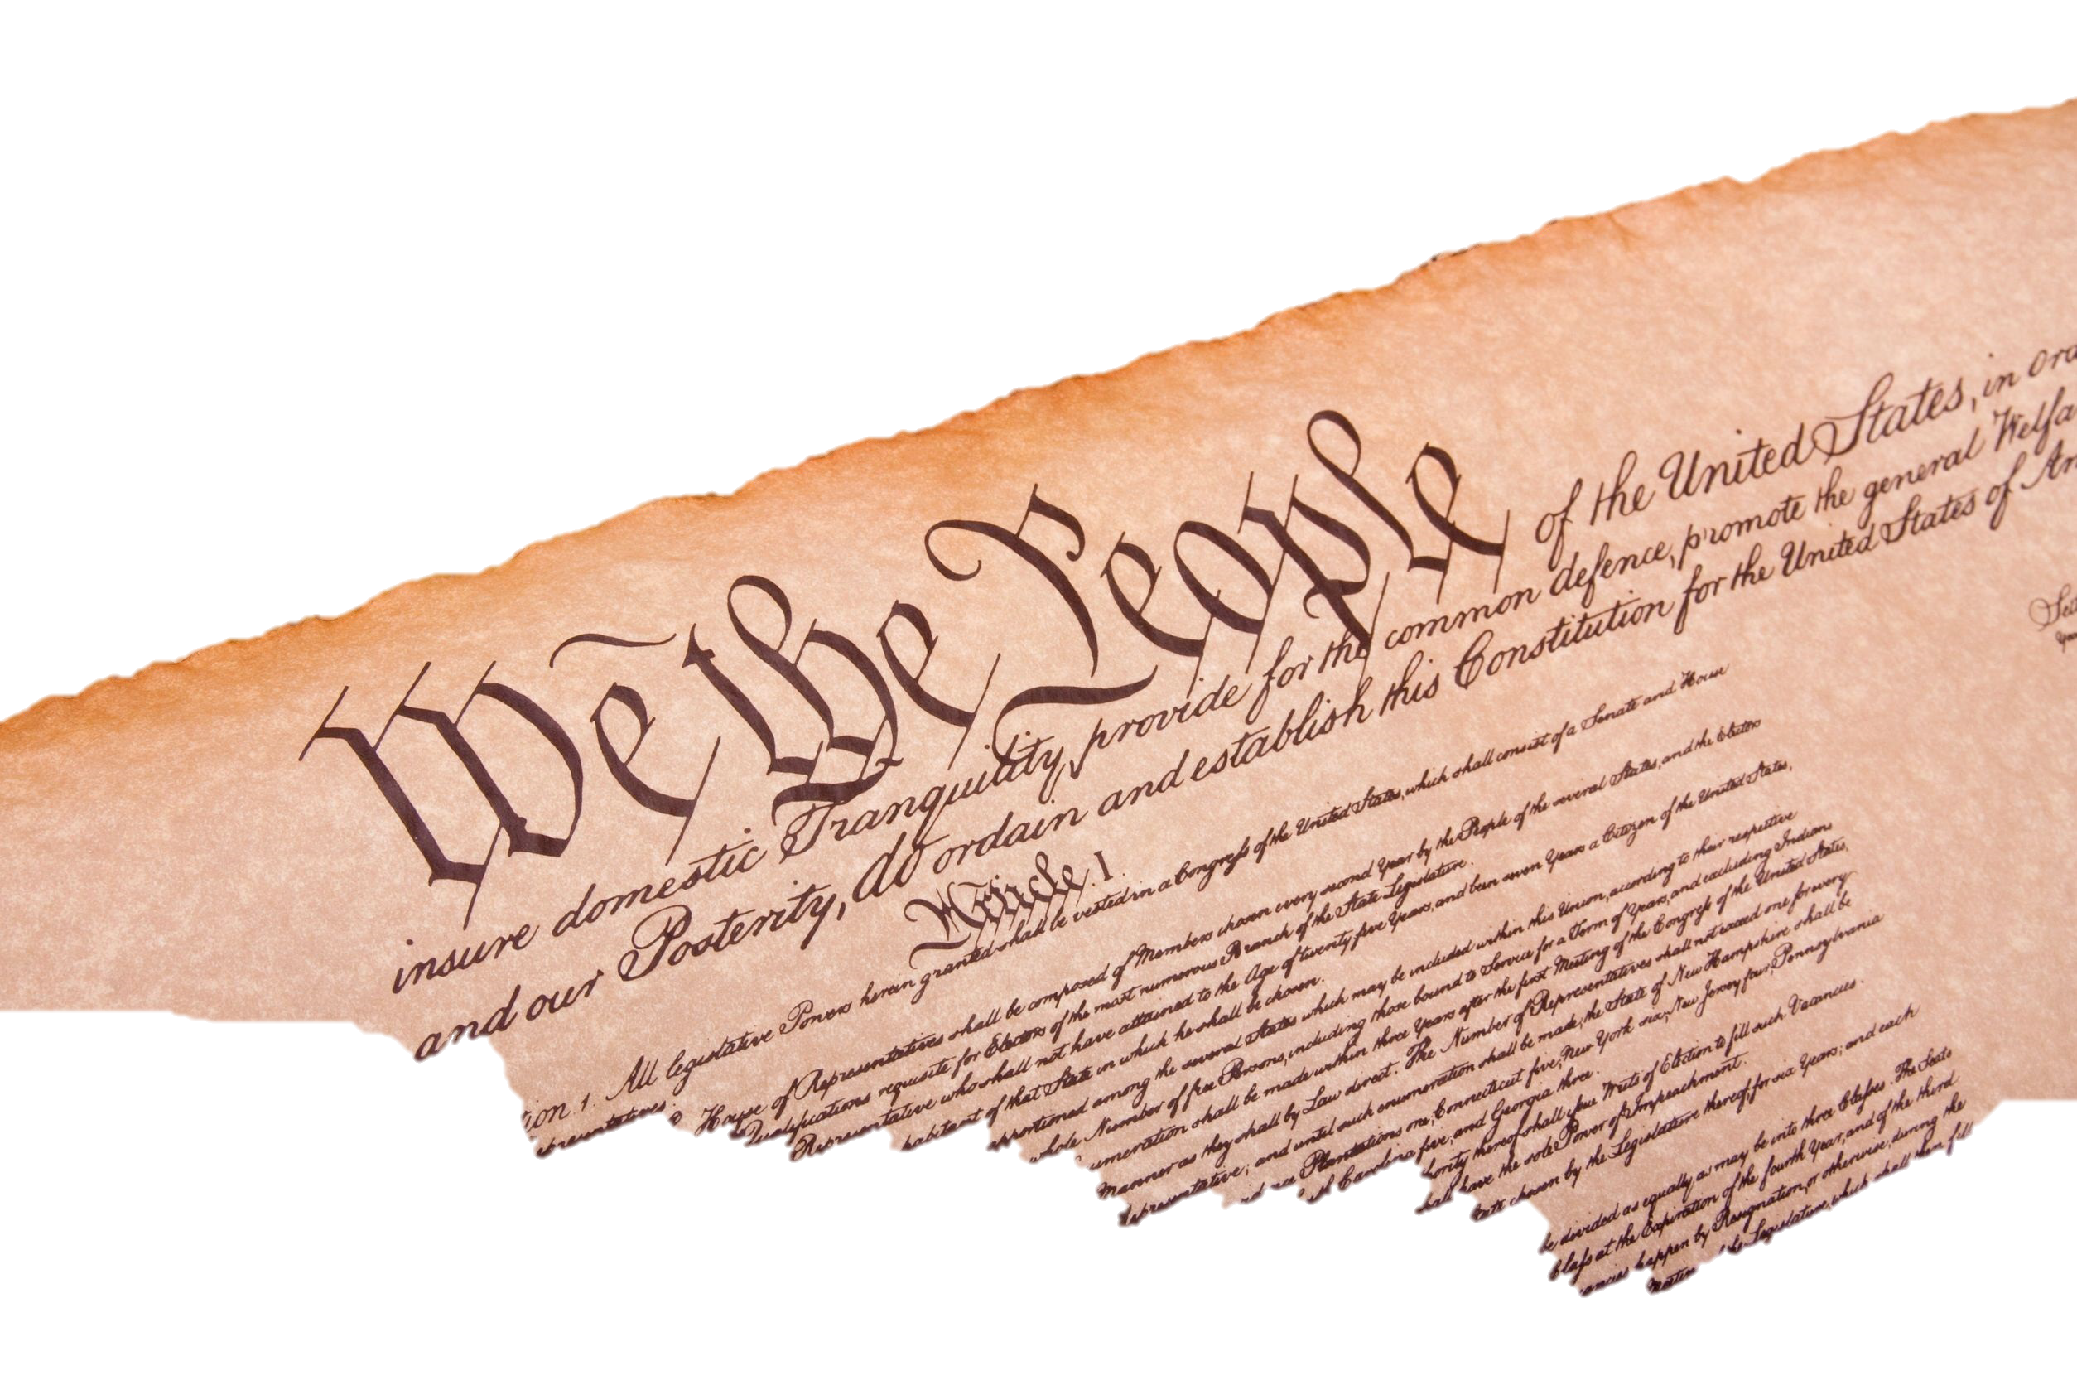
PREAMBLE
A More Perfect Union
Establish justice
Insure domestic tranquility
Provide for the common defense
Promote the general welfare
Secure the blessings of liberty

Slide 10
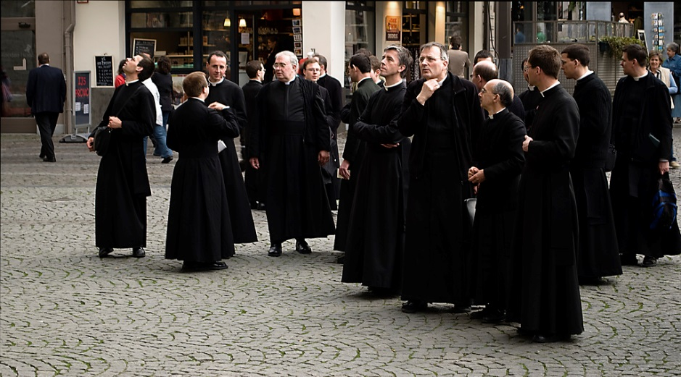
Theocracy
Photo by Daan M

Slide 11
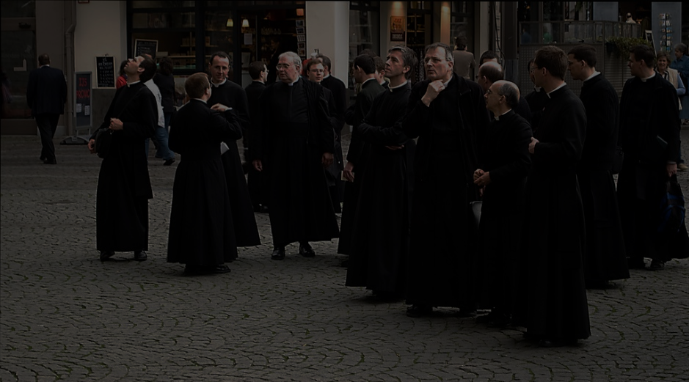
DIVINE RIGHT
When Marduk sent me to rule over men, to give the protection of right to the land, I did right and righteousness... and brought about the well-being of the oppressed.
Photo by Daan M

Slide 12
TRIAL

Slide 13
Burden of pROOF
INNOCENT
until proven
GUILTY

Slide 14
DUE PROCESS

Slide 15
SIXTH AMENDMENT
TO THE U.S. CONSTITUTION
In all criminal prosecutions, the accused shall enjoy the right to a speedy and public trial, by an impartial jury… to be informed of the nature and cause of the accusation; to be confronted with the witnesses against him…
6

Slide 16
Gonna Jump in the RiveR, but First…
Photo by DAVID HOLT

Slide 17
ORDEAL
Photo by Kyla

Slide 18
PROVE YOUR INNOCENCE
Photo by Kyla

Slide 19
REPUTATION
Harsh punishments for perjury were intended to safeguard people’s reputation from false accusers.

Slide 20
Thou shalt not bear false witness against thy neighbor.
-- Exodus 20:16

Slide 21
Fourteenth Amendment
Ratified July 9, 1868
BIRTHRIGHT
CITIZENSHIP

Slide 22
Fourteenth Amendment
Ratified July 9, 1868
Equal protection of laws

Slide 23
FAMILY LAW
Hammurabi’s Code gave fathers unlimited control over their families.

Slide 24
195
If a son strikes his father, his hands shall be hewn off.
Photo by Alper Çuğun

Slide 25
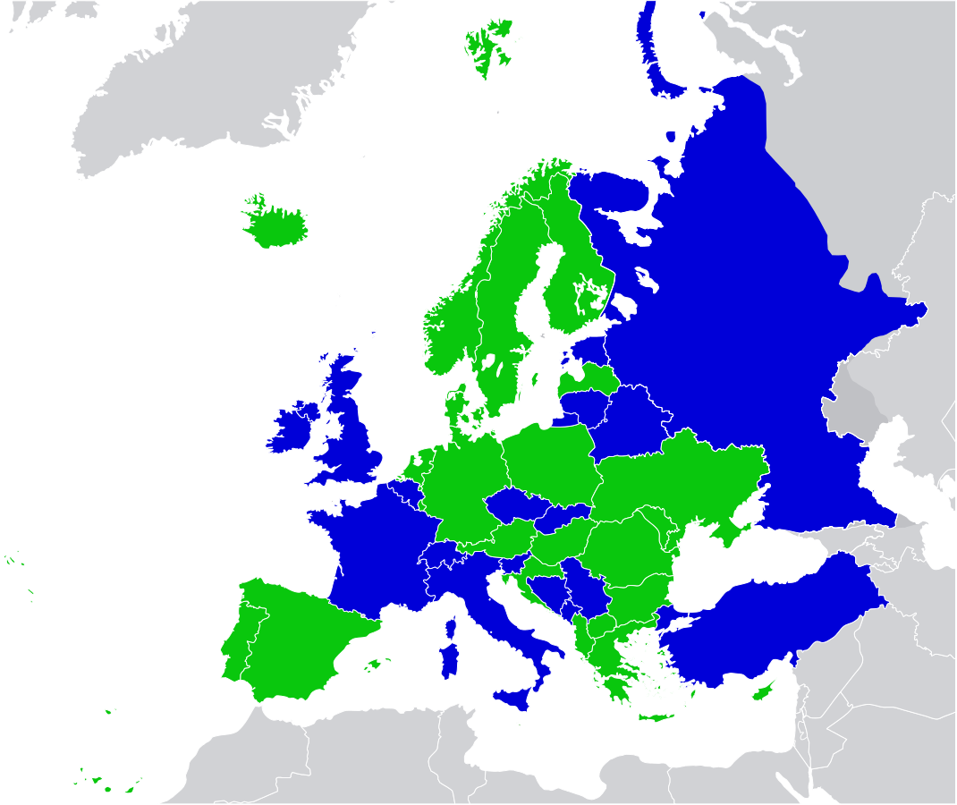
Corporal Punishment in Europe Today
Illegal in the Home
Legal in Home Only
Source: http://www.endcorporalpunishment.org

Slide 26
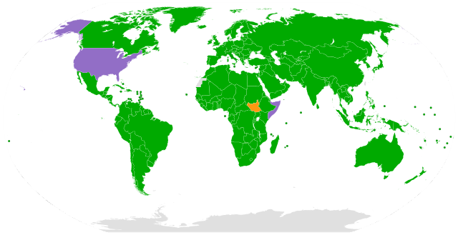
U.N. CONVENTION ON THE RIGHTS OF THE CHILD
http://www.unicef.org
Map by L.tak
The U.S. has not ratified the U.N. Convention on the Rights of the Child due to concerns over parental rights.

Slide 27
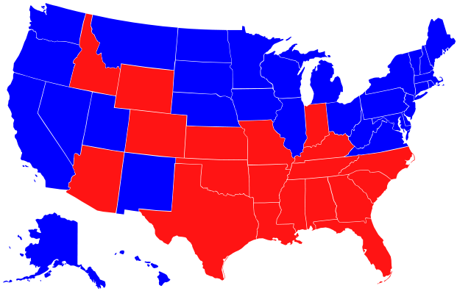
Corporal punishment in the U.S.
Legal in Schools
Home Only
Source: Theshibboleth (Wikipedia)

Slide 28
Women Under Hammurabi’s Code
129. If a man's wife be surprised (in flagrante delicto) with another man, both shall be tied and thrown into the water, but the husband may pardon his wife and the king his slaves.
Article about Babylonian women: http://www.womenintheancientworld.com
Some rights reserved by K. Sawyer Photography

Slide 29
Women Under Hammurabi’s Code
130. If a man violate the wife (betrothed or child-wife) of another man, who has never known a man, and still lives in her father's house, and sleep with her and be surprised, this man shall be put to death, but the wife is blameless.
Article about Babylonian women: http://www.womenintheancientworld.com
Some rights reserved by K. Sawyer Photography

Slide 30
Women Under Hammurabi’s Code
132. If the "finger is pointed" at a man's wife about another man, but she is not caught sleeping with the other man, she shall jump into the river for her husband.
Article about Babylonian women: http://www.womenintheancientworld.com
Some rights reserved by K. Sawyer Photography

Slide 31
DOUBLE STANDARD
Women were not equal under the law.
Article about Babylonian women: http://www.womenintheancientworld.com
Some rights reserved by K. Sawyer Photography

Slide 32
Property and Commerce
Hammurabi’s Code protects property rights, but also contains extensive economic regulation by the government.

Slide 33
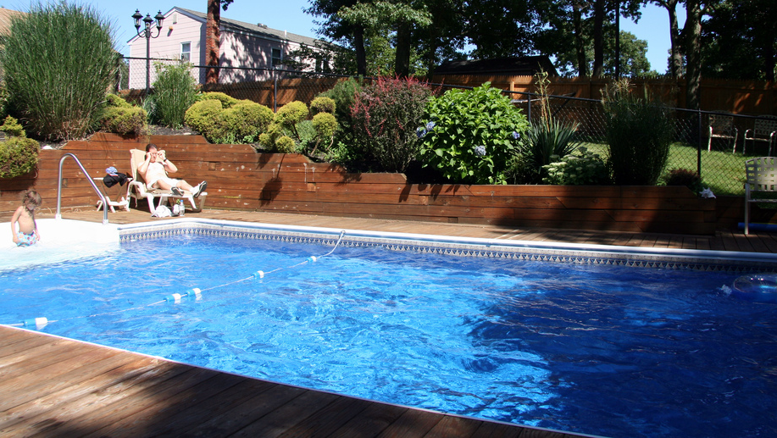
Liability
Photo by Gail Frederick

Slide 34
YOU ARE RESPONSIBLE
for what happens on your property.
for the quality of your work.
Photo by Gail Frederick

Slide 35
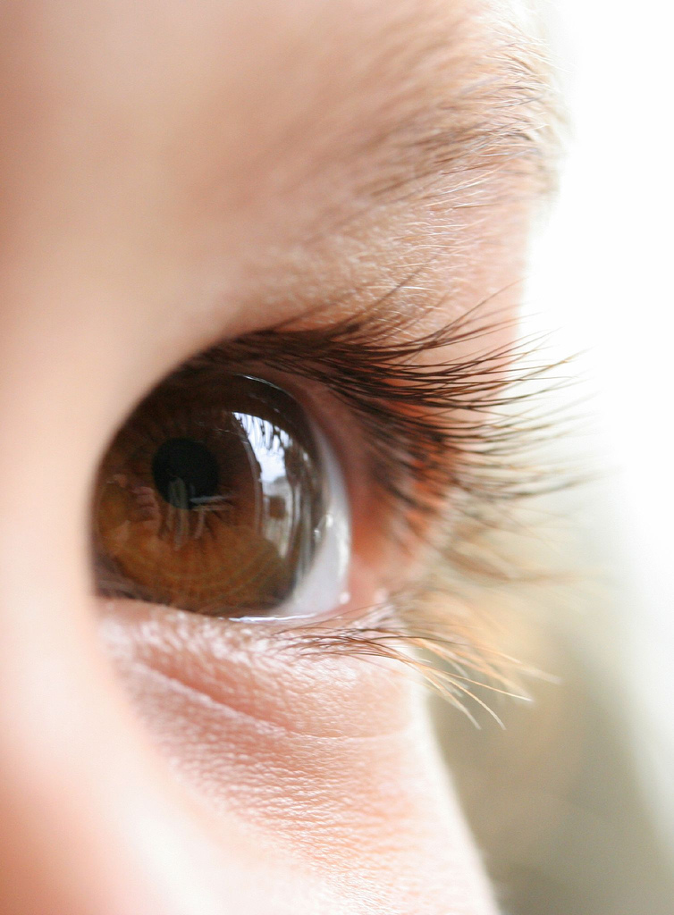
AN EYE FOR AN EYE?
Photo by peasap

Slide 36
DEPENDS on whose eye
Photo by peasap

Slide 37
Social Hierarchy
King
Nobles
Slaves
Commoners
Someone’s social class would often determine the severity of the punishment.

Slide 38
IN A NUTSHELL...
Hammurabi’s Code is known for:
Strict Penalties
most involving death and mutilation
Gender & Class Discrimination
Harsh Punishment of perjury
Reputation was important in an age without electronic records.

Slide 39
LEARNING.
DELIVERED.

