Slide 1
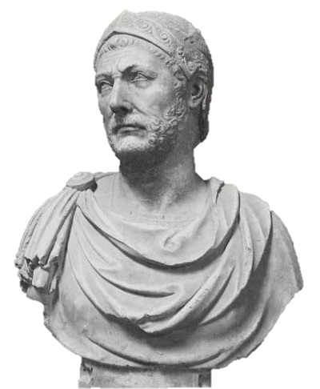

The SECOND Punic War
Hannibal vs.
the Romans

Slide 2
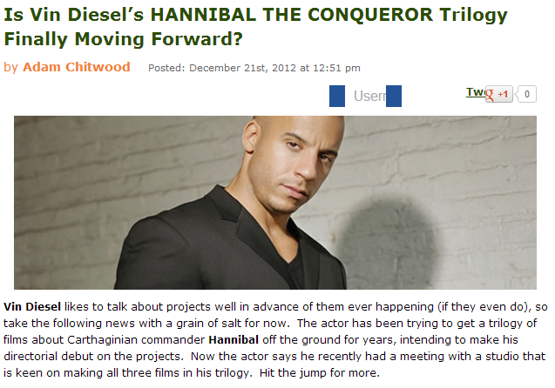
Source: http://collider.com/vin-diesel-hannibal-the-conqueror-trilogy/

Slide 3
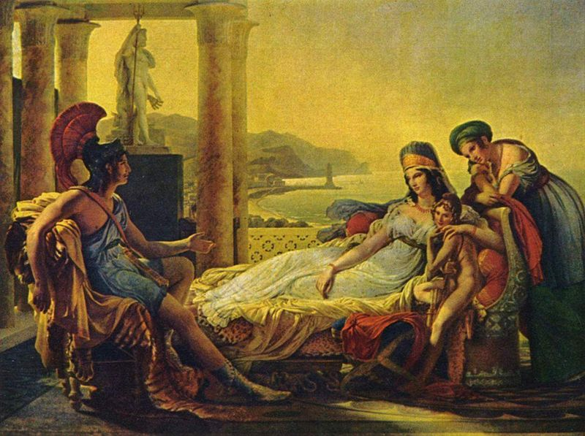
Dido and Aeneas
From Virgil’s Aeneid
Pierre-Narcisse Guérin, Aeneas tells Dido the misfortunes of the Trojan city.
Oil on canvas, 1815.

Slide 4
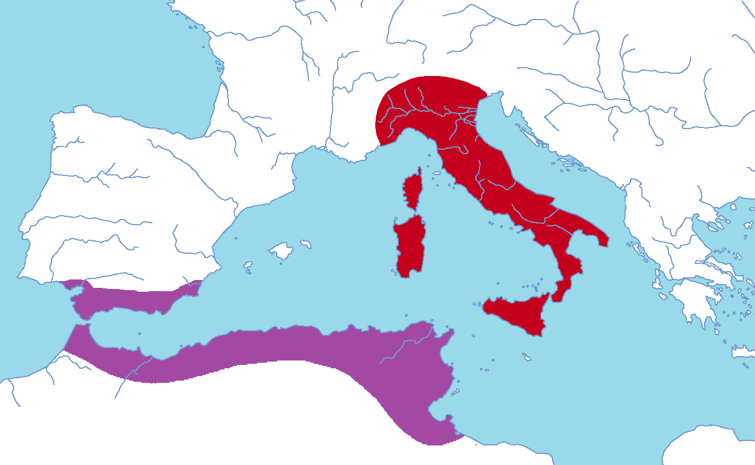
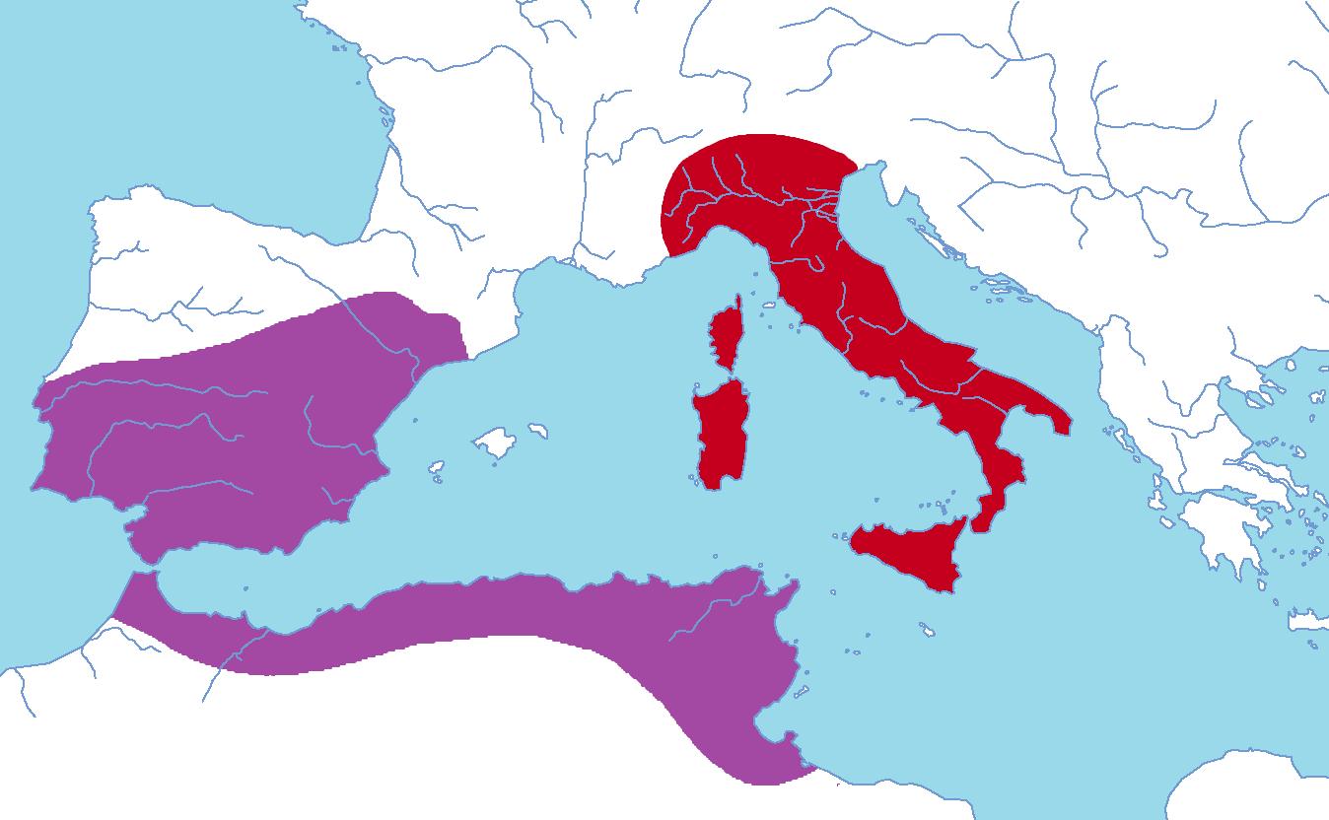
Carthage Rebounds

Slide 5
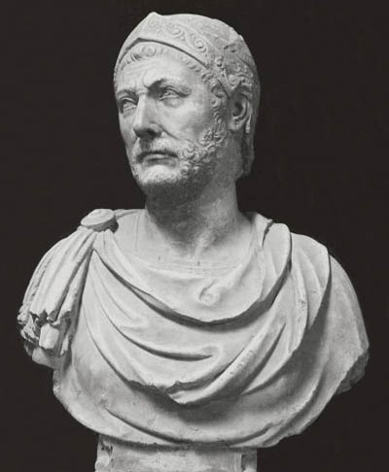
HANNIBAL
BARCA
Carthaginian General

Slide 6
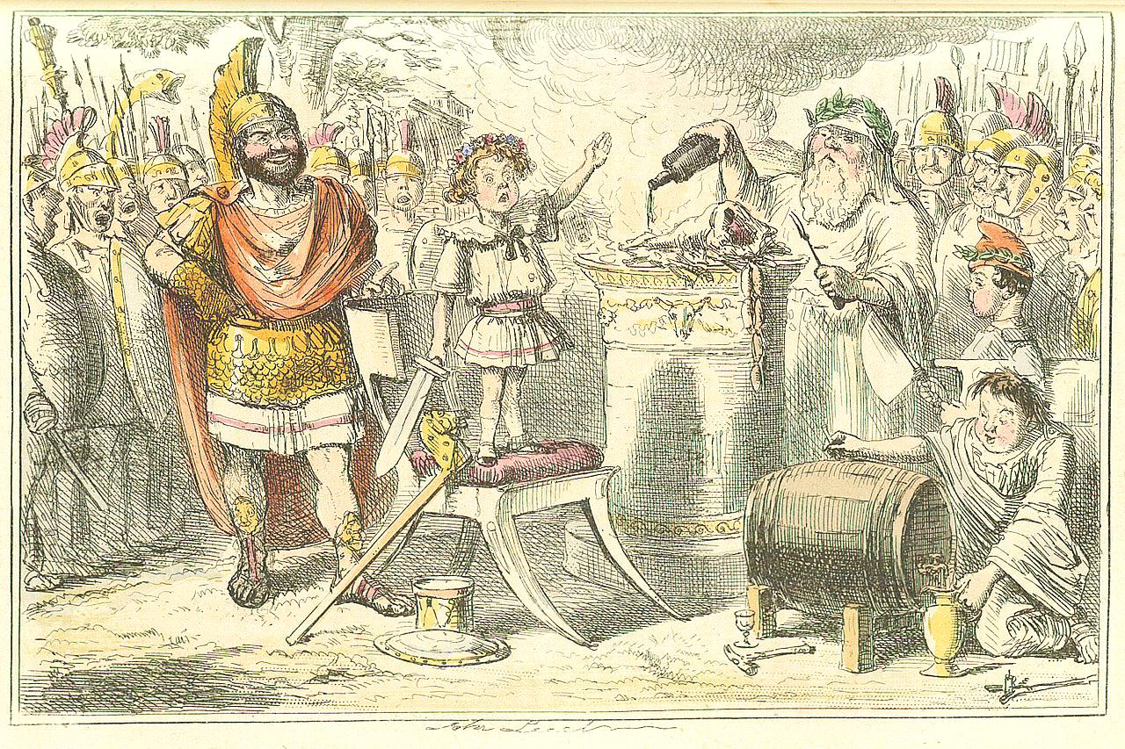
I’ll NEVER be a friend to Rome!
Notes:
Image by John Leech, from: The Comic History of Rome by Gilbert Abbott A Beckett

Slide 7
HANNIBAL’S ROUTE

Slide 8
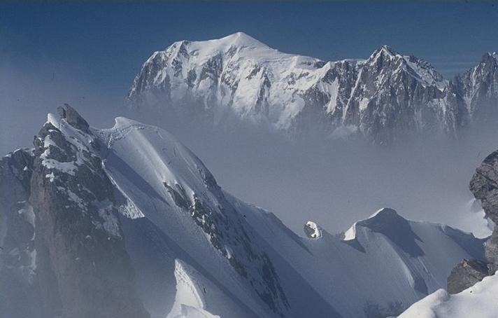
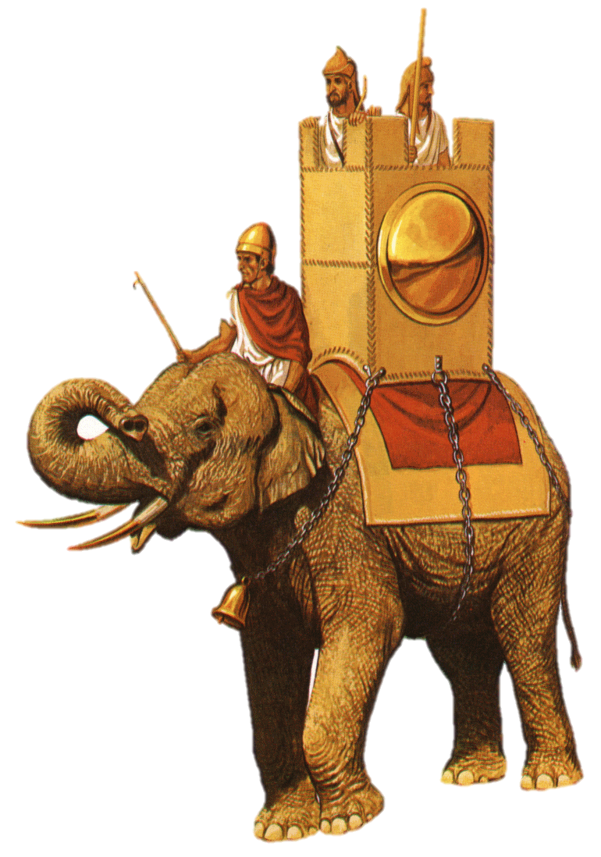
Crossing the Alps
war elephants

Slide 9
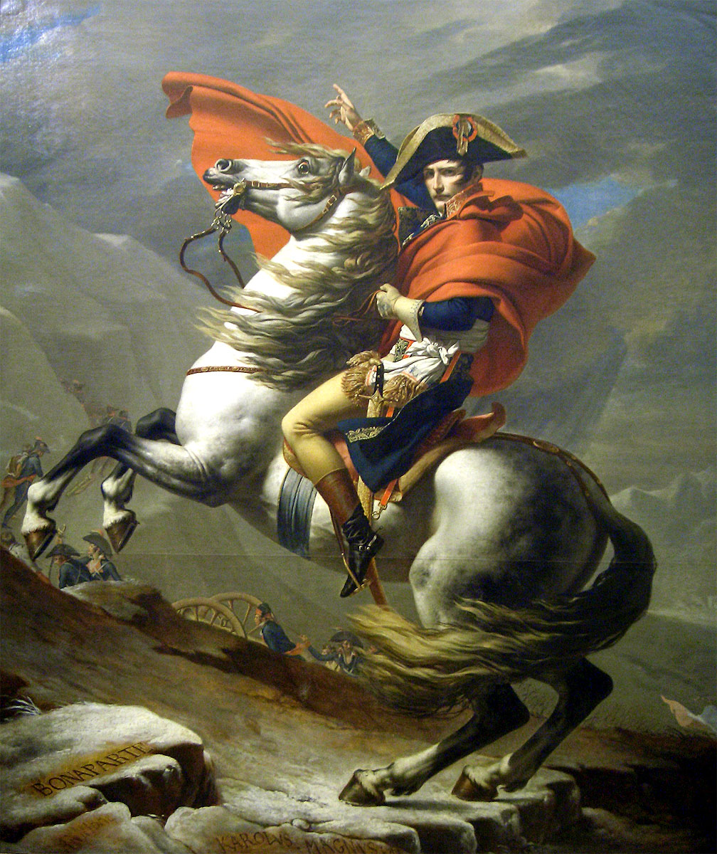
Notes:
Jacques-Louis David, “Napoleon Crossing the Alps,” 1800

Slide 10
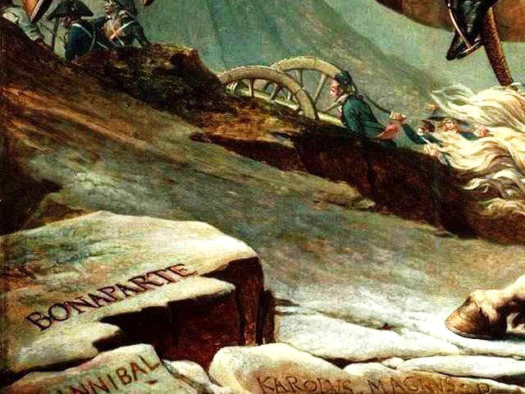

Slide 11
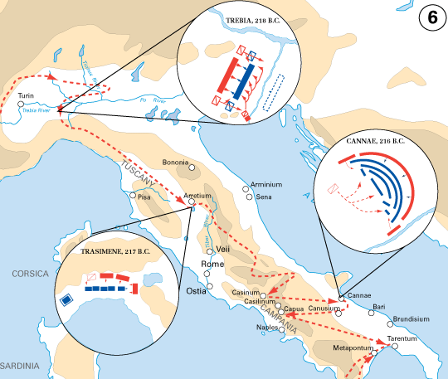
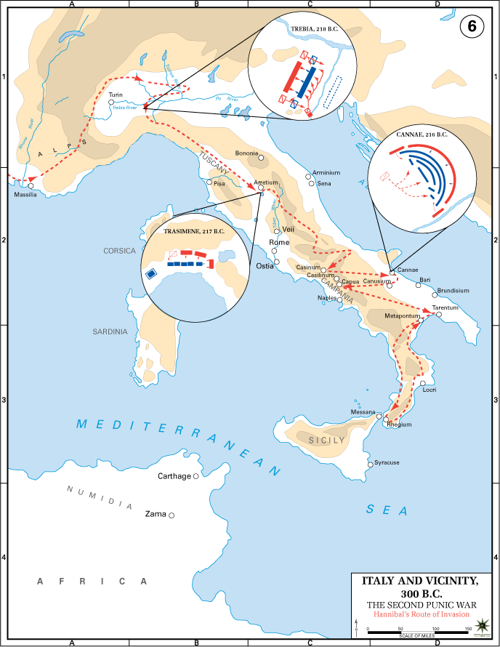
Hannibal in Italy
Trebia (218 B.C.)
Lake
Trasimene (217 B.C.)
Cannae (216 B.C.)
Map Credit: USMA

Slide 12

TREBIA
216 B.C.
Three things
Hannibal defeats IMPETUOUS Romans
A
R
E
mbush
iver
lephants
responsible for the Roman defeat.
BACK

Slide 13
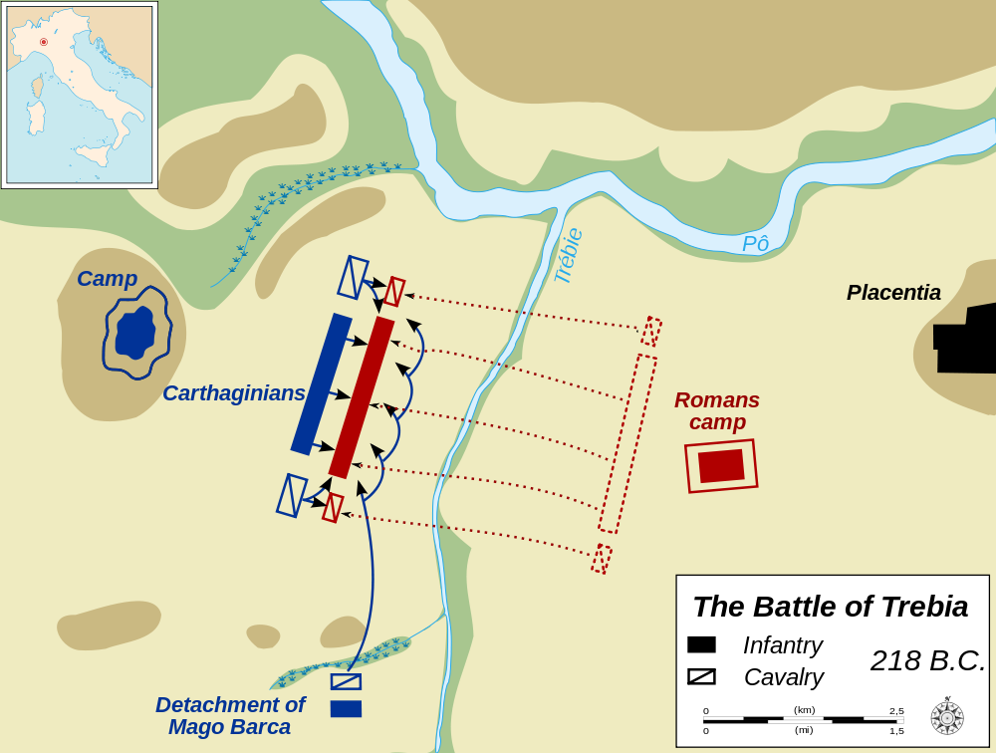

Slide 14
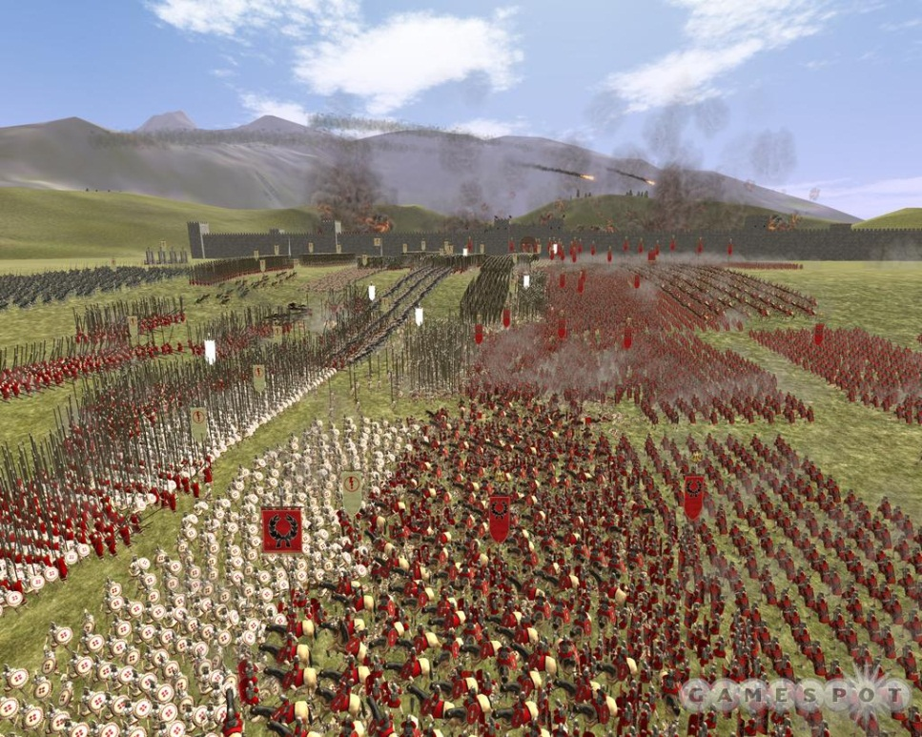

Game Time!

Slide 15
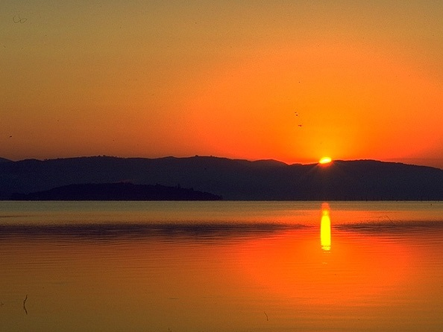
Lake Trasimene
217 B.C.
Hannibal vs.
G. Flaminius
Hannibal:
Know the Enemy

Slide 16
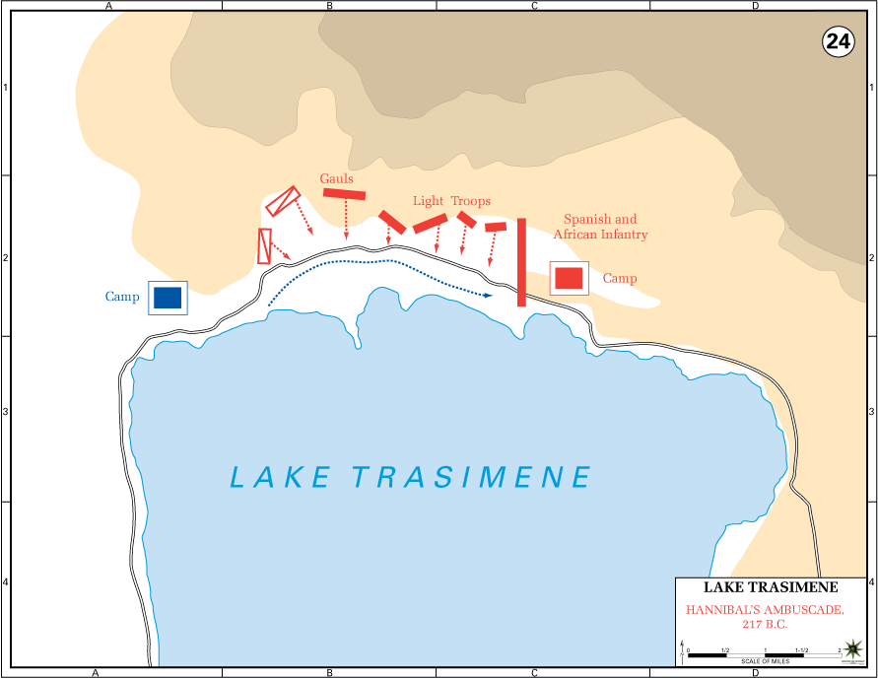
Lake Trasimene
217 B.C.
AMBUSH
http://www.dean.usma.edu/history/web03/atlases/AncientWarfare/index.htm

Slide 17
QUESTION
After being decisively defeated by Hannibal in two major battles, how would you recommend that the Romans conduct the war from this point?

Slide 18
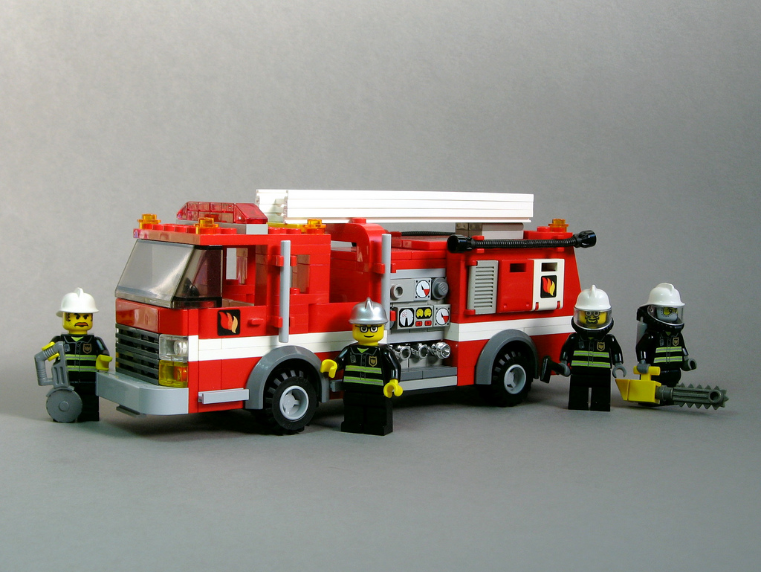
EMERGENCY!!!
Photo by Dunechaser

Slide 19

DICTATOR
IN CASE OF
EMERGENCY
6 Months

Slide 20
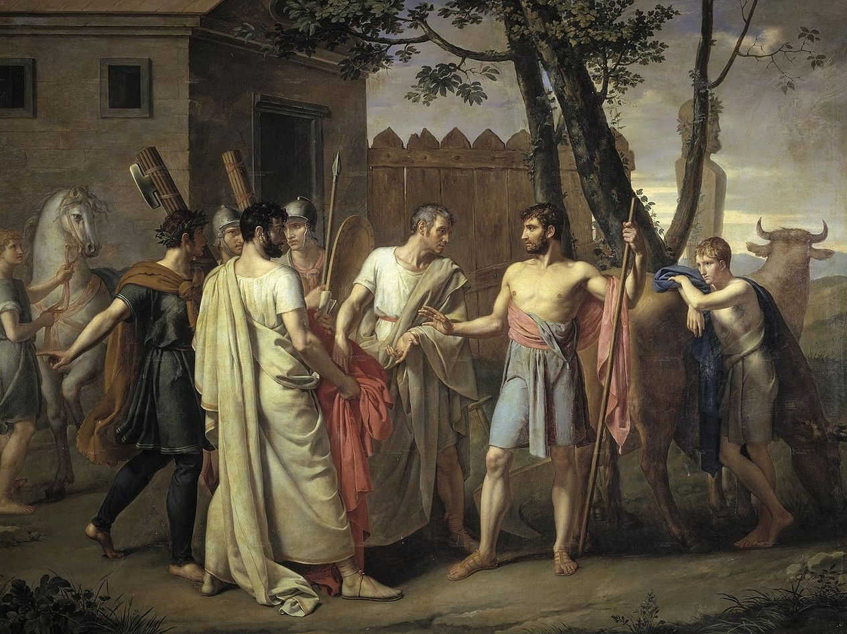
Cincinnatus
Model Dictator
16 Days
Notes:
Cincinato abandona el arado para dictar leyes a Roma, c.1806 de Juan Antonio Ribera

Slide 21
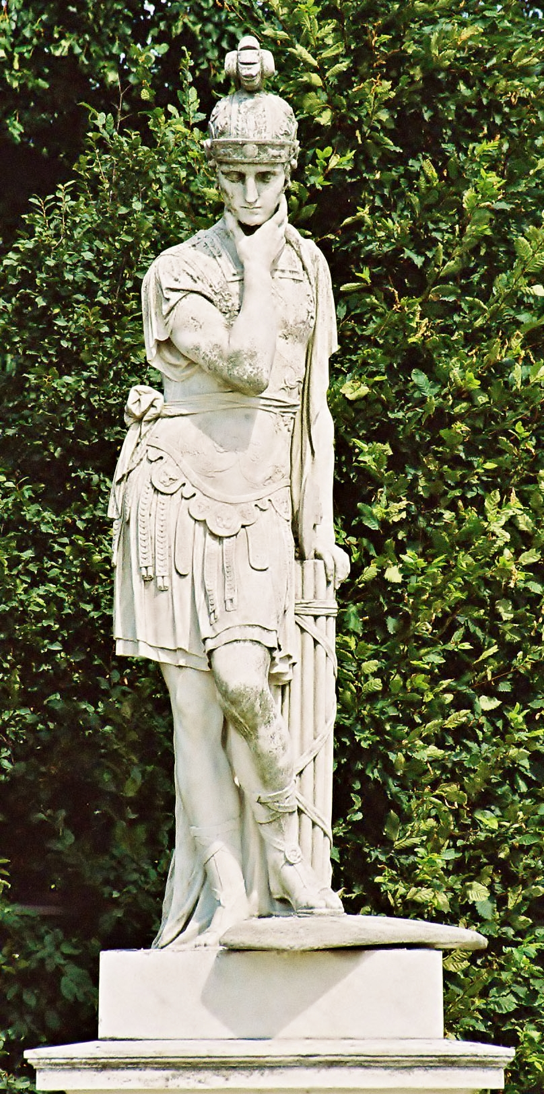
Fabius Maximus
Dictator
“Fabian Tactics”
AVOID Decisive Engagements

Slide 22
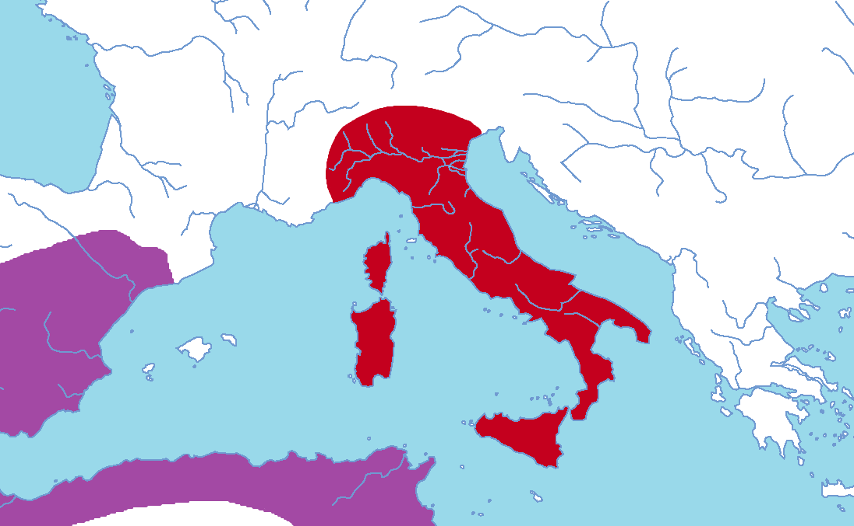

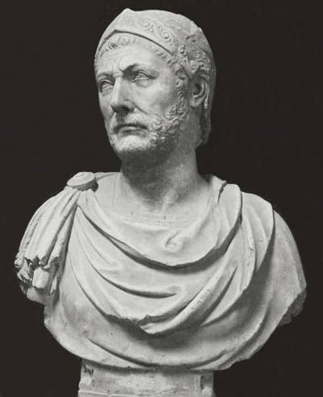
Fabian Tactics
Not Now!
Let’s Fight!

Slide 23
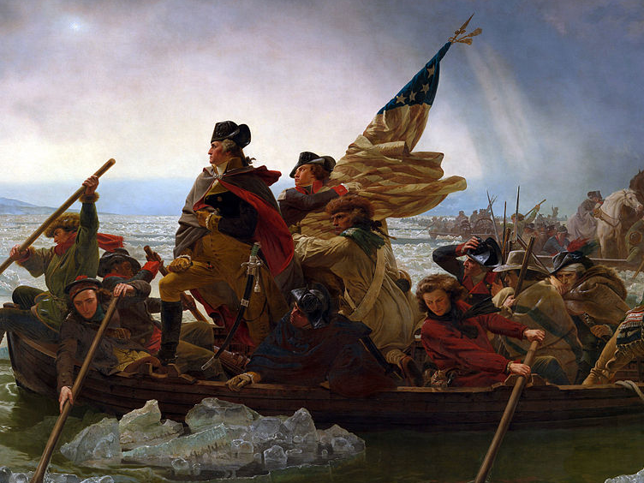
“American Fabius”

Slide 24
URGH!!!
Fabian tactics frustrated Hannibal.

Slide 25
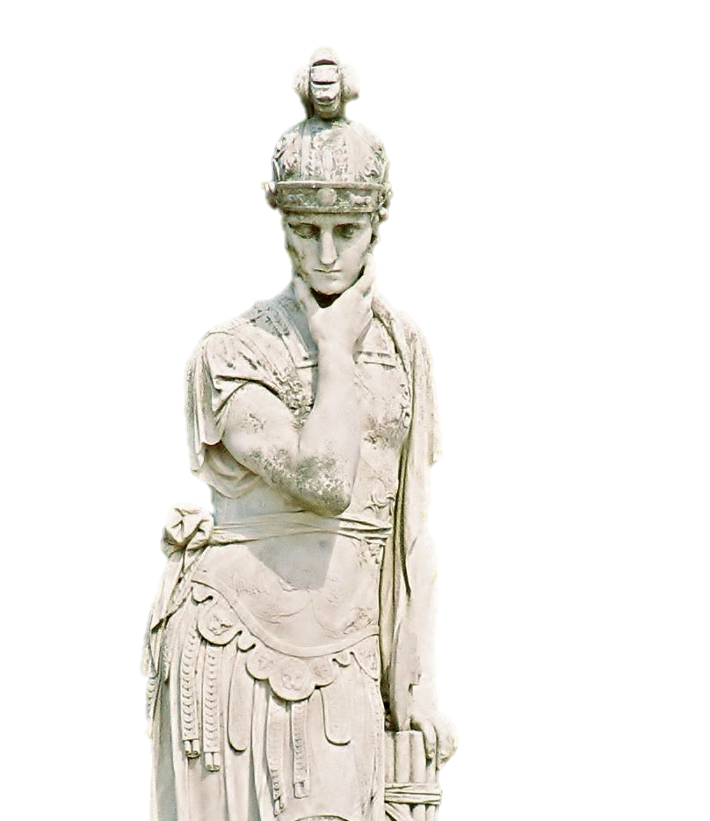
CUNCTATOR
“delayer”
Fabian tactics frustrated the Romans, too!

Slide 26
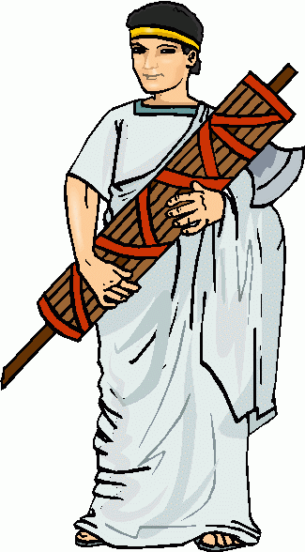
Consular Elections
216 B.C.
The Patricians WANT Hannibal to win the war!
DISTRUST
L.A. Paulus
Patrician
G.T. Varro
Plebeian
Clipart from Clipartheaven.com

Slide 27
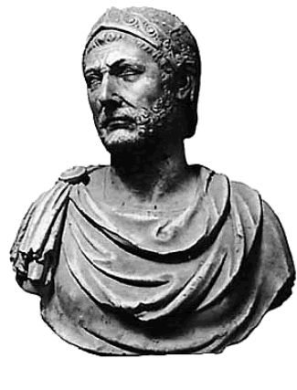
CANNAE
ROME |  | CARTHAGE
70,000 Men |  | 40,000 Men
Paulus | Varro | Hannibal

Slide 28
STRATEGIES
ROME |  | CARTHAGE
Restraint | ENGAGE! | Hope for Stupidity
Paulus | Varro | Hannibal

Slide 29


CANNAE
The consuls took turns commanding on alternate days…
Restraint | ENGAGE! | Restraint | ENGAGE! | Restraint | ENGAGE!
Paulus | Varro | Paulus | Varro | Paulus | Varro

Slide 30


United States
Principles of War
MOOSEMUSS

Slide 31
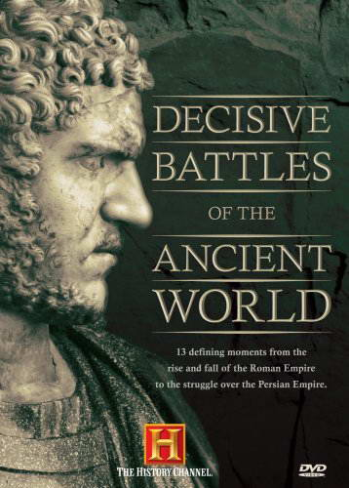
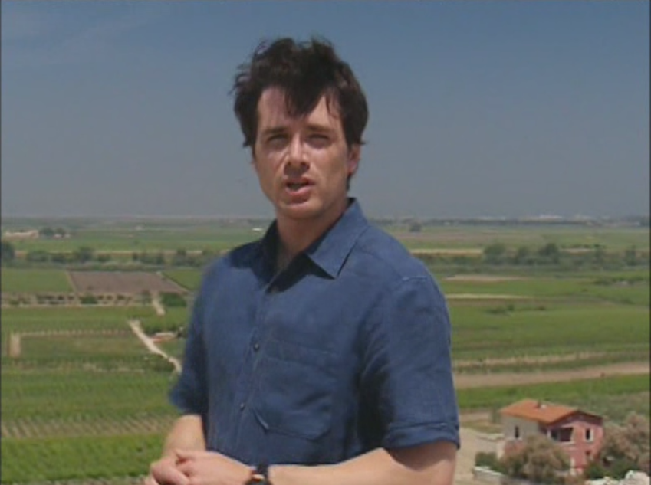
Video Time!

Slide 32
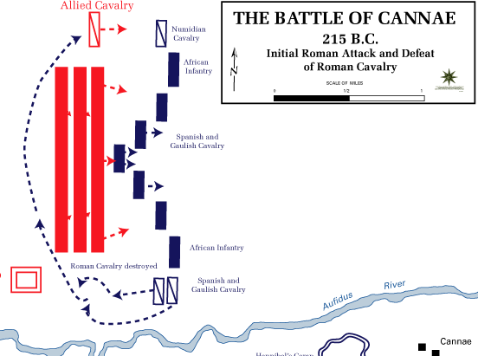

Slide 33
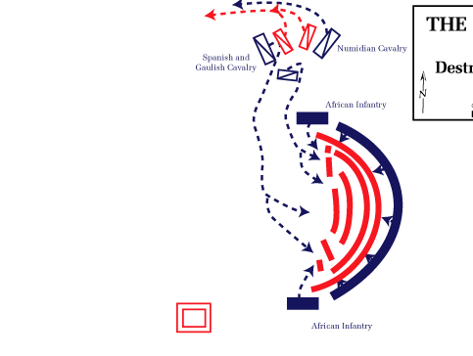
encirclement
Hannibal encircled and destroyed a Roman army nearly twice the size of his own.

Slide 34
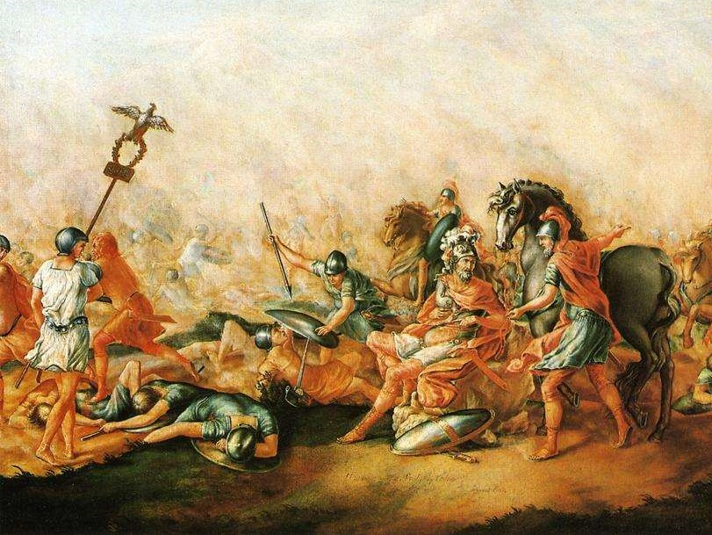
DUTY
Aemelius Paulus, the patrician consul, refused to leave the battlefield (although he had been against going to battle).
Varro, his colleague, left the field.
John Trumbull, The Death of Aemilius Paulus (1773)

Slide 35
3
Victories
in three years
Map Credit: USMA

Slide 36
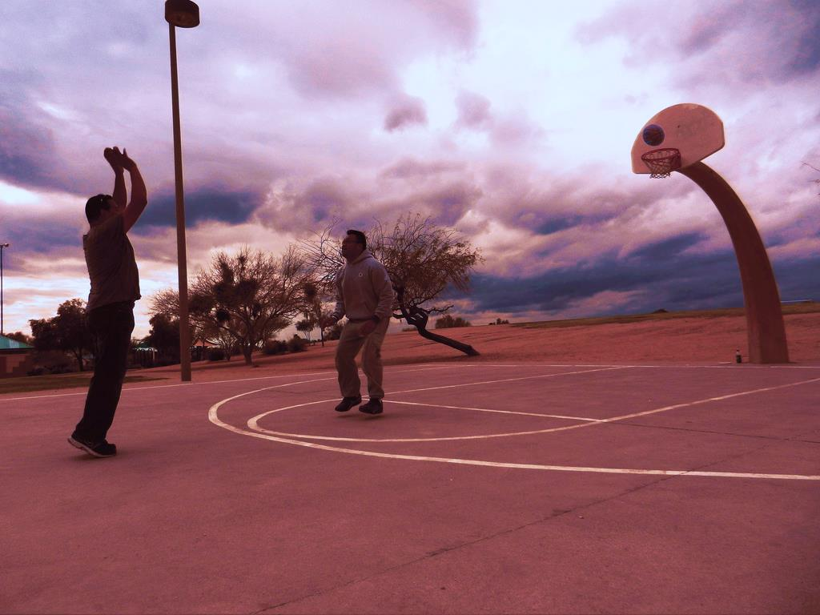
Follow Your Shot
Photo by rtcosmin

Slide 37
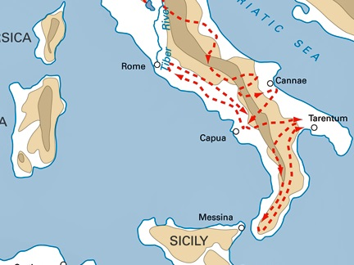
Hannibal’s Objective

Slide 38
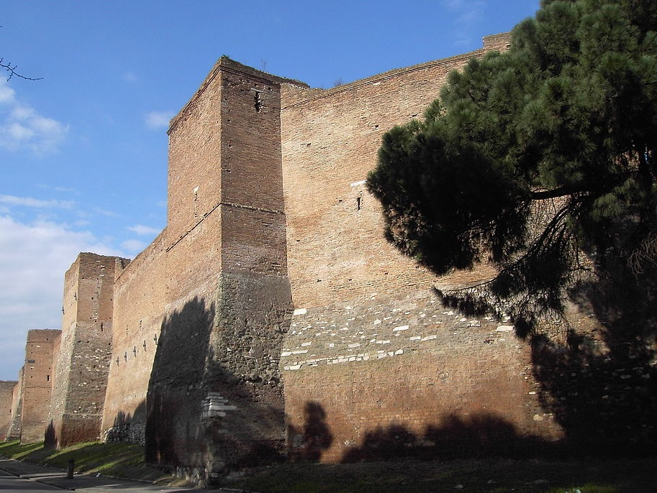


Slide 39
“Hannibal, you know how to gain a victory, but you don’t know how to use it!”
- Maharbal

Slide 40
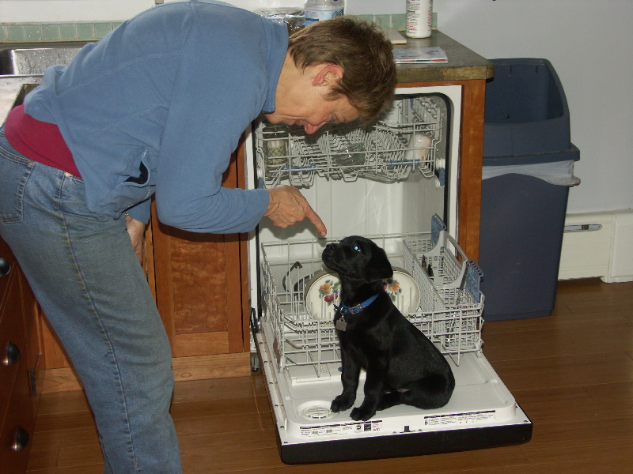
“Hannibal ad portas!”

Slide 41
Hannibal spent fourteen years wandering around Italy.

Slide 42
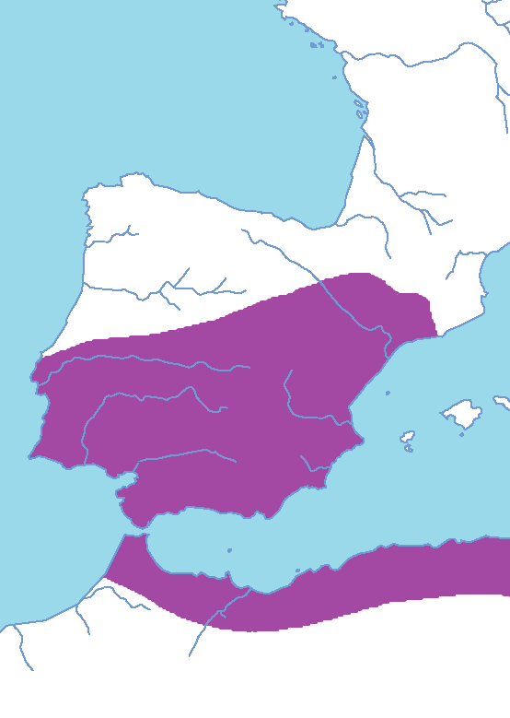
The Spanish Front
211 B.C.
The Scipios are killed in Spain

Slide 43
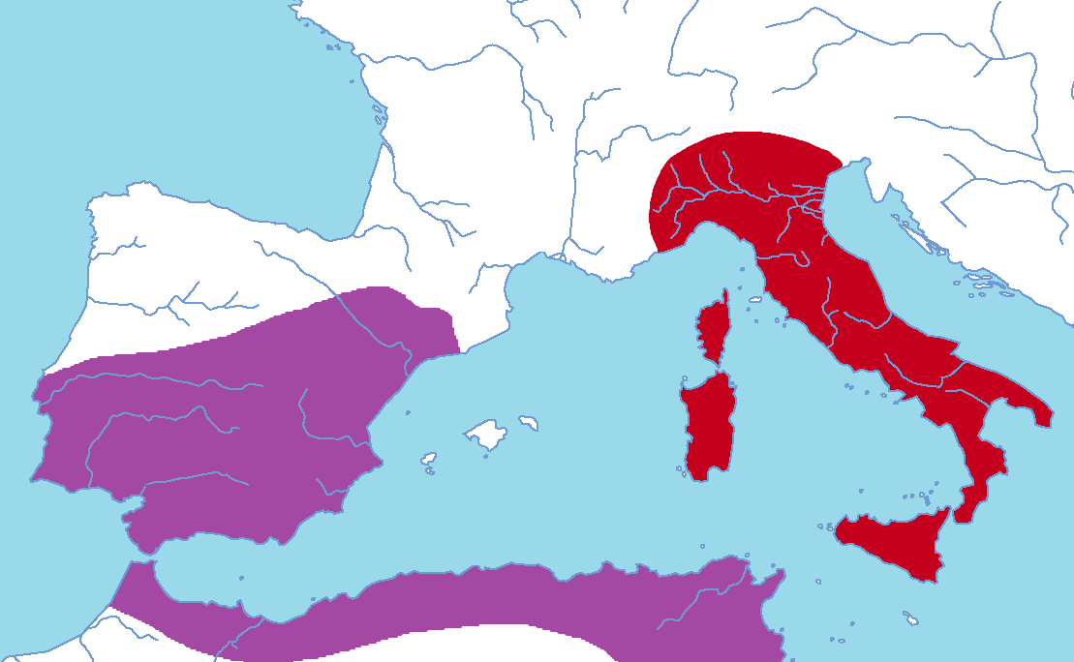
Volunteers???

Slide 44
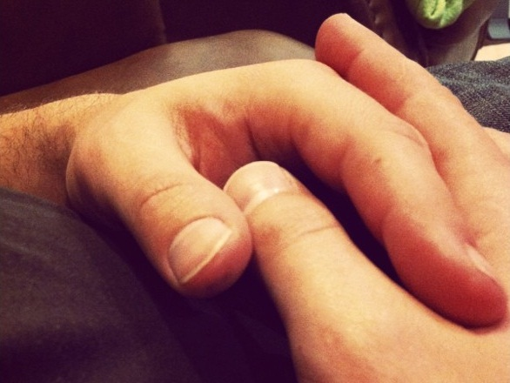
NOPE
Photo by ohsarahrose

Slide 45
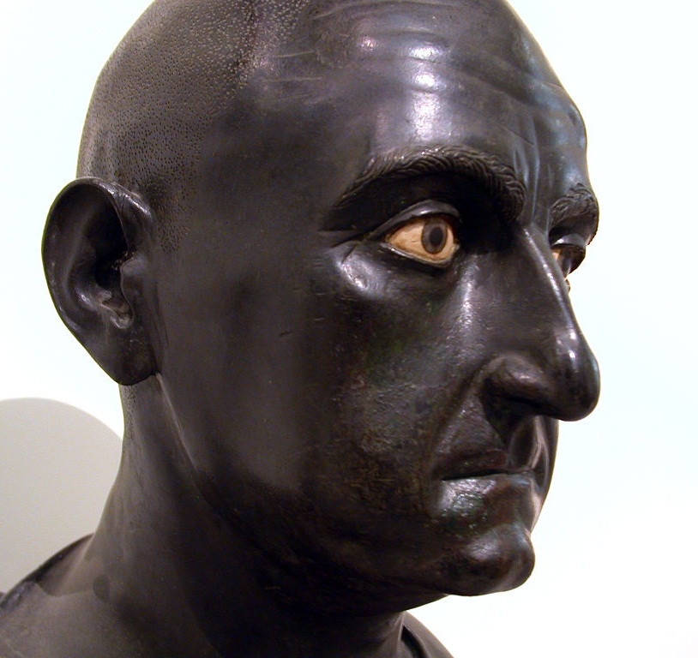

Publius c. Scipio
Age 24
I’ll go.
Photo by Massimo Finizio

Slide 46
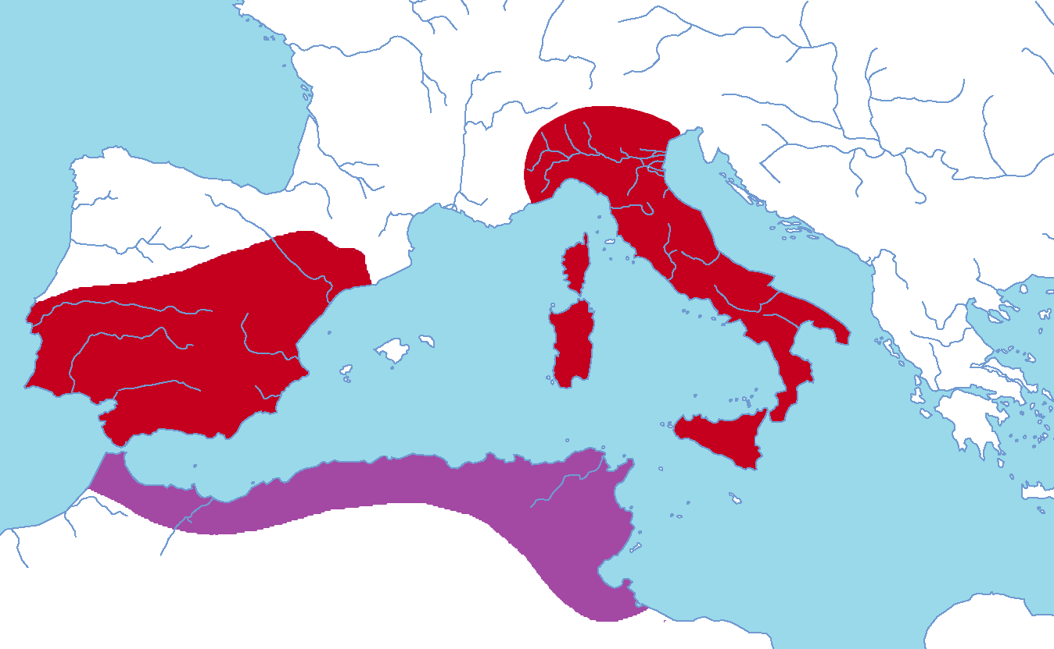
VICTORY!!!

Slide 47
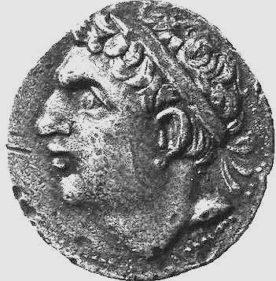
Hasdrubal Barca
Hannibal’s Brother
PLAN:
Reinforce

Slide 48
Hasdrubal’s Plan
Hannibal

Slide 49
The roman risk
Hannibal

Slide 50
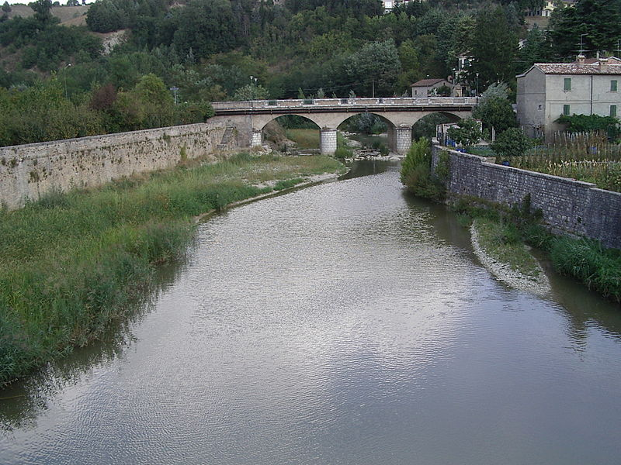
Metaurus
207 B.C.
ROMANS DEFEAT HASDRUBAL
The Battle of the Metaurus was decisive because it guaranteed that Hannibal would not have a large enough army to besiege Rome.
Photo by Adri08

Slide 51
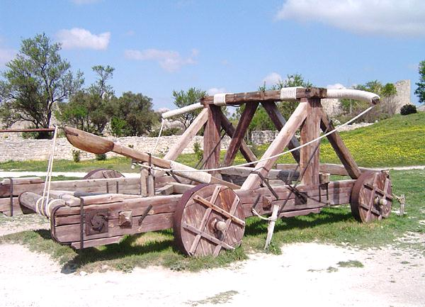
A Present for Hannibal
Image by ChrisO

Slide 52
Consular Elections
206 B.C.

Slide 53
Publius c. Scipio
Age 30
Vote for me.
Photo by Massimo Finizio

Slide 54

Cursus honorum
Consul
Praetor
Military Service

Slide 55
Scipio’s Plan
Hannibal
Carthage

Slide 56
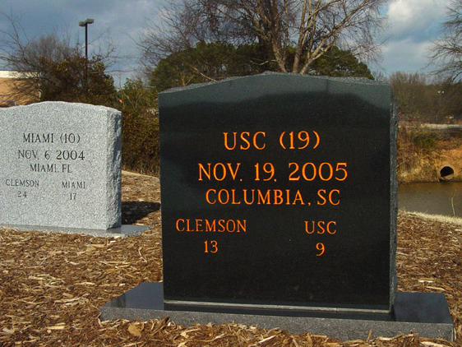
ROAD WIN
Photo Source: http://graphics.fansonly.com/photos

Slide 57
Scipio Vs. Fabius
I don’t like it.
Photo by Massimo Finizio
Is the plan too risky?

Slide 58
Hannibal
Help!!!
Carthage

Slide 59
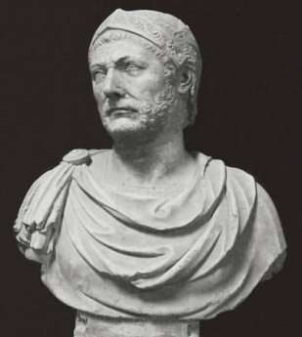
Uh… okay.
Hannibal
Help!!!
Carthage

Slide 60
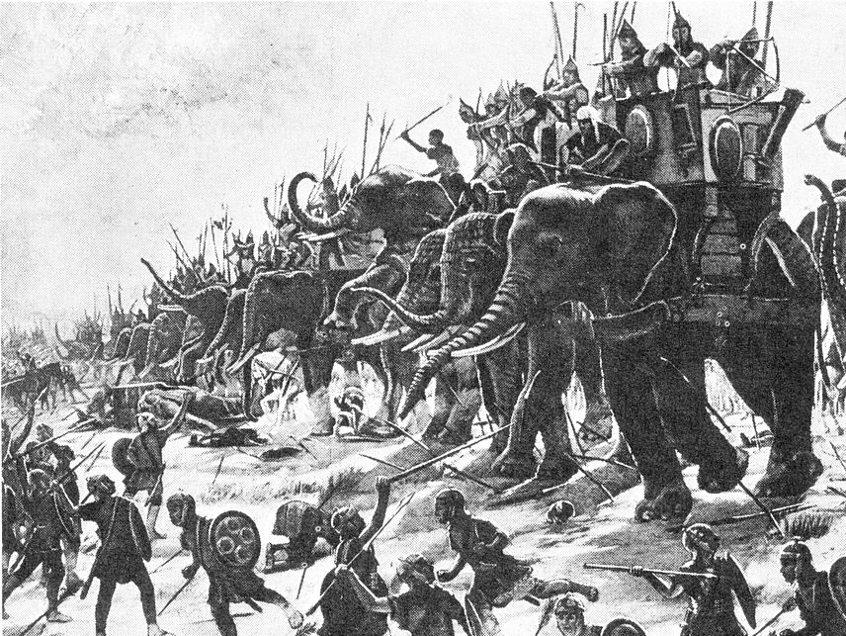
ZAMA
202 B.C.

Slide 61
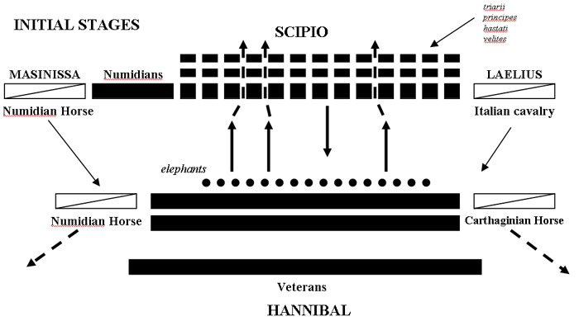
Scipio’s Victory
http://www.visbellica.com/Scenarios/Zama/sc_zama.htm

Slide 62
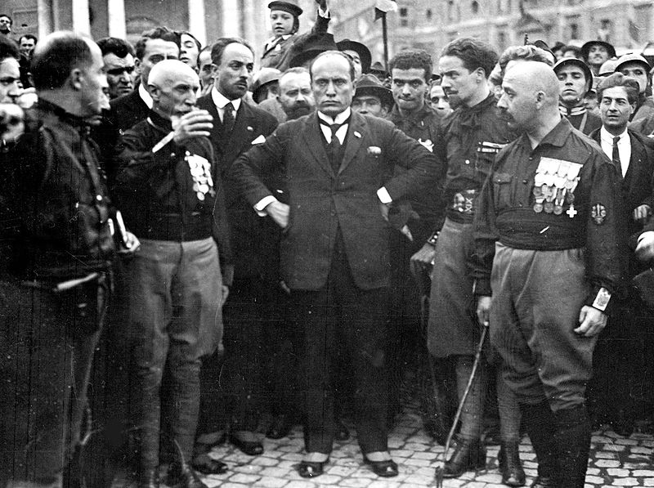
What do dictators do in their free time?

Slide 63
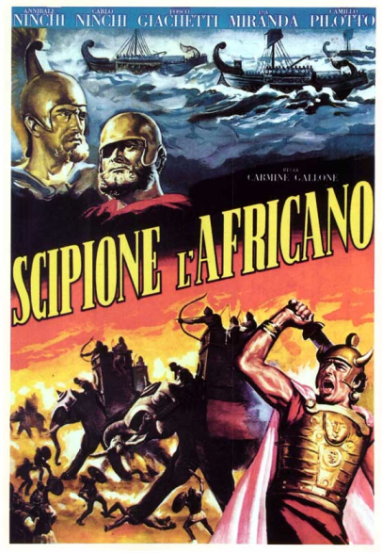

Fascist Italy’s Epic Movie
CLICK
to view the Battle of Zama as dramatized in Fascist Italy’s 1937 epic, Scipio Africanus.

Slide 64
AFRICANUS
Photo by Massimo Finizio

Slide 65
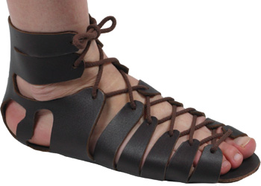
A HARSH PEACE
Reparations
Disarmament
Photo Source: www.romansandals.co.uk

Slide 66




Carthago dilenda est
The Third Punic War
“Punic War
Fun Time”
Part III

Slide 67
Cato the Elder
Roman Senator
After EVERY speech:
“Carthago delenda est!”
(Carthage must be destroyed!)

Slide 68
Scipio Aemilianus
Carthage

Slide 69

The Ruins of Carthage

Slide 70








