Slide 1
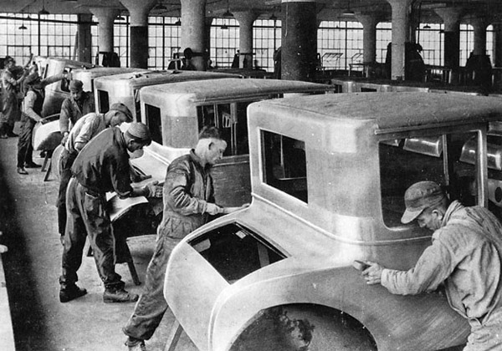
The 1920s
The Economy, Mass Production, Appliances, Consumer Culture, Entertainment, Advertising, and the Black Experience
INTENSIVE REVIEW (USHC 6.1)

Slide 2
BOOMING Economy
Unprecedented Economic Growth

Slide 3
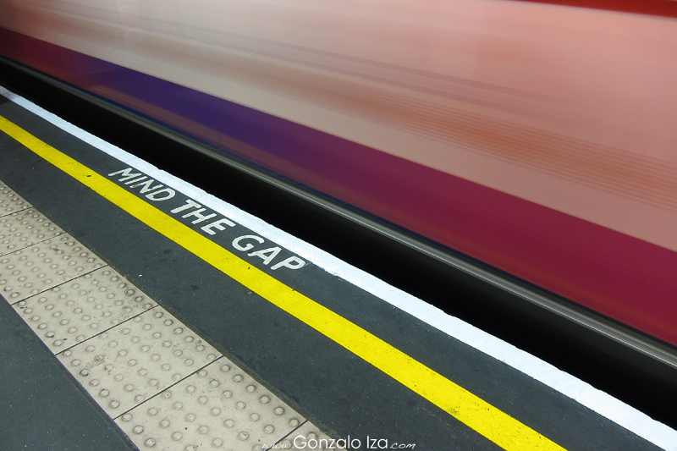
But the GAP widened

Slide 4
Between the HAVES
Photo by cadfael1979

Slide 5
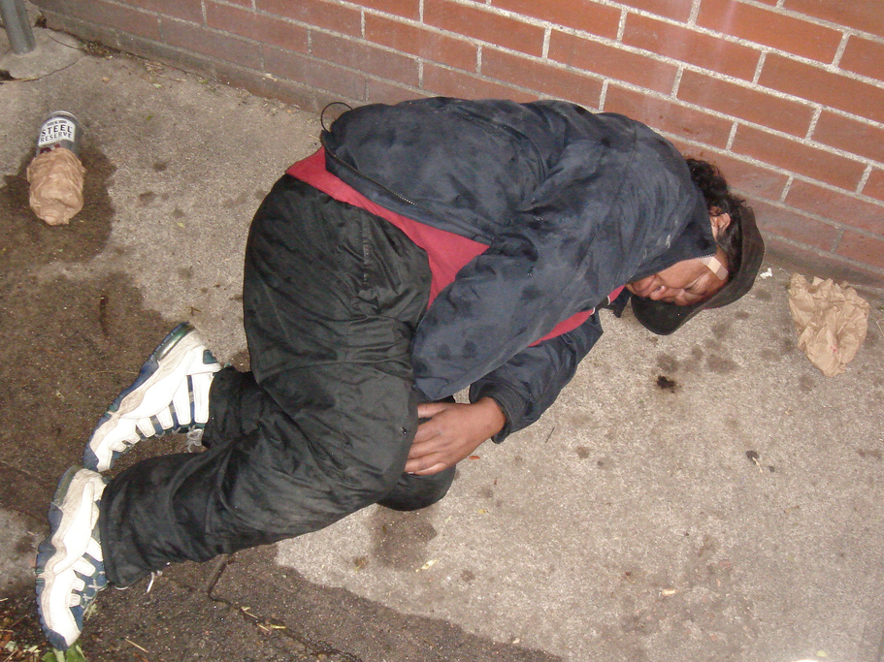
And the HAVE NOTS
Photo by Rob!

Slide 6
THE LOSERS
Farmers
Laborers
by United Nations Photo
by Tymtoi

Slide 7
Henry Ford’s Assembly Line
More efficient (cheaper) production
Less need for skilled laborers

Slide 8
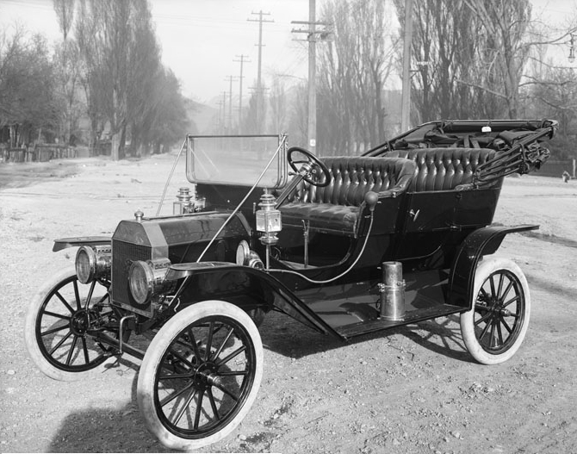
The Decade of the Automobile
Ford Model T

Slide 9
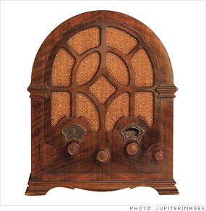
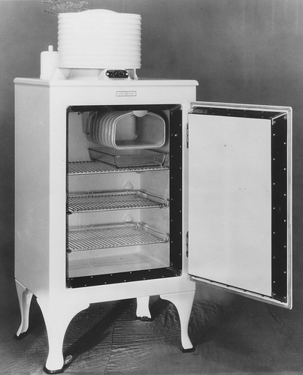
Mass Production
Radios & Refrigerators

Slide 10
Electrical Appliances

Slide 11
Notes:
http://tothetwenties.blogspot.com/2009/11/i-dont-mind-housekeeping-bit.html

Slide 12
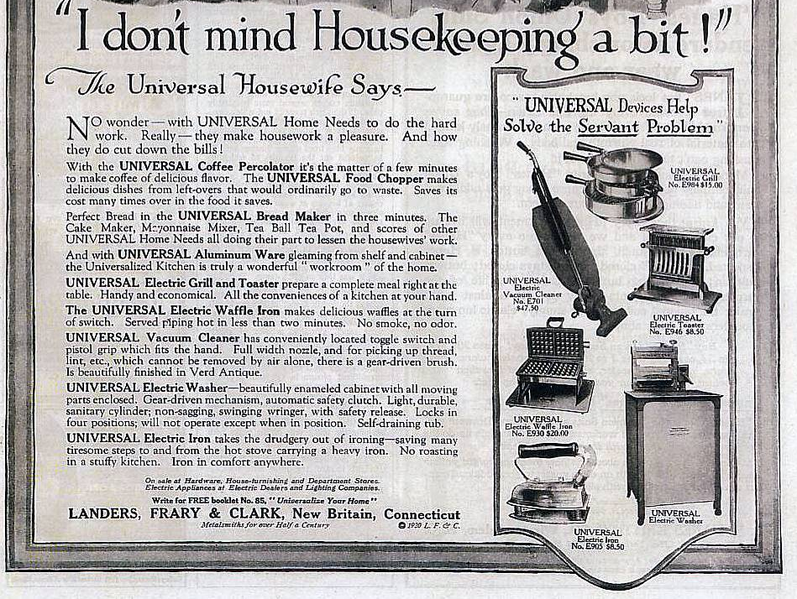

Slide 13
Installment Plan
Notes:
http://ruins.files.wordpress.com/2006/11/pecoadbest.jpg%3Fw%3D440%26h%3D540amp

Slide 14
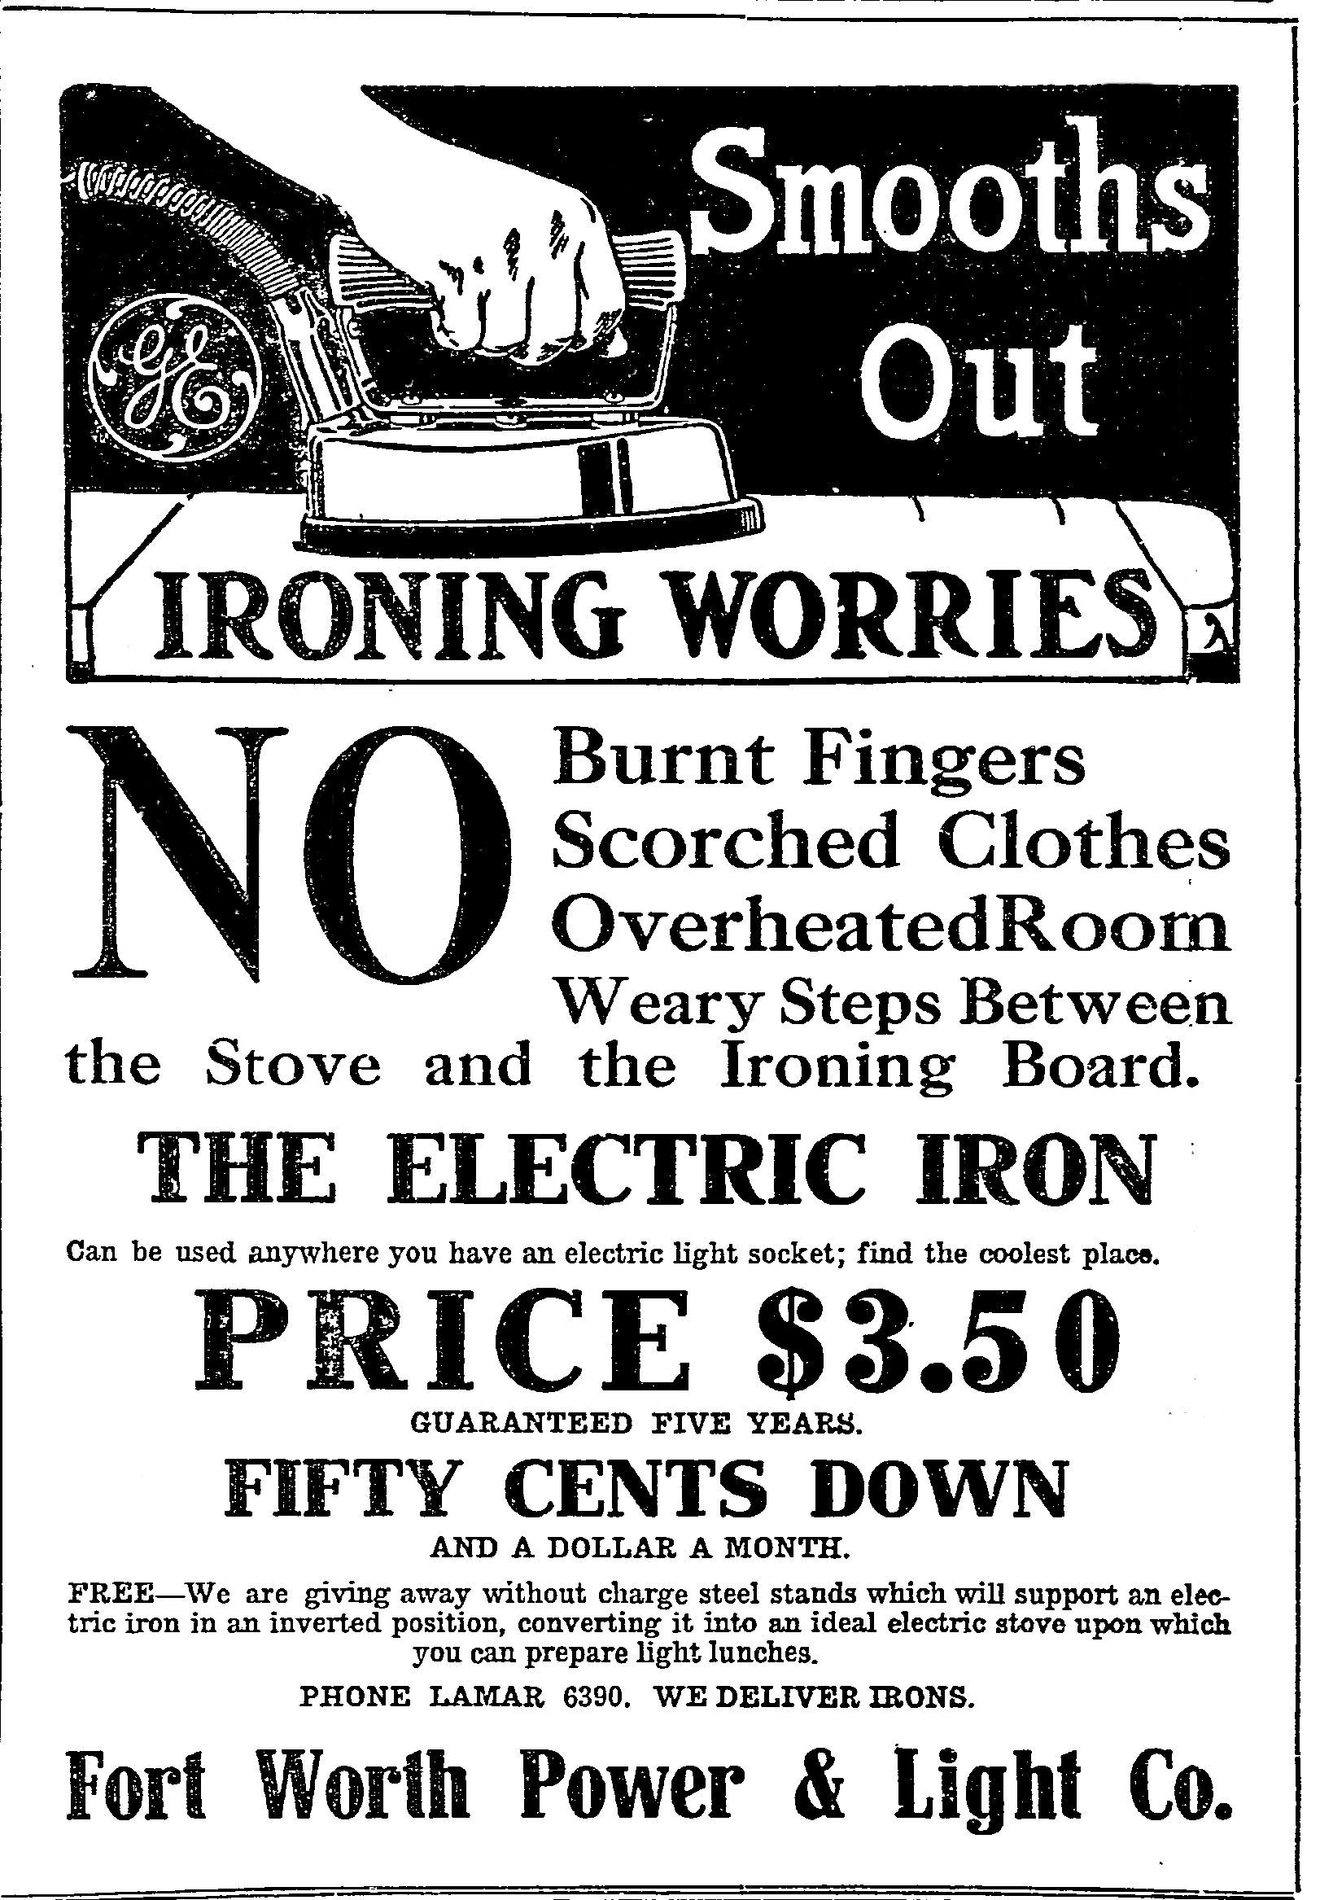

Slide 15
Buy NOW
Pay LATER

Slide 16
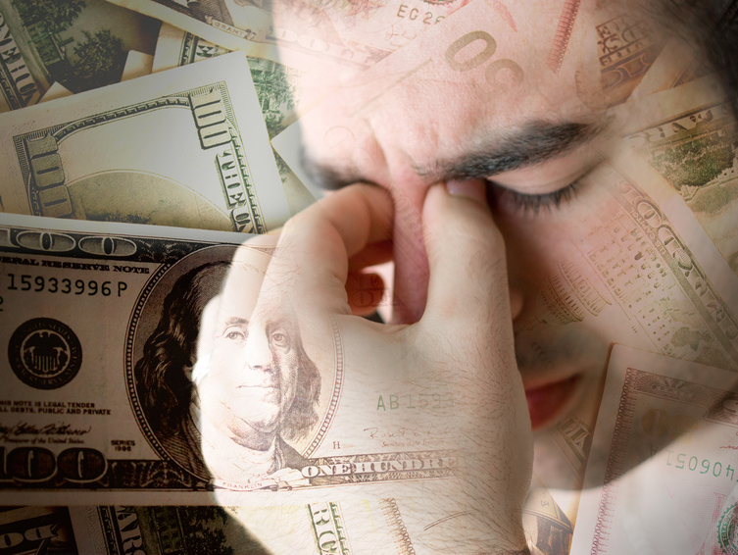
DEBT
A Big Problem

Slide 17
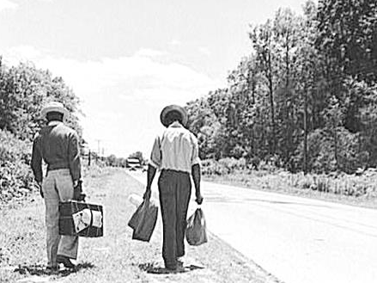
The Great Migration
1916-1930
African Americans Leave the South

Slide 18
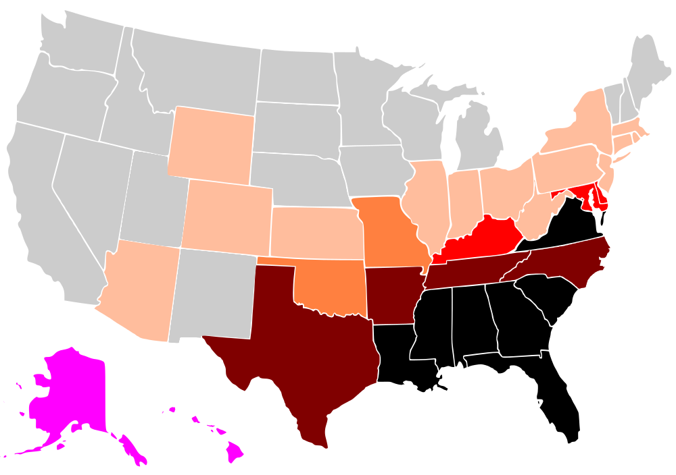
Black % of Population
1900
Black = 35.00+% Brown = 20.00-34.99% Red = 10.00-19.99% Orange = 5.00-9.99% Light orange = 1.00-4.99% Gray = 0.99% or less

Slide 19
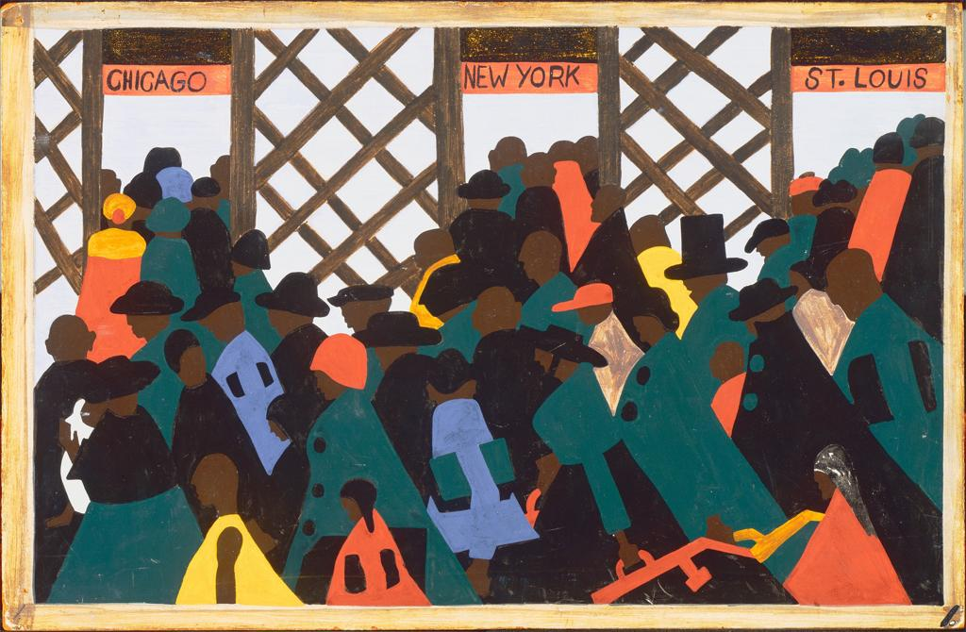
DESTINATION:
Northern Cities
CLICK for more paintings from Jacob Lawrence’s Migration Series

Slide 20
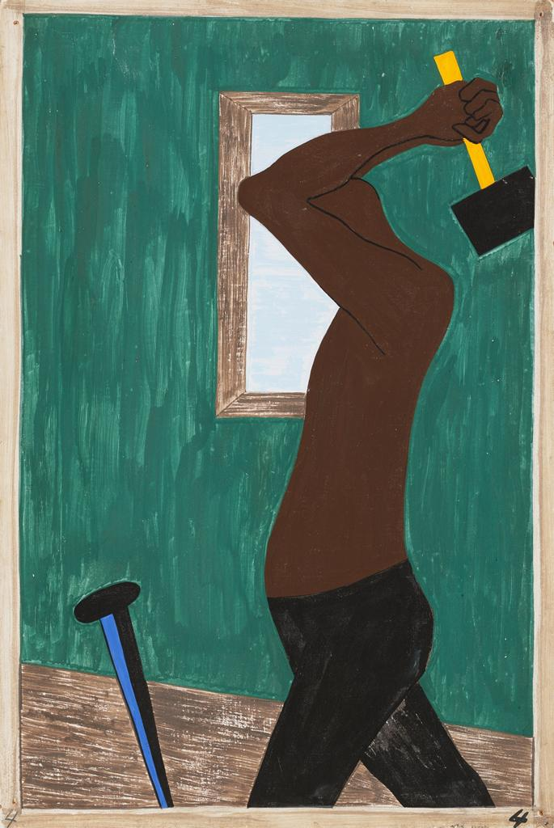
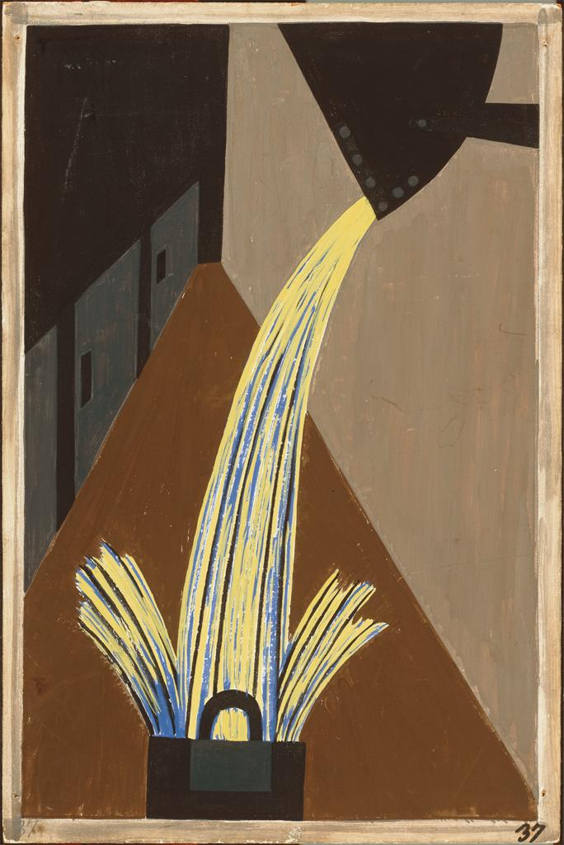
Employment Opportunities
CLICK for more paintings from Jacob Lawrence’s Migration Series

Slide 21
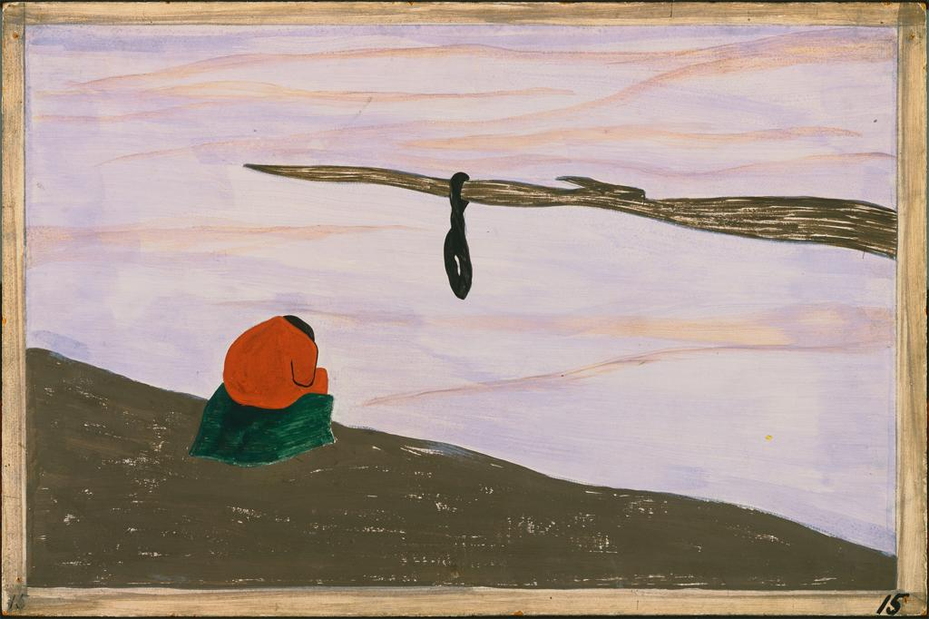
ESCAPE Lynching
CLICK for more paintings from Jacob Lawrence’s Migration Series

Slide 22
Black % of Population
1900
Black = 35.00+% Brown = 20.00-34.99% Red = 10.00-19.99% Orange = 5.00-9.99% Light orange = 1.00-4.99% Gray = 0.99% or less

Slide 23
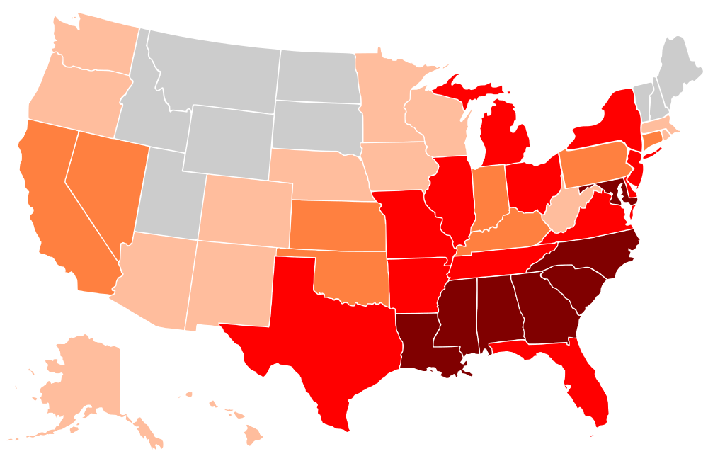
Black % of Population
1990
Black = 35.00+% Brown = 20.00-34.99% Red = 10.00-19.99% Orange = 5.00-9.99% Light orange = 1.00-4.99% Gray = 0.99% or less

Slide 24
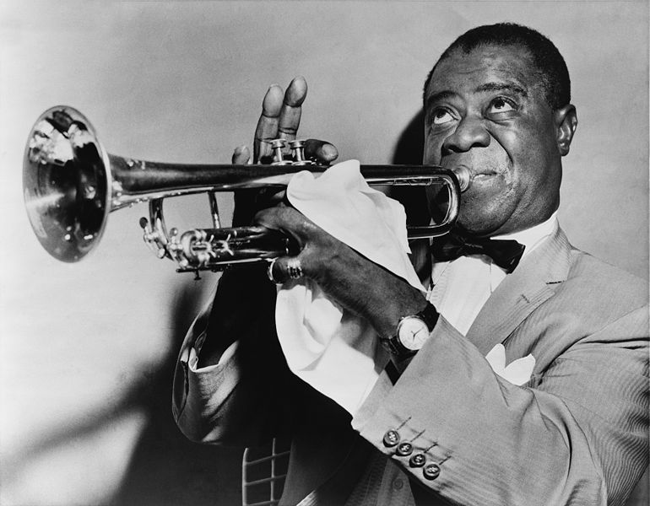
JAZZ
Black music popular with white audiences

Slide 25
JAZZ
The prevalence of Jazz on the radio broke down a cultural barrier.

Slide 26
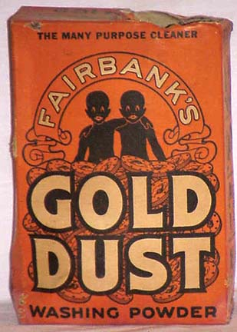
But Racial stereotypes still persisted.
The “Gold Dust Twins” had a radio show, too!

Slide 27
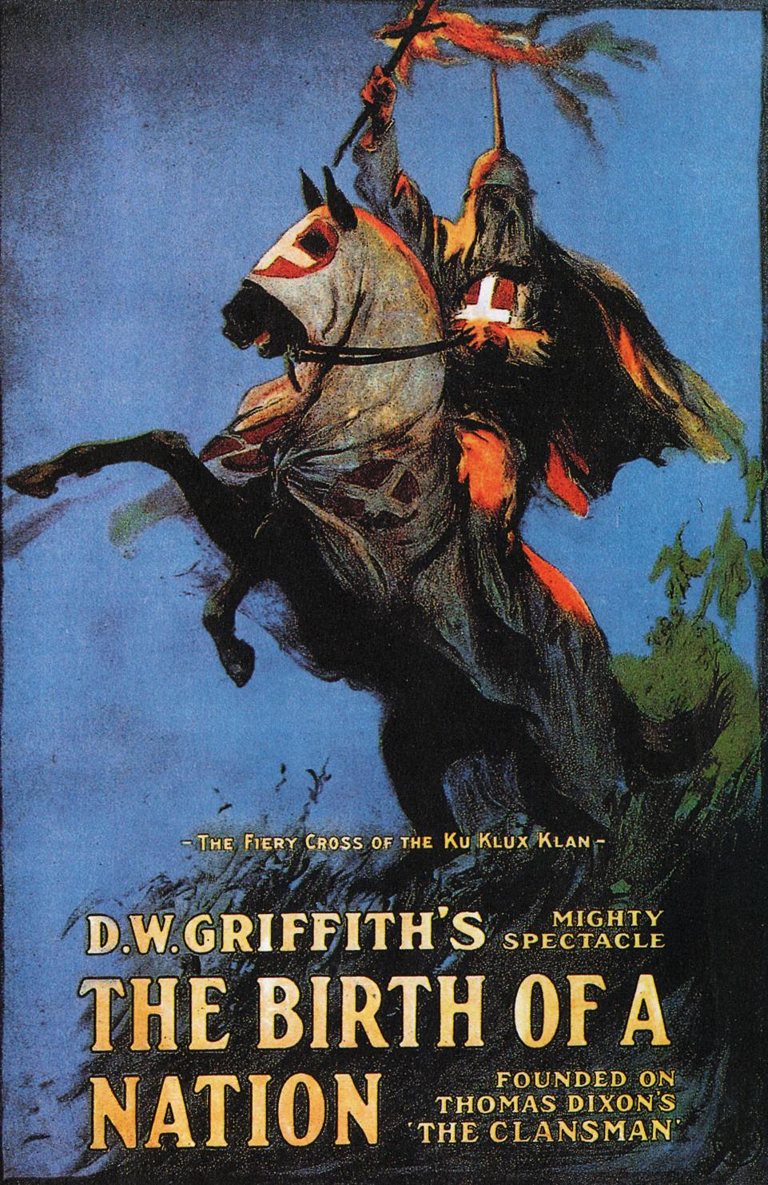
The Most SUCCESSFUL Silent Film EVER

Slide 28
Harlem Renaissance
African American intellectual movement
Literature, Poetry, Art, etc.
Langston Hughes novelist and poet

