Slide 1
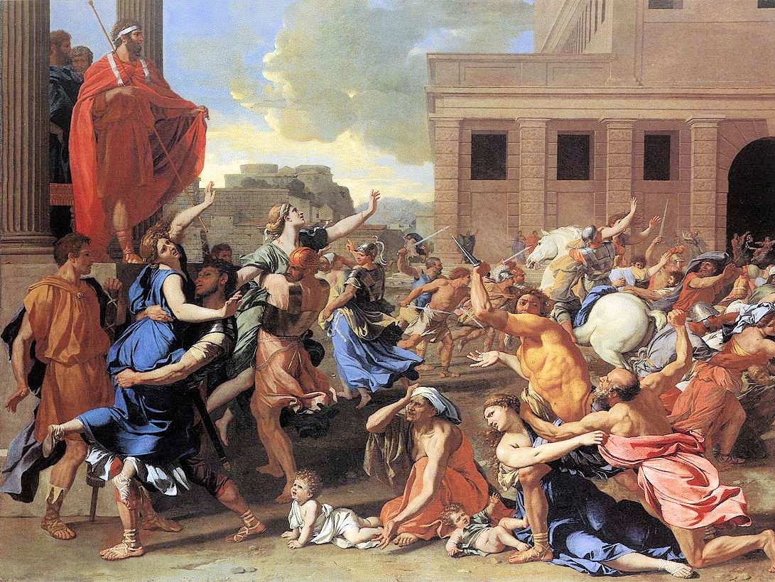

The Roman Monarchy

Slide 2
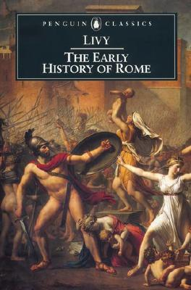
TITVS LIVIVS
“Livy” (59 BC – AD 17)
Roman Historian
Ab Urbe Condita
From the Founding
of the City
142 Books
(35 are extant)
Periochae
(Summaries)

Slide 3
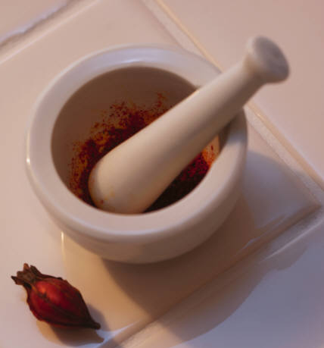
“The study of history is the best medicine for a sick mind.”
-- Livy

Slide 4
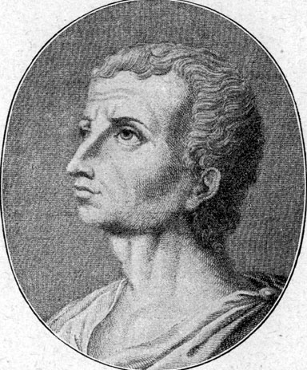
TITVS LIVIVS
Moralist
Emphasis on Rome’s
humble beginnings
Livy
(Fictitious Portrait)

Slide 5
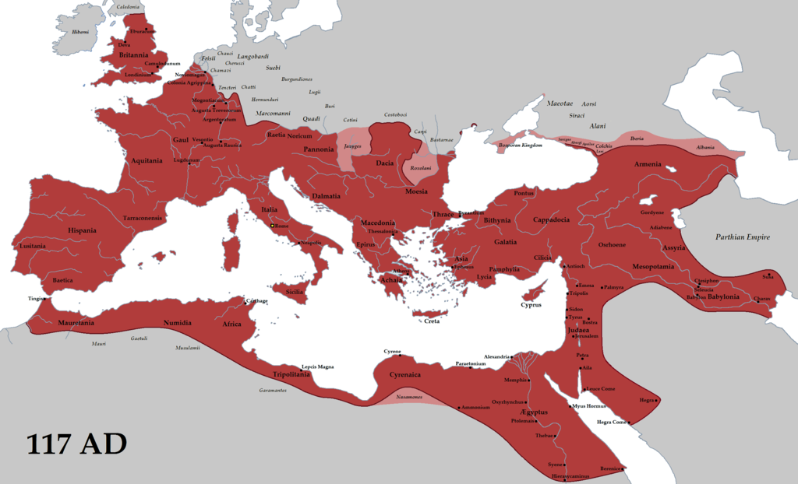
The Roman Empire
Map Credit: Tataryn77

Slide 6
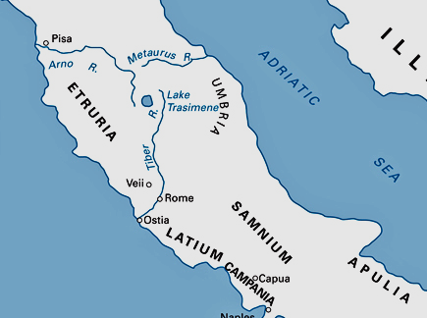
IN THE BEGINNING…
Source:
http://www.emersonkent.com/map_archive/italy_218_bc.htm

Slide 7
PERIODS
OF ROMAN HISTORY
Monarchy | 753 - 509 B.C.
Republic | 509 - 27 B.C.
Empire | 27 B.C. – 476 A.D.

Slide 8
ROMAN KINGS
SEVEN
Legendary
Kings
A lot of archaic history is “based on a true story.”

Slide 9
THE
ROMAN KINGS
Light Purple
(NOT TESTED)

Slide 10
Elected
Hereditary
INTERREGNUM
“Between Kings”

Slide 11
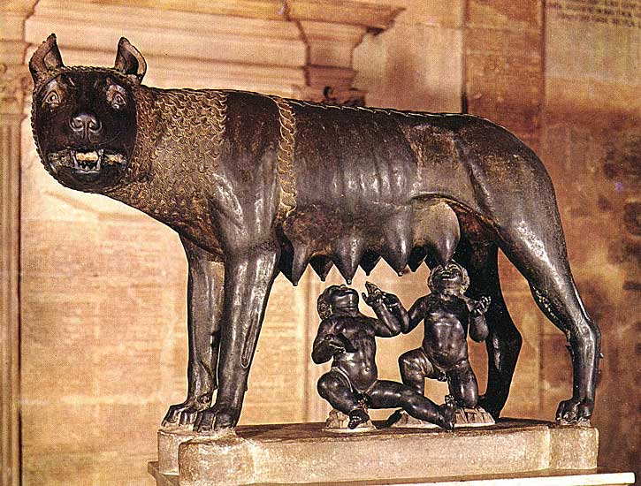
ROMVLVS
Legendary Founder
Humble Beginnings

Slide 12
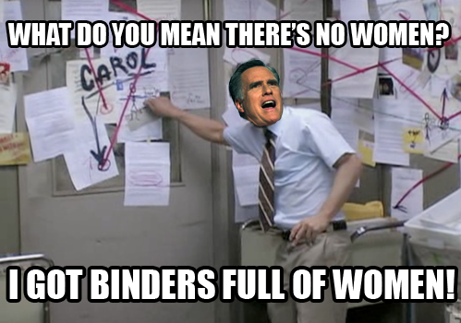
http://www.youtube.com/watch?v=wfXgpem78kQ

Slide 13
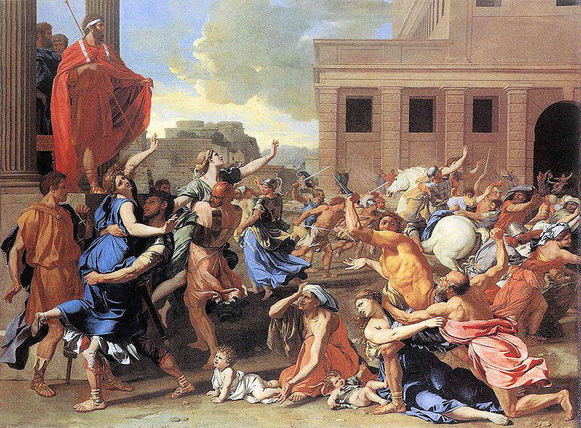
Nicolas Poussin, The Rape of the Sabine Women

Slide 14
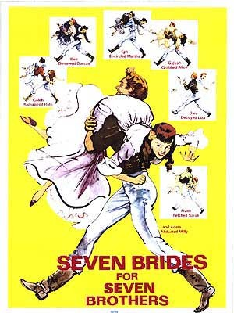
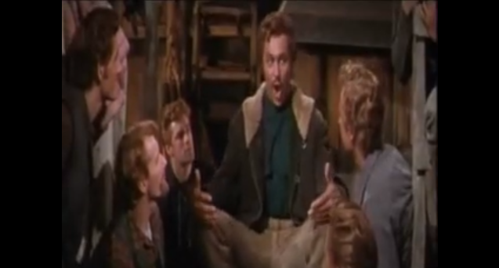
“Sobbin’” Women
https://www.youtube.com

Slide 15
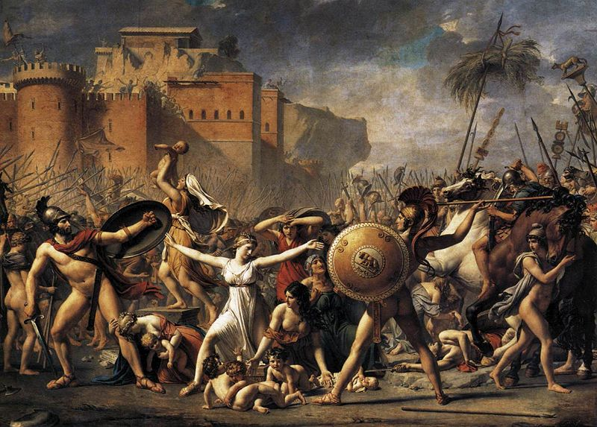
Jacques-Louis David, The Sabine Women

Slide 16
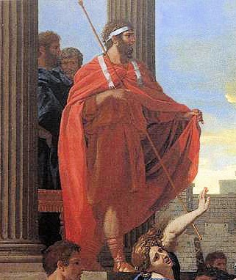
How can I add some dignity to this office?

Slide 17

LICTORS
(Bodyguards)

Slide 18



FASCES
Power of
Life & Death
Symbol of Roman Power
Appropriated By:
Strength Through Unity
United States
Fascist Italy

Slide 19
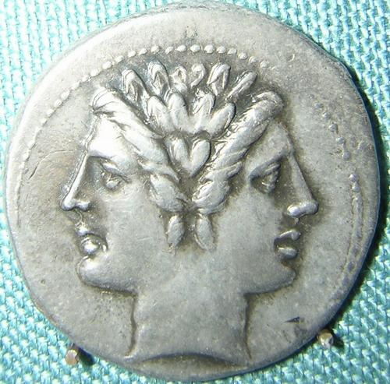

NVMA POMPILIVS
Civil Religion
Peace
Temple of Janus
Calendar
Reform
+ January
+ February
JANVS

Slide 21

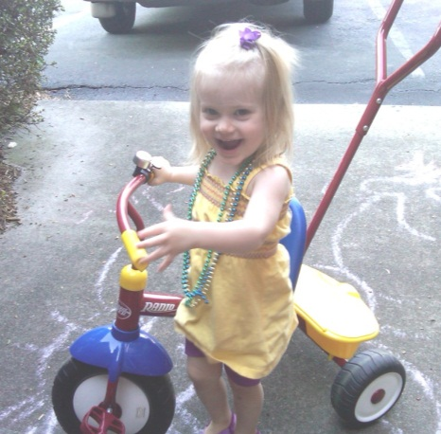
SERVIVS TVLLIVS
A Legendary
Miracle
The Servian
Reforms
Unfortunate
Family Life

Slide 22
fAIRNESS
What makes something fair?

Slide 23
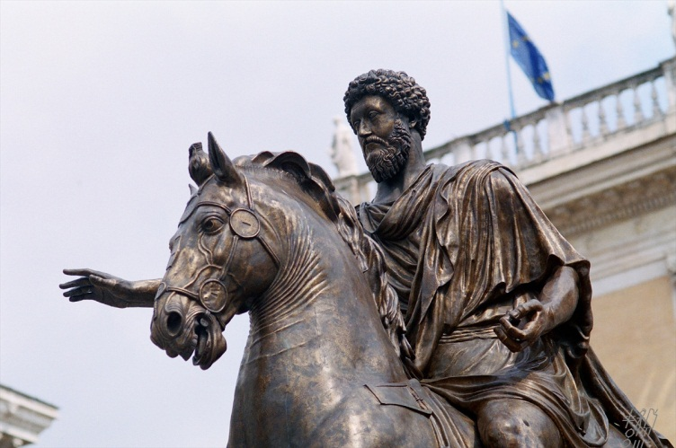
EQUESTRIANS
Photo by 5telios

Slide 24
THE SERVIAN REFORMS
EQUESTRIANS
The Wealthy:
Pay more taxes
Have more influence

Slide 25
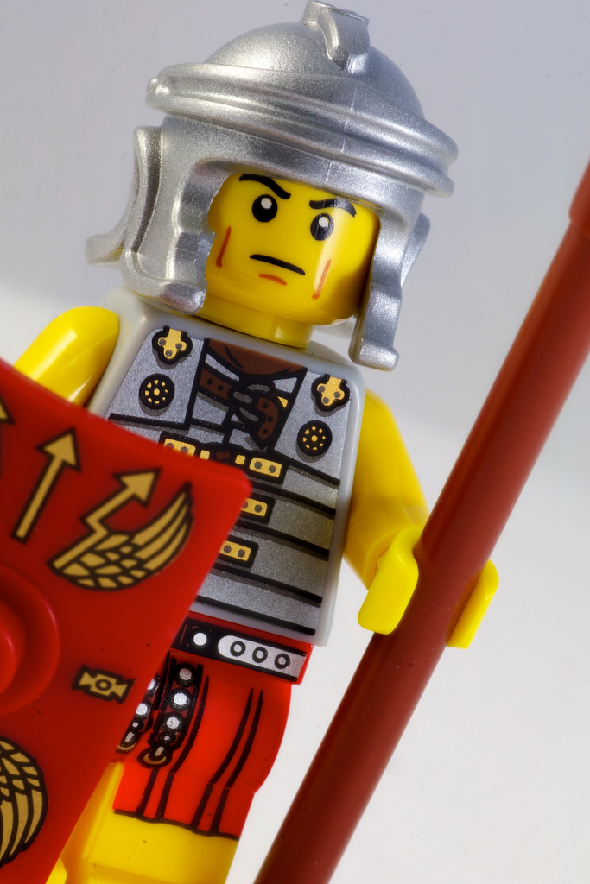
Six Classes of
INFANTRY:
1. 80 Centuries
2. 20 Centuries
3. 20 Centuries
4. 20 Centuries
5. 30 Centuries
6. One Century
Photo by Paul Hudson

Slide 26
Rich Man’s
WAR
Rich Man’s
FIGHT
Photo by Paul Hudson

Slide 27
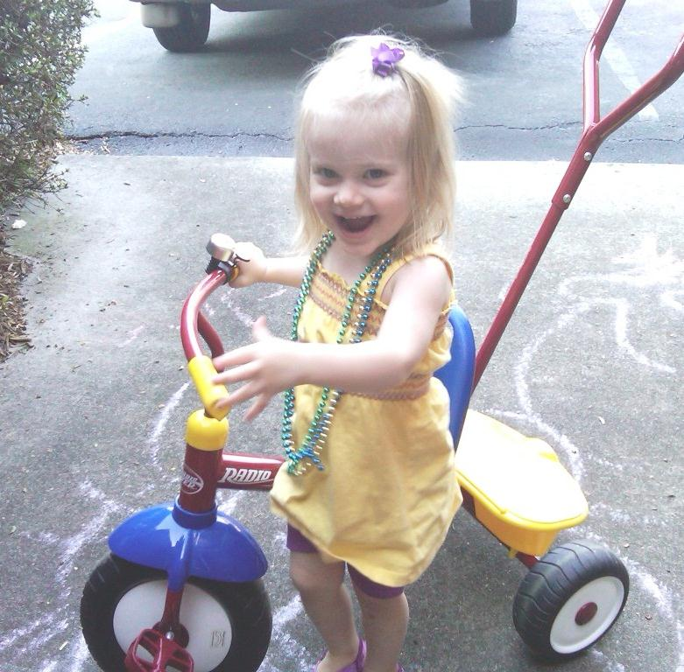
FAMILY

Slide 28
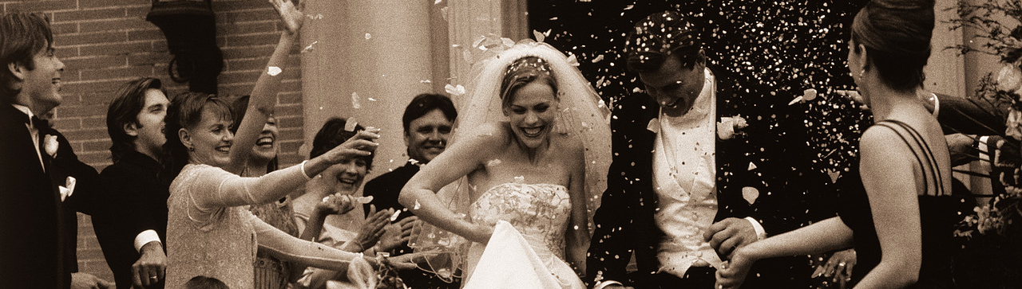
V
VI
Tarquinius Priscus
Servius Tullius
SON
SON
Tullia
Tullia

Slide 29
V
VI
Tarquinius Priscus
Servius Tullius
Tullia
SON
SON
Tullia

Slide 30
I like his brother better.
I like her sister better.
Tullia
SON
SON
Tullia

Slide 31
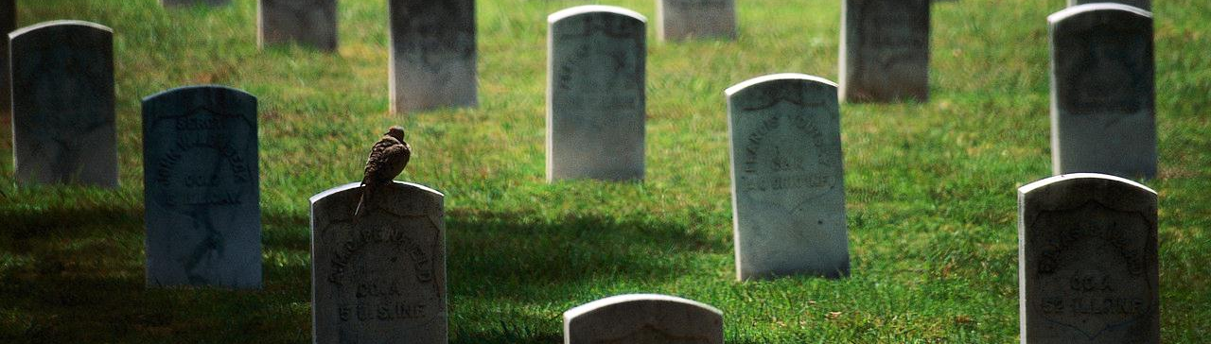
Now, let’s kill my dad.
Uh…
Tullia
SON
SON
Tullia

Slide 32
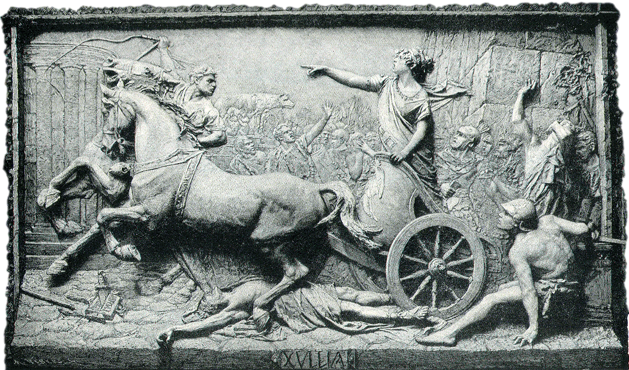
“With Servius, true kingship came to an end; never again was a Roman king to rule in accordance with humanity and justice.”
-- Livy

Slide 33
LVCIVS TARQVINIVS SVPVRBVS
Understanding
Roman Names
  Praenomen
  (First)
  Nomen
  (Last)
  Cognomen
  (Nickname)

Slide 34

TARQUIN “THE PROUD”
HARSHRuler

Slide 35
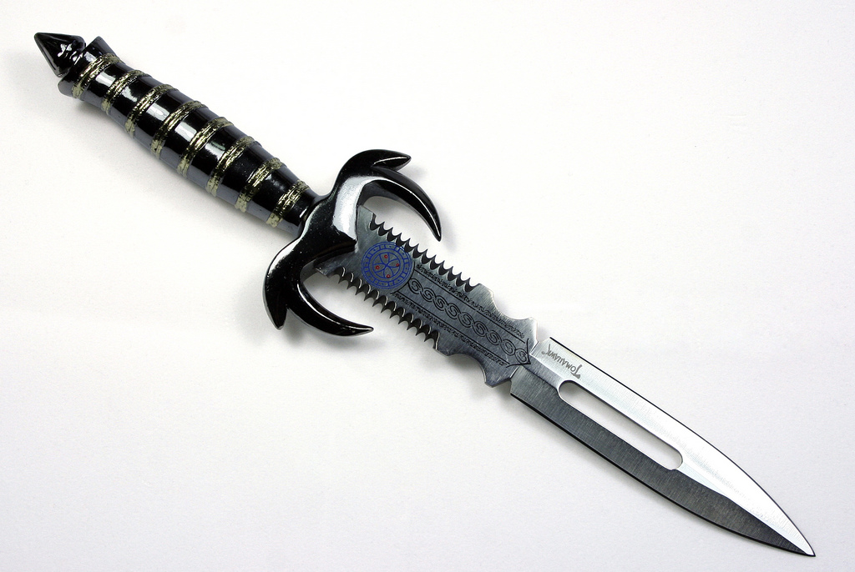
purges
Tarquin had his relatives and important senators killed so that they would not be a threat to him.
Photo by ~Brenda-Starr~

Slide 36

PATER FAMILIAS
(Family Patriarch)
EXTENSIVE
PATERNAL RIGHTS

Slide 37
vitae necisque potestas

Slide 38
I would never kill my kids, but it’s good to have the option!

Slide 39
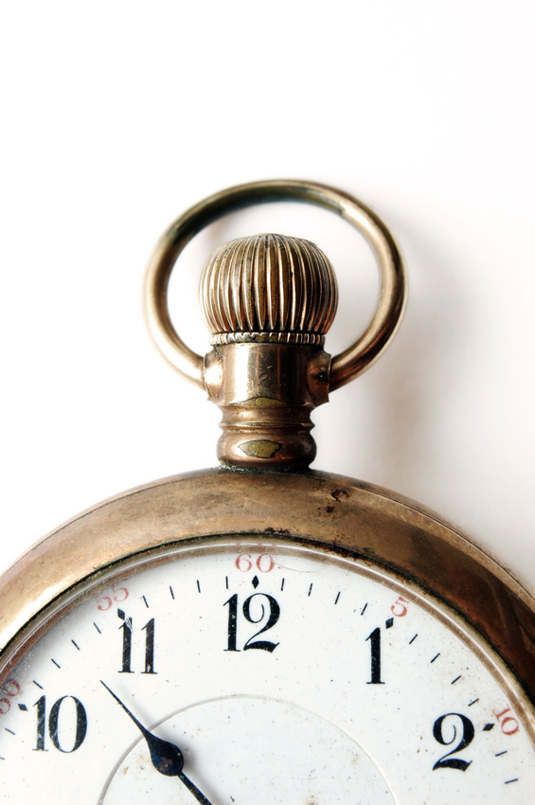
Tarquin arrives late for a meeting…
Someone complains…
…and dies!

Slide 40
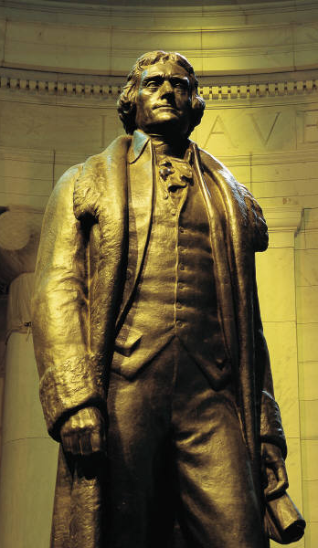

Jefferson on the Nature of Revolutions
“Prudence, indeed, will dictate that Governments long established should not be changed for light and transient causes; and accordingly all experience hath shewn that mankind are more disposed to suffer, while evils are sufferable than to right themselves by abolishing the forms to which they are accustomed…

Slide 41
Jefferson on the Nature of Revolutions
“But when a long train of abuses and usurpations, pursuing invariably the same Object evinces a design to reduce them under absolute Despotism, it is their right, it is their duty, to throw off such Government, and to provide new Guards for their future security.”
-- The Declaration of Independence

Slide 42
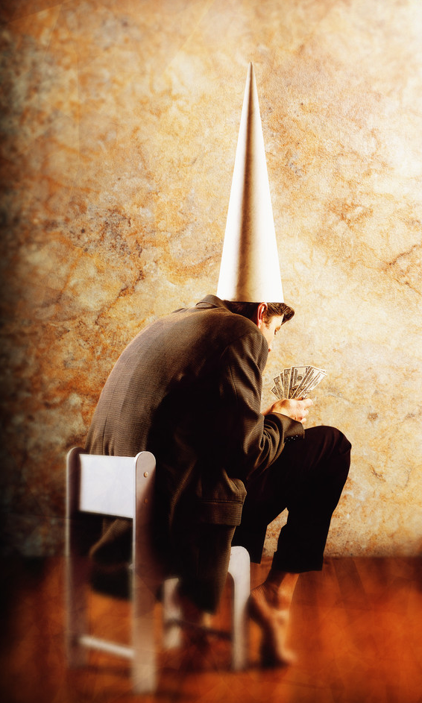
LVCIVS JVNIVS BRVTVS
Tarquin’s
nephew
SURVIVAL

Slide 43
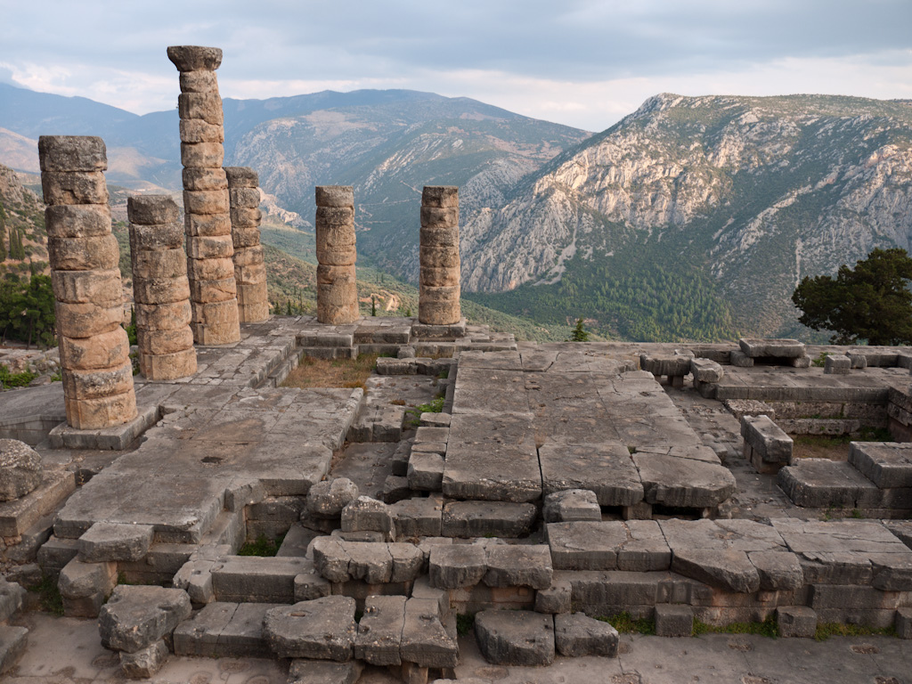
“The first to kiss his mother...”
Photo by: Charles Nadeau

Slide 44
ROMAN HONOR
MEN
WOMEN
Virtue
Chastity
Simplicity
Simplicity
Public Service
Good Children
Military Service
Honor Husband
in the Public Sphere

Slide 45
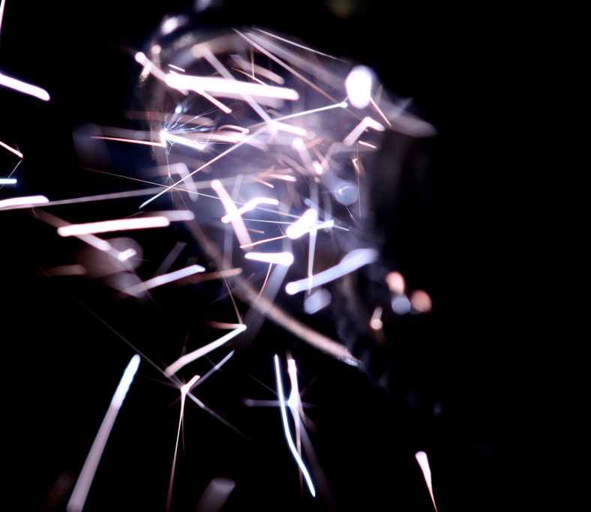
The spark
A Violation of Feminine Honor
Photo by Daniel Dionne

Slide 47
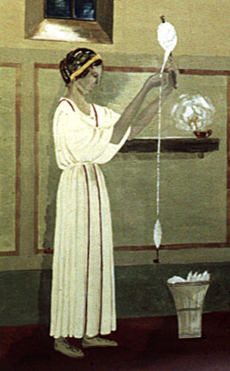
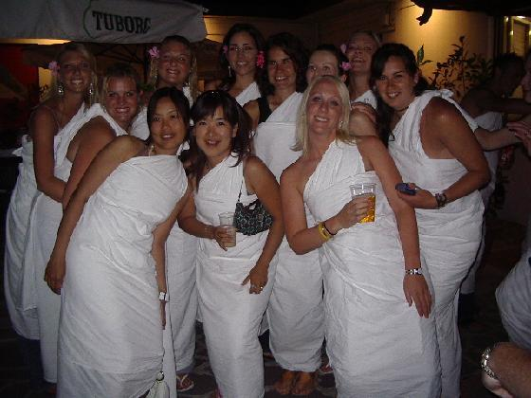
THE REVOLVTION
Sextus Tarquinius and Friends:
Who has the best wife?
Ideal
Lucretia
Non-Ideal

Slide 48
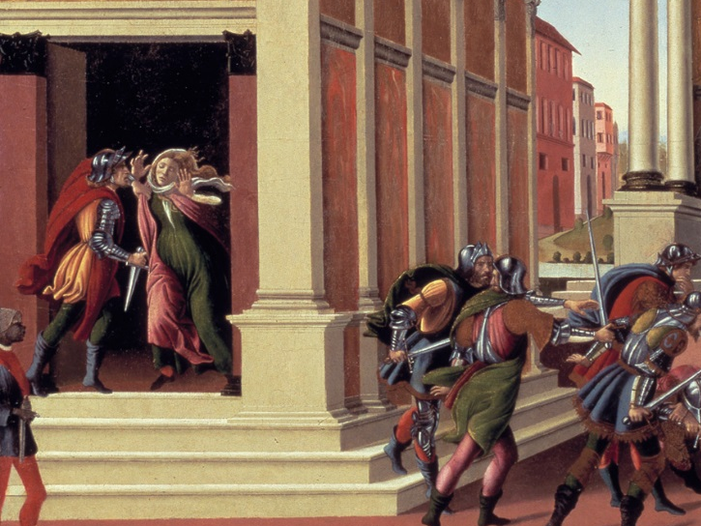
Sandro Botticelli
The Story of Lucretia

Slide 49


Slide 51
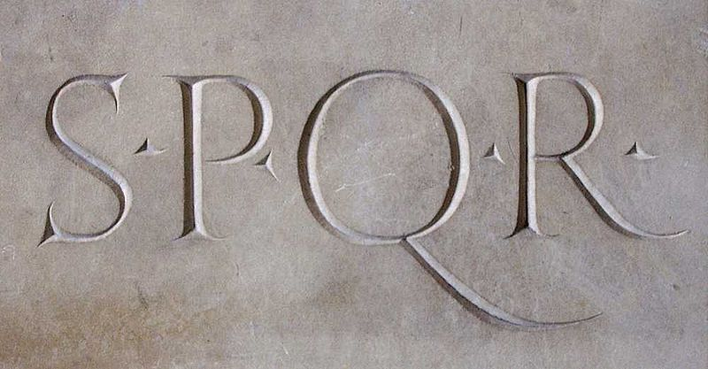
RES PVBLICA
“Commonwealth”
Senatus Populusque Romanus
“The Senate and the People of Rome”

Slide 52
https://www.youtube.com/watch?v=tZ9SMVC8-C4

Slide 53







