Slide 1
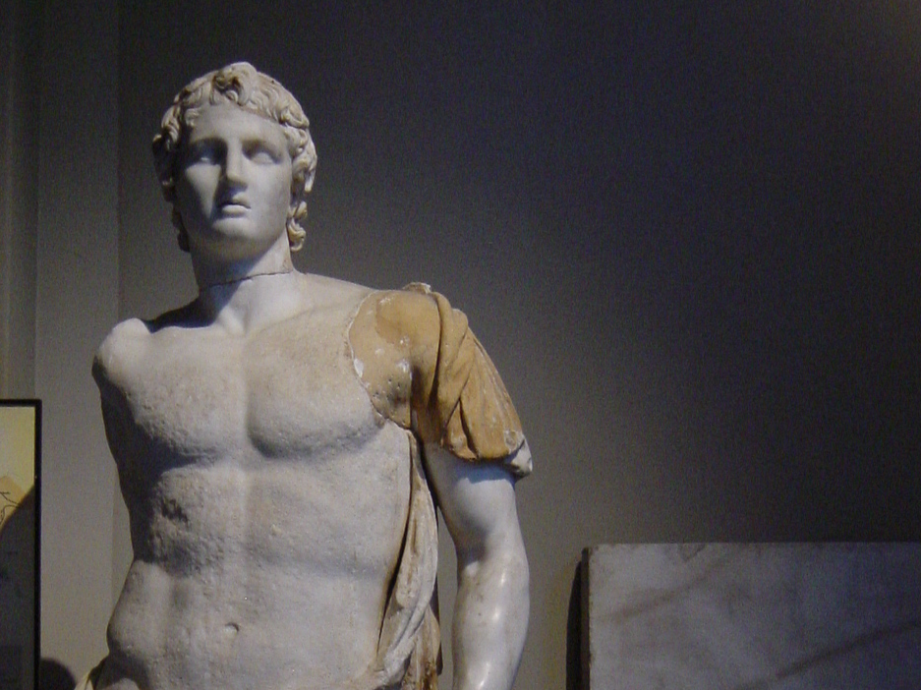
Alexander
the
Great
Photo Credit: Giovanni Dall'Orto

Slide 2
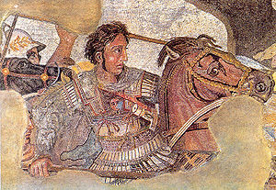
TERMS LIST
Philip II
Demosthenes
Orator
Philippic
Alexander the Great
Gordian Knot
Battle of Gaugamela
Hellenism
Alexander’s Empire
Seleucid Empire
Ptolemaic Empire
Essential Questions
How did Alexander’s use of appropriate technologies help him achieve victories over the Persians?
How did the spread of Hellenism affect the cultural development of the Eastern Mediterranean in the centuries following Alexander’s conquests?

Slide 3
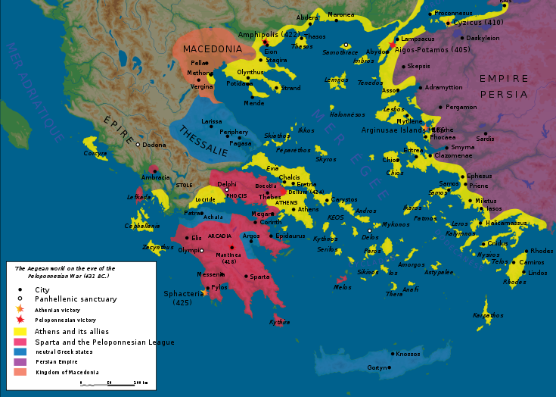
Macedonia
Map Credit:
Marsyas
Macedonia was a second-rate power before Athens and Sparta weakened each other in the Peloponnesian War.

Slide 4
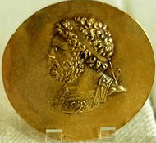
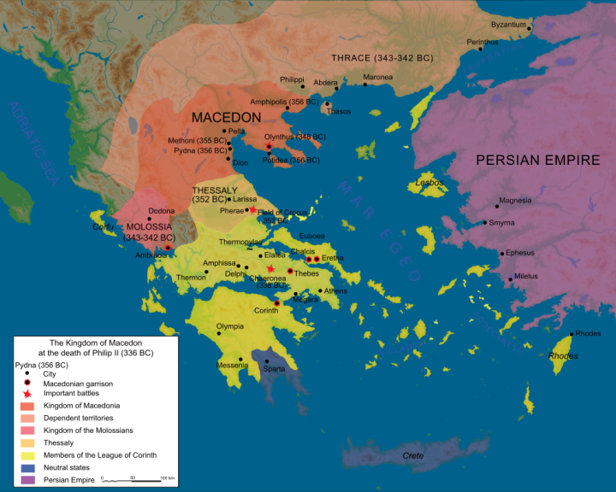
Philip II
  King of Macedon
Father of Alexander the Great
Conquered most Greek city-states

Slide 5
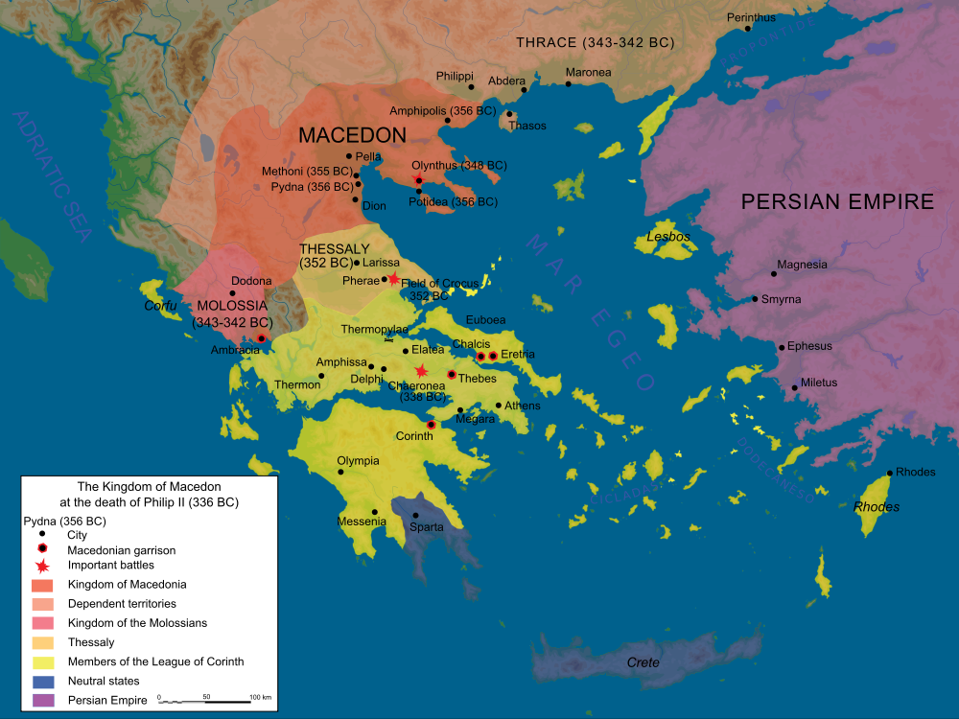
Macedonian Empire
At the Death of Philip II
Map Credit:
Marsyas
Which Greek city-state remained unconquered by Philip?

Slide 6
Laconic

Slide 7
Macedonian Empire
"You are advised to submit without further delay, for if I bring my army into your land, I will destroy your farms, slay your people, and raze your city.”
At the Death of Philip II
Map Credit:
Marsyas

Slide 8
Macedonian Empire
"You are advised to submit without further delay, for if I bring my army into your land, I will destroy your farms, slay your people, and raze your city.”
At the Death of Philip II
IF.
Map Credit:
Marsyas

Slide 9
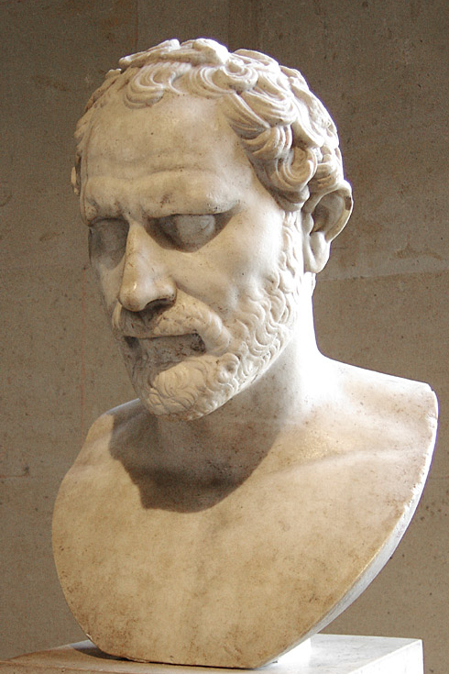
Demosthenes
Athenian Orator
Philippics
  Orations against Philip II
Plutarch's
Life of Demosthenes
FAIL
Photo Credit: Sting

Slide 10
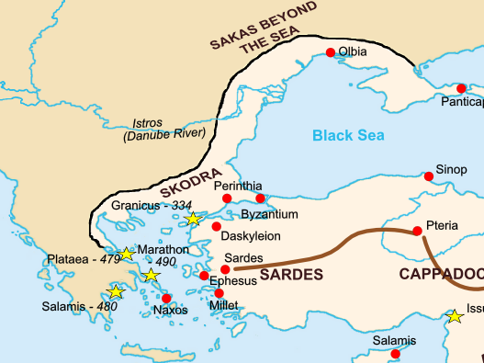
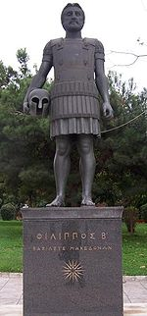
Philip’s Plan
Unite Greece by invading Persia
Map Credit: Fabienkhan

Slide 11
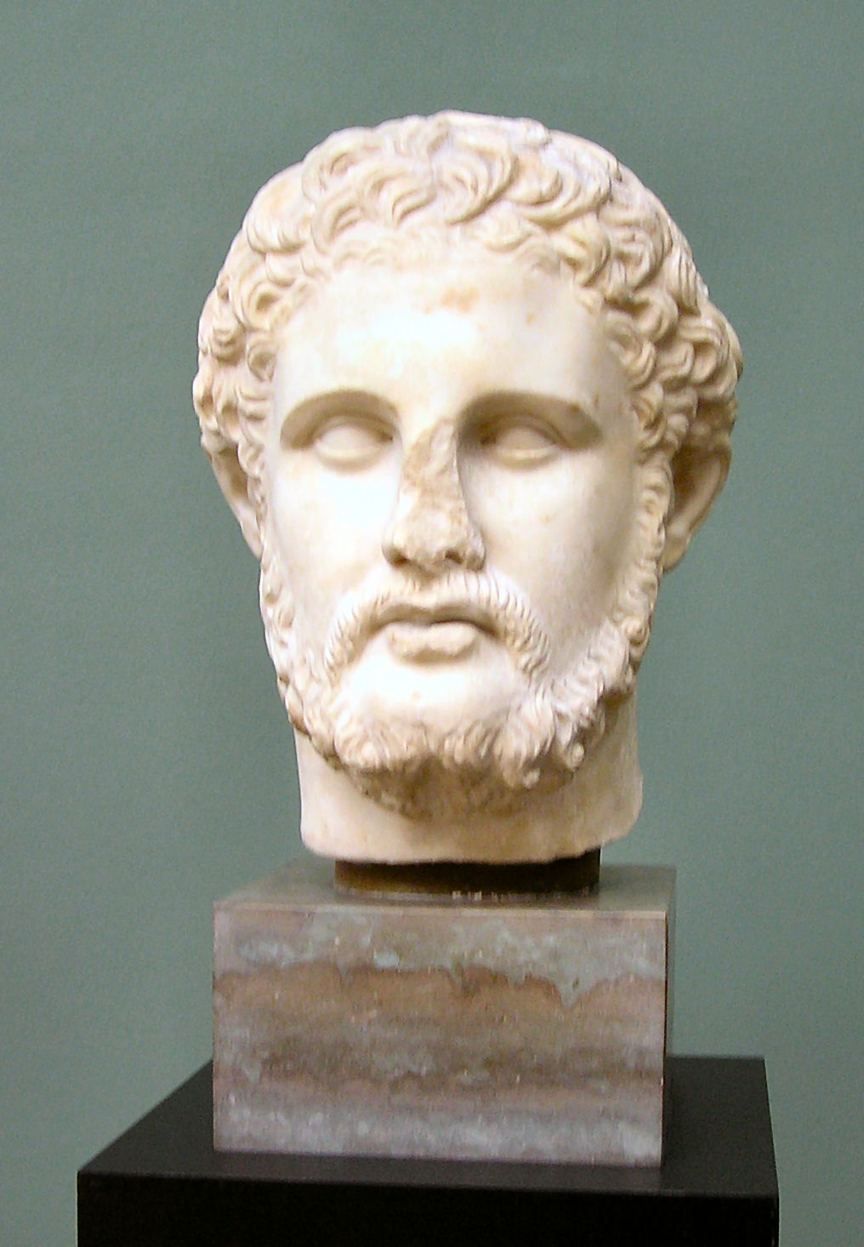
ASSASSINATED

Slide 12
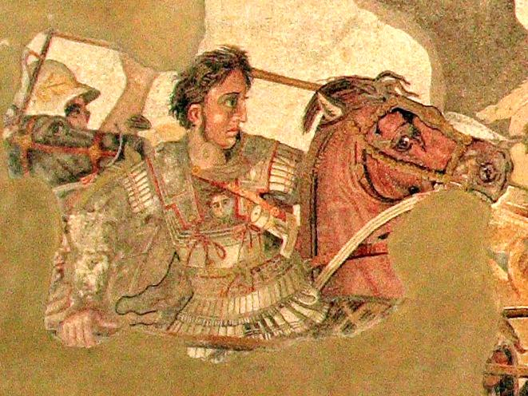
Philip’s plan would be carried out by his son, Alexander.
Photo Credit: Magrippa

Slide 13
Alexander the Great
King of Macedon
  (336-323 B.C.)
Conqueror
Explorer
Cultural Ambassador

Slide 14
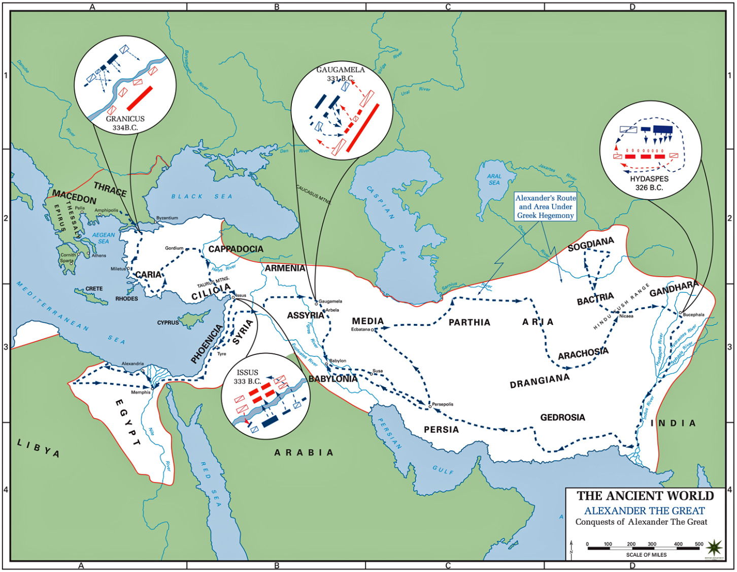

Alexander’s Conquests
http://www.emersonkent.com/map_archive/alexander_the_great_conquests.htm

Slide 15
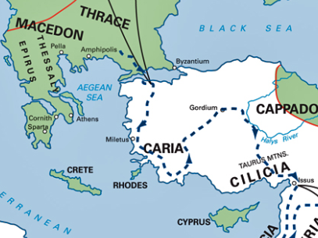

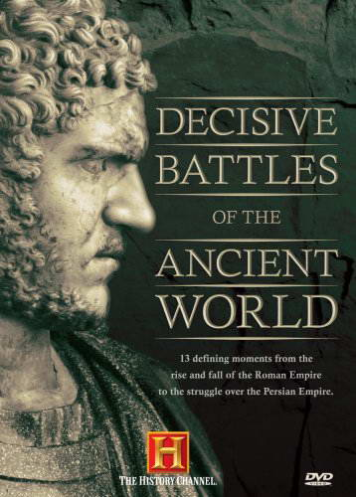


Granicus
The
Gordian Knot
Issus

Slide 16
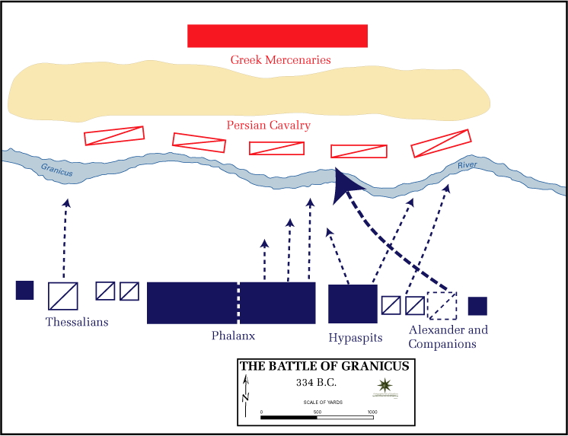

Slide 17
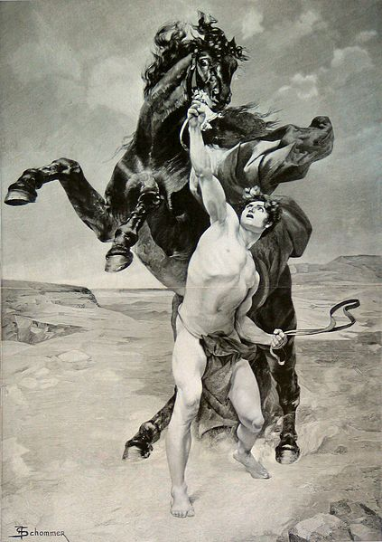


Companion Cavalry
Alexander personally commanded his Companion Cavalry, placing himself in the thick of every battle.
Alexander taming his horse, Bucephalus

Slide 18
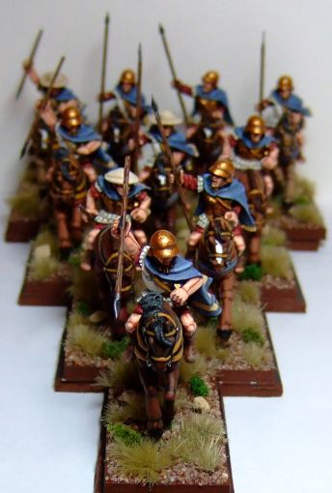
Companion Cavalry
The Companions charged in a wedge formation.
Photo: Scott MacPhee

Slide 19
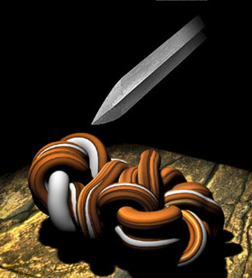
The Gordian Knot
Sometimes, the most complex problems have the simplest solutions…

Slide 20
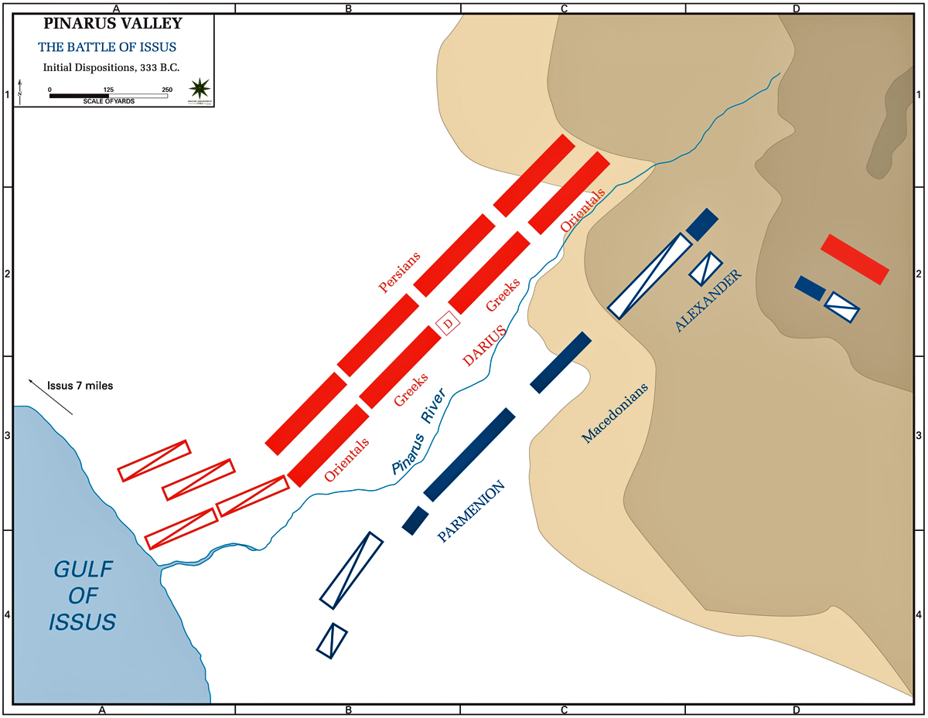

Slide 21
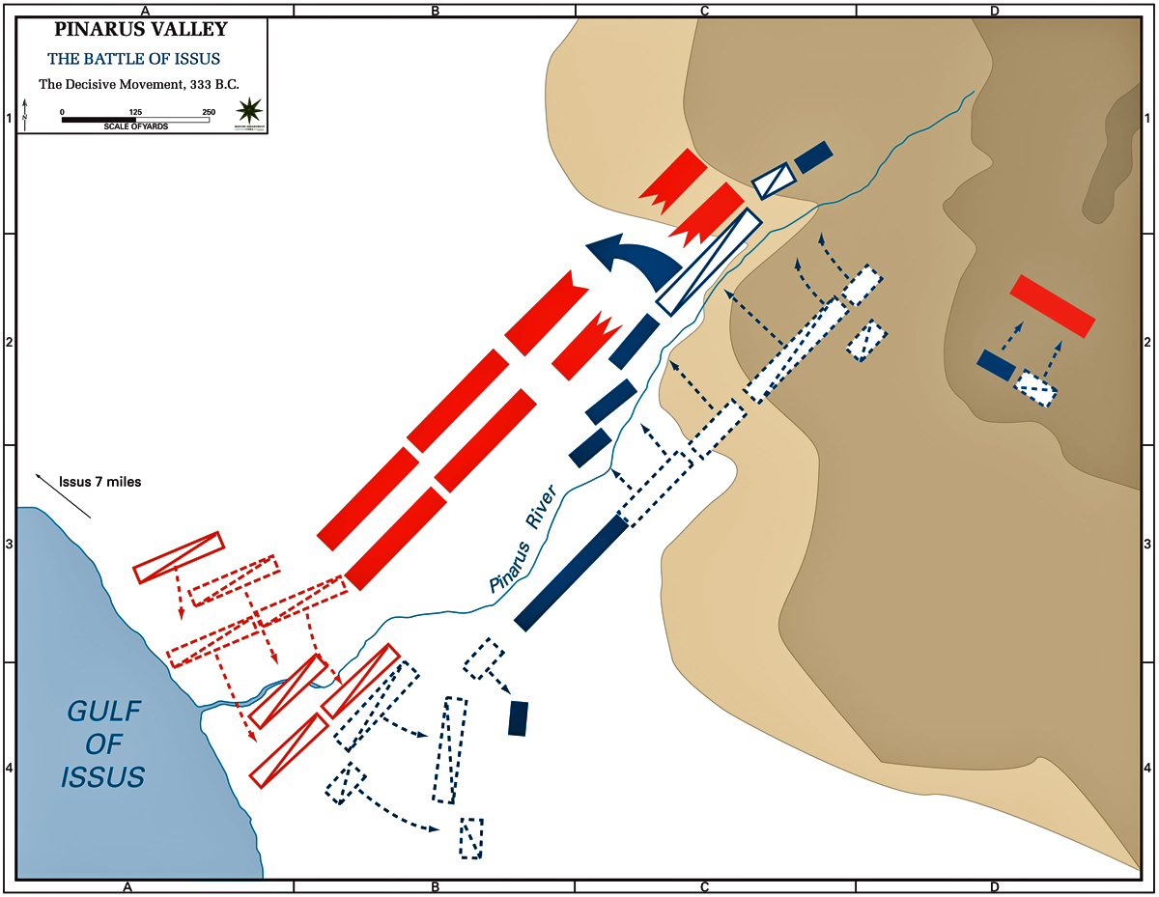

Slide 22
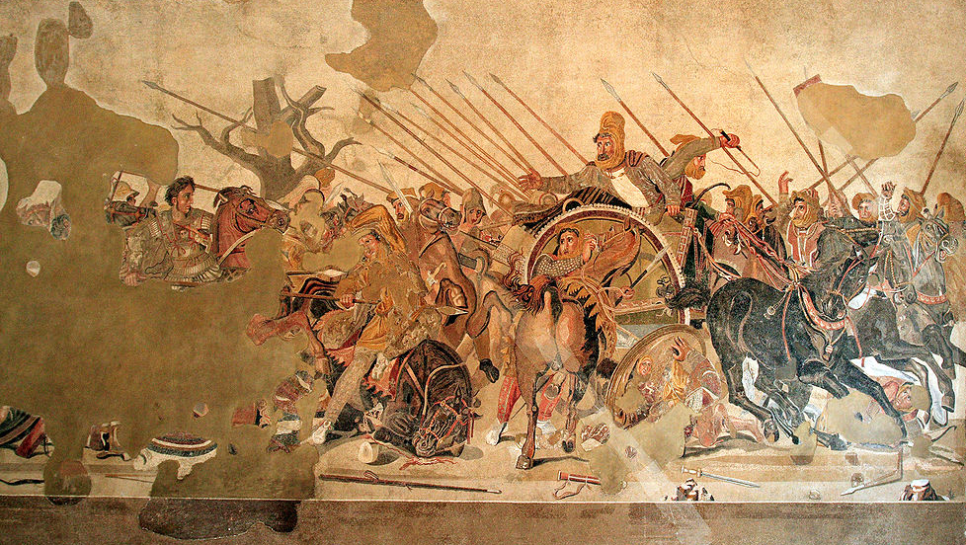
The Alexander Mosaic
(Pompeii)
Photo Credit: Magrippa

Slide 23
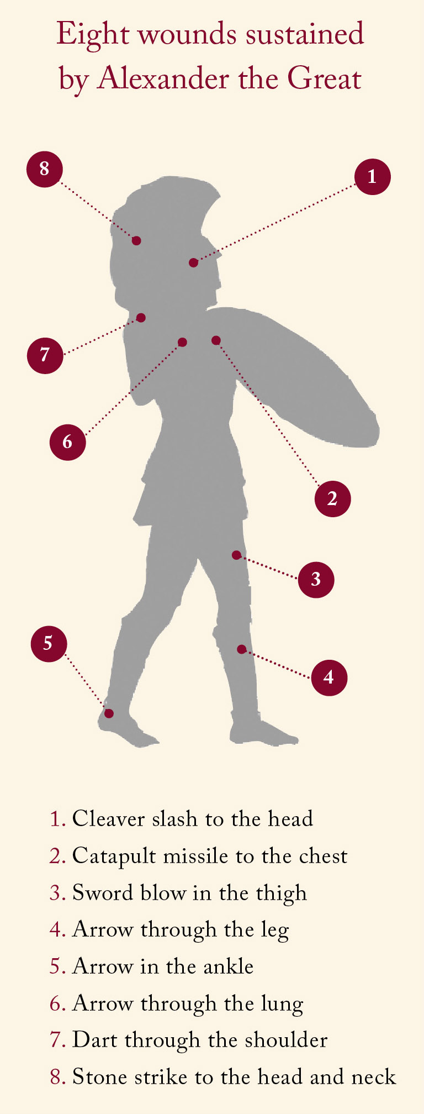
Source: Lapham's Quarterly

Slide 24
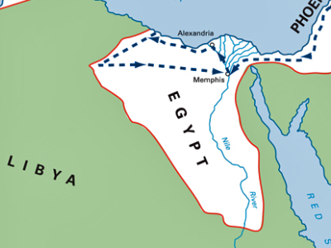
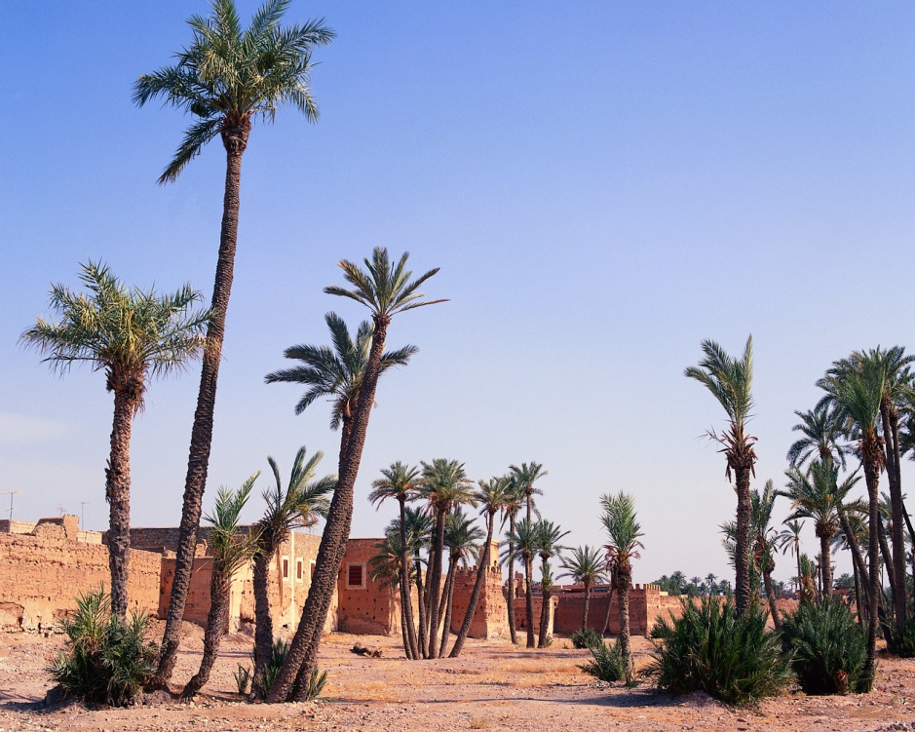
Alexandria
Siwa Oasis

Slide 25
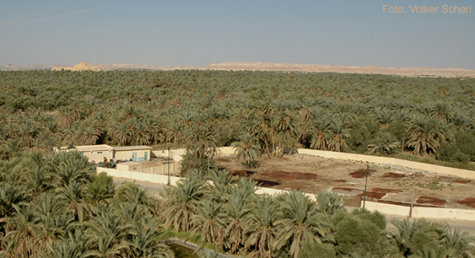
The Siwa Oasis

Slide 26
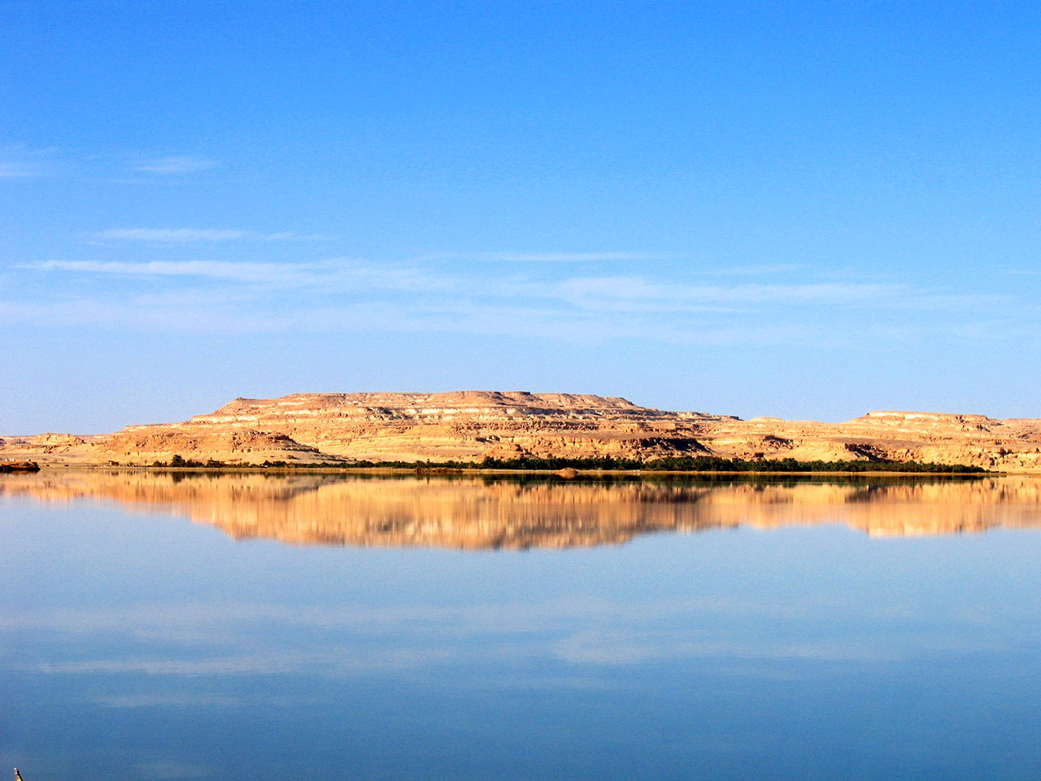
Lake Siwa
Photo Credit: tronics

Slide 27
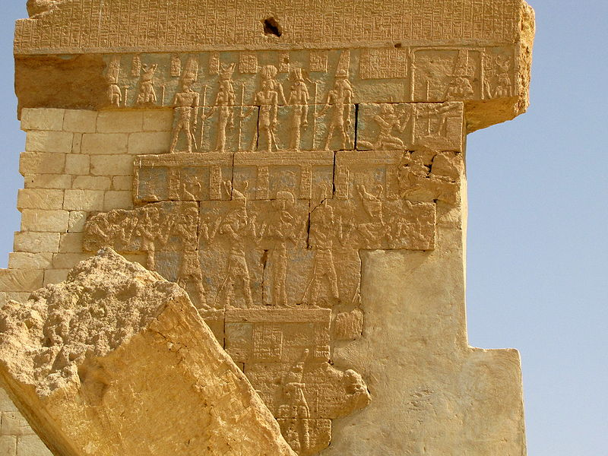
The Temple of Amun

Slide 28
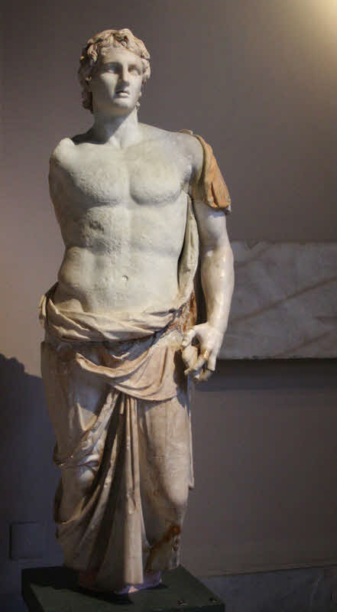
The Son of God

Slide 29
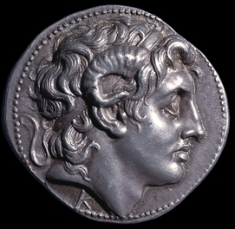
Photo Credit: British Museum

Slide 30
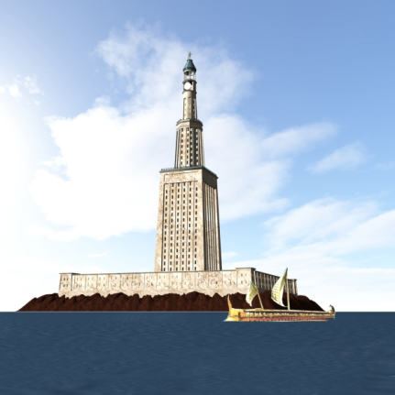
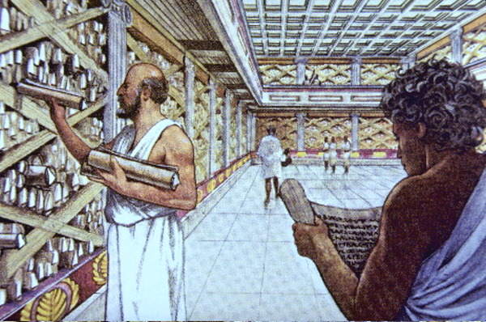
Alexandria
Alexandria
(Nile Delta)
  The most famous of many cities that Alexander named after himself
Alexandria
Lighthouse
Library

Slide 31
The Lighthouse
7
of Alexandria
The Lighthouse of Alexandria is one of the Seven Wonders of the Ancient World.

Slide 32
Gaugamela
Babylon

Slide 33
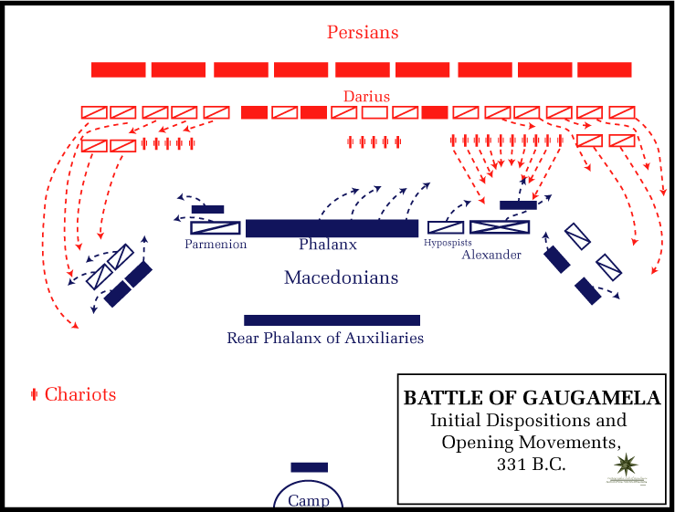
Alexander’s DECISIVE victory over Darius of Persia

Slide 34
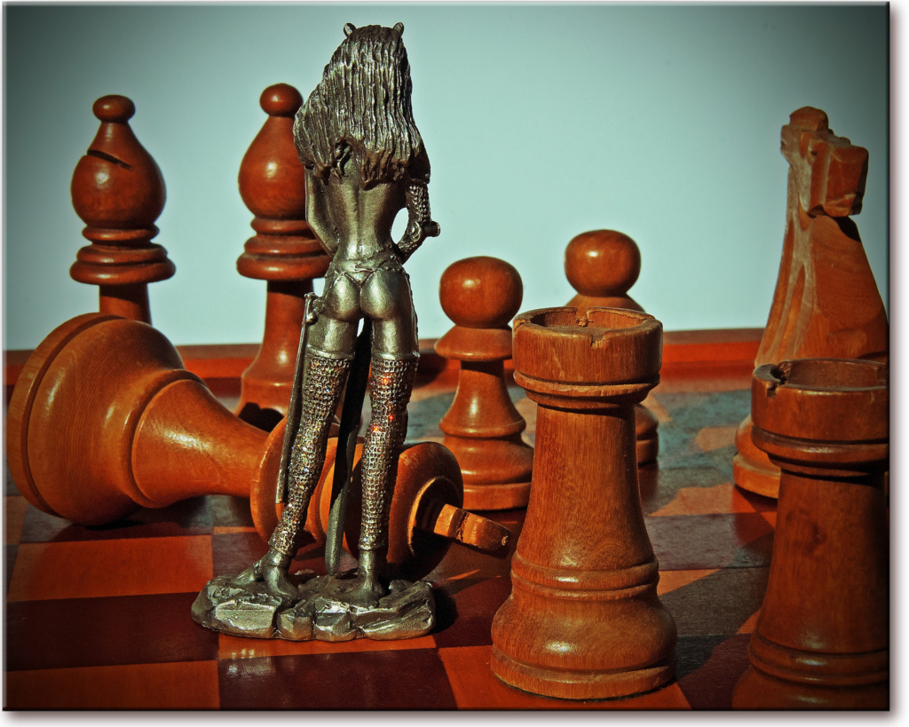
Photo Credit: Leonard John Matthews

Slide 35
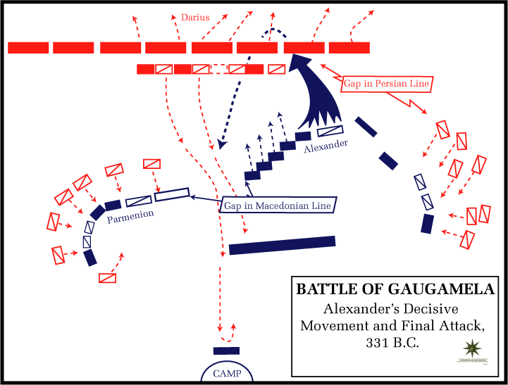
Alexander’s DECISIVE victory over Darius of Persia

Slide 36
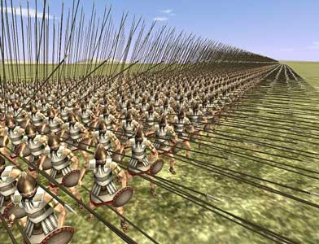
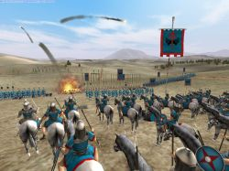
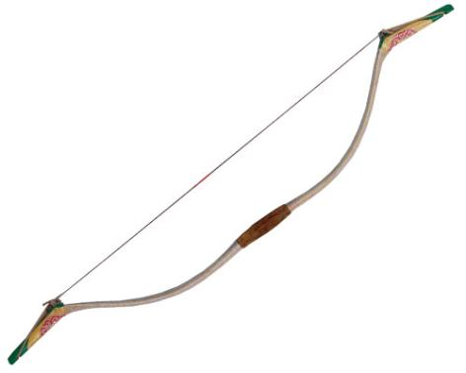
Appropriate Technologies
Rome :Total War Screenshot
Cavalry
Rome :Total War Screenshot
Phalanx
Archers
Alexander modified his army to fight on flat terrain. The Persians had failed to conquer Greece because they did not modify their tactics.

Slide 37
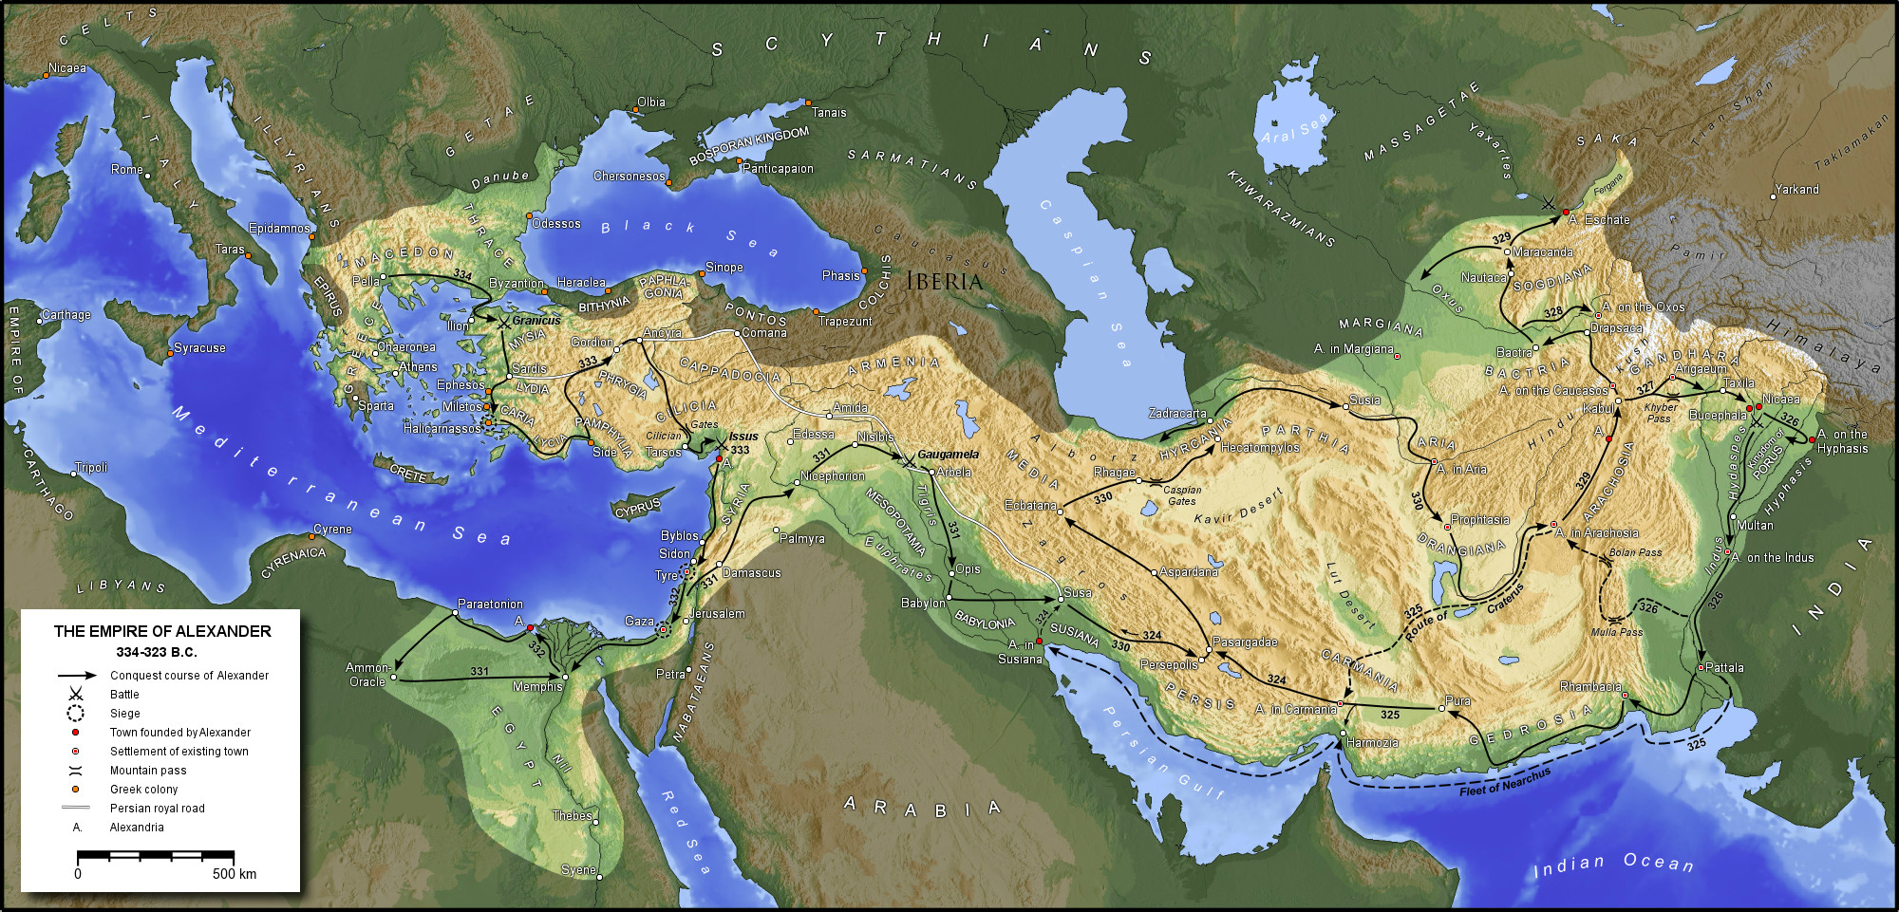
Alexander’s Empire

Slide 38

Infinite
Credit: NASA

Slide 39
Gaugamela
Alexander returned to Babylon after his conquests, but died there in 323 at the age of 32.
Babylon

Slide 40
Kratistos

Slide 41
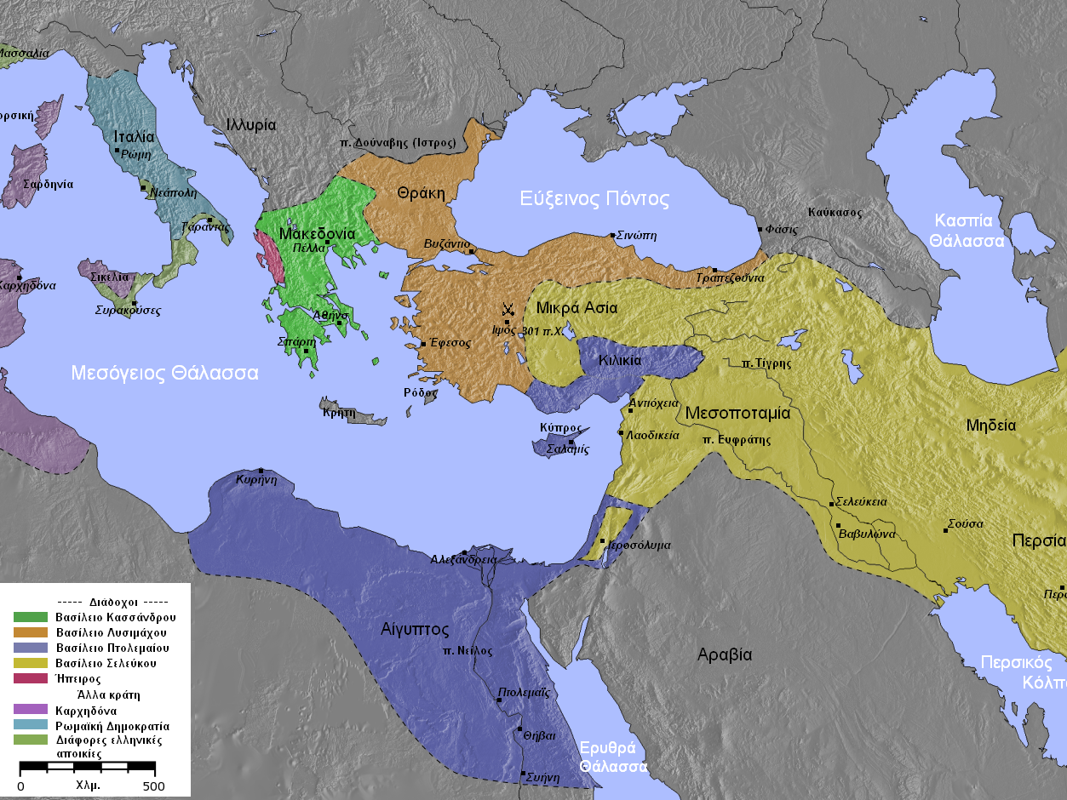
“To the strongest…”
Alexander’s generals battled for his empire after his death, finally dividing it.
Map Credit: Captain_Blood

Slide 42
“To the strongest…”
Seleucid Empire
Ptolemaic Empire
Map Credit: Captain_Blood

Slide 43
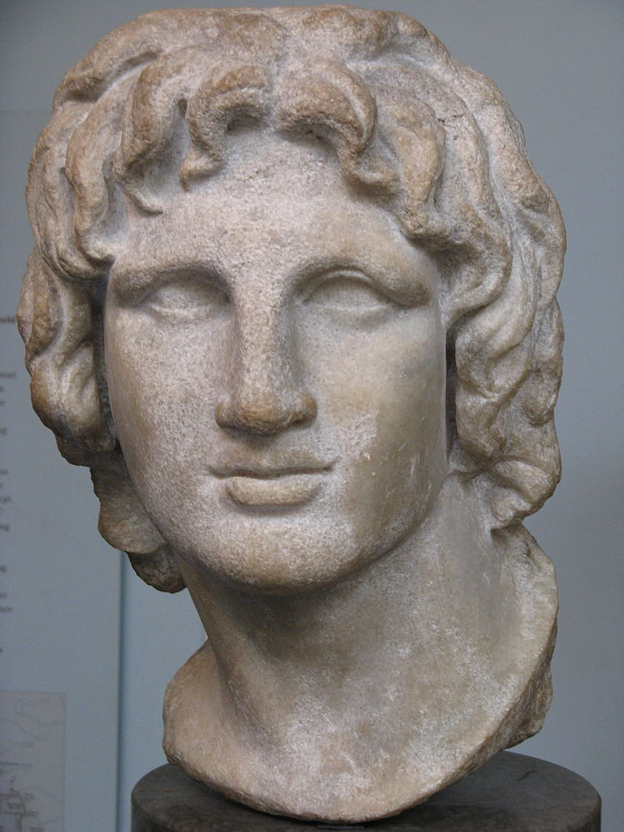
“For my part, I assure you, I had rather excel others in the knowledge of what is excellent, than in the extent of my power and dominion.”
-- Alexander
Photo Credit: Yair Haklai

Slide 44

Alexander the Philosopher
Socrates
Plato
Aristotle
Alexander kept two things
under his pillow at all times...
Alexander

Slide 45
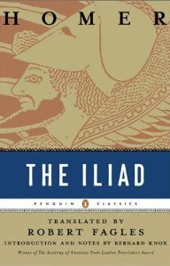
Alexander the Philosopher
Socrates
Plato
Aristotle
Alexander kept two things
under his pillow at all times...
Alexander

Slide 46
HELLENISM
As a result of Alexander’s conquests, Greek language and culture spread throughout the Eastern Mediterranean.

Slide 47
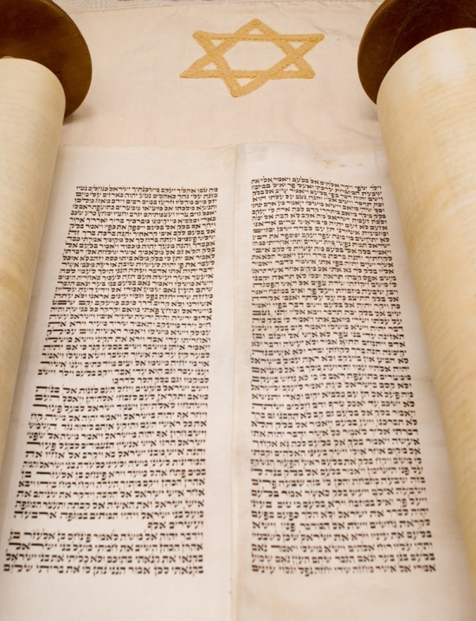
LLX
The Septuagint
The Hebrew Bible was translated into Greek during the 3rd century B.C.

Slide 48
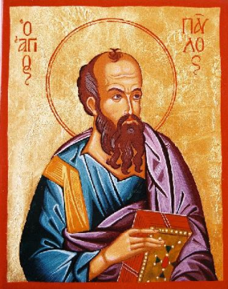
Hellenistic Judaism
Tarsus
  The Apostle Paul was born here and raised as a Hellenized Jew.
Although native Judeans rebelled against Alexander’s heirs, Jews of the Diaspora embraced Hellenism.

Slide 49

Alexander
Continues to Inspire
http://www.youtube.com/watch?v=JjxWzdk1eiA

Slide 50








